Slide 1
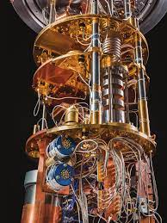
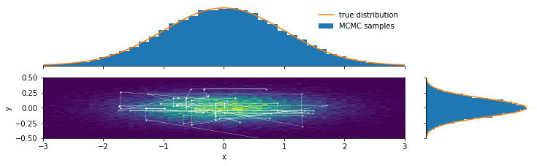
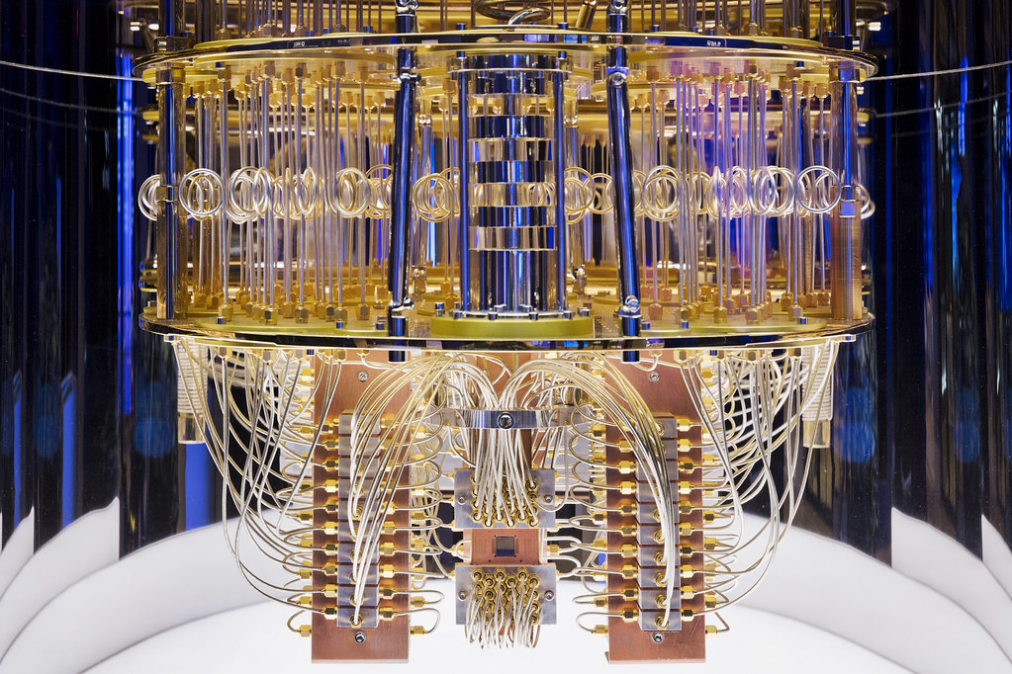
Lecture 42: Sampling Techniques and
Quantum Computing
Objectives:
MCMC Techniques
Nonparametric Bayesian Models
Quantum Computing
Resources:
MachineLearningMastery: A Gentle Introduction
Harati: Nonparametric Bayesian Models
IBM: Quantum Computing
QCVC: Quantum Computing For The Curious

Slide 2
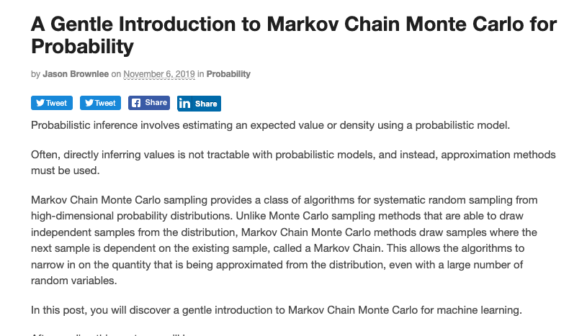
Markov Chain Monte Carlo Methods
Generalization of any data-driven
statistical model is a challenge.
How many degrees of freedom?
Solution: Infer complexity from
the data (nonparametric model).
Nonparametric models are very
flexible – the number of parameters
can grow with the amount of data.
Calculating a quantity from a
probabilistic model is referred to
more generally as probabilistic inference, or simply inference.
The typical solution is to draw independent samples from the probability distribution, then repeat this process many times to approximate the desired quantity. This is referred to as Monte Carlo sampling or Monte Carlo integration, named for the city in Monaco that has many casinos.
The solution to sampling probability distributions in high-dimensions is to use Markov Chain Monte Carlo, or MCMC for short.
Notes:
XOR: x_1, x_2, and we want to transform to x_1^2, x_2^2, x_1 x_2
It can also be viewed as feature extraction from the feature vector x, but now we extract more feature than the number of features in x.

Slide 3
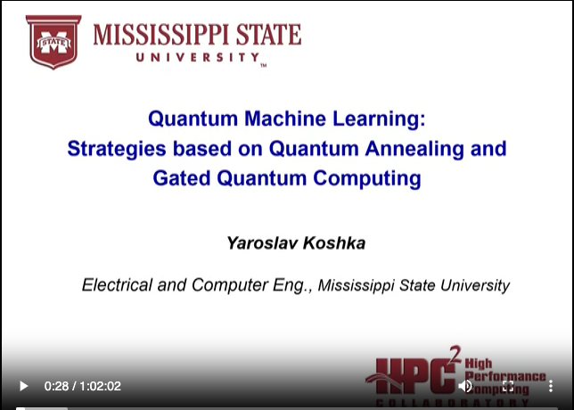
Quantum Computing
Quantum computing is an area
of computer science that uses the
principles of quantum theory.
Quantum theory explains the
behavior of energy and material
on the atomic and subatomic levels.
Quantum computing uses
subatomic particles, such as
electrons or photons. Quantum
bits, or qubits, allow these
particles to exist in more than one
state (i.e., 1 and 0) at the same time.
Theoretically, linked qubits can “exploit the interference between their wave-like quantum states to perform calculations that might otherwise take millions of years.”
Classical computers today employ a stream of electrical impulses (1 and 0) in a binary manner to encode information in bits. This restricts their processing ability, compared to quantum computing.
Notes:
XOR: x_1, x_2, and we want to transform to x_1^2, x_2^2, x_1 x_2
It can also be viewed as feature extraction from the feature vector x, but now we extract more feature than the number of features in x.

Slide 4
Summary
Sampling techniques, once popular in machine learning, are being revisited due to their relevance to quantum computing.
Quantum computers solve certain constrained optimization problems very efficiently.
It remains to be seen how quantum computing will impact machine learning.
Current hardware is incapable of handling complex ML systems, so researchers are exploring hybrid approaches.
Notes:
http://www.iro.umontreal.ca/~bengioy/papers/ftml.pdf

