Slide 1

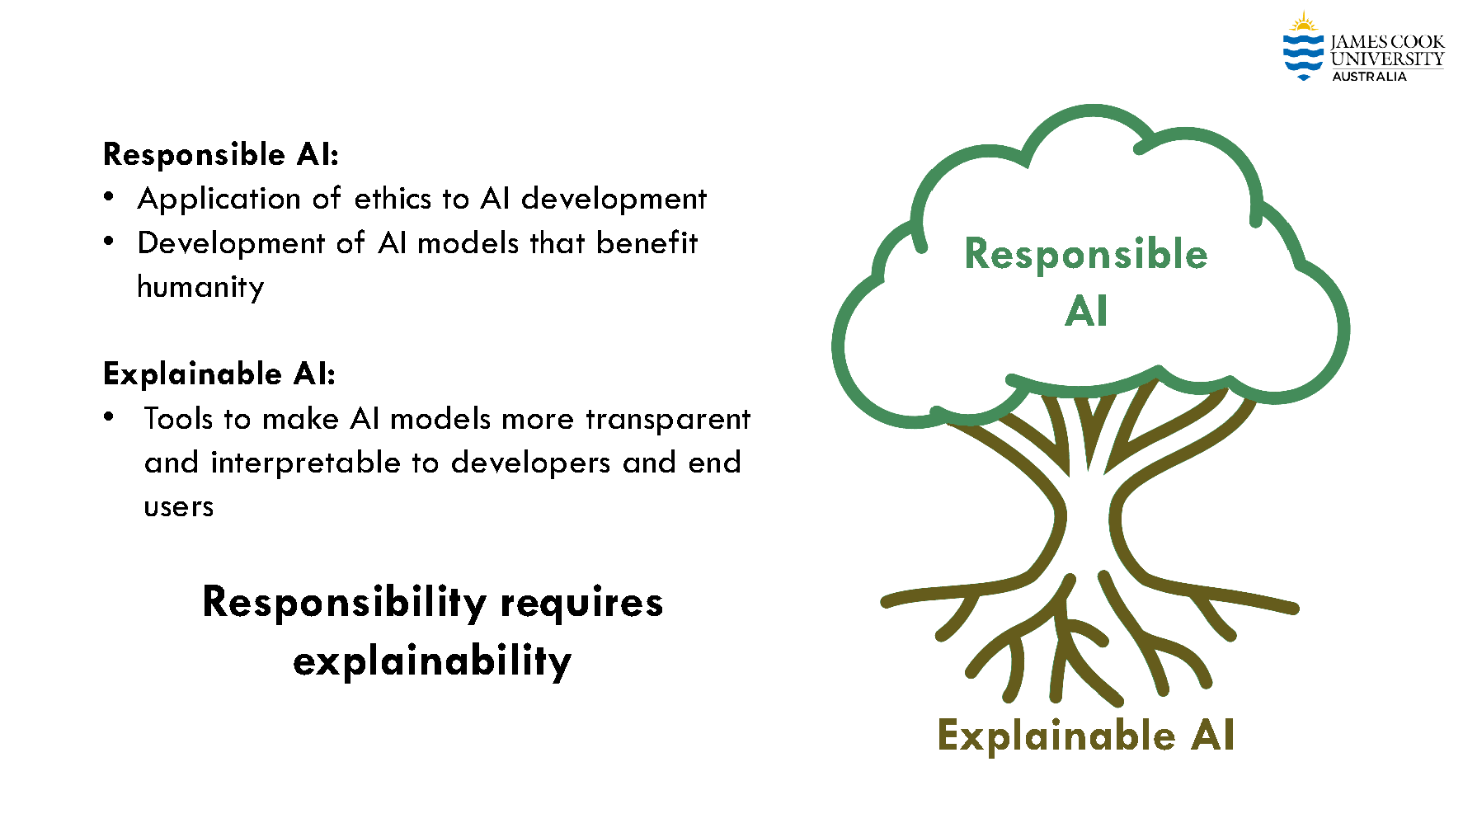
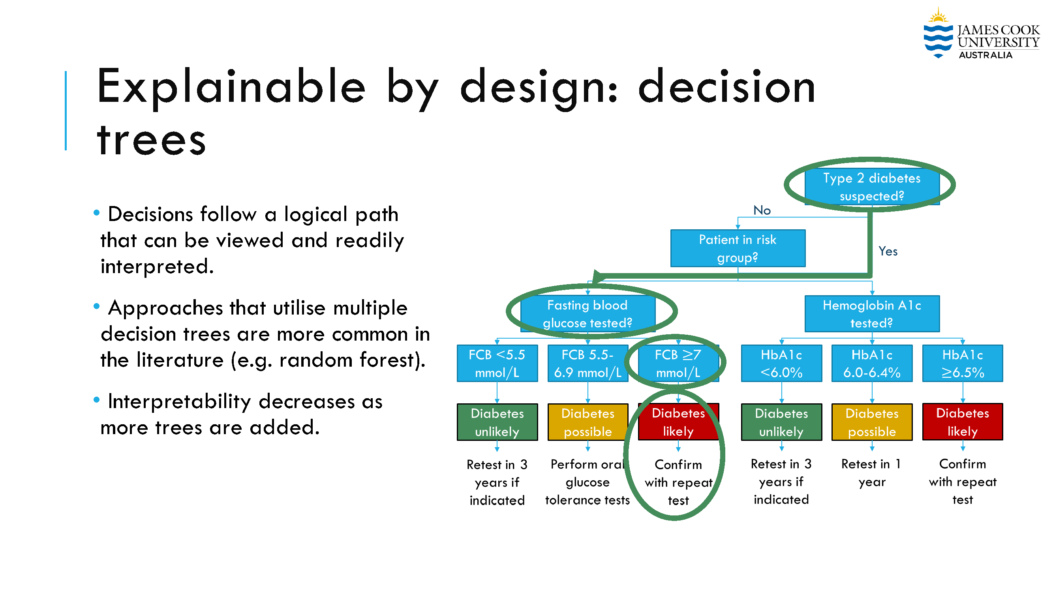
Lecture 38: Trustworthiness in AI
Objectives:
Post-Hoc Explainability
Explainability for Privacy and Security
Explainability for Robustness
Video:
Baker: IEEE SPMB 2024
Tailor: Trustworthy AI Explained
IBM: Trustworthy AI
Resources:
IBM: Explainable AI
Mitosis: Explainable AI
Baker: Explainability in AI
Hoiem: Ethics of AI

