Slide 1
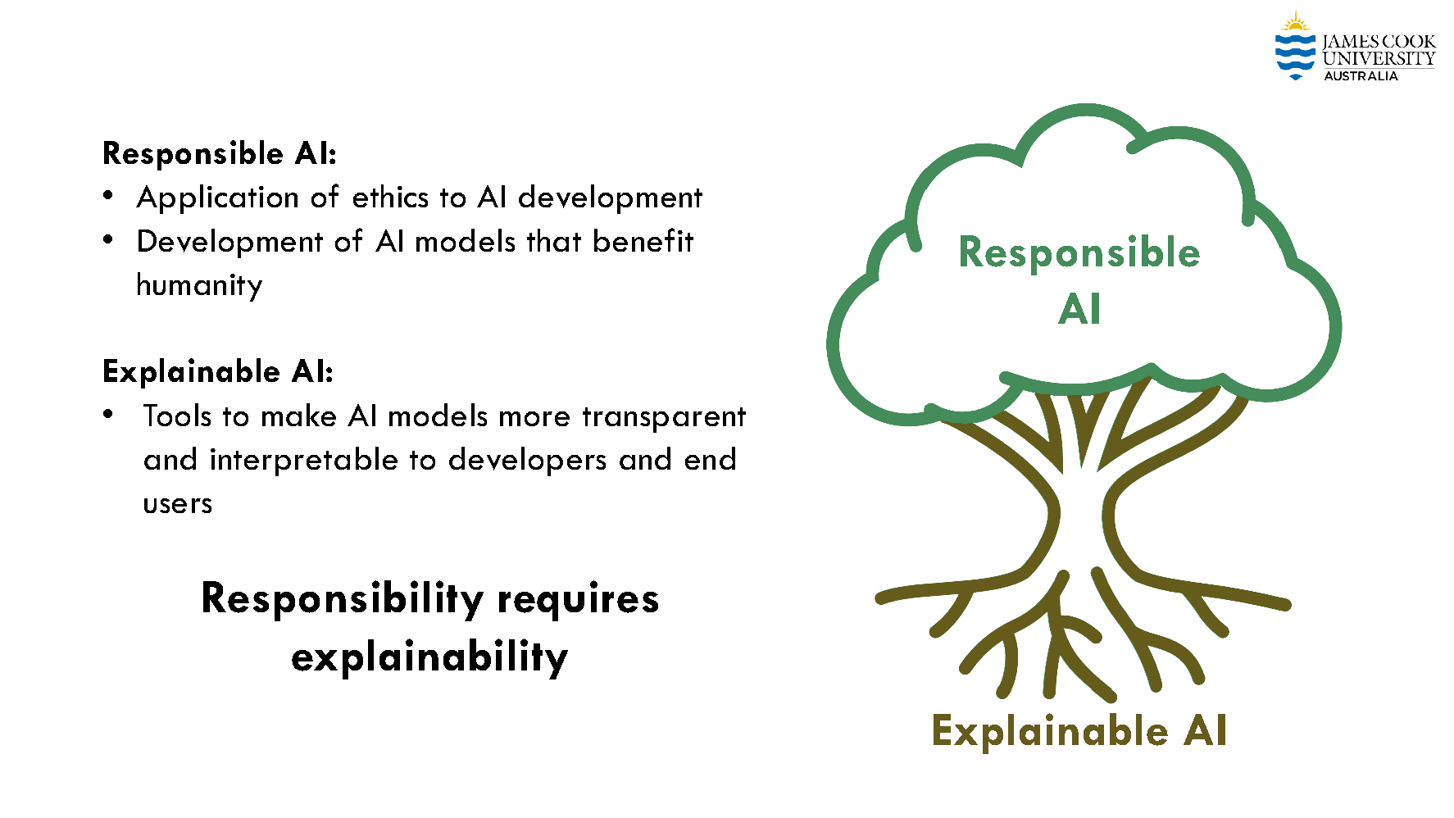
Lecture 37: Explainability in AI
Objectives:
Explainability
SHapley Additive exPlanations (SHAP)
Local Interpretable Model-agnostic Explanations (LIME)
Ablation Studies
Video:
Baker: IEEE SPMB 2024
Resources:
IBM: Explainable AI
Mitosis: Explainable AI
Baker: Explainability in AI
Hoiem: Ethics of AI

