Slide 1
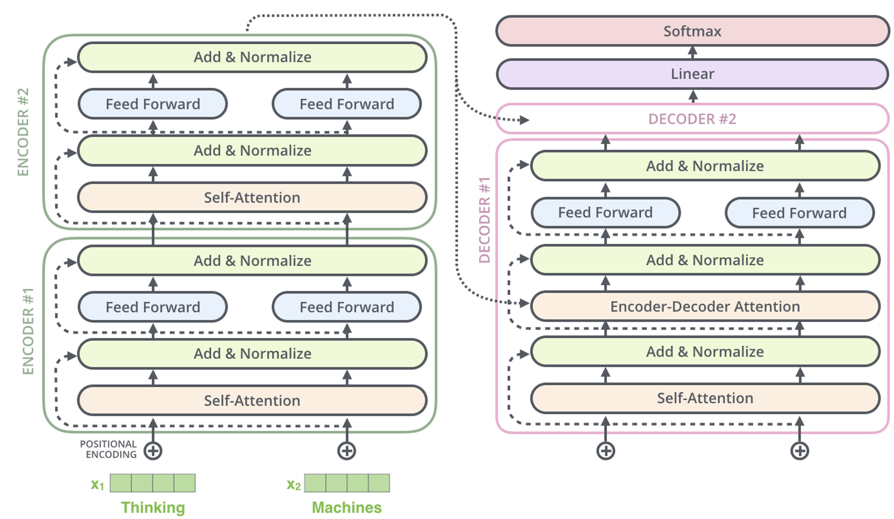
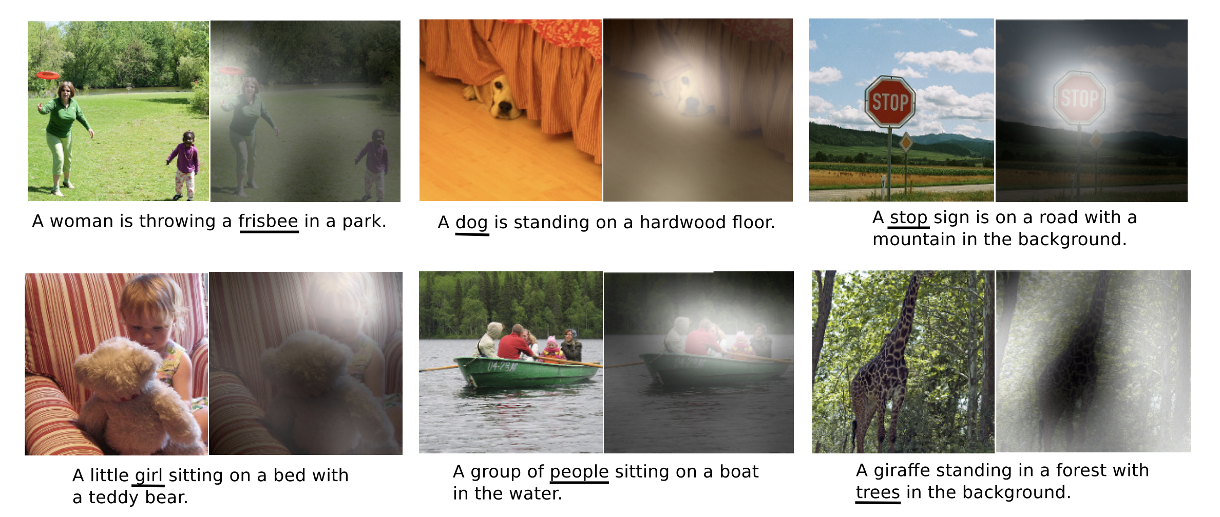
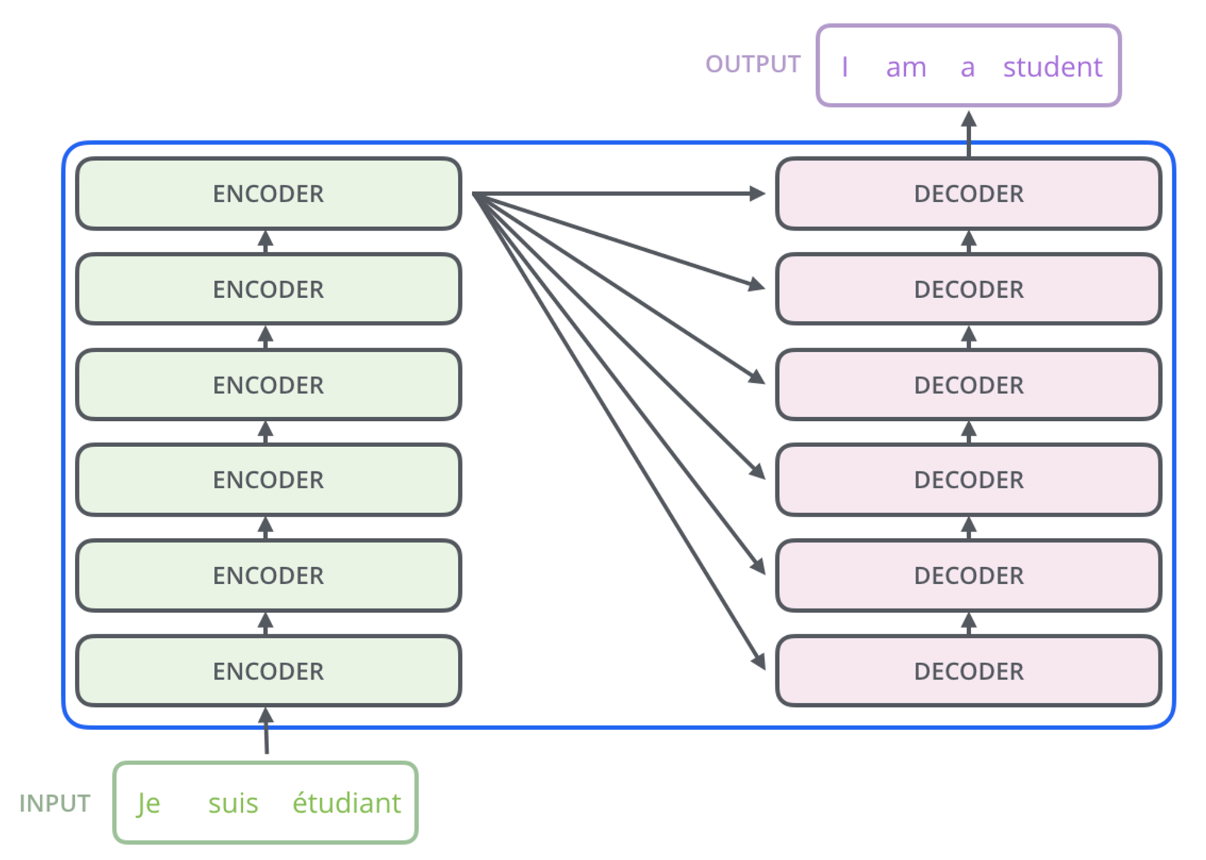
Lecture 34: Attention and Transformers
Objectives:
Attention
Transformers
Pretraining
Resources:
Wiki: Transformers
Medium: What is a Transformer?
A.K.: Modeling Sequences
M.L.: Deep Learning for Biotech
S.W.: Deep Learning
Thundiyil: Transformers

Slide 2
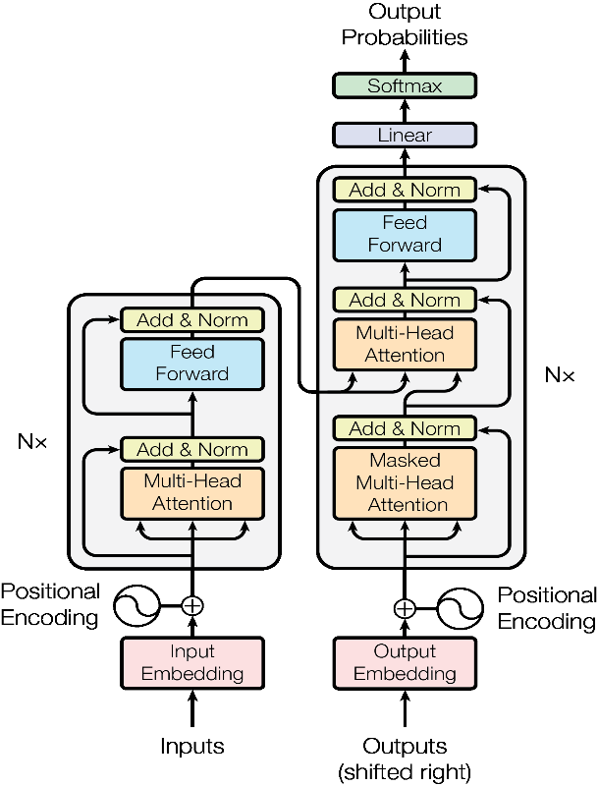
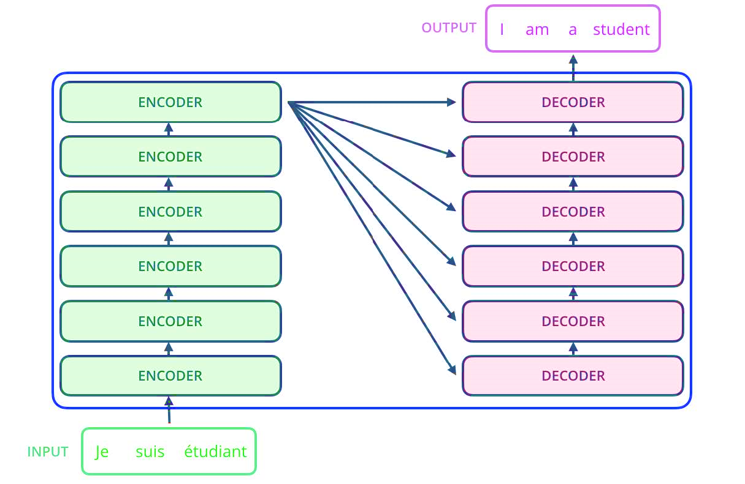
A Typical Transformer Network
Encoder:
Decoder:

Slide 3
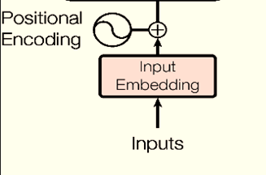
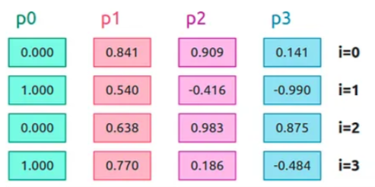
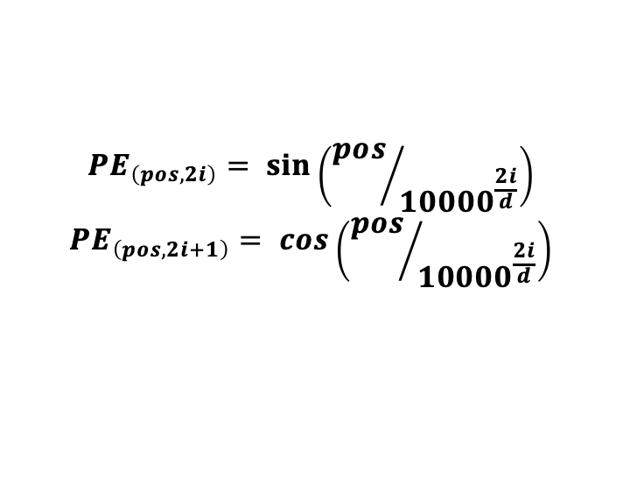
Input Embedding and Positional Encoding
Input Embedding
Positional Encoding
majesty
king
kid
$${PE}_{\left(pos, 2i\right)}= \sin\left({pos}/{{10000}^{\frac{2i}{d}}}\right)$$
$${PE}_{\left(pos, 2i+1\right)}= \cos\left({pos}/{{10000}^{\frac{2i}{d}}}\right)$$

Slide 4

Input Embedding Overview

Slide 5

Positional Encoding Overview

Slide 6
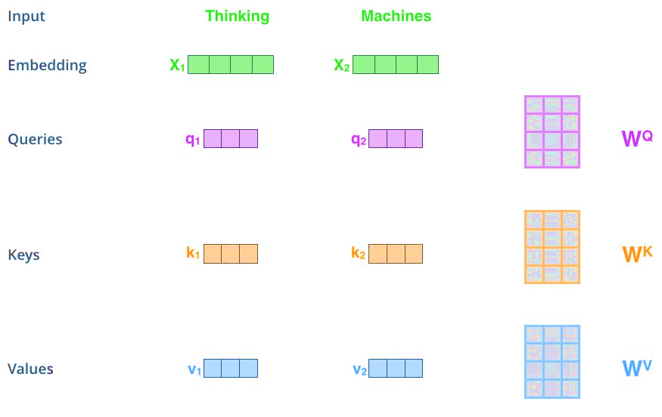
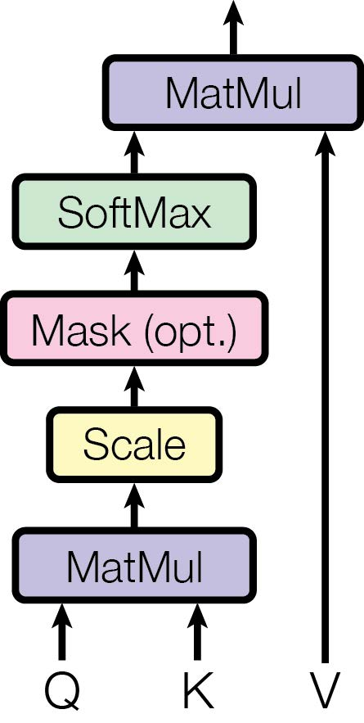

Self Attention
$Attention\left(Q,K,V\right)=softmax \left(\frac{QK^{T}}{\sqrt{d_{k}}}\right) V$

Slide 7
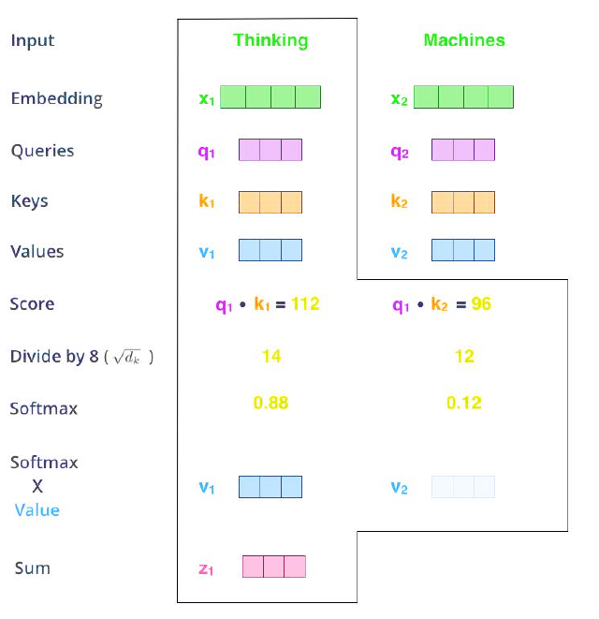
Self Attention

Slide 8

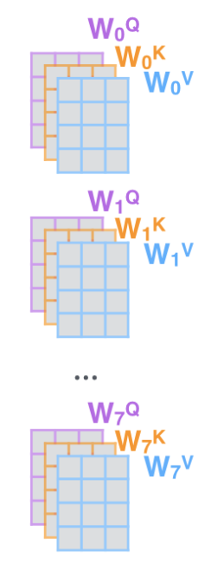
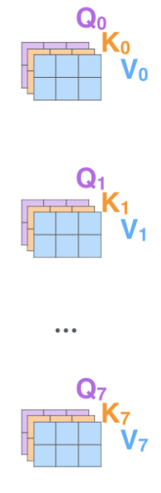
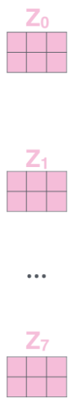

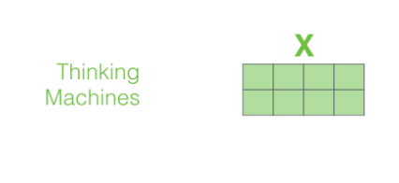
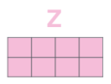
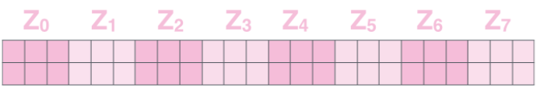
Multi Head Attention

Slide 9
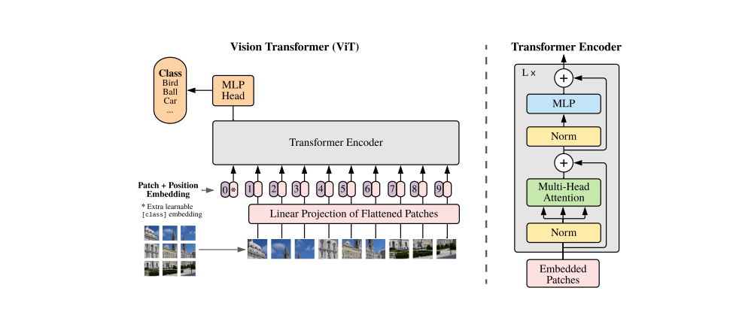
Transformer In Vision (ViT)

Slide 10
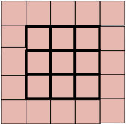
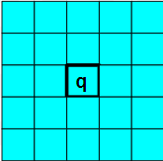
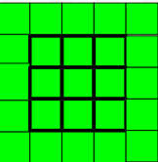
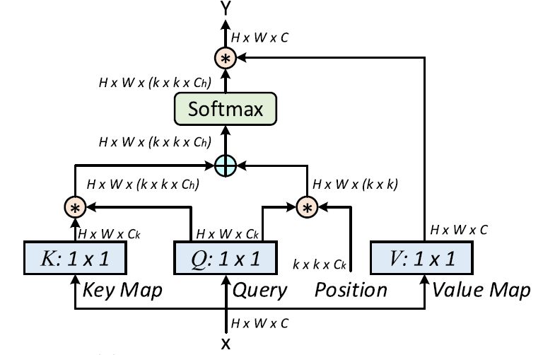
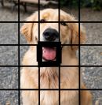

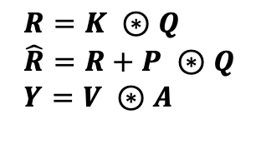


Multi Head Attention in Vision Backbone
K
soft
$$R=K ⊛Q \\ \hat{R}=R+P ⊛Q \\ Y=V ⊛A$$
$$W_{K}$$
$$W_{V}$$
Q
$$W_{Q}$$
V
Y
X

Slide 11
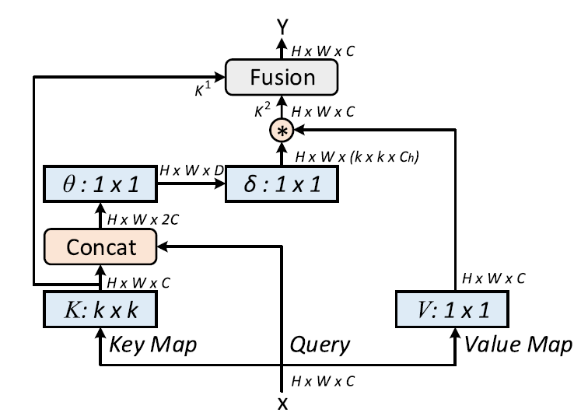
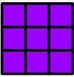
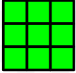

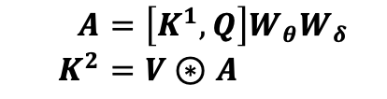
Contextual Transformer (CoT) Block
S
k
$$A=\left[K^{1}, Q\right]W_{θ}W_{δ} \\ K^{2}=V⊛A$$
k
q
q
$$W_{V}$$
V
D
O

Slide 12
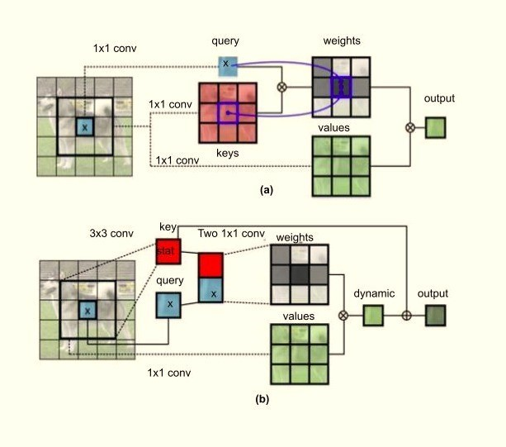
Conventional Transformer and CoT Blocks

Slide 13
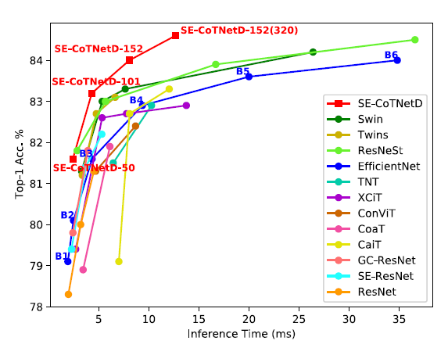
Inference Time Vs. Accuracy
Measuring inference time

Slide 14
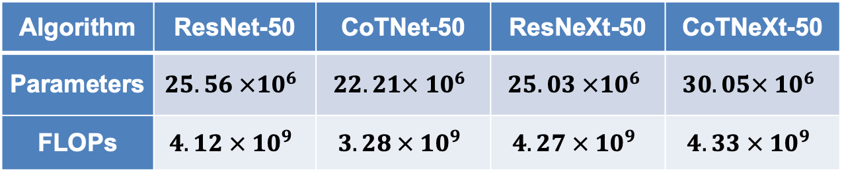
Comparison of Different Configurations
Comparison with ResNet approaches:
Optimization of the CoT block:
Algorithm | ResNet-50 | CoTNet-50 | ResNeXt-50 | CoTNeXt-50
Parameters | $$25.56 ×{10}^{6}$$ | $$22.21× {10}^{6}$$ | $$25.03 ×{10}^{6}$$ | $$30.05× {10}^{6}$$
FLOPs | $$4.12 × {10}^{9}$$ | $$3.28 × {10}^{9}$$ | $$4.27 × {10}^{9}$$ | $$4.33 × {10}^{9}$$
Algorithm | Params | FLOPs | Top-1 Accuracy | Top-5 Accuracy
Static Context | 17.1 M | 2.7 | 77.1 | 93.5
Dynamic Context | 20.3 M | 3.3 | 78.5 | 94.1
Linear Fusion | 20.3 M | 3.3 | 78.7 | 94.2
Concatenate | 22.8 M | 3.7 | 78.9 | 94.3
CoT | 22.2 M | 3.3 | 79.2 | 94.5

Slide 15
Summary
Transformers were enabled by the development of self attention.
Transformers encode long-term and short-term context better than LSTMs or other equivalent architectures.
Transformers have resulted in major improvements in performance on most major machine learning tasks.
Model complexity has increased dramatically (Medium, Labelrr).

Slide 16
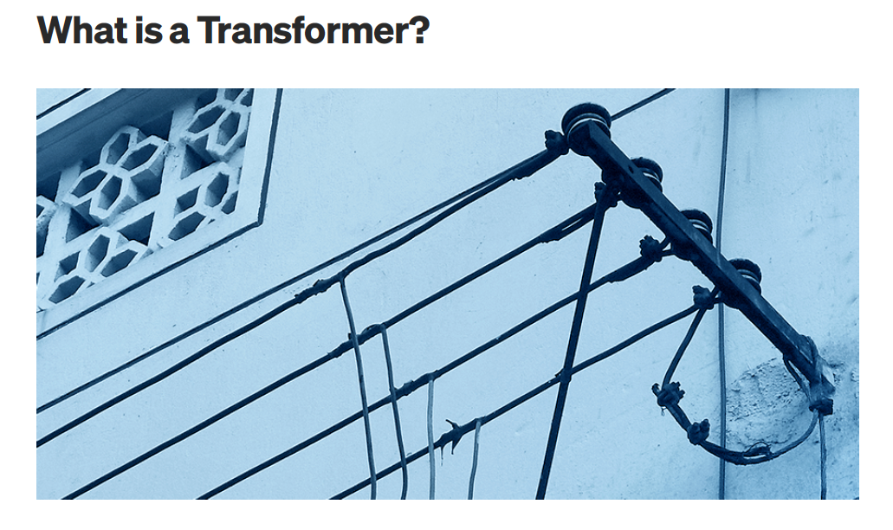

Slide 17
CS 1678: Intro to Deep Learning
Modeling Sequences/Sets:
Transformers
Prof. Adriana Kovashka
University of Pittsburgh
March 25, 2021

Slide 18
Plan for this lecture
Background
  Context prediction, unsupervised learning
Transformer models
  Self-attention
  Adapting self-attention for sequential data
  The transformer architecture, encoder/decoder
  Pre-training, BERT
Transformers beyond language

Slide 19
Additional resources
Learning about transformers on your own?
  Key recommended resource:
    http://nlp.seas.harvard.edu/2018/04/03/attention.html
    The Annotated Transformer by Sasha Rush
    Jupyter Notebook using PyTorch that explains everything!
  The Illustrated Transformer
    http://jalammar.github.io/illustrated-transformer/
  Attention visualizer
    https://github.com/jessevig/bertviz
Adapted from Christopher Manning

Slide 20
How do we represent the meaning of a word?
Definition: meaning (Webster dictionary)
the idea that is represented by a word, phrase, etc.
the idea that a person wants to express by using words, signs, etc.
the idea that is expressed in a work of writing, art, etc. Commonest linguistic way of thinking of meaning:
signifier (symbol) ⟺ signified (idea or thing)
= denotational semantics
Christopher Manning

Slide 21

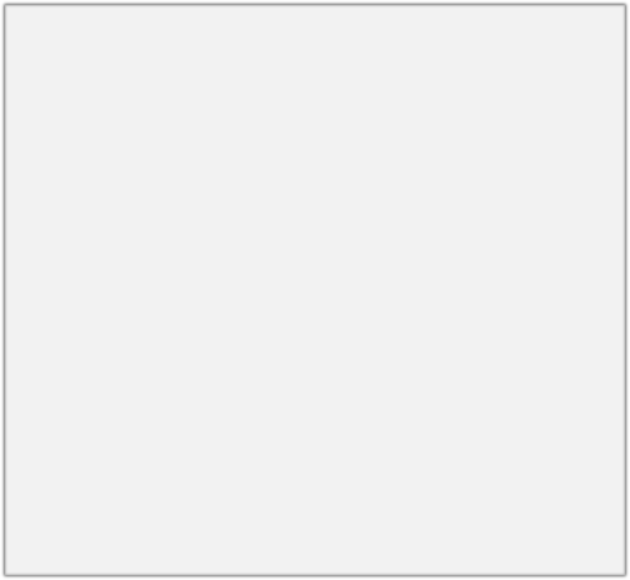
How do we have usable meaning in a computer?
Common solution: Use e.g. WordNet, a thesaurus containing lists of synonym sets and hypernyms (“is a” relationships).
e.g. synonym sets containing “good”: e.g. hypernyms of “panda”:
from nltk.corpus import wordnet as wn
poses = { 'n':'noun', 'v':'verb', 's':'adj (s)', 'a':'adj', 'r':'adv'}
for synset in wn.synsets("good"):
print("{}: {}".format(poses[synset.pos()],
", ".join([l.name() for l in synset.lemmas()])))
from nltk.corpus import wordnet as wn panda = wn.synset("panda.n.01") hyper = lambda s: s.hypernyms() list(panda.closure(hyper))
noun: good
noun: good, goodness noun: good, goodness
noun: commodity, trade_good, good adj: good
adj (sat): full, good adj: good
adj (sat): estimable, good, honorable, respectable adj (sat): beneficial, good
adj (sat): good
adj (sat): good, just, upright
…
adverb: well, good
adverb: thoroughly, soundly, good
[Synset('procyonid.n.01'), Synset('carnivore.n.01'), Synset('placental.n.01'), Synset('mammal.n.01'), Synset('vertebrate.n.01'), Synset('chordate.n.01'), Synset('animal.n.01'), Synset('organism.n.01'), Synset('living_thing.n.01'), Synset('whole.n.02'),
Synset('object.n.01'), Synset('physical_entity.n.01'), Synset('entity.n.01')]
Christopher Manning

Slide 22
Problems with resources like WordNet
Great as a resource but missing nuance
  e.g. “proficient” is listed as a synonym for “good”. This is only correct in some contexts.
Missing new meanings of words
  e.g., wicked, badass, nifty, wizard, genius, ninja, bombest
  Impossible to keep up-to-date!
Subjective
Requires human labor to create and adapt
Can’t compute accurate word similarity
Christopher Manning

Slide 23
Representing words as discrete symbols
In traditional NLP, we regard words as discrete symbols: hotel, conference, motel – a localist representation
Means one 1, the rest 0s
Words can be represented by one-hot vectors:
motel = [0 0 0 0 0 0 0 0 0 0 1 0 0 0 0]
hotel = [0 0 0 0 0 0 0 1 0 0 0 0 0 0 0]
Vector dimension = number of words in vocab (e.g. 500,000)
Christopher Manning

Slide 24
Problem with words as discrete symbols
Sec. 9.2.2
Example: in web search, if user searches for “Seattle motel”, we would like to match documents containing “Seattle hotel”.
But:
motel = [0 0 0 0 0 0 0 0 0 0 1 0 0 0 0]
hotel = [0 0 0 0 0 0 0 1 0 0 0 0 0 0 0]
These two vectors are orthogonal.
There is no natural notion of similarity for one-hot vectors!
Solution:
Could try to rely on WordNet’s list of synonyms to get similarity?
  But it is well-known to fail badly: incompleteness, etc.
Instead: learn to encode similarity in the vectors themselves
Christopher Manning

Slide 25
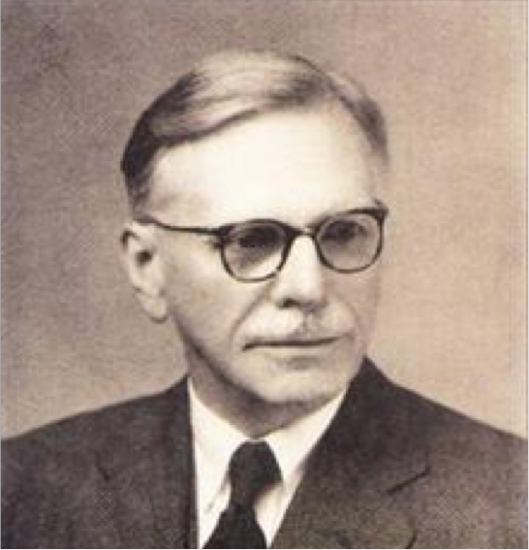
Representing words by their context
Distributional semantics: A word’s meaning is given by the words that frequently appear close-by
  “You shall know a word by the company it keeps” (J. R. Firth 1957)
  One of the most successful ideas of modern statistical NLP!
When a word w appears in a text, its context is the set of words that appear nearby (within a fixed-size window).
Use the many contexts of w to build up a representation of w
…government debt problems turning into
…saying that Europe needs unified
…India has just given its
banking
banking banking
crises as happened in 2009…
regulation to replace the hodgepodge… system a shot in the arm…
These context words will represent banking
Christopher Manning

Slide 26
What can we learn from reconstructing the input?
Stanford University is located in , California.
John Hewitt

Slide 27
What can we learn from reconstructing the input?
I put fork down on the table.
John Hewitt

Slide 28
What can we learn from reconstructing the input?
The woman walked across the street, checking for traffic over shoulder.
John Hewitt

Slide 29
What can we learn from reconstructing the input?
I went to the ocean to see the fish, turtles, seals, and .
John Hewitt

Slide 30
What can we learn from reconstructing the input?
Overall, the value I got from the two hours watching it was the sum total of the popcorn and the drink.
The movie was .
John Hewitt

Slide 31
What can we learn from reconstructing the input?
Iroh went into the kitchen to make some tea.
Standing next to Iroh, Zuko pondered his destiny.
Zuko left the .
John Hewitt

Slide 32
What can we learn from reconstructing the input?
I was thinking about the sequence that goes 1, 1, 2, 3, 5, 8, 13, 21,
John Hewitt

Slide 33
Word vectors
We will build a dense vector for each word, chosen so that it is similar to vectors of words that appear in similar contexts
0.286
0.792
−0.177
−0.107
0.109
−0.542
0.349
0.271
banking =
Note: word vectors are sometimes called word embeddings or word representations. They are a distributed representation.
Christopher Manning

Slide 34
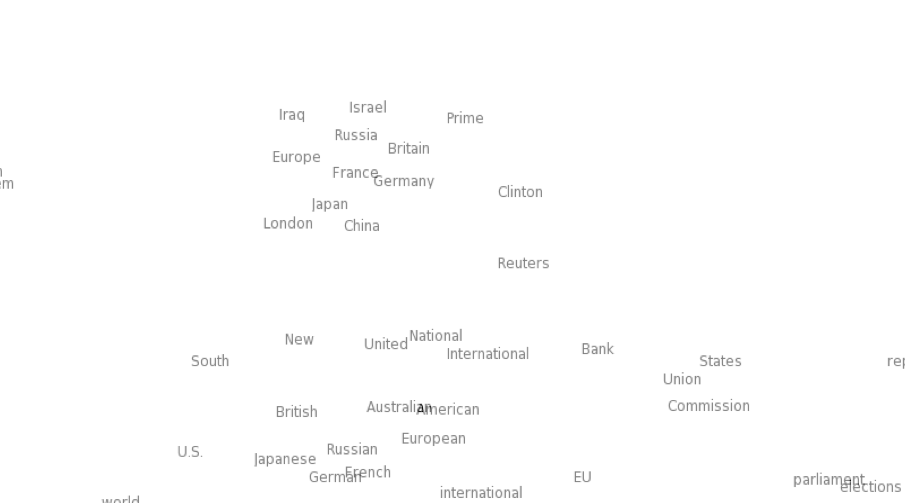

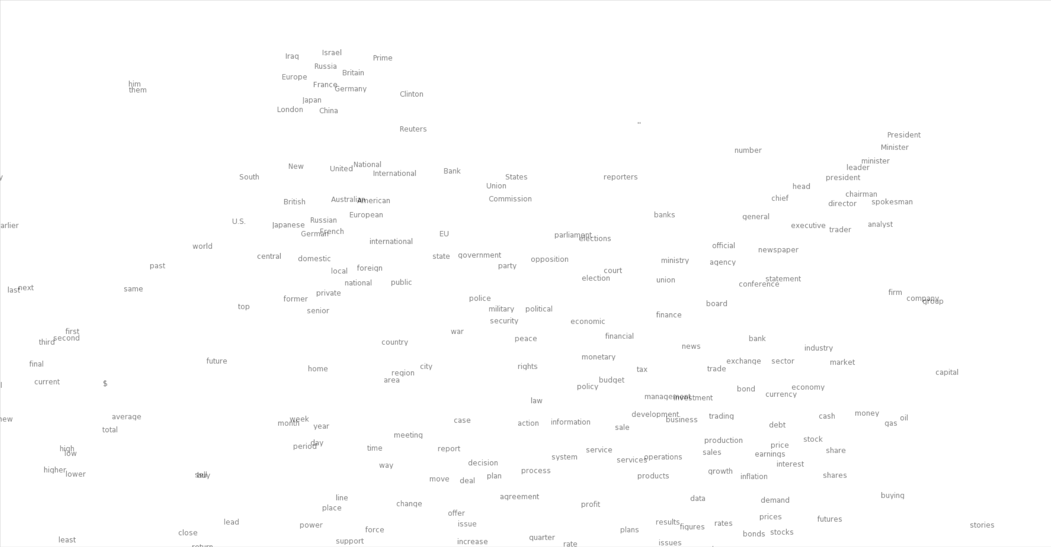
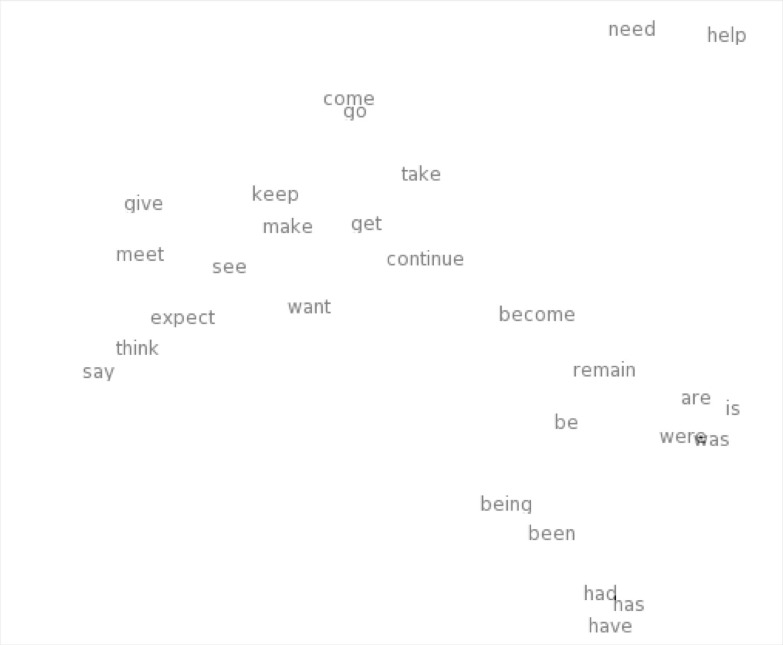
Word meaning as a neural word vector – visualization
0.286
0.792
−0.177
−0.107
0.109
−0.542
0.349
0.271
0.487
expect =
Christopher Manning

Slide 35
Word2Vec Overview
Word2vec (Mikolov et al. 2013) is a framework for learning word vectors
Idea:
We have a large corpus of text
Every word in a fixed vocabulary is represented by a vector
Go through each position t in the text, which has a center word
c and context (“outside”) words o
Use the similarity of the word vectors for c and o to calculate the probability of o given c (or vice versa)
Keep adjusting the word vectors to maximize this probability
Christopher Manning

Slide 36
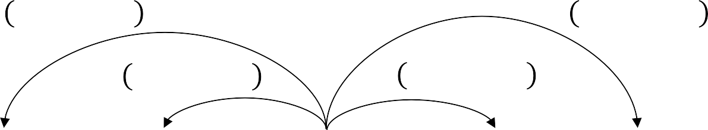
Word2Vec Overview
Example windows and process for computing P(w_{t+j}|w_{t})
P w_{t-2}|w_{t}
P w_{t+2}|w_{t}
P w_{t-1}|w_{t}
P w_{t+1}|w_{t}
…
problems
turning
into
banking
crises
as
…
outside context words in window of size 2
center word at position t
outside context words in window of size 2
Christopher Manning

Slide 37
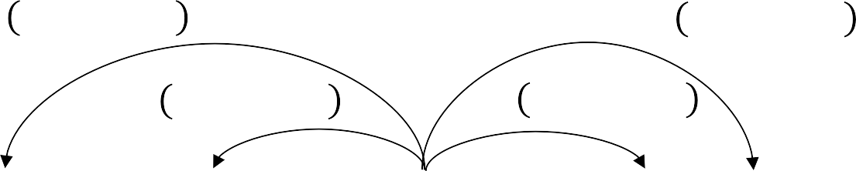
Word2Vec Overview
Example windows and process for computing P(w_{t+j}|w_{t})
P w_{t-2}|w_{t}
P w_{t+2}|w_{t}
P w_{t-1}|w_{t}
P w_{t+1}|w_{t}
…
problems
turning
into
banking
crises
as
…
outside context words in window of size 2
center word at position t
outside context words in window of size 2
Christopher Manning

Slide 38
Word2Vec: objective function
For each position t = 1, … , T, predict context words within a window of fixed size m, given center word w_{j}.
The objective function is the (average) negative log likelihood:
Minimizing objective function ⟺ Maximizing predictive accuracy
Christopher Manning

Slide 39
Word2Vec: objective function
We want to minimize the objective function:
Question: How to calculate P(w_{t+j}|w_{t} ; θ)?
Answer: We will use two vectors per word w:
  v_{w} when w is a center word
  u_{w} when w is a context word
Then for a center word c and a context word o:
Christopher Manning

Slide 40
Word2Vec: prediction function
This is an example of the softmax function ℝ^{n} → ℝ^{n}
The softmax function maps arbitrary values to a probability distribution p_{i}
  “max” because amplifies probability of largest x_{i}
  “soft” because still assigns some probability to smaller x_{i}
  Frequently used in Deep Learning
Christopher Manning

Slide 41

ELMo: Embeddings from Language Models
Deep contextualized word representations. Peters et al. NAACL 2018. https://arxiv.org/abs/1802.05365
Breakout version of word token vectors or
contextual word vectors
Learn word token vectors using long contexts not context windows (here, whole sentence, could be longer)
Learn a deep Bi-NLM and use all its layers in prediction
Christopher Manning

Slide 42
ELMo: Embeddings from Language Models
Train a bidirectional LM
Aim at performant but not overly large LM:
  Use 2 biLSTM layers
  Use character CNN to build initial word representation
  User 4096 dim hidden/cell LSTM states with 512 dim projections to next input
  Use a residual connection
  Tie parameters of token input and output (softmax) and tie these between forward and backward LMs
Adapted from Christopher Manning

Slide 43
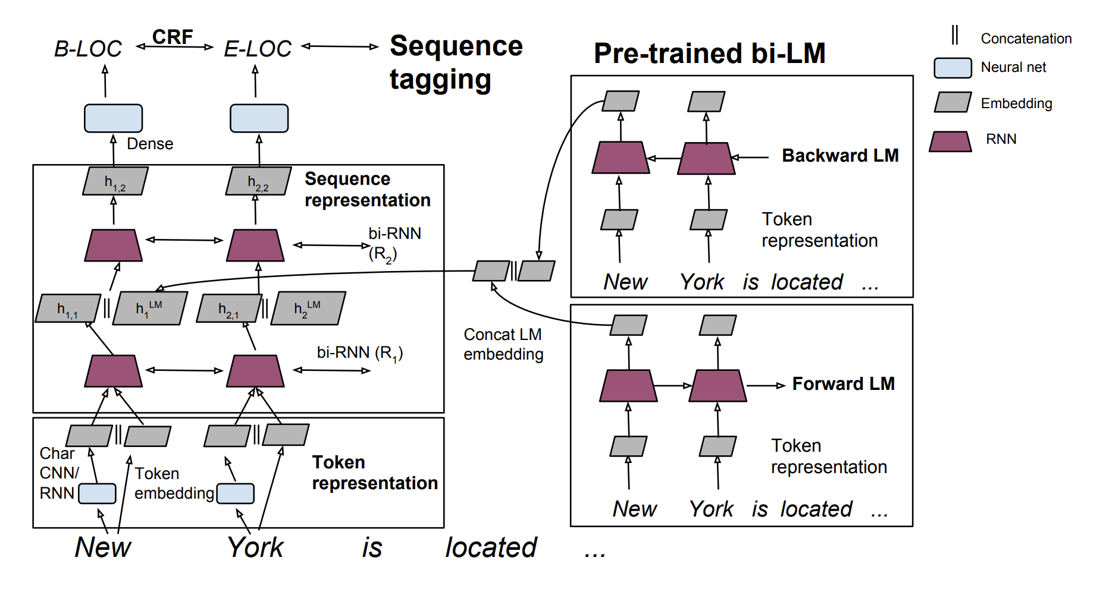
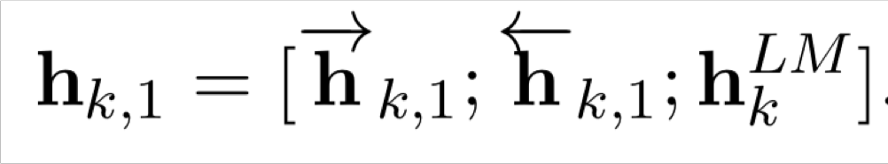
ELMo used in a sequence tagger
Christopher Manning, figure from https://tsenghungchen.github.io/posts/elmo/, paper at https://arxiv.org/pdf/1802.05365.pdf

Slide 44
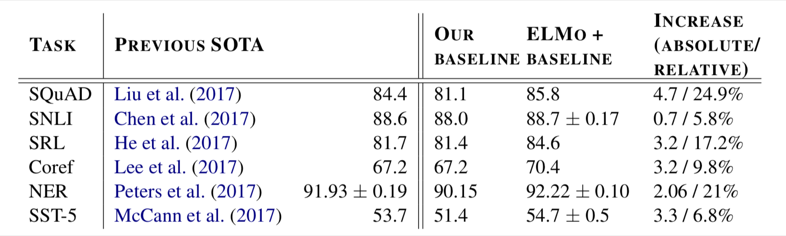
ELMo results: Great for all tasks
Christopher Manning

Slide 45
ELMo: Roles of different layers
The two biLSTM NLM layers have differentiated uses/meanings
  Lower layer is better for lower-level syntax, etc.
    Part-of-speech tagging, syntactic dependencies, NER
  Higher layer is better for higher-level semantics
    Sentiment, Semantic role labeling, question answering, SNLI
Adapted from Christopher Manning

Slide 46
Issues with recurrent models:
Linear interaction distance
O(sequence length) steps for distant word pairs to interact means:
  Hard to learn long-distance dependencies (because gradient problems!)
  Linear order of words is “baked in”; not necessarily the right way to think about sentences…
The chef who …
was
Info of chef has gone through O(sequence length) many layers!
Adapted from John Hewitt

Slide 47
Issues with recurrent models:
Lack of parallelizability
Forward and backward passes have O(sequence length) unparallelizable operations
  GPUs can perform a bunch of independent computations at once!
  But future RNN hidden states can’t be computed in full before past RNN
hidden states have been computed
  Inhibits training on very large datasets!
1
2
3
T
0
1
2
T-1
h₁ h₂
h_{T}
Numbers indicate min # of steps before a state can be computed
John Hewitt

Slide 48
If not recurrence, then what?
How about word windows?
Word window models aggregate local contexts
  Also known as 1D convolution
  Number of unparallelizable operations not tied to sequence length!
window window embedding
2 |  | 2 |  | 2 |  | 2 |  | 2 |  | 2 |  | 2 |  | 2
1 |  | 1 |  | 1 |  | 1 |  | 1 |  | 1 |  | 1 |  | 1
0 |  | 0 |  | 0 |  | 0 |  | 0 |  | 0 |  | 0 |  | 0
h₁
h₂
h_{T}
Numbers indicate min # of steps before a state can be computed
Adapted from John Hewitt

Slide 49
If not recurrence, then what?
How about word windows?
Word window models aggregate local contexts
What about long-distance dependencies?
  Stacking word window layers allows interaction between farther words
  But if your sequences are too long, you’ll just ignore long-distance context
window (size=5)
Red states
indicate those
“visible” to h_{k}
window (size=5) embedding
h₁
h_{k}
h_{T}
Too far from h_{k} to be considered
Adapted from John Hewitt

Slide 50
If not recurrence, then what?
How about attention?
Attention treats each word’s representation as a query to access and incorporate information from a set of values.
  We saw attention from the decoder to the encoder; today we’ll think about
attention within a single sentence.
If attention gives us access to any state… maybe we can just use attention and don’t need the RNN?
Number of unparallelizable operations not tied to sequence length.
All words interact at every layer!
2 |  | 2 |  | 2 |  | 2 |  | 2 |  | 2 |  | 2 |  | 2
1 |  | 1 |  | 1 |  | 1 |  | 1 |  | 1 |  | 1 |  | 1
0 |  | 0 |  | 0 |  | 0 |  | 0 |  | 0 |  | 0 |  | 0
All words attend
to all words in previous layer; most arrows here are omitted
attention
attention embedding
h₁
h₂
h_{T}
Adapted from John Hewitt

Slide 51
Self-Attention
Attention operates on queries, keys, and values.
We have some queries 𝑞 , 𝑞 , … , 𝑞 . Each query is 𝑞_{i} ∈ ℝ^{𝑑}
The number of queries can differ from the number of keys and
values in practice.
1 2 𝑇
We have some keys 𝑘₁, 𝑘₂, … , 𝑘_{𝑇}. Each key is 𝑘_{𝑖} ∈ ℝ^{𝑑}
We have some values 𝑣₁, 𝑣₂, … , 𝑣_{𝑇}. Each value is 𝑣_{𝑖} ∈ ℝ^{𝑑}
In self-attention, the queries, keys, and values are drawn from the same source.
  For example, if the output of the previous layer is 𝑥₁, … , 𝑥_{𝑇}, (one vec per word) we could let 𝑣_{𝑖} = 𝑘_{𝑖} = 𝑞_{𝑖} = 𝑥_{𝑖} (that is, use the same vectors for all of them!)
The (dot product) self-attention operation is as follows:
exp(𝑒_{𝑖𝑗})
𝑒 = 𝑞_{i}^{𝖳}𝑘 𝛼 =
output = Σ _{𝑗} 𝛼 𝑣
𝑖𝑗 𝑗
𝑖𝑗
𝑖 𝑖𝑗 𝑗
𝑖
Σ
_{𝑗'}
exp(𝑒_{𝑖𝑗’} )
Compute outputs as weighted sum of values
Compute key- query affinities
Compute attention weights from affinities
(softmax)
John Hewitt

Slide 52
Self-Attention
In the diagram at the right, we have stacked self-attention blocks, like we might stack LSTM layers.
Can self-attention be a drop-in
replacement for recurrence?
No. It has a few issues, which
we’ll go through.
First, self-attention is an operation on sets. It has no inherent notion of order.
self-attention
𝑞₁
𝑘₁ 𝑣₁
𝑘₂
𝑞₂
𝑞₃
𝑞_{𝑇}
𝑣₂ 𝑘₃ 𝑣₃
𝑘_{𝑇}
𝑣_{𝑇}
…
self-attention
𝑘₂ 𝑣₂ 𝑘₃ 𝑞₃ 𝑣₃
𝑞₁
𝑘₁ 𝑣₁
𝑞₂
𝑘_{𝑇}
𝑞_{𝑇}
𝑣_{𝑇}
…
𝑤₁
The
𝑤₂
chef
𝑤₃
who
𝑤_{𝑇}
food
Self-attention doesn’t know the order of its inputs.
John Hewitt

Slide 53
Barriers and solutions for Self-Attention as a building block
Barriers
Doesn’t have an inherent
notion of order!
Solutions
John Hewitt

Slide 54
Fixing the first self-attention problem:
Sequence order
Since self-attention doesn’t build in order information, we need to encode the order of the
sentence in our keys, queries, and values.
Consider representing each sequence index as a vector
𝑝_{𝑖} ∈ ℝ^{𝑑}, for 𝑖 ∈ {1,2, … , 𝑇} are position vectors
Don’t worry about what the 𝑝_{𝑖} are made of yet!
Easy to incorporate this info into our self-attention block: just add the 𝑝_{𝑖} to our inputs!
Let 𝑣_{𝑖} ‘, 𝑘_{𝑖} ‘, 𝑞_{𝑖} ‘ be our old values, keys, and queries.
𝑣_{𝑖} = 𝑣_{𝑖} ‘ + 𝑝_{𝑖}
𝑞_{𝑖} = 𝑞_{𝑖} ‘ + 𝑝_{𝑖}
𝑘_{𝑖} = 𝑘_{𝑖} ‘ + 𝑝_{𝑖}
In deep self-attention networks, we do this at the first layer! You could concatenate them as well, but people mostly just add…
John Hewitt

Slide 55

Position representation vectors through sinusoids
Sinusoidal position representations: concatenate sinusoidal functions of varying periods:
sin(𝑖/10000^{2∗1/𝑑}) cos(𝑖/10000^{2∗1/𝑑})
𝑝_{𝑖} =
𝑑
Dimension
sin(𝑖/10000^{2∗}2^{/𝑑})
𝑑
cos(𝑖/10000^{2∗}2^{/𝑑})
Index in the sequence
Pros:
  Periodicity indicates that maybe “absolute position” isn’t as important
  Maybe can extrapolate to longer sequences as periods restart!
Cons:
  Not learnable; also the extrapolation doesn’t really work!
Image: https://timodenk.com/blog/linear-relationships-in-the-transformers-positional-encoding/
John Hewitt

Slide 56
Barriers and solutions for Self-Attention as a building block
Barriers
Doesn’t have an inherent
notion of order!
Solutions
Add position representations to the inputs
No nonlinearities for deep
learning! It’s all just weighted
averages
John Hewitt

Slide 57
Adding nonlinearities in self-attention
Note that there are no elementwise nonlinearities in self-attention; stacking more self-attention layers just re-averages value vectors
Easy fix: add a feed-forward network
to post-process each output vector.
FF
FF
FF
self-attention
FF
…
FF
FF
FF
self-attention
FF
𝑚_{𝑖} = 𝑀𝐿𝑃 output_{𝑖}
= 𝑊₂ ∗ ReLU 𝑊₁ × output_{𝑖} + 𝑏₁
…
+ 𝑏₂
𝑤₁
The
𝑤₂
chef
𝑤₃
who
𝑤_{𝑇}
food
Intuition: the FF network processes the result of attention
John Hewitt

Slide 58
Barriers and solutions for Self-Attention as a building block
Barriers
Doesn’t have an inherent
notion of order!
No nonlinearities for deep learning magic! It’s all just weighted averages
Need to ensure we don’t “look at the future” when predicting a sequence
  Like in machine translation
  Or language modeling
Solutions
Add position representations to the inputs
Easy fix: apply the same feedforward network to each self- attention output.
John Hewitt

Slide 59
Masking the future in self-attention
We can look at these (not greyed out) words
To use self-attention in decoders, we need to ensure we can’t peek at the future.
−∞ | −∞ | −∞ | −∞
 | −∞ | −∞ | −∞
 |  | −∞ | −∞
 |  |  | −∞
[START]
At every timestep, we could change the set of keys and queries to include only past words. (Inefficient!)
To enable parallelization, we mask out attention to future words by setting attention scores to −∞.
𝑒_{𝑖𝑗} =
The
For encoding these words
chef
who
𝑞^{𝖳}𝑘_{𝑗}, 𝑗 < 𝑖
𝑖
−∞, 𝑗 ≥ 𝑖
John Hewitt

Slide 60
Barriers and solutions for Self-Attention as a building block
Barriers
Doesn’t have an inherent
notion of order!
No nonlinearities for deep learning magic! It’s all just weighted averages
Need to ensure we don’t “look at the future” when predicting a sequence
  Like in machine translation
  Or language modeling
Solutions
Add position representations to the inputs
Easy fix: apply the same feedforward network to each self- attention output.
Mask out the future by artificially setting attention weights to 0!
John Hewitt

Slide 61
Necessities for a self-attention building block:
Self-attention:
  the basis of the method.
Position representations:
  Specify the sequence order, since self-attention is an unordered function of its inputs.
Nonlinearities:
  At the output of the self-attention block
  Frequently implemented as a simple feed-forward network.
Masking:
  In order to parallelize operations while not looking at the future.
  Keeps information about the future from “leaking” to the past.
That’s it! But this is not the Transformer model we’ve been hearing about.
John Hewitt

Slide 62
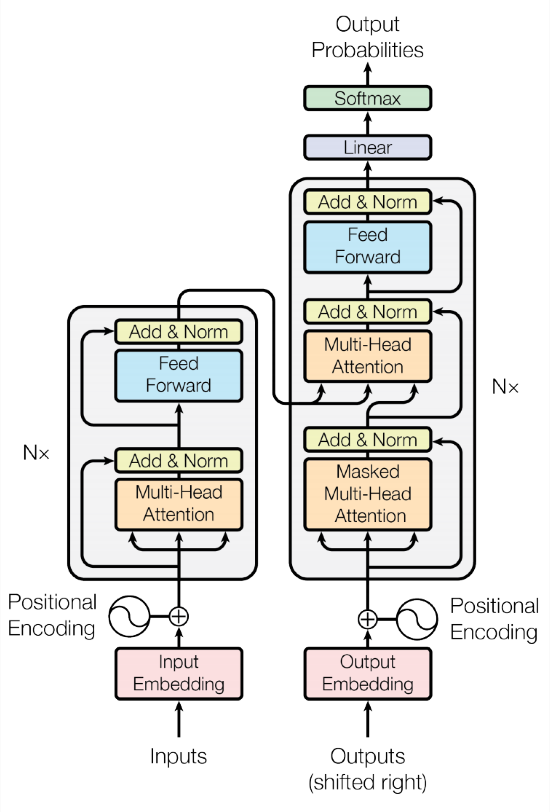
Transformer Overview
Attention is all you need. 2017. Aswani, Shazeer, Parmar, Uszkoreit, Jones, Gomez, Kaiser, Polosukhin https://arxiv.org/pdf/1706.03762.pdf
Non-recurrent sequence-to- sequence encoder-decoder model
Task: machine translation with parallel corpus
Predict each translated word
Final cost/error function is standard cross-entropy error on top of a softmax classifier
This and related figures from paper ⇑
Christopher Manning

Slide 63
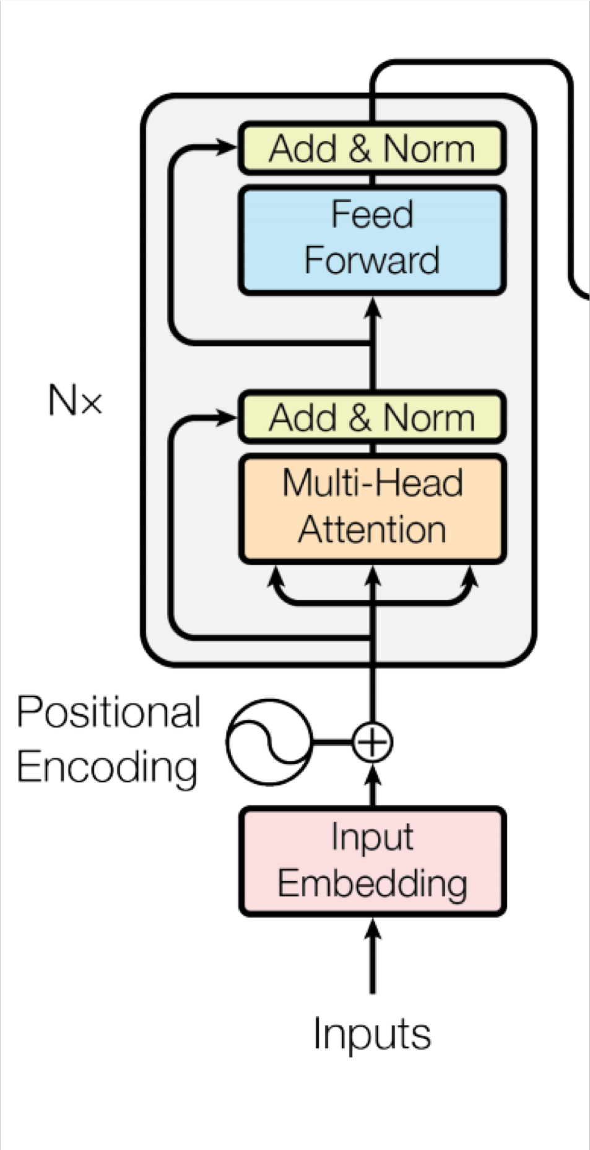
Transformer Encoder
For encoder, at each block, we use the same Q, K and V
from the previous layer
Blocks are repeated 6 times (in vertical stack)
Christopher Manning

Slide 64



Transformer Decoder
2 sublayer changes in decoder
Masked decoder self-attention on previously generated outputs:
Encoder-Decoder Attention, where queries come from previous decoder layer and keys and values come from output of encoder
Blocks repeated 6 times also
Christopher Manning

Slide 65




The Transformer Encoder-Decoder
[Vaswani et al., 2017]
Another look at the Transformer Encoder and Decoder Blocks at a high level
[predictions!]
Transformer Encoder
Transformer Decoder
[decoder attends to encoder states]
Transformer
Encoder
Transformer Decoder
Word Embeddings
+
Position Representations
Word
Embeddings
+
Position
Representations
[input sequence]
[output sequence]
John Hewitt

Slide 66
The Transformer Encoder-Decoder
[Vaswani et al., 2017]
Next, let’s look at the Transformer Encoder and Decoder Blocks
What’s left in a Transformer Encoder Block that we haven’t covered?
Key-query-value attention: How do we get the 𝑘, 𝑞, 𝑣 vectors from a single word embedding?
Multi-headed attention: Attend to multiple places in a single layer!
Tricks to help with training!
  Residual connections
  Layer normalization
  Scaling the dot product
  These tricks don’t improve what the model is able to do; they help improve the training process
John Hewitt

Slide 67
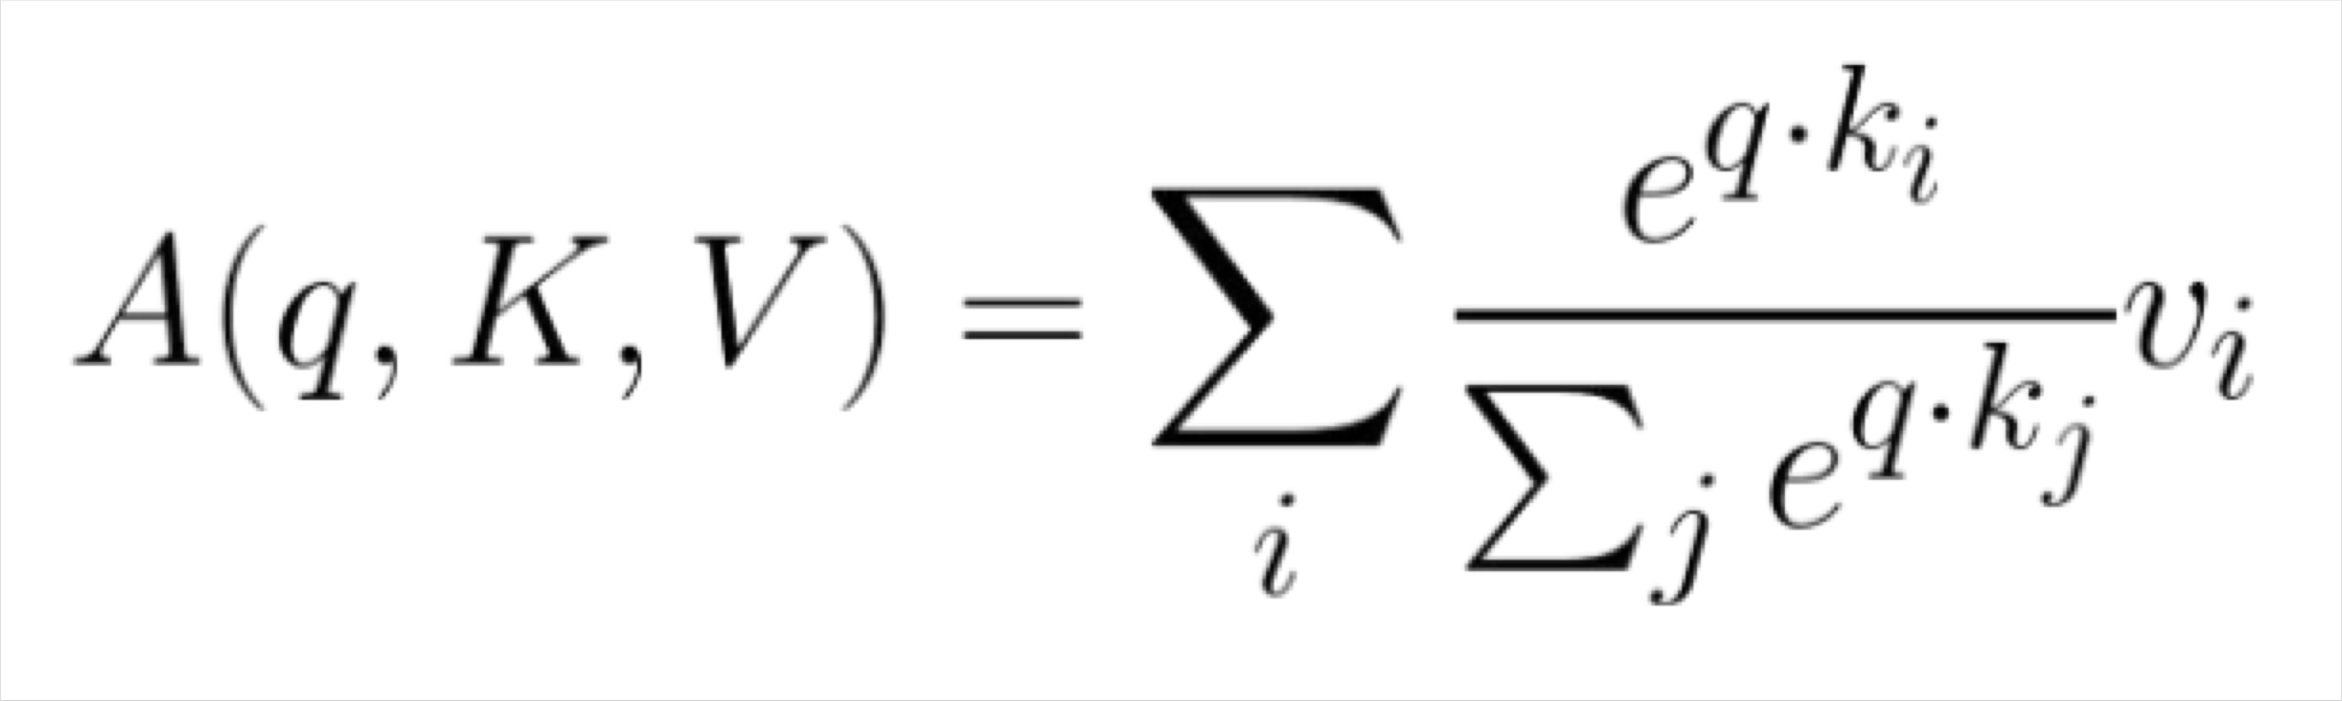
The Transformer Encoder:
Dot-Product Attention
Inputs: a query q and a set of key-value (k-v) pairs to an output
Query, keys, values, and output are all vectors
Output is weighted sum of values, where
Weight of each value is computed by an inner product of query and corresponding key
Queries and keys have same dimensionality d_{k ,} value have d_{v}
Christopher Manning

Slide 68
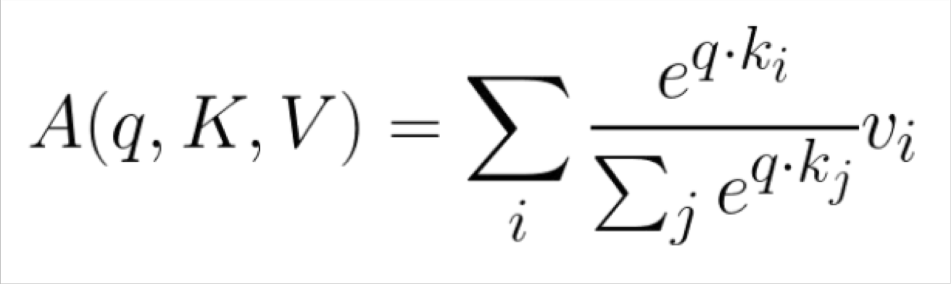
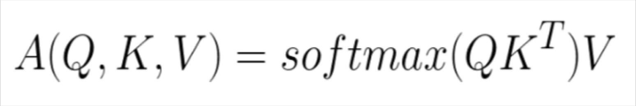
The Transformer Encoder:
Dot-Product Attention – Matrix notation
When we have multiple queries q, we stack them in a matrix Q:
Becomes:
[|Q| x d_{k}] x [d_{k} x |K|] x [|K| x d_{v}]
softmax row-wise
= [|Q| x d_{v}]
Christopher Manning

Slide 69
The Transformer Encoder:
Key-Query-Value Attention
We saw that self-attention is when keys, queries, and values come from the same
source. The Transformer does this in a particular way:
  Let 𝑥₁, … , 𝑥_{𝑇} be input vectors to the Transformer encoder; 𝑥_{𝑖} ∈ ℝ^{𝑑}
Then keys, queries, values are:
  𝑘_{𝑖} = 𝐾𝑥_{𝑖}, where 𝐾 ∈ ℝ^{𝑑×𝑑} is the key matrix.
  𝑞_{𝑖} = 𝑄𝑥_{𝑖}, where Q ∈ ℝ^{𝑑×𝑑} is the query matrix.
  𝑣_{𝑖} = 𝑉𝑥_{𝑖}, where V ∈ ℝ^{𝑑×𝑑} is the value matrix.
These matrices allow different aspects of the 𝑥 vectors to be used/emphasized in each of the three roles.
John Hewitt

Slide 70
The Transformer Encoder:
Key-Query-Value Attention
Let’s look at how key-query-value attention is computed, in matrices.
  Let 𝑋 = 𝑥₁; … ; 𝑥_{𝑇} ∈ ℝ^{𝑇×𝑑} be the concatenation of input vectors.
  First, note that 𝑋𝐾 ∈ ℝ^{𝑇×𝑑}, 𝑋𝑄 ∈ ℝ^{𝑇×𝑑}, 𝑋𝑉 ∈ ℝ^{𝑇×𝑑}.
𝖳
The output is defined as output = softmax 𝑋𝑄 𝑋𝐾 ^{T} × 𝑋𝑉.
First, take the query-key dot products in one matrix
All pairs of attention scores!
= 𝑋𝑄𝐾^{𝖳} 𝑋^{𝖳}
𝖳
𝑋𝑄
multiplication: 𝑋𝑄 𝑋𝐾
_{𝐾}𝖳 _{𝑋}𝖳
𝑇×𝑇
∈ ℝ
Next, softmax, and compute the weighted average with another matrix multiplication.
softmax
𝑋𝑄𝐾^{𝖳} 𝑋^{𝖳}
𝑋𝑉
=
output ∈ ℝ^{𝑇×𝑑}
John Hewitt

Slide 71
The Transformer Encoder:
Multi-headed attention
What if we want to look in multiple places in the sentence at once?
For word 𝑖, self-attention “looks” where 𝑥^{𝖳}𝑄^{𝖳}𝐾𝑥_{𝑗} is high, but maybe we want
𝑖
to focus on different 𝑗 for different reasons?
We’ll define multiple attention “heads” through multiple Q,K,V matrices
𝑑
Let, 𝑄_{𝑃}, 𝐾_{𝑃}, 𝑉_{𝑃} ∈ ℝ ^{ℎ}, where ℎ is the number of attention heads, and 𝑃 ranges
from 1 to ℎ.
Each attention head performs attention independently:
𝑑×
output_{𝑃} = softmax 𝑋𝑄_{𝑃}𝐾^{𝖳}𝑋^{𝖳} ∗ 𝑋𝑉_{𝑃}, where output_{𝑃} ∈ ℝ^{𝑑/ℎ}
𝑃
Then the outputs of all the heads are combined!
  output = 𝑌[output₁; … ; output_{ℎ}], where 𝑌 ∈ ℝ^{𝑑×𝑑}
Each head gets to “look” at different things, and construct value vectors
differently.
John Hewitt

Slide 72
The Transformer Encoder:
Multi-headed attention
What if we want to look in multiple places in the sentence at once?
For word 𝑖, self-attention “looks” where 𝑥^{𝖳}𝑄^{𝖳}𝐾𝑥_{𝑗} is high, but maybe we want
𝑖
to focus on different 𝑗 for different reasons?
We’ll define multiple attention “heads” through multiple Q,K,V matrices
𝑑
Let, 𝑄_{𝑃}, 𝐾_{𝑃}, 𝑉_{𝑃} ∈ ℝ ^{ℎ}, where ℎ is the number of attention heads, and 𝑃 ranges
from 1 to ℎ.
𝑑×
Single-head attention
(just the query matrix)
Multi-head attention
(just two heads here)
Same amount of computation as single-head self- attention!
𝑋
=
𝑋𝑄
𝑋
𝑄₁ 𝑄₂ =
𝑋𝑄₁ 𝑋𝑄₂
𝑄
John Hewitt

Slide 73
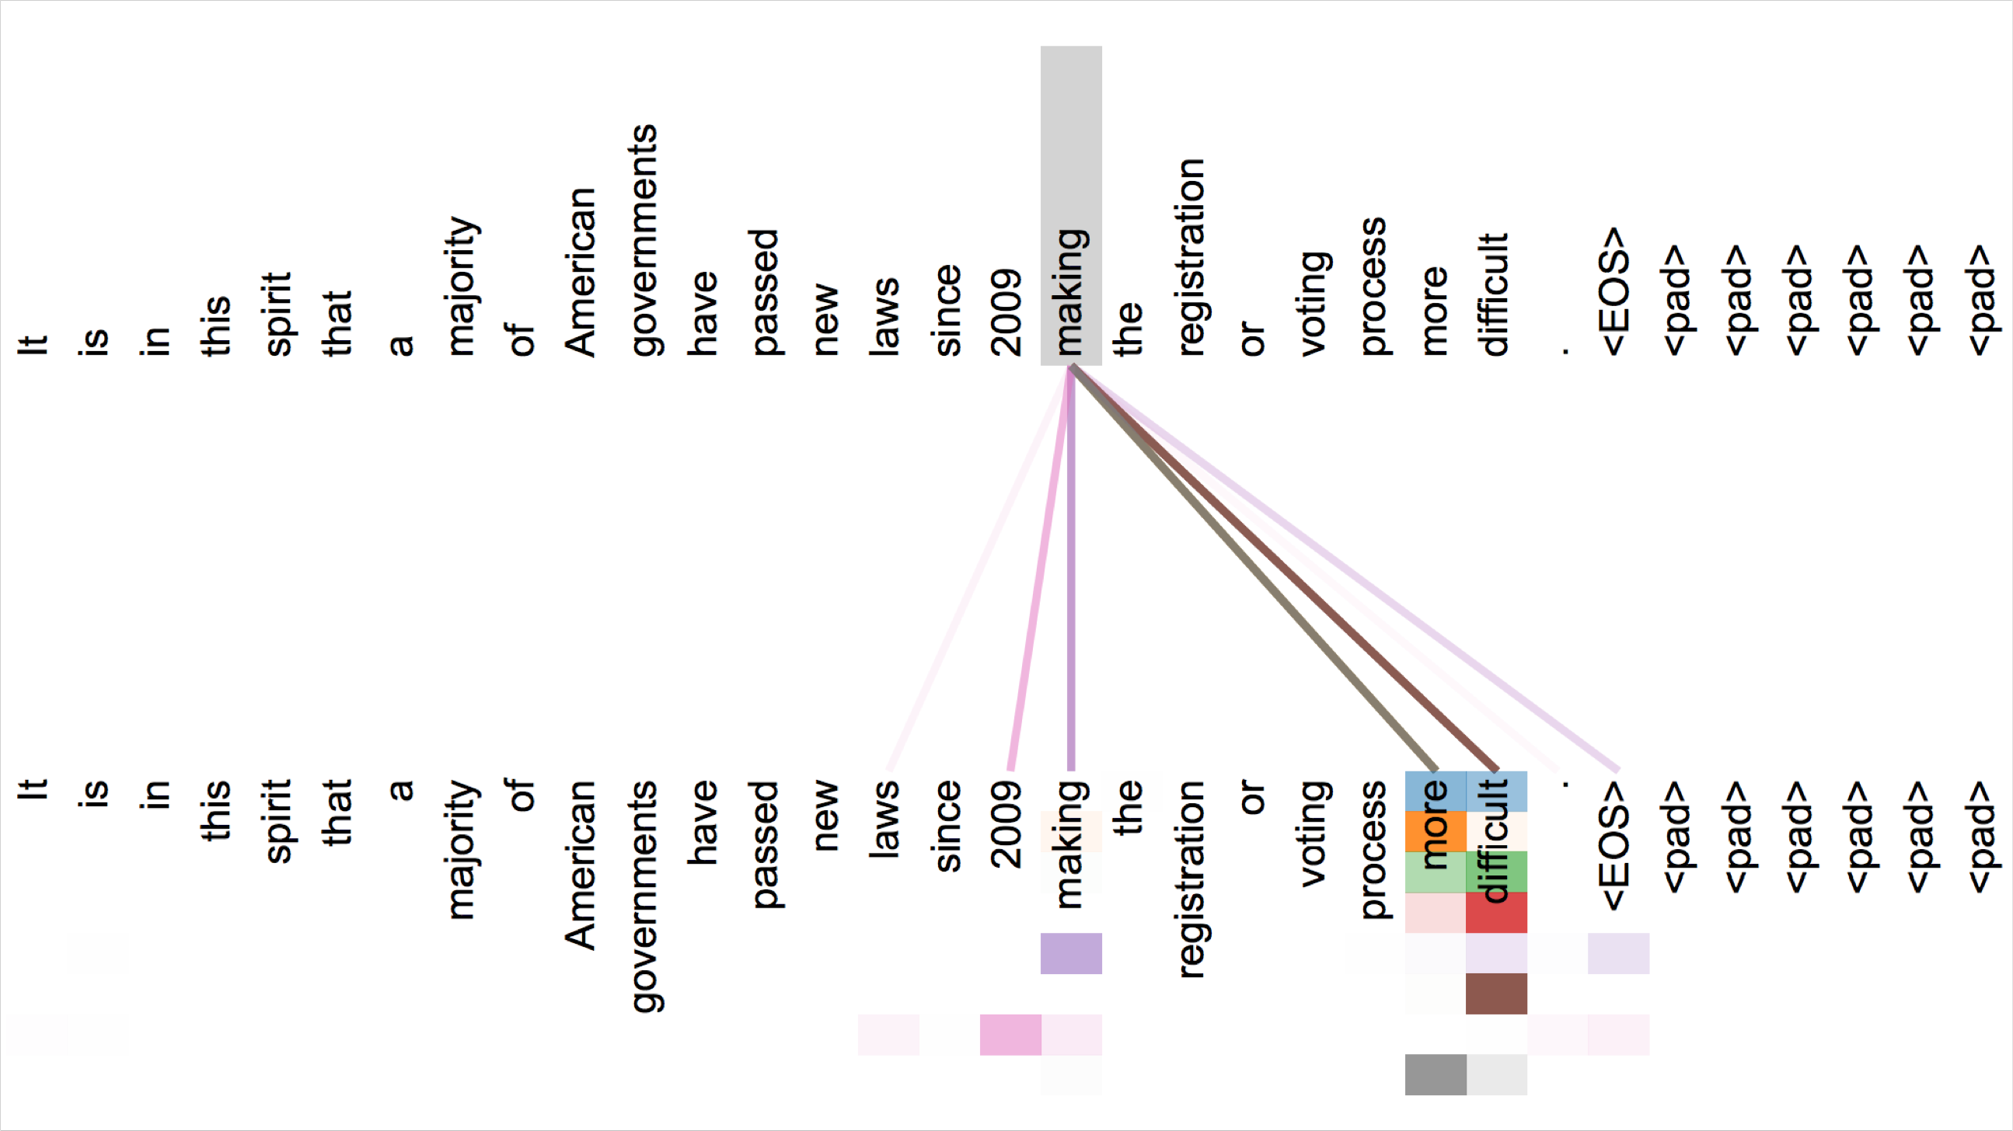
Attention visualization in layer 5
Words start to pay attention to other words in sensible ways
Christopher Manning

Slide 74
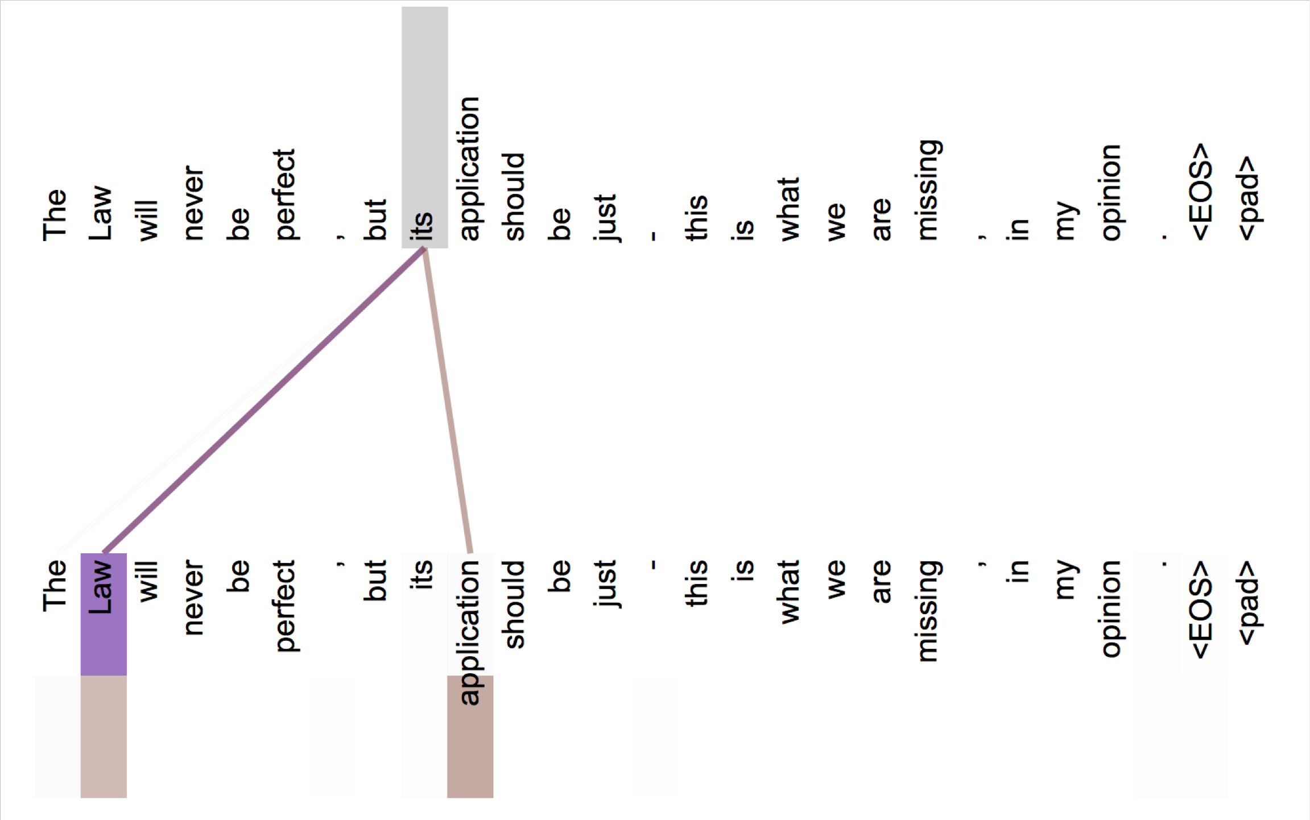
Attention visualization: Implicit anaphora resolution
In 5th layer. Isolated attentions from just the word ‘its’ for attention heads 5 and 6. Note that the attentions are very sharp for this word.
Christopher Manning

Slide 75


Parallel attention heads
I
kicked
the
ball
Who
To whom?
Did what?
I
kicked
the
ball
Ashish Vaswani

Slide 76

The Transformer Encoder:
Residual connections [He et al., 2016]
Residual connections are a trick to help models train better.
  Instead of 𝑋^{(𝑖)} = Layer(𝑋 ^{𝑖−1} ) (where 𝑖 represents the layer)
_{𝑋}(𝑖−1) _{𝑋}(𝑖)
Layer
We let 𝑋^{(𝑖)} = 𝑋^{(𝑖−1)} + Layer(𝑋 ^{𝑖−1} ) (so we only have to learn “the residual”
from the previous layer)
_{𝑋}(𝑖−1) _{𝑋}(𝑖)
Layer
+
Residual connections are thought to make the loss landscape considerably smoother (thus easier training!)
[no residuals] [residuals]
[Loss landscape visualization, Li et al., 2018, on a ResNet]
John Hewitt

Slide 77
The Transformer Encoder:
Layer normalization [Ba et al., 2016]
Layer normalization is a trick to help models train faster.
Idea: cut down on uninformative variation in hidden vector values by normalizing to unit mean and standard deviation within each layer.
  LayerNorm’s success may be due to its normalizing gradients [Xu et al., 2019]
Let 𝑥 ∈ ℝ^{𝑑} be an individual (word) vector in the model.
Let 𝜇 = Σ_{j=1}^{𝑑} 𝑥_{𝑗} ; this is the mean; 𝜇 ∈ ℝ.
1
𝑑
Σ^{d}
2
𝑥 − 𝜇 ; this is the standard deviation; 𝜎 ∈ ℝ.
Let 𝜎 =
Let 𝛾 ∈ ℝ^{𝑑} and 𝛽 ∈ ℝ^{𝑑} be learned “gain” and “bias” parameters. (Can omit!)
Then layer normalization computes:
𝑗=1
𝑗
𝑥 − 𝜇
∗ 𝛾 + 𝛽
output =
∗ 𝛾 + 𝛽
Modulate by learned elementwise gain and bias
𝜎 + 𝜖
Normalize by scalar mean and variance
Modulate by learned elementwise gain and bias
John Hewitt

Slide 78
The Transformer Encoder:
Scaled Dot Product [Vaswani et al., 2017]
“Scaled Dot Product” attention is a final variation to aid in Transformer training.
When dimensionality 𝑑 becomes large, dot products between vectors become large, inputs to the softmax function can be large, making gradients small.
Instead of the self-attention function we’ve seen:
output_{𝑃} = softmax 𝑋𝑄_{𝑃}𝐾^{𝖳}𝑋^{𝖳} ∗ 𝑋𝑉_{𝑃}
𝑃
We divide the attention scores by 𝑑/ℎ, to stop the scores from becoming large
just as a function of 𝑑/ℎ (The dimensionality divided by the number of heads.)
output_{𝑃} = softmax
𝑋𝑄_{𝑃}𝐾^{𝖳}𝑋^{𝖳}
∗ 𝑋𝑉_{𝑃}
𝑃
𝑑/ℎ
John Hewitt

Slide 79
The Transformer Encoder-Decoder
[Vaswani et al., 2017]
Looking back at the whole model, zooming in on an Encoder block:
[predictions!]
Transformer Encoder
Transformer Decoder
[decoder attends to encoder states]
Transformer
Encoder
Transformer Decoder
Word Embeddings
+
Position Representations
Word
Embeddings
+
Position
Representations
[input sequence]
[output sequence]
John Hewitt

Slide 80


The Transformer Encoder-Decoder
[Vaswani et al., 2017]
Looking back at the whole model, zooming in on an Encoder block:
Transformer
Encoder
[predictions!]
Transformer Decoder
Residual + LayerNorm
[decoder attends to encoder states]
Feed-Forward
Residual + LayerNorm
Transformer Decoder
Multi-Head Attention
Word Embeddings
+
Position Representations
Word
Embeddings
+
Position
Representations
[input sequence]
[output sequence]
John Hewitt

Slide 81


The Transformer Encoder-Decoder
[Vaswani et al., 2017]
Looking back at the whole model, zooming in on a Decoder block:
Transformer Encoder
[predictions!]
Transformer Decoder
Residual + LayerNorm Feed-Forward Residual + LayerNorm
Multi-Head Cross-Attention Residual + LayerNorm
Masked Multi-Head Self-Attention
Transformer
Encoder
Word Embeddings
+
Position Representations
Word
Embeddings
+
Position
Representations
[input sequence]
[output sequence]
John Hewitt

Slide 82

The Transformer Encoder-Decoder
[Vaswani et al., 2017]
The only new part is attention from decoder to encoder. Like we saw in previous lecture!
Transformer Encoder
[predictions!]
Transformer Decoder
Residual + LayerNorm
Feed-Forward
Residual + LayerNorm Multi-Head Cross-Attention
Residual + LayerNorm
Masked Multi-Head Self-Attention
Transformer
Encoder
Word Embeddings
+
Position Representations
Word
Embeddings
+
Position
Representations
[input sequence]
[output sequence]
John Hewitt

Slide 83
The Transformer Decoder:
Cross-attention (details)
We saw self-attention is when keys, queries, and values come from the same source.
In the decoder, we have attention that looks more like what we saw last week.
Let ℎ₁, … , ℎ_{𝑇} be output vectors from the Transformer encoder; 𝑥_{𝑖} ∈ ℝ^{𝑑}
Let 𝑧₁, … , 𝑧_{𝑇} be input vectors from the Transformer decoder, 𝑧_{𝑖} ∈ ℝ^{𝑑}
Then keys and values are drawn from the encoder (like a memory):
  𝑘_{𝑖} = 𝐾ℎ_{𝑖}, 𝑣_{𝑖} = 𝑉ℎ_{𝑖}.
And the queries are drawn from the decoder, 𝑞_{𝑖} = 𝑄𝑧_{𝑖}.
John Hewitt

Slide 84
The Transformer Encoder:
Cross-attention (details)
Let’s look at how cross-attention is computed, in matrices.
Let H = ℎ₁; … ; ℎ_{𝑇}
Let Z = 𝑧₁; … ; 𝑧_{𝑇}
∈ ℝ^{𝑇×𝑑} be the concatenation of encoder vectors.
∈ ℝ^{𝑇×𝑑} be the concatenation of decoder vectors.
𝖳
The output is defined as output = softmax 𝑍𝑄 𝐻𝐾 × 𝐻𝑉.
First, take the query-key dot products in one matrix
All pairs of attention scores!
= 𝑍𝑄𝐾^{𝖳} 𝐻^{𝖳}
𝖳
𝑍𝑄
multiplication: 𝑍𝑄 𝐻𝐾
_{𝐾}𝖳 _{𝐻}𝖳
𝑇×𝑇
∈ ℝ
Next, softmax, and compute the weighted average with another matrix multiplication.
softmax
𝑍𝑄𝐾^{𝖳} 𝐻^{𝖳}
𝐻𝑉
=
output ∈ ℝ^{𝑇×𝑑}
John Hewitt

Slide 85

Great Results with Transformers
Next, document generation!
The old standard
Transformers all the way down.
[Liu et al., 2018]; WikiSum dataset
John Hewitt

Slide 86
What would we like to fix about the Transformer?
Quadratic compute in self-attention:
  Computing all pairs of interactions means our computation grows
quadratically with the sequence length!
  For recurrent models, it only grew linearly!
Position representations:
  Are simple absolute indices the best we can do to represent position?
  Relative linear position attention [Shaw et al., 2018]
  Dependency syntax-based position [Wang et al., 2019]
John Hewitt

Slide 87
Quadratic computation as function of seq. length
One of the benefits of self-attention over recurrence was that it’s highly
parallelizable.
However, its total number of operations grows as 𝑂 𝑇²𝑑 , where 𝑇 is the sequence length, and 𝑑 is the dimensionality.
= 𝑋𝑄𝐾^{𝖳} 𝑋^{𝖳}
Need to compute all pairs of interactions!
𝑂 𝑇²𝑑
𝑋𝑄
_{𝐾}𝖳 _{𝑋}𝖳
∈ ℝ
𝑇×𝑇
Think of 𝑑 as around 𝟏, 𝟎𝟎𝟎.
  So, for a single (shortish) sentence, 𝑇 ≤ 30; 𝑇² ≤ 𝟗𝟎𝟎.
  In practice, we set a bound like 𝑇 = 512.
  But what if we’d like 𝑻 ≥ 𝟏𝟎, 𝟎𝟎𝟎? For example, to work on long documents?
John Hewitt

Slide 88


Recent work on improving on quadratic self-attention cost
Considerable recent work has gone into the question, Can we build models like
Transformers without paying the 𝑂 𝑇² all-pairs self-attention cost?
For example, Linformer [Wang et al., 2020]
Key idea: map the sequence length dimension to a lower- dimensional space for values, keys
Inference time (s)
Sequence length / batch size
John Hewitt

Slide 89

Recent work on improving on quadratic self-attention cost
Considerable recent work has gone into the question, Can we build models like
Transformers without paying the 𝑂 𝑇² all-pairs self-attention cost?
For example, BigBird [Zaheer et al., 2021]
Key idea: replace all-pairs interactions with a family of other interactions, like local windows, looking at everything, and random interactions.
John Hewitt

Slide 90
Pretraining models
In modern NLP:
All (or almost all) parameters in NLP
networks are initialized via pretraining.
Pretraining methods hide parts of the input from the model, and train the model to reconstruct those parts.
This has been exceptionally effective at building strong:
  representations of language
  parameter initializations for strong NLP
models.
𝒚
Pretrained jointly
… the movie was …
[This model has learned how to represent entire sentences through pretraining]
Adapted from John Hewitt

Slide 91
Pretraining through language modeling
[Dai and Le, 2015]
Recall the language modeling task:
Model 𝑝_{𝜃} 𝑤_{𝑡} 𝑤_{1:𝑡−1}), the probability distribution over words given their past contexts.
There’s lots of data for this! (In English.)
goes
to
make
tasty
tea END
Decoder
(Transformer, LSTM, ++ )
Pretraining through language modeling:
Train a neural network to perform language modeling on a large amount of text.
Save the network parameters.
Iroh goes to
make
tasty tea
John Hewitt

Slide 92

The Pretraining / Finetuning Paradigm
Pretraining can improve NLP applications by serving as parameter initialization.
Step 1: Pretrain (on language modeling)
Lots of text; learn general things!
Step 2: Finetune (on your task)
Not many labels; adapt to the task!
goes to
make tasty tea END
☺/☹
Decoder
Decoder
(Transformer, LSTM, ++ )
(Transformer, LSTM, ++ )
Iroh
goes
to
make
tasty
tea
… the movie was …
John Hewitt

Slide 93
Capturing meaning via context:
What kinds of things does pretraining learn?
There’s increasing evidence that pretrained models learn a wide variety of things about
the statistical properties of language:
Stanford University is located in , California. [Trivia]
I put fork down on the table. [syntax]
The woman walked across the street, checking for traffic over shoulder. [coreference]
I went to the ocean to see the fish, turtles, seals, and . [lexical semantics/topic]
Overall, the value I got from the two hours watching it was the sum total of the popcorn
and the drink. The movie was . [sentiment]
Iroh went into the kitchen to make some tea. Standing next to Iroh, Zuko pondered his destiny. Zuko left the . [some reasoning – this is harder]
I was thinking about the sequence that goes 1, 1, 2, 3, 5, 8, 13, 21, [some basic
arithmetic; they don’t learn the Fibonnaci sequence]
Models also learn – and can exacerbate racism, sexism, all manner of bad biases.
More on all this in the interpretability lecture!
Adapted from John Hewitt

Slide 94


Pretraining for three types of architectures
The neural architecture influences the type of pretraining, and natural use cases.
Language models! What we’ve seen so far.
Nice to generate from; can’t condition on future words
Decoders
Gets bidirectional context – can condition on future!
Wait, how do we pretrain them?
Encoders
Encoder- Decoders
Good parts of decoders and encoders?
What’s the best way to pretrain them?
John Hewitt

Slide 95
Pretraining decoders
When using language model pretrained decoders, we can ignore that they were trained to model 𝑝 𝑤_{𝑡} 𝑤_{1:𝑡−1}).
We can finetune them by training a classifier
on the last word’s hidden state.
☺/☹
Linear
𝐴, 𝑏
ℎ₁, … , ℎ_{𝑇}
ℎ₁, … , ℎ_{𝑇} = Decoder 𝑤₁, … , 𝑤_{𝑇}
𝑦 ∼ 𝐴𝑤_{𝑇} + 𝑏
Where 𝐴 and 𝑏 are randomly initialized and specified by the downstream task.
𝑤₁, … , 𝑤_{𝑇}
Gradients backpropagate through the whole network.
[Note how the linear layer hasn’t been
pretrained and must be learned from scratch.]
John Hewitt

Slide 96
Pretraining decoders
It’s natural to pretrain decoders as language models and then
use them as generators, finetuning their 𝑝_{𝜃}
^{𝑤}𝑡 ^{𝑤}1:𝑡−1^{)!}
This is helpful in tasks where the output is a sequence with a vocabulary like that at pretraining time!
Dialogue (context=dialogue history)
Summarization (context=document)
𝑤₂ 𝑤₃ 𝑤₄ 𝑤₅ 𝑤₆
𝐴, 𝑏
ℎ₁, … , ℎ_{𝑇}
ℎ₁, … , ℎ_{𝑇} = Decoder 𝑤₁, … , 𝑤_{𝑇}
𝑤_{𝑡} ∼ 𝐴𝑤_{𝑡−1} + 𝑏
𝑤₁ 𝑤₂ 𝑤₃ 𝑤₄ 𝑤₅
[Note how the linear layer has been pretrained.]
Where 𝐴, 𝑏 were pretrained in the language model!
John Hewitt

Slide 97
Generative Pretrained Transformer (GPT)
[Radford et al., 2018]
2018’s GPT was a big success in pretraining a decoder!
Transformer decoder with 12 layers.
768-dimensional hidden states, 3072-dimensional feed-forward hidden layers.
Byte-pair encoding with 40,000 merges
Trained on BooksCorpus: over 7000 unique books.
  Contains long spans of contiguous text, for learning long-distance dependencies.
The acronym “GPT” never showed up in the original paper; it could stand for
“Generative PreTraining” or “Generative Pretrained Transformer”
[Devlin et al., 2018]
John Hewitt

Slide 98
Generative Pretrained Transformer (GPT)
[Radford et al., 2018]
How do we format inputs to our decoder for finetuning tasks?
Natural Language Inference: Label pairs of sentences as entailing/contradictory/neutral
Premise: The man is in the doorway
Hypothesis: The person is near the door
entailment
Radford et al., 2018 evaluate on natural language inference.
Here’s roughly how the input was formatted, as a sequence of tokens for the decoder.
[START] The man is in the doorway [DELIM] The person is near the door [EXTRACT]
The linear classifier is applied to the representation of the [EXTRACT] token.
John Hewitt

Slide 99

Generative Pretrained Transformer (GPT)
[Radford et al., 2018]
GPT results on various natural language inference datasets.
John Hewitt

Slide 100

Increasingly convincing generations (GPT2) [Radford et al., 2018]
We mentioned how pretrained decoders can be used in their capacities as language models. GPT-2, a larger version of GPT trained on more data, was shown to produce relatively convincing samples of natural language.
John Hewitt

Slide 101
Aside: Word structure and subword models
Let’s take a look at the assumptions we’ve made about a language’s vocabulary.
We assume a fixed vocab of tens of thousands of words, built from the training set. All novel words seen at test time are mapped to a single UNK.
word hat learn
taaaaasty laern
vocab mapping pizza (index) tasty (index) UNK (index) UNK (index) UNK (index)
embedding
Common
words
Variations
misspellings
novel items
Transformerify
John Hewitt

Slide 102

Aside: Word structure and subword models
Finite vocabulary assumptions make even less sense in many languages.
Many languages exhibit complex morphology, or word structure.
  The effect is more word types, each occurring fewer times.
Example: Swahili verbs can have hundreds of conjugations, each encoding a wide variety of information. (Tense, mood, definiteness, negation, information about the object, ++)
Here’s a small fraction of the
conjugations for ambia – to tell.
[Wiktionary]
John Hewitt

Slide 103
Aside: The byte-pair encoding algorithm
Subword modeling in NLP encompasses a wide range of methods for reasoning about structure below the word level. (Parts of words, characters, bytes.)
The dominant modern paradigm is to learn a vocabulary of parts of words (subword tokens).
At training and testing time, each word is split into a sequence of known subwords.
Byte-pair encoding is a simple, effective strategy for defining a subword vocabulary.
Start with a vocabulary containing only characters and an “end-of-word” symbol.
Using a corpus of text, find the most common adjacent characters “a,b”; add “ab” as a subword.
Replace instances of the character pair with the new subword; repeat until desired vocab size.
Originally used in NLP for machine translation; now a similar method (WordPiece) is used in pretrained
models.
[Sennrich et al., 2016, Wu et al., 2016]
John Hewitt

Slide 104
Aside: Word structure and subword models
Common words end up being a part of the subword vocabulary, while rarer words are split into (sometimes intuitive, sometimes not) components.
In the worst case, words are split into as many subwords as they have characters.
word
vocab mapping hat
learn
taa## aaa## sty la## ern## Transformer## ify
embedding
hat learn
taaaaasty laern
Common
words
Variations
misspellings
novel items
Transformerify
John Hewitt

Slide 105
Pretraining encoders:
What pretraining objective to use?
So far, we’ve looked at language model pretraining. But encoders get bidirectional context, so we can’t do language modeling!
Idea: replace some fraction of words in the input with a special [MASK] token; predict these words.
store
𝐴, 𝑏
ℎ₁, … , ℎ_{𝑇}
went
ℎ₁, … , ℎ_{𝑇} = Encoder 𝑤₁, … , 𝑤_{𝑇}
𝑦_{𝑖} ∼ 𝐴𝑤_{𝑖} + 𝑏
Only add loss terms from words that are “masked out.” If 𝑥 ’ is the masked version of 𝑥, we’re learning 𝑝_{𝜃}(𝑥|𝑥’ ). Called Masked LM.
I [M] to the [M]
[Devlin et al., 2018]
John Hewitt

Slide 106
BERT: Bidirectional Encoder Representations from Tranformers
Devlin et al., 2018 proposed the “Masked LM” objective and released the weights of a pretrained Transformer, a model they labeled BERT.
Some more details about Masked LM for BERT:
Predict a random 15% of (sub)word tokens.
  Replace input word with [MASK] 80% of the time
  Replace input word with a random token 10% of the time
  Leave input word unchanged 10% of the time (but still predict it!)
Why? Doesn’t let the model get complacent and not build strong representations of non-masked words. (No masks are seen at fine-tuning time!)
[Predict these!]
went to
Transformer Encoder
store
I pizza to the [M]
[Replaced]
[Not replaced]
[Masked]
[Devlin et al., 2018]
John Hewitt

Slide 107
BERT: Bidirectional Encoder Representations from Tranformers
Mask out k% of the input words, and then predict the masked words
  They always use k = 15%
store
↑
gallon
↑
the man went to the [MASK] to buy a [MASK] of milk
Too little masking: Too expensive to train
Too much masking: Not enough context
Christopher Manning

Slide 108

BERT: Bidirectional Encoder Representations from Tranformers
Additional task: Next sentence prediction
To learn relationships between sentences, predict whether Sentence B is actual sentence that proceeds Sentence A, or a random sentence
Adapted from Christopher Manning

Slide 109

BERT: Bidirectional Encoder Representations from Tranformers
The pretraining input to BERT was two separate contiguous chunks of text:
In addition to masked input reconstruction, BERT was trained to predict whether one chunk follows the other or is randomly sampled.
Later work has argued this “next sentence prediction” is not necessary.
[Devlin et al., 2018, Liu et al., 2019]
Adapted from John Hewitt

Slide 110
BERT: Bidirectional Encoder Representations from Tranformers
Details about BERT
Two models were released:
  BERT-base: 12 layers, 768-dim hidden states, 12 attention heads, 110 million params.
  BERT-large: 24 layers, 1024-dim hidden states, 16 attention heads, 340 million params.
Trained on:
  BooksCorpus (800 million words)
  English Wikipedia (2,500 million words)
Pretraining is expensive and impractical on a single GPU.
  BERT was pretrained with 64 TPU chips for a total of 4 days.
  (TPUs are special tensor operation acceleration hardware)
Finetuning is practical and common on a single GPU
  “Pretrain once, finetune many times.”
[Devlin et al., 2018]
John Hewitt

Slide 111

BERT: Bidirectional Encoder Representations from Tranformers
BERT was massively popular and hugely versatile; finetuning BERT led to new state-of- the-art results on a broad range of tasks.
QQP: Quora Question Pairs (detect paraphrase questions)
QNLI: natural language inference over question answering data
SST-2: sentiment analysis
CoLA: corpus of linguistic acceptability (detect whether sentences are grammatical.)
STS-B: semantic textual similarity
MRPC: microsoft paraphrase corpus
RTE: small natural language inference corpus
John Hewitt
[Devlin et al., 2018]

Slide 112
Extensions of BERT
You’ll see a lot of BERT variants like RoBERTa, SpanBERT, +++
Some generally accepted improvements to the BERT pretraining formula:
RoBERTa: mainly just train BERT for longer and remove next sentence prediction!
SpanBERT: masking contiguous spans of words makes a harder, more useful pretraining task
It’s
bly
irr##
esi## sti## bly
BERT
SpanBERT
[MASK]
irr##
esi##
sti## [MASK] good
It’
[MASK] [MASK] [MASK] [MASK]
good
[Liu et al., 2019; Joshi et al., 2020]
John Hewitt

Slide 113

Extensions of BERT
A takeaway from the RoBERTa paper: more compute, more data can improve pretraining even when not changing the underlying Transformer encoder.
[Liu et al., 2019; Joshi et al., 2020]
John Hewitt

Slide 114



Pretraining encoder-decoders:
What pretraining objective to use?
What Raffel et al., 2018 found to work best was span corruption. Their model: T5.
Replace different-length spans from the input with unique placeholders; decode out the spans that were removed!
This is implemented in text preprocessing: it’s still an objective that looks like language modeling at the decoder side.
John Hewitt

Slide 115



Pretraining encoder-decoders:
What pretraining objective to use?
A fascinating property of T5: it can be finetuned to answer a wide range of questions, retrieving knowledge from its parameters.
NQ: Natural Questions WQ: WebQuestions TQA: Trivia QA
220 million params
770 million params
3 billion params
11 billion params
All “open-domain”
versions
[Raffel et al., 2018]
John Hewitt

Slide 116
GPT-3, in-context learning, very large models
So far, we’ve interacted with pretrained models in two ways:
Sample from the distributions they define (maybe providing a prompt)
Fine-tune them on a task we care about, and take their predictions.
Very large language models seem to perform some kind of learning without gradient steps simply from examples you provide within their contexts.
GPT-3 is the canonical example of this. The largest T5 model had 11 billion parameters.
GPT-3 has 175 billion parameters.
John Hewitt

Slide 117
GPT-3, in-context learning, very large models
Very large language models seem to perform some kind of learning without gradient steps simply from examples you provide within their contexts.
The in-context examples seem to specify the task to be performed, and the conditional distribution mocks performing the task to a certain extent.
Input (prefix within a single Transformer decoder context):
“
thanks -> merci hello -> bonjour mint -> menthe otter -> ”
Output (conditional generations):
loutre…”
John Hewitt

Slide 118

GPT-3, in-context learning, very large models
Very large language models seem to perform some kind of learning without gradient steps simply from examples you provide within their contexts.
John Hewitt

Slide 119

Transformers in vision
Dosovitskiy, ICLR 2021, https://github.com/google-research/vision_transformer
https://www.youtube.com/watch?v=TrdevFK_am4

Slide 120

Cross-modal transformers
Chen et al., “UNITER: Learning UNiversal Image-TExt Representations”, arxiv 2019

Slide 121

Cross-modal transformers
Lu et al., “ViLBERT: Pretraining Task-Agnostic Visiolinguistic Representations for Vision-and-Language Tasks”, NeurIPS 2019

Slide 122

Cross-modal transformers
Tan and Bansal, “LXMERT: Learning Cross-Modality Encoder Representationsfrom Transformers”, EMNLP 2019

Slide 123


Visual Commonsense Reasoning leaderboard
https://visualcommonsense.com/leaderboard/

Slide 124




Cost of training
ULMfit Jan 2018
Training: 1 GPU day
GPT
June 2018 Training
240 GPU days
BERT Oct 2018
Training
256 TPU days
~320–560
GPU days
GPT-2 Feb 2019
Training
~2048 TPU v3
days according to a reddit thread
Christopher Manning

