Slide 1
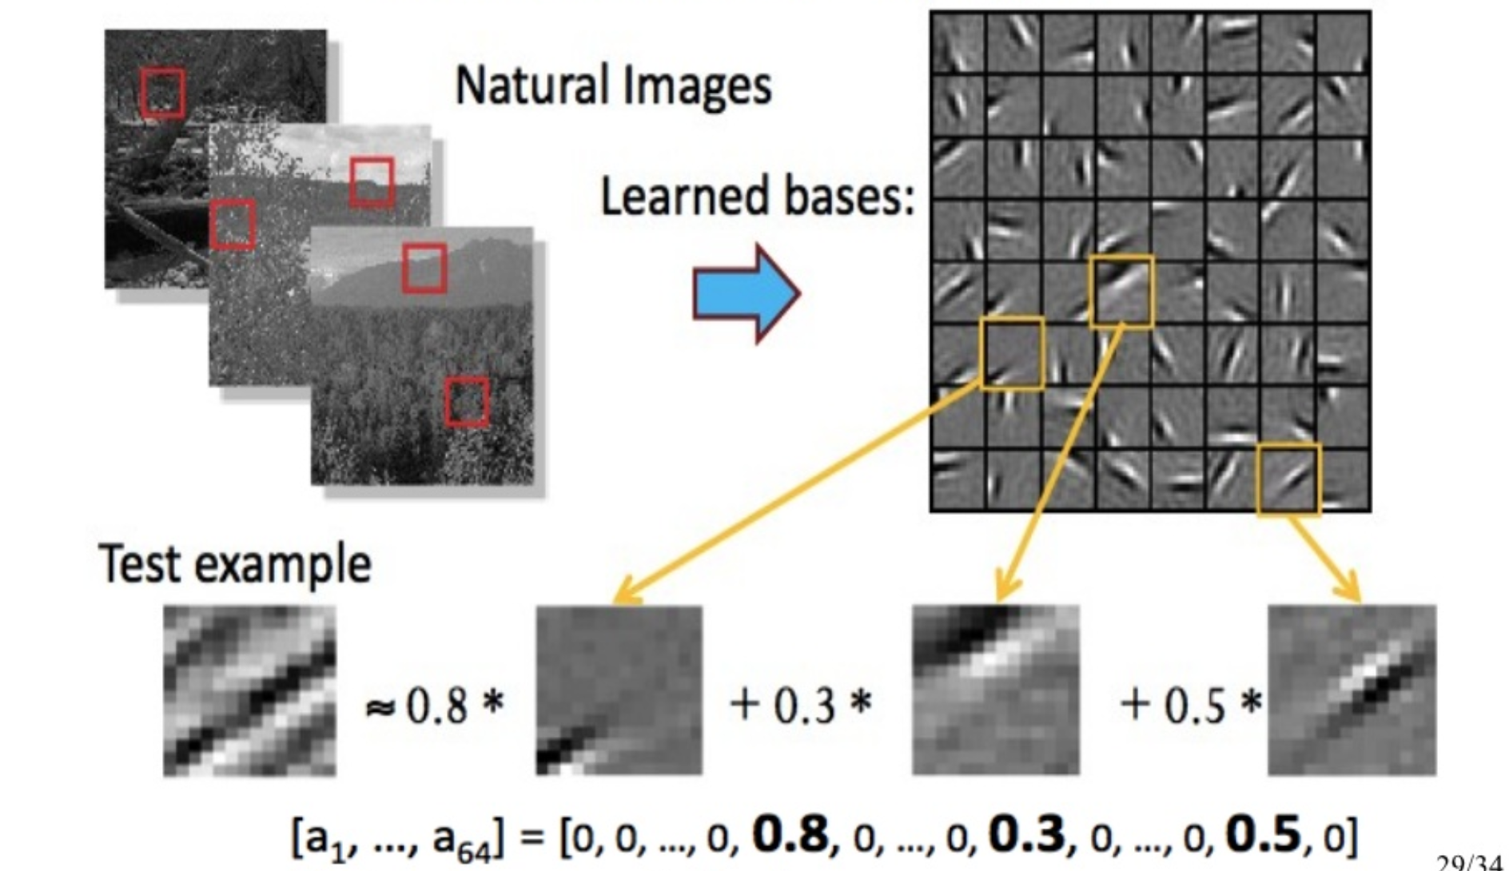
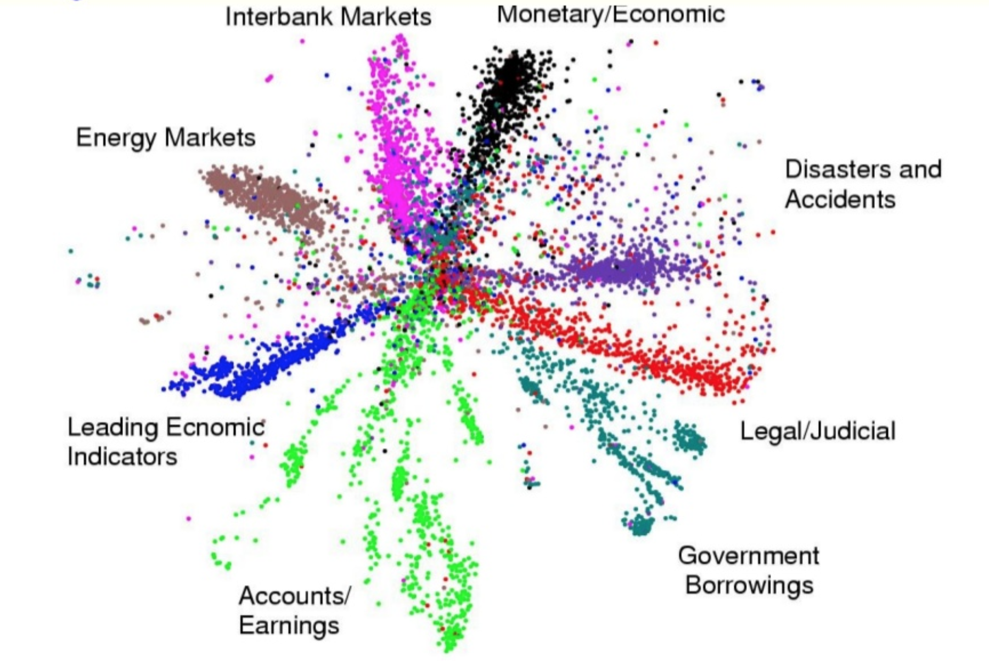
Lecture 33: Alternative Activation Functions and Optimizers
Objectives:
A Taxonomy of Architectures
Activation Functions
Optimization Algorithms
Resources:
Textbook (Sects. 5.4 – 5.6)
Aurora: History of AI
DataScienceCenter: The Neural Network Zoo
ML-Cheatsheet: Activation Functions
Ruder: Gradient Descent Algorithms

Slide 2
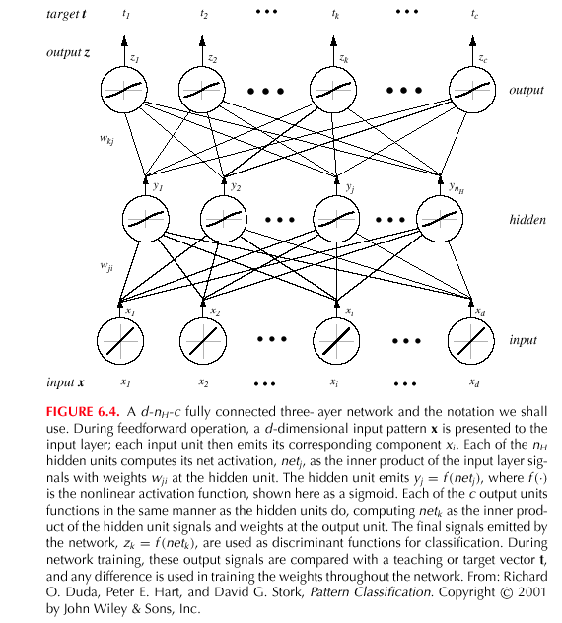
Multilayer Perceptron (MLP)
Notes:
XOR: x_1, x_2, and we want to transform to x_1^2, x_2^2, x_1 x_2
It can also be viewed as feature extraction from the feature vector x, but now we extract more feature than the number of features in x.

Slide 3
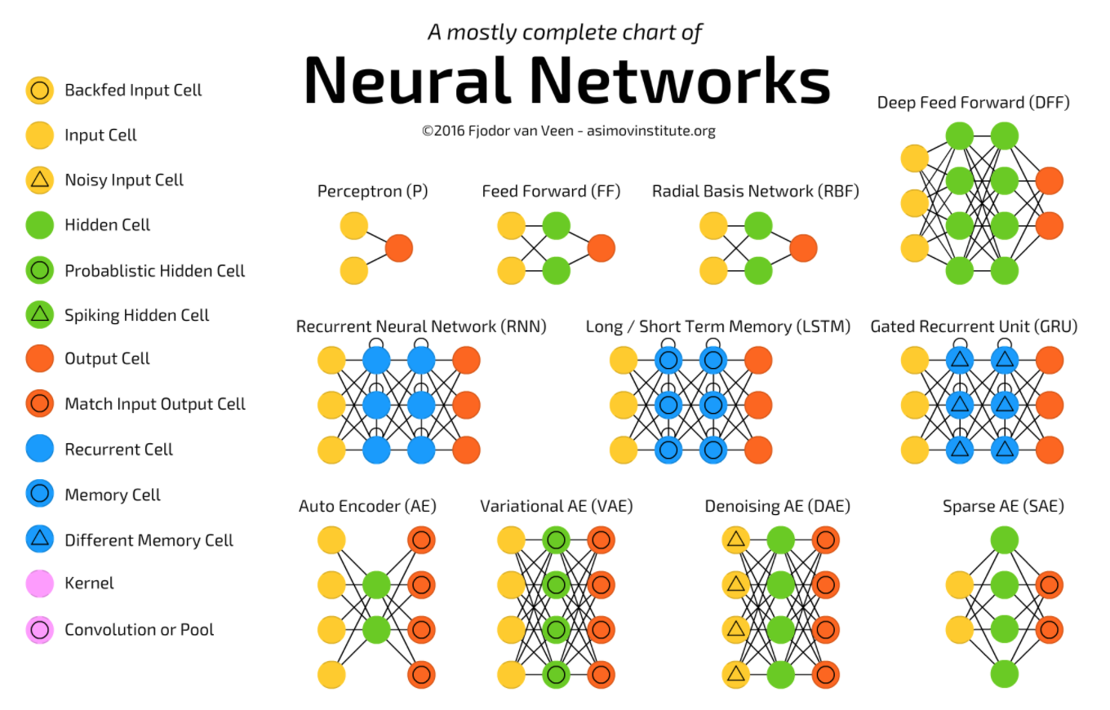
A Taxonomy of Architectures
Notes:
http://www.iro.umontreal.ca/~bengioy/papers/ftml.pdf

Slide 4
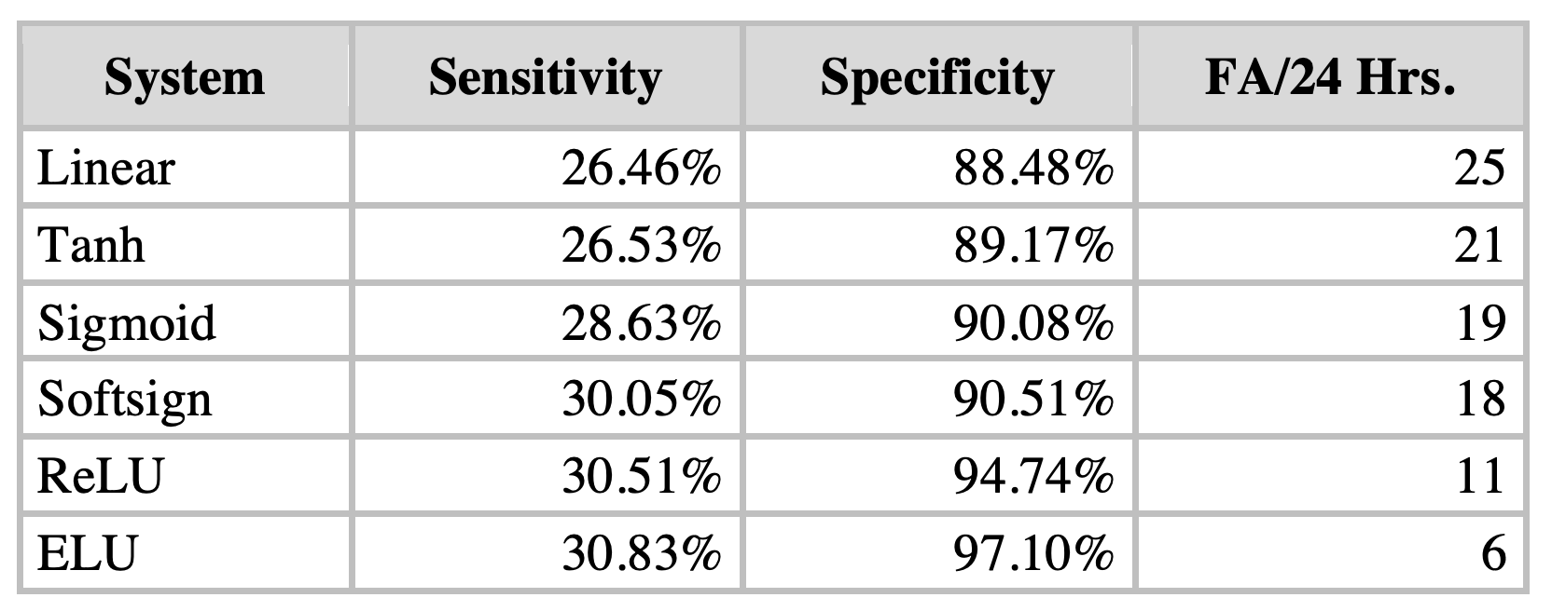
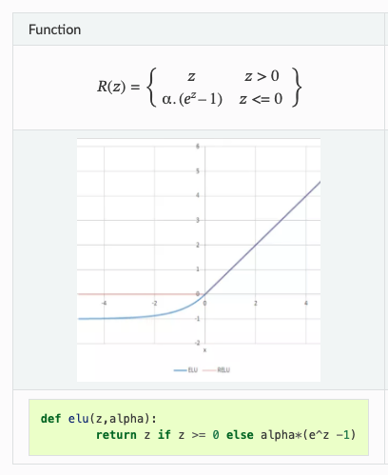
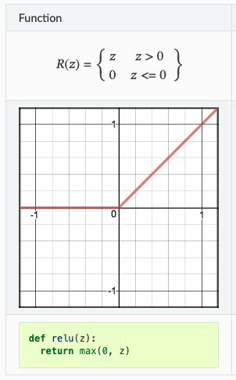
Comparison of Activation Functions
ELU:
Exponential
Linear
Unit
ReLU:
Rectified
Linear
Units
Notes:
http://www.iro.umontreal.ca/~bengioy/papers/ftml.pdf

Slide 5

Why different optimization algorithms?
The main difference is actually how they treat the learning rate.
Stochastic Gradient Descent:
Theta (weights) is getting changed according to the gradient of the loss with respect to theta.
alpha is the learning rate.
If alpha is very small, convergence will be very slow. On the other hand, large alpha will lead to divergence.
Notes:
http://www.iro.umontreal.ca/~bengioy/papers/ftml.pdf

Slide 6
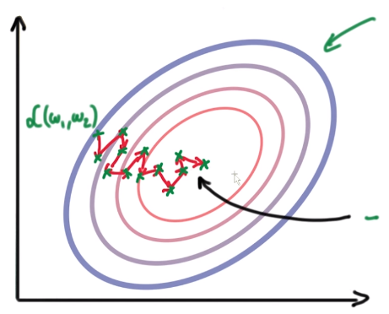

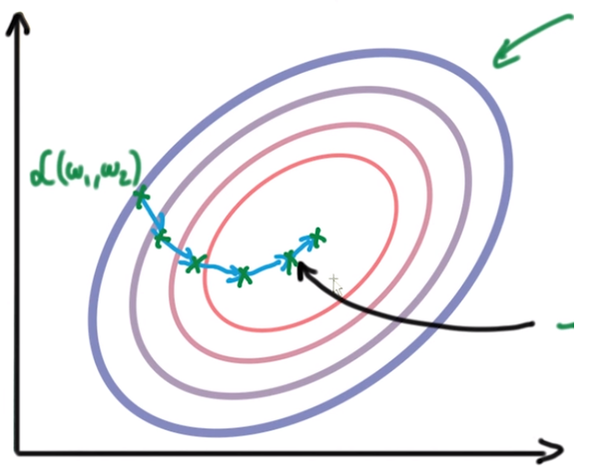
Why different optimization algorithms?
Due to the diversity of each training example, the gradient of the loss (L) changes quickly after each iteration. We are taking small steps but they are quite zig-zag (even though we slowly reach to a loss minima).
To overcome this, we introduce momentum. Basically taking knowledge from previous steps about where we should be heading. We are introducing a new hyperparameter:
Notes:
http://www.iro.umontreal.ca/~bengioy/papers/ftml.pdf

Slide 7
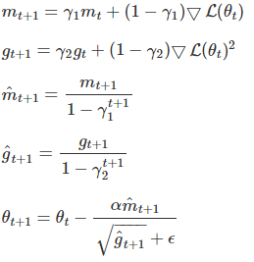

Adaptive Moment Estimation (Adam)
Adam is another method that computes adaptive learning rates for each parameter.
Like Adadelta and RMSprop, but in addition to storing an exponentially decaying average of past squared gradients $g_{t}$, Adam also keeps an exponentially decaying average of past gradients $m_{t}$, similar to momentum:
Notes:
http://www.iro.umontreal.ca/~bengioy/papers/ftml.pdf

Slide 8
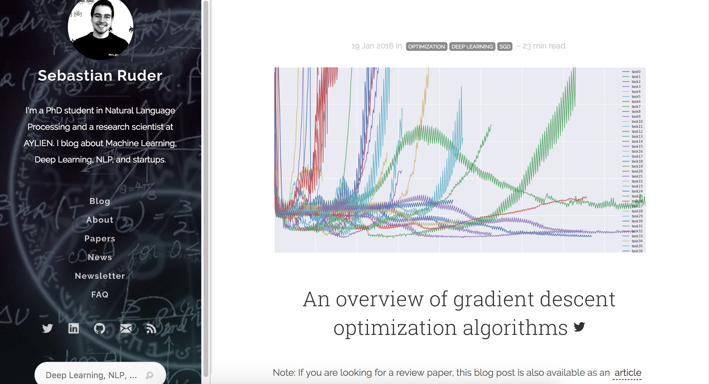
Gradient Descent Algorithms For Optimization
Notes:
http://www.iro.umontreal.ca/~bengioy/papers/ftml.pdf

Slide 9
Gradient Descent Algorithms For Optimization
SGD: Stochastic Gradient Descent http://ufldl.stanford.edu/tutorial/supervised/OptimizationStochasticGradientDescent/
RMSprop: Root Mean Square Propagation http://www.cs.toronto.edu/~tijmen/csc321/slides/lecture_slides_lec6.pdf)
Adagrad: Adaptive Gradient Algorithm
http://jmlr.org/papers/v12/duchi11a.html
Adadelta: an extension of Adagrad that seeks to reduce its aggressive, monotonically decreasing learning rate
https://arxiv.org/abs/1212.5701
Adam: Adaptive Moment Estimation – keeps separate learning rates for each weight as well as an exponentially decaying average of previous gradients.
http://arxiv.org/abs/1412.6980v8
Adamax: A variant of Adam that scales the gradient inversely proportionally to the ℓ₂ norm of the past gradients
https://arxiv.org/abs/1412.6980v8
Nadam: Nesterov-accelerated Adaptive Moment Estimation
http://cs229.stanford.edu/proj2015/054_report.pdf
Notes:
http://www.iro.umontreal.ca/~bengioy/papers/ftml.pdf

Slide 10
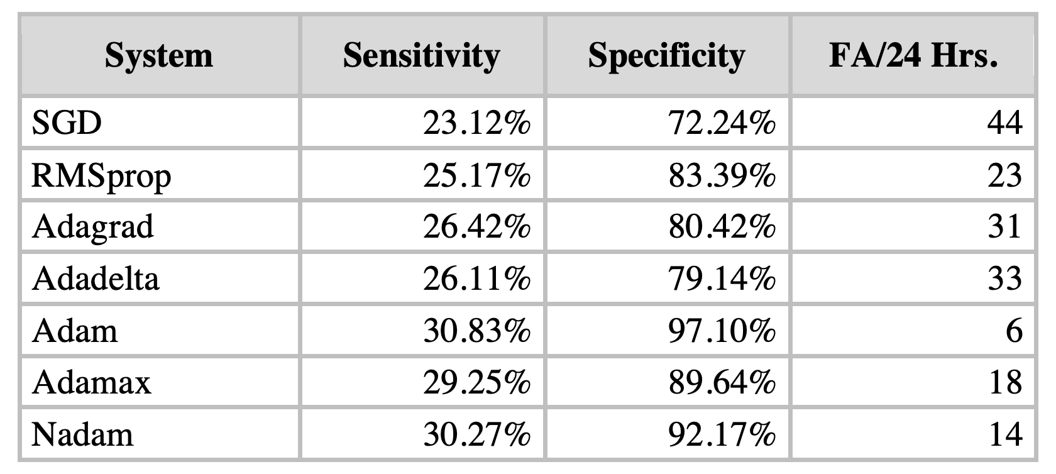
Comparison of Optimization Algorithms
Notes:
http://www.iro.umontreal.ca/~bengioy/papers/ftml.pdf

Slide 11
Summary
Optimization algorithms play an important role in allowing deep learning systems to converge.
Stochastic gradient descent and specifically Adam are popular approaches that are widely used.
Notes:
http://www.iro.umontreal.ca/~bengioy/papers/ftml.pdf

