Slide 1
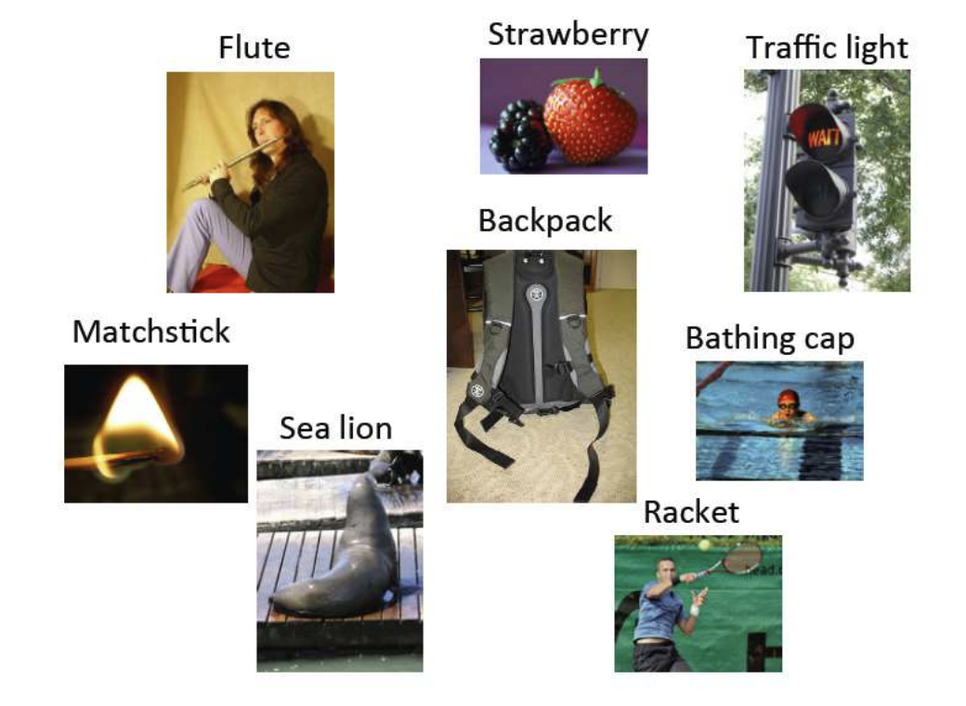
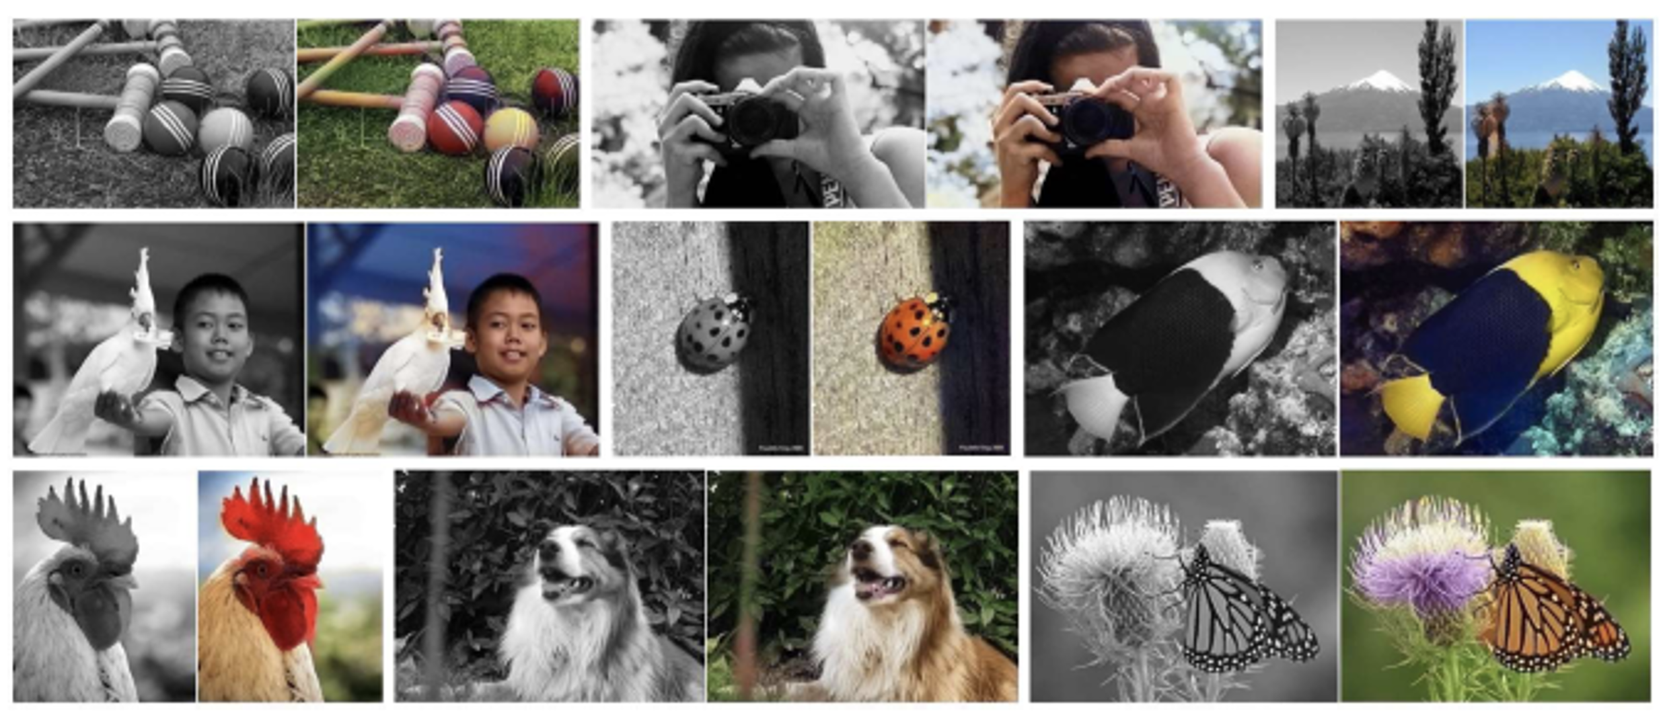
Lecture 32: Transfer Learning
Objectives:
Domain Adaptation
Leverage Out of Domain Data
Resources:
Notes
What is Transfer Learning?
Transfer Learning with CNNs
Build a Model with Transfer Learning
Transfer Learning Guide

Slide 2
Transfer Learning in Astronomy:
A New Machine Learning Paradigm
What is Transfer Learning?
What is Domain Adaptation?
A Case Study in Supernova Ia Classification

Slide 3
MOTIVATION TRANSFER LEARNING
Motivation for transfer learning
The goal is to transfer knowledge gathered from previous
experience.
Also called Inductive Transfer or Learning to Learn.
Once a predictive model is built, there are reasons to believe the model will cease to be valid at some point in time.
Source Domain
Target Domain

Slide 4
Traditional Approach to Classification
DB1
DB2
DBn
Learning System
Learning System
Learning System

Slide 5
Transfer Learning
DB1
DB2
Source
domain
DB new
Target
domain
Learning System
Learning System
Learning System
Knowledge

Slide 6
Transfer Learning
Scenarios:
Labeling in a new domain is costly.
DB1 (labeled)
DB2 (unlabeled)
Classification of Cepheids
Classification of Long Period
Variable Stars LPV

Slide 7
Transfer Learning
Scenarios:
2. Data is outdated. Model created with one survey but
a new survey is now available.
Survey 1
Survey 2
?
Learning System

Slide 8
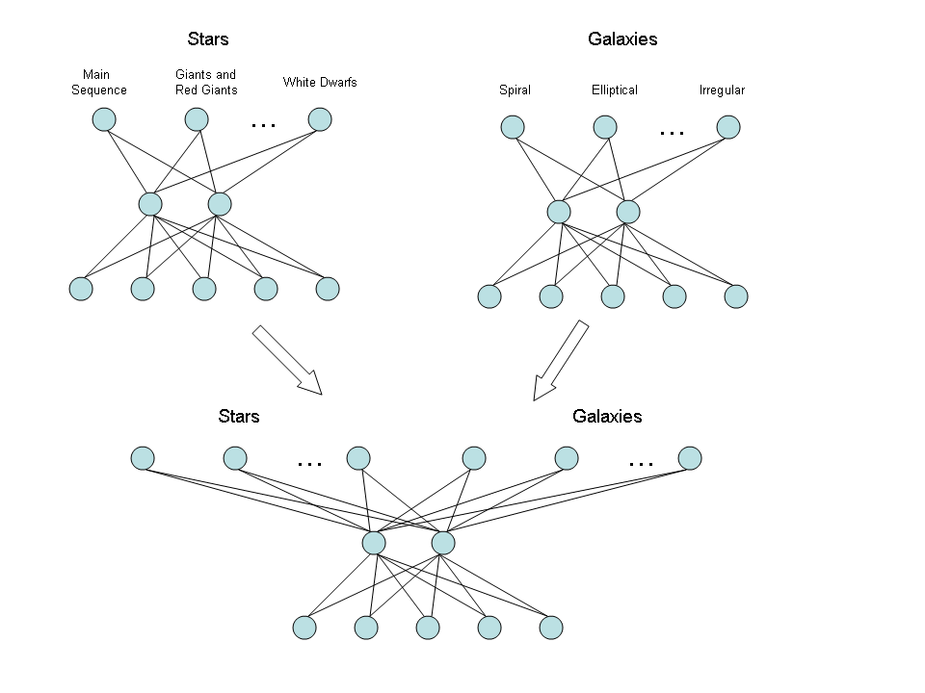
MULTITASK LEARNING:
Train in Parallel with Combined Architecture
Figure obtained from Brazdil, et. Al. Metalearning: Applications to Data Mining, Chapter 7, Springer, 2009.

Slide 9
Knowledge of Parameters
Assume prior distribution of parameters
Source
domain
Learn parameters and adjust prior distribution
Target
domain
Learn parameters using the source prior
distribution.

Slide 10
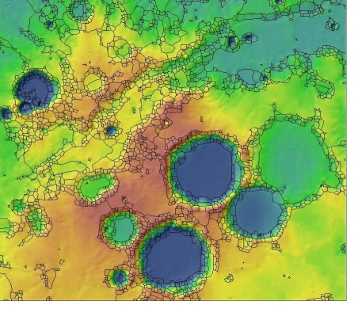
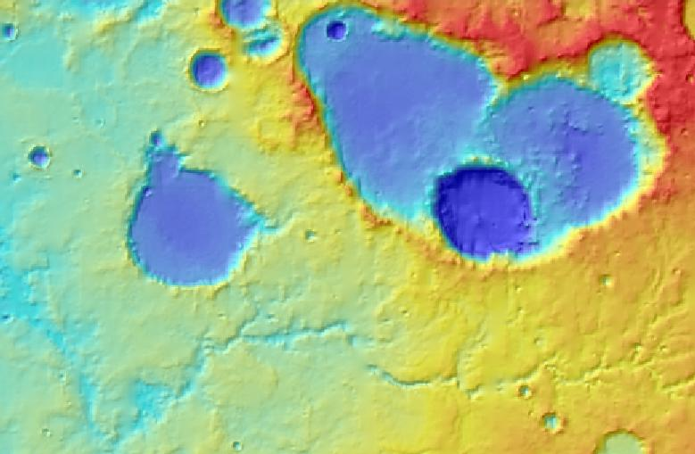
Knowledge of Parameters
Find coefficients w_{s} using SVMs
Find coefficients w_{T} using SVMs
initializing the search with w_{s}

Slide 11
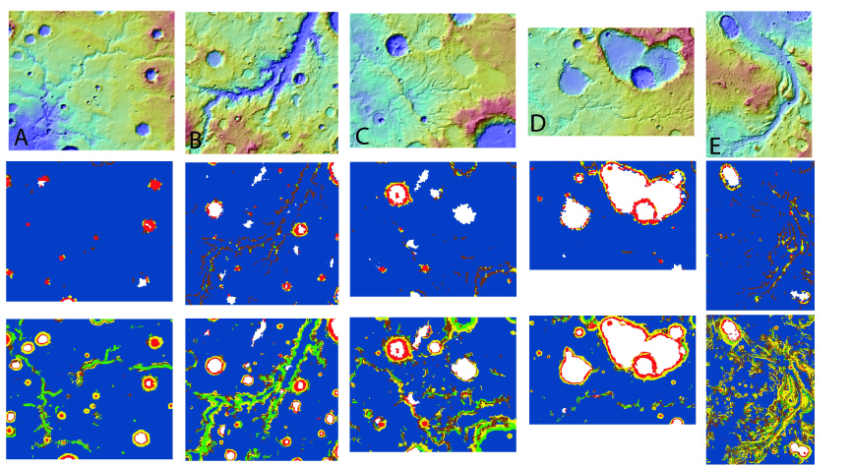
Feature Transfer
Identify common
Features to all tasks

Slide 12
Transfer Learning in Astronomy:
A New Machine Learning Paradigm
What is Transfer Learning?
What is Domain Adaptation?
A Case Study in Supernova Ia Classification

Slide 13
Domain Adaptation
Source Class 1
Source Class 2
Target

Slide 14
Domain Adaptation
Target Class 1
Target Class 2

Slide 15
Domain Adaptation
Source
Domain
Labeled
Source
Data
Train
Domain Adaptation
algorithm
Target Domain
Unlabeled Target Data
Test
Classifier
Predicted Labels

Slide 16
Covariate Shift
Covariate Shift:
  P_{S}(X) ≠ P_{T}(X) , P_{S}(Y|X) = P_{T}(Y|X)
Source Class 1
Source Class 2
Target Class 1
Target Class 2

Slide 17
Instance Based Methods
Source Class 1
Source Class 2
Target

Slide 18
Instance Based Methods
Source Class 1
Source Class 2
Target

Slide 19
Instance Based Methods
Source Class 1 Data
Source Class 2 Data
Target Data
Source Model
Target Model

Slide 20
Instance Based Methods
Source Class 1
Source Class 2
Target Class 1
Target Class 2

Slide 21
Instance Based Methods
Target Class 1
Target Class 2

Slide 22
Feature-Based Methods
  When source instances cannot represent the target distribution at all in the parameter space, we can project source and target datasets to common feature space (i.e., we can align both datasets).

Slide 23
Assumptions Domain Adaptation
O.K.
NO
Source Class 1
Source Class 2
Target

Slide 24
Active Learning
DB new
Target
Domain
(unlabeled data)
Active Learning
What examples need labeling to guarantee a hypothesis
with small predictive error?
Expert labels (few) examples
Learning System

Slide 25
Active Learning
Unlabeled Target Point
Queried Data
Target Class 1
Target Class 2

Slide 26
Active Learning
Unlabeled Target Point
Queried Data
Target Class 1
Target Class 2

Slide 27
Active Learning
Unlabeled Target Point
Queried Data
Target Class 1
Target Class 2

Slide 28
Active Learning
Unlabeled Target Point
Queried Data
Target Class 1
Target Class 2

Slide 29
Active Learning
Unlabeled Target Point
Queried Data
Target Class 1
Target Class 2

Slide 30
Domain Adaptation + Active Learning
Predicted Labels
Source
Domain
Labeled
Source
Data
Domain Adaptation
Labeled Target Data
Target Domain
Unlabeled Target Data
Active
Learning
Train
Test
Classifier

Slide 31
Transfer Learning in Astronomy:
A New Machine Learning Paradigm
What is Transfer Learning?
What is Domain Adaptation?
A Case Study in Supernova Ia Classification

Slide 32
Source and Target using supernova datasets
Spectroscopy
  Enable parameter inference from astronomical data
    determine the presence of individual chemical elements (spectral lines)
    infer the distance (redshift) to extragalactic sources
  Expensive and time-consuming process
  Unfeasible to obtain measurements for all cataloged objects
Photometry:
  Low resolution counterpart
  Summarize the intensity of electromagnetic radiation in a handful of broad wavelength windows (filters).
  Information on individual spectral lines is not accessible.

Slide 33
Overview
Automatic SN Classification Using
Machine Learning
Training data labeled through spectroscopy
Test data obtained through photometry
Domain Adaptation
Active Learning

Slide 34
Sample Selection Bias
Training Set
Test Set
Brighter nearby objects
(spectroscopy)
Extensive Deeper
Surveys
(photometry)
Main assumption in supervised learning is not warranted
Notes:
What is machine learning?

Slide 35
Automated Classification of Supernova Ia
How can we take advantage of existing supernova datasets already classified using spectroscopy to develop an automated classification method using new photometric surveys?

Slide 36
Experimental Setup
Data Acquisition:
  Simulated data stemming from the Supernova Photometric Classification Challenge, traditionally called post-SNPCC
  Mimic the characteristics of Dark Energy Survey (DES) data
  Select only objects having at least 3 observed epochs per filter, with at least 1 of them being before -3 days and at least 1 after +24 days since maximum brightness.
  In each filter, light curve fitting is performed using Gaussian process regression, and the resulting function is sampled with a window of 1 day. No quality cuts are imposed (SNR>0).
Datasets:
  Source Dataset - Labeled (Photometric)
  Test Dataset – Unlabeled (Spectroscopic)
Classes:
  Supernova Ia Vs Supernova Ib and Supernova Ic

Slide 37
Experimental Setup
Dimensionality Reduction :
  Original : 108 Features
  For this research : 20 Features, reduced by KPCA
Active Learning :
  50% Pool, 50% Test
  10 Pairs
  10 Runs

Slide 38
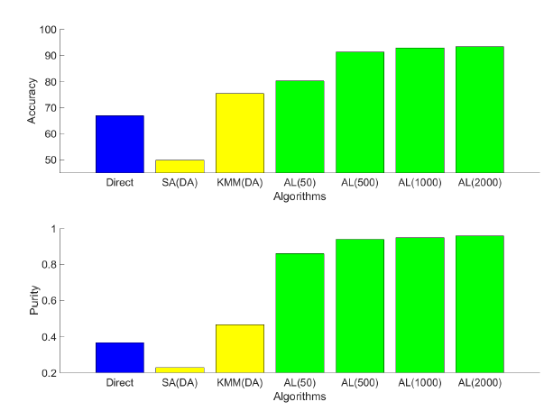
Results: Accuracy and Purity
Accuracy and Precision on Target Data using Domain Adaptation and Active Learning.

Slide 39
Thank you!

