Slide 1



Knowledge Transfer via Multiple Model Local Structure Mapping
KDD’08 Las Vegas, NV
Jing Gao† Wei Fan‡ Jing Jiang†Jiawei Han†
†University of Illinois at Urbana-Champaign
‡IBM T. J. Watson Research Center

Slide 2
Outline
Introduction to transfer learning
Related work
  Sample selection bias
  Semi-supervised learning
  Multi-task learning
  Ensemble methods
Learning from one or multiple source domains
  Locally weighted ensemble framework
  Graph-based heuristic
Experiments
Conclusions

Slide 3
Standard Supervised Learning
training (labeled)
test (unlabeled)
Classifier
85.5%
New York Times
New York Times
Ack. From Jing Jiang’s slides

Slide 4
In Reality……
training (labeled)
test (unlabeled)
Classifier
64.1%
Labeled data not available!
Reuters
New York Times
New York Times
Ack. From Jing Jiang’s slides

Slide 5
Domain Difference → Performance Drop
train
test
ideal setting
Classifier
NYT
NYT
85.5%
New York Times
New York Times
realistic setting
Classifier
Reuters
NYT
64.1%
Reuters
New York Times
Ack. From Jing Jiang’s slides

Slide 6
Other Examples
Spam filtering
  Public email collection → personal inboxes
Intrusion detection
  Existing types of intrusions → unknown types of intrusions
Sentiment analysis
  Expert review articles→ blog review articles
The aim
  To design learning methods that are aware of the training and test domain difference
Transfer learning
  Adapt the classifiers learnt from the source domain to the new domain

Slide 7
Outline
Introduction to transfer learning
Related work
  Sample selection bias
  Semi-supervised learning
  Multi-task learning
  Ensemble methods
Learning from one or multiple source domains
  Locally weighted ensemble framework
  Graph-based heuristic
Experiments
Conclusions

Slide 8
Sample Selection Bias
(Covariance Shift)
Motivating examples
  Load approval
  Drug testing
  Training set: customers participating in the trials
  Test set: the whole population
Problems
  Training and test distributions differ in P(x), but not in P(y|x)
  But the difference in P(x) still affects the learning performance

Slide 9
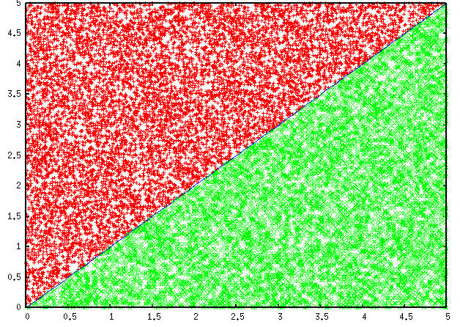
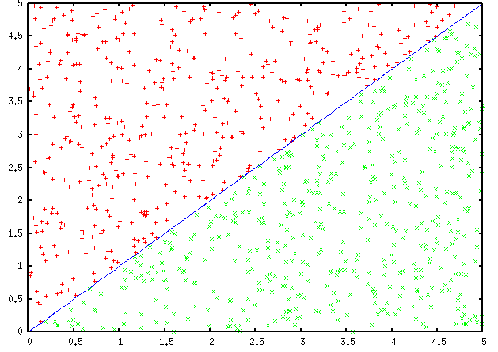
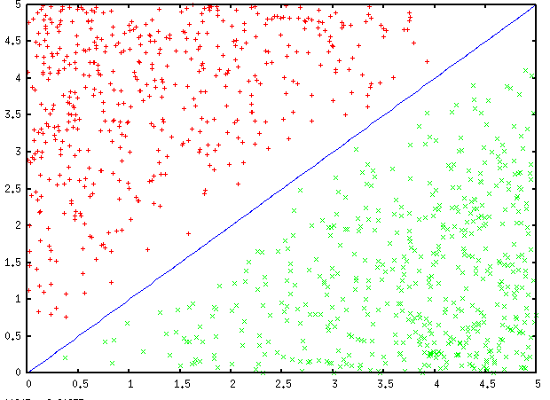
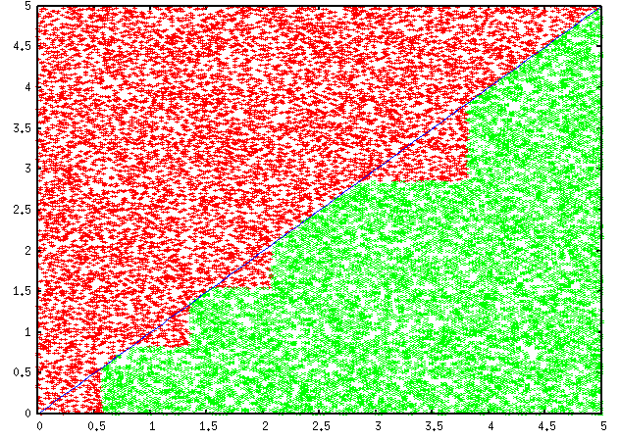
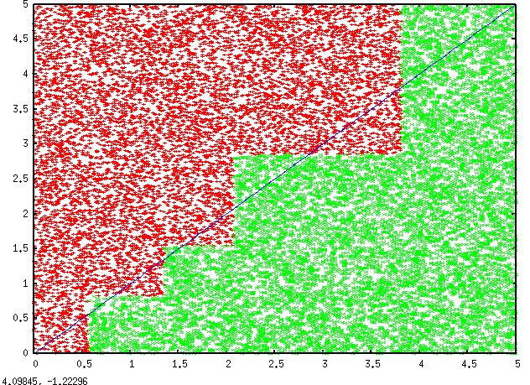
Sample Selection Bias
(Covariance Shift)
Unbiased 96.405%
Biased 92.7%
Ack. From Wei Fan’s slides

Slide 10
Sample Selection Bias
(Covariance Shift)
Existing work
  Reweight training examples according to the distribution difference and maximize the re-weighted likelihood
  Estimate the probability of a observation being selected into the training set and use this probability to improve the model
  Use P(x,y) to make predictions instead of using P(y|x)

Slide 11
Semi-supervised Learning
(Transductive Learning)
Labeled Data
Test set
Model
Unlabeled Data
Transductive
Applications and problems
  Labeled examples are scarce but unlabeled data are abundant
  Web page classification, review ratings prediction

Slide 12
Semi-supervised Learning
(Transductive Learning)
Existing work
  Self-training
    Give labels to unlabeled data
  Generative models
    Unlabeled data help get better estimates of the parameters
  Transductive SVM
    Maximize the unlabeled data margin
  Graph-based algorithms
    Construct a graph based on labeled and unlabeled data, propagate labels along the paths
  Distance learning
    Map the data into a different feature space where they could be better separated

Slide 13
Learning from Multiple Domains
Multi-task learning
  Learn several related tasks at the same time with shared representations
  Single P(x) but multiple output variables
Transfer learning
  Two stage domain adaptation: select generalizable features from training domains and specific features from test domain

Slide 14
Ensemble Methods
Improve over single models
  Bayesian model averaging
  Bagging, Boosting, Stacking
  Our studies show their effectiveness in stream classification
Model weights
  Usually determined globally
  Reflect the classification accuracy on the training set

Slide 15
Ensemble Methods
Transfer learning
  Generative models:
    Traing and test data are generated from a mixture of different models
    Use Dirichlet Process prior to couple the parameters of several models from the same parameterized family of distributions
  Non-parametric models
    Boost the classifier with labeled examples which represent the true test distribution

Slide 16
Outline
Introduction to transfer learning
Related work
  Sample selection bias
  Semi-supervised learning
  Multi-task learning
Learning from one or multiple source domains
  Locally weighted ensemble framework
  Graph-based heuristic
Experiments
Conclusions

Slide 17
All Sources of Labeled Information
training (labeled)
test (completely unlabeled)
Reuters
Classifier
?
……
New York Times
Newsgroup

Slide 18
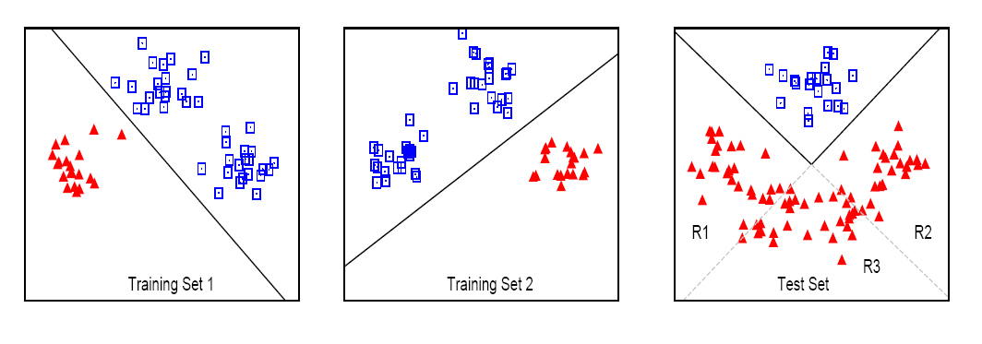
A Synthetic Example
Training
(have conflicting concepts)
Test
Partially overlapping

Slide 19
Goal
Source
Domain
Source
Domain
Target
Domain
Source
Domain
To unify knowledge that are consistent with the test domain from multiple source domains (models)

Slide 20
Summary of Contributions
Transfer from one or multiple source domains
  Target domain has no labeled examples
Do not need to re-train
  Rely on base models trained from each domain
  The base models are not necessarily developed for transfer learning applications

Slide 21
Locally Weighted Ensemble
Training set 1
M₁
x-feature value y-class label
Training set 2
Training set
M₂
Test example x
……
……
Training set k
M_{k}

Slide 22
Modified Bayesian Model Averaging
Bayesian Model Averaging
Modified for Transfer Learning
M₁
M₁
Test set
Test set
M₂
M₂
……
……
M_{k}
M_{k}

Slide 23
Global versus Local Weights
x
y
M₁
w_{g}
w_{l}
M₂
w_{g}
w_{l}
2.40 5.23
-2.69 0.55
-3.97 -3.62
2.08 -3.73
5.08 2.15
1.43 4.48
……
1
0
0
0
0
1
…
0.6
0.4
0.2
0.1
0.6
1
…
0.3
0.3
0.3
0.3
0.3
0.3
…
0.2
0.6
0.7
0.5
0.3
1
…
0.9
0.6
0.4
0.1
0.3
0.2
…
0.7
0.7
0.7
0.7
0.7
0.7
…
0.8
0.4
0.3
0.5
0.7
0
…
Training
Locally weighting scheme
  Weight of each model is computed per example
  Weights are determined according to models’ performance on the test set, not training set

Slide 24
Synthetic Example Revisited
M₁
M₂
M₁
M₂
Training
(have conflicting concepts)
Test
Partially overlapping

Slide 25
Optimal Local Weights
Higher Weight
C₁
0.9 0.1
Test example x
0.8 0.2
C₂
0.4 0.6
w
f
H
0.9 0.4
w¹
0.8
=
0.1 0.6
w²
0.2
Optimal weights
  Solution to a regression problem

Slide 26
Approximate Optimal Weights
Optimal weights
  Impossible to get since f is unknown!
How to approximate the optimal weights
  M should be assigned a higher weight at x if P(y|M,x) is closer to the true P(y|x)
Have some labeled examples in the target domain
  Use these examples to compute weights
None of the examples in the target domain are labeled
  Need to make some assumptions about the relationship between feature values and class labels

Slide 27
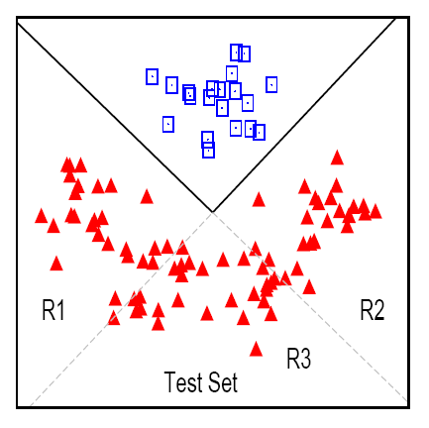
Clustering-Manifold Assumption
  Test examples that are closer in feature space are more likely to share the same class label.

Slide 28
Graph-based Heuristics
Graph-based weights approximation
  Map the structures of models onto test domain
weight on x
Clustering Structure
M₁
M₂

Slide 29

Graph-based Heuristics
Higher Weight
Local weights calculation
  Weight of a model is proportional to the similarity between its neighborhood graph and the clustering structure around x.

Slide 30
Local Structure Based Adjustment
Why adjustment is needed?
  It is possible that no models’ structures are similar to the clustering structure at x
  Simply means that the training information are conflicting with the true target distribution at x
Error
Error
Clustering Structure
M₁
M₂

Slide 31

Local Structure Based Adjustment
How to adjust?
  Check if is below a threshold
  Ignore the training information and propagate the labels of neighbors in the test set to x
Clustering Structure
M₁
M₂

Slide 32
Verify the Assumption
Need to check the validity of this assumption
  Still, P(y|x) is unknown
  How to choose the appropriate clustering algorithm
Findings from real data sets
  This property is usually determined by the nature of the task
  Positive cases: Document categorization
  Negative cases: Sentiment classification
  Could validate this assumption on the training set

Slide 33
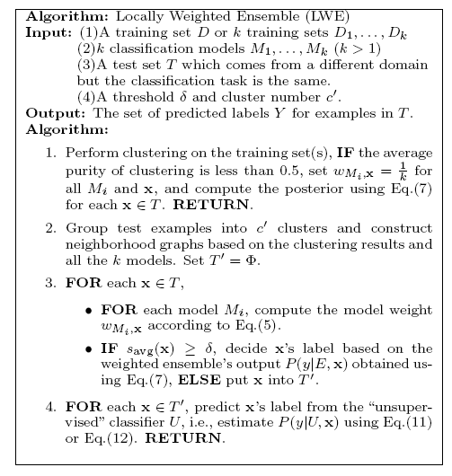
Algorithm
Check Assumption
Neighborhood Graph
Construction
Model Weight
Computation
Weight Adjustment

Slide 34
Outline
Introduction to transfer learning
Related work
  Sample selection bias
  Semi-supervised learning
  Multi-task learning
Learning from one or multiple source domains
  Locally weighted ensemble framework
  Graph-based heuristic
Experiments
Conclusions

Slide 35
Data Sets
Different applications
  Synthetic data sets
  Spam filtering: public email collection → personal inboxes (u01, u02, u03) (ECML/PKDD 2006)
  Text classification: same top-level classification problems with different sub-fields in the training and test sets (Newsgroup, Reuters)
  Intrusion detection data: different types of intrusions in training and test sets.

Slide 36
Baseline Methods
Baseline Methods
  One source domain: single models
    Winnow (WNN), Logistic Regression (LR), Support Vector Machine (SVM)
    Transductive SVM (TSVM)
  Multiple source domains:
    SVM on each of the domains
    TSVM on each of the domains
  Merge all source domains into one: ALL
    SVM, TSVM
  Simple averaging ensemble: SMA
  Locally weighted ensemble without local structure based adjustment: pLWE
  Locally weighted ensemble: LWE
Implementation
  Classification: SNoW, BBR, LibSVM, SVMlight
  Clustering: CLUTO package

Slide 37
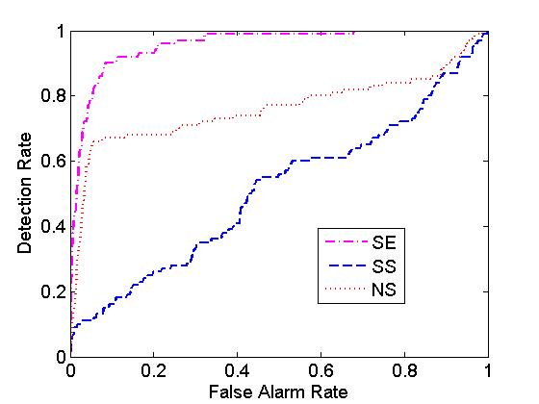
Performance Measure
Prediction Accuracy
  0-1 loss: accuracy
  Squared loss: mean squared error
Area Under ROC Curve
(AUC)
  Tradeoff between true positive
  rate and false positive rate
  Should be 1 ideally

Slide 38
A Synthetic Example
Training
(have conflicting concepts)
Test
Partially overlapping

Slide 39
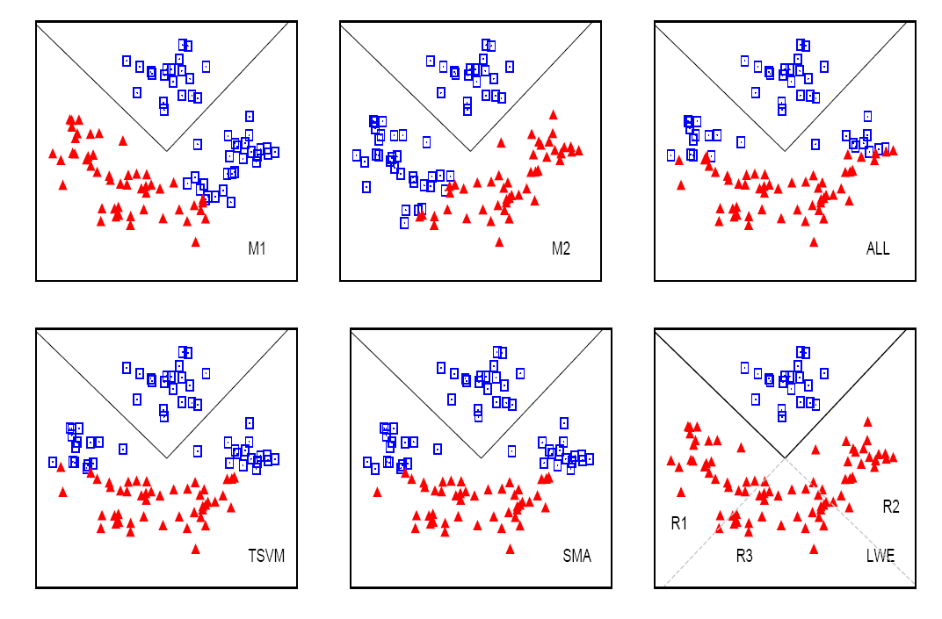
Experiments on Synthetic Data

Slide 40
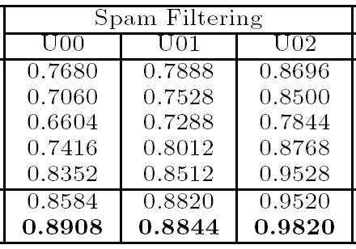
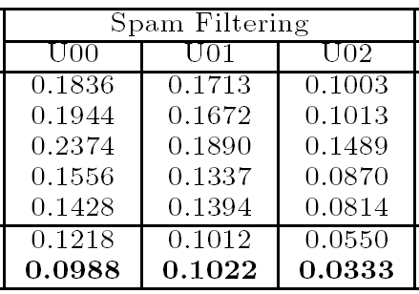
Spam Filtering
Accuracy
Problems
  Training set: public emails
  Test set: personal emails from three users: U00, U01, U02
WNN
LR
SVM
SMA
TSVM
pLWE
LWE
MSE
WNN
LR
SVM
SMA
TSVM
pLWE
LWE

Slide 41
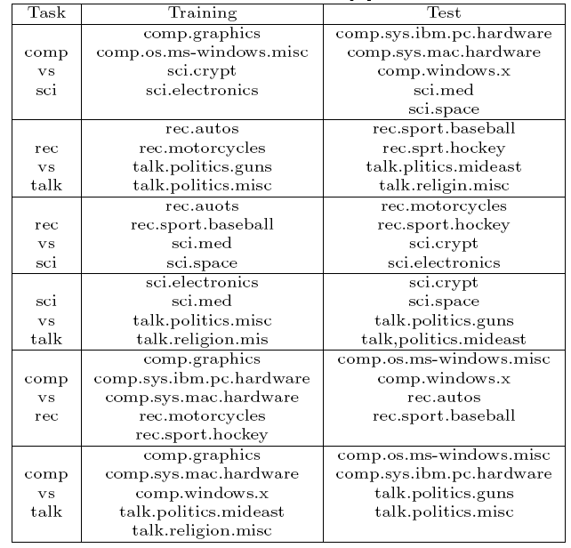
20 Newsgroup
C vs S
R vs T
R vs S
S vs T
C vs R
C vs T

Slide 42
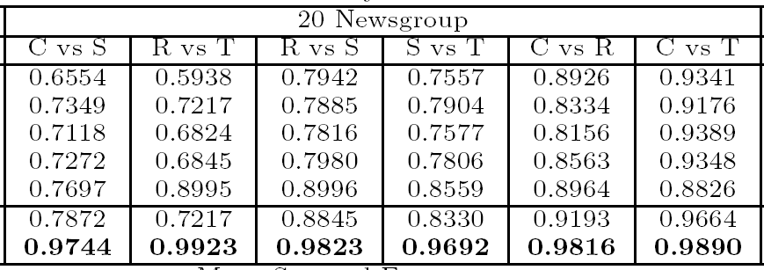
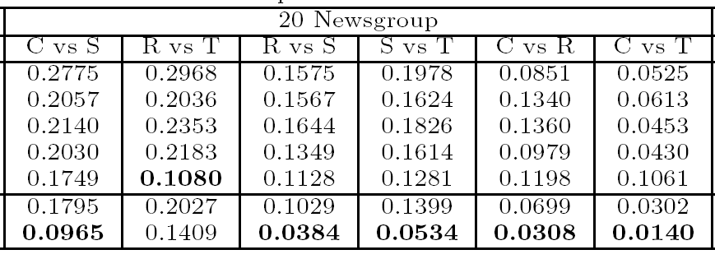
Acc
WNN
LR
SVM
SMA
TSVM
pLWE
LWE
MSE
WNN
LR
SVM
SMA
TSVM
pLWE
LWE

Slide 43
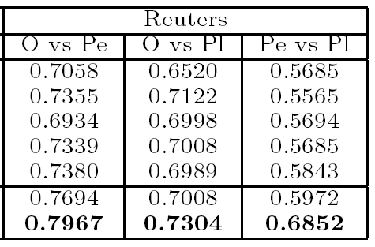
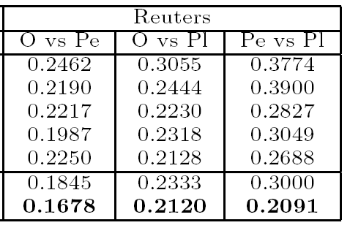
Reuters
Accuracy
Problems
  Orgs vs People (O vs Pe)
  Orgs vs Places (O vs Pl)
  People vs Places (Pe vs Pl)
WNN
LR
SVM
SMA
TSVM
pLWE
LWE
MSE
WNN
LR
SVM
SMA
TSVM
pLWE
LWE

Slide 44
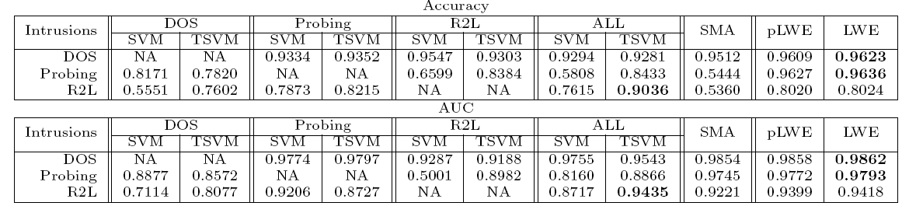
Intrusion Detection
Problems (Normal vs Intrusions)
  Normal vs R2L (1)
  Normal vs Probing (2)
  Normal vs DOS (3)
Tasks
  2 + 1 -> 3 (DOS)
  3 + 1 -> 2 (Probing)
  3 + 2 -> 1 (R2L)

Slide 45
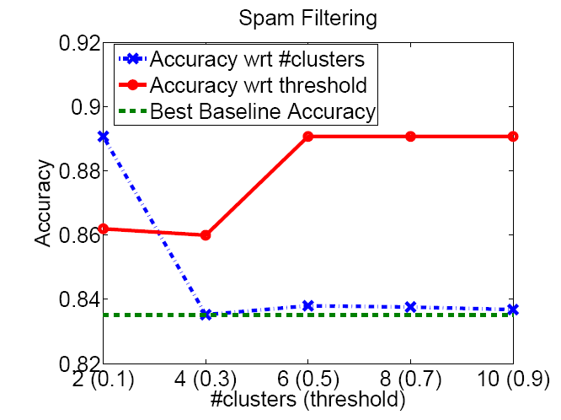
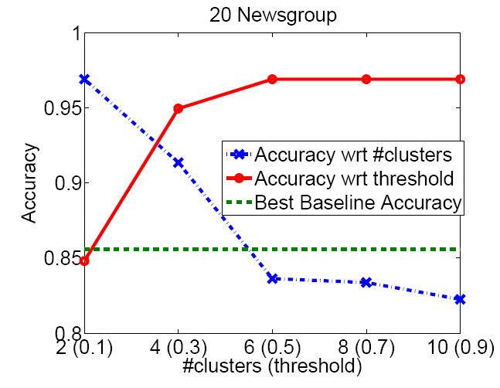
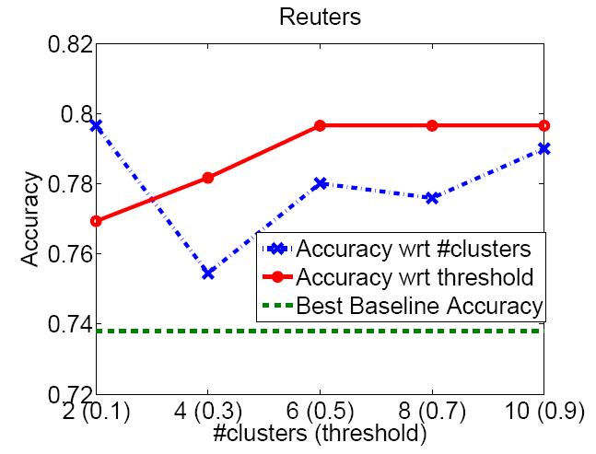
Parameter Sensitivity
Parameters
  Selection threshold in local structure based adjustment
  Number of clusters

Slide 46
Outline
Introduction to transfer learning
Related work
  Sample selection bias
  Semi-supervised learning
  Multi-task learning
Learning from one or multiple source domains
  Locally weighted ensemble framework
  Graph-based heuristic
Experiments
Conclusions

Slide 47
Conclusions
Locally weighted ensemble framework
  transfer useful knowledge from multiple source domains
Graph-based heuristics to compute weights
  Make the framework practical and effective

Slide 48
Feedbacks
Transfer learning is real problem
  Spam filtering
  Sentiment analysis
Learning from multiple source domains is useful
  Relax the assumption
  Determine parameters

Slide 49
Thanks!
Any questions?
http://www.ews.uiuc.edu/~jinggao3/kdd08transfer.htm
jinggao3@illinois.edu
Office: 2119B

