Slide 1
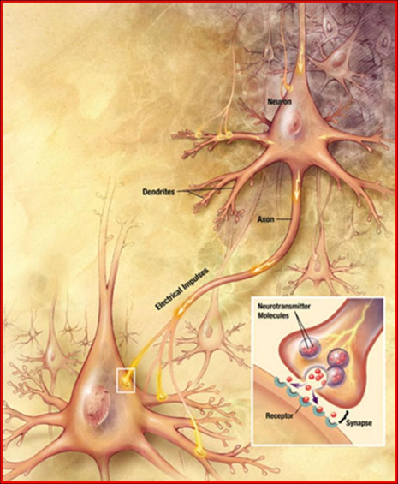
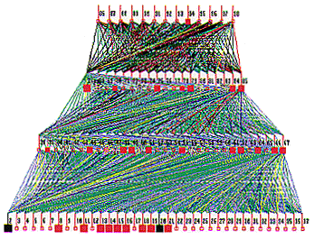
Lecture 25: Vanishing Gradients and Regularization
Objectives: Backpropagation Stopping Criteria Overfitting Regularization
Resources: Textbook (Sections 3.3, 5.3) DHS: Chapter 6 AM: Neural Network Tutorial NSFC: Introduction to NNs GH: Short Courses

Slide 2
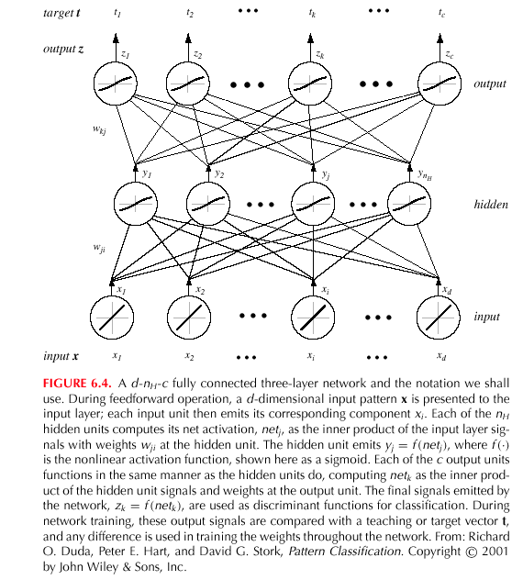
Backpropagation (Cont.)
Notes:
XOR: x_1, x_2, and we want to transform to x_1^2, x_2^2, x_1 x_2
It can also be viewed as feature extraction from the feature vector x, but now we extract more feature than the number of features in x.

Slide 3
Network Learning (Cont.)
Since $netk=wkty$: $\frac{∂{net}_{k}}{∂w_{kj}}=y_{j}.$
Therefore, the weight update (or learning rule) for the hidden-to-output weights is: $Δwkj=ηδkyj=η(tk – zk) f’(netk)yj$.
The error on the input-to-hidden units is: $\frac{∂J}{∂w_{ji}}=\frac{∂J}{∂y_{j}}∙\frac{∂y_{j}}{∂{net}_{j}}∙\frac{∂{net}_{j}}{∂w_{ji}}$
The first term is given by:
We define the sensitivity for a hidden unit:
which demonstrates that “the sensitivity at a hidden unit is simply the sum of the individual sensitivities at the output units weighted by the hidden-to-output weights $wkj$; all multipled by $f’(netk)$.”
The learning rule for the input-to-hidden weights is:

Slide 4
Learning Curves
Before training starts, the error on the training set is high; through the learning process, the error becomes smaller.
The error per pattern depends on the amount of training data and the expressive power (such as the number of weights) in the network.
The average error on an independent test set is always higher than on the training set, and it can decrease as well as increase.
A validation set is used in order to decide when to stop training; we do not want to overfit the network and decrease the power of the classifier generalization.

Slide 5
Gradient descent
pick a starting point (w)
repeat until loss doesn’t decrease in all dimensions:
pick a dimension
move a small amount in that dimension towards decreasing loss (using the derivative)
What is this doing?

Slide 6
Perceptron learning algorithm!
repeat until convergence (or for some # of iterations):
for each training example (f₁, f₂, …, f_{m}, label):
if prediction * label ≤ 0: // they don’t agree
for each w_{j}:
w_{j} = w_{j} + f_{j}*label
b = b + label
or
where

Slide 7
The constant
learning rate
label
prediction
When is this large/small?

Slide 8
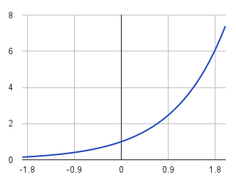
The constant
label
prediction
If they’re the same sign, as the predicted gets larger there update gets smaller
If they’re different, the more different they are, the bigger the update

Slide 9
One concern
loss
What is this calculated on?
Is this what we want to optimize?
w

Slide 10
Perceptron learning algorithm!
repeat until convergence (or for some # of iterations):
for each training example (f₁, f₂, …, f_{m}, label):
if prediction * label ≤ 0: // they don’t agree
for each w_{j}:
w_{j} = w_{j} + f_{j}*label
b = b + label
Note: for gradient descent, we always update
or
where

Slide 11
One concern
loss
We’re calculating this on the training set
We still need to be careful about overfitting!
The min w,b on the training set is generally NOT the min for the test set
w
How did we deal with this for the perceptron algorithm?

Slide 12
Overfitting revisited: regularization
A regularizer is an additional criteria to the loss function to make sure that we don’t overfit
It’s called a regularizer since it tries to keep the parameters more normal/regular
It is a bias on the model forces the learning to prefer certain types of weights over others

Slide 13
Regularizers
Should we allow all possible weights?
Any preferences?
What makes for a “simpler” model for a linear model?

Slide 14
Regularizers
Generally, we don’t want huge weights
If weights are large, a small change in a feature can result in a large change in the prediction
Also gives too much weight to any one feature
Might also prefer weights of 0 for features that aren’t useful
How do we encourage small weights? or penalize large weights?

Slide 15
Regularizers
How do we encourage small weights? or penalize large weights?

Slide 16
Common regularizers
sum of the weights
sum of the squared weights
What’s the difference between these?

Slide 17
Summary
Reviewed backpropagation and gradient descent.
Discussed the vanishing gradient problem.
Discussed overfitting.
Introduced the concept of regularization.
Introduced common approaches to regularization.

Slide 18
Regularization
David Kauchak CS 451 – Fall 2013

Slide 19
Model-based machine learning
pick a model
pick a criteria to optimize (aka objective function)
develop a learning algorithm
Find w and b that minimize the 0/1 loss

Slide 20
Model-based machine learning
pick a model
pick a criteria to optimize (aka objective function)
develop a learning algorithm
use a convex surrogate loss function
Find w and b that minimize the surrogate loss

Slide 21
Finding the minimum
You’re blindfolded, but you can see out of the bottom of the blindfold to the ground right by your feet. I drop you off somewhere and tell you that you’re in a convex shaped valley and escape is at the bottom/minimum. How do you get out?

Slide 22
Gradient descent
pick a starting point (w)
repeat until loss doesn’t decrease in all dimensions:
pick a dimension
move a small amount in that dimension towards decreasing loss (using the derivative)

Slide 23
Some maths

Slide 24
Gradient descent
pick a starting point (w)
repeat until loss doesn’t decrease in all dimensions:
pick a dimension
move a small amount in that dimension towards decreasing loss (using the derivative)
What is this doing?

Slide 25
Perceptron learning algorithm!
repeat until convergence (or for some # of iterations):
for each training example (f₁, f₂, …, f_{m}, label):
if prediction * label ≤ 0: // they don’t agree
for each w_{j}:
w_{j} = w_{j} + f_{j}*label
b = b + label
or
where

Slide 26
The constant
learning rate
label
prediction
When is this large/small?

Slide 27
The constant
label
prediction
If they’re the same sign, as the predicted gets larger there update gets smaller
If they’re different, the more different they are, the bigger the update

Slide 28
One concern
loss
What is this calculated on?
Is this what we want to optimize?
w

Slide 29
Perceptron learning algorithm!
repeat until convergence (or for some # of iterations):
for each training example (f₁, f₂, …, f_{m}, label):
if prediction * label ≤ 0: // they don’t agree
for each w_{j}:
w_{j} = w_{j} + f_{j}*label
b = b + label
Note: for gradient descent, we always update
or
where

Slide 30
One concern
loss
We’re calculating this on the training set
We still need to be careful about overfitting!
The min w,b on the training set is generally NOT the min for the test set
w
How did we deal with this for the perceptron algorithm?

Slide 31
Overfitting revisited: regularization
A regularizer is an additional criteria to the loss function to make sure that we don’t overfit
It’s called a regularizer since it tries to keep the parameters more normal/regular
It is a bias on the model forces the learning to prefer certain types of weights over others

Slide 32
Regularizers
Should we allow all possible weights?
Any preferences?
What makes for a “simpler” model for a linear model?

Slide 33
Regularizers
Generally, we don’t want huge weights
If weights are large, a small change in a feature can result in a large change in the prediction
Also gives too much weight to any one feature
Might also prefer weights of 0 for features that aren’t useful
How do we encourage small weights? or penalize large weights?

Slide 34
Regularizers
How do we encourage small weights? or penalize large weights?

Slide 35
Common regularizers
sum of the weights
sum of the squared weights
What’s the difference between these?

Slide 36
Common regularizers
sum of the weights
sum of the squared weights
Squared weights penalizes large values more
Sum of weights will penalize small values more

Slide 37
p-norm
sum of the weights (1-norm)
sum of the squared weights (2-norm)
p-norm
Smaller values of p (p < 2) encourage sparser vectors
Larger values of p discourage large weights more

Slide 38
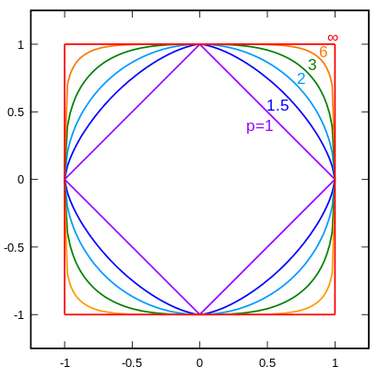
p-norms visualized
lines indicate penalty = 1
w₁
w₂
p | w₂
1 | 0.5
1.5 | 0.75
2 | 0.87
3 | 0.95
∞ | 1
For example, if w₁ = 0.5

Slide 39
p-norms visualized
all p-norms penalize larger weights
p < 2 tends to create sparse (i.e. lots of 0 weights)
p > 2 tends to like similar weights
Notes:
- The 1 norm penalizes non-zero weights, e.g

Slide 40
Model-based machine learning
pick a model
pick a criteria to optimize (aka objective function)
develop a learning algorithm
Find w and b that minimize

Slide 41
Minimizing with a regularizer
We know how to solve convex minimization problems using gradient descent:
If we can ensure that the loss + regularizer is convex then we could still use gradient descent:
make convex

Slide 42
Convexity revisited
One definition: The line segment between any two points on the function is above the function
Mathematically, f is convex if for all x₁, x₂:
the value of the function at some point between x₁ and x₂
the value at some point on the line segment between x₁ and x₂
Notes:
Put another way, the right hand side says, take the value of the function at x1, take the value of the function at x2 and then “linearly” average them based on t. This represents a line segment between f(x1) and f(x2)

Slide 43
Adding convex functions
Claim: If f and g are convex functions then so is the function z=f+g
Prove:
Mathematically, f is convex if for all x₁, x₂:

Slide 44
Adding convex functions
By definition of the sum of two functions:
Then, given that:
We know:
So:

Slide 45
Minimizing with a regularizer
We know how to solve convex minimization problems using gradient descent:
If we can ensure that the loss + regularizer is convex then we could still use gradient descent:
convex as long as both loss and regularizer are convex

Slide 46
p-norms are convex
p-norms are convex for p >= 1

Slide 47
Model-based machine learning
pick a model
pick a criteria to optimize (aka objective function)
develop a learning algorithm
Find w and b that minimize

Slide 48
Our optimization criterion
Loss function: penalizes examples where the prediction is different than the label
Regularizer: penalizes large weights
Key: this function is convex allowing us to use gradient descent

Slide 49
Gradient descent
pick a starting point (w)
repeat until loss doesn’t decrease in all dimensions:
pick a dimension
move a small amount in that dimension towards decreasing loss (using the derivative)

Slide 50
Some more math
…
(some math happens)

Slide 51
Gradient descent
pick a starting point (w)
repeat until loss doesn’t decrease in all dimensions:
pick a dimension
move a small amount in that dimension towards decreasing loss (using the derivative)

Slide 52
The update
learning rate
direction to update
regularization
constant: how far from wrong
What effect does the regularizer have?

Slide 53
The update
learning rate
direction to update
regularization
constant: how far from wrong
If w_{j} is positive, reduces w_{j}
If w_{j} is negative, increases w_{j}
moves w_{j} towards 0

Slide 54
L1 regularization

Slide 55
L1 regularization
learning rate
direction to update
regularization
constant: how far from wrong
What effect does the regularizer have?

Slide 56
L1 regularization
learning rate
direction to update
regularization
constant: how far from wrong
If w_{j} is positive, reduces by a constant
If w_{j} is negative, increases by a constant
moves w_{j} towards 0
regardless of magnitude

Slide 57
Regularization with p-norms
L1:
L2:
Lp:
How do higher order norms affect the weights?
Notes:
if they’re magnitude > 1, reduce them drastically
if they’re magnitude < 1, much slower reductions for higher p

Slide 58
Regularizers summarized
L1 is popular because it tends to result in sparse solutions (i.e. lots of zero weights)
However, it is not differentiable, so it only works for gradient descent solvers
L2 is also popular because for some loss functions, it can be solved directly (no gradient descent required, though often iterative solvers still)
Lp is less popular since they don’t tend to shrink the weights enough

Slide 59
The other loss functions
Without regularization, the generic update is:
where
exponential
hinge loss
squared error

Slide 60
Many tools support these different combinations
Look at scikit learning package:
http://scikit-learn.org/stable/modules/sgd.html

Slide 61
Common names
(Ordinary) Least squares: squared loss
Ridge regression: squared loss with L2 regularization
Lasso regression: squared loss with L1 regularization
Elastic regression: squared loss with L1 AND L2 regularization
Logistic regression: logistic loss

