Slide 1
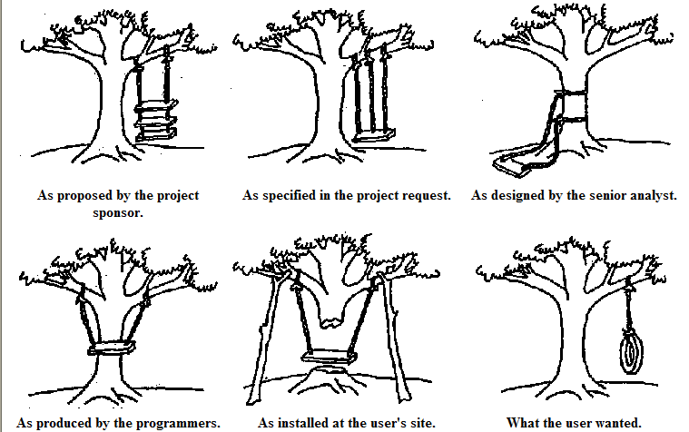
Lecture 16: Experimental Design –
Foundations of Machine Learning
Objectives:
Occam’s Razor
No Free Lunch Theorem
Minimum Description Length
Generalization
Confusion Matrices and Other Metrics
Scoring of Sequential Decoding Systems
Resources:
Textbook (Sections 11.1 – 11.6)
WIKI: Occam's Razor
CSCG: MDL On the Web
MS: No Free Lunch
RogerGrosse: Generalization
Wiki: Confusion Matrix
Wiki: ROC Curves
NIST: Scoring Tools
ISIP: Scoring Metrics

Slide 2
Introduction
With such a wide variety of algorithms to choose from, which one is best?
Are there any reasons to prefer one algorithm over another?
Occam’s Razor: if performance of two algorithms on the same training data is the same, choose the simpler algorithm.
Do simpler or smoother classifiers generalize better?
In some fields, basic laws of physics or nature, such as conservation of energy, provide insight. Are there analogous concepts in machine learning?
The Bayes Error Rate is one such example. But this is mainly of theoretical interest and is rarely, if ever, known in practice. Why?

Slide 3
Introduction
In this section of the course, we seek mathematical foundations that are independent of a particular classifier or algorithm.
Are there techniques that we can use to make any algorithm better?
We will discuss techniques, such as jackknifing or cross-validation, that can be applied to any algorithm.
We will also discuss some important philosophical points:
No pattern classification method is inherently superior to any other.
It is the type of problem, prior distributions and other application-specific information that determine which algorithm is best.
Can we develop techniques or design guidelines to match an algorithm to an application and to predict its performance?
Can we combine classifiers to get better performance?

Slide 4
Important Consequences
If one algorithm outperforms another, it is a consequence of its fit to the particular problem, not the general superiority of the algorithm.
Thus far, we have estimated performance using a test data set which is sampled independently from the problem space.
This approach has many pitfalls, since it is hard to avoid overlap between the training and test sets.
We have learned about methods that can drive the error rate to zero on the training set. Hence, using held-out data is important.

Slide 5
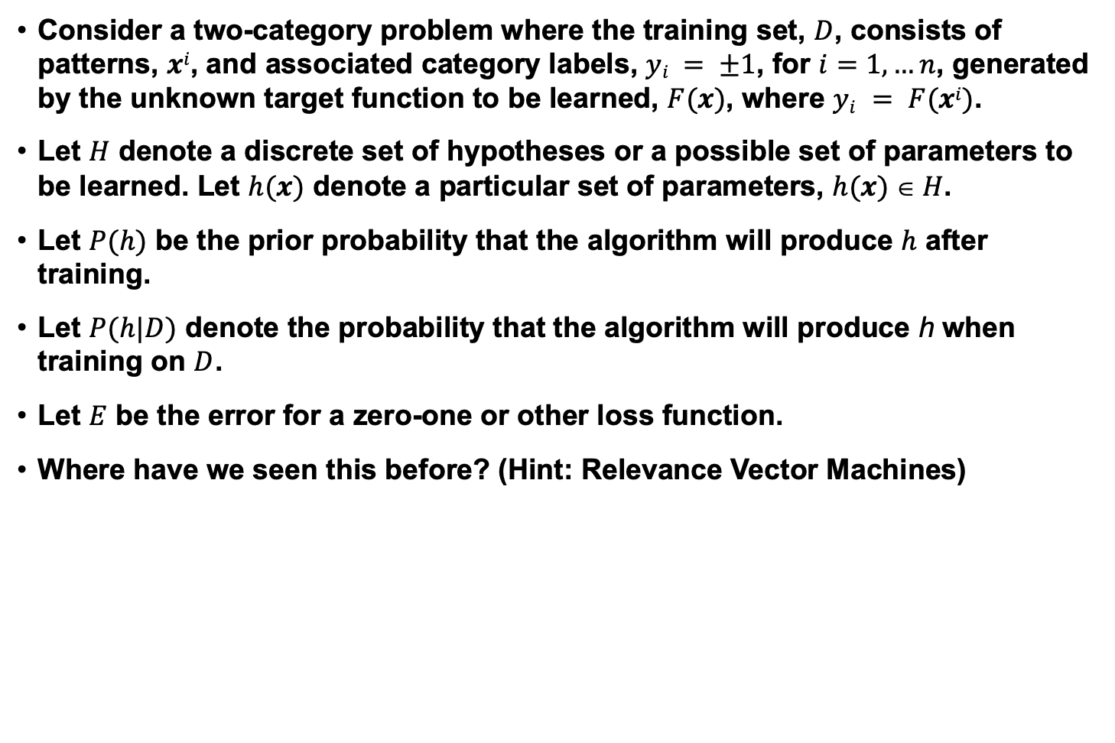
Probabilistic Models of Learning
Consider a two-category problem where the training set, $D$, consists of patterns, $xi$, and associated category labels, $yi = ±1$, for $i=1,…n$, generated by the unknown target function to be learned, $F(x)$, where $yi = F(xi)$.
Let $H$ denote a discrete set of hypotheses or a possible set of parameters to be learned. Let $h(x)$ denote a particular set of parameters, $h(x)  H$.
Let $P(h)$ be the prior probability that the algorithm will produce $h$ after training.
Let $P(h|D)$ denote the probability that the algorithm will produce h when training on $D$.
Let $E$ be the error for a zero-one or other loss function.
Where have we seen this before? (Hint: Relevance Vector Machines)

Slide 6
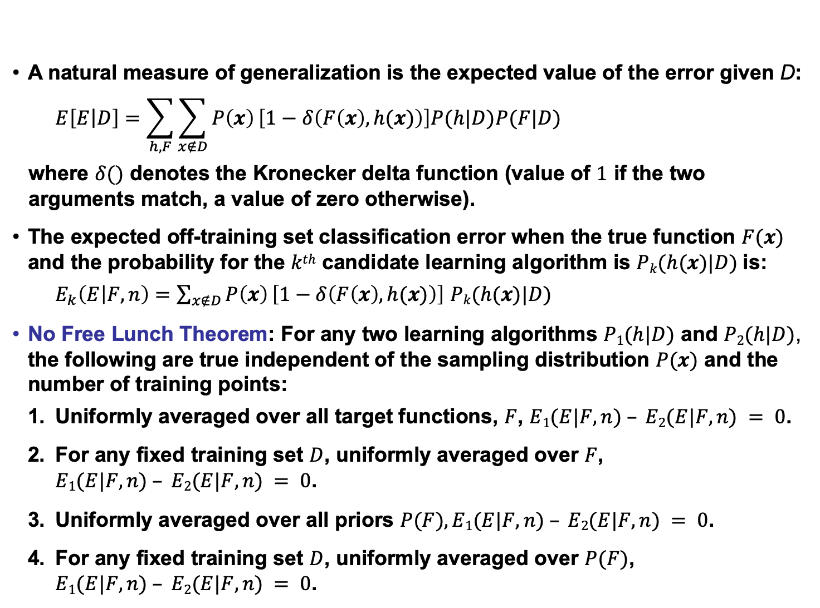
No Free Lunch Theorem
A natural measure of generalization is the expected value of the error given D:
$$E\left[E\left|D\right.\right]=\sum_{h,F}{\sum_{x∉D}{P\left(x\right)}\left[1−δ\left(F\left(x\right),h(x)\right)\right]P(h|D)P(F|D)}$$
where $δ()$ denotes the Kronecker delta function (value of $1$ if the two arguments match, a value of zero otherwise).
The expected off-training set classification error when the true function $F(x)$ and the probability for the $kth$ candidate learning algorithm is $Pk(h(x)|D)$is:
$E_{k}\left(E | F,n\right)=\sum_{x∉D}{P\left(x\right)}\left[1−δ\left(F\left(x\right),h(x)\right)\right]$ $Pk(h(x)|D)$
No Free Lunch Theorem: For any two learning algorithms $P1(h|D)$ and $P2(h|D)$, the following are true independent of the sampling distribution $P(x)$ and the number of training points:
Uniformly averaged over all target functions, $F$, $E1(E|F,n) – E2(E|F,n) = 0$.
For any fixed training set $D$, uniformly averaged over $F$,
$E1(E|F,n) – E2(E|F,n) = 0$.
Uniformly averaged over all priors $P(F), E1(E|F,n) – E2(E|F,n) = 0$.
For any fixed training set $D$, uniformly averaged over $P(F)$,
$E1(E|F,n) – E2(E|F,n) = 0$.

Slide 7
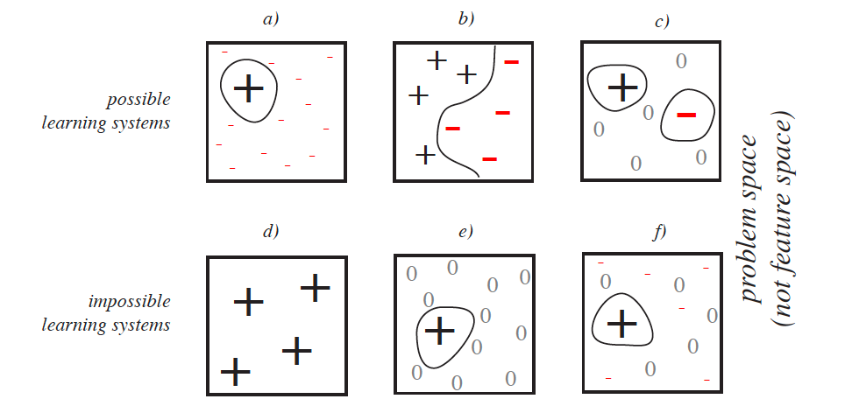
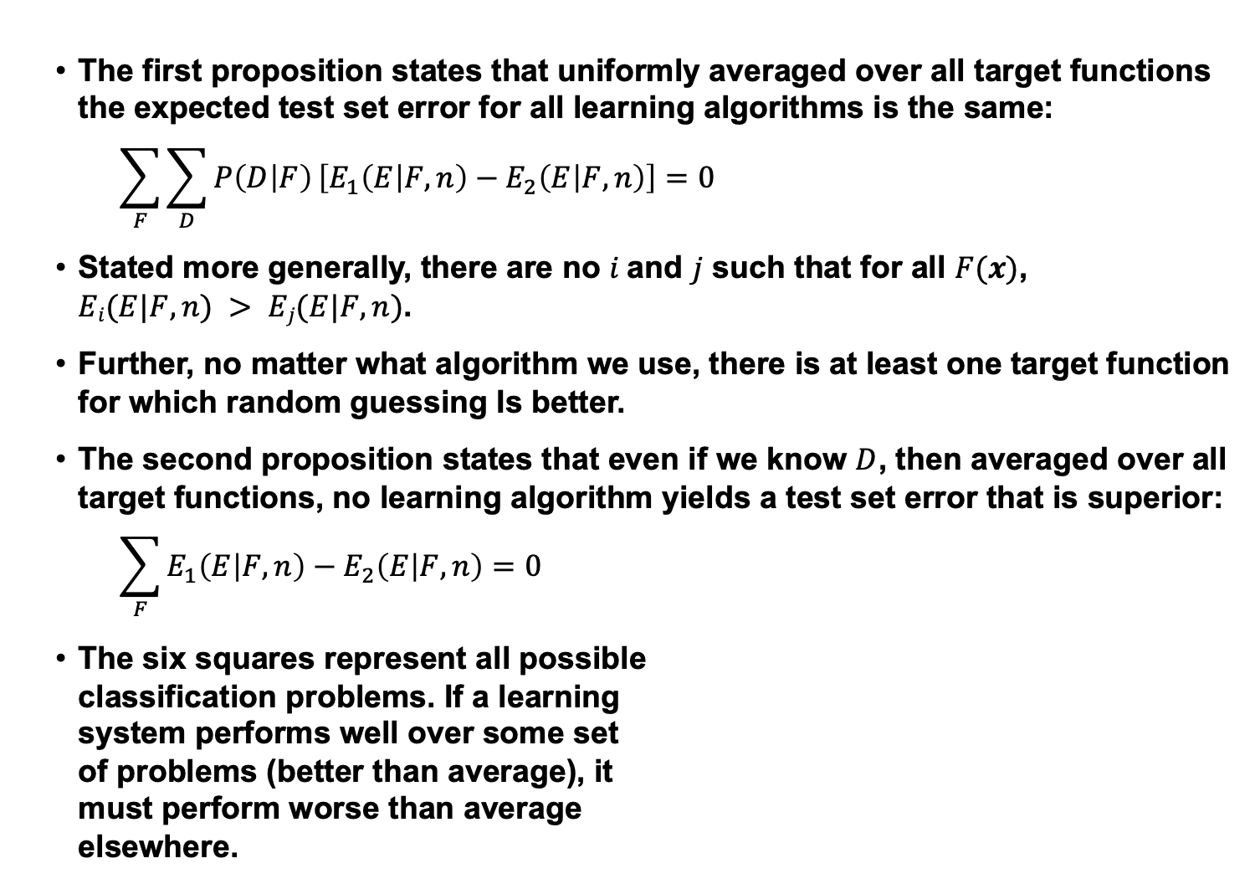
Analysis
The first proposition states that uniformly averaged over all target functions the expected test set error for all learning algorithms is the same:
$$\sum_{F}{\sum_{D}{P\left(D | F\right)}}\left[E_{1}\left(E | F,n\right)−E_{2}\left(E | F,n\right)\right]=0$$
Stated more generally, there are no $i$and $j$ such that for all $F(x)$,
$Ei(E|F,n) > Ej(E|F,n)$.
Further, no matter what algorithm we use, there is at least one target function for which random guessing Is better.
The second proposition states that even if we know $D$, then averaged over all target functions, no learning algorithm yields a test set error that is superior:
$$\sum_{F}{E_{1}\left(E | F,n\right)−E_{2}\left(E | F,n\right)=0}$$
The six squares represent all possible
classification problems. If a learning
system performs well over some set
of problems (better than average), it
must perform worse than average
elsewhere.

Slide 8
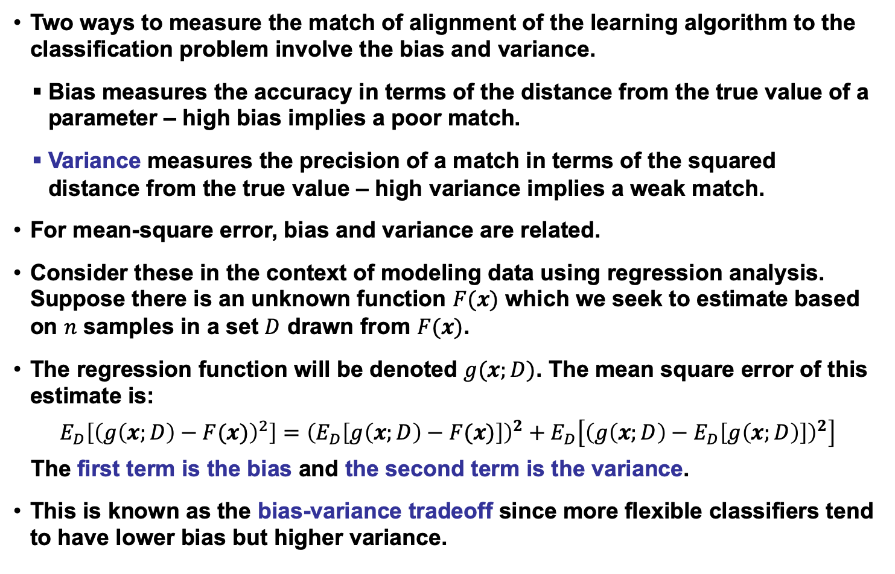
Bias and Variance
Two ways to measure the match of alignment of the learning algorithm to the classification problem involve the bias and variance.
Bias measures the accuracy in terms of the distance from the true value of a parameter – high bias implies a poor match.
Variance measures the precision of a match in terms of the squared distance from the true value – high variance implies a weak match.
For mean-square error, bias and variance are related.
Consider these in the context of modeling data using regression analysis. Suppose there is an unknown function $F(x)$ which we seek to estimate based on $n$ samples in a set $D$ drawn from $F(x)$.
The regression function will be denoted $g(x;D)$. The mean square error of this estimate is:
$$E_{D}\left[{\left(g\left(x;D\right)−F(x)\right)}^{2}\right]={\left(E_{D}\left[g\left(x;D\right)−F(x)\right]\right)}^{2}+E_{D}\left[{\left(g\left(x;D\right)−E_{D}\left[g\left(x;D\right)\right]\right)}^{2}\right]$$
The first term is the bias and the second term is the variance.
This is known as the bias-variance tradeoff since more flexible classifiers tend to have lower bias but higher variance.

Slide 9
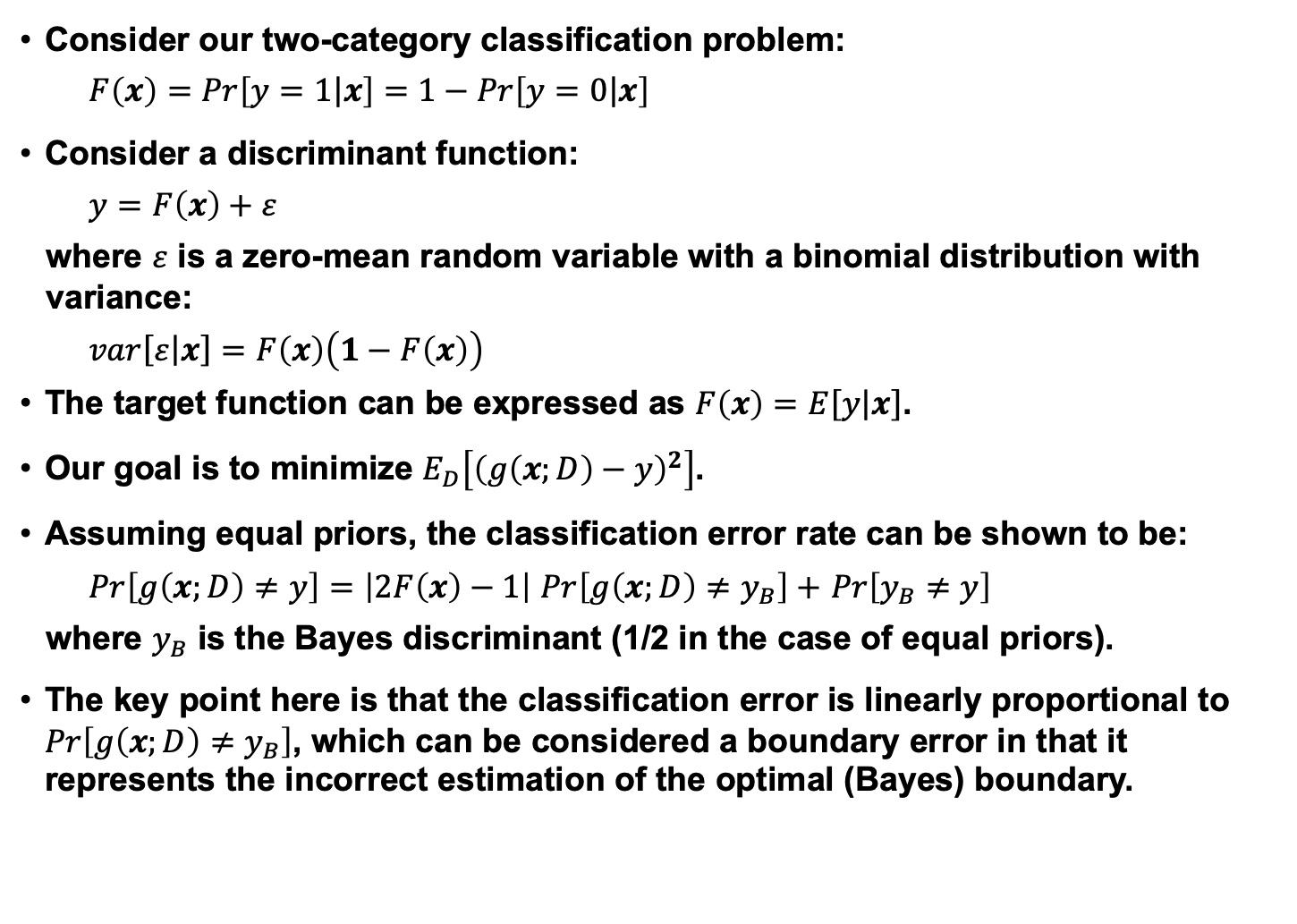
Bias and Variance for a Two-Class Problem
Consider our two-category classification problem:
$$F\left(x\right)=Pr\left[\left.y=1\right|x\right]=1−Pr\left[\left.y=0\right|x\right]$$
Consider a discriminant function:
$$y=F\left(x\right)+ε$$
where $ε$ is a zero-mean random variable with a binomial distribution with variance:
$$var\left[ε\right.\left|\left.x\right]\right.=F\left(x\right)\left(1−F\left(x\right)\right)$$
The target function can be expressed as $F\left(x\right)=E\left[y\right.\left|\left.x\right]\right.$.
Our goal is to minimize $E_{D}\left[{\left(g\left(x;D\right)−y\right)}^{2}\right]$.
Assuming equal priors, the classification error rate can be shown to be:
$Pr\left[g\left(x;D\right)≠y\right]=\left|2F\left(x\right)−1\right|$ $Pr\left[g\left(x;D\right)≠y_{B}\right]+$ $Pr\left[y_{B}≠y\right]$
where $y_{B}$ is the Bayes discriminant (1/2 in the case of equal priors).
The key point here is that the classification error is linearly proportional to $Pr\left[g\left(x;D\right)≠y_{B}\right]$, which can be considered a boundary error in that it represents the incorrect estimation of the optimal (Bayes) boundary.

Slide 10
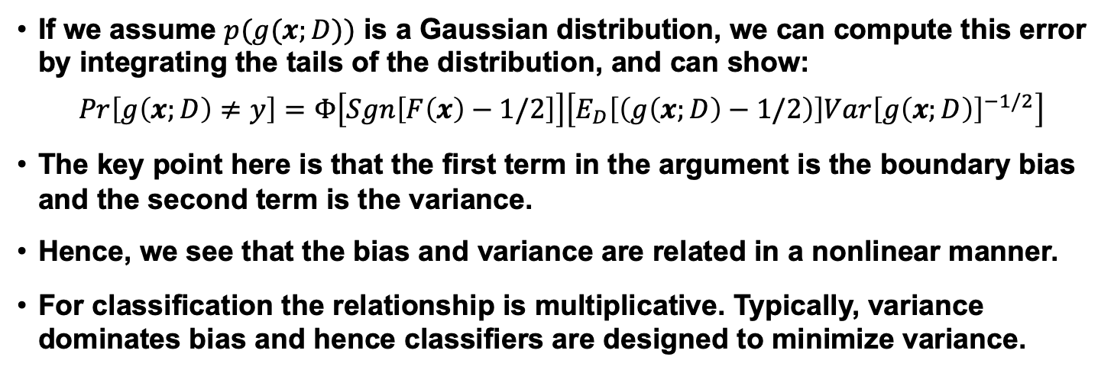
Nonlinear Relationship Between Bias and Variance
If we assume $p(g(x;D))$ is a Gaussian distribution, we can compute this error by integrating the tails of the distribution, and can show:
$$Pr\left[g\left(x;D\right)≠y\right]=Φ\left[Sgn\left[F\left(x\right)−1/2\right]\right]\left[E_{D}\left[\left(g\left(x;D\right)−1/2\right)\right]{Var\left[g\left(x;D\right)\right]}^{−1/2}\right]$$
The key point here is that the first term in the argument is the boundary bias and the second term is the variance.
Hence, we see that the bias and variance are related in a nonlinear manner.
For classification the relationship is multiplicative. Typically, variance dominates bias and hence classifiers are designed to minimize variance.

Slide 11
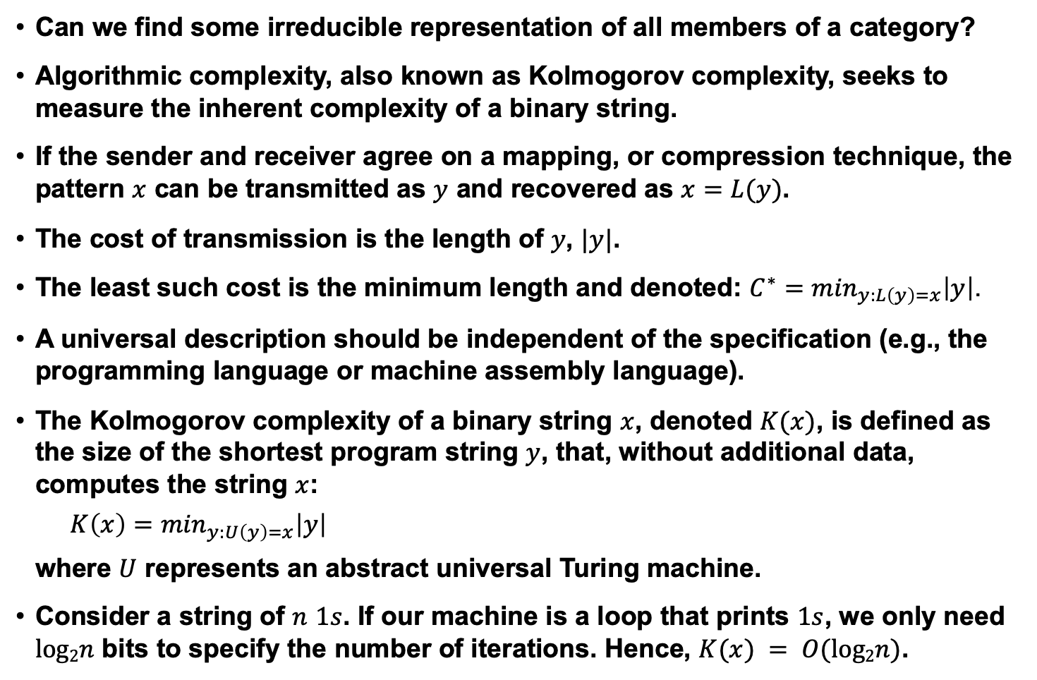
Algorithmic Complexity
Can we find some irreducible representation of all members of a category?
Algorithmic complexity, also known as Kolmogorov complexity, seeks to measure the inherent complexity of a binary string.
If the sender and receiver agree on a mapping, or compression technique, the pattern $x$ can be transmitted as $y$ and recovered as $x=L(y)$.
The cost of transmission is the length of $y$, $|y|$.
The least such cost is the minimum length and denoted: $C^{∗}=\min_{y:L\left(y\right)=x}\left|y\right|$.
A universal description should be independent of the specification (e.g., the programming language or machine assembly language).
The Kolmogorov complexity of a binary string $x$, denoted $K(x)$, is defined as the size of the shortest program string $y$, that, without additional data, computes the string $x$:
$$K\left(x\right)=\min_{y:U\left(y\right)=x}\left|y\right|$$
where $U$ represents an abstract universal Turing machine.
Consider a string of $n$ $1s$. If our machine is a loop that prints $1s$, we only need $log2n$ bits to specify the number of iterations. Hence, $K(x) = O(log2n)$.

Slide 12
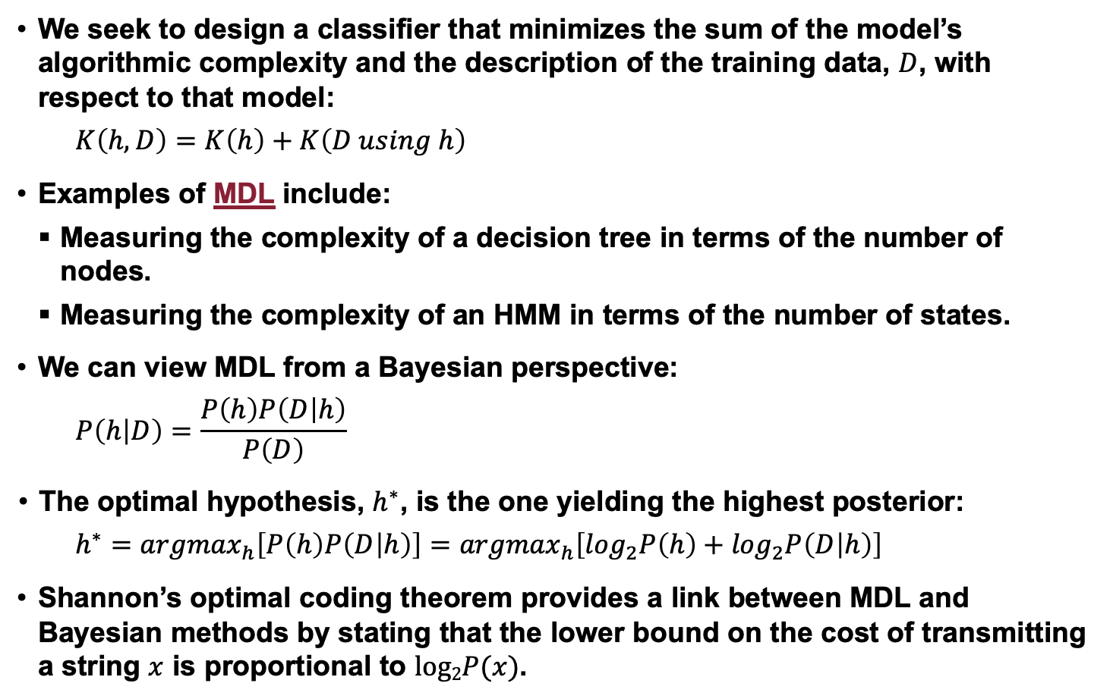
Minimum Description Length (MDL)
We seek to design a classifier that minimizes the sum of the model’s algorithmic complexity and the description of the training data, $D$, with respect to that model:
$$K\left(h,D\right)=K\left(h\right)+K\left(D using h\right)$$
Examples of MDL include:
Measuring the complexity of a decision tree in terms of the number of nodes.
Measuring the complexity of an HMM in terms of the number of states.
We can view MDL from a Bayesian perspective:
$$P\left(h | D\right)=\frac{P\left(h\right)P\left(D | h\right)}{P\left(D\right)}$$
The optimal hypothesis, $h^{∗}$, is the one yielding the highest posterior:
$h^{∗}={argmax}_{h}\left[P\left(h\right)P\left(D | h\right)\right]=$ ${argmax}_{h}\left[\log_{2}P\left(h\right)+\log_{2}P\left(D | h\right)\right]$
Shannon’s optimal coding theorem provides a link between MDL and Bayesian methods by stating that the lower bound on the cost of transmitting a string $x$ is proportional to $log2P(x)$.

Slide 13
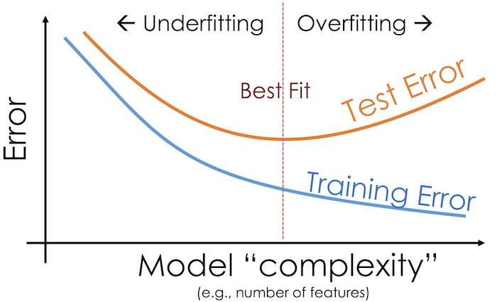
Generalization

Slide 14
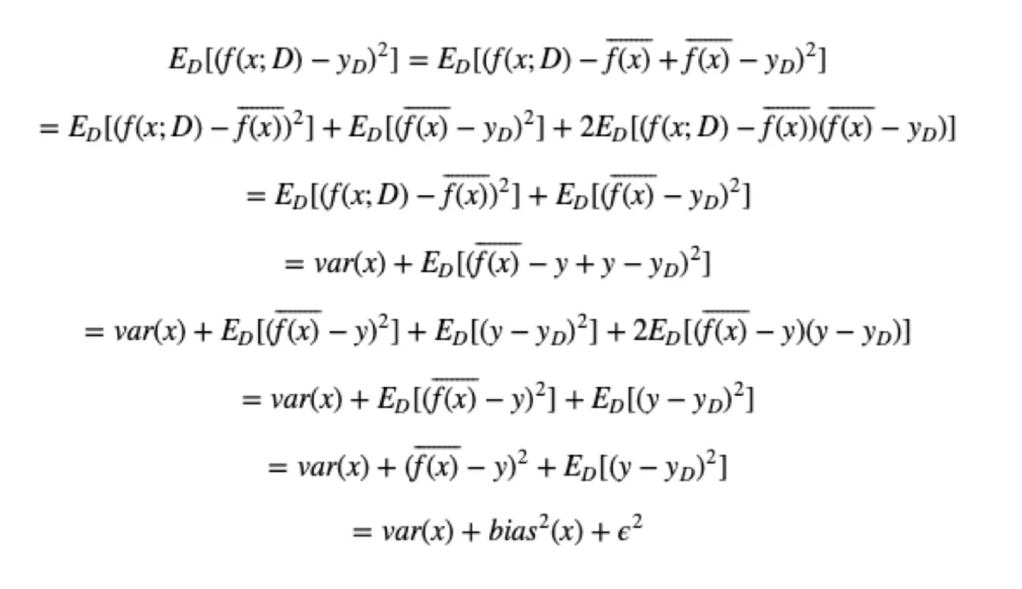
The Bias and Variance Tradeoff

Slide 15
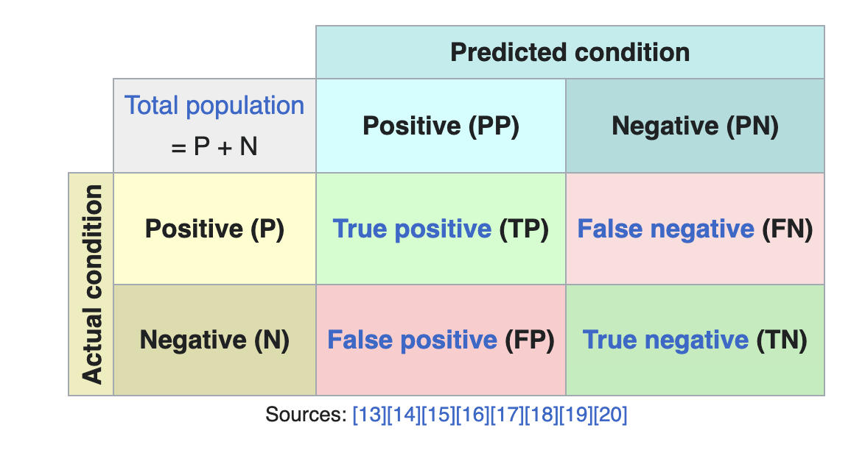
Confusion Matrices

Slide 16
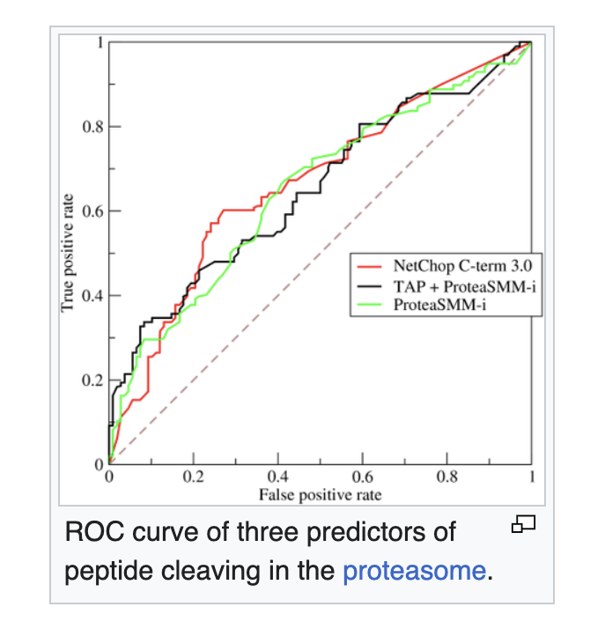
Receiver Operating Characteristics

Slide 17
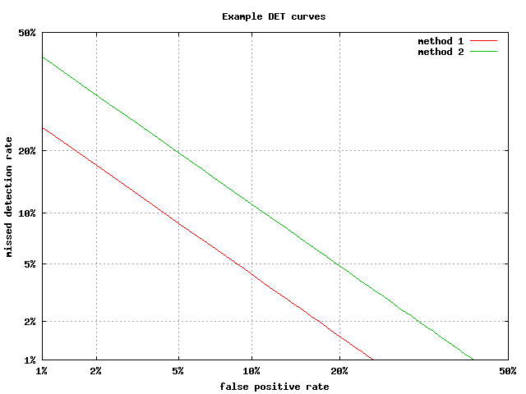
Detection Error Tradeoff (DET) Curves

Slide 18
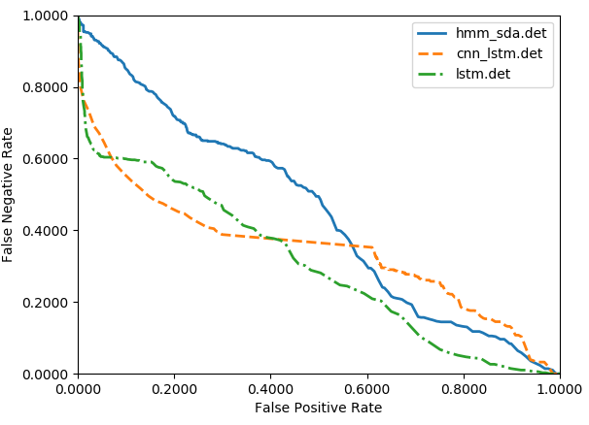
Example: Which System is Better?

Slide 19
Summary
Occam’s Razor: simpler models generalize better.
Cross-Validation: discussed our general goal of finding learning techniques that improve the performance of any machine learning algorithm.
The No Free Lunch Theorem:
If we average over all possible data sets, no algorithm is better or worse. What tends to differentiate algorithms are the degree to which their assumptions match the requirements of a specific problem.
There is always some chance that some algorithm can produce a better result on a specific database – one can get “lucky” from time to time.
There is no general theory that guides the selection of the best algorithm, but we can do an exhaustive search.
To demonstrate a fundamental improvement, one should measure performance on several substantially different tasks if superiority cannot be proved theoretically.
Algorithmic Complexity and Minimum Description Length: algorithms must be compared at the same degree of complexity.
Evaluation: We evaluate systems using a variety of measures that are based on confusion matrices and false alarm rates.

Slide 20
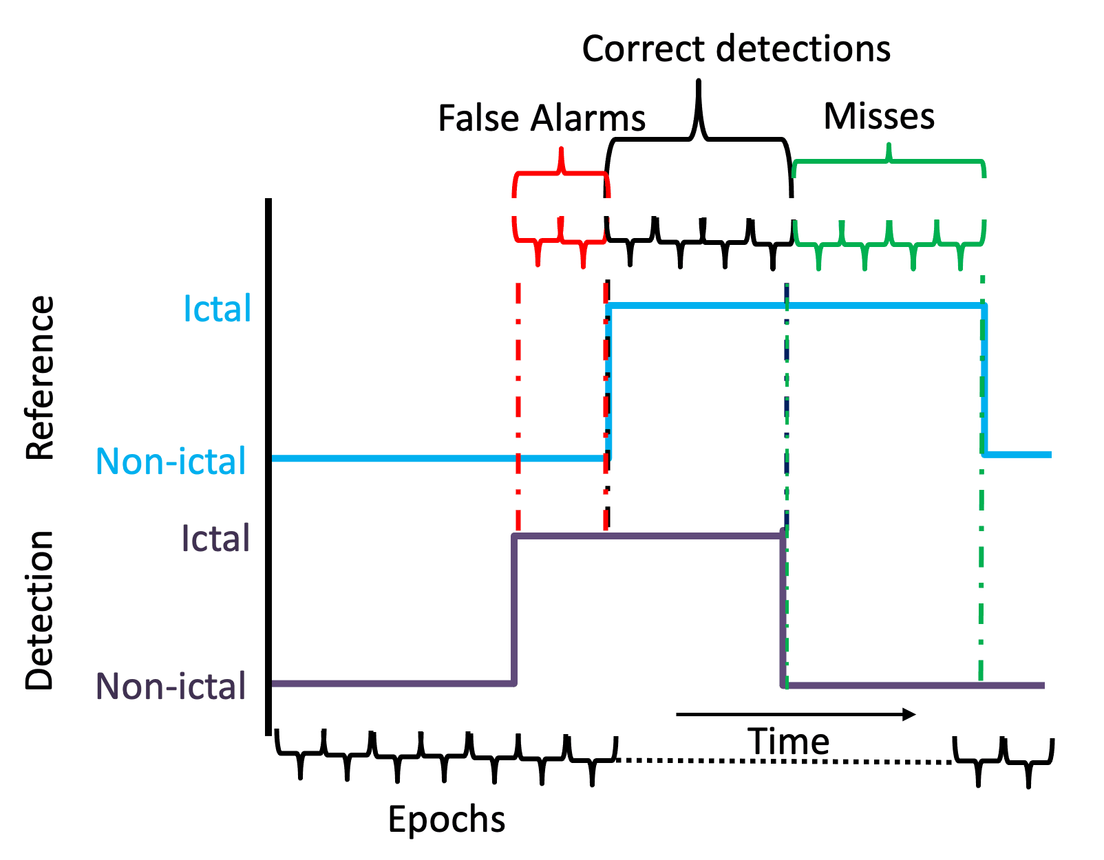




Validation of Temporal Scoring Metrics
for Automatic Seizure Detection
V. Shah
I. Obeid
J. Picone
G. Ekladious
R. Iskander
Y. Roy

Slide 21
Standardized databases and evaluation metrics accelerate research and technology development by enabling direct comparisons of research results.
The bioengineering community lacks standard evaluation metrics for scoring of sequential decoding algorithms.
The Neureka 2020 Epilepsy Challenge was created to bring a community-wide focus on automated seizure detection and establish meaningful baselines.
In this presentation, we analyze the results of 4 research groups that provided sufficiently detailed results using four evaluation metrics:
  Dynamic Programming Alignment (DPAL)
  Epoch Sampling (EPCH)
  Any-Overlap Method (OVLP)
  Time Aligned Event Scoring (TAES)
We validate the use of the TAES metric because it evaluates partial overlaps and penalizes errors based on a reference event’s duration.
We also demonstrate that scoring a system using multiple metrics gives insight into the system’s behavior that can be used to improve an algorithm and optimally tune it for a specific evaluation metric.

Slide 22

The Neureka™ 2020 Epilepsy Challenge
Based on the Temple University Hospital
Seizure Detection Corpus (TUSZ) v1.5.2,
which includes a blind evaluation set.
The results were scored using v3.3.3 of
our open source evaluation software.
Time Aligned Event Scoring (TAES) was
used as a basis for ranking the submissions.
In order to stimulate interest in the use of
low cost commercial sensors, penalties were further imposed based on the number of channels.
To emphasize the importance of a low false alarm rate, a single integrated metric was used that penalized false alarms and the number of channels:
$$P=Sens−2.5∗\left(FA\right)−7.5∗\left(NC/19\right)$$
where Sens, FA and NC are sensitivity, false alarms per 24 hours and the number of channels respectively.
This metric was designed with an expectation that Sens would be in the range of 40%, FAs in the range of 10, and so that NC would be a tiebreaker.
Description | Train | Dev
Patients | 592 | 50
Sessions | 1,185 | 238
Files | 4,599 | 1,013
No. Events | 2,377 | 673
Event Dur. (sec.) | 169,794 | 58,445
Total Dur (sec.) | 2,710,483 | 613,232

Slide 23
Open Source Scoring Software
The scoring metrics used for evaluating a system should reflect the performance requirements of an application (e.g., word error rate in speech recognition is highly correlated with the usability of a voice interface).
Clinicians are overwhelmingly emphatic that false alarm rate is the most important criterion for user acceptance.
Clinicians argue that performance goals for seizure detection are 75% sensitivity and 1 false alarm per 24 hours for a system to be usable.
We have introduced open source sequential decoding software that integrates five metrics for measuring similarity and produces a wide variety of popular statistics for evaluating system performance:
https://www.isip.piconepress.com/publications/unpublished/book_sections/2021/springer/metrics/
This software has been used internally for many years and one external evaluation conducted by IBM Research.
The Python implementation of the scoring software can be found at:
https://www.isip.piconepress.com/projects/tuh_eeg/downloads/nedc_eval_eeg
Using the Neureka Challenge data, we have analyzed several of the leading systems and validate the accuracy of our Time-Aligned Event Scoring (TAES) metric, showing it correlates with other measure including DET curves.

Slide 24
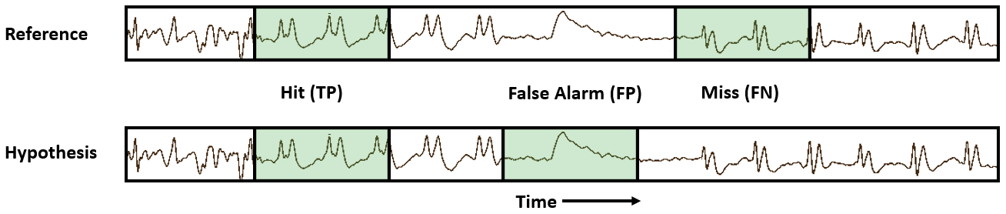
Fundamental Scores and Derived Measures
There are 4 fundamental quantities that must be calculated to derive most performance measures:
  True Positive (TP)
  False Positive (FP)
  False Negative (FN)
  True Negative (TN)
From these we calculate traditional measures such as:
Sensitivity = TP / (TP + FN) Accuracy = (TP+TN)/(TP+FN+TN+FP)
Specificity = TN / (TN + FP) Precision = TP/(TP + FN)
There are many ways to compute quantities such as TP and FP. In our scoring software, we introduce four ways to measure errors.

Slide 25
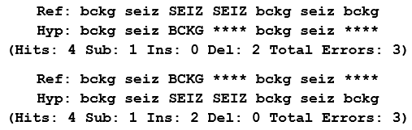
Evaluation Metrics – Dynamic Programming Align. (DPAL)
Popularized in the speech recognition community when time alignments were not available. Computed error rates correlate well with time-aligned results.
Minimizes an edit distance (the Levenshtein distance) to map the hypotheses onto the reference:
Three types of errors are recorded: substitution, deletion and insertion.
A dynamic programming algorithm is used to find the optimal alignment. Weights can be applied to different error classes (we use equal weights).
A fast, simple algorithm with few tunable parameters that can be easily applied to system output.
Alignments do not necessarily reflect the errors that actually occurred, though the aggregated results display the correct trends.

Slide 26
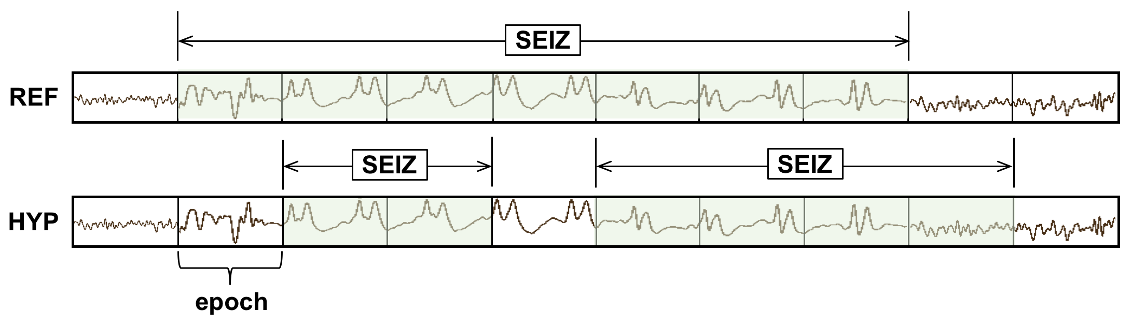
Evaluation Metrics – Epoch-based Sampling (EPCH)
Uses a metric that treats the reference and hypothesis as signals sampled at a fixed frame rate (an epoch):
The epoch duration used for scoring EEG events is 1.0 second.
Fixed-size epochs avoid the problem of disambiguating overlap between reference and hypothesis events (a ‘many to many’ mapping).
Tends to bias scores by weighting longer events more heavily and tends to produce a higher value of specificity.
Since seizure events can be very long, this is a concern.
Also, since each epoch is scored independently, false alarms are very high because each event can generate more than one false alarm.

Slide 27
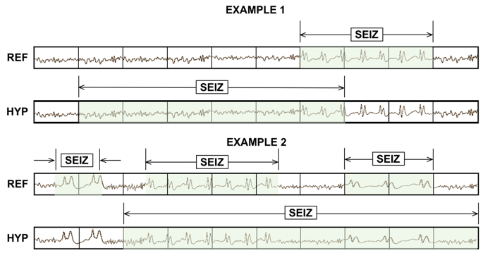
Evaluation Metrics – Any-Overlap (OVLP)
If a hypothesis event
overlaps within the
proximity of the
reference event, it is
considered a hit.
No penalty when
multiple reference
events overlap with
a single large
hypothesis event.
Misses and false alarms are counted when no overlap between hypothesis and reference is found.
Short and long events are weighed equally.
A very permissive metric that scores a match as correct even though the accuracy of the time alignment might be very poor.
Widely used in the neuroengineering community because it tends to produce a high sensitivity. Used in FDA submissions which has created an overly optimistic view of the accuracy of state of the art systems.

Slide 28
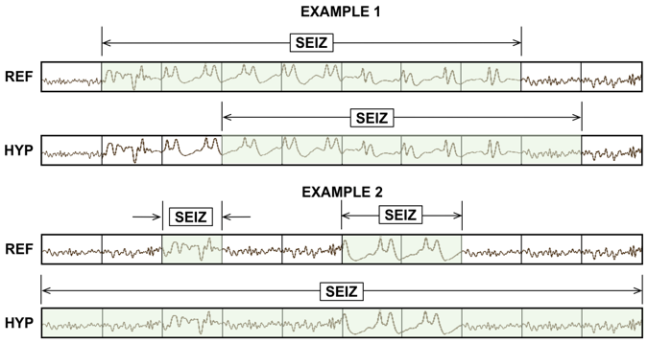
Evaluation Metrics – Time-aligned Event Scoring (TAES)
Similar to EPCH, TAES scores events based on their time-alignments.
A seizure can vary in duration from a few seconds to hours depending on its type and severity. TAES attempts to balance errors on short duration events with errors on long duration events.
The amount of
overlap is tabulated
for each error.
Each event is
weighed equally by
normalizing the score
to a range of [0.0,1.0].
Multiple hypotheses
that map to the same
reference event are
accumulated into
a single score.
Multiple reference events that map to the same hypothesis event add FP errors for all but the first event.

Slide 29
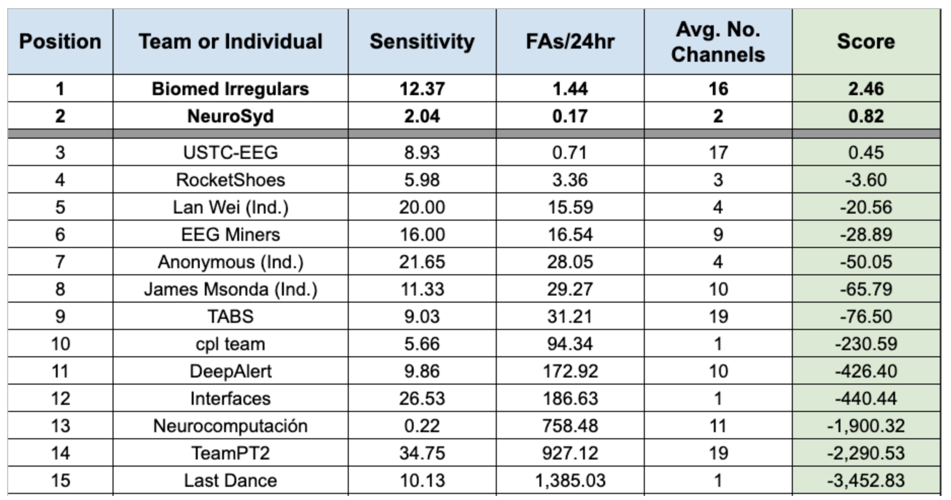
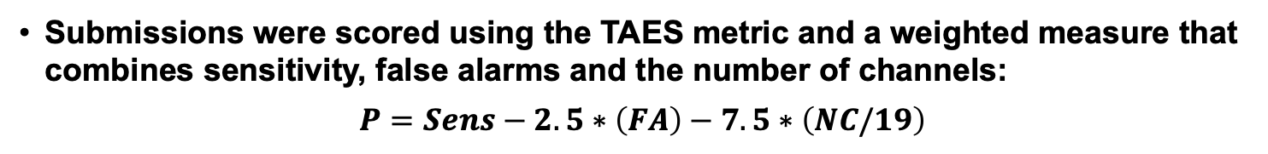
System Performance – Neureka Leaderboard
Submissions were scored using the TAES metric and a weighted measure that combines sensitivity, false alarms and the number of channels:
$$P=Sens−2.5∗\left(FA\right)−7.5∗\left(NC/19\right)$$
sia
pnc98
1zk
yff

Slide 30
Analysis of Several Selected Neureka Contributions (dev)
All sites were invited to submit detailed results. Only four external sites participated: Lan Wei (1zk), NeuroSyd (pnc98), EEG miners (yff) and Biomed Irregulars (sia).
We also included an internally
developed system (nedc).
Some sites could not produce
detailed hypothesis files
necessary for analysis ☹
Comparisons using multiple
evaluation metrics gives
greater insight into a
system’s behavior.
nedc and 1zk are balanced
and have the highest
sensitivities but higher
FA rates.
pnc98 was biased to have a
low FA rate. It is conservative
in how it assigns an onset.
System |  | nedc | 1zk | pnc98 | yff
D P A L | Sens | 37.23 | 27.64 | 6.98 | 20.51
 | Spec | 96.88 | 85.27 | 98.33 | 91.98
 | FAs | 5.63 | 29.16 | 2.54 | 14.09
E P C H | Sens | 36.28 | 13.78 | 1.56 | 31.18
 | Spec | 97.30 | 97.89 | 99.99 | 94.06
 | FAs | 2,101 | 1,647 | 8 | 4,644
O V L P | Sens | 40.29 | 23.92 | 6.39 | 26.15
 | Spec | 97.56 | 90.29 | 99.65 | 94.19
 | FAs | 5.77 | 25.36 | 0.85 | 14.23
T A E S | Sens | 32.60 | 14.36 | 2.04 | 14.03
 | Spec | 90.72 | 83.53 | 99.42 | 87.44
 | FAs | 17.03 | 31.32 | 0.87 | 21.42

Slide 31
Analysis of Several Selected Neureka Contributions (dev)
1zk performs well on isolated events because FA rates for all metrics are comparable. The difference between OVLP and TAES sensitivities suggest that while parts of an event are identified correctly, the alignments are off.
pnc98 is conservative in detecting
boundaries and only correctly
identifies the center region
of an event.
yff detects regions which extend
beyond the boundaries of an
event. This is inferred by
comparing OVLP FA rates with
TAES and EPCH FA rates.
nedc tends to generate a single
long hypothesis that maps to
multiple reference events, which
can be seen by difference in
FA rates for OVLP and TAES.
Overall performance was better on
the eval set than the dev sets which suggests the eval set is relatively easier.
System |  | nedc | 1zk | pnc98 | yff
D P A L | Sens | 37.23 | 27.64 | 6.98 | 20.51
 | Spec | 96.88 | 85.27 | 98.33 | 91.98
 | FAs | 5.63 | 29.16 | 2.54 | 14.09
E P C H | Sens | 36.28 | 13.78 | 1.56 | 31.18
 | Spec | 97.30 | 97.89 | 99.99 | 94.06
 | FAs | 2,101 | 1,647 | 8 | 4,644
O V L P | Sens | 40.29 | 23.92 | 6.39 | 26.15
 | Spec | 97.56 | 90.29 | 99.65 | 94.19
 | FAs | 5.77 | 25.36 | 0.85 | 14.23
T A E S | Sens | 32.60 | 14.36 | 2.04 | 14.03
 | Spec | 90.72 | 83.53 | 99.42 | 87.44
 | FAs | 17.03 | 31.32 | 0.87 | 21.42

Slide 32
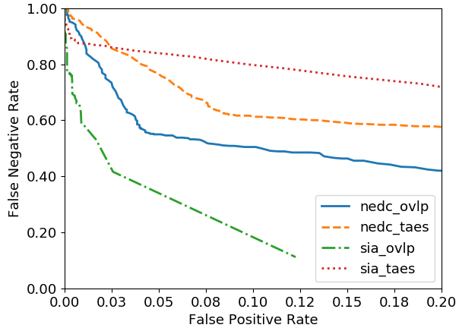
DET Analysis: nedc vs. sia (eval)
Many sites could not provide data
suitable for DET curve analysis because their systems did not output a ‘confidence’:
sia has a low FA rate at the expense of sensitivity.
nedc has a higher sensitivity and a higher FA rate.
In cases like this, performance must be compared using a DET curve:
Scores |  | sia | nedc
A T W V | Sens | 22.70 | 41.08
 | Spec | 99.02 | 93.20
 | FAs | 1.61 | 13.36
D P A L | Sens | 23.45 | 42.96
 | Spec | 99.47 | 94.39
 | FAs | 0.96 | 11.77
E P C H | Sens | 12.84 | 51.58
 | Spec | 99.97 | 98.38
 | FAs | 25 | 1,301
O V L P | Sens | 23.26 | 42.96
 | Spec | 99.74 | 95.54
 | FAs | 0.64 | 11.45
T A E S | Sens | 11.37 | 35.55
 | Spec | 99.46 | 91.80
 | FAs | 0.99 | 17.23

Slide 33
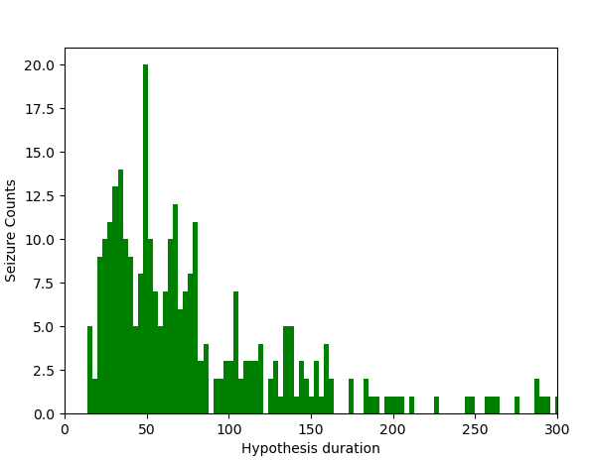
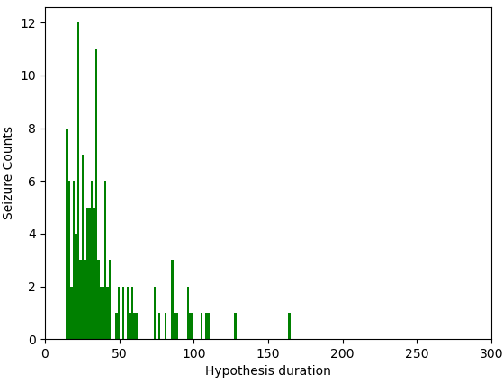
Statistical Analysis: nedc vs. sia
Hypothesis event durations for nedc and sia are significantly different.
A distribution of event durations for both systems are shown to the right.
The sia system detects seizures which are mostly in the range of 15-40 seconds in duration.
The nedc system detects seizures for durations as low as 4 seconds.
The sia system is very careful with overdetection and performs well with mid-duration seizure events.
The nedc system provides more balanced performance across metrics whereas the sia system performs better where time-alignment and partial overlaps are important.
System: nedc
System: sia

Slide 34
Statistical Analysis
Pairwise Pearson’s correlation coefficient was calculated for all four metrics for all 16 submissions.
OVLP and DPAL are highly correlated.
DPAL and EPCH show very low correlation in terms of both sensitivity and specificity.
EPCH and TAES show higher correlation in terms of sensitivity but EPCH fails to correlate well with the other metrics.
TAES combines salient features of the other metrics and provides a more accurate view of overall performance.
 | DPAL | EPCH | OVLP | TAES
DPAL | 1.00 | 0.4029 (p=0.121) | 0.9535 (p<0.001) | 0.5746 (p=0.019)
EPCH | — | 1.00 | 0.6141 (p=0.011) | 0.9144 (p<0.001)
OVLP | — | — | 1.00 | 0.7641 (p<0.001)
TAES | — | — | — | 1.00
 | DPAL | EPCH | OVLP | TAES
DPAL | 1.00 | 0.6676 (p=0.004) | 0.9985 (p<0.001) | 0.9980 (p<0.001)
EPCH | — | 1.00 | 0.6777 (p=0.003) | 0.6948 (p=0.002)
OVLP | — | — | 1.00 | 0.9971 (p<0.001)
TAES | — | — | — | 1.00

Slide 35
Summary
Seizure events can vary significantly in duration. Each event should be weighed equally regardless of its duration to avoid bias.
Traditional metrics, such as OVLP, are too lenient when it comes to assessing the time alignment of a hypothesis.
TAES, by scoring partial overlaps and weighing seizure events equally, was designed to evaluate systems where time-alignments are crucial and ‘many-to-many’ mappings between reference and hypothesis events are required.
Analyzing systems using multiple scoring metrics can provide insight into a system’s behavior without the need for extensive manual error analysis.
Standardization of scoring software in the research community is an important step towards accelerating progress and establishing statistically significant advances.
Many modern machine learning algorithms, when properly evaluated, are marginally different on difficult tasks such as seizure prediction. Real world challenges such as artifacts and event segmentation dominate system performance.
Neureka™ 2020 Epilepsy Challenge demonstrated that the TAES metric is a viable alternative to traditional scoring metrics.

Slide 36
Acknowledgments
The Neureka 2020 Epilepsy Challenge was made by possible by a generous grant from Novela Neurotech (https://www.novelaneuro.com).
The research reported in this publication by the Neural Engineering Data Consortium was most recently supported by the National Science Foundation Partnership for Innovation award number IIP-1827565 and the Pennsylvania Commonwealth Universal Research Enhancement Program (PA CURE). Any opinions, findings, and conclusions or recommendations expressed in this material are those of the author(s) and do not necessarily reflect the official views of any of these organizations.

Slide 37
References
The Neureka Challenge:
Y. Roy, R. Iskander, and J. Picone, “The Neureka® 2020 Epilepsy Challenge,” NeuroTechX, 2020. [Online]. Available: https://neureka-challenge.com/. [Accessed: 01-Jul-2020].
V. Shah et al., “The Temple University Hospital Seizure Detection Corpus,” Front. Neuroinform., vol. 12, pp. 1–6, 2018.
I. Obeid and J. Picone, “Machine Learning Approaches to Automatic Interpretation of EEGs,” in Biomedical Signal Processing in Big Data, 1st ed., E. Sejdik and T. Falk, Eds. Boca Raton, Florida, USA: CRC Press, 2017 (in press).
V. Shah, M. Golmohammadi, I. Obeid, and J. Picone, “Objective Evaluation Metrics for Automatic Classification of EEG Events,” in Signal Processing in Medicine and Biology: Emerging Trends in Research and Applications, 1st ed., I. Obeid, I. Selesnick, and J. Picone, Eds. New York City, New York, USA: Springer, 2021, pp. 1–26.
V. Shah and J. Picone, “NEDC Eval EEG: A Comprehensive Scoring Package for Sequential Decoding of Multichannel Signals,” The TUH EEG Project Web Site, 2019. [Online]. Available: https://www.isip.piconepress.com/projects/tuh_eeg/downloads/nedc_eval_eeg/. [Accessed: 01-Jul-2020].
Participants:
nedc: M. Golmohammadi, V. Shah, I. Obeid, and J. Picone, “Deep Learning Approaches for Automatic Seizure Detection from Scalp Electroencephalograms,” in Signal Processing in Medicine and Biology: Emerging Trends in Research and Applications, 1st ed., I. Obeid, I. Selesnick, and J. Picone, Eds. New York, New York, USA: Springer, 2020, pp. 233–274.
lwei: L. Wei and C. Mooney, “An Automatic Seizure Detection Method for Clinical EEG data,” in Proceedings of the IEEE Signal Processing in Medicine and Biology Symposium (SPMB), 2020.
pnc98: Y. Yang, N. D. Truong, C. Maher, A. Nikpour, and O. Kavehei, “Two-Channel Epileptic Seizure Detection with Blended Multi-Time Segments Electroencephalography (EEG) Spectrogram,” in Proceedings of the IEEE Signal Processing in Medicine and Biology Symposium (SPMB), 2020.
yff: T. Anand, M. G. Kumar, M. Sur, R. Aghoram, and H. Murphy, “Seizure Detection Using Time Delay Neural Networks and LSTM,” in Proceedings of the IEEE Signal Processing in Medicine and Biology Symposium (SPMB), 2020.
sia: C. Chatzichristos et al., “Epileptic Seizure Detection in EEG via Fusion of Multi-View Attention-Gated U-net Deep Neural Networks,” in Proceedings of the IEEE Signal Processing in Medicine and Biology Symposium (SPMB), 2020.

