Slide 1
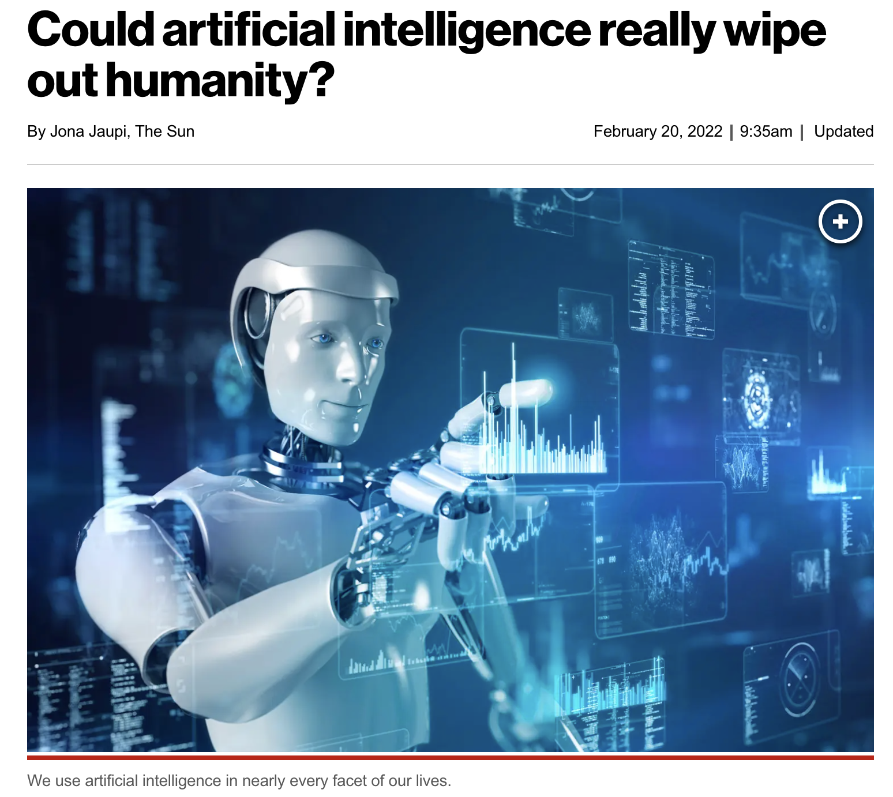
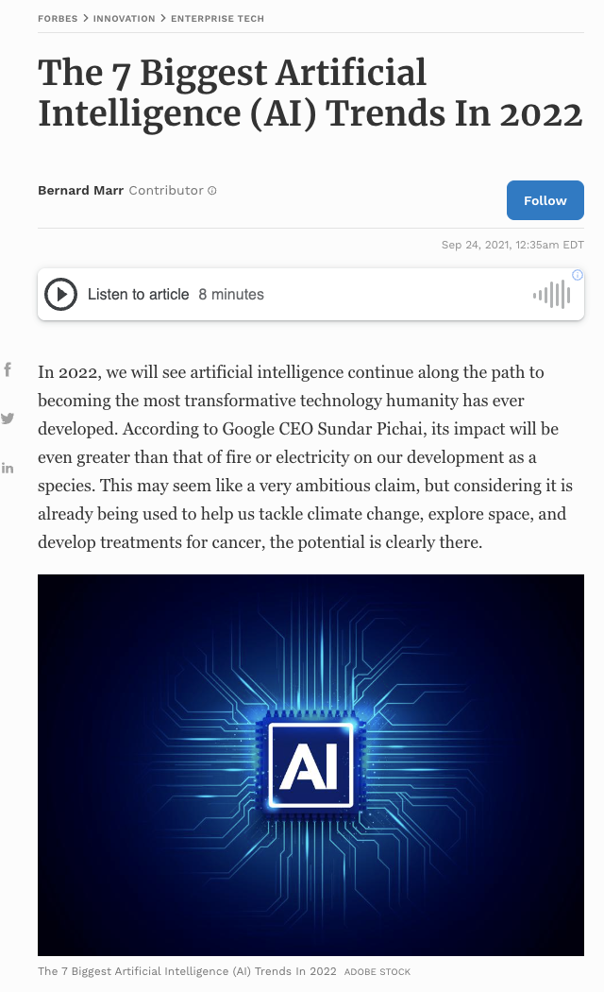
Lecture 01: Course Overview
Objectives:
Course Goals
Terminology
The Design Cycle
Generalization and Risk
Understanding vs. Recognition
Feature Confusability
Common Mistakes
Three Rules of Machine Learning
Resources:
Course Syllabus
Textbook (Sections 1.1 – 1.3)
TED Talks

Slide 2



Multidisciplinary Approach
Dispel The Hype: Artificial Intelligence (AI) is not taking over the world anytime soon. Machine learning (ML) systems are simply good at memorizing patterns and emulating functional mappings.
Technology: Introduce you to the tools and concepts being used in modern machine learning research and technology development.
Theoretical Underpinnings: Develop a mathematically rigorous understanding of ML algorithms.
Connections: Connect a wide range of topics such as statistics, experimental design and signal processing via their foundations in mathematics, statistics and machine learning.

Slide 3
Terminology
Pattern Recognition: “the act of taking raw data and taking an action based on the category of the pattern.”
Common Applications: speech and image recognition, machine translation, fingerprint identification (biometrics) and just about everything else including financial modeling, autonomous vehicles and even drug discovery.
Related Terminology:
  Machine Learning: “It gives computers the ability to learn without being explicitly programmed.” (Arthur Samuel, 1959)
  The ability of a machine to improve its performance based on previous results.
  Machine Understanding: acting on the intentions of the user
  generating the data.
  Big Data: “Big data is like teenage sex: everyone talks about it, nobody really knows how to do it, everyone thinks everyone else is doing it, so everyone claims they are doing it.” (Dan Ariely, 2013)
  Statistics: There is a strong connection between modern engineering, statistics and machine learning. Many of the same tools are used but known by different names.

Slide 4
The Classic Machine Learning Paradigm
Key issues:
  Is the data representative of the problem?
  Do the features capture meaningful differences between patterns?
  How do we find the best model?
  How do we estimate the parameters of the model?
  How do we evaluate performance?
Collect Data
Evaluate Classifier
Select Features
Train Classifier
Choose Model
Other considerations:
The answers are often application specific and data dependent.
Customers/users don’t often completely understand their requirements.
Data collection is often an on-going process that drives the technology.

Slide 5
Philosophical Questions
Which has had more impact on artificial intelligence:
  Data: Do we have access to more data than ever before? Have we learned how to better use data?
  Computational Resources: Has cloud and cluster computing revolutionized our ability to run large experiments?
  Algorithms: Have machine learning algorithms gotten better? Or are we simply using more parameters and memorizing more data?
For example, ChatGPT and similar technologies use trillions of parameters and often petabytes of data to train the system.
This was not possible 50 years ago for many reasons.
There are many computational issues associated with developing these kinds of systems.

Slide 6

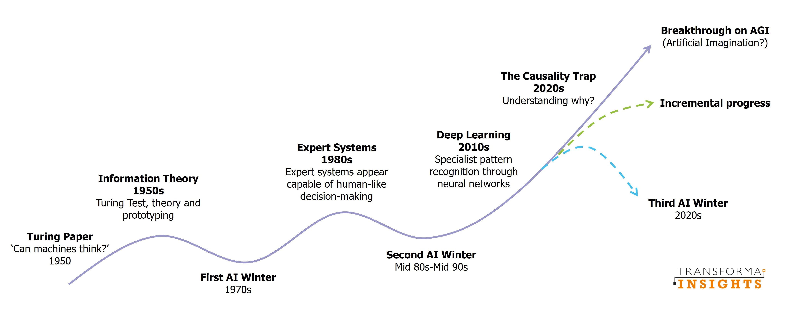
Does Anyone Remember the Last AI Winter?

Slide 7



The Importance of Driving Research Using Big Data
Bob Mercer, IBM Speech Research (1985):
“There is no data like more data.”
Dan Ariely, Duke University (2013):
“Big Data is like teenage sex: everyone talks about it,
nobody really knows how to do it,
everyone thinks everyone else is doing it,
so everyone claims they are doing it.”
Douglas Merrill, Zestfinance.com (2013):
“Given enough data, everything is statistically significant.”

Slide 8
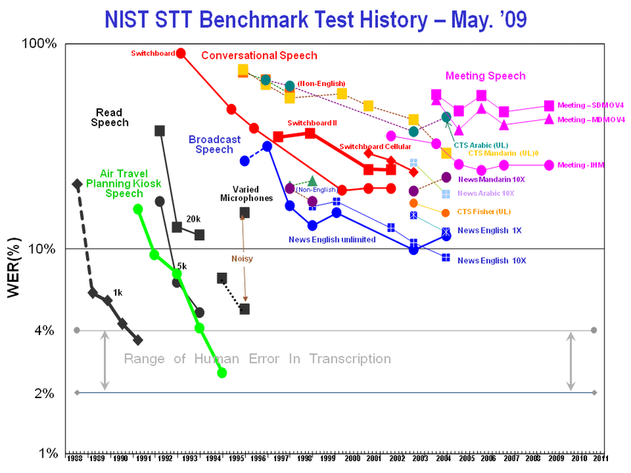
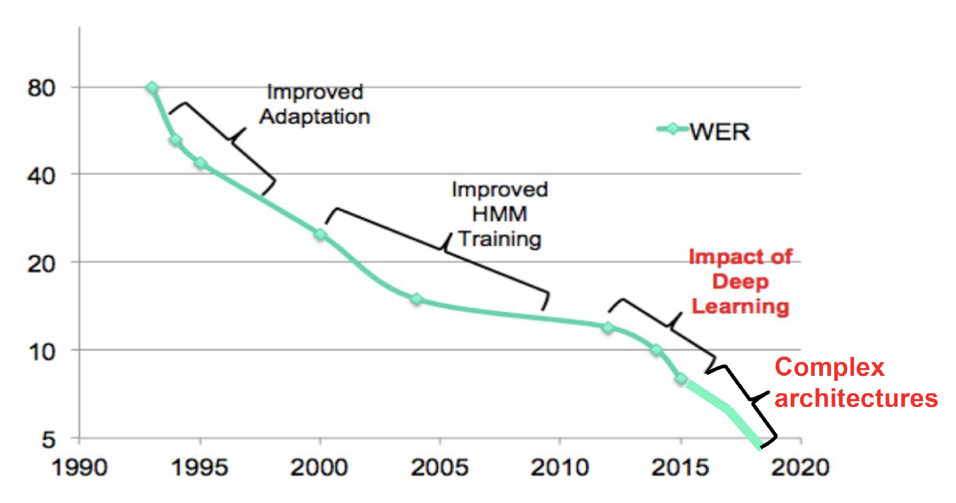
Speech Recognition Did Not Happen Overnight
Services like Siri and Alexa were overnight successes that were 50 years in the making…
The common evaluation paradigm in speech recognition dates back to the 1980’s when the first industry-wide speech recognition evaluation results were published.
The Linguistic Data Consortium was established by DoD in 1992 to provide human language technology data and resources to the community to drive research and standardize evaluation.

Slide 9
Generalization And Risk
How much trust can we place in
isolated data points?
What is the optimal decision surface?
Suppose you now receive two more data points?
The optimal decision surface is still a line, so this
new data is consistent with our current beliefs.
Next, you receive two more data points. What is the
optimal decision surface?
The optimal decision surface changes abruptly with
these two new data points. Is this a good thing?
In this course, we will study techniques that can easily drive the error rate to zero on the training data – referred to as overtraining. Is this the best classifier for previously unseen data?
We will see that the collection of data that accurately characterizes the problem, is critical:
“There is no data like more data.”
Some applications, particularly bioengineering, only have limited data. Some events, such as natural disasters (e.g. tsunamis), do not have more than a few data points.
For such applications, we must use model-based approaches (e.g. differential equations).
Can we integrate prior knowledge about the likelihood of each class, application constraints (e.g., N-gram frequencies, the grammar of a language or the physics of the real world) to make better decisions when faced with limited amounts of data?

Slide 10



Recognition or Understanding?
Which of these images are most scenic?
Half of the battle in building a machine learning system is understanding the requirements and developing data (e.g., annotated data) to support those requirements. We often iterate several times to get things ‘right’.
How can we develop a system to automatically determine scenic beauty? (Hint: feature combination)
Solutions to such problems require good feature extraction, good decision theory and good user interface engineering (e.g., Alexa).

Slide 11
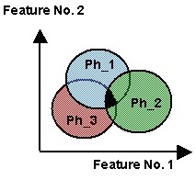
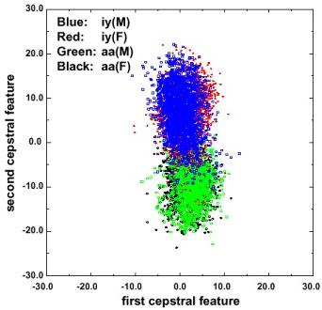
Traditional Model-Based Features Are Confusable
Regions of overlap represent the classification error
Error rates can be computed with knowledge of the joint probability distributions (see probability of error in transmission).
Context is used to reduce overlap.
In real problems, features are confusable and represent actual variation in the data.
The traditional role of the signal processing engineer has been to develop better features (e.g., “invariants”).

Slide 12
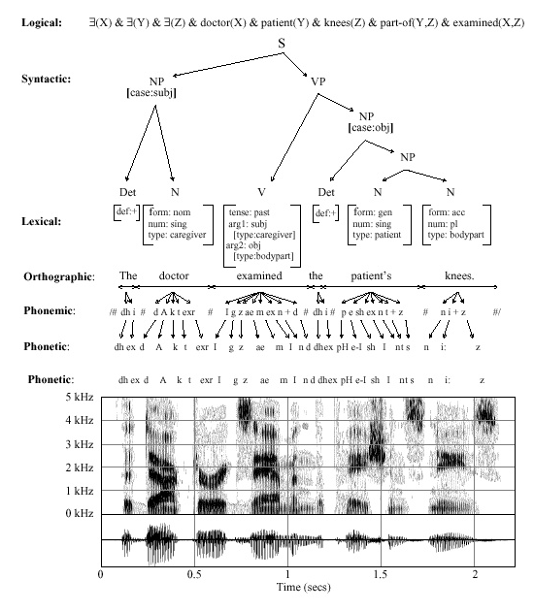
Classical Pattern Recognition: Problem Decomposition
Decision
Post-Processing
End-to-End Deep Learning
Classification
Feature Extraction
Segmentation
Sensing
Input

Slide 13
Common Mistakes Made By Novices
I got 100% accuracy on...
  Almost any algorithm works some of the time, but few real-world problems have ever been completely solved.
  Training on the evaluation data is forbidden.
  Once you use evaluation data, you should discard it.
My algorithm is better because...
  Statistical significance and experimental design play a big role in determining the validity of a result.
  There is always some probability a random choice of an algorithm will produce a better result.
Hence, in this course, we will also learn how to evaluate algorithms and quite a bit about experimental design.

Slide 14
Summary
Three fundamental rules of machine learning:
There is no data like more data.
Are your results statistically significant?
When you compare two algorithms, you must compare them on equal footing (e.g., same data, number of parameters, compute time, latency).
Pattern recognition vs. machine learning vs. machine understanding vs. statistics: significant overlap between these fields.
We will focus more on decision theory and less on feature extraction.
This course emphasizes statistical and data-driven methods for optimizing system design and parameter values.

Slide 15
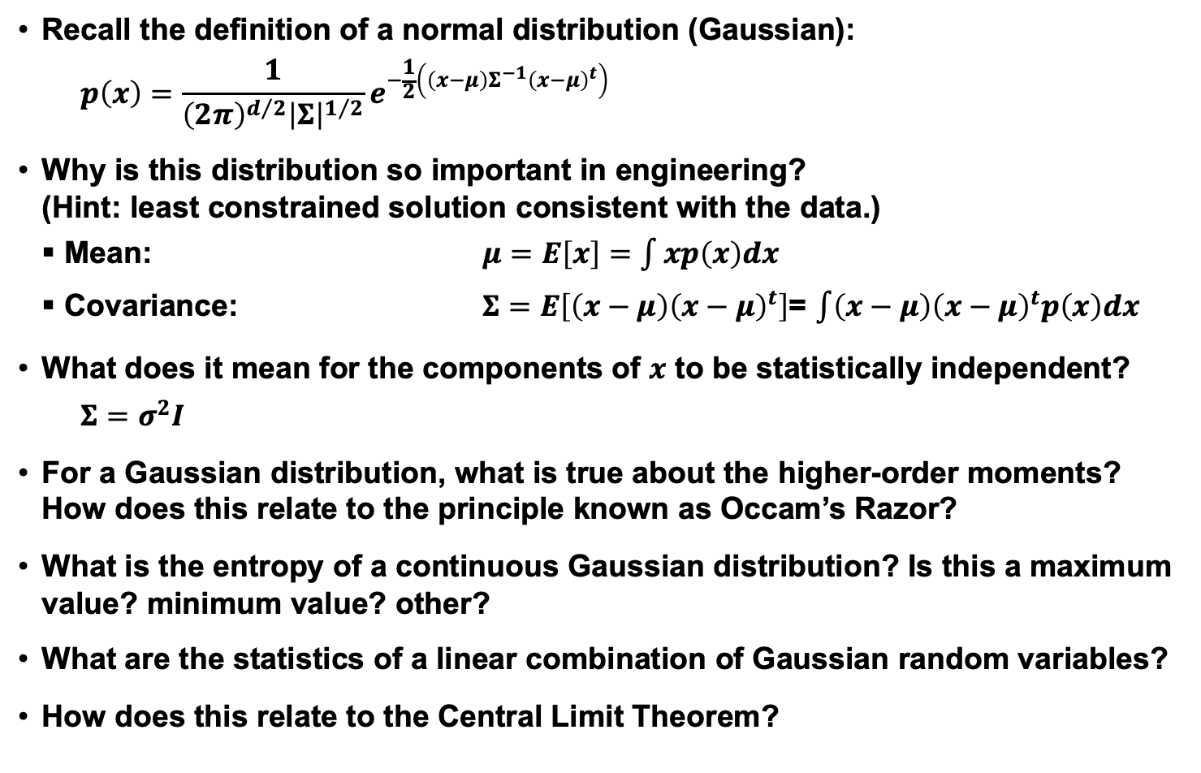
Review: Normal Distributions
Recall the definition of a normal distribution (Gaussian):
$$p\left(x\right)=\frac{1}{{\left(2π\right)}^{d/2}{\left|Σ\right|}^{1/2}}e^{−\frac{1}{2}\left(\left(x−μ\right)Σ^{−1}{\left(x−μ\right)}^{t}\right)}$$
Why is this distribution so important in engineering?
(Hint: least constrained solution consistent with the data.)
Mean: $μ=E\left[x\right]=\int{xp\left(x\right)dx}$
Covariance: $Σ=E\left[\left(x−μ\right){\left(x−μ\right)}^{t}\right]$= $\int{\left(x−μ\right){\left(x−μ\right)}^{t}p\left(x\right)dx}$
What does it mean for the components of $x$ to be statistically independent?
$$Σ=σ^{2}I$$
For a Gaussian distribution, what is true about the higher-order moments? How does this relate to the principle known as Occam’s Razor?
What is the entropy of a continuous Gaussian distribution? Is this a maximum value? minimum value? other?
What are the statistics of a linear combination of Gaussian random variables?
How does this relate to the Central Limit Theorem?

Slide 16
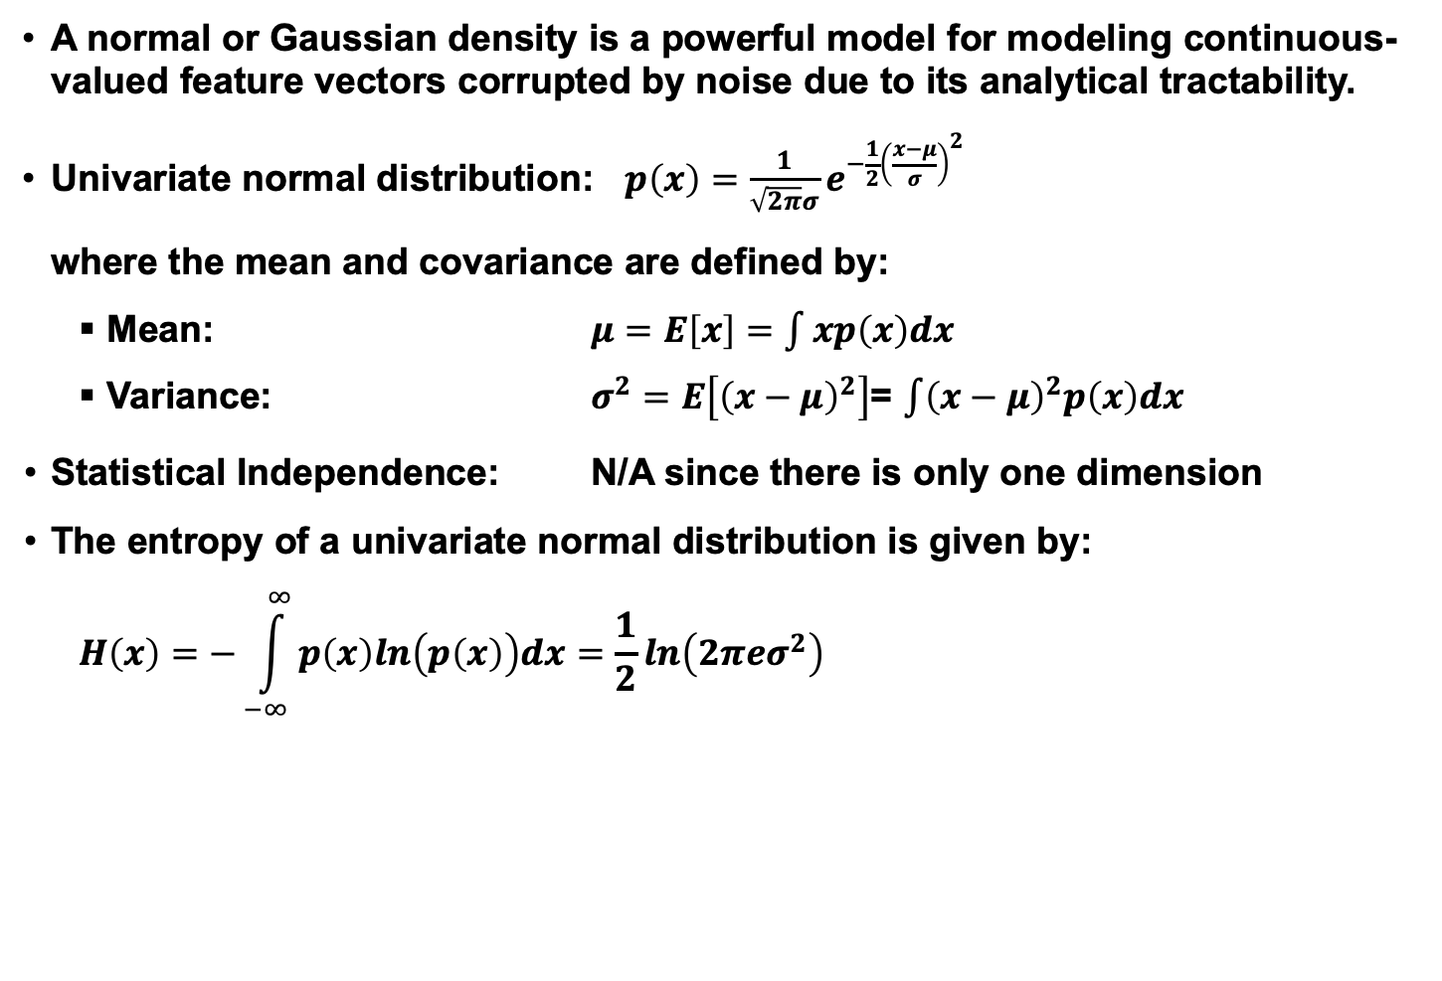
Review: Univariate Normal Distribution
A normal or Gaussian density is a powerful model for modeling continuous-valued feature vectors corrupted by noise due to its analytical tractability.
Univariate normal distribution: $p\left(x\right)=\frac{1}{\sqrt{2π}σ}e^{−\frac{1}{2}{\left(\frac{x−μ}{σ}\right)}^{2}}$
where the mean and covariance are defined by:
Mean: $μ=E\left[x\right]=\int{xp\left(x\right)dx}$
Variance: $σ^{2}=E\left[{\left(x−μ\right)}^{2}\right]$= $\int{{\left(x−μ\right)}^{2}p\left(x\right)dx}$
Statistical Independence: N/A since there is only one dimension
The entropy of a univariate normal distribution is given by:
$$H\left(x\right)=−\int_{−∞}^{∞}{p\left(x\right)ln\left(p\left(x\right)\right)dx=\frac{1}{2}ln\left(2π{eσ}^{2}\right)}$$

Slide 17
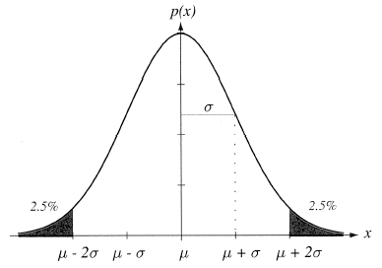

Review: Mean and Variance
A normal distribution is completely
specified by its mean and variance:
The peak is at: $p\left(μ\right)=\frac{1}{\left(\sqrt{2π}\right)σ}$ .
$66\%$ of the area is within one σ;
$95\%$ is within $2$; $99\%$ is within $3$.
A normal distribution achieves the
maximum entropy of all distributions
having a given mean and variance.
Central Limit Theorem: The sum of a
large number of small, independent random variables will lead to a Gaussian distribution.
Can you provide an intuitive explanation for this? (Hint: convolution.)

Slide 18
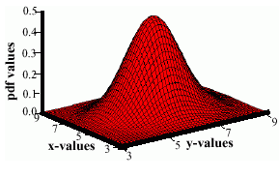
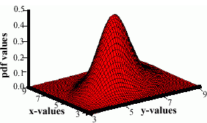
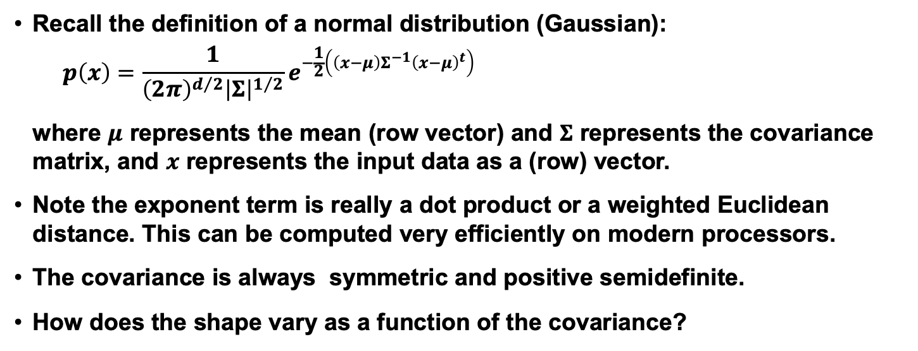
Review: Multivariate Normal Distributions
Recall the definition of a normal distribution (Gaussian):
$$p\left(x\right)=\frac{1}{{\left(2π\right)}^{d/2}{\left|Σ\right|}^{1/2}}e^{−\frac{1}{2}\left(\left(x−μ\right)Σ^{−1}{\left(x−μ\right)}^{t}\right)}$$
where $μ$ represents the mean (row vector) and $Σ$ represents the covariance matrix, and $x$ represents the input data as a (row) vector.
Note the exponent term is really a dot product or a weighted Euclidean distance. This can be computed very efficiently on modern processors.
The covariance is always symmetric and positive semidefinite.
How does the shape vary as a function of the covariance?

Slide 19
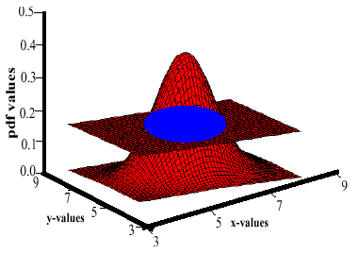
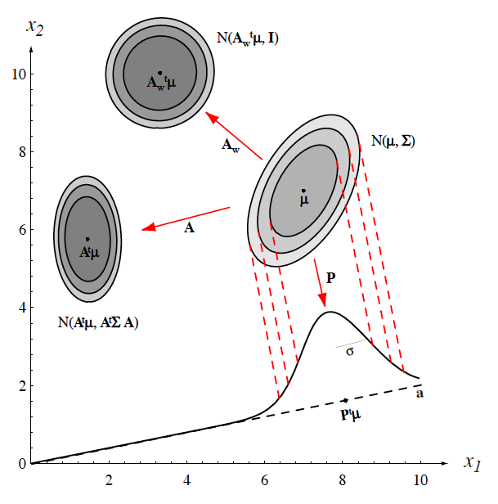
Review: Support Regions
The pdf of 2D random vector requires 3D to visualize (the third dimension is the value, or height, of the pdf).
We cannot directly visualize the pdf of a 3D random vector since this would require four dimensions. Also, it is difficult to visualize a 3D function and understand its shape.
A support region is the obtained from the intersection of a Gaussian distribution with a horizontal plane (the locus of points that the same probability).
For a horizontal plane, this generates an ellipse whose points are of equal probability density.
The shape of the support region is defined by the covariance matrix.

Slide 20
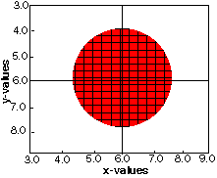
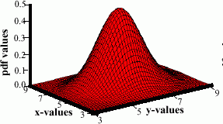
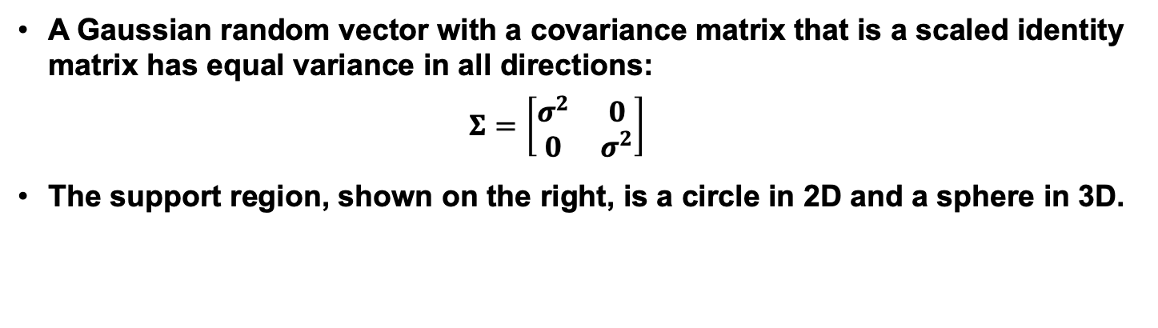
Review: Identity Covariance
A Gaussian random vector with a covariance matrix that is a scaled identity matrix has equal variance in all directions:
$$Σ=\left[\begin{matrix}σ^{2} & 0 \\ 0 & σ^{2}\end{matrix}\right]$$
The support region, shown on the right, is a circle in 2D and a sphere in 3D.

Slide 21
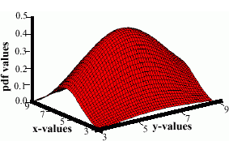
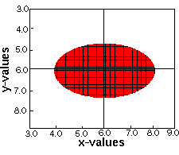
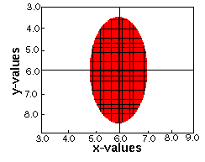
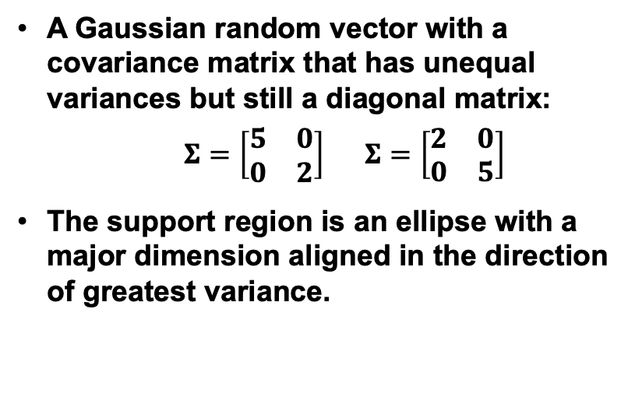
Review: Unequal Variances
A Gaussian random vector with a covariance matrix that has unequal variances but still a diagonal matrix:
$Σ=\left[\begin{matrix}5 & 0 \\ 0 & 2\end{matrix}\right]$ $Σ=\left[\begin{matrix}2 & 0 \\ 0 & 5\end{matrix}\right]$
The support region is an ellipse with a major dimension aligned in the direction of greatest variance.

Slide 22
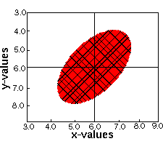
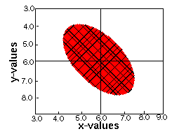
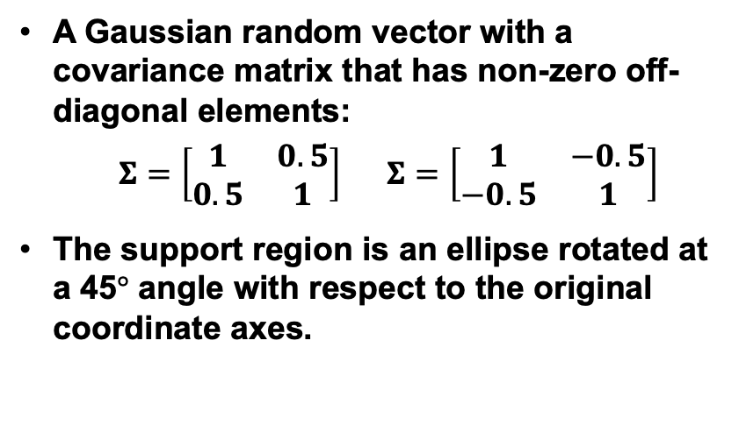
Review: Nonzero Off-Diagonal Elements
A Gaussian random vector with a covariance matrix that has non-zero off-diagonal elements:
$Σ=\left[\begin{matrix}1 & 0.5 \\ 0.5 & 1\end{matrix}\right]$ $Σ=\left[\begin{matrix}1 & −0.5 \\ −0.5 & 1\end{matrix}\right]$
The support region is an ellipse rotated at a 45$°$ angle with respect to the original coordinate axes.

Slide 23
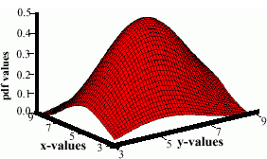
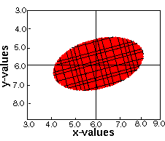
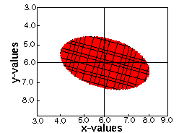
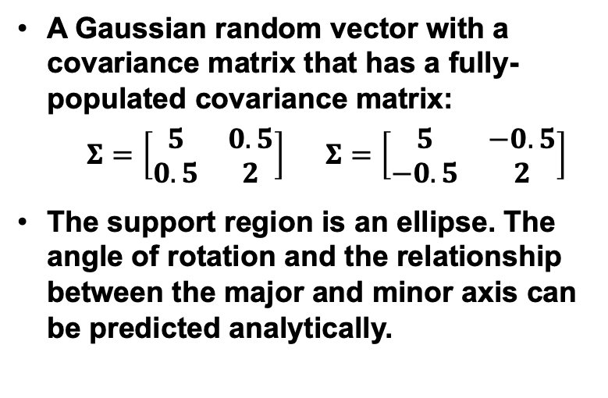
Review: Unconstrained or “Full” Covariance
A Gaussian random vector with a covariance matrix that has a fully-populated covariance matrix:
$Σ=\left[\begin{matrix}5 & 0.5 \\ 0.5 & 2\end{matrix}\right]$ $Σ=\left[\begin{matrix}5 & −0.5 \\ −0.5 & 2\end{matrix}\right]$
The support region is an ellipse. The angle of rotation and the relationship between the major and minor axis can be predicted analytically.

Slide 24
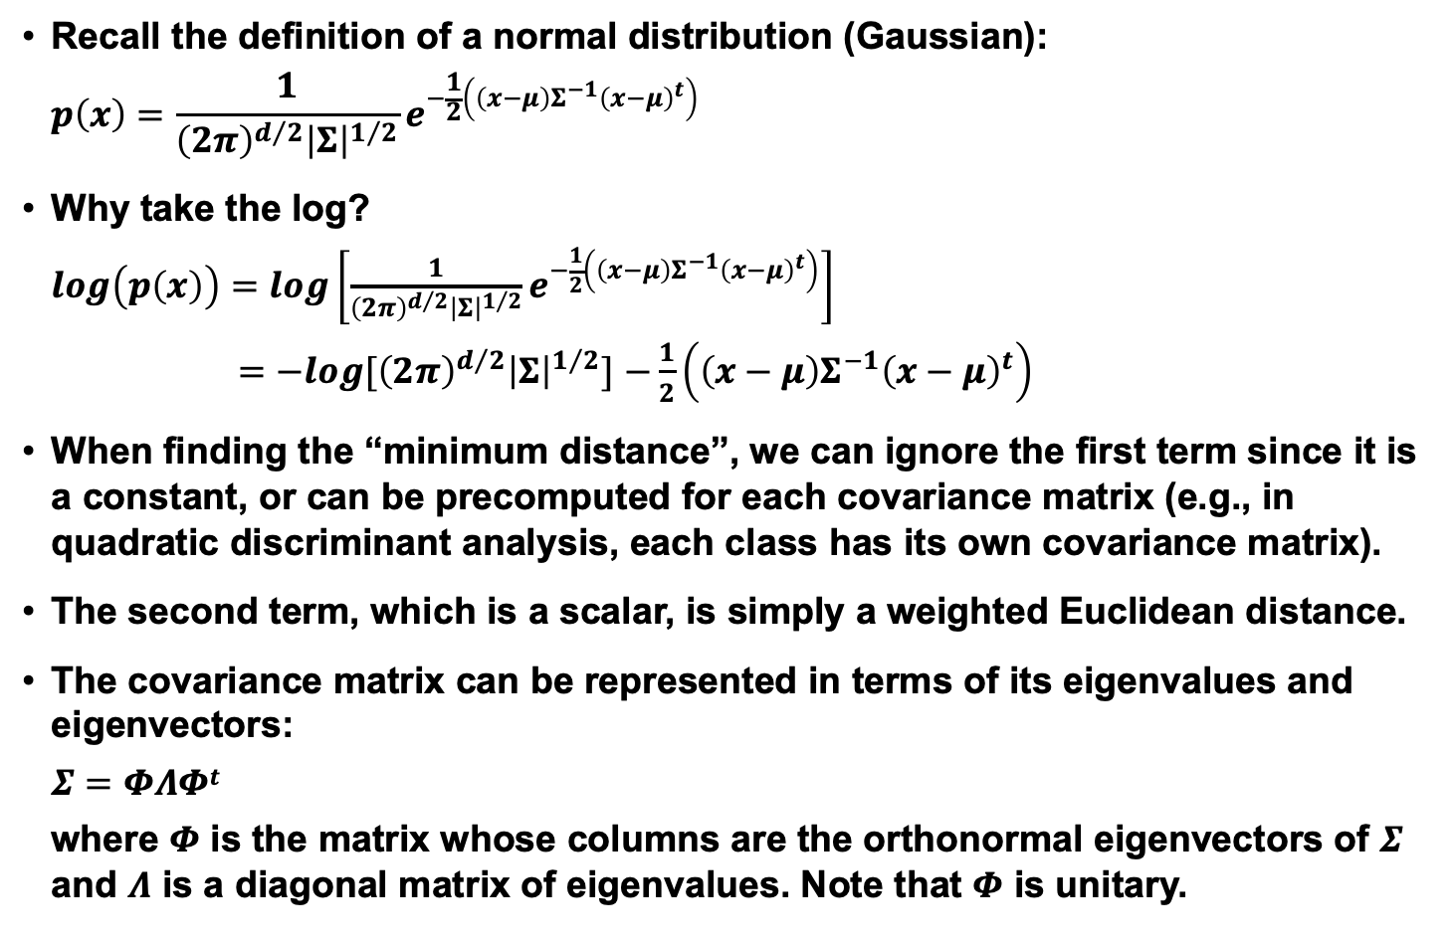
Review: Log Probabilities
Recall the definition of a normal distribution (Gaussian):
$$p\left(x\right)=\frac{1}{{\left(2π\right)}^{d/2}{\left|Σ\right|}^{1/2}}e^{−\frac{1}{2}\left(\left(x−μ\right)Σ^{−1}{\left(x−μ\right)}^{t}\right)}$$
Why take the log?
$log\left(p\left(x\right)\right)=log\left[\frac{1}{{\left(2π\right)}^{d/2}{\left|Σ\right|}^{1/2}}e^{−\frac{1}{2}\left(\left(x−μ\right)Σ^{−1}{\left(x−μ\right)}^{t}\right)}\right]$
$=−log[{\left(2π\right)}^{d/2}{\left|Σ\right|}^{1/2}]$ $−\frac{1}{2}\left(\left(x−μ\right)Σ^{−1}{\left(x−μ\right)}^{t}\right)$
When finding the “minimum distance”, we can ignore the first term since it is a constant, or can be precomputed for each covariance matrix (e.g., in quadratic discriminant analysis, each class has its own covariance matrix).
The second term, which is a scalar, is simply a weighted Euclidean distance.
The covariance matrix can be represented in terms of its eigenvalues and eigenvectors:
$$Σ=ΦΛΦt$$
where $Φ$ is the matrix whose columns are the orthonormal eigenvectors of $Σ$ and $Λ$ is a diagonal matrix of eigenvalues. Note that $Φ$ is unitary.

Slide 25
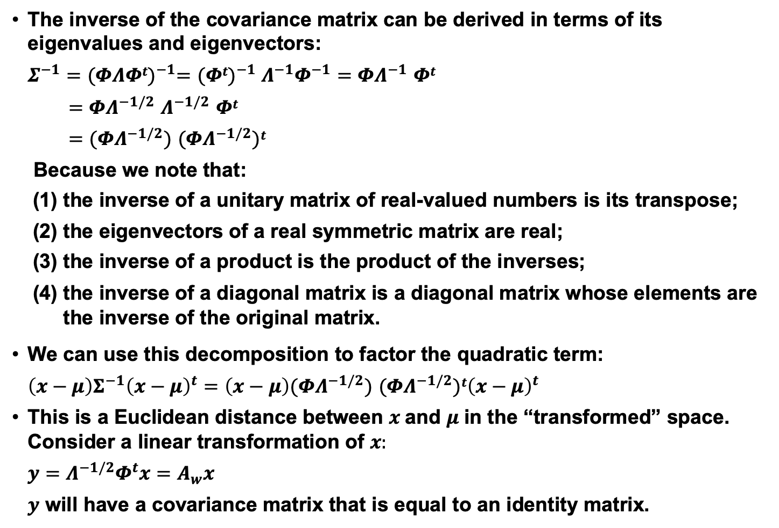
Review: Covariance Decomposition
The inverse of the covariance matrix can be derived in terms of its eigenvalues and eigenvectors:
$$Σ^{−1}={(ΦΛΦt)}^{−1}={(Φt)}^{−1} Λ^{−1}Φ^{−1}=ΦΛ^{−1} Φt$$
$$=ΦΛ^{−1/2} Λ^{−1/2} Φt$$
$=(ΦΛ^{−1/2})$ ${(ΦΛ}^{−1/2})t$
Because we note that:
the inverse of a unitary matrix of real-valued numbers is its transpose;
the eigenvectors of a real symmetric matrix are real;
the inverse of a product is the product of the inverses;
the inverse of a diagonal matrix is a diagonal matrix whose elements are the inverse of the original matrix.
We can use this decomposition to factor the quadratic term:
$\left(x−μ\right)Σ^{−1}{\left(x−μ\right)}^{t}=$ $\left(x−μ\right)(ΦΛ^{−1/2}) {(ΦΛ}^{−1/2})t{\left(x−μ\right)}^{t}$
This is a Euclidean distance between $x$and $μ$in the “transformed” space. Consider a linear transformation of $x:$
$$y=Λ^{−1/2}Φ^{t}x=A_{w}x$$
$y$ will have a covariance matrix that is equal to an identity matrix.

Slide 26
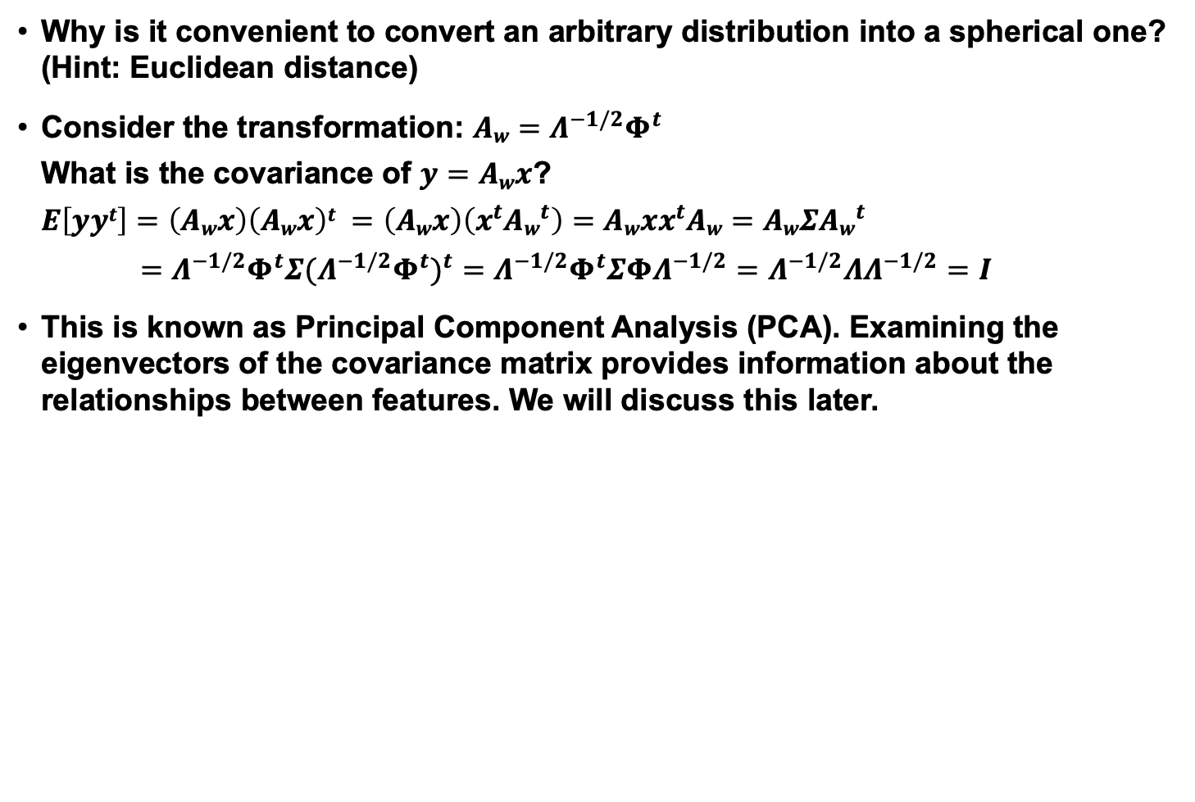
Review: Whitening Transformations
Why is it convenient to convert an arbitrary distribution into a spherical one? (Hint: Euclidean distance)
Consider the transformation: $Aw=Λ^{−1/2}Φ^{t}$
What is the covariance of $y=Awx$?
$E\left[yyt\right]=\left(Awx\right)\left(Awx\right)t =\left(Awx\right)\left({x^{t}Aw}^{t}\right)=Awxx^{t}Aw=AwΣ{Aw}^{t}$
$=Λ^{−1/2}Φ^{t}Σ{{(Λ}^{−1/2}Φ^{t})}^{t}=Λ^{−1/2}Φ^{t}ΣΦΛ^{−1/2}=Λ^{−1/2}ΛΛ^{−1/2}=I$
This is known as Principal Component Analysis (PCA). Examining the eigenvectors of the covariance matrix provides information about the relationships between features. We will discuss this later.

Slide 27
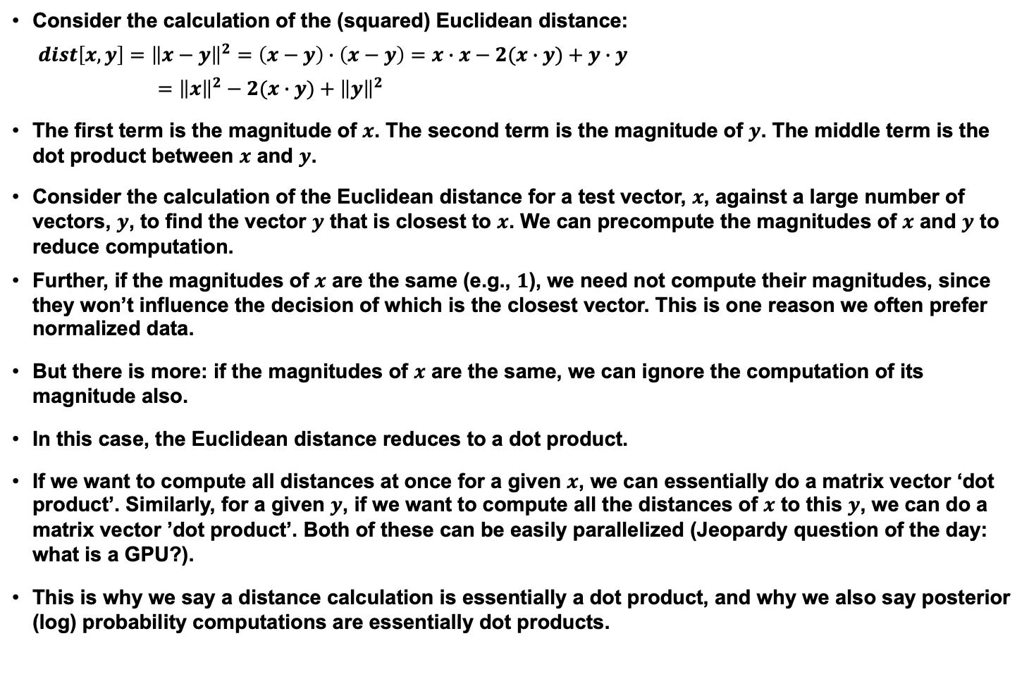
Review: Euclidean Distance and Dot Products
Consider the calculation of the (squared) Euclidean distance:
$dist\left[x,y\right]={\left\|x−y\right\|}^{2}=\left(x−y\right)∙\left(x−y\right)=x∙x−2(x∙y)+y∙y$
$$={\left\|x\right\|}^{2}−2(x∙y)+{\left\|y\right\|}^{2}$$
The first term is the magnitude of $x$. The second term is the magnitude of $y$. The middle term is the dot product between $x$ and $y$.
Consider the calculation of the Euclidean distance for a test vector, $x$, against a large number of vectors, $y$, to find the vector $y$ that is closest to $x$. We can precompute the magnitudes of $x$ and $y$ to reduce computation.
Further, if the magnitudes of $x$ are the same (e.g., $1$), we need not compute their magnitudes, since they won’t influence the decision of which is the closest vector. This is one reason we often prefer normalized data.
But there is more: if the magnitudes of $x$ are the same, we can ignore the computation of its magnitude also.
In this case, the Euclidean distance reduces to a dot product.
If we want to compute all distances at once for a given $x$, we can essentially do a matrix vector ‘dot product’. Similarly, for a given $y$, if we want to compute all the distances of $x$ to this $y$, we can do a matrix vector ’dot product’. Both of these can be easily parallelized (Jeopardy question of the day: what is a GPU?).
This is why we say a distance calculation is essentially a dot product, and why we also say posterior (log) probability computations are essentially dot products.

