Slide 1
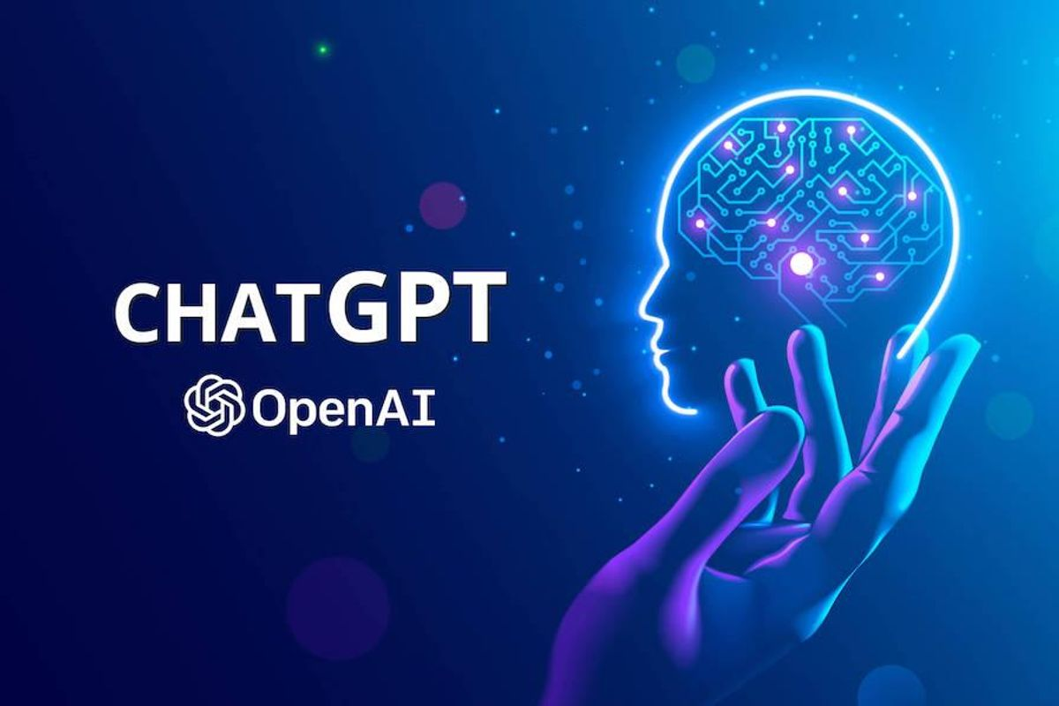
Lecture 42: Large Language Models and the ChatGPT Revolution
Objectives:
More About Attention
More About Transformers
More About Pretraining
More About Language Models
More… More… More…
Resources:
TowardsDataScience: How Does ChatGPT Work?
AssemblyAI: How ChatGPT Actually Works
TechTarget: What is GPT-3?
ScienceFocus: Everything you need to know about ChatGPT

Slide 2
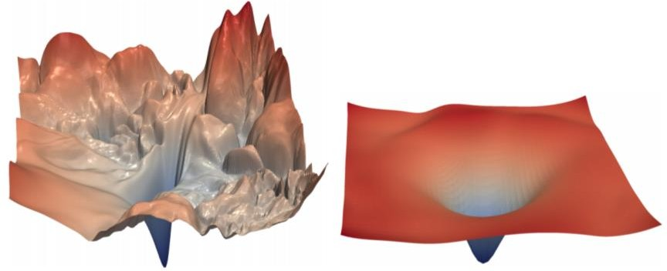
The Transformer Encoder: Residual connections [He et al., 2016]
Residual connections are a trick to help models train better.
Instead of 𝑋^{(𝑖)} = Layer(𝑋 ^{𝑖−1} ) (where 𝑖 represents the layer)
_{𝑋}(𝑖−1) _{𝑋}(𝑖)
Layer
We let 𝑋^{(𝑖)} = 𝑋^{(𝑖−1)} + Layer(𝑋 ^{𝑖−1} ) (so we only have to learn “the residual”
from the previous layer)
_{𝑋}(𝑖−1) _{𝑋}(𝑖)
Layer
+
Residual connections are thought to make the loss landscape considerably smoother (thus easier training!)
[no residuals] [residuals]
[Loss landscape visualization, Li et al., 2018, on a ResNet]
John Hewitt

Slide 3
The Transformer Encoder: Layer normalization [Ba et al., 2016]
Layer normalization is a trick to help models train faster.
Idea: cut down on uninformative variation in hidden vector values by normalizing to unit mean and standard deviation within each layer.
LayerNorm’s success may be due to its normalizing gradients [Xu et al., 2019]
Let 𝑥 ∈ ℝ^{𝑑} be an individual (word) vector in the model.
Let 𝜇 = Σ_{j=1}^{𝑑} 𝑥_{𝑗} ; this is the mean; 𝜇 ∈ ℝ.
1
𝑑
Σ^{d}
2
𝑥 − 𝜇 ; this is the standard deviation; 𝜎 ∈ ℝ.
Let 𝜎 =
Let 𝛾 ∈ ℝ^{𝑑} and 𝛽 ∈ ℝ^{𝑑} be learned “gain” and “bias” parameters. (Can omit!)
Then layer normalization computes:
𝑗=1
𝑗
𝑥 − 𝜇
∗ 𝛾 + 𝛽
output =
∗ 𝛾 + 𝛽
Modulate by learned elementwise gain and bias
𝜎 + 𝜖
Normalize by scalar mean and variance
Modulate by learned elementwise gain and bias
John Hewitt

Slide 4
The Transformer Encoder: Scaled Dot Product [Vaswani et al., 2017]
“Scaled Dot Product” attention is a final variation to aid in Transformer training.
When dimensionality 𝑑 becomes large, dot products between vectors become large, inputs to the softmax function can be large, making gradients small.
Instead of the self-attention function we’ve seen:
output_{𝑃} = softmax 𝑋𝑄_{𝑃}𝐾^{𝖳}𝑋^{𝖳} ∗ 𝑋𝑉_{𝑃}
𝑃
We divide the attention scores by 𝑑/ℎ, to stop the scores from becoming large
just as a function of 𝑑/ℎ (The dimensionality divided by the number of heads.)
output_{𝑃} = softmax
𝑋𝑄_{𝑃}𝐾^{𝖳}𝑋^{𝖳}
∗ 𝑋𝑉_{𝑃}
𝑃
𝑑/ℎ
John Hewitt

Slide 5
The Transformer Encoder-Decoder [Vaswani et al., 2017]
Looking back at the whole model, zooming in on an Encoder block:
[predictions!]
Transformer Encoder
Transformer Decoder
[decoder attends to encoder states]
Transformer
Encoder
Transformer Decoder
Word Embeddings
+
Position Representations
Word
Embeddings
+
Position
Representations
[input sequence]
[output sequence]
John Hewitt

Slide 6
The Transformer Encoder-Decoder [Vaswani et al., 2017]
Looking back at the whole model, zooming in on an Encoder block:
Transformer
Encoder
[predictions!]
Transformer Decoder
Residual + LayerNorm
[decoder attends to encoder states]
Feed-Forward
Residual + LayerNorm
Transformer Decoder
Multi-Head Attention
Word Embeddings
+
Position Representations
Word
Embeddings
+
Position
Representations
[input sequence]
[output sequence]
John Hewitt

Slide 7
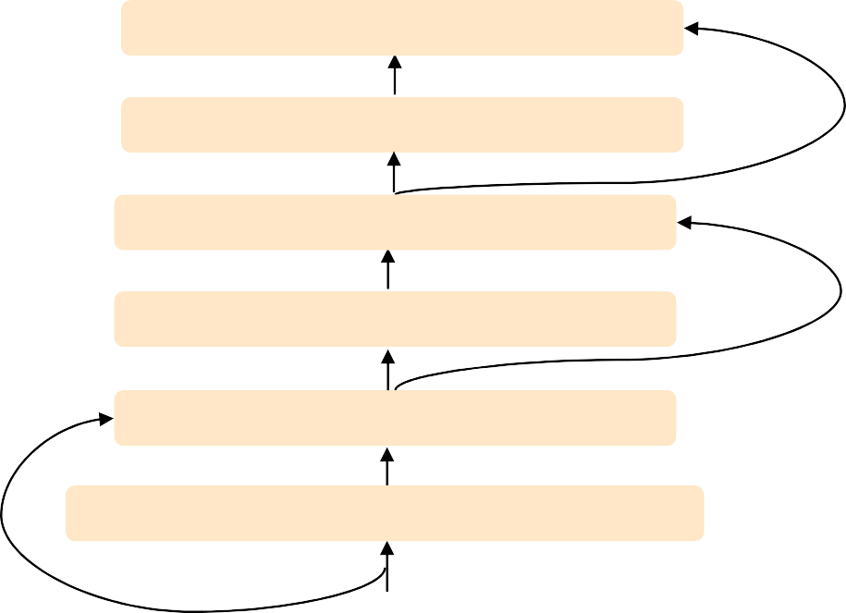
The Transformer Encoder-Decoder [Vaswani et al., 2017]
Looking back at the whole model, zooming in on a Decoder block:
Transformer Encoder
[predictions!]
Transformer Decoder
Residual + LayerNorm Feed-Forward Residual + LayerNorm
Multi-Head Cross-Attention Residual + LayerNorm
Masked Multi-Head Self-Attention
Transformer
Encoder
Word Embeddings
+
Position Representations
Word
Embeddings
+
Position
Representations
[input sequence]
[output sequence]
John Hewitt

Slide 8
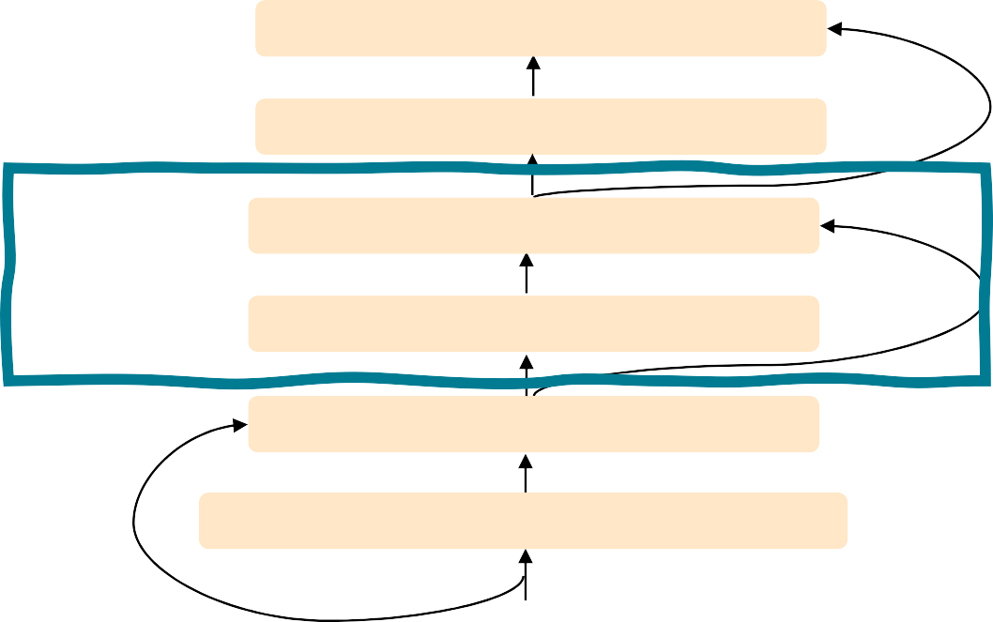
The Transformer Encoder-Decoder [Vaswani et al., 2017]
The only new part is attention from decoder to encoder. Like we saw in previous lecture!
Transformer Encoder
[predictions!]
Transformer Decoder
Residual + LayerNorm
Feed-Forward
Residual + LayerNorm Multi-Head Cross-Attention
Residual + LayerNorm
Masked Multi-Head Self-Attention
Transformer
Encoder
Word Embeddings
+
Position Representations
Word
Embeddings
+
Position
Representations
[input sequence]
[output sequence]
John Hewitt

Slide 9
The Transformer Decoder: Cross-attention (details)
We saw self-attention is when keys, queries, and values come from the same source.
In the decoder, we have attention that looks more like what we saw last week.
Let ℎ₁, … , ℎ_{𝑇} be output vectors from the Transformer encoder; 𝑥_{𝑖} ∈ ℝ^{𝑑}
Let 𝑧₁, … , 𝑧_{𝑇} be input vectors from the Transformer decoder, 𝑧_{𝑖} ∈ ℝ^{𝑑}
Then keys and values are drawn from the encoder (like a memory):
𝑘_{𝑖} = 𝐾ℎ_{𝑖}, 𝑣_{𝑖} = 𝑉ℎ_{𝑖}.
And the queries are drawn from the decoder, 𝑞_{𝑖} = 𝑄𝑧_{𝑖}.
John Hewitt

Slide 10
The Transformer Encoder: Cross-attention (details)
Let’s look at how cross-attention is computed, in matrices.
Let H = ℎ₁; … ; ℎ_{𝑇}
Let Z = 𝑧₁; … ; 𝑧_{𝑇}
∈ ℝ^{𝑇×𝑑} be the concatenation of encoder vectors.
∈ ℝ^{𝑇×𝑑} be the concatenation of decoder vectors.
𝖳
The output is defined as output = softmax 𝑍𝑄 𝐻𝐾 × 𝐻𝑉.
First, take the query-key dot products in one matrix
All pairs of attention scores!
= 𝑍𝑄𝐾^{𝖳} 𝐻^{𝖳}
𝖳
𝑍𝑄
multiplication: 𝑍𝑄 𝐻𝐾
_{𝐾}𝖳 _{𝐻}𝖳
𝑇×𝑇
∈ ℝ
Next, softmax, and compute the weighted average with another matrix multiplication.
softmax
𝑍𝑄𝐾^{𝖳} 𝐻^{𝖳}
𝐻𝑉
=
output ∈ ℝ^{𝑇×𝑑}
John Hewitt

Slide 11
Great Results with Transformers
Next, document generation!
The old standard
Transformers all the way down.
[Liu et al., 2018]; WikiSum dataset
John Hewitt

Slide 12
What would we like to fix about the Transformer?
Quadratic compute in self-attention:
Computing all pairs of interactions means our computation grows
quadratically with the sequence length!
For recurrent models, it only grew linearly!
Position representations:
Are simple absolute indices the best we can do to represent position?
Relative linear position attention [Shaw et al., 2018]
Dependency syntax-based position [Wang et al., 2019]
John Hewitt

Slide 13
Quadratic computation as function of seq. length
One of the benefits of self-attention over recurrence was that it’s highly
parallelizable.
However, its total number of operations grows as 𝑂 𝑇²𝑑 , where 𝑇 is the sequence length, and 𝑑 is the dimensionality.
= 𝑋𝑄𝐾^{𝖳} 𝑋^{𝖳}
Need to compute all pairs of interactions!
𝑂 𝑇²𝑑
𝑋𝑄
_{𝐾}𝖳 _{𝑋}𝖳
∈ ℝ
𝑇×𝑇
Think of 𝑑 as around 𝟏, 𝟎𝟎𝟎.
So, for a single (shortish) sentence, 𝑇 ≤ 30; 𝑇² ≤ 𝟗𝟎𝟎.
In practice, we set a bound like 𝑇 = 512.
But what if we’d like 𝑻 ≥ 𝟏𝟎, 𝟎𝟎𝟎? For example, to work on long documents?
John Hewitt

Slide 14
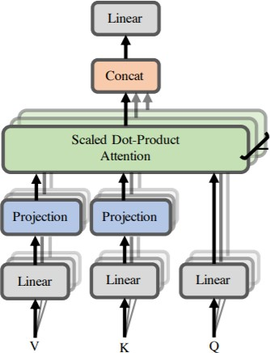
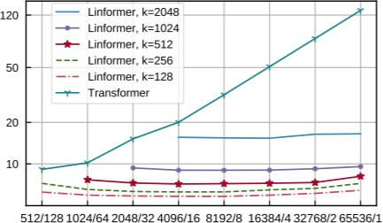
Recent work on improving on quadratic self-attention cost
Considerable recent work has gone into the question, Can we build models like
Transformers without paying the 𝑂 𝑇² all-pairs self-attention cost?
For example, Linformer [Wang et al., 2020]
Key idea: map the sequence length dimension to a lower- dimensional space for values, keys
Inference time (s)
Sequence length / batch size
John Hewitt

Slide 15
Recent work on improving on quadratic self-attention cost
Considerable recent work has gone into the question, Can we build models like
Transformers without paying the 𝑂 𝑇² all-pairs self-attention cost?
For example, BigBird [Zaheer et al., 2021]
Key idea: replace all-pairs interactions with a family of other interactions, like local windows, looking at everything, and random interactions.
John Hewitt

Slide 16
Pretraining models
In modern NLP:
All (or almost all) parameters in NLP
networks are initialized via pretraining.
Pretraining methods hide parts of the input from the model, and train the model to reconstruct those parts.
This has been exceptionally effective at building strong:
representations of language
parameter initializations for strong NLP
models.
𝒚
Pretrained jointly
… the movie was …
[This model has learned how to represent entire sentences through pretraining]
Adapted from John Hewitt

Slide 17
Pretraining through language modeling [Dai and Le, 2015]
Recall the language modeling task:
Model 𝑝_{𝜃} 𝑤_{𝑡} 𝑤_{1:𝑡−1}), the probability distribution over words given their past contexts.
There’s lots of data for this! (In English.)
goes
to
make
tasty
tea END
Decoder
(Transformer, LSTM, ++ )
Pretraining through language modeling:
Train a neural network to perform language modeling on a large amount of text.
Save the network parameters.
Iroh goes to
make
tasty tea
John Hewitt

Slide 18
The Pretraining / Finetuning Paradigm
Pretraining can improve NLP applications by serving as parameter initialization.
Step 1: Pretrain (on language modeling)
Lots of text; learn general things!
Step 2: Finetune (on your task)
Not many labels; adapt to the task!
goes to
make tasty tea END
☺/☹
Decoder
Decoder
(Transformer, LSTM, ++ )
(Transformer, LSTM, ++ )
Iroh
goes
to
make
tasty
tea
… the movie was …
John Hewitt

Slide 19
Capturing meaning via context: What kinds of things does pretraining learn?
There’s increasing evidence that pretrained models learn a wide variety of things about
the statistical properties of language:
Stanford University is located in , California. [Trivia]
I put fork down on the table. [syntax]
The woman walked across the street, checking for traffic over shoulder. [coreference]
I went to the ocean to see the fish, turtles, seals, and . [lexical semantics/topic]
Overall, the value I got from the two hours watching it was the sum total of the popcorn
and the drink. The movie was . [sentiment]
Iroh went into the kitchen to make some tea. Standing next to Iroh, Zuko pondered his destiny. Zuko left the . [some reasoning – this is harder]
I was thinking about the sequence that goes 1, 1, 2, 3, 5, 8, 13, 21, [some basic
arithmetic; they don’t learn the Fibonnaci sequence]
Models also learn – and can exacerbate racism, sexism, all manner of bad biases.
More on all this in the interpretability lecture!
Adapted from John Hewitt

Slide 20
Pretraining for three types of architectures
The neural architecture influences the type of pretraining, and natural use cases.
Language models! What we’ve seen so far.
Nice to generate from; can’t condition on future words
Decoders
Gets bidirectional context – can condition on future!
Wait, how do we pretrain them?
Encoders
Encoder- Decoders
Good parts of decoders and encoders?
What’s the best way to pretrain them?
John Hewitt

Slide 21
Pretraining decoders
When using language model pretrained decoders, we can ignore that they were trained to model 𝑝 𝑤_{𝑡} 𝑤_{1:𝑡−1}).
We can finetune them by training a classifier
on the last word’s hidden state.
☺/☹
Linear
𝐴, 𝑏
ℎ₁, … , ℎ_{𝑇}
ℎ₁, … , ℎ_{𝑇} = Decoder 𝑤₁, … , 𝑤_{𝑇}
𝑦 ∼ 𝐴𝑤_{𝑇} + 𝑏
Where 𝐴 and 𝑏 are randomly initialized and specified by the downstream task.
𝑤₁, … , 𝑤_{𝑇}
Gradients backpropagate through the whole network.
[Note how the linear layer hasn’t been
pretrained and must be learned from scratch.]
John Hewitt

Slide 22
Pretraining decoders
It’s natural to pretrain decoders as language models and then
use them as generators, finetuning their 𝑝_{𝜃}
^{𝑤}𝑡 ^{𝑤}1:𝑡−1^{)!}
This is helpful in tasks where the output is a sequence with a vocabulary like that at pretraining time!
Dialogue (context=dialogue history)
Summarization (context=document)
𝑤₂ 𝑤₃ 𝑤₄ 𝑤₅ 𝑤₆
𝐴, 𝑏
ℎ₁, … , ℎ_{𝑇}
ℎ₁, … , ℎ_{𝑇} = Decoder 𝑤₁, … , 𝑤_{𝑇}
𝑤_{𝑡} ∼ 𝐴𝑤_{𝑡−1} + 𝑏
𝑤₁ 𝑤₂ 𝑤₃ 𝑤₄ 𝑤₅
[Note how the linear layer has been pretrained.]
Where 𝐴, 𝑏 were pretrained in the language model!
John Hewitt

Slide 23
Generative Pretrained Transformer (GPT) [Radford et al., 2018]
2018’s GPT was a big success in pretraining a decoder!
Transformer decoder with 12 layers.
768-dimensional hidden states, 3072-dimensional feed-forward hidden layers.
Byte-pair encoding with 40,000 merges
Trained on BooksCorpus: over 7000 unique books.
Contains long spans of contiguous text, for learning long-distance dependencies.
The acronym “GPT” never showed up in the original paper; it could stand for
“Generative PreTraining” or “Generative Pretrained Transformer”
[Devlin et al., 2018]
John Hewitt

Slide 24
Generative Pretrained Transformer (GPT) [Radford et al., 2018]
How do we format inputs to our decoder for finetuning tasks?
Natural Language Inference: Label pairs of sentences as entailing/contradictory/neutral
Premise: The man is in the doorway
Hypothesis: The person is near the door
entailment
Radford et al., 2018 evaluate on natural language inference.
Here’s roughly how the input was formatted, as a sequence of tokens for the decoder.
[START] The man is in the doorway [DELIM] The person is near the door [EXTRACT]
The linear classifier is applied to the representation of the [EXTRACT] token.
John Hewitt

Slide 25
Generative Pretrained Transformer (GPT) [Radford et al., 2018]
GPT results on various natural language inference datasets.
John Hewitt

Slide 26
Increasingly convincing generations (GPT2) [Radford et al., 2018]
We mentioned how pretrained decoders can be used in their capacities as language models. GPT-2, a larger version of GPT trained on more data, was shown to produce relatively convincing samples of natural language.
John Hewitt

Slide 27
Aside: Word structure and subword models
Let’s take a look at the assumptions we’ve made about a language’s vocabulary.
We assume a fixed vocab of tens of thousands of words, built from the training set. All novel words seen at test time are mapped to a single UNK.
word hat learn
taaaaasty laern
vocab mapping pizza (index) tasty (index) UNK (index) UNK (index) UNK (index)
embedding
Common
words
Variations
misspellings
novel items
Transformerify
John Hewitt

Slide 28
Aside: Word structure and subword models
Finite vocabulary assumptions make even less sense in many languages.
Many languages exhibit complex morphology, or word structure.
The effect is more word types, each occurring fewer times.
Example: Swahili verbs can have hundreds of conjugations, each encoding a wide variety of information. (Tense, mood, definiteness, negation, information about the object, ++)
Here’s a small fraction of the
conjugations for ambia – to tell.
[Wiktionary]
John Hewitt

Slide 29
Aside: The byte-pair encoding algorithm
Subword modeling in NLP encompasses a wide range of methods for reasoning about structure below the word level. (Parts of words, characters, bytes.)
The dominant modern paradigm is to learn a vocabulary of parts of words (subword tokens).
At training and testing time, each word is split into a sequence of known subwords.
Byte-pair encoding is a simple, effective strategy for defining a subword vocabulary.
Start with a vocabulary containing only characters and an “end-of-word” symbol.
Using a corpus of text, find the most common adjacent characters “a,b”; add “ab” as a subword.
Replace instances of the character pair with the new subword; repeat until desired vocab size.
Originally used in NLP for machine translation; now a similar method (WordPiece) is used in pretrained
models.
[Sennrich et al., 2016, Wu et al., 2016]
John Hewitt

Slide 30
Aside: Word structure and subword models
Common words end up being a part of the subword vocabulary, while rarer words are split into (sometimes intuitive, sometimes not) components.
In the worst case, words are split into as many subwords as they have characters.
word
vocab mapping hat
learn
taa## aaa## sty la## ern## Transformer## ify
embedding
hat learn
taaaaasty laern
Common
words
Variations
misspellings
novel items
Transformerify
John Hewitt

Slide 31
Pretraining encoders: What pretraining objective to use?
So far, we’ve looked at language model pretraining. But encoders get bidirectional context, so we can’t do language modeling!
Idea: replace some fraction of words in the input with a special [MASK] token; predict these words.
store
𝐴, 𝑏
ℎ₁, … , ℎ_{𝑇}
went
ℎ₁, … , ℎ_{𝑇} = Encoder 𝑤₁, … , 𝑤_{𝑇}
𝑦_{𝑖} ∼ 𝐴𝑤_{𝑖} + 𝑏
Only add loss terms from words that are “masked out.” If 𝑥 ’ is the masked version of 𝑥, we’re learning 𝑝_{𝜃}(𝑥|𝑥’ ). Called Masked LM.
I [M] to the [M]
[Devlin et al., 2018]
John Hewitt

Slide 32
BERT: Bidirectional Encoder Representations from Tranformers
Devlin et al., 2018 proposed the “Masked LM” objective and released the weights of a pretrained Transformer, a model they labeled BERT.
Some more details about Masked LM for BERT:
Predict a random 15% of (sub)word tokens.
Replace input word with [MASK] 80% of the time
Replace input word with a random token 10% of the time
Leave input word unchanged 10% of the time (but still predict it!)
Why? Doesn’t let the model get complacent and not build strong representations of non-masked words. (No masks are seen at fine-tuning time!)
[Predict these!]
went to
Transformer Encoder
store
I pizza to the [M]
[Replaced]
[Not replaced]
[Masked]
[Devlin et al., 2018]
John Hewitt

Slide 33
BERT: Bidirectional Encoder Representations from Tranformers
Mask out k% of the input words, and then predict the masked words
They always use k = 15%
store
↑
gallon
↑
the man went to the [MASK] to buy a [MASK] of milk
Too little masking: Too expensive to train
Too much masking: Not enough context
Christopher Manning

Slide 34
BERT: Bidirectional Encoder Representations from Tranformers
Additional task: Next sentence prediction
To learn relationships between sentences, predict whether Sentence B is actual sentence that proceeds Sentence A, or a random sentence
Adapted from Christopher Manning

Slide 35
BERT: Bidirectional Encoder Representations from Tranformers
The pretraining input to BERT was two separate contiguous chunks of text:
In addition to masked input reconstruction, BERT was trained to predict whether one chunk follows the other or is randomly sampled.
Later work has argued this “next sentence prediction” is not necessary.
[Devlin et al., 2018, Liu et al., 2019]
Adapted from John Hewitt

Slide 36
BERT: Bidirectional Encoder Representations from Tranformers
Details about BERT
Two models were released:
BERT-base: 12 layers, 768-dim hidden states, 12 attention heads, 110 million params.
BERT-large: 24 layers, 1024-dim hidden states, 16 attention heads, 340 million params.
Trained on:
BooksCorpus (800 million words)
English Wikipedia (2,500 million words)
Pretraining is expensive and impractical on a single GPU.
BERT was pretrained with 64 TPU chips for a total of 4 days.
(TPUs are special tensor operation acceleration hardware)
Finetuning is practical and common on a single GPU
“Pretrain once, finetune many times.”
[Devlin et al., 2018]
John Hewitt

Slide 37
BERT: Bidirectional Encoder Representations from Tranformers
BERT was massively popular and hugely versatile; finetuning BERT led to new state-of- the-art results on a broad range of tasks.
QQP: Quora Question Pairs (detect paraphrase questions)
QNLI: natural language inference over question answering data
SST-2: sentiment analysis
CoLA: corpus of linguistic acceptability (detect whether sentences are grammatical.)
STS-B: semantic textual similarity
MRPC: microsoft paraphrase corpus
RTE: small natural language inference corpus
John Hewitt
[Devlin et al., 2018]

Slide 38
Extensions of BERT
You’ll see a lot of BERT variants like RoBERTa, SpanBERT, +++
Some generally accepted improvements to the BERT pretraining formula:
RoBERTa: mainly just train BERT for longer and remove next sentence prediction!
SpanBERT: masking contiguous spans of words makes a harder, more useful pretraining task
It’s
bly
irr##
esi## sti## bly
BERT
SpanBERT
[MASK]
irr##
esi##
sti## [MASK] good
It’
[MASK] [MASK] [MASK] [MASK]
good
[Liu et al., 2019; Joshi et al., 2020]
John Hewitt

Slide 39
Extensions of BERT
A takeaway from the RoBERTa paper: more compute, more data can improve pretraining even when not changing the underlying Transformer encoder.
[Liu et al., 2019; Joshi et al., 2020]
John Hewitt

Slide 40
Pretraining encoder-decoders: What pretraining objective to use?
What Raffel et al., 2018 found to work best was span corruption. Their model: T5.
Replace different-length spans from the input with unique placeholders; decode out the spans that were removed!
This is implemented in text preprocessing: it’s still an objective that looks like language modeling at the decoder side.
John Hewitt

Slide 41
Pretraining encoder-decoders: What pretraining objective to use?
A fascinating property of T5: it can be finetuned to answer a wide range of questions, retrieving knowledge from its parameters.
NQ: Natural Questions WQ: WebQuestions TQA: Trivia QA
220 million params
770 million params
3 billion params
11 billion params
All “open-domain”
versions
[Raffel et al., 2018]
John Hewitt

Slide 42
GPT-3, in-context learning, very large models
So far, we’ve interacted with pretrained models in two ways:
Sample from the distributions they define (maybe providing a prompt)
Fine-tune them on a task we care about, and take their predictions.
Very large language models seem to perform some kind of learning without gradient steps simply from examples you provide within their contexts.
GPT-3 is the canonical example of this. The largest T5 model had 11 billion parameters.
GPT-3 has 175 billion parameters.
John Hewitt

Slide 43
GPT-3, in-context learning, very large models
Very large language models seem to perform some kind of learning without gradient steps simply from examples you provide within their contexts.
The in-context examples seem to specify the task to be performed, and the conditional distribution mocks performing the task to a certain extent.
Input (prefix within a single Transformer decoder context):
“
thanks -> merci hello -> bonjour mint -> menthe otter -> ”
Output (conditional generations):
loutre…”
John Hewitt

Slide 44
GPT-3, in-context learning, very large models
Very large language models seem to perform some kind of learning without gradient steps simply from examples you provide within their contexts.
John Hewitt

Slide 45
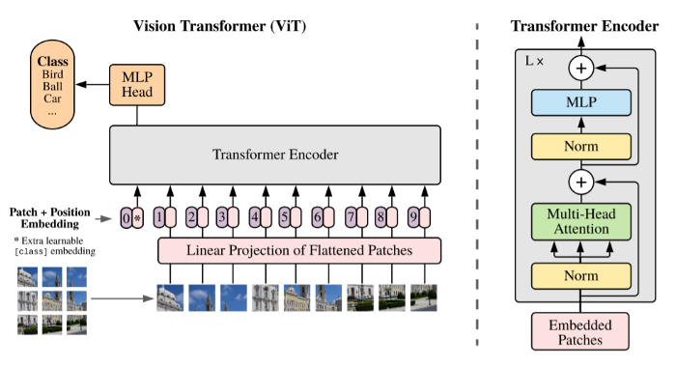
Transformers in vision
Dosovitskiy, ICLR 2021, https://github.com/google-research/vision_transformer
https://www.youtube.com/watch?v=TrdevFK_am4

Slide 46
Cross-modal transformers
Chen et al., “UNITER: Learning UNiversal Image-TExt Representations”, arxiv 2019

Slide 47
Cross-modal transformers
Lu et al., “ViLBERT: Pretraining Task-Agnostic Visiolinguistic Representations for Vision-and-Language Tasks”, NeurIPS 2019

Slide 48
Cross-modal transformers
Tan and Bansal, “LXMERT: Learning Cross-Modality Encoder Representationsfrom Transformers”, EMNLP 2019

Slide 49
Visual Commonsense Reasoning leaderboard
https://visualcommonsense.com/leaderboard/

Slide 50
Cost of training
ULMfit Jan 2018
Training: 1 GPU day
GPT
June 2018 Training
240 GPU days
BERT Oct 2018
Training
256 TPU days
~320–560
GPU days
GPT-2 Feb 2019
Training
~2048 TPU v3
days according to a reddit thread
Christopher Manning

