Slide 1
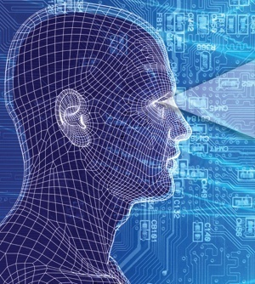
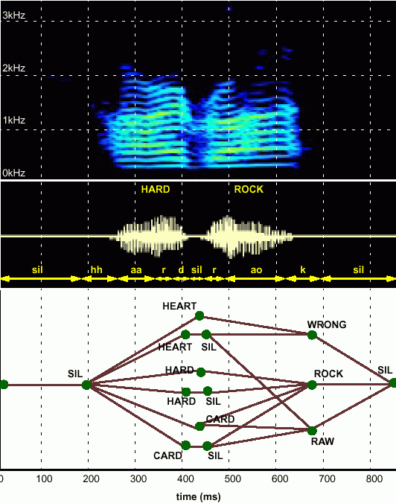
Lecture 41: Human Language Technology
(Sequential Decoding)
From Bits to Blogs
Joseph Picone, PhD
Professor
Department of Electrical and Computer Engineering
Temple University
URL:

Slide 2
Fundamental Challenges: Generalization and Risk
What makes the development of human language technology so difficult?
“In any natural history of the human species, language would stand out as the preeminent trait.”
“For you and I belong to a species with a remarkable trait: we can shape events in each other’s brains with exquisite precision.”
S. Pinker, The Language Instinct: How the Mind Creates Language, 1994
Some fundamental challenges:
Diversity of data, much of which defies simple mathematical descriptions or physical constraints (e.g., Internet data).
Too many unique problems to be solved (e.g., 6,000 language, billions of speakers, thousands of linguistic phenomena).
Generalization and risk are fundamental challenges (e.g., how much can we rely on sparse data sets to build high performance systems).
Underlying technology is applicable to many application domains:
Fatigue/stress detection, acoustic signatures (defense, homeland security);
EEG/EKG and many other biological signals (biomedical engineering);
Open source data mining, real-time event detection (national security).

Slide 3
Abstract
What makes machine understanding of human language so difficult?
“In any natural history of the human species, language would stand out as the preeminent trait.”
“For you and I belong to a species with a remarkable trait: we can shape events in each other’s brains with exquisite precision.”
S. Pinker, The Language Instinct: How the Mind Creates Language, 1994
In this presentation, we will:
Discuss the complexity of the language problem in terms of three key engineering approaches: statistics, signal processing and machine learning.
Introduce the basic ways in which we process language by computer.
Discuss some important applications that continue to drive the field (commercial and defense/homeland security).

Slide 4
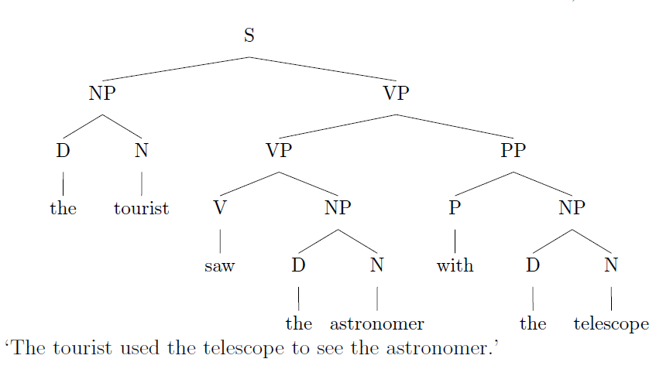
Language Defies Conventional Mathematical Descriptions
According to the Oxford English Dictionary, the 500 words used most in the English language each have an average of 23 different meanings. The word “round,” for instance, has 70 distinctly different meanings.
(J. Gray, http://www.gray-area.org/Research/Ambig/#SILLY )
Are you smarter than a 5th grader?
“The tourist saw the astronomer on the hill with a telescope.”
Hundreds of linguistic phenomena we must take into account to understand written language.
Each can not always be perfectly identified (e.g., Microsoft Word)
95% x 95% x … = a small number
D. Radev, Ambiguity of Language
Is SMS messaging even a language? “y do tngrs luv 2 txt msg?”

Slide 5
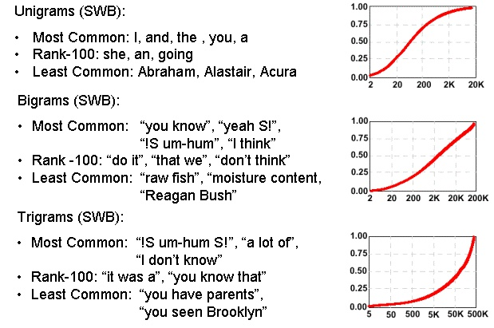
Communication Depends on Statistical Outliers
A small percentage of words constitute a large percentage of word tokens used in conversational speech:
Conventional statistical approaches are based on average behavior (means) and deviations from this average behavior (variance).
Consider the sentence:
“Show me all the web pages about Franklin Telephone in Oktoc County.”
Key words such as “Franklin” and “Oktoc” play a significant role in the meaning of the sentence.
What are the prior probabilities of these words?
Consequence: the prior probability of just about any meaningful sentence is close to zero. Why?

Slide 6
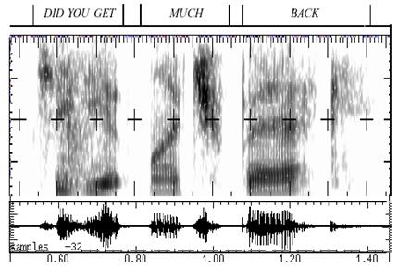
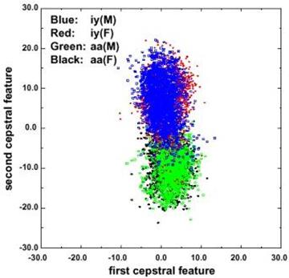
Fundamental Challenges in Spontaneous Speech
Common phrases experience significant reduction (e.g., “Did you get” becomes “jyuge”).
Approximately 12% of phonemes and 1% of syllables are deleted.
Robustness to missing data is a critical element of any system.
Linguistic phenomena such as coarticulation produce significant overlap in the feature space.
Decreasing classification error rate requires increasing the amount of linguistic context.
Modern systems condition acoustic probabilities using units ranging from phones to multiword phrases.

Slide 7
Human Performance is Impressive
Human performance exceeds machine performance by a factor ranging from 4x to 10x depending on the task.
On some tasks, such as credit card number recognition, machine performance exceeds humans due to human memory retrieval capacity.
The nature of the noise is as important as the SNR (e.g., cellular phones).
A primary failure mode for humans is inattention.
A second major failure mode is the lack of familiarity with the domain (i.e., business terms and corporation names).
Word Error Rate
20%
Wall Street Journal (Additive Noise)
15%
Machines
10%
5%
Human Listeners (Committee)
0%
10 dB
16 dB
22 dB
Quiet
Speech-To-Noise Ratio

Slide 8

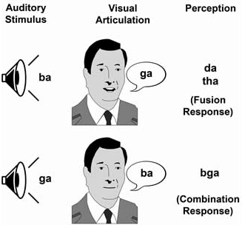
Human Performance is Robust
Cocktail Party Effect: the ability to focus one’s listening attention on a single talker among a mixture of conversations and noises.
McGurk Effect: visual cues of a cause a shift in perception of a sound, demonstrating multimodal speech perception.
Sound localization is enabled by our binaural hearing, but also involves cognition.
Suggests that audiovisual integration mechanisms in speech take place rather early in the perceptual process.

Slide 9
Human Language Technology (HLT)
Audio Processing:
Speech Coding/Compression (mpeg)
Text to Speech Synthesis (voice response systems)
Pattern Recognition / Machine Learning:
Language Identification (defense)
Speaker Identification (biometrics for security)
Speech Recognition (automated operator services)
Natural Language Processing (NLP):
Entity/Content Extraction (ask.com, cuil.com)
Summarization and Gisting (CNN, defense)
Machine Translation (Google search)
Integrated Technologies:
Real-time Speech to Speech Translation (videoconferencing)
Multimodal Speech Recognition (automotive)
Human Computer Interfaces (tablet computing)
All technologies share a common technology base: machine learning.

Slide 10
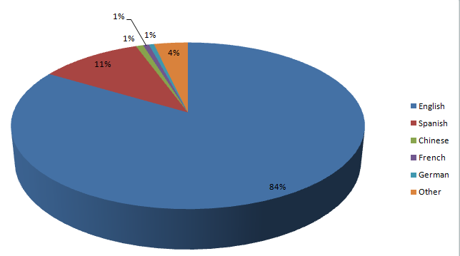
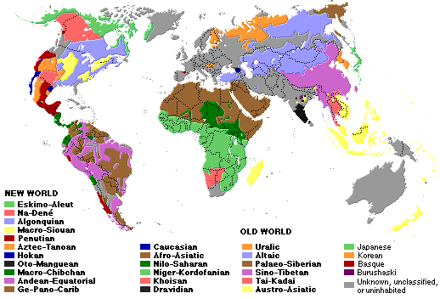
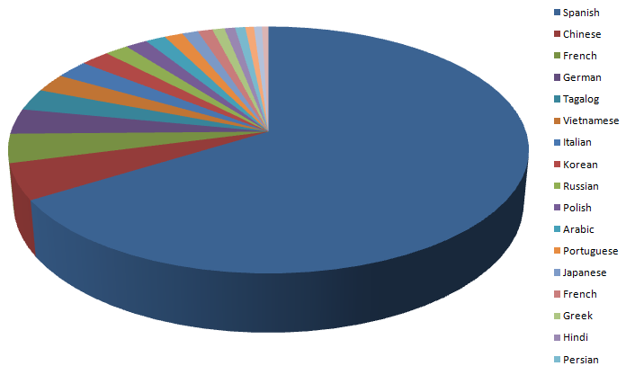
The World’s Languages
There are over 6,000 known languages in the world.
The dominance of English is being challenged by growth in Asian and Arabic languages.
Common languages are used to facilitate communication; native languages are often used for covert communications.
U.S. 2000 Census
Non-English Languages

Slide 11
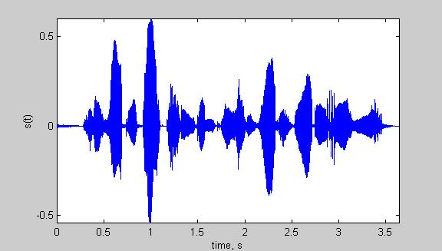
Speech Recognition Architectures
Core components of modern speech recognition systems:
Transduction: conversion of an electrical or acoustic signal to a digital signal;
Feature Extraction: conversion of samples to vectors containing the salient information;
Acoustic Model: statistical representation of basic sound patterns (e.g., hidden Markov models);
Language Model: statistical model of common words or phrases (e.g., N-grams);
Search: finding the best hypothesis for the data using an optimization procedure.
Input
Speech
Acoustic
Front-end
Acoustic Models
P(A/W)
Language Model
P(W)
Search
Recognized Utterance

Slide 12
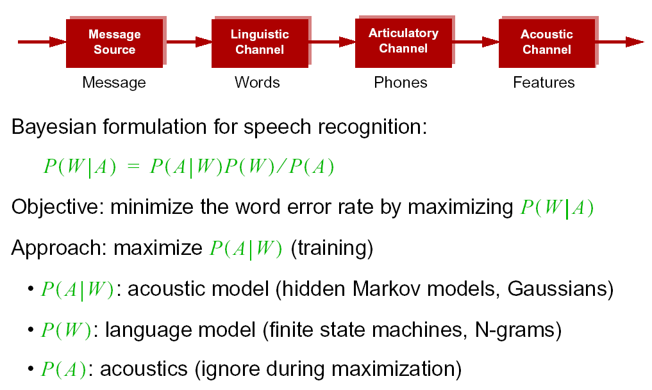
Statistical Approach: Noisy Communication Channel Model

Slide 13
Speech Recognition Overview
Based on a noisy communication channel
model in which the intended message is
corrupted by a sequence of noisy models
Bayesian approach is most common:
Objective: minimize word error rate by
maximizing P(W|A)
P(A|W): Acoustic Model
P(W): Language Model
P(A): Evidence (ignored)
Acoustic models use hidden Markov
models with Gaussian mixtures.
P(W) is estimated using probabilistic
N-gram models.
Parameters can be trained using generative (ML)
or discriminative (e.g., MMIE, MCE, or MPE) approaches.
Input
Speech
Feature
Extraction
Acoustic
Front-end
Acoustic Models
P(A/W)
Language Model
P(W)
Search
Recognized Utterance

Slide 14
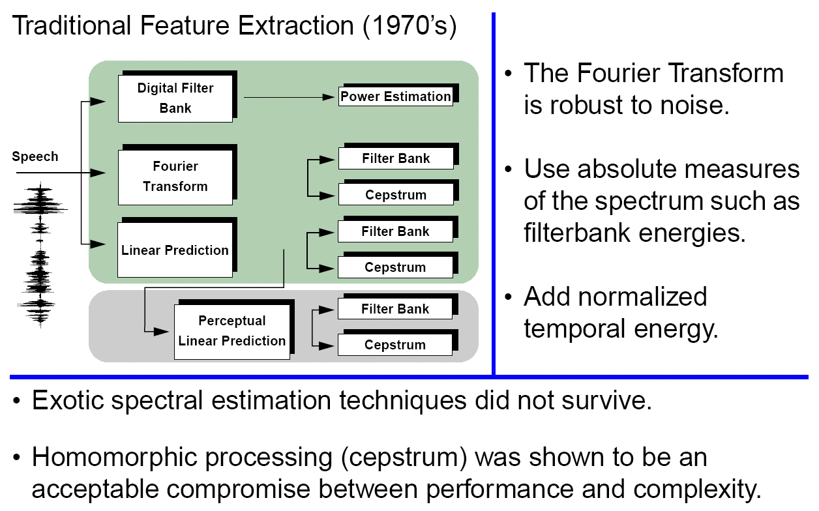
Signal Processing in Speech Recognition

Slide 15
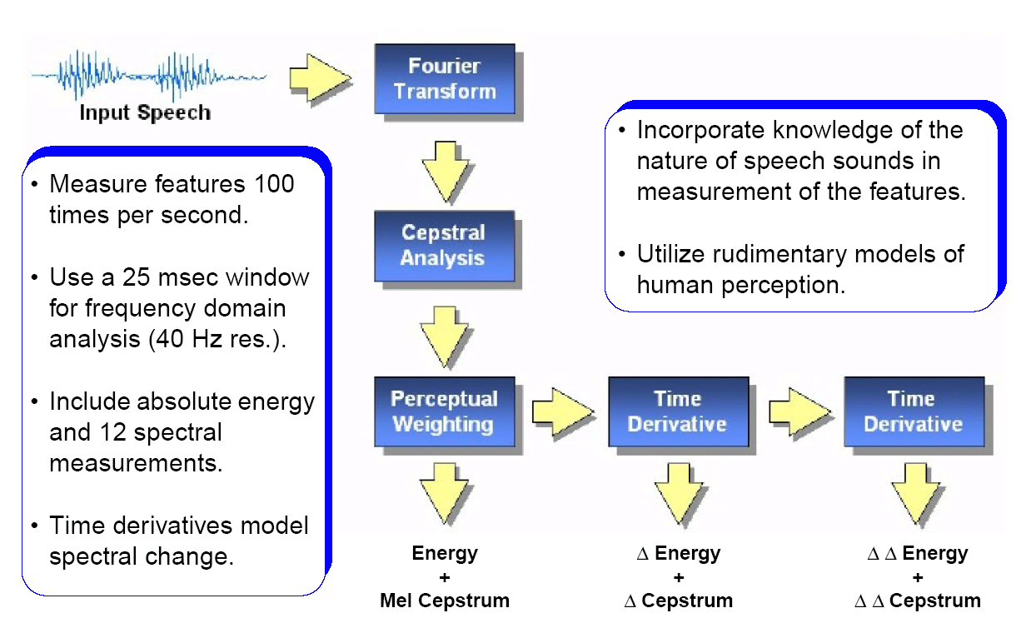
Features: Convert a Signal to a Sequence of Vectors

Slide 16
iVectors: Towards Invariant Features
The i-vector representation is a data-driven approach for feature extraction that provides a general framework for separating systematic variations in the data, such as channel, speaker and language.
The feature vector is modeled as a sum of three (or more) components:
M = m + Tw + ε
where M is the supervector, m is a universal background model, ε is a noise term, and w is the target low-dimensional feature vector.
M is formed as a concatenation of consecutive feature vectors.
This high-dimensional feature vector is then mapped into a low-dimensional space using factor analysis techniques such as Linear Discriminant Analysis (LDA).
The dimension of T can be extremely large (~20,000 x 100), but the dimension of the resulting feature vector, w, is on the order of a traditional feature vector (~50).
The i-Vector representation has been shown to give significant reductions (20% relative) in EER on speaker/language identification tasks.

Slide 17
Speech Recognition Overview
Based on a noisy communication channel
model in which the intended message is
corrupted by a sequence of noisy models
Bayesian approach is most common:
Objective: minimize word error rate by
maximizing P(W|A)
P(A|W): Acoustic Model
P(W): Language Model
P(A): Evidence (ignored)
Acoustic models use hidden Markov
models with Gaussian mixtures.
P(W) is estimated using probabilistic
N-gram models.
Parameters can be trained using generative (ML)
or discriminative (e.g., MMIE, MCE, or MPE) approaches.
Input
Speech
Acoustic
Front-end
Research Focus
Acoustic Models
P(A/W)
Language Model
P(W)
Search
Recognized Utterance

Slide 18
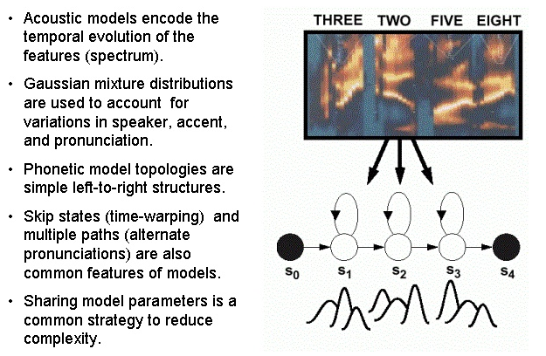
Acoustic Models: Capture the Time-Frequency Evolution

Slide 19
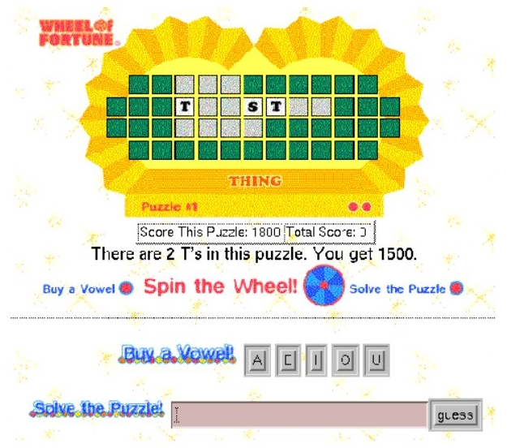
Language Modeling: Word Prediction

Slide 20
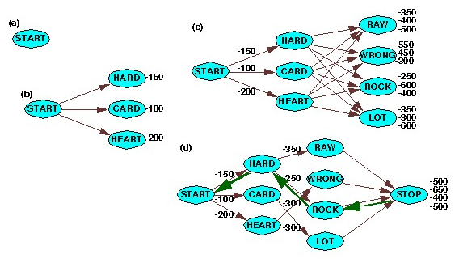
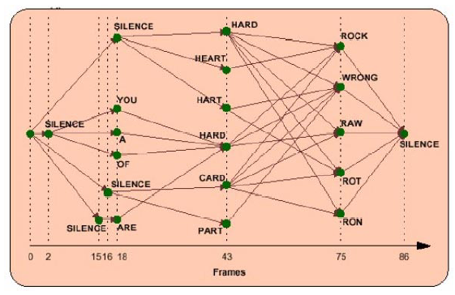
Search: Finding the Best Path
breadth-first
time synchronous
beam pruning
supervision
word prediction
natural language

Slide 21


Information Retrieval From Voice Enables Analytics
Speech Activity Detection
“What is the number one complaint of my customers?”
Gender Identification
Language Identification
Speaker Identification
Keyword Search
Speech to Text
Relationship
Analysis
Entity
Extraction
Relational Database

Slide 22


Content-Based Searching
Once the underlying data is analyzed and “marked up” with metadata that reveals content such as language and topic, search engines can match based on meaning.
Such sites make use several human language technologies and allow you to search multiple types of media (e.g., audio tracks of broadcast news).
This is an emerging area for the next generation Internet.

Slide 23
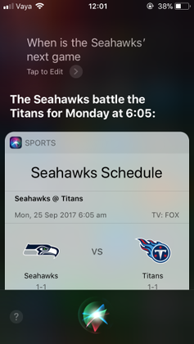
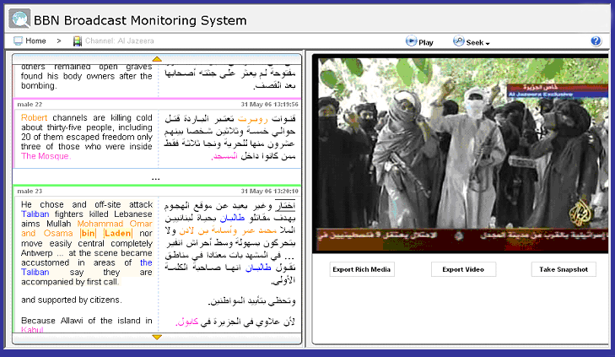
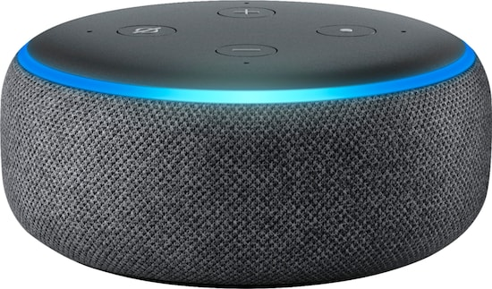
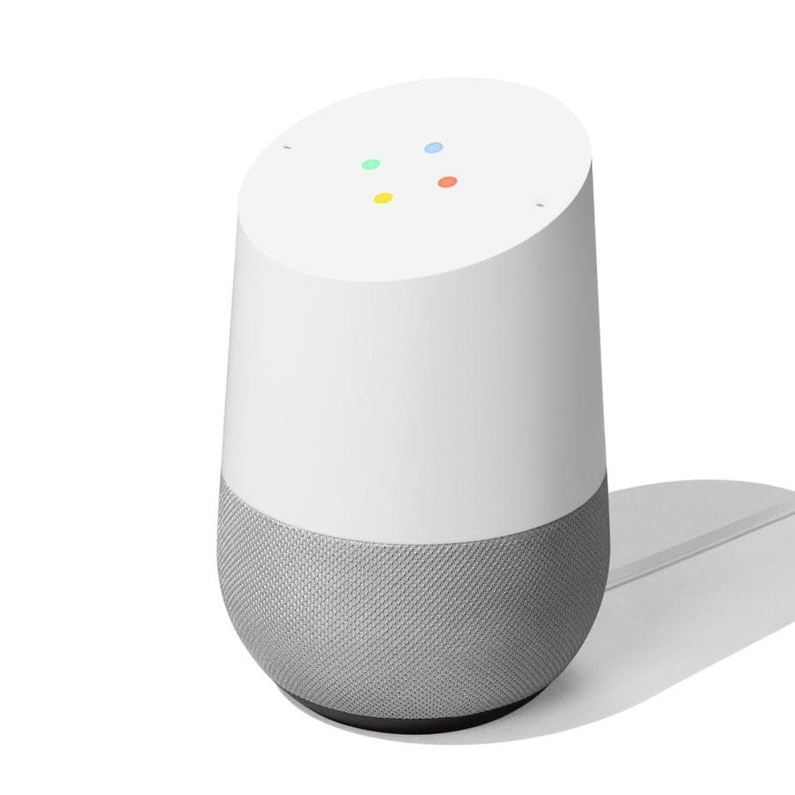
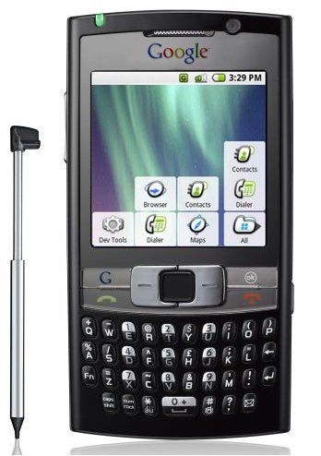
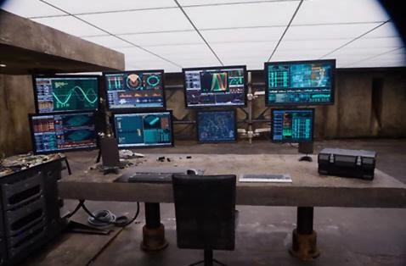
Applications Continually Find New Uses for the Technology
Siri, Alexis, Google Home are excellent examples of how to leverage imperfect technology
Real-time translation of news broadcasts in multiple languages
Google search using voice queries
Keyword search of audio and video
Real-time speech translation in 150 languages
Monitoring of communications networks for military and homeland security applications

Slide 24
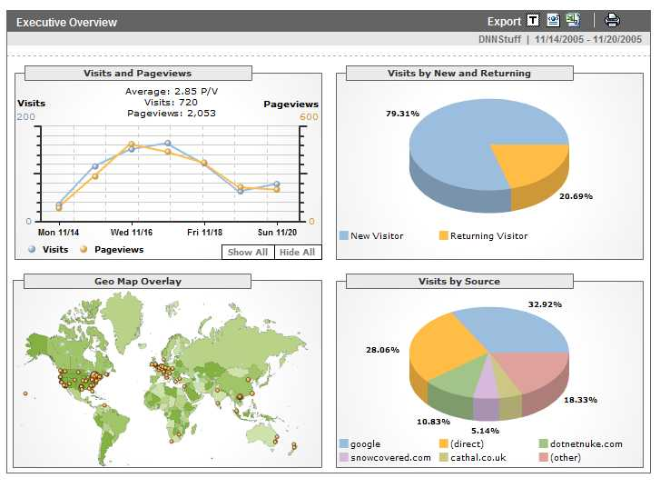
Analytics
Definition: A tool or process that allows an entity (i.e., business) arrive at an optimal or realistic decision based on existing data. (Wiki).
Google is building a highly
profitable business around
analytics derived from people
using its search engine.
Any time you access a web page,
you are leaving a footprint of
yourself, particularly with respect
to what you like to look at.
This has allows advertisers to tailor
their ads to your personal interests
by adapting web pages to your
habits.
Web sites such as amazon.com, netflix.com and pandora.com have taken this concept of personalization to the next level.
As people do more browsing from their telephones, which are now GPS enabled, an entirely new class of applications is emerging that can track your location, your interests and your network of “friends.”

Slide 25
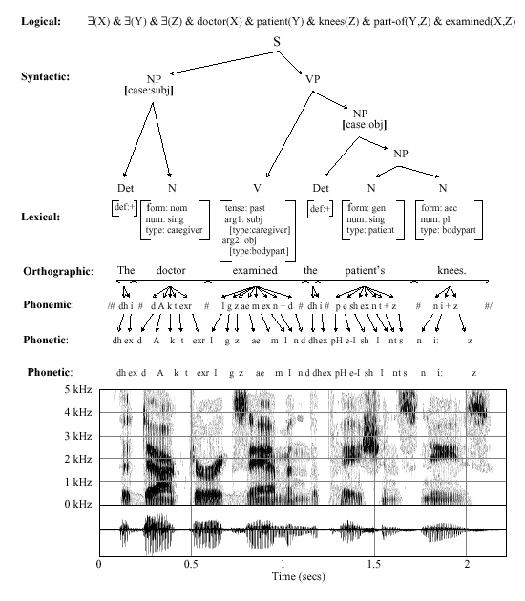
Speech Recognition is Information Extraction
Traditional Output:
  best word sequence
  time alignment of information
Other Outputs:
  word graphs
  N-best sentences
  confidence measures
  metadata such as speaker identity, accent, and prosody
Applications:
  Information localization
  data mining
  emotional state
  stress, fatigue, deception

Slide 26
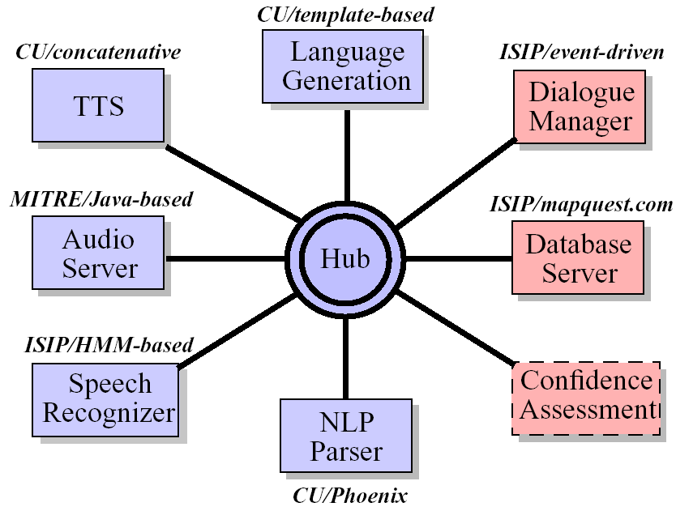
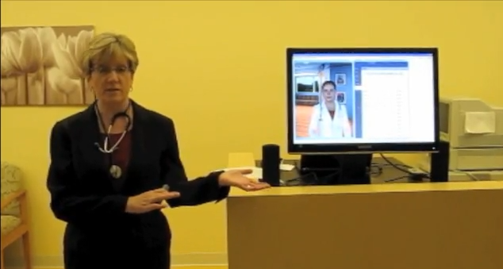
Dialog Systems
DARPA Communicator architecture
Extendable distributed processing architecture
Frame-based dialog manager
Open-source speech recognition
Goal: combine the best of all research systems to assess
state of the art
Dialog systems for involve speech recognition, speech synthesis, avatars, and even gesture and emotion recognition
Avatars increasingly lifelike
But… systems tend to be application-specific

Slide 27


Future Directions
How do we get better?
Supervised transcription is slow, expensive and limited. Unsupervised learning on large amounts of data is viable.
More data, more data, more data…
YouTube is opening new possibilities
Courtroom and governmental
proceedings are providing significant
amounts of parallel text
Google???
But this type of data is imperfect…
… and learning algorithms are still very primitive
And neuroscience has yet to inform our learning algorithms!

Slide 28
Brief Bibliography of Related Research
S. Pinker, The Language Instinct: How the Mind Creates Language, William Morrow and Company, New York, New York, USA, 1994.
F. Juang and L.R. Rabiner, “Automatic Speech Recognition - A Brief History of the Technology,” Elsevier Encyclopedia of Language and Linguistics, 2nd Edition, 2005.
M. Benzeghiba, et al., “Automatic Speech Recognition and Speech Variability, A Review,” Speech Communication, vol. 49, no. 10-11, pp. 763–786, October 2007.
B.J. Kroger, et al., “Towards a Neurocomputational Model of Speech Production and Perception,” Speech Communication, vol. 51, no. 9, pp. 793-809, September 2009.
B. Lee, “The Biological Foundations of Language”, available at http://www.duke.edu/~pk10/language/neuro.htm (a review paper).
M. Gladwell, Blink: The Power of Thinking Without Thinking, Little, Brown and Company, New York, New York, USA, 2005.

