Slide 1
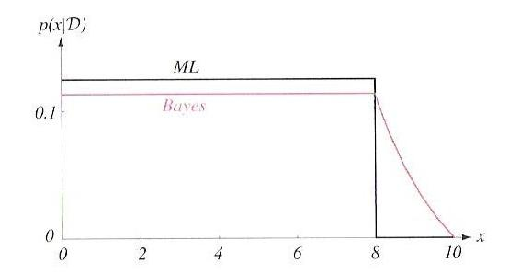
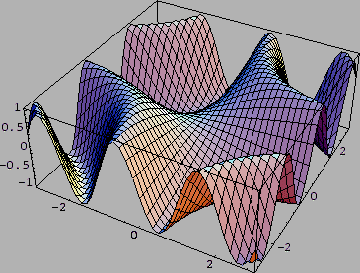
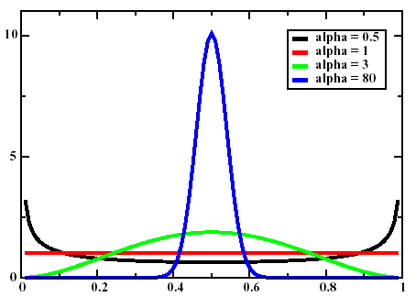
Lecture 09: Bayesian Learning
• Objectives:
Bayesian Estimation (Review)
Example: Multivariate Gaussians
General Bayesian Solutions
Recursive Learning
Comparison to Maximum Likelihood
Resources:
DHS: Chapter 3 (Part 5)
J.O.S.: Bayesian Parameter Estimation
A.K.: The Holy Trinity
A.E.: Bayesian Methods
J.H.: Euro Coin

Slide 2
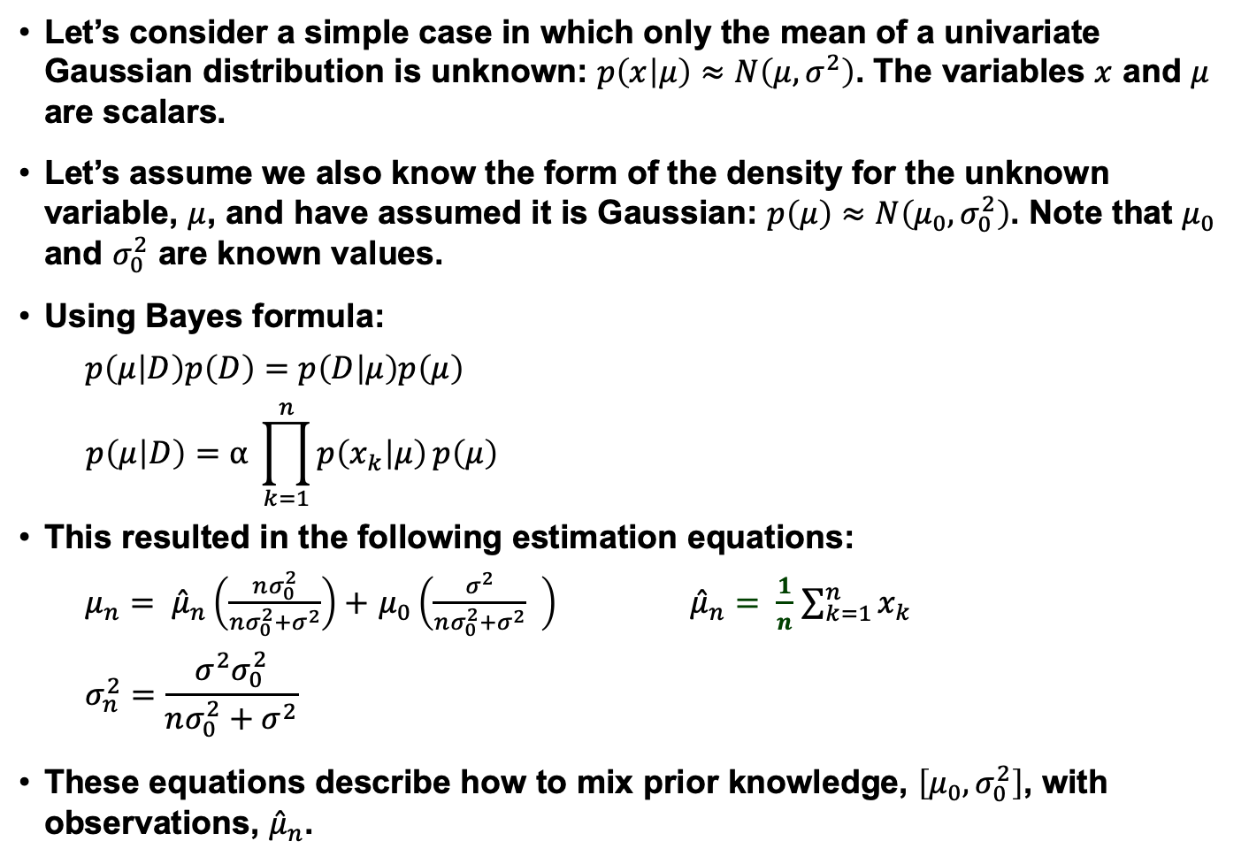
Univariate Gaussian Case
Let’s consider a simple case in which only the mean of a univariate Gaussian distribution is unknown: $p\left(x | μ\right)≈N\left(μ,σ^{2}\right)$. The variables $x$ and $μ$ are scalars.
Let’s assume we also know the form of the density for the unknown variable, $μ$, and have assumed it is Gaussian: $p\left(μ\right)≈N\left(μ_{0}, σ_{0}^{2}\right)$. Note that $μ_{0}$ and $σ_{0}^{2}$ are known values.
Using Bayes formula:
$p\left(μ | D\right)p\left(D\right)=$ $p\left(D | μ\right)p\left(μ\right)$
$$p\left(μ | D\right)=α \prod_{k=1}^{n}{p\left(x_{k} | μ\right)}p\left(μ\right)$$
This resulted in the following estimation equations:
$μ_{n}= {\hat{μ}}_{n}\left(\frac{nσ_{0}^{2}}{nσ_{0}^{2}+σ^{2}}\right)+$ $μ_{0}\left(\frac{σ^{2}}{nσ_{0}^{2}+σ^{2}} \right)$ ${\hat{μ}}_{n}= \frac{1}{n}$ $\sum_{k=1}^{n}{x_{k}}$
$$σ_{n}^{2}=\frac{σ^{2}σ_{0}^{2}}{nσ_{0}^{2}+σ^{2}}$$
These equations describe how to mix prior knowledge, $\left[μ_{0},σ_{0}^{2}\right]$, with observations, ${\hat{μ}}_{n}$.

Slide 3
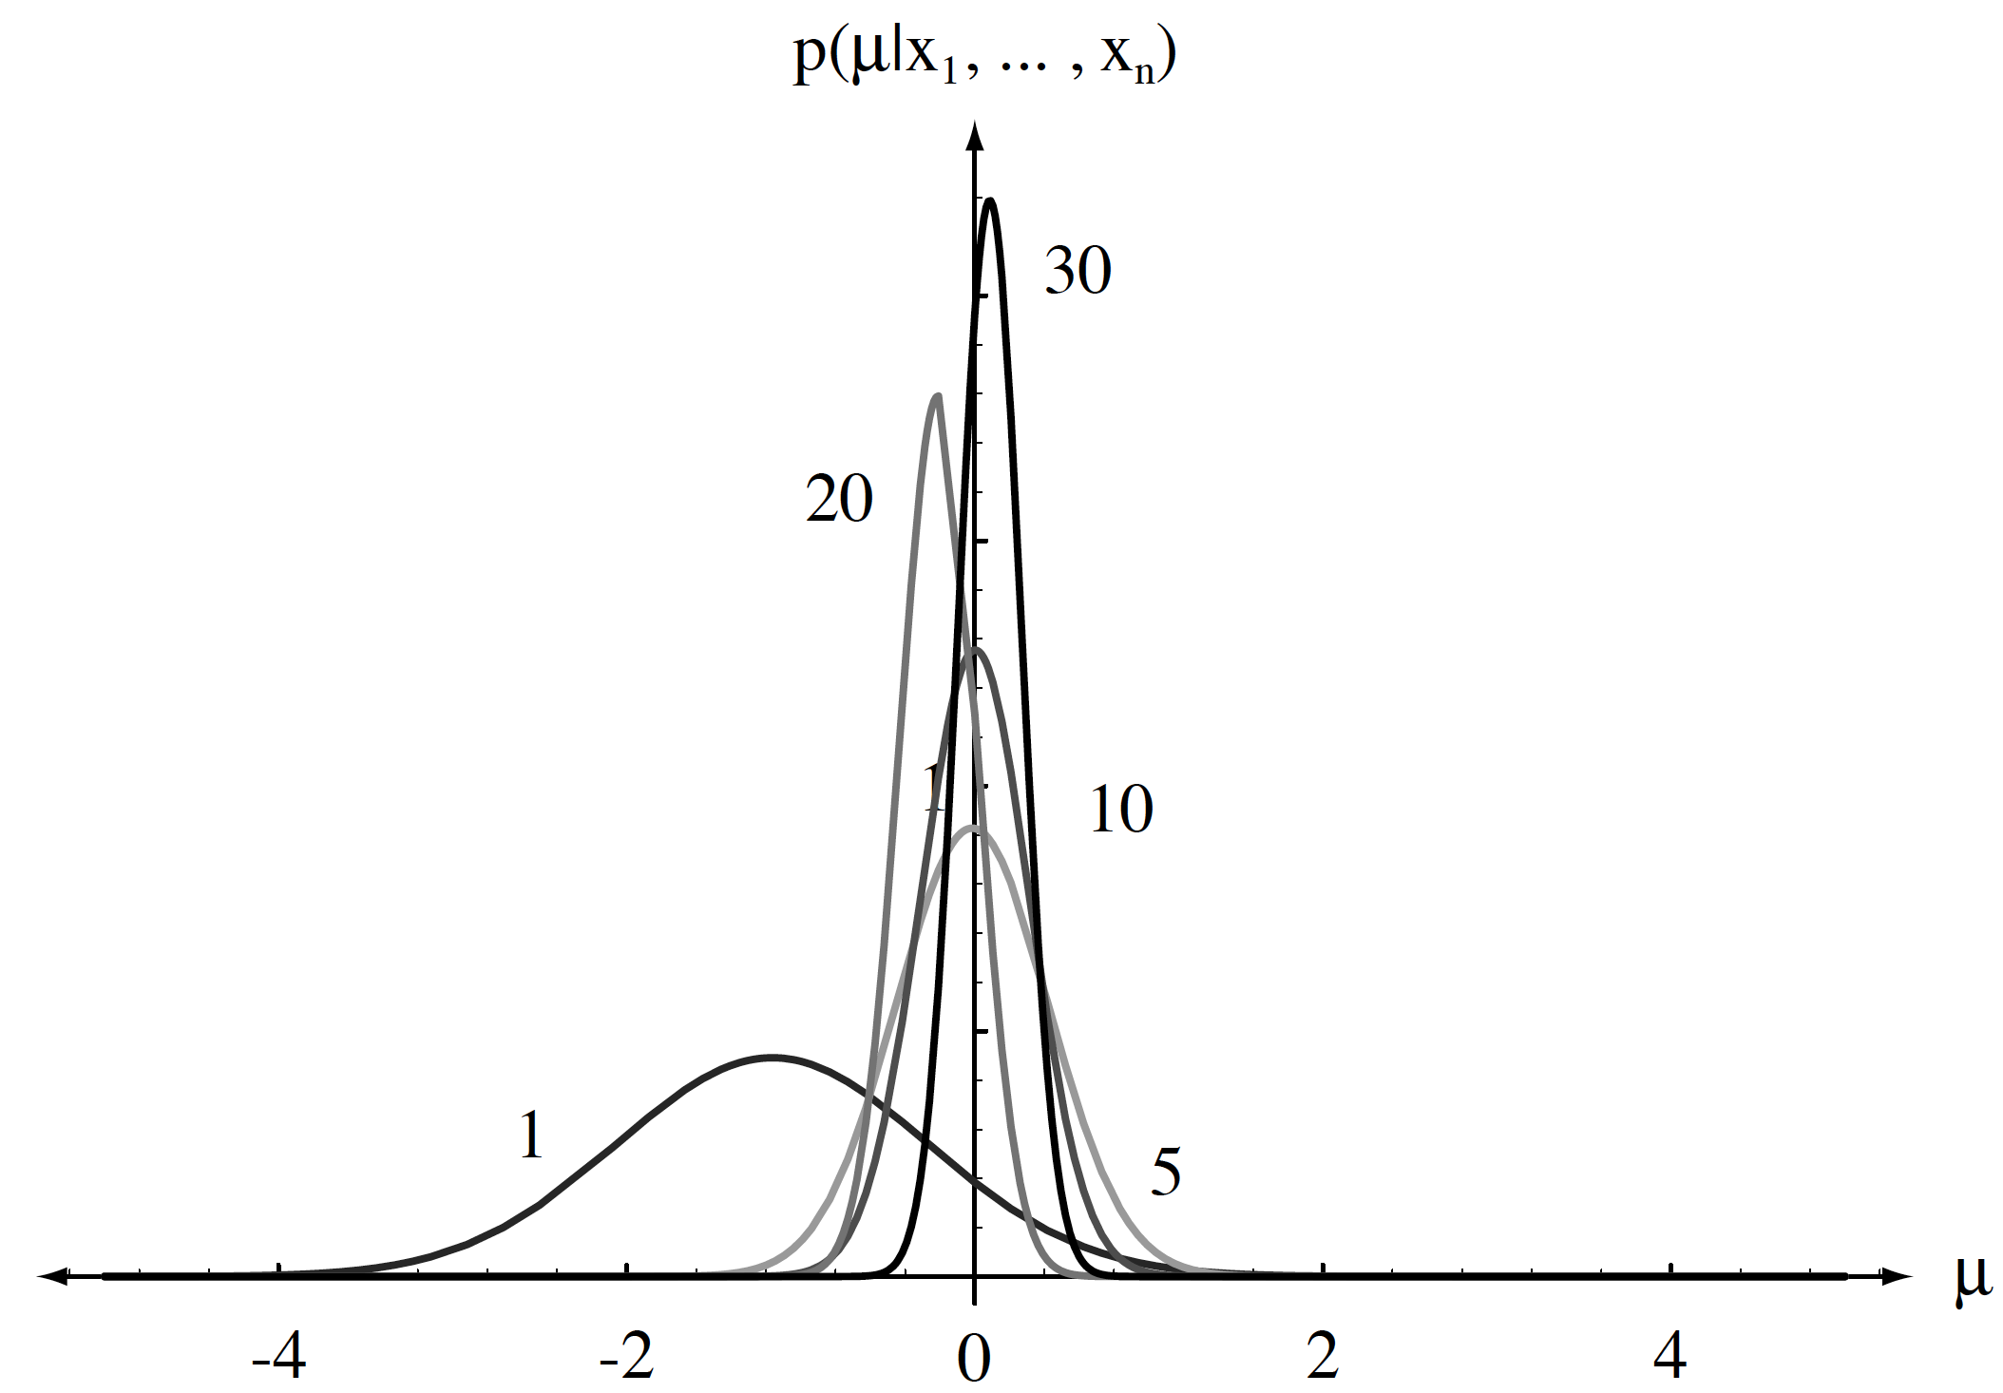
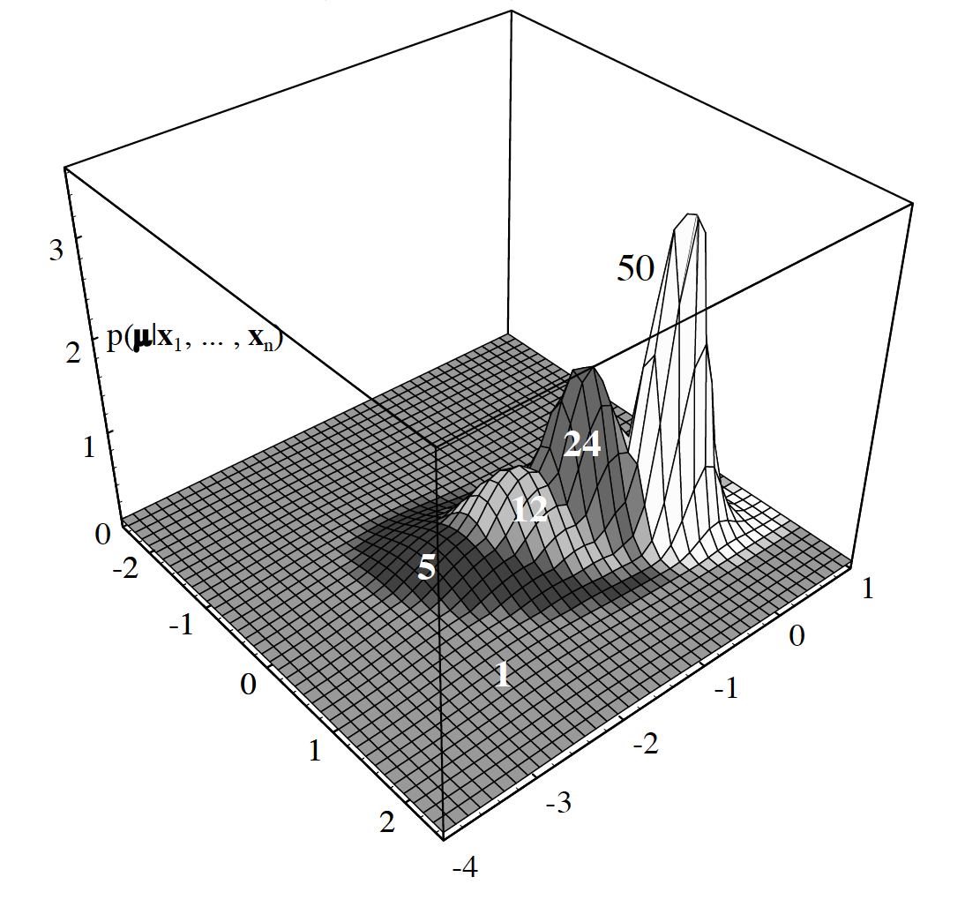
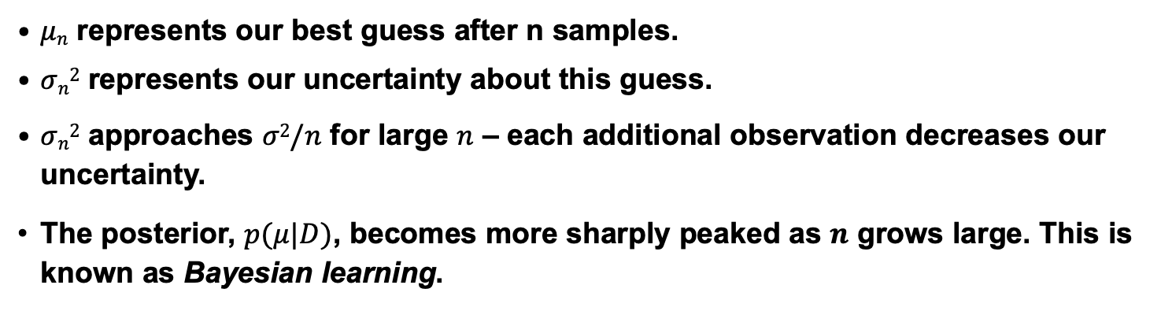
Bayesian Learning
$μn$ represents our best guess after n samples.
$σn2$ represents our uncertainty about this guess.
$σn2$ approaches $σ2/n$ for large $n$ – each additional observation decreases our uncertainty.
The posterior, $p(μ|D)$, becomes more sharply peaked as $n$ grows large. This is known as Bayesian learning.

Slide 4
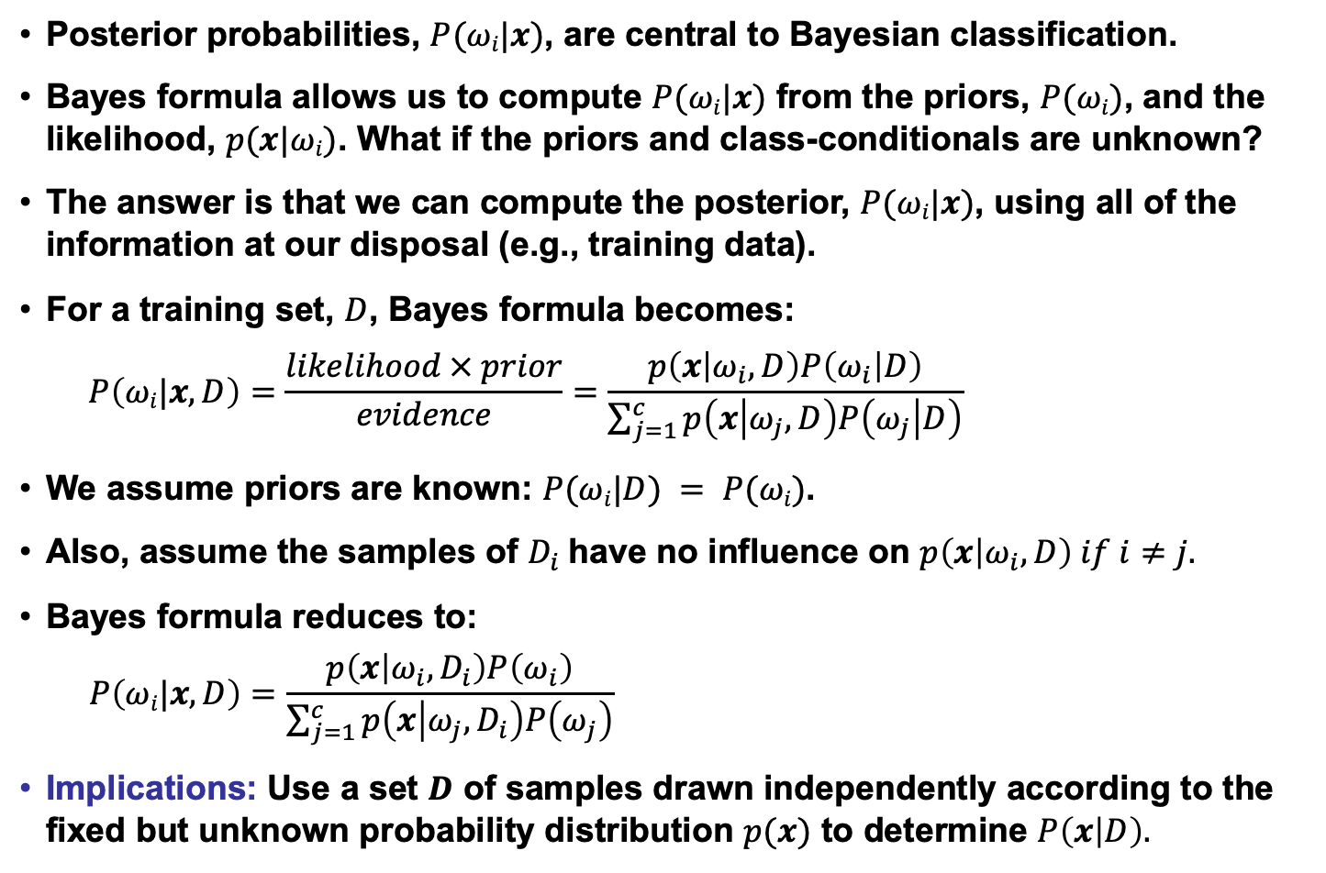
Class-Conditional Densities
Posterior probabilities, $P(ωi|x)$, are central to Bayesian classification.
Bayes formula allows us to compute $P(ωi|x)$ from the priors, $P(ωi)$, and the likelihood, $p(x|ωi)$. What if the priors and class-conditionals are unknown?
The answer is that we can compute the posterior, $P(ωi|x)$, using all of the information at our disposal (e.g., training data).
For a training set, $D$, Bayes formula becomes:
$$P\left(ωi|x,D\right)=\frac{likelihood × prior}{evidence}=\frac{p\left(x | ω_{i},D\right)P\left(ω_{i} | D\right)}{\sum_{j=1}^{c}{p\left(x | ω_{j},D\right)P\left(ω_{j} | D\right)}}$$
We assume priors are known: $P(ωi|D) = P(ωi)$.
Also, assume the samples of $D_{i}$have no influence on $p\left(x | ω_{i}, D\right) if i≠j.$
Bayes formula reduces to:
$$P\left(ωi|x,D\right)=\frac{p\left(x | ω_{i},D_{i}\right)P\left(ω_{i}\right)}{\sum_{j=1}^{c}{p\left(x | ω_{j},D_{i}\right)P\left(ω_{j}\right)}}$$
Implications: Use a set $D$ of samples drawn independently according to the fixed but unknown probability distribution $p(x)$ to determine $P\left(x | D\right).$

Slide 5
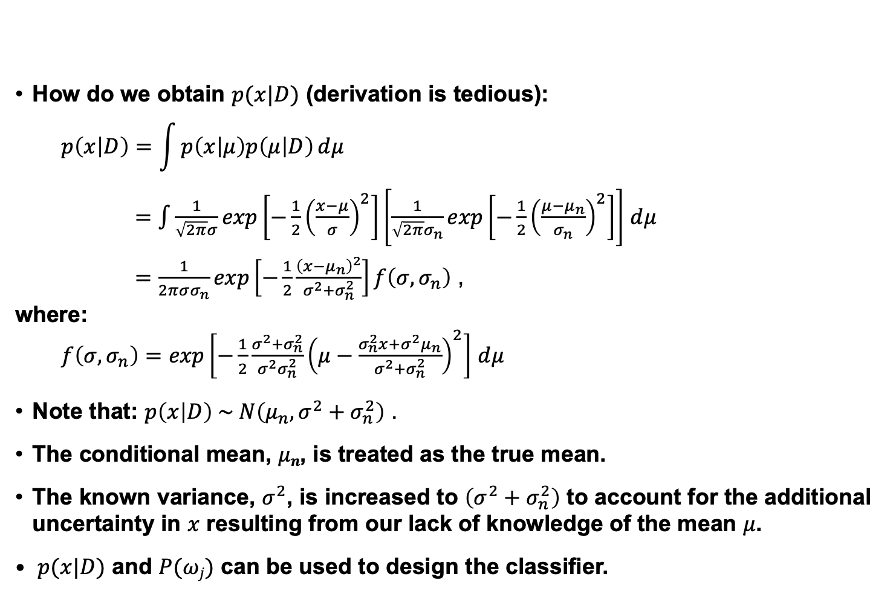
Class-Conditional Density
How do we obtain $p(x|D)$ (derivation is tedious):
$$p\left(x | D\right)=\int{p\left(x | μ\right)p\left(μ | D\right)}ⅆμ$$
$=\int{\frac{1}{\sqrt{2π}σ}exp\left[−\frac{1}{2}{\left(\frac{x−μ}{σ}\right)}^{2}\right]\left[\frac{1}{\sqrt{2π}σ_{n}}exp\left[−\frac{1}{2}{\left(\frac{μ−μ_{n}}{σ_{n}}\right)}^{2}\right]\right]}$ $ⅆμ$
$=\frac{1}{2πσσ_{n}}exp\left[−\frac{1}{2}\frac{{\left(x−μ_{n}\right)}^{2}}{σ^{2}+σ_{n}^{2}}\right]f\left(σ,σ_{n}\right)$ ,
where:
$f\left(σ,σ_{n}\right)=exp\left[−\frac{1}{2}\frac{σ^{2}+σ_{n}^{2}}{σ^{2}σ_{n}^{2}}{\left(μ−\frac{σ_{n}^{2}x+σ^{2}μ_{n}}{σ^{2}+σ_{n}^{2}}\right)}^{2}\right]$ $ⅆμ$
Note that: $p\left(x | D\right) \sim N\left(μ_{n},σ^{2}+σ_{n}^{2}\right)$ .
The conditional mean, $μn$, is treated as the true mean.
The known variance, $σ^{2}$, is increased to $\left(σ^{2}+σ_{n}^{2}\right)$ to account for the additional uncertainty in $x$ resulting from our lack of knowledge of the mean $μ$.
$p(x|D)$ and $P(ωj)$ can be used to design the classifier.

Slide 6
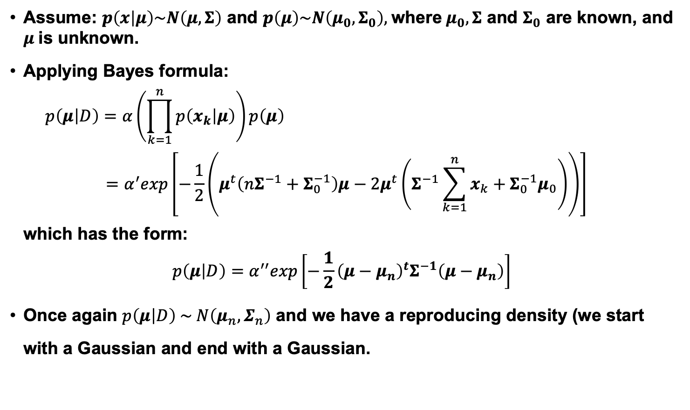
The Multivariate Gaussian Case: Unknown Mean
Assume: $p\left(x | μ\right)\sim N\left(μ,Σ\right)$ and $p\left(μ\right)\sim N\left(μ_{0},Σ_{0}\right),$where$μ_{0},Σ$ and $Σ_{0}$ are known, and $μ$is unknown.
Applying Bayes formula:
$$p\left(μ | D\right)=α\left(\prod_{k=1}^{n}{p\left(x_{k} | μ\right)}\right)p\left(μ\right)$$
$$=α^{′}exp\left[−\frac{1}{2}\left(μ^{t}\left(nΣ^{−1}+Σ_{0}^{−1}\right)μ−2μ^{t}\left(Σ^{−1}\sum_{k=1}^{n}{x_{k}}+Σ_{0}^{−1}μ_{0}\right)\right)\right]$$
which has the form:
$$p\left(μ | D\right)=α^{′′}exp\left[−\frac{1}{2}{\left(μ−μ_{n}\right)}^{t}Σ^{−1}\left(μ−μ_{n}\right)\right]$$
Once again $p\left(μ | D\right) \sim N\left(μ_{n}, Σ_{n}\right)$ and we have a reproducing density (we start with a Gaussian and end with a Gaussian.

Slide 7
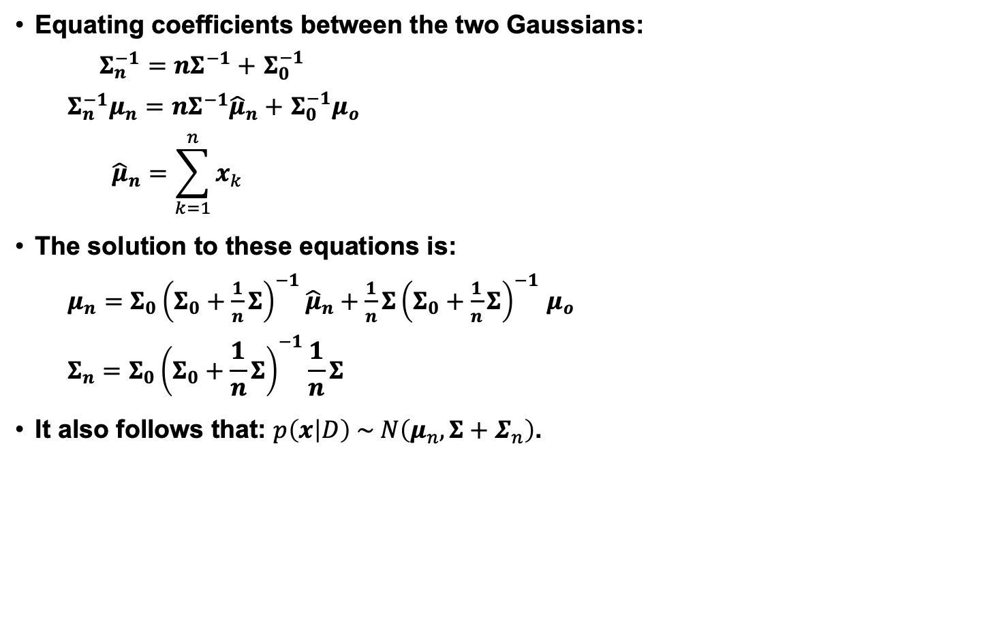
Estimation Equations
Equating coefficients between the two Gaussians:
$Σ_{n}^{−1}=nΣ^{−1}+$ $Σ_{0}^{−1}$
$Σ_{n}^{−1}μ_{n}=nΣ^{−1}{\hat{μ}}_{n}+$ $Σ_{0}^{−1}μ_{o}$
$${\hat{μ}}_{n}=\sum_{k=1}^{n}{x_{k}}$$
The solution to these equations is:
$μ_{n}=Σ_{0}{{\left(Σ_{0}+\frac{1}{n}Σ\right)}^{−1}\hat{μ}}_{n}+\frac{1}{n}Σ{\left(Σ_{0}+\frac{1}{n}Σ\right)}^{−1}$ $μ_{o}$
$${Σ_{n}=Σ}_{0}{\left(Σ_{0}+\frac{1}{n}Σ\right)}^{−1}\frac{1}{n}Σ$$
It also follows that: $p\left(x | D\right) \sim N\left(μ_{n}, {Σ+Σ}_{n}\right)$.

Slide 8
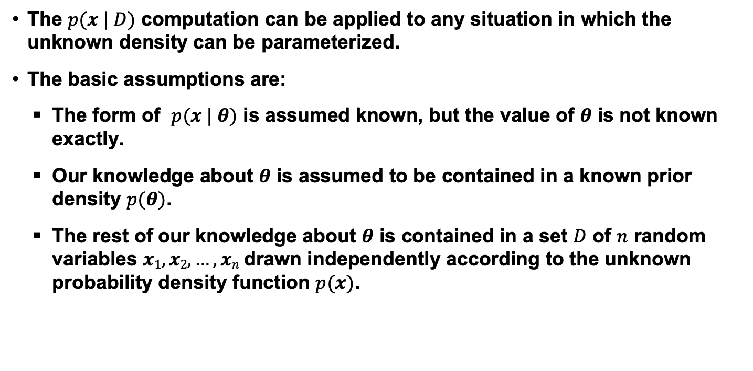
General Theory
The $p(x | D)$ computation can be applied to any situation in which the unknown density can be parameterized.
The basic assumptions are:
  The form of $p(x | θ)$ is assumed known, but the value of $θ$ is not known exactly.
  Our knowledge about $θ$ is assumed to be contained in a known prior density $p(θ)$.
  The rest of our knowledge about $θ$ is contained in a set $D$ of $n$ random variables $x1, x2, …, xn$drawn independently according to the unknown probability density function $p(x)$.

Slide 9
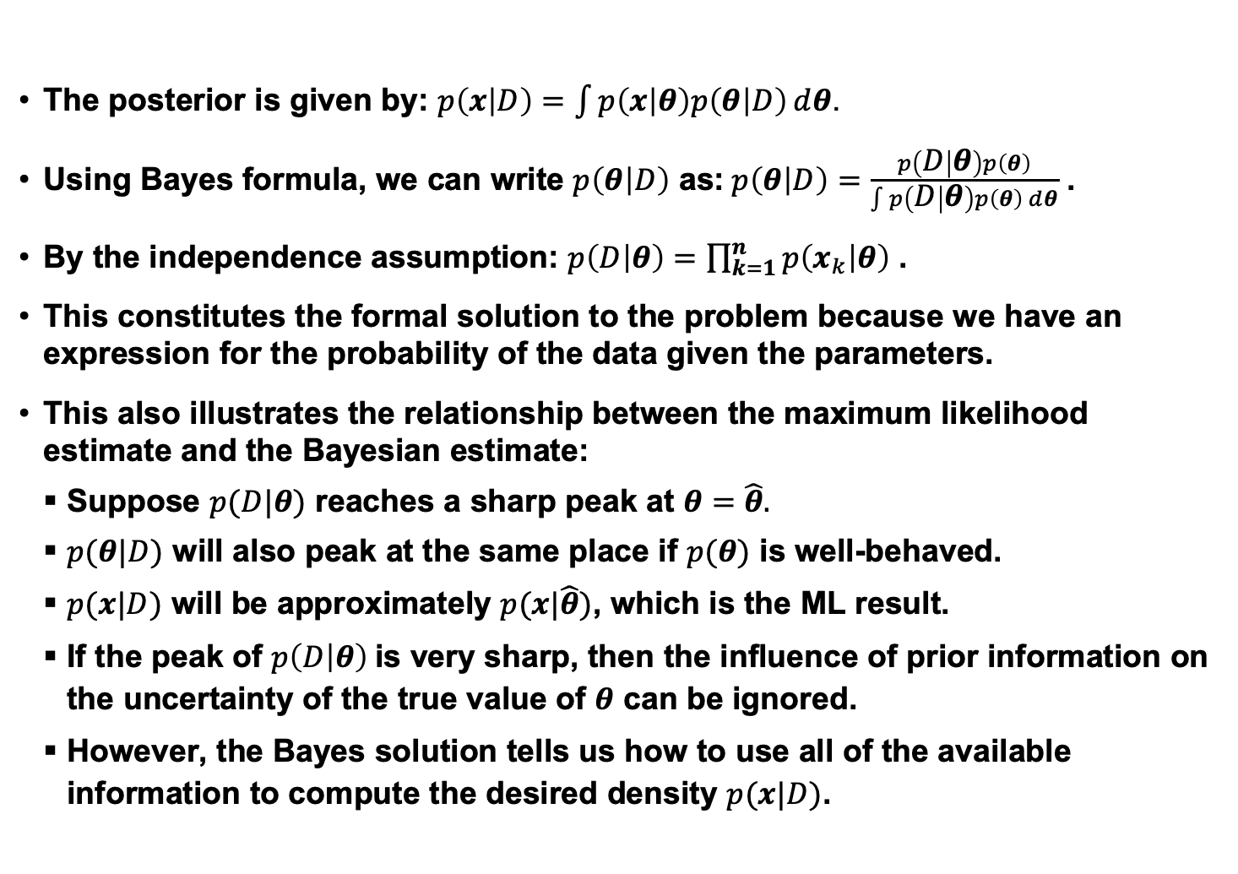
Formalization of Bayesian Parameter Estimation
The posterior is given by: $p\left(x | D\right)=\int{p\left(x | θ\right)p\left(θ | D\right)}ⅆθ$.
Using Bayes formula, we can write $p\left(θ | D\right)$ as:$p\left(θ | D\right)=\frac{p\left(D | θ\right)p\left(θ\right)}{\int{p\left(D | θ\right)p\left(θ\right)ⅆθ}}$ .
By the independence assumption: $p\left(D | θ\right)=\prod_{k=1}^{n}{p\left(x_{k} | θ\right)}$ .
This constitutes the formal solution to the problem because we have an expression for the probability of the data given the parameters.
This also illustrates the relationship between the maximum likelihood estimate and the Bayesian estimate:
Suppose $p(D|θ)$ reaches a sharp peak at $θ=\hat{θ}.$
$p(θ|D)$ will also peak at the same place if $p(θ)$ is well-behaved.
$p(x|D)$ will be approximately $p(x|\hat{θ})$, which is the ML result.
If the peak of $p\left(D | θ\right)$is very sharp, then the influence of prior information on the uncertainty of the true value of $θ$ can be ignored.
However, the Bayes solution tells us how to use all of the available information to compute the desired density $p(x|D)$.

Slide 10
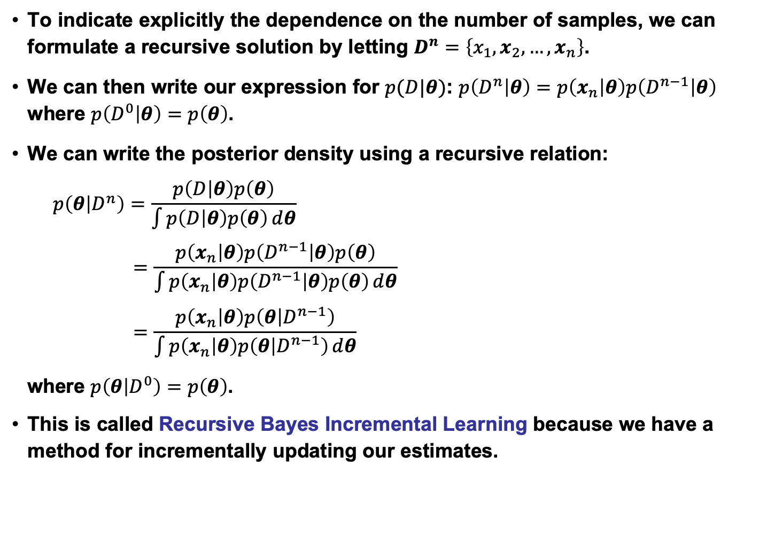
Recursive Bayes Incremental Learning
To indicate explicitly the dependence on the number of samples, we can formulate a recursive solution by letting $D^{n}=\left\{x_{1},x_{2},…,x_{n}\right\}$.
We can then write our expression for $p(D|θ)$: $p\left(D^{n} | θ\right)=p\left(x_{n} | θ\right)p\left(D^{n−1} | θ\right)$ where $p\left(D^{0} | θ\right)=p\left(θ\right)$.
We can write the posterior density using a recursive relation:
$$p\left(θ | D^{n}\right)=\frac{p\left(D | θ\right)p\left(θ\right)}{\int{p\left(D | θ\right)p\left(θ\right)ⅆθ}}$$
$$=\frac{p\left(x_{n} | θ\right)p\left(D^{n−1} | θ\right)p\left(θ\right)}{\int{p\left(x_{n} | θ\right)p\left(D^{n−1} | θ\right)p\left(θ\right)ⅆθ}}$$
$$=\frac{p\left(x_{n} | θ\right)p\left(θ | D^{n−1}\right)}{\int{p\left(x_{n} | θ\right)p\left(θ | D^{n−1}\right)ⅆθ}}$$
where $p\left(θ | D^{0}\right)=p\left(θ\right)$.
This is called Recursive Bayes Incremental Learning because we have a method for incrementally updating our estimates.

Slide 11
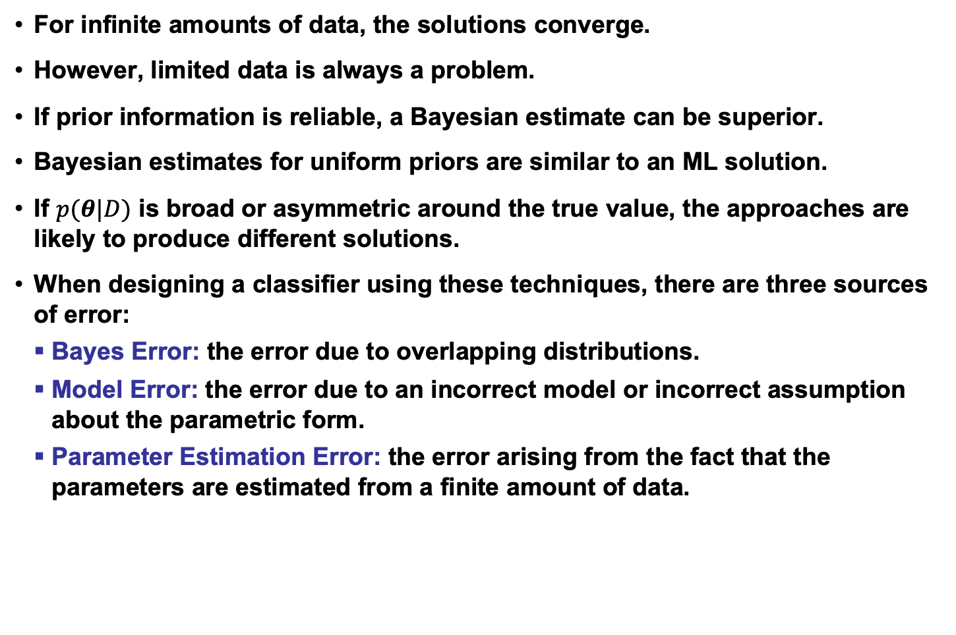
When do ML and Bayesian Estimation Differ?
For infinite amounts of data, the solutions converge.
However, limited data is always a problem.
If prior information is reliable, a Bayesian estimate can be superior.
Bayesian estimates for uniform priors are similar to an ML solution.
If $p(θ|D)$ is broad or asymmetric around the true value, the approaches are likely to produce different solutions.
When designing a classifier using these techniques, there are three sources of error:
  Bayes Error: the error due to overlapping distributions.
  Model Error: the error due to an incorrect model or incorrect assumption about the parametric form.
  Parameter Estimation Error: the error arising from the fact that the parameters are estimated from a finite amount of data.

Slide 12
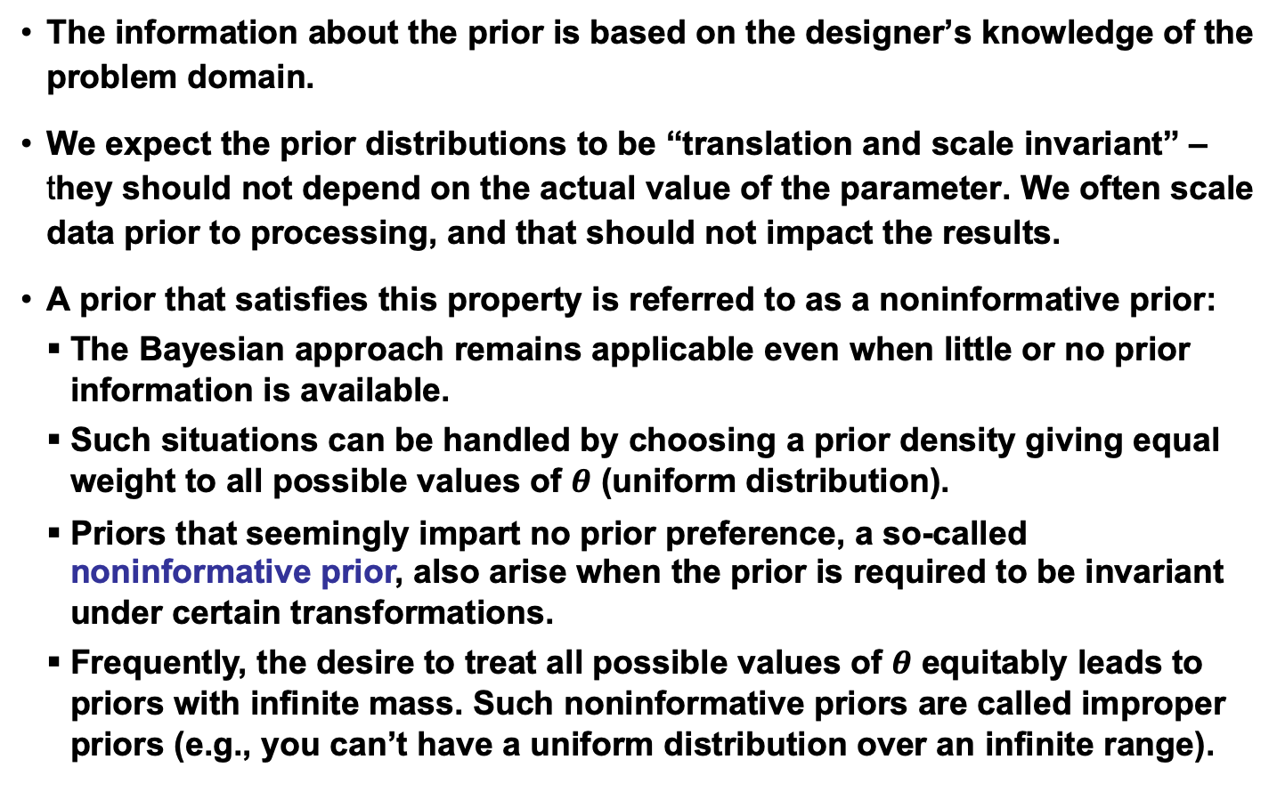
Noninformative Priors and Invariance
The information about the prior is based on the designer’s knowledge of the problem domain.
We expect the prior distributions to be “translation and scale invariant” – they should not depend on the actual value of the parameter. We often scale data prior to processing, and that should not impact the results.
A prior that satisfies this property is referred to as a noninformative prior:
  The Bayesian approach remains applicable even when little or no prior information is available.
  Such situations can be handled by choosing a prior density giving equal weight to all possible values of $θ$ (uniform distribution).
  Priors that seemingly impart no prior preference, a so-called noninformative prior, also arise when the prior is required to be invariant under certain transformations.
  Frequently, the desire to treat all possible values of $θ$ equitably leads to priors with infinite mass. Such noninformative priors are called improper priors (e.g., you can’t have a uniform distribution over an infinite range).

Slide 13
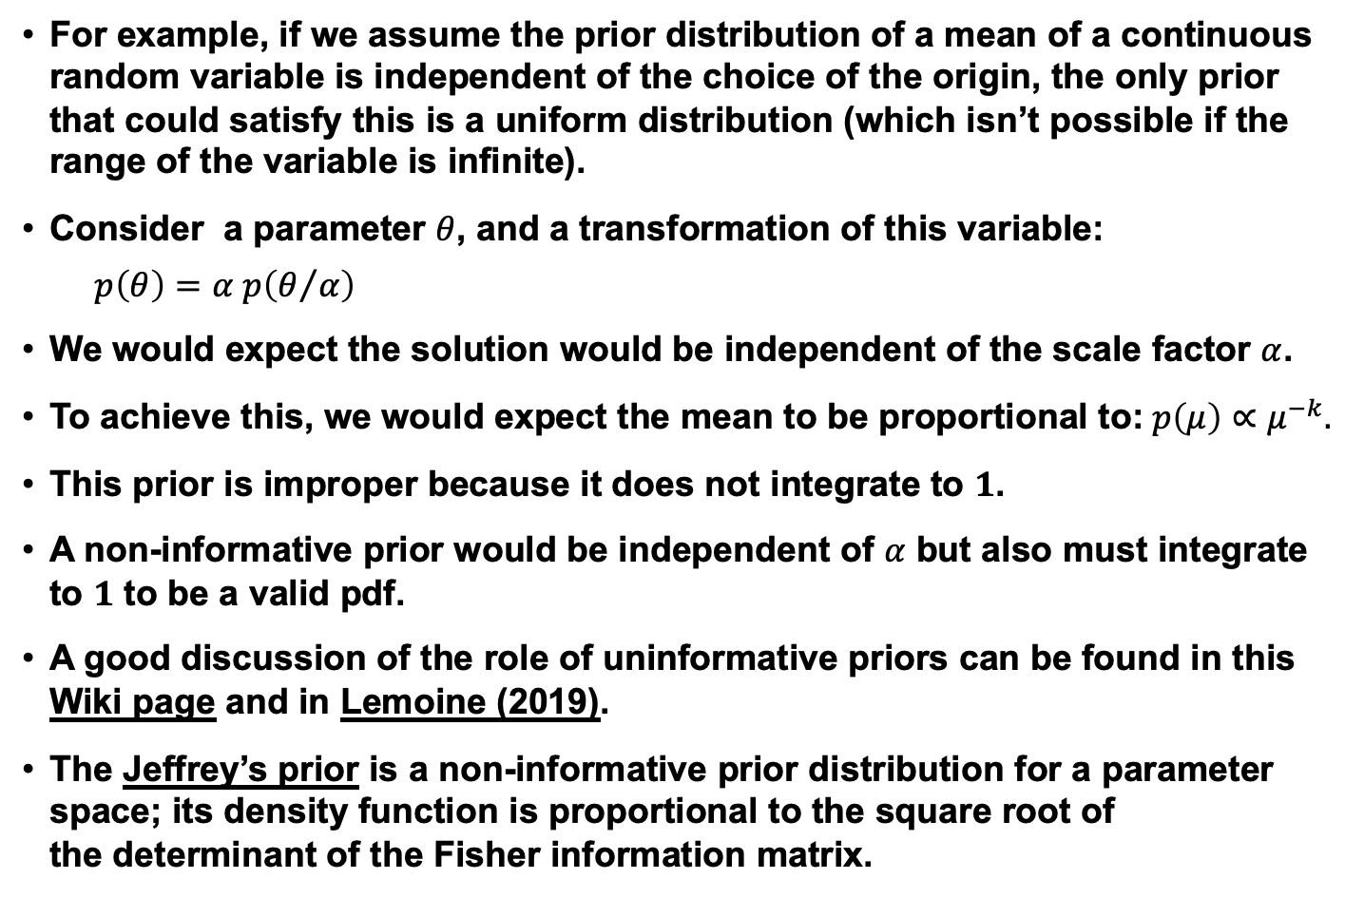
Example of Non-informative Priors
For example, if we assume the prior distribution of a mean of a continuous random variable is independent of the choice of the origin, the only prior that could satisfy this is a uniform distribution (which isn’t possible if the range of the variable is infinite).
Consider a parameter $θ$, and a transformation of this variable:
$$p\left(θ\right)=α p\left(θ/α\right)$$
We would expect the solution would be independent of the scale factor $α$.
To achieve this, we would expect the mean to be proportional to:$p\left(μ\right)∝μ^{−k}.$
This prior is improper because it does not integrate to $1$.
A non-informative prior would be independent of $α$ but also must integrate to $1$ to be a valid pdf.
A good discussion of the role of uninformative priors can be found in this Wiki page and in Lemoine (2019).
The Jeffrey’s prior is a non-informative prior distribution for a parameter space; its density function is proportional to the square root of the determinant of the Fisher information matrix.

Slide 14
Summary
Reviewed Bayesian parameter estimation for the case of an unknown mean in a Gaussian distribution.
Extended the result to the case of a multivariate Gaussian random variable.
Summarized the general theory for Bayesian estimation.
Compared Bayesian estimation to maximum likelihood estimation.
Introduced recursive Bayesian incremental learning which is a computationally efficient way to find solutions.
Introduced the concept of a noninformative prior and explained its relevance to a solution to the parameter estimation problem that is scale invariant.

