Slide 1
Lecture 04: Risk and Likelihood Ratios
Objectives:
Bayes Decision Rule
Evidence
The Two-Class Problem
Loss Functions
Likelihood Ratios
Resources:
DHS: Chapter 2 (Part 2)

Slide 2
Bayes Decision Rule
Our simplest decision rule:
For an observation $x$, decide $ω1$ if $P(ω1|x) > P(ω2|x)$; otherwise, decide $ω2$ .
Probability of error:
$$P\left(error | x\right)=\left\{\begin{matrix}P\left(ω2 | x\right) x∈ω1 \\ P\left(ω_{1} | x\right) x∈ω_{2}\end{matrix}\right.$$
The average probability of error is given by:
$P\left(error\right)=\int_{−∞}^{∞}{P\left(error | x\right)p\left(x\right) dx=}$ $min\left[P\left(ω1 | x\right),P(ω2|x)\right]$
Bayes decision rule:
$$x∈ω1 iff p\left(x|ω1\right)P\left(ω1\right)>p\left(x|ω2\right)P\left(ω2\right)$$
Special cases:
$p\left(x|ω1\right)$= $p\left(x|ω2\right)$: $x$ gives us no useful information.
$P\left(ω1\right)=P\left(ω2\right)$: priors give no useful information.

Slide 3
Posterior Probabilities
Bayes Rule:
$$P\left(ω_{j} | x\right)=\frac{p\left(x | ω_{j}\right)P\left(ω_{j}\right)}{p\left(x\right)}$$
can be expressed in words as:
$$posterior=\frac{likelihood × prior}{evidence}$$
By measuring x, we can convert the prior probability, P(ω_{j}), into a posterior probability, P(ω_{j}|x).
Evidence can be viewed as a scale factor and is often ignored in optimization applications (e.g., speech recognition).
Bayes Rule allows us to train a system by collecting data in what is called a supervised mode (e.g., collect a sea bass sample and measure its length, speak a specific set of words and measure the feature vectors).

Slide 4
Generalization of the Two-Class Problem
Generalization of the preceding ideas:
Use of more than one feature (e.g., length and lightness)
Use more than two states of nature (e.g., N-way classification)
Allowing actions other than a decision to decide on the state of nature (e.g., rejection: refusing to take an action when alternatives are close or confidence is low)
Introduce a loss of function which is more general than the probability of error (e.g., errors are not equally costly)
Let us replace the scalar x by the vector, $x$, in a $d$-dimensional Euclidean space, $Rd$, called the feature space.

Slide 5
Loss Function
Let $\{ω1, ω2,…, ωc\}$be the set of $c$ categories
Let $\{α1,α2,…,αa\}$ be the set of $a$ possible actions
Let $λ(αi|ωj)$be the loss incurred for taking action $αi$ when the state of nature is $ωj$.
The posterior, $P\left(ωj | x\right)$, can be computed from Bayes formula:
$$P\left(ωj | x\right)=\frac{p\left(x | ωj\right)P\left(ωj\right)}{p\left(x\right)}$$
where the evidence is:
$$p\left(x\right)=\sum_{j=1}^{c}{p\left(x | ωj\right)P\left(ωj\right)}$$
The expected loss from taking action $α_{i}$ is:
$$R\left(αi | x\right)=\sum_{j=1}^{c}{λ\left(αi | x\right)P\left(ωj | x\right) .}$$

Slide 6
Bayes Risk
An expected loss is called a risk.
$R(ωi|x)$ is called the conditional risk.
A general decision rule is a function $α(x)$ that tells us which action to take for every possible observation.
The overall risk is given by:
$$R=\int{R\left(α\left(x\right) | x\right)p\left(x\right)dx}$$
If we choose $α(x)$ so that $R(αi(x))$is as small as possible for every $x$, the overall risk will be minimized.
Compute the conditional risk for every $ω$ and select the action that minimizes $R(ωi|x)$. This is denoted $R^{∗}$, and is referred to as the Bayes risk.
The Bayes risk is the best performance that can be achieved (for the given data set or problem definition).

Slide 7
Two-Category Classification
Let $α1$ correspond to $ω1$, $α2$ to $ω2$, and $λij= λ(αi|ωj)$.
The conditional risk is given by:
$$R(α1|x) = λ11P(ω1|x) + λ12P(ω2|x)$$
$$R(α2|x) = λ21P(ω1|x) + λ22P(ω2|x)$$
Our decision rule is:
$choose:$ $ω1 if: R(α1|x) < R(α2|x)$; $otherwise:$ $decide$ $ω2$
This results in the equivalent rule:
$choose:$ $ω1 if: (λ21− λ11) P(x|ω1) > (λ12− λ22) P(x|ω2)$;
$otherwise:$ $decide$ $ω2$
If the loss incurred for making an error is greater than that incurred for being correct, the factors $(λ21− λ11)$ and $(λ12− λ22)$ are positive, and the ratio of these factors simply scales the posteriors.

Slide 8
Likelihood
By employing Bayes formula, we can replace the posteriors:
$$(λ21− λ11) P(x|ω1) > (λ12− λ22) P(x|ω2)$$
by the prior probabilities and conditional densities:
$choose:$ $ω1 if:(λ21− λ11) p(x|ω1) P(ω1) > (λ12− λ22) p(x|ω2) P(ω2);$ $otherwise:$ $decide$ $ω2$
If $λ21− λ11$is positive, our rule becomes:
$$choose ω1 if:\frac{p(x|ω1)}{p(x|ω2)}>\frac{λ12− λ22}{λ21− λ11}\frac{P(ω2)}{P(ω1)}$$
If the loss factors are identical, and the prior probabilities are equal, this reduces to a standard likelihood ratio:
$$choose ω1 if: \frac{p(x|ω1)}{p(x|ω2)}>1$$

Slide 9
Minimum Error Rate
Consider a symmetrical or zero-one loss function:
$$λ\left(α_{i} | ω_{j}\right)= \left\{\begin{matrix}0, i=j \\ 1, i≠j\end{matrix} i,j=1, 2, 3, …, c\right.$$
The conditional risk is:
$$\begin{matrix}R\left(αi | x\right)=\sum_{j=1}^{c}{R(αi|ωj)P\left(ωj | x\right)} \\ =\sum_{j≠i}^{c}{P\left(ωj | x\right)} \\ =1−P\left(ωi | x\right)\end{matrix}$$
The conditional risk is the average probability of error.
To minimize error, maximize $P(ωi|x)$ — also known as maximum a posteriori decoding (MAP).

Slide 10
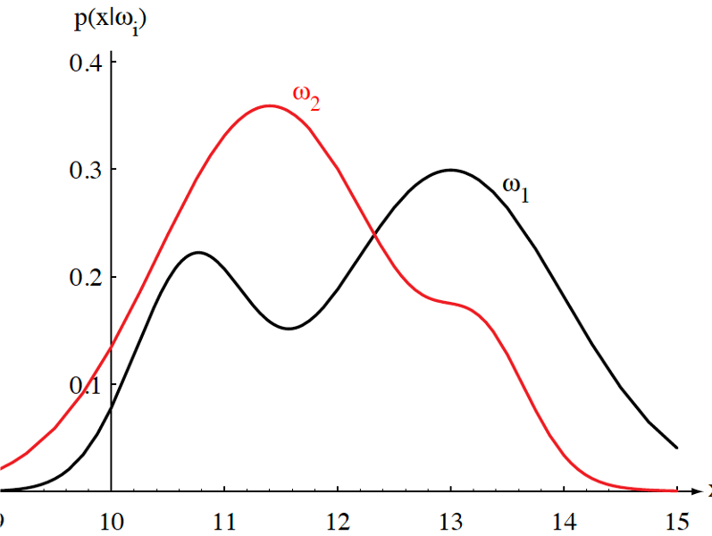
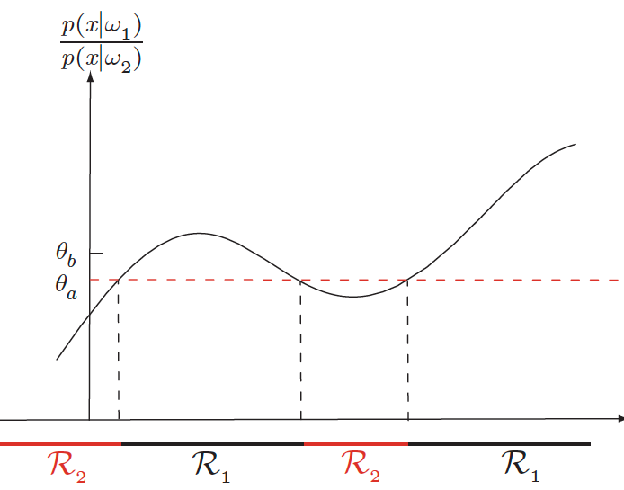
Likelihood Ratio
Minimum error rate classification:
$$choose ωi if: P(ωi| x) > P(ωj| x) for all j≠i$$

Slide 11
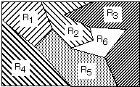
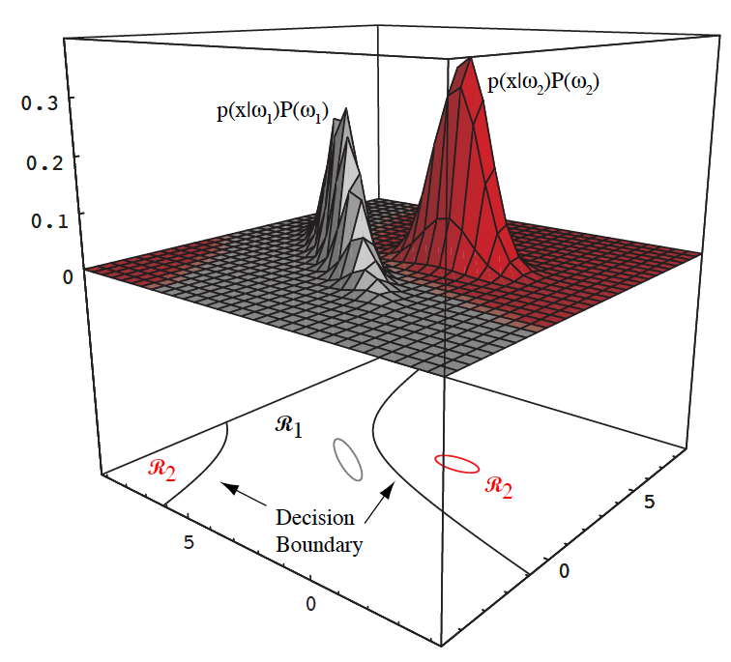
Decision Surfaces
We can visualize our decision rule several ways:

Slide 12
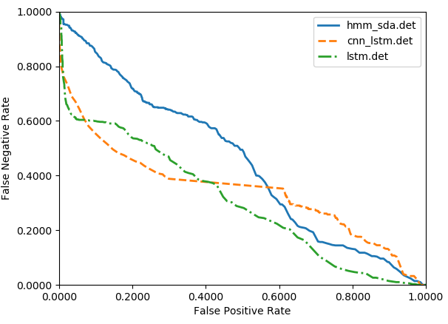
Example: Which System is Better?

Slide 13
Summary
Bayes Decision Rule: what is its relationship to minimum error?
Decision Criteria: Several viable choices for decision rules.
Decision Surfaces: The shape of the decision surface is influenced by the number of categories and the statistics of the data.
Bayes Risk: what is its relation to performance?
Generalized Risk: what are some alternate formulations for decision criteria based on risk? What are some applications where these formulations would be appropriate?
Minimum Error Rate: How do we determine the minimum achievable error rate?
Likelihood Ratio: a simple decision rule or method for evaluating a classifier over a range of operating conditions. Convenient for two-class problems.

Slide 14
Minimax Criterion
Design our classifier to minimize the worst overall risk (avoid catastrophic failures)
Factor overall risk into contributions for each region:
$$R =\int_{R_{1}}{\left[λ_{11}P\left(ω_{1}\right)p\left(x | ω_{1}\right)+λ_{12}P\left(ω_{2}\right)p\left(x | ω_{2}\right)\right]ⅆx}$$ $+\int_{R_{2}}{\left[λ_{21}P\left(ω_{1}\right)p\left(x | ω_{1}\right)+λ_{22}P\left(ω_{2}\right)p\left(x | ω_{2}\right)\right]ⅆx}$
Using a simplified notation (Van Trees, 1968):
$P_{1}=$ $P\left(ω_{1}\right)$; $P_{2}=$ $P\left(ω_{2}\right)$;
$I_{11}=$ $\int_{R_{1}}{p\left(x | ω_{1}\right)ⅆx}$; $I_{12}=$ $\int_{R_{1}}{p\left(x | ω_{2}\right)ⅆx}$;
$I_{21}=$ $\int_{R_{2}}{p\left(x | ω_{1}\right)ⅆx}$; $I_{22}=$ $\int_{R_{2}}{p\left(x | ω_{2}\right)ⅆx}$;

Slide 15
Minimax Criterion
We can rewrite the risk:
$$R=P_{1}λ_{11}I_{11}+P_{2}λ_{12}I_{12}+P_{1}λ_{21}I_{21}+P_{2}λ_{22}I_{22}$$
Note that $I11=1−I21$ and $I22=1−I12$:
$$R=P_{1}λ_{11}\left(1−I_{21}\right)+P_{2}λ_{12}I_{12}+P_{1}λ_{21}I_{21}+P_{2}λ_{22}\left(1−I_{21}\right)$$
We make this substitution because we want the risk in terms of error probabilities and priors.
Multiply out, add and subtract $P1λ21$, and rearrange:
$$R=P_{1}λ_{21}+P_{1}λ_{11}−P_{1}λ_{12}I_{21}−P_{1}λ_{21}+P_{1}λ_{21}I_{21}+P_{2}λ_{22}−P_{2}λ_{22}I_{12}$$
$=P_{1}λ_{21}+P_{2}λ_{22}+P_{2}\left(λ_{12}−λ_{22}\right)I_{12}+$ $\left[{−P}_{1}λ_{11}I_{21}−P_{1}λ_{21}+P_{1}λ_{21}I_{21}+P_{1}λ_{11}\right]$
$=P_{1}λ_{21}+P_{2}λ_{22}+P_{2}\left(λ_{12}−λ_{22}\right)I_{12}−$ $P_{1}\left(λ_{21}−λ_{11}\right)\left(1−I_{21}\right)$
But $P1 =1− P2$:
$R=$ $λ_{21}\left(1−P_{2}\right)+P_{2}λ_{22}+P_{2}\left(λ_{12}−λ_{22}\right)I_{12}−\left(1−P_{2}\right)\left(λ_{21}−λ_{11}\right)\left(1−I_{21}\right)$
$=$ $λ_{21}−λ_{21}P_{2}+P_{2}λ_{22}+P_{2}\left(λ_{12}−λ_{22}\right)I_{12}−\left(1−P_{2}\right)\left(λ_{21}−λ_{11}\right)\left(1−I_{21}\right)$
$=$ $λ_{21}+\left(λ_{11}−λ_{12}\right)\left(1−I_{21}\right)+P_{2}\left[\left(λ_{22}−λ_{21}\right)+{\left(λ_{12}−λ_{22}\right)I}_{12}−\left(λ_{11}−λ_{21}\right) I_{12}\right]$

Slide 16
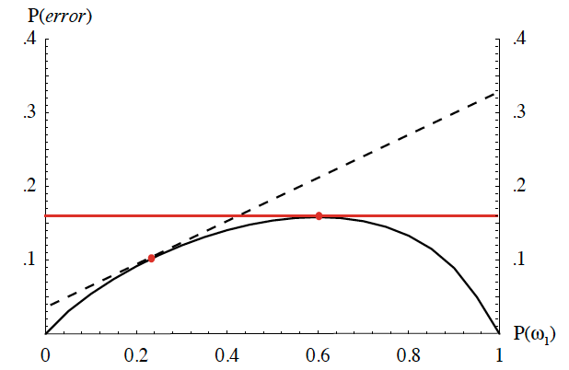
Minimax Criterion (Cont.)
Continuing:
$R=$ $λ_{21}+λ_{11}−λ_{21}−λ_{11}I_{21}+λ_{21}I_{21}+$
$P_{2}\left[\left(λ_{22}−λ_{21}\right)+\left(λ_{12}−λ_{22}\right)I_{12}−\left(λ_{11}−λ_{21}\right)I_{12}\right]$
$=$ $λ_{11}\left(1−I_{21}\right)+λ_{21}I_{21}$ ${+ P}_{2}\left[\left(λ_{22}−λ_{21}\right)+\left(λ_{12}−λ_{22}\right)I_{12}−\left(λ_{11}−λ_{21}\right)I_{12}\right]$
Note that the risk is linear in $P2$:$R= A{+ P}_{2}\left[B\right]$
If we can find a boundary such that the second term, $B$, is zero, then the minimax risk becomes:
$R=$ $λ_{21}+λ_{11}−λ_{21}−λ_{11}I_{21}+λ_{21}I_{21}+$
$P_{2}\left[\left(λ_{22}−λ_{21}\right)+\left(λ_{12}−λ_{22}\right)I_{12}−\left(λ_{11}−λ_{21}\right)I_{12}\right]$
$=$ $λ_{11}\left(1−I_{21}\right)+λ_{21}I_{21}=$ $λ_{11}+$ $\left(λ_{21}−λ_{11}\right)I_{21}$
For each value of the prior, there is an associated Bayes error rate.
Minimax: find the maximum Bayes error for the prior $P1$, and then use the corresponding decision region.

Slide 17
Neyman-Pearson Criterion
Guarantee the total risk is less than some fixed constant (or cost).
Minimize the risk subject to the constraint:
$$\int{R\left(α_{i} | x\right)ⅆx< constant}$$
(e.g., must not misclassify more than 1% of salmon as sea bass).
Typically must adjust boundaries numerically.
For some distributions (e.g., Gaussian), analytical solutions do exist.

