Slide 1
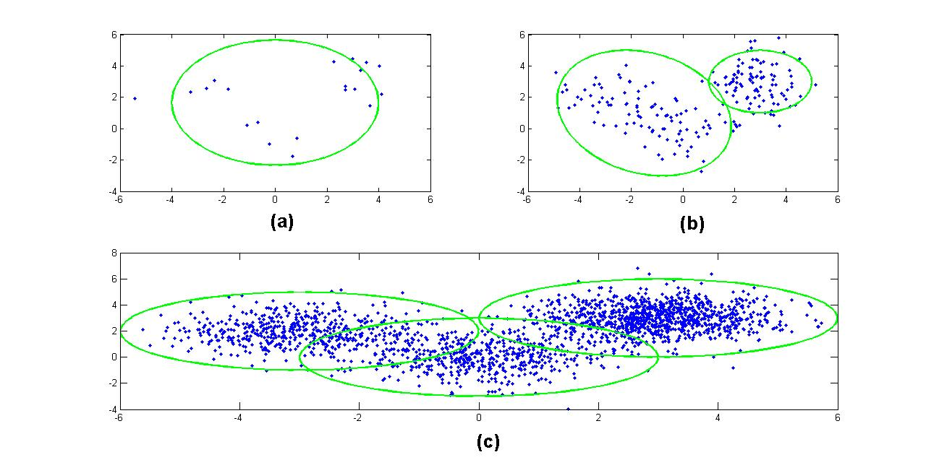
Lecture 33: Regularization
Objectives:
Iterative Solutions
Convex Optimization
Regularizers
P-Norms
Resources:
Quora: Regularization
BB: Regularization
Teh: Bayesian Nonparametric Models
Orbanz: Nonparametric Models

Slide 2
Regularization
David Kauchak
CS 451 – Fall 2013

Slide 3
Model-based machine learning
pick a model
pick a criteria to optimize (aka objective function)
develop a learning algorithm
Find w and b that minimize the 0/1 loss

Slide 4
Model-based machine learning
pick a model
pick a criteria to optimize (aka objective function)
develop a learning algorithm
use a convex surrogate loss function
Find w and b that minimize the surrogate loss

Slide 5


Finding the minimum
You’re blindfolded, but you can see out of the bottom of the blindfold to the ground right by your feet. I drop you off somewhere and tell you that you’re in a convex shaped valley and escape is at the bottom/minimum. How do you get out?

Slide 6
Gradient descent
  pick a starting point (w)
  repeat until loss doesn’t decrease in all dimensions:
    pick a dimension
    move a small amount in that dimension towards decreasing loss (using the derivative)

Slide 7
Some maths

Slide 8
Gradient descent
  pick a starting point (w)
  repeat until loss doesn’t decrease in all dimensions:
    pick a dimension
    move a small amount in that dimension towards decreasing loss (using the derivative)
What is this doing?

Slide 9
Perceptron learning algorithm!
repeat until convergence (or for some # of iterations):
for each training example (f₁, f₂, …, f_{m}, label):
if prediction * label ≤ 0: // they don’t agree
for each w_{j}:
w_{j} = w_{j} + f_{j}*label
b = b + label
or
where

Slide 10
The constant
learning rate
label
prediction
When is this large/small?

Slide 11
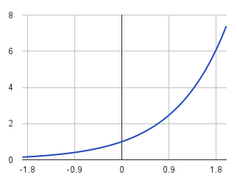
The constant
label
prediction
If they’re the same sign, as the predicted gets larger there update gets smaller
If they’re different, the more different they are, the bigger the update

Slide 12
One concern
loss
What is this calculated on?
Is this what we want to optimize?
w

Slide 13
Perceptron learning algorithm!
repeat until convergence (or for some # of iterations):
for each training example (f₁, f₂, …, f_{m}, label):
if prediction * label ≤ 0: // they don’t agree
for each w_{j}:
w_{j} = w_{j} + f_{j}*label
b = b + label
Note: for gradient descent, we always update
or
where

Slide 14
One concern
loss
We’re calculating this on the training set
We still need to be careful about overfitting!
The min w,b on the training set is generally NOT the min for the test set
w
How did we deal with this for the perceptron algorithm?

Slide 15
Overfitting revisited: regularization
A regularizer is an additional criteria to the loss function to make sure that we don’t overfit
It’s called a regularizer since it tries to keep the parameters more normal/regular
It is a bias on the model forces the learning to prefer certain types of weights over others

Slide 16
Regularizers
Should we allow all possible weights?
Any preferences?
What makes for a “simpler” model for a linear model?

Slide 17
Regularizers
Generally, we don’t want huge weights
If weights are large, a small change in a feature can result in a large change in the prediction
Also gives too much weight to any one feature
Might also prefer weights of 0 for features that aren’t useful
How do we encourage small weights? or penalize large weights?

Slide 18
Regularizers
How do we encourage small weights? or penalize large weights?

Slide 19
Common regularizers
sum of the weights
sum of the squared weights
What’s the difference between these?

Slide 20
Common regularizers
sum of the weights
sum of the squared weights
Squared weights penalizes large values more
Sum of weights will penalize small values more

Slide 21
p-norm
sum of the weights (1-norm)
sum of the squared weights
(2-norm)
p-norm
Smaller values of p (p < 2) encourage sparser vectors
Larger values of p discourage large weights more

Slide 22
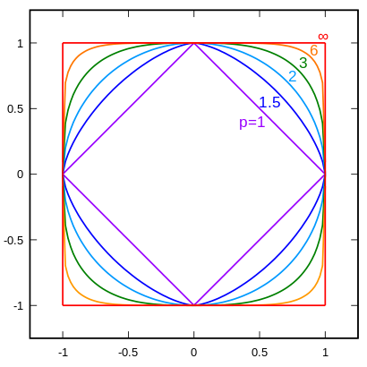
p-norms visualized
lines indicate penalty = 1
w₁
w₂
p | w₂
1 | 0.5
1.5 | 0.75
2 | 0.87
3 | 0.95
∞ | 1
For example, if w₁ = 0.5

Slide 23
p-norms visualized
all p-norms penalize larger weights
p < 2 tends to create sparse (i.e. lots of 0 weights)
p > 2 tends to like similar weights
Notes:
- The 1 norm penalizes non-zero weights, e.g

Slide 24

Model-based machine learning
pick a model
pick a criteria to optimize (aka objective function)
develop a learning algorithm
Find w and b that minimize

Slide 25
Minimizing with a regularizer
We know how to solve convex minimization problems using gradient descent:
If we can ensure that the loss + regularizer is convex then we could still use gradient descent:
make convex

Slide 26
Convexity revisited
One definition: The line segment between any two points on the function is above the function
Mathematically, f is convex if for all x₁, x₂:
the value of the function at some point between x₁ and x₂
the value at some point on the line segment between x₁ and x₂
Notes:
Put another way, the right hand side says, take the value of the function at x1, take the value of the function at x2 and then “linearly” average them based on t. This represents a line segment between f(x1) and f(x2)

Slide 27
Adding convex functions
Claim: If f and g are convex functions then so is the function z=f+g
Prove:
Mathematically, f is convex if for all x₁, x₂:

Slide 28
Adding convex functions
By definition of the sum of two functions:
Then, given that:
We know:
So:

Slide 29
Minimizing with a regularizer
We know how to solve convex minimization problems using gradient descent:
If we can ensure that the loss + regularizer is convex then we could still use gradient descent:
convex as long as both loss and regularizer are convex

Slide 30
p-norms are convex
p-norms are convex for p >= 1

Slide 31
Model-based machine learning
pick a model
pick a criteria to optimize (aka objective function)
develop a learning algorithm
Find w and b that minimize

Slide 32
Our optimization criterion
Loss function: penalizes examples where the prediction is different than the label
Regularizer: penalizes large weights
Key: this function is convex allowing us to use gradient descent

Slide 33
Gradient descent
  pick a starting point (w)
  repeat until loss doesn’t decrease in all dimensions:
    pick a dimension
    move a small amount in that dimension towards decreasing loss (using the derivative)

Slide 34
Some more math
…
(some math happens)

Slide 35
Gradient descent
  pick a starting point (w)
  repeat until loss doesn’t decrease in all dimensions:
    pick a dimension
    move a small amount in that dimension towards decreasing loss (using the derivative)

Slide 36
The update
learning rate
direction to update
regularization
constant: how far from wrong
What effect does the regularizer have?

Slide 37
The update
learning rate
direction to update
regularization
constant: how far from wrong
If w_{j} is positive, reduces w_{j}
If w_{j} is negative, increases w_{j}
moves w_{j} towards 0

Slide 38
L1 regularization

Slide 39
L1 regularization
learning rate
direction to update
regularization
constant: how far from wrong
What effect does the regularizer have?

Slide 40
L1 regularization
learning rate
direction to update
regularization
constant: how far from wrong
If w_{j} is positive, reduces by a constant
If w_{j} is negative, increases by a constant
moves w_{j} towards 0
regardless of magnitude

Slide 41
Regularization with p-norms
L1:
L2:
Lp:
How do higher order norms affect the weights?
Notes:
if they’re magnitude > 1, reduce them drastically
if they’re magnitude < 1, much slower reductions for higher p

Slide 42
Regularizers summarized
L1 is popular because it tends to result in sparse solutions (i.e. lots of zero weights)
  However, it is not differentiable, so it only works for gradient descent solvers
L2 is also popular because for some loss functions, it can be solved directly (no gradient descent required, though often iterative solvers still)
Lp is less popular since they don’t tend to shrink the weights enough

Slide 43
The other loss functions
Without regularization, the generic update is:
where
exponential
hinge loss
squared error

Slide 44
Many tools support these different combinations
Look at scikit learning package:
http://scikit-learn.org/stable/modules/sgd.html

Slide 45
Common names
(Ordinary) Least squares: squared loss
Ridge regression: squared loss with L2 regularization
Lasso regression: squared loss with L1 regularization
Elastic regression: squared loss with L1 AND L2 regularization
Logistic regression: logistic loss

Slide 46
Summary
Complex cost functions are difficult to optimize
Regularization allows us to achieve optimal designs

