Slide 1
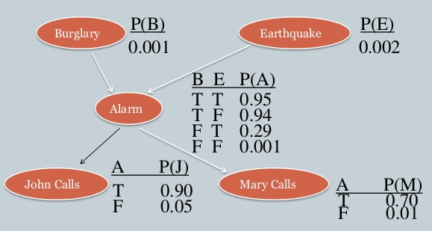
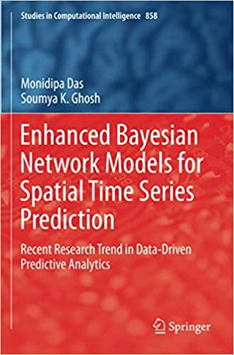
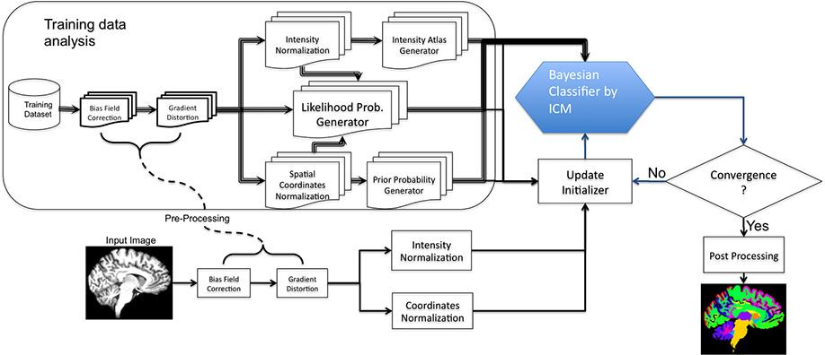
Lecture 17: Bayesian Belief Networks and Markov Random Fields
Objectives:
Graphical Models
Bayesian Belief Networks
Markov Random Fields
Conditional Random Fields
Applications
Resources:
D.H.S.: Bayesian Belief Networks
MLM: Bayesian Networks
Wiki: Bayesian Networks
Meek: Learning Parameters
MCAI: Bayesian Net Example
Wiki: Markov Random Field ABPK: Markov Random Field
NRR: Markov Random Field

Slide 2
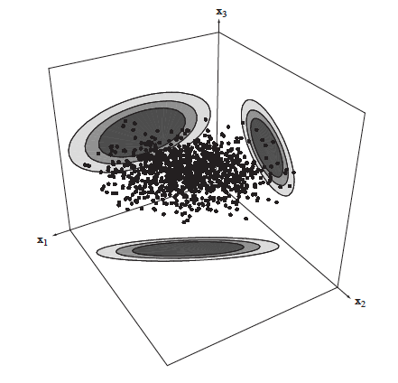
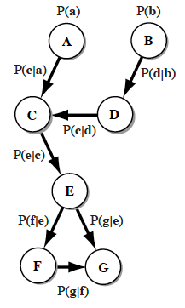
Why Belief Networks or Probabilistic Graphs?
We have assumed we could parameterize the distributions by a feature vector $θ$ (Bayes Rule/ML). If we had prior information about the distribution of $θ$, this too could be used (Bayesian Parameter Estimation).
Sometimes our knowledge about a distribution is not directly of this type, but instead about the statistical dependencies (or independencies) among the component features (e.g. $x1$ and $x3$ are statistically independent, but $x2$ and $x3$ are not).
Bayesian Belief Networks are a way to encode statistical dependencies using a directed acyclic graph (DAG).
There are many related variants: probabilistic graphical models, Bayesian nets, dynamic Bayesian networks.
Developing the model topology and estimating the parameters, including latent variables, are challenges.
To some extent, these structures have been supplanted by deep learning systems.

Slide 3
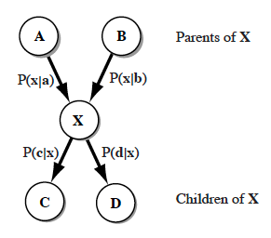
Elements of a Bayesian Net
A belief network consists of nodes (labelled with upper case bold letters) and their associated discrete states (in lower-case).
The node $A$ has states $a1$, $a2$, ..., denoted simply $a$; node $B$ has states $b1$, $b2$, ..., denoted $b$, and so forth.
The links between nodes represent conditional probabilities.
$P(c|a)$ can be described by a matrix: $\left[P(ci|aj)\right]$.
It is useful to distinguish the set of nodes before $X$, called called its parents $P$, and the set of those nodes after $X,$ called its children $C$.
When we evaluate the probabilities at $X$, we must treat the parents of $X$ differently from its children. Thus, $A$ and $B$ are in $𝒫$ of $X$ while $C$ and $D$ are in $𝒞$ of $X$.
The belief of a set of propositions $x = (x1, x2, …)$on node $X$ describes the relative belief probabilities of the variables given all the evidence $e$ throughout the rest of the network, i.e., $P(x|e)$.

Slide 4
Factorization of Probabilities
We can divide the dependency of the belief upon the parents and children:
$P\left(x | e\right)∝P\left(e^{𝒞} | x\right)$ $P\left(x | e^{𝒫}\right)$
$$P\left(e^{𝒞} | x\right)=P\left(e_{𝒞_{1}},e_{𝒞_{2}},…,e_{𝒞_{\left|𝒞\right|}} | x\right)=\prod_{j=1}^{\left|𝒞\right|}{P\left(e_{𝒞_{j}} | x\right)}$$
Incorporating evidence from parent nodes is a bit more subtle:
$P\left(x | e^{𝒫}\right)=$ $P\left(x | e_{𝒫_{1}},e_{𝒫_{2}},…,e_{𝒫_{\left|𝒫\right|}}\right)=\sum_{all 𝒫_{mn}}{P\left(x | 𝒫_{mn}\right)\prod_{i=1}^{\left|\left|𝒫\right|\right|}{P\left(𝒫_{i} | e_{𝒫_{i}}\right)}}$
Therefore, we can write a final expression for $P\left(x | e\right)$:
$$P\left(x | e\right)∝\prod_{j=1}^{\left|𝒞\right|}{P\left(e_{𝒞_{j}} | x\right)}\sum_{all 𝒫_{mn}}{P\left(x | 𝒫_{mn}\right)\prod_{i=1}^{\left|\left|𝒫\right|\right|}{P\left(𝒫_{i} | e_{𝒫_{i}}\right)}}$$
The probability of a particular values for node $X$ is the product of two factors:
The first is due to the children (the product of their independent likelihoods).
The second is the sum over all possible configurations of states on the parent nodes of the prior probabilities of their values and the conditional probabilities of the $x$ variables given those parent values.
The final values must be normalized to represent probabilities.

Slide 5
A Simple Example
B | P(B)
false | 0.999
true | 0.001
E | P(E)
false | 0.998
true | 0.002
Burglary
Earthquake
Alarm
B | E | A | P(A|B,E)
false | false | false | 0.999
false | false | true | 0.001
false | true | false | 0.710
false | true | true | 0.290
true | false | false | 0.060
true | false | true | 0.940
true | true | false | 0.050
true | true | true | 0.950

Slide 6
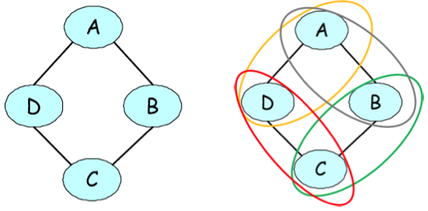
Markov Random Field
A Markov random field is an undirected graphical model:
Undirected graph $G = (V, E)$
One node for each random variable
Potential function or "factor" associated with cliques, $𝒞$, of the graph
Nonnegative potential functions represent interactions and need not correspond to conditional probabilities (may not even sum to one)
Example: undirected graphical representation of a joint probability of voting preferences over four individuals.
A,B,C,D represent four people.
(A,B), (B,C), (C,D), and (D,A) are friends, and friends tend to have similar voting preferences.
The ellipses encircling pairs of nodes illustrate the pairwise factors present in the model.

Slide 7
Factorization of the Joint Distribution
Corresponds to a factorization of the joint distribution:
$$p\left(x\right)=p\left(x_{1},x_{n},…,x_{n}\right)=\frac{1}{Z}\prod_{c∈𝒞}{ψ_{c}\left(x_{c}\right)}$$
$$Z=\sum_{x_{1},…,x_{n}}{\prod_{c∈𝒞}{ψ_{c}\left(x_{c}\right)}}$$
The normalizing constant, $Z$, is called the partition function.
Assume some variables are independent:
$p\left(x_{A},x_{B},x_{c}\right)=$ $\frac{1}{Z}$ $ψ_{AB}\left(x_{A},x_{B}\right)$ $ψ_{BC}\left(x_{B},x_{C}\right)$
Each variable is independent of all of its non-neighbors given its neighbors:
All paths leaving a single variable must pass through some neighbor
If the joint probability distribution, $p$, factorizes with respect to the graph $G$, then $G$ is an I-map for $p$.
If $G$ is an I-map of a strictly positive distribution $p$, then $p$ factorizes with respect to the graph $G$ (Hamersley-Clifford Theorem).
Example: $p\left(A,B,C,D\right)=ψ_{c}\left(A,B\right)ψ_{c}\left(B,C\right)ψ_{c}\left(C,D\right)ψ_{c}\left(D,A\right)$

Slide 8
Comparison Between BNs and MRFs
Property | Bayesian Belief Networks | Markov Random Fields
Factorization | Conditional Distributions | Potential Functions
Distribution | Product of Conditional Distributions | Normalized Product of Potentials
Cycles | Not Allowed | Allowed
Partition Function | 1 | Potentially NP-hard to Compute
Independence Test | d-Separation | Graph Separation
MRFs have several advantages over directed models:
They can be applied to a wider range of problems in which there is no natural directionality associated with variable dependencies.
Undirected graphs can succinctly express certain dependencies that Bayesian nets cannot easily describe (although the converse is also true).
They also possess several important drawbacks:
Computing the normalization constant $Z$ requires summing over a potentially exponential number of assignments (NP-hard).
Undirected models may be difficult to interpret.
BNs are a special case of MRFs with a very specific type of clique factor and a normalizing constant of one.

Slide 9
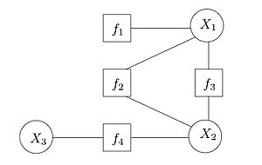
Other Similar Types of Models
Conditional Random Fields: undirected graphical models that represent conditional probability distributions:
$$p(Y|X)=\frac{1}{Z\left(x\right)}\prod_{c∈𝒞}{ψ_{c}\left(x_{c},y_{c}\right)}$$
$$Z\left(x\right)=\sum_{y∈𝒴}{\prod_{c∈𝒞}{ψ_{c}\left(x_{c},y_{c}\right)}}$$
An important special case of Markov Random Fields common in supervised learning settings in which we are given $x$ and want to predict $y$.
This setting is also known as structured prediction.
Log-Linear Models:
$ψ_{c}\left(x_{c},y_{c}\right)=$ $exp\left(w∙f_{c}\left(x_{C},y_{C}\right)\right)$
Factor Graphs: view MRFs in a way where factors and variables are explicit and separate in the representation.
A factor graph is a bipartite graph where one group is the variables in the distribution being modeled, and the other group is the factors defined on these variables. Edges go between factors and variables.

Slide 10
Applications to Image Processing

Slide 11
Applications to Image Processing

Slide 12
Applications to Image Processing

Slide 13
Applications to Image Processing

Slide 14
Applications to Image Processing

Slide 15
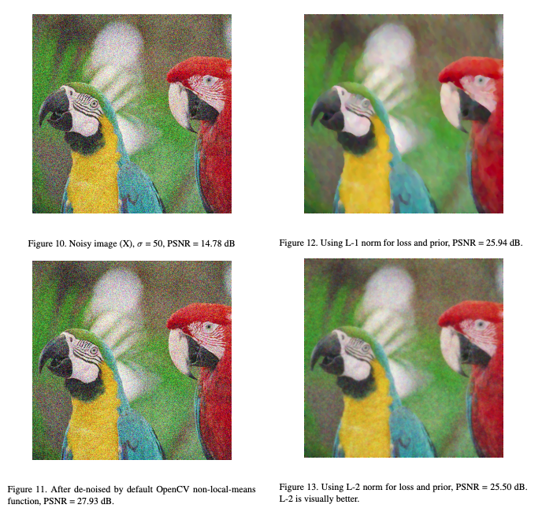
Applications to Image Processing

Slide 16
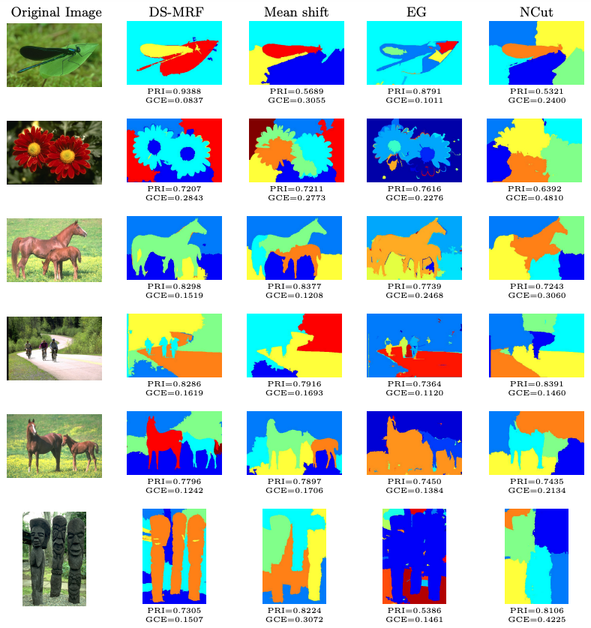
Applications to Image Processing

Slide 17
Summary
Hidden Markov Model: a directed graph in which nodes, or states, represent output (emission) distributions and arcs represent transitions between these nodes. Emission distributions can be discrete or continuous.
Bayesian Belief Network: a directed acyclic graph that can be used to encode dependencies using conditional probabilities.
Parameter Estimation: it is possible to learn the structure of the networks and the parameters of the probability distributions using optimization and information theory techniques.
Markov Random Field: a generalization that supports automated learning of dependencies.
Conditional Random Fields: undirected graphical models that represent conditional probability distributions and support learning of mappings.
Applications: Graphical representations of the relationships between data are used in many areas of science including social network analysis, disease modeling, genomics and human computer dialog systems.

