Slide 1
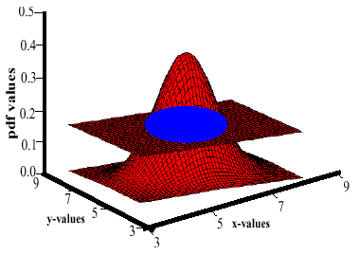
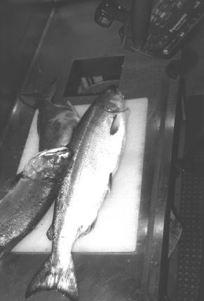
Lecture 02: Feature Selection and Decision Surfaces
Objectives:
Feature Selection
Feature Correlation
Decision Surfaces
The Bayesian Approach
The Noisy Communication Model
Resources:
Syllabus
DHS: Chapter 1
DJM: Information Theory

Slide 2
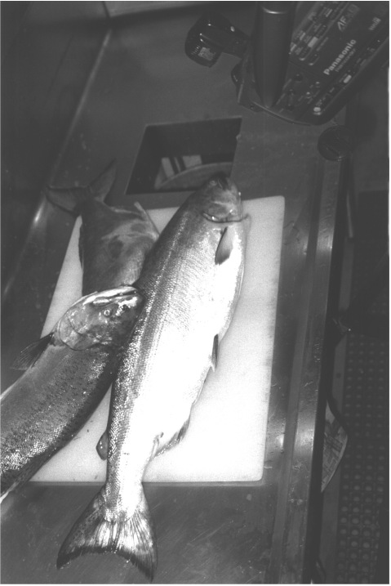
Image Processing Example: Sorting Fish
Sorting Fish: we seek to sort incoming fish according to their species using an optical sensing system (e.g., sea bass or salmon?)
Problem Analysis:
  We will set up one or more cameras, collect some sample images to use for system development.
  How much data do we need to collect to develop a high performance system?
  We decide to extract features automatically from the images.
  With a little bit of thought, we decide to consider features such as length, lightness, width, number and shape of fins, position of mouth, etc.
  But how do we decide what is the best combination of features?
Sensing
Segmentation
Feature Extraction

Slide 3
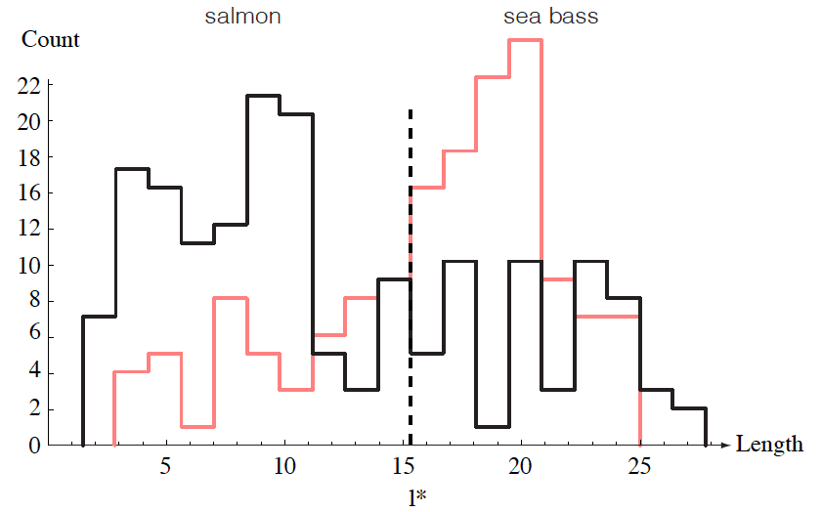
Length As A Discriminator of the Species
Conclusion: Length is a poor discriminator

Slide 4
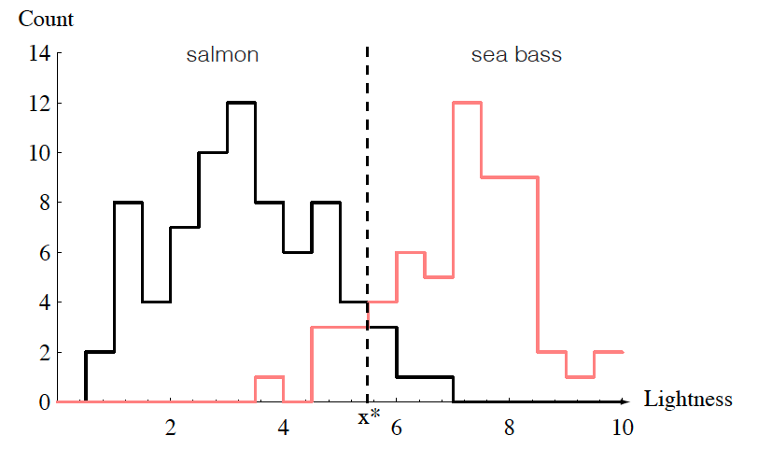
Add Another Feature: Lightness
Lightness is a better feature than length because it reduces the misclassification error.
Can we combine features in such a way that we improve performance?
(Hint: correlation)

Slide 5
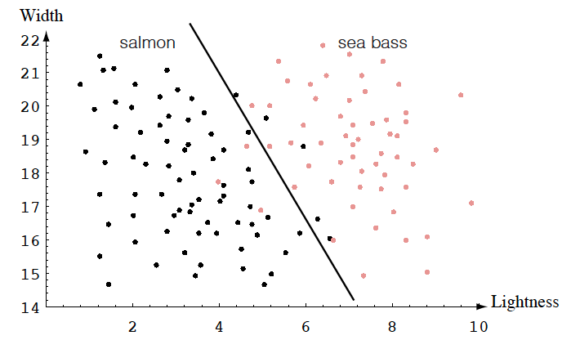
Feature Combination: Width And Lightness
Treat features as a N-tuple (two-dimensional vector)
Create a scatter plot
Draw a line (regression) separating the two classes

Slide 6
Decision Theory
Can we do better than a linear classifier?
What is wrong with this decision surface? (Hint: generalization)

Slide 7
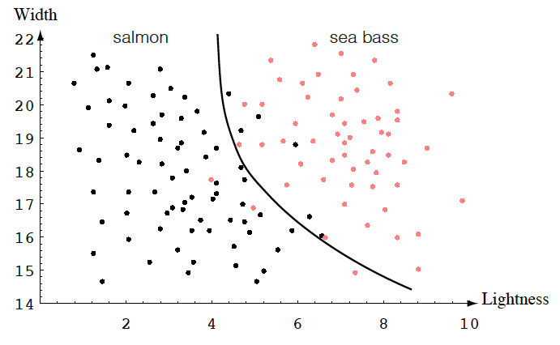
Generalization and Risk Revisited
Why might a smoother decision surface be a better choice?
(Hint: Occam’s Razor).
This course investigates how to find such “optimal” decision surfaces.
We provide system designers with the tools to make intelligent
trade-offs between accuracy, cost, false alarms, etc.

Slide 8
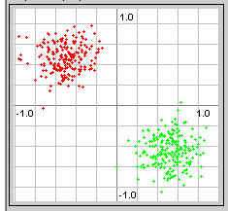
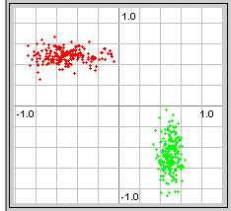
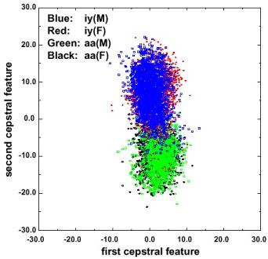
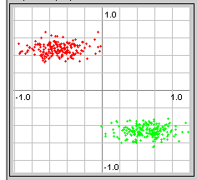
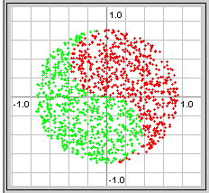
Feature Correlation
Degrees of difficulty:
Real data is often much harder:

Slide 9
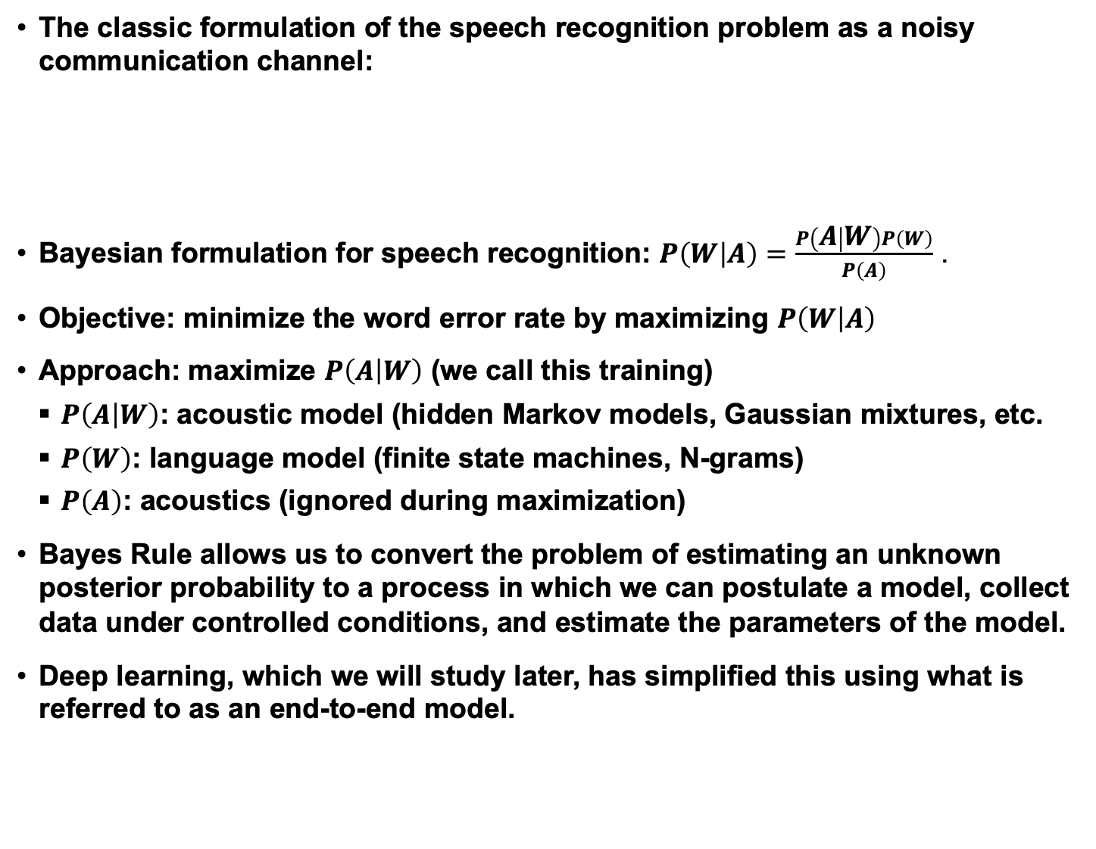
Bayesian Formulations
The classic formulation of the speech recognition problem as a noisy communication channel:
Bayesian formulation for speech recognition: $P\left(W | A\right)=\frac{P\left(A | W\right)P\left(W\right)}{P\left(A\right)}$ .
Objective: minimize the word error rate by maximizing $P\left(W | A\right)$
Approach: maximize $P\left(A | W\right)$ (we call this training)
  $P\left(A | W\right)$: acoustic model (hidden Markov models, Gaussian mixtures, etc.
  $P\left(W\right)$: language model (finite state machines, N-grams)
  $P\left(A\right)$: acoustics (ignored during maximization)
  Bayes Rule allows us to convert the problem of estimating an unknown posterior probability to a process in which we can postulate a model, collect data under controlled conditions, and estimate the parameters of the model.
  Deep learning, which we will study later, has simplified this using what is referred to as an end-to-end model.
Message
Source
Linguistic
Channel
Articulatory
Channel
Acoustic
Channel
Message
Words
Phones
Features

Slide 10
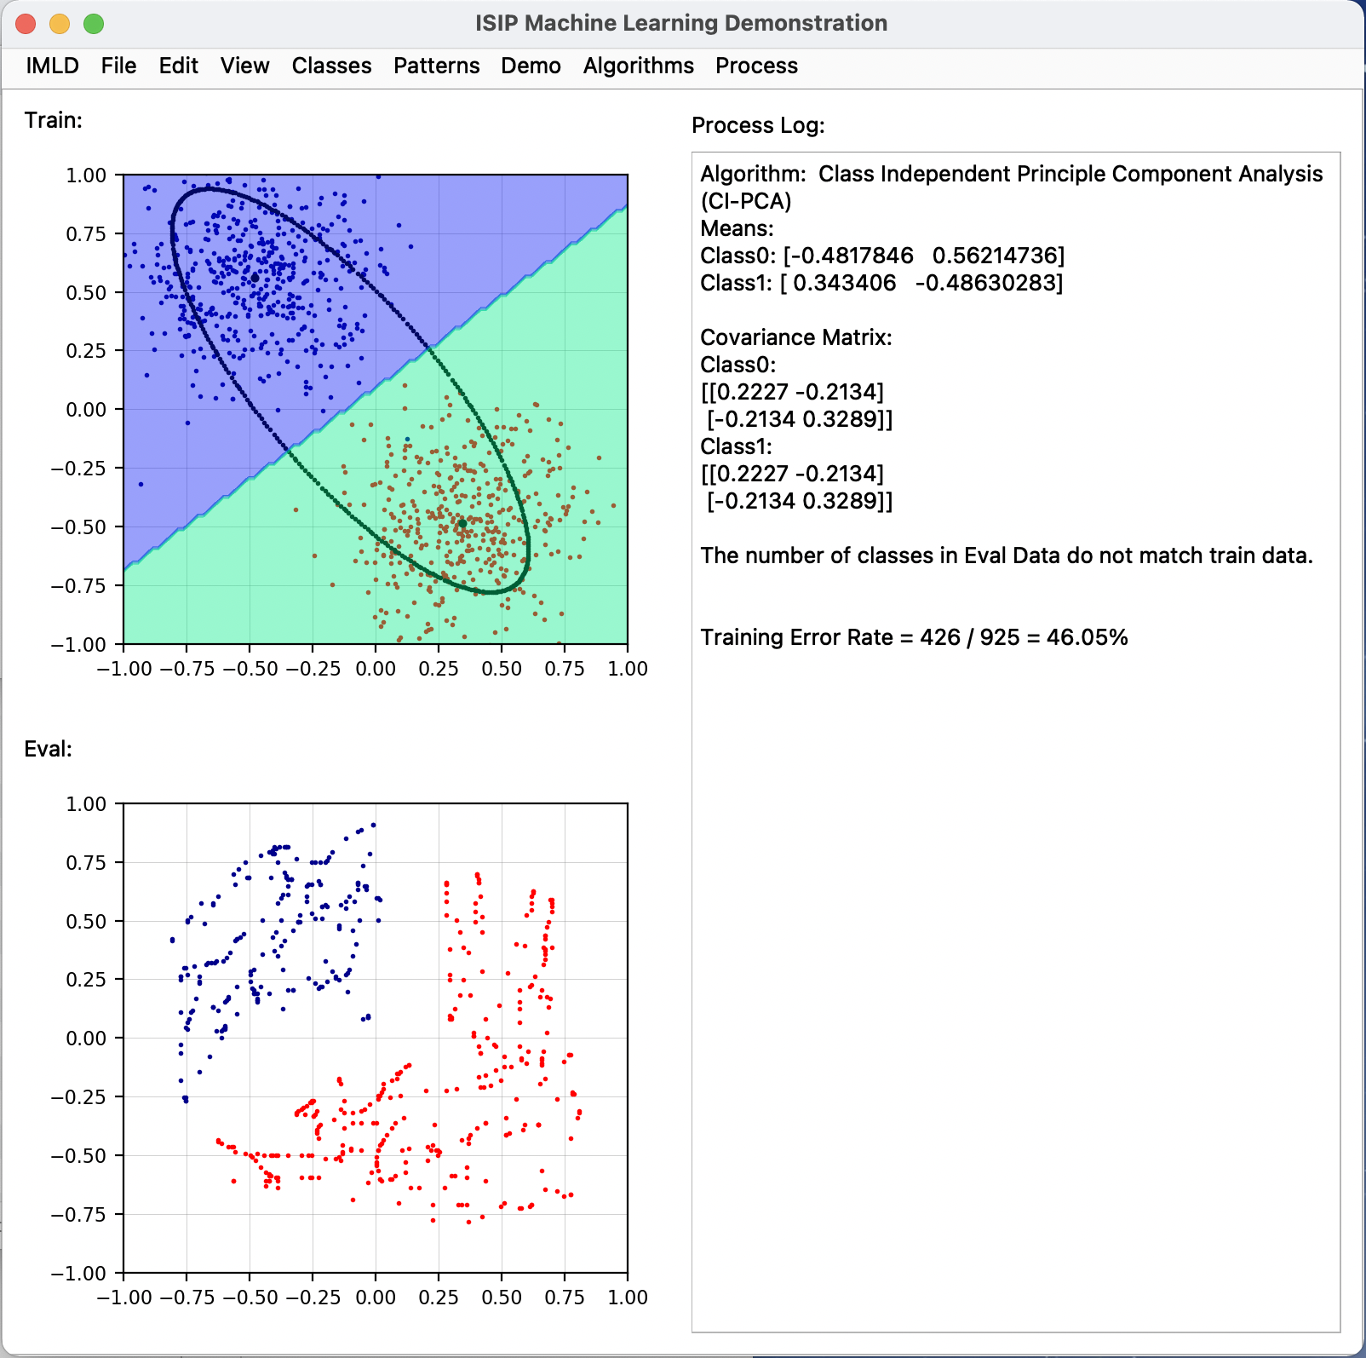
ISIP Machine Learning Demo (IMLD)
There are many excellent resources on the Internet that demonstrate pattern recognition concepts.
There are many Python, MATLAB and C++ toolboxes that implement state of the art algorithms.
One such resource is the ISIP Machine Learning Demo (IMLD) that lets you quickly explore how a variety of algorithms process the same data.
Users can create data sets with the application, save them to disk, or upload new data sets.
Users can select from a variety of machine learning algorithms.
Users can test generalization by creating training and open-set evaluation sets.
….
The application is written in Python using PyQT5, PyQtGraph and the Python machine learning package SciKit-Learn.
Warning: still under development.

Slide 11
Summary
When you have limited amounts of data, good feature selection can be important.
Features are often based on our understanding of the problem (e.g., the physics for physical signals) – we refer to these as model-based features.
Correlation between features is something we must learn how to properly handle.
Decision rules based on thresholds, or hyperplanes, can work well if the data is properly conditioned.
Many real-world problems require nonlinear decision surfaces.
Bayesian approaches allow us to integrate domain knowledge, often referred to as subject matter expertise, using simple statistical models.

Slide 12
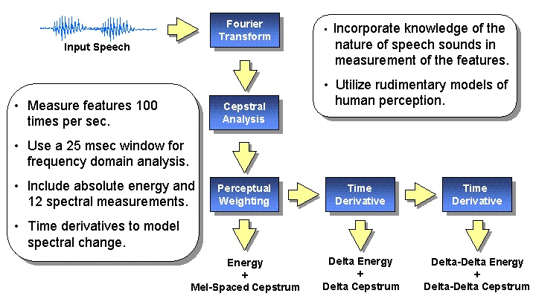
Review: Mel Frequency Cepstral Coefficients

Slide 13
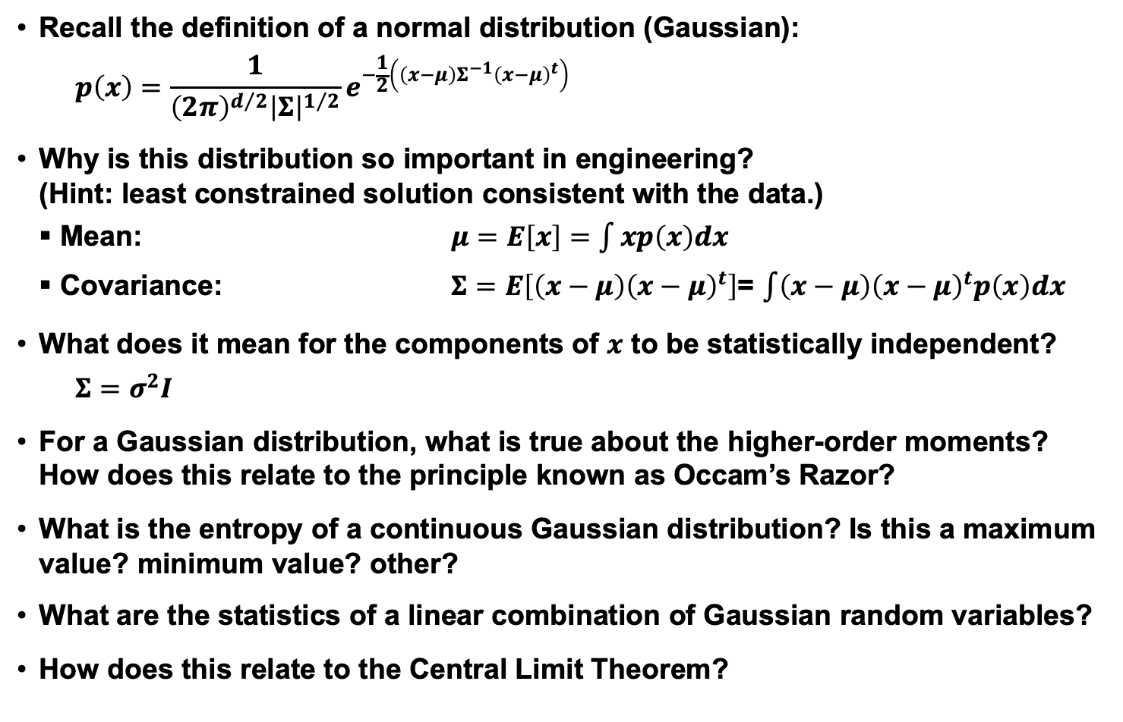
Review: Normal Distributions
Recall the definition of a normal distribution (Gaussian):
$$p\left(x\right)=\frac{1}{{\left(2π\right)}^{d/2}{\left|Σ\right|}^{1/2}}e^{−\frac{1}{2}\left(\left(x−μ\right)Σ^{−1}{\left(x−μ\right)}^{t}\right)}$$
Why is this distribution so important in engineering?
(Hint: least constrained solution consistent with the data.)
Mean: $μ=E\left[x\right]=\int{xp\left(x\right)dx}$
Covariance: $Σ=E\left[\left(x−μ\right){\left(x−μ\right)}^{t}\right]$= $\int{\left(x−μ\right){\left(x−μ\right)}^{t}p\left(x\right)dx}$
What does it mean for the components of $x$ to be statistically independent?
$$Σ=σ^{2}I$$
For a Gaussian distribution, what is true about the higher-order moments? How does this relate to the principle known as Occam’s Razor?
What is the entropy of a continuous Gaussian distribution? Is this a maximum value? minimum value? other?
What are the statistics of a linear combination of Gaussian random variables?
How does this relate to the Central Limit Theorem?

Slide 14
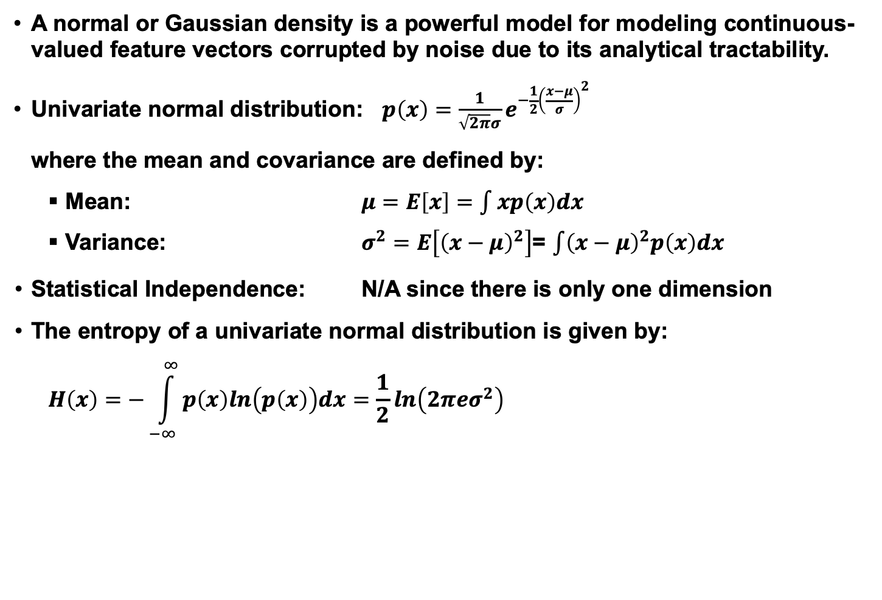
Review: Univariate Normal Distribution
A normal or Gaussian density is a powerful model for modeling continuous-valued feature vectors corrupted by noise due to its analytical tractability.
Univariate normal distribution: $p\left(x\right)=\frac{1}{\sqrt{2π}σ}e^{−\frac{1}{2}{\left(\frac{x−μ}{σ}\right)}^{2}}$
where the mean and covariance are defined by:
Mean: $μ=E\left[x\right]=\int{xp\left(x\right)dx}$
Variance: $σ^{2}=E\left[{\left(x−μ\right)}^{2}\right]$= $\int{{\left(x−μ\right)}^{2}p\left(x\right)dx}$
Statistical Independence: N/A since there is only one dimension
The entropy of a univariate normal distribution is given by:
$$H\left(x\right)=−\int_{−∞}^{∞}{p\left(x\right)ln\left(p\left(x\right)\right)dx=\frac{1}{2}ln\left(2π{eσ}^{2}\right)}$$

Slide 15
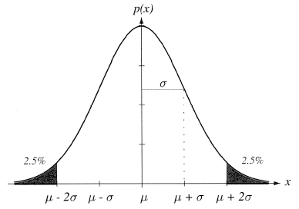

Review: Mean and Variance
A normal distribution is completely
specified by its mean and variance:
The peak is at: $p\left(μ\right)=\frac{1}{\left(\sqrt{2π}\right)σ}$ .
$66\%$ of the area is within one σ;
$95\%$ is within $2$; $99\%$ is within $3$.
A normal distribution achieves the
maximum entropy of all distributions
having a given mean and variance.
Central Limit Theorem: The sum of a
large number of small, independent random variables will lead to a Gaussian distribution.
Can you provide an intuitive explanation for this? (Hint: convolution.)

Slide 16
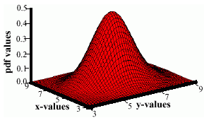
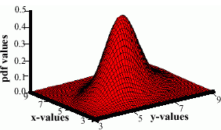

Review: Multivariate Normal Distributions
Recall the definition of a normal distribution (Gaussian):
$$p\left(x\right)=\frac{1}{{\left(2π\right)}^{d/2}{\left|Σ\right|}^{1/2}}e^{−\frac{1}{2}\left(\left(x−μ\right)Σ^{−1}{\left(x−μ\right)}^{t}\right)}$$
where $μ$ represents the mean (vector) and $Σ$ represents the covariance.
Note the exponent term is really a dot product or a weighted Euclidean distance. This can be computed very efficiently on modern processors.
The covariance is always symmetric and positive semidefinite.
How does the shape vary as a function of the covariance?

Slide 17
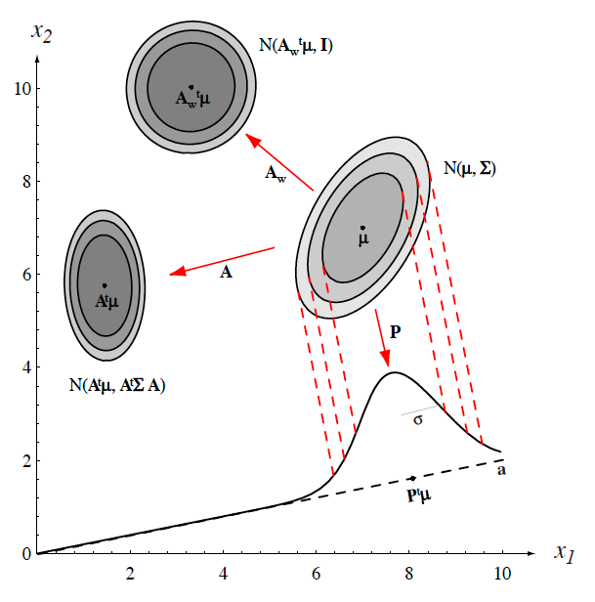
Review: Support Regions
The pdf of 2D random vector requires 3D to visualize (the third dimension is the value, or height, of the pdf).
We cannot directly visualize the pdf of a 3D random vector since this would require four dimensions. Also, it is difficult to visualize a 3D function and understand its shape.
A support region is the obtained from the intersection of a Gaussian distribution with a horizontal plane (the locus of points that the same probability).
For a horizontal plane, this generates an ellipse whose points are of equal probability density.
The shape of the support region is defined by the covariance matrix.

Slide 18
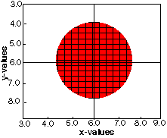
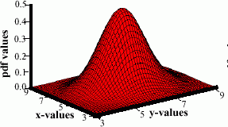
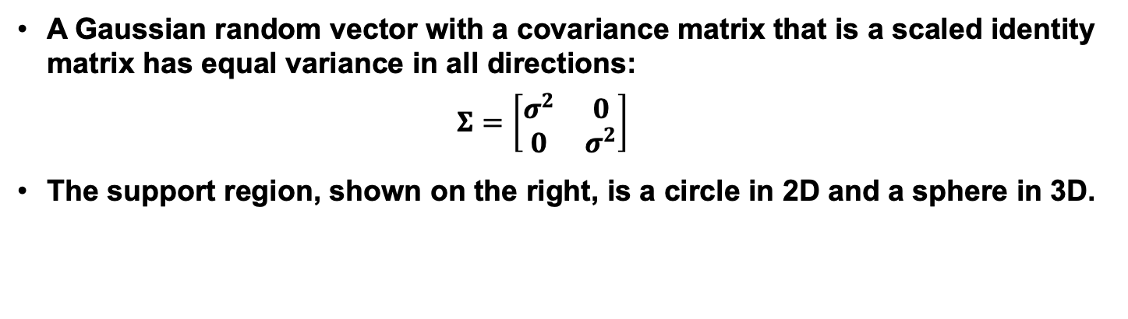
Review: Identity Covariance
A Gaussian random vector with a covariance matrix that is a scaled identity matrix has equal variance in all directions:
$$Σ=\left[\begin{matrix}σ^{2} & 0 \\ 0 & σ^{2}\end{matrix}\right]$$
The support region, shown on the right, is a circle in 2D and a sphere in 3D.

Slide 19
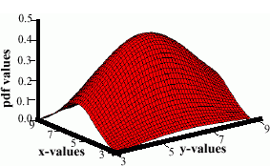
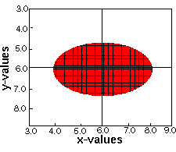
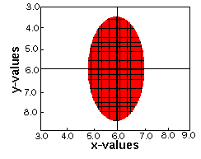
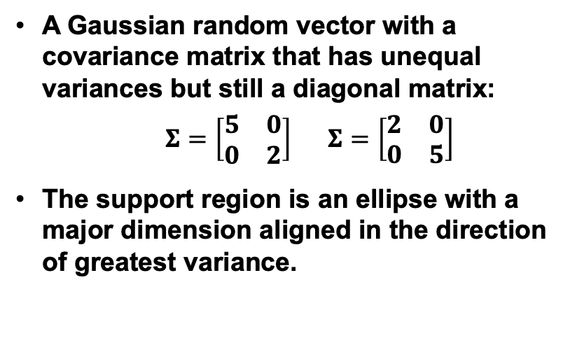
Review: Unequal Variances
A Gaussian random vector with a covariance matrix that has unequal variances but still a diagonal matrix:
$Σ=\left[\begin{matrix}5 & 0 \\ 0 & 2\end{matrix}\right]$ $Σ=\left[\begin{matrix}2 & 0 \\ 0 & 5\end{matrix}\right]$
The support region is an ellipse with a major dimension aligned in the direction of greatest variance.

Slide 20
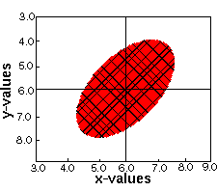
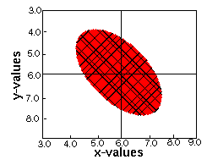
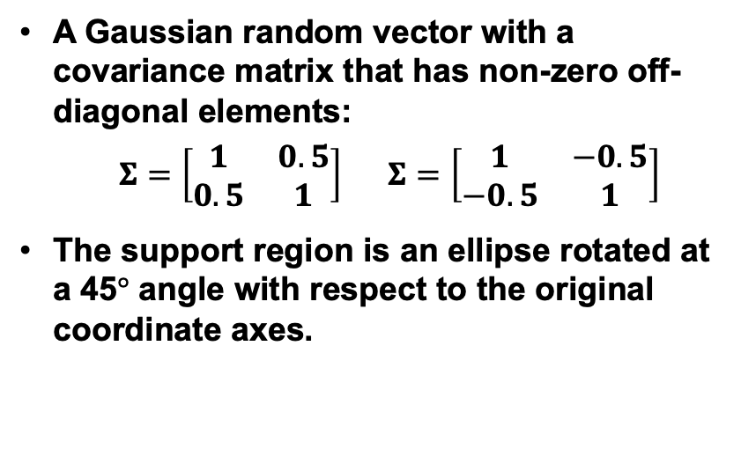
Review: Nonzero Off-Diagonal Elements
A Gaussian random vector with a covariance matrix that has non-zero off-diagonal elements:
$Σ=\left[\begin{matrix}1 & 0.5 \\ 0.5 & 1\end{matrix}\right]$ $Σ=\left[\begin{matrix}1 & −0.5 \\ −0.5 & 1\end{matrix}\right]$
The support region is an ellipse rotated at a 45$°$ angle with respect to the original coordinate axes.

Slide 21
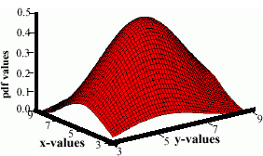
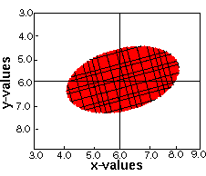
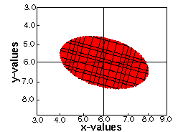
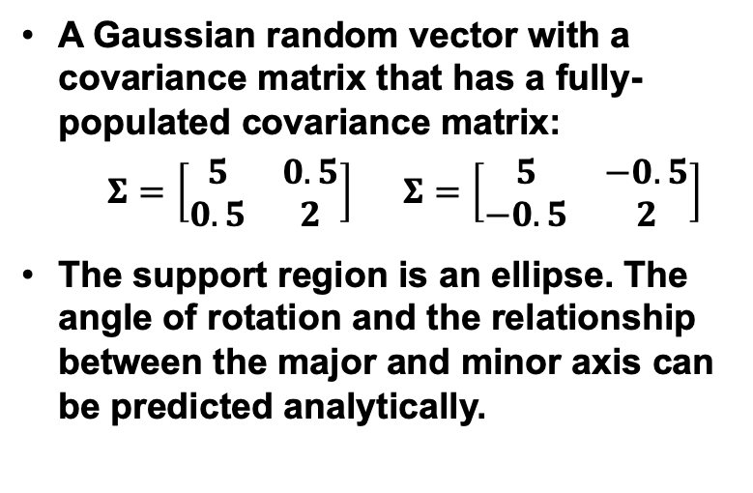
Review: Unconstrained or “Full” Covariance
A Gaussian random vector with a covariance matrix that has a fully-populated covariance matrix:
$Σ=\left[\begin{matrix}5 & 0.5 \\ 0.5 & 2\end{matrix}\right]$ $Σ=\left[\begin{matrix}5 & −0.5 \\ −0.5 & 2\end{matrix}\right]$
The support region is an ellipse. The angle of rotation and the relationship between the major and minor axis can be predicted analytically.

