Slide 1
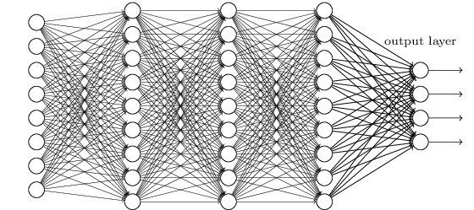
Enabling Deep Learning Approaches for Automatic Interpretation of EEGs
J. Picone, Vinit Shah and Iyad Obeid
Neural Engineering Data Consortium
Temple University

Slide 2
Abstract
Electronic medical records (EMRs) collected at every hospital in the country collectively contain a staggering wealth of biomedical knowledge. EMRs can include unstructured text, temporally constrained measurements (e.g., vital signs), multichannel signal data (e.g., EEGs), and image data (e.g., MRIs). This information could be transformative if properly harnessed.
We are focused on the automatic interpretation of clinical EEGs collected since 2002 at Temple University Hospital (30,000+ sessions/16,000+ patients). The corpus contains EEG signal data, reports, and automatically-generated annotations of key features (e.g. abnormal) and events (e.g., seizure).
Automated processing of EEGs is a challenging machine learning problem because the multichannel signal often has an extremely low signal to noise ratio. Events of interest such as seizures are easily confused with signal artifacts (e.g., eye movements) or benign variants (e.g., slowing).
We have developed a cohort retrieval system that allows clinicians to retrieve relevant EMRs using standard queries (e.g. “Young patients with focal cerebral dysfunction who were treated with Topamax”). The system integrates temporal and spatial context for signal and text data.
Applications of this system include clinical support, education and training. The data and tools are available from the NEDC web site (www.nedcdata.org).

Slide 3
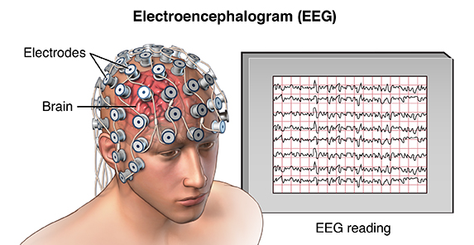
What is an EEG ?
Electroencephalography (EEG) is a popular tool used to diagnose brain related illnesses.
Scalp Electroencephalogram (EEG) monitoring is a non-invasive and convenient method to assess electrical activity from brain.
Interpretation of EEGs is challenging, and its accurate annotation requires extensive training.
Diagnosis is performed considering the factors such as patient’s video recordings, medical history, age, environmental & physiological changes, etc.

Slide 4
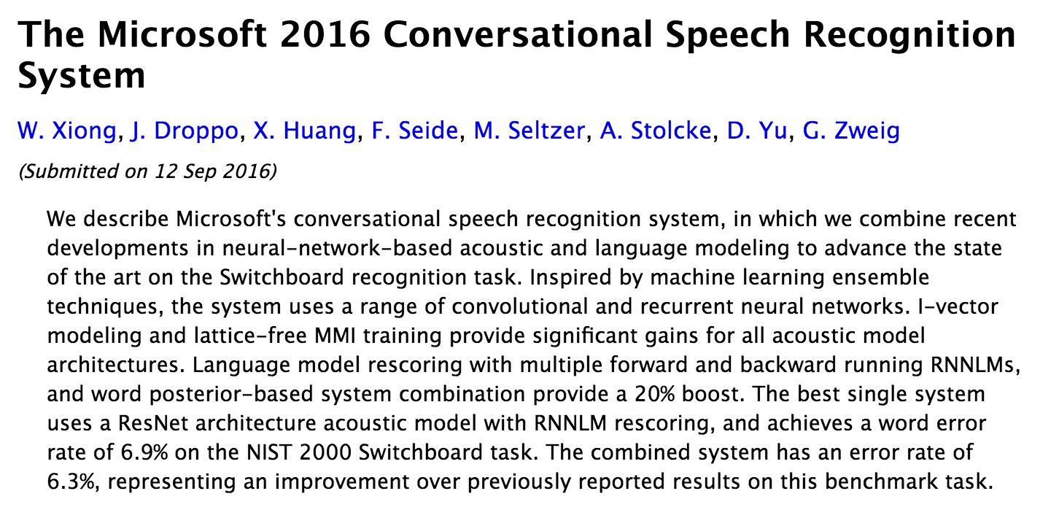
Why Is Big Data So Important?
Deep learning systems have contributed to reductions in error rates in speech recognition from 80% in the 1990’s to 6.9% in 2016.
Progress in the last 5 years alone has been significant.
Markov Model
Deep Learning
Deep learning systems require large amounts of data:
Corpus | Training Speech | SGMM WER | DNN WER
BABEL Pashto | 10 hours | 69.2% | 67.6%
BABEL Pashto | 80 hours | 50.2% | 42.3%
Fisher English | 2000 hours | 15.4% | 10.3%

Slide 5
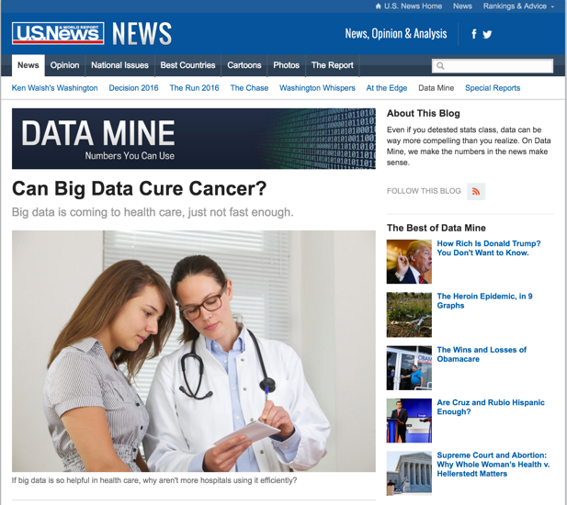
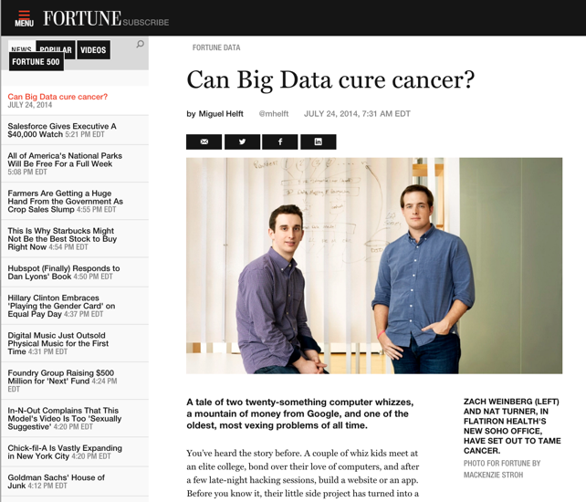
Big Data is Everywhere
Bob Mercer, IBM Speech Research (1985):
“There is no data like more data.”
Dan Ariely, Duke University (2013):
“Big Data is like teenage sex: everyone talks about it, nobody really knows how to do it, everyone thinks everyone else is doing it, so everyone claims they are doing it.”
Douglas Merrill, Zestfinance.com (2013):
“Given enough data, everything is statistically significant.”

Slide 6
Where Does This Data Come From?
In commercially viable applications, there are significant economic motivations to develop large data resources.
In many bioengineering applications, the commercial opportunities are not as significant, so the development of data resources is lagging.
However, the healthcare industry is awash in vast amounts of unstructured data:
The TUH EEG Corpus: over 30,000 EEGs from over 16,000 patients in the last 14 years collected in a clinical setting at an urban public hospital.
At least 4 Petabytes of data including raw EEGs and video.
At least 1M pathology slides are read and interpreted daily across the U.S.
Little of this data is being captured for research purposes due to IRB and HIPAA concerns.

Slide 7
Why Big Data Is Critical
Medicine by its nature deals with statistical outliers and rare events. Rare diseases are often hard to diagnose yet are critical to effective healthcare:
Example: Temple Hospital’s Department of Neurology conducts about 3,000 EEGs per year, and less than 1% of these patients are diagnosed with posterior reversible encephalopathy syndrome (PRES).
It is difficult to build powerful analytics with such small sample sizes.
Every patient seems to be unique in some way:
“CLINICAL HISTORY: This is a 50-year-old male with previous surgery for a left frontal glioma now with accelerating complex partial seizures.
MEDICATIONS: Dilantin, Ativan, and others.”
“CLINICAL HISTORY: A 69-year-old male with known ascending arch aneurysm, recent worsening after GI bleed.”
MEDICATIONS: Etomidate, midazolam fentanyl, vecuronium, protamine, gabapentin, scopolamine patch, others.”
Clinicians see a small percentage of the total population throughout their career, and must stay current through continuing education.

Slide 8
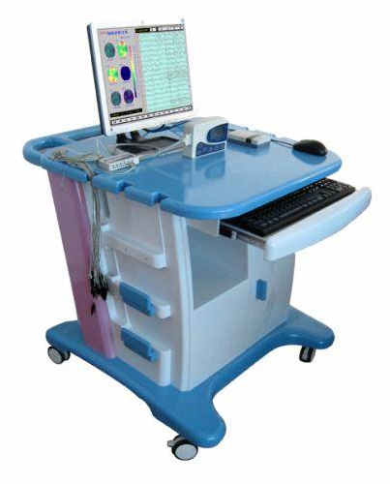
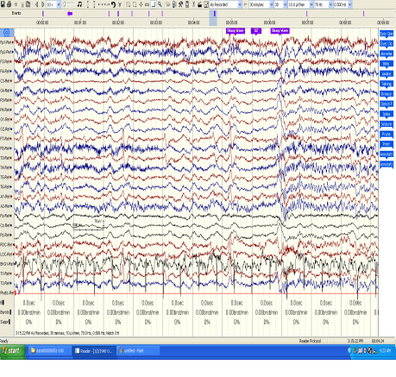
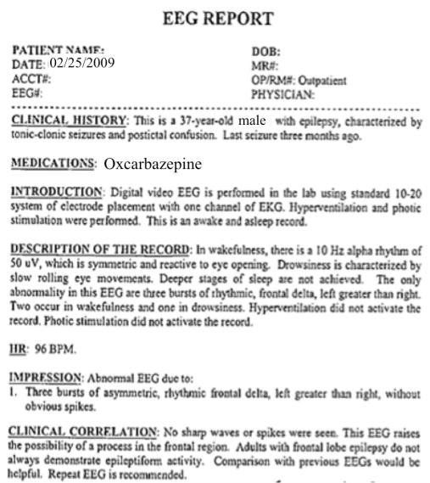
The Temple University Hospital EEG Corpus Synopsis: The world’s largest publicly available EEG corpus consisting of 30,000+ EEGs collected from 16,000+ patients, collected over 16 years. Includes EEG signal data, physician’s diagnoses and patient medical histories. A total of 1.4 Tbytes of data.
Impact:
Sufficient data to support application of state of the art machine learning algorithms
Patient medical histories, particularly drug treatments, supports statistical analysis of correlations between signals and treatments
Historical archive also supports investigation of EEG changes over time for a given patient
Over 1,300 customers have subscribed to the corpus
Database Overview:
28,000+ EEGs collected at Temple University Hospital from 2002 to 2018 (an ongoing process)
Recordings vary from 24 to 36 channels of signal data sampled at 250 Hz
Patients range in age from 18 to 90+ with an average of 1.6 EEGs per patient
72% of the patients have one session; 16% have two sessions; 12% have three or more sessions
Data includes a test report generated by a technician, an impedance report and a physician’s report
Personal information has been redacted
Clinical history and medication history are included
Physician notes are captured in three fields: description, impression and correlation fields.

Slide 9
Cohort Retrieval
Queries can be submitted that search signals and reports.
A simple query building interface is supported.
Search results are displayed in a way that link signals and reports.
Users can easily review and select the top-ranked results.
The user interface is being co-developed with feedback from expert neurologists.

Slide 10
Case Study: Manual Interpretation of EEGs
EEGs are used to diagnose a variety of brain-related illnesses including seizures and epilepsy.
EEG data is recorded for a period of time ranging from 20 minutes (short-term, outpatient) to several days (long-term, inpatient).
Approximately 93% of short-term EEGs are inconclusive. It is very difficult to replicate the conditions under which a patient seizes.
Manual interpretation of an EEG is performed by a board-certified neurologist. It takes several years to receive this certification.
Patient Preparation
EEG Recording
EEG ranging from 22 minutes to several days is recorded
EEG is Interpreted
Certified physicians interpret EEG
Patients are prepared for the test
EEG Report is Produced
Report of findings (e.g. abnormality) is prepared

Slide 11
The Classic Machine Learning Paradigm
Key issues:
Is the data representative of the problem?
Do the features capture meaningful differences between patterns?
How do we find the best model?
How do we estimate the parameters of the model?
How do we evaluate performance?
Collect Data
Evaluate Classifier
Select Features
Train Classifier
Choose Model
Other considerations:
The answers are often application specific and data dependent.
Customers/users don’t often completely understand their requirements.
Data collection is often an on-going process that drives the technology.

Slide 12
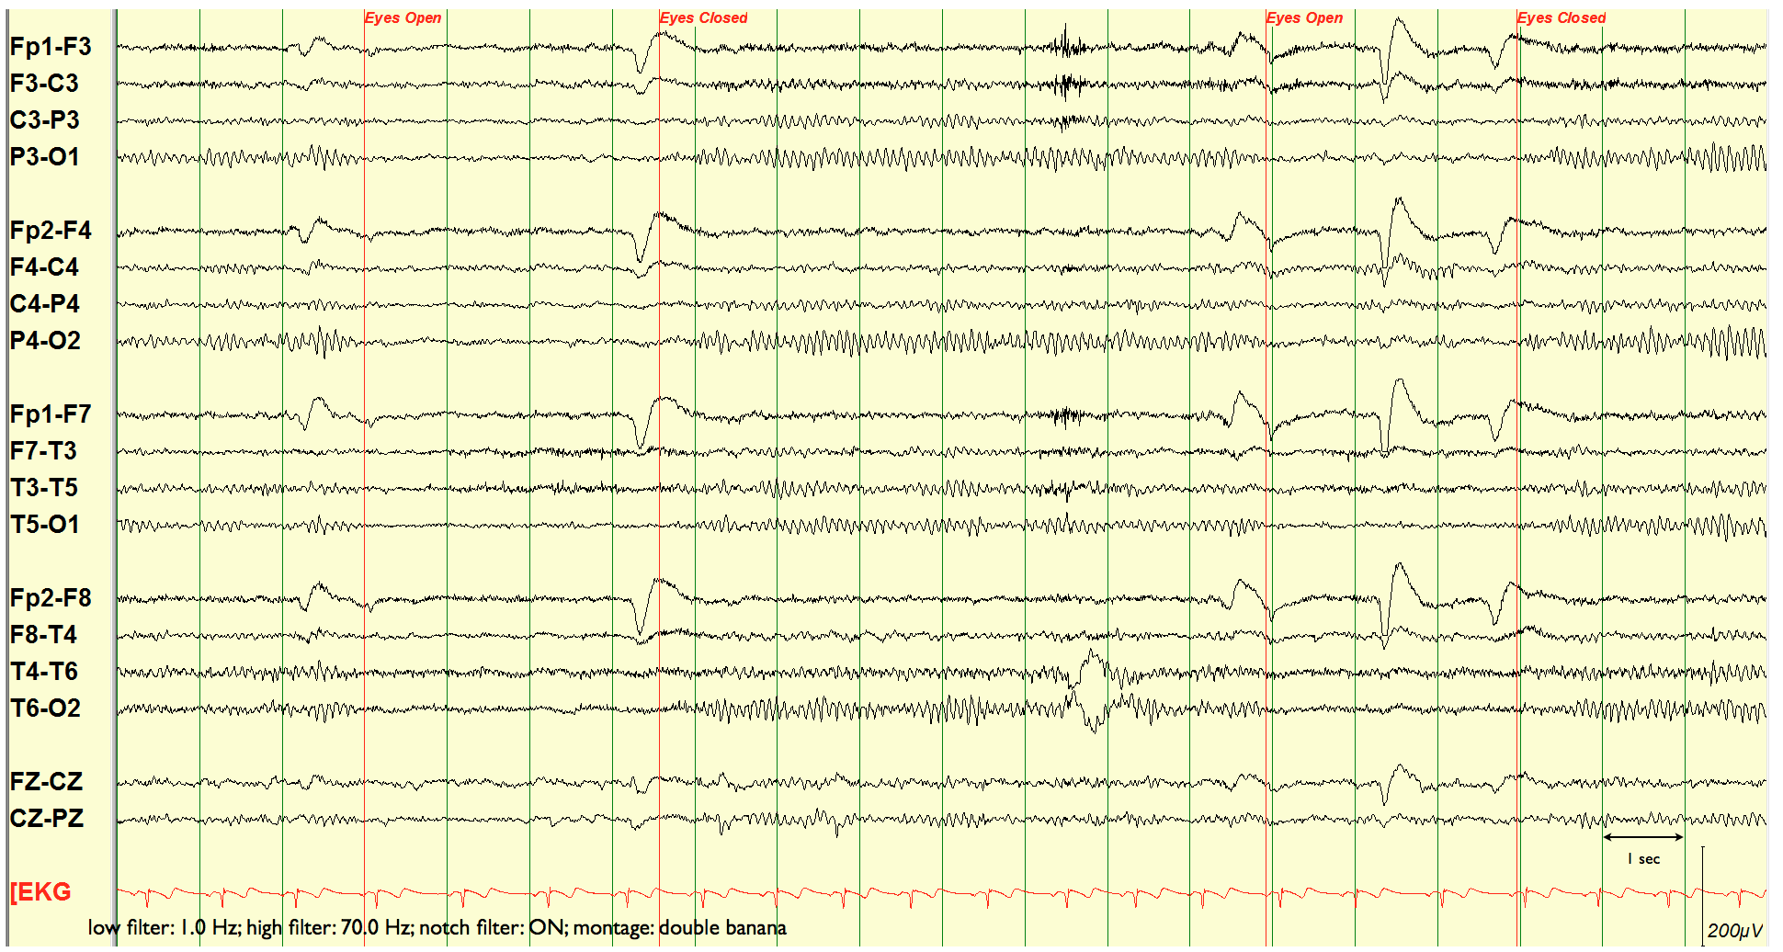
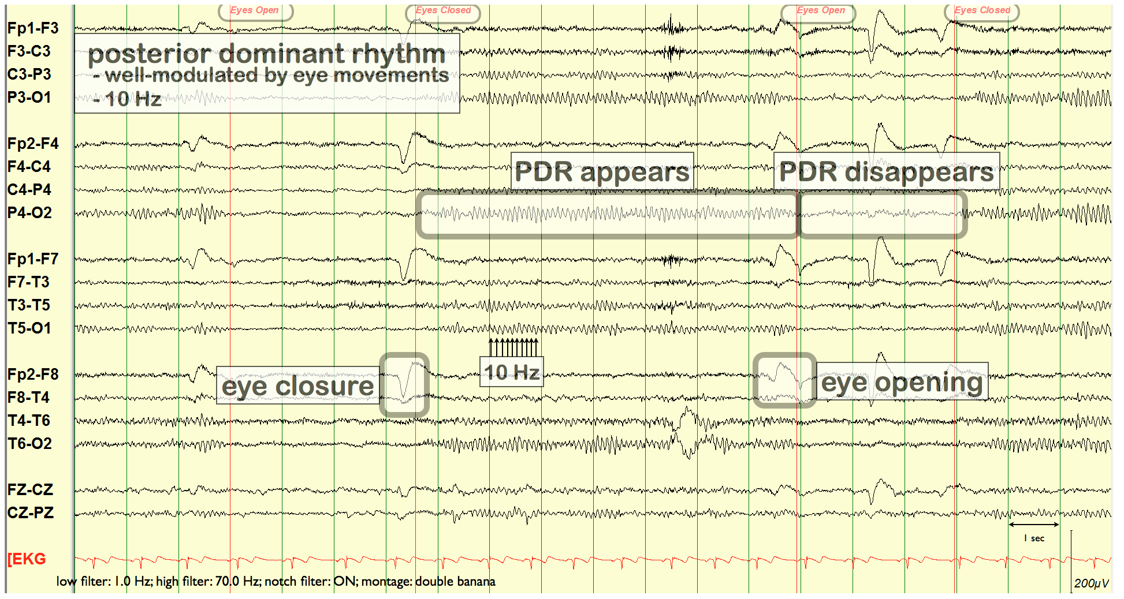
EEG Signals Are Challenging To Interpret
Neurologists visually inspect waveforms looking for epileptiform discharges (e.g., spikes) that are an indication of abnormalities.
Though there is general agreement on a diagnosis, interrater agreement on annotation of local events is low.

Slide 13
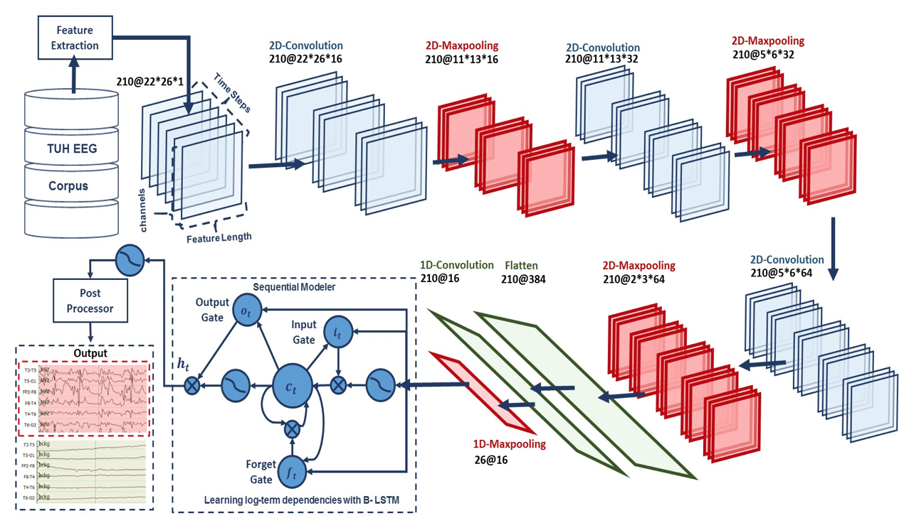
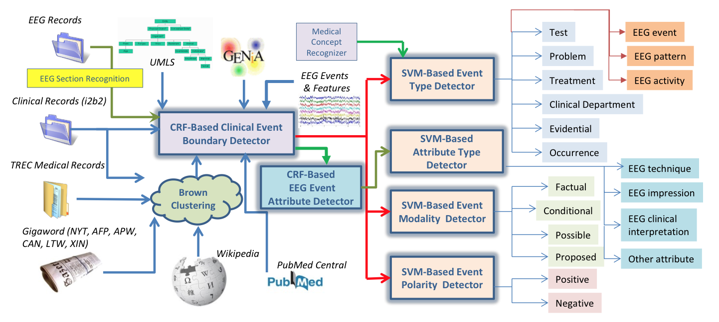
Overview: Two Main Components
AutoEEG: hyper-real-time automated identification and localization of EEG signal events
Identification of the temporal and spatial location of EEG signal events such as spikes.
Two levels of deep learning are used (CNN followed by LSTM), followed by a postprocessor that uses a statistical language model.
MERCuRY: Multi-modal EncephalogRam patient Cohort discoverY
Automated identification of EEG activities, EEG events and patterns as well as their attributes in EEG reports.
Identification of medical concepts that describe the clinical picture and therapy of the patients.

Slide 14
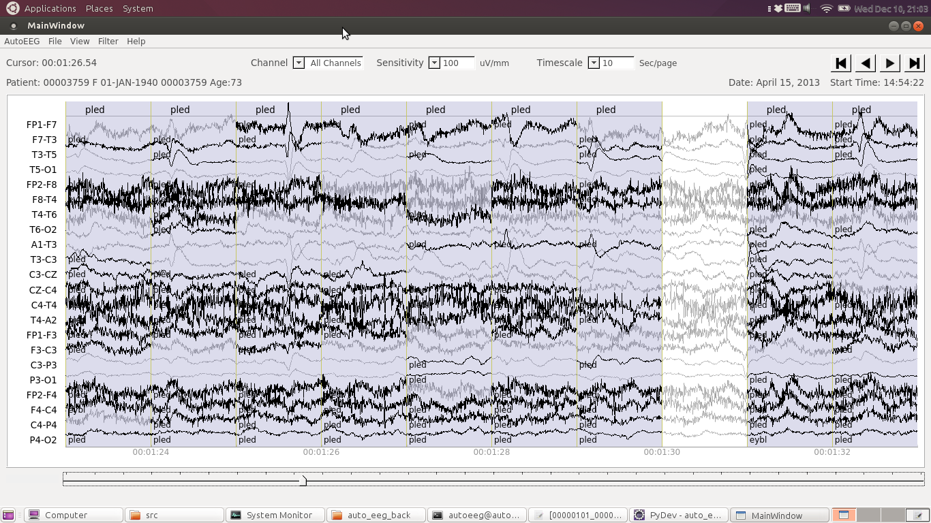
EEG Signal Event Detection
High performance event detection using a multi-pass deep learning approach.
Events are localized in time (e.g., start time and duration) and space (e.g., EEG channels map to location on the scalp).
Physiological data is searchable by labels and types of events.
The user interface emulates existing clinical tools.
Customizable visualizations supported include waveforms, spectrograms and energy.
Spectrograms are increasingly being used to verify the onset of a seizure.

Slide 15
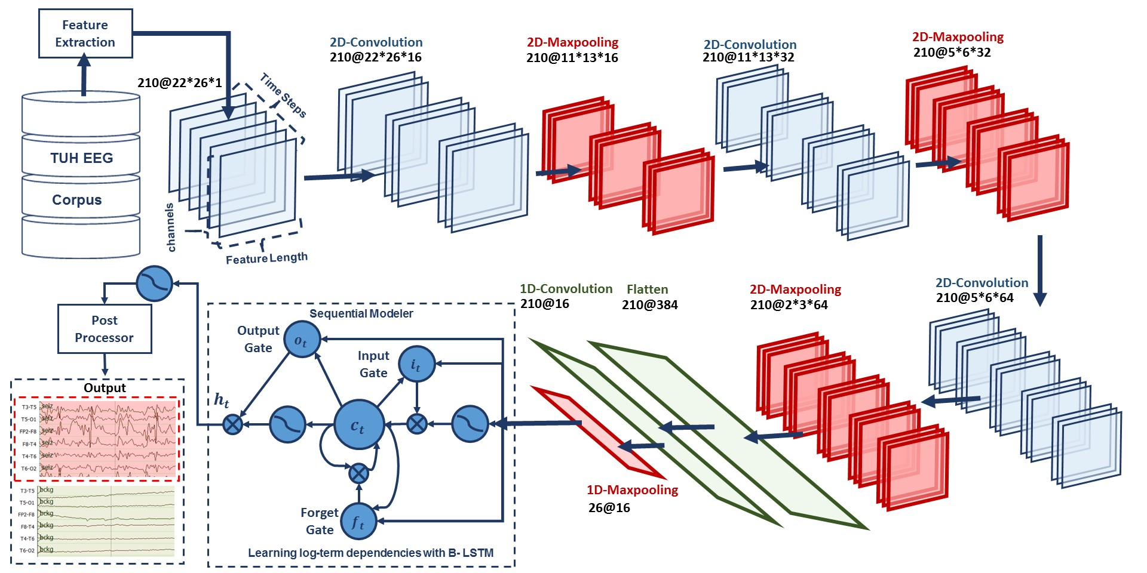
AutoEEG: Automatic Interpretation of EEGs
AutoEEG is a hybrid system that uses three levels of processing to achieve high performance event detection on clinical data:
Pass 1 (P1): 2D Convolutional Neural Network (CNN)
Pass 2 (P2): Bidirectional Long Short Term Memory Network (B-LTSM)
Pass 3 (P3): A statistical language model is used to model event sequences

Slide 16
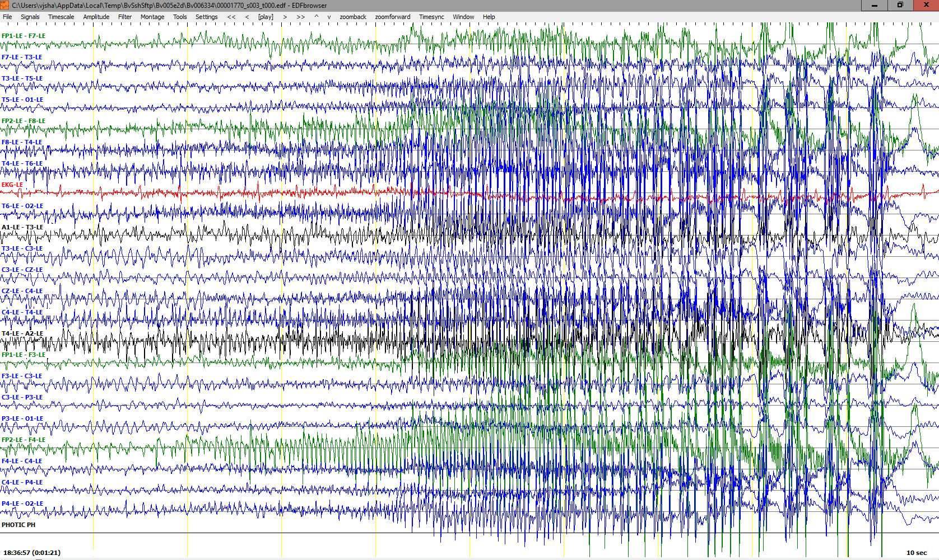
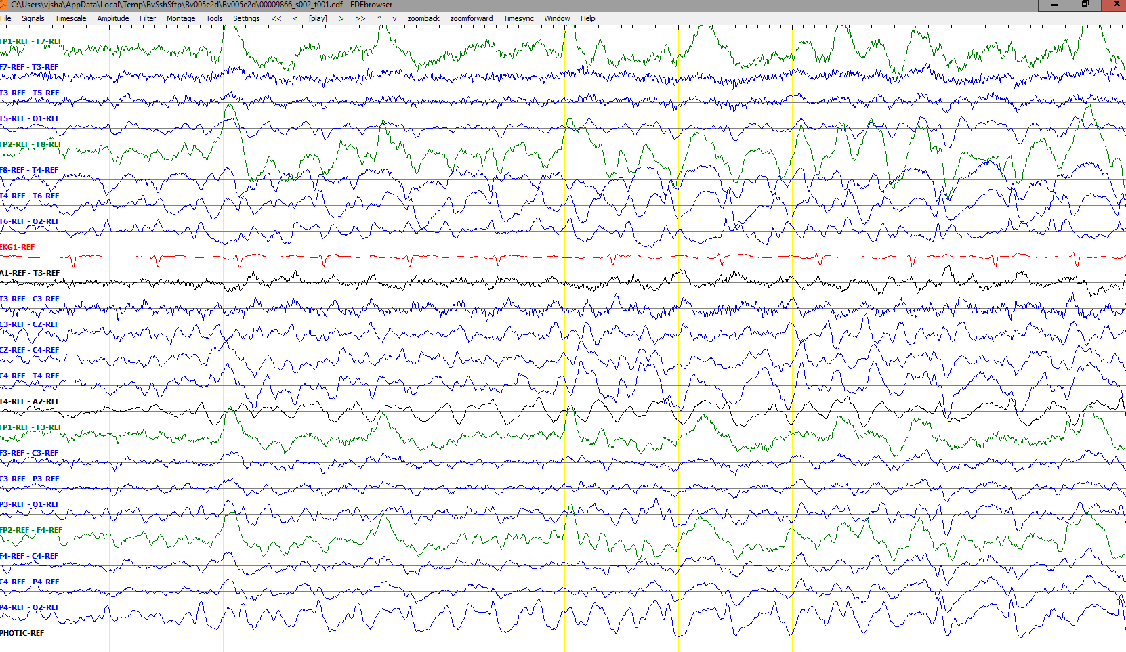
Seizure Morphologies
Electrographic seizures can be detected either by observing epileptiform activities or by observing artifacts related to specific types of seizures.
There are multiple types of seizures (i.e. tonic-clonic/grand mal, absence/petit mal, complex-partial)
Interpretation of focal seizures require temporal as well as sufficient level of spatial information.
Typically interpreters look for epileptiform activity such as spike and wave discharges and its evolution over time.
Easy seizures show clear evolution in signal’s frequency and amplitude.

Slide 17
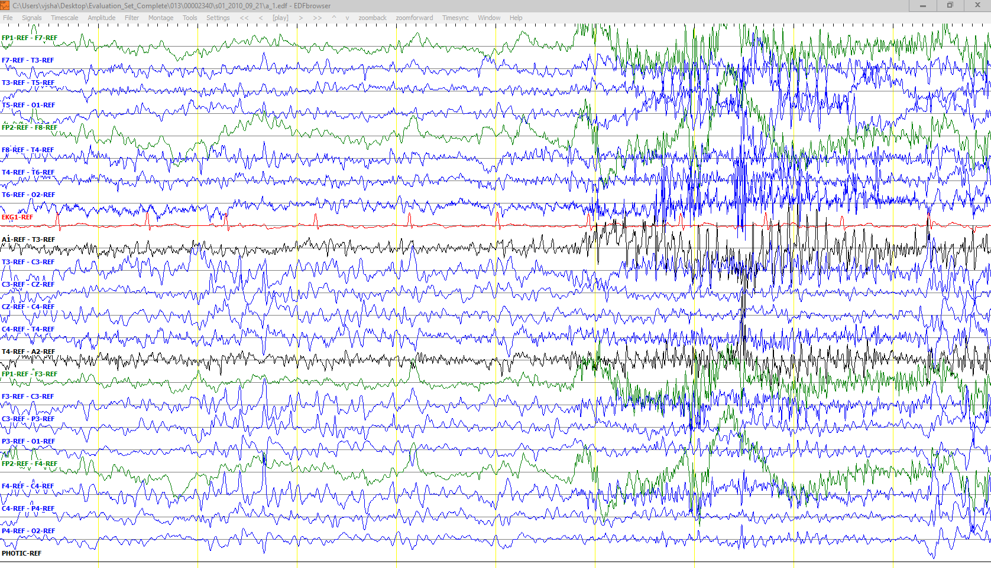
Inconclusive Segments
Some EEG records are very challenging and show wide spread epileptiform features along with artifacts (i.e. Shivers). Obscured patterns as such could also make interpretation inconclusive.
There are specific rules implemented by American Clinical Neurophysiology Society (ACNS) for diagnosis of patients with epilepsy.
Accurate onset and offset detection of an ictal is, in many cases, subjective which encourages us to use Any-Overlap method for scoring.
Shivers
Epileptiform Activity

Slide 18
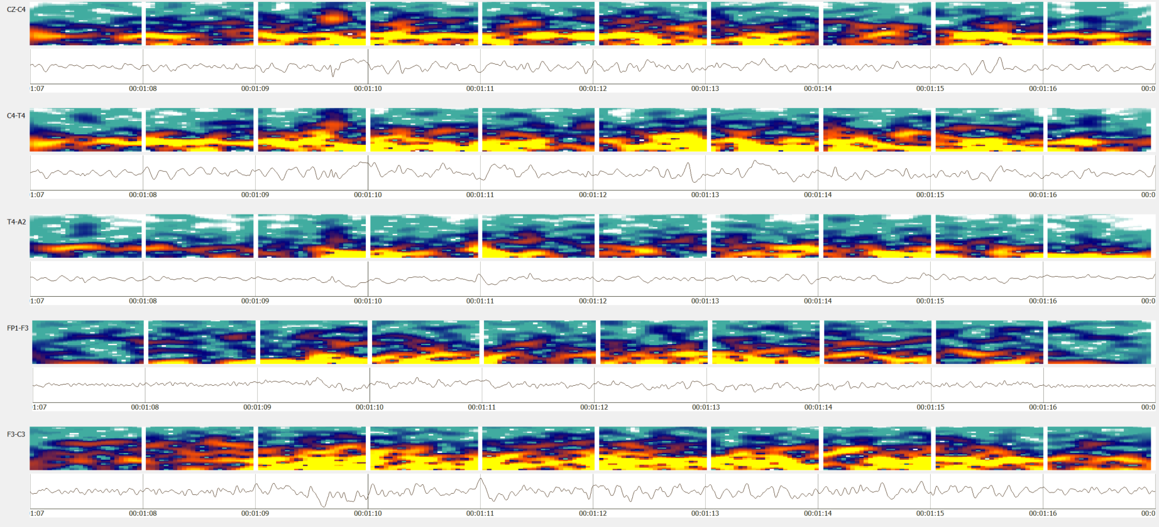
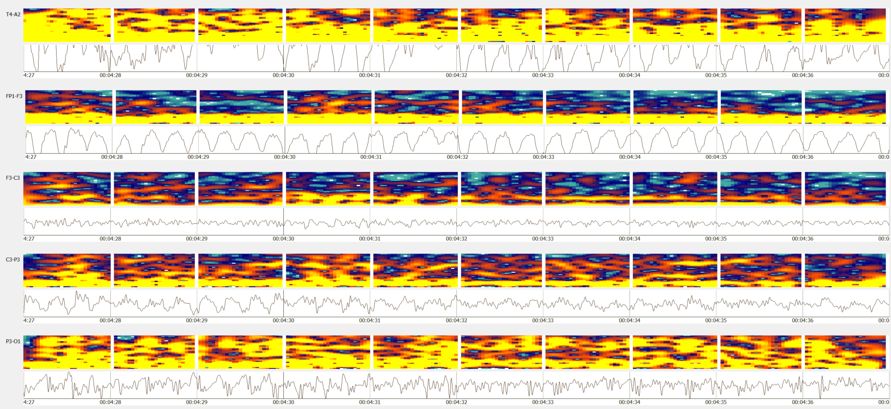
Spectral Properties of an Ictal Seizure
Seizures usually occur within the range of 2.5 to 25 Hz.
Seizure duration can rand from 3 seconds to days.
Generalized seizures are easy to spot due to their high energy in specific frequency bands.
Waxing-waning patterns (e.g., bursts) can be mistakenly identified as ictal.

Slide 19
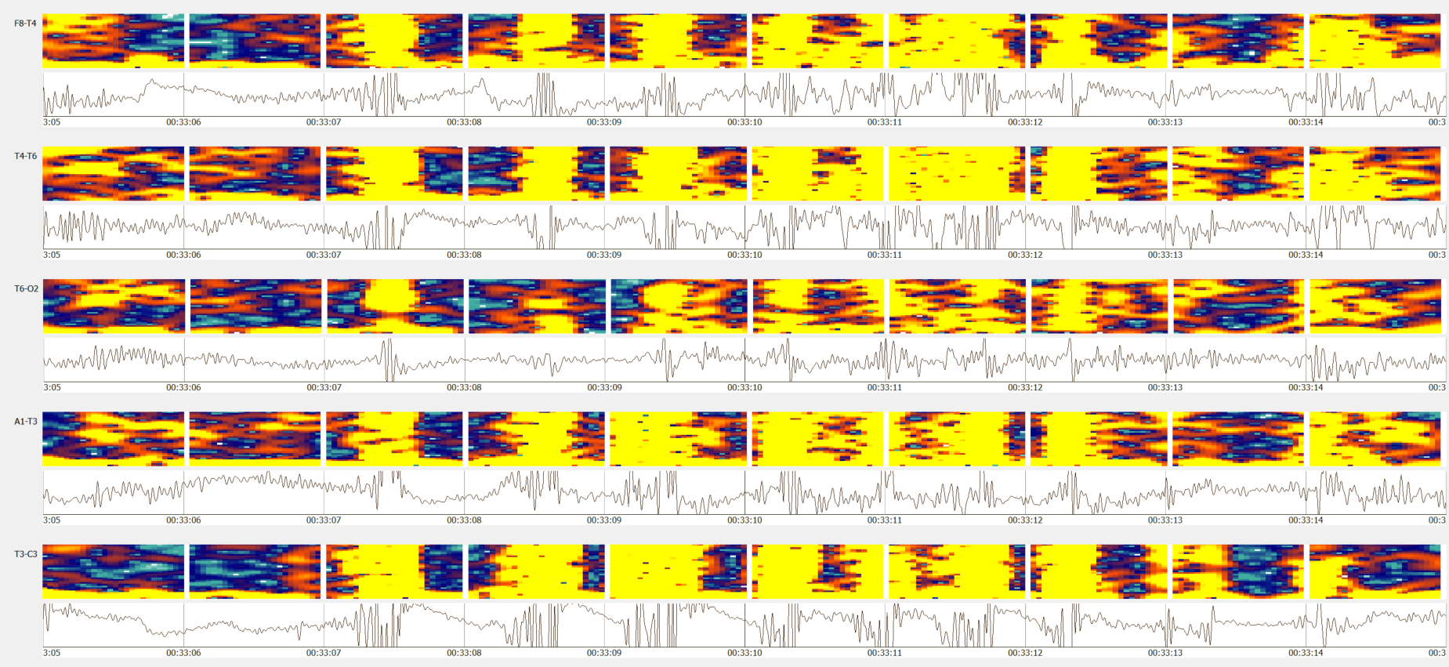
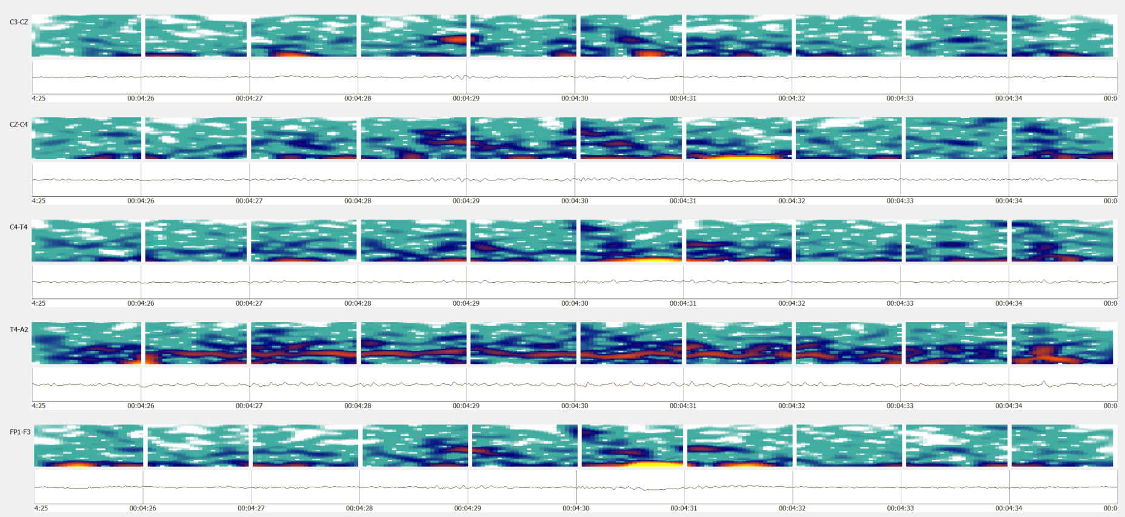
Artifacts and Medications Pose Challenges
Artifacts such as chewing resemble features of tonic-clonic and complex-partial seizures.
This is usually disambiguated from the context/history of the record.
Medication makes it more difficult.
Subtle seizures such as extremely focal, low energy seizures are widespread in ICU patients due to medication.

Slide 20
Experimental Setup
Electroencephalography (EEG) is a popular tool used to diagnose brain related illnesses.
The 10-20 system is a universally accepted method for the placement of electrodes for any EEG test or experiment.
Six separate channel configurations were selected to optimize the spatial information specific to the application of seizure detection:
The TUH EEG Seizure Corpus (TUSZ - v1.1.1) was used in this study:
A TCP montage was applied prior to generating features, and standard linear frequency cepstral coefficient (LFCC) features were used.
Seizure Corpus | Version 1.1.1
Dataset | Training set |  | Evaluation set
 | w/seiz | Total | w/seiz | Total
Patients | 71 | 196 | 38 | 50
Sessions | 102 | 456 | 89 | 230
Epochs (sec.) | 51,140 (5.51%) | 928,962 (100.00%) | 53,930 (8.96%) | 601,649 (100.00%)

Slide 21
Evaluation Metrics
Any Overlap method (OVLP):
Any overlap method is a permissive method which looks for the detection of an event within a proximity of the reference.
This metric tend to produce higher sensitivities since only isolated events are considered as false alarms.
Multiple overlapping events detected in bursts are also counted as detection.
Performance measures are calculated in terms of Sensitivity and Specificity (or false alarms per 24 hours):
Sensitivity = ( True Positives / (True Positives + False Negatives) )
Specificity = (True Negatives / (True Negatives + False Positives) )
False Alarm rate = Rate of ( ( # Target False Positives / Total duration ) × (60 × 60 × 24) )

Slide 22
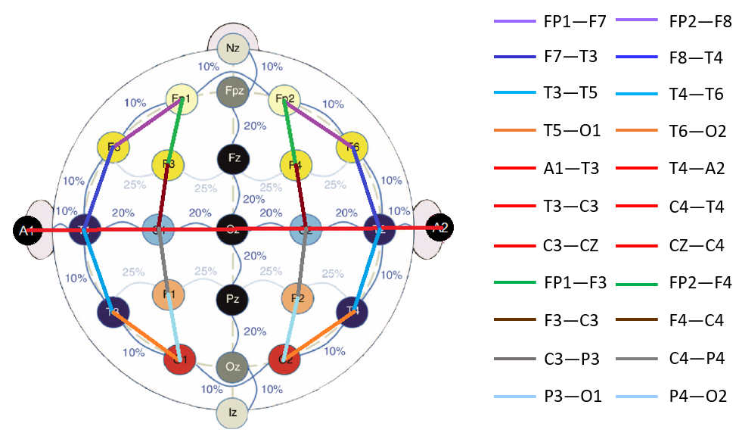
Temporal Central Parasagittal (TCP) Montage
A TCP montage is a type of longitudinal and transverse bipolar montage.
Differential channels, such as FP1-F7 (longitudinal) and C3-CZ (transverse), help in removing static noise and improving spatial information.
Transverse
Longitudinal

Slide 23
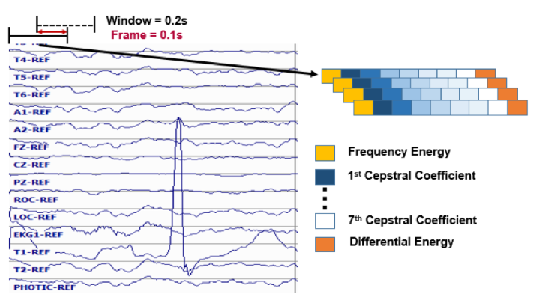
Feature Extraction
 | Version 1.2.1
 | Training set |  | Evaluation set
 | w/seiz | Total | w/seiz | Total
Patients | 119 | 265 | 38 | 50
Sessions | 182 | 583 | 98 | 239
Epochs (sec.) | 76,517 (6.4%) | 1,196,381 (100.0%) | 55,765 (9.0%) | 618,096 (100.0%)
TUH EEG Seizure Corpus (v1.2.1) was used:
The database consists of clinical data with many types of seizures and lots of artifacts.
World’s largest open source repository of EEG data.
Standard frequency domain features are used:
10 frames per second
0.2 second analysis window
9 base features including energy, differential energy, and 7 cepstral coefficients.
1st and 2nd derivatives are used for most features.
Total dimension: 26.

Slide 24
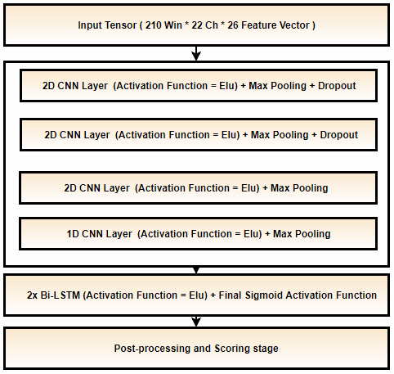
Baseline System: CNN-LSTM
Three baseline systems:
CNN-LSTM system
Channel based LSTM networks
A Kaldi multipass system with P-norm and MLP networks.
CNN-LSTM Architecture:
Each sample is a 21 sec. long window for all 22 channels.
Trained with constant learning rate with a kernel size of (3, 3).
Heuristic postprocessing approaches are applied which include a threshold for output probabilities and seizure events of a certain duration.
An Adam optimizer is used.
CNN-LSTM Model

Slide 25
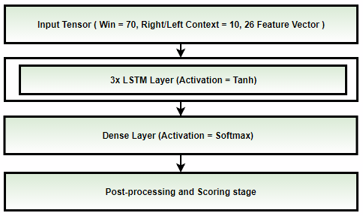
Baseline System: LSTM
Channel based LSTM Architecture:
Each sample is a 7 sec. long window with right/left context (splice width) of 11 frames (1.1 sec.).
Each channel is processed individually so that the model only learns spike/sharp and wave discharges.
Trained with annealing learning rate after CV loss is stagnated for 3 consecutive epochs.
SGD optimizer with nestrov momentum is used.
A small CNN-LSTM-MLP model is used for postprocessing followed by heuristic postprocessing.
LSTM Model

Slide 26
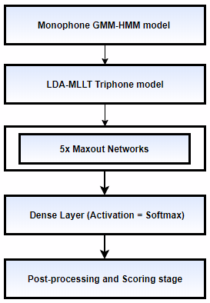
Baseline System: Kaldi
Kaldi baseline systems:
Kaldi multipass systems with P-norm (Dan’s DNN (nnet2) implementation)
Kaldi multipass systems with MLP networks (TF implementation).
Kaldi P-norm fast:
Fixed Affined Component / LDA is applied to decorrelate splice window of 11 (Left/Right context of 5).
Training is performed for 20 epochs with annealing learning rate with last 5 epochs with constant minimum lr.
P-norm Input dim = 2000 & Output dim = 400.
Preconditioned SGD is used which is a matrix valued learning rate.
Kaldi DNN (TF):
Tensorflow’s MLP network with 3 hidden layers is implemented.
Priors, decision tree and alignments from Kaldi’s LDA-MLLT systems are used for acoustic modeling.

Slide 27
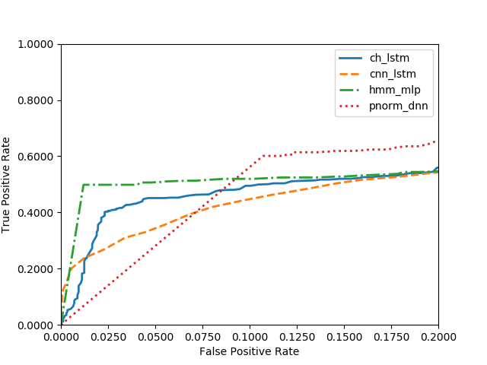
Performance
Kaldi models use word boundary information during event classification.
Kaldi’s best performance is only ~50% sensitivity @ 2.58 FAs/24 hours (with word boundaries).
Channel-based LSTM network outperforms other models with no word boundary information.
DNN Model | Sensitivity (%) | FA/24 Hours
CNN-LSTM | 30.8% | 6.7
LSTM | 40.3% | 5.8
Kaldi P-Norm | 60.1% | 25.7
Kaldi MLP | 49.8% | 2.6
ROC curve for the target/seizure class.
The region of interest is when the FA is low (< 10 FAs/24 hours).

Slide 28
Summary
Big data resources such as the TUH EEG Corpus are enabling the application of state of the art machine learning algorithms.
The ability to search both EEG signal and text data from a unified framework can be useful in clinical, educational and training applications.
Cohort retrieval allows practitioners to retrieve patients with similar medical histories, morphologies, etc. from large resources such as TUH EEG.
The ability to automatically index data with high accuracy greatly reduces the cost to bring up some applications.
Future work:
Expand TUH EEG at the rate of about 3,000 sessions/yr.
Manually annotate seizure data with a goal of tripling the size of TUH EEG Seizure (TUSZ) by 2020.
Automatically annotate the entire corpus for normal/abnormal, seizures, three types of relevant signal events (PLEDs, GPEDS, spikes), and three types of background events (eye movements, artifacts and general background). We are also annotating artifacts by subtype.
We continue to develop improved seizure detection technology based on new deep learning approaches. There is still a large gap between state of the art performance and clinical acceptance.

