Slide 1
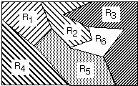
Lecture 05: Decision Surfaces
• Objectives:
Discriminant Functions Gaussian Distributions
Resources:
DHS: Chapter 2 (Part 3) K.F.: Intro to PR X. Z.: PR Course A.N. : Gaussian Discriminants

Slide 2
Posterior Probabilities
Bayes Rule:
$$P\left(ω_{j} | x\right)=\frac{p\left(x | ω_{j}\right)P\left(ω_{j}\right)}{p\left(x\right)}$$
can be expressed in words as:
$$posterior=\frac{likelihood × prior}{evidence}$$
By measuring x, we can convert the prior probability, P(ω_{j}), into a posterior probability, P(ω_{j}|x).
Evidence can be viewed as a scale factor and is often ignored in optimization applications (e.g., speech recognition).
Bayes Rule allows us to train a system by collecting data in what is called a supervised mode (e.g., collect a sea bass sample and measure its length, speak a specific set of words and measure the feature vectors).

Slide 3
Likelihood Ratio
Minimum error rate classification:
$$choose ωi if: P(ωi| x) > P(ωj| x) for all j≠i$$

Slide 4
Multicategory Decision Surfaces
Define a set of discriminant functions: $gi(x), i = 1,…, c$
Define a decision rule:
$$choose ωi if: g_{i}\left(x\right)>g_{j}\left(x\right) for all j≠i$$
For a Bayes classifier, let $gi(x) = −R(ωi|x)$ because the maximum discriminant function will correspond to the minimum conditional risk.
For the minimum error rate case, let $gi(x) = P(ωi|x)$, so that the maximum discriminant function corresponds to the maximum posterior probability.
Choice of discriminant function is not unique:
multiply or add by same positive constant
Replace $gi(x)$ with a monotonically increasing function, $f(gi(x))$.

Slide 5
Decision Surfaces
We can visualize our decision rule several ways:
$$choose ωi if: g_{i}\left(x\right)>g_{j}\left(x\right) for all j≠i$$

Slide 6
Network Representation of a Classifier
A classifier can be visualized as a connected graph with arcs and weights:
What are the advantages of this type of visualization?

Slide 7
Univariate Normal Distribution
A normal or Gaussian density is a powerful model for modeling continuous-valued feature vectors corrupted by noise due to its analytical tractability.
Univariate normal distribution:
$$p\left(x\right)=\frac{1}{\sqrt{2πσ}}exp\left(−\frac{1}{2}{\left(\frac{x−μ}{σ}\right)}^{2}\right)$$
where the mean and covariance are defined by:
$μ=E\left[x\right]$ $=\int_{−∞}^{∞}{x p\left(x\right) dx}$
$$σ^{2}=E\left[{\left(x−μ\right)}^{2}\right]=\int_{−∞}^{∞}{{\left(x−μ\right)}^{2} p\left(x\right) dx}$$
The entropy of a univariate normal distribution is given by:
$$H\left(p\left(x\right)\right)=H\left(x\right)=−\int_{−∞}^{∞}{p\left(x\right) ln\left(p\left(x\right)\right) dx=ln\left(σ\sqrt{2πe}\right)=\frac{1}{2}ln\left(2πeσ^{2}\right)}$$
Note that for a uniform discrete distribution with N values, $H\left(x\right)=\log_{2}\left(N\right).$

Slide 8
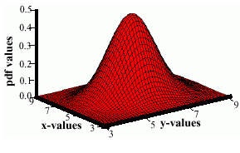
Multivariate Normal Distributions
A multivariate distribution is defined as:
$$p\left(x\right)=\frac{1}{\left({2π}^{d/2}\right){\left|Σ\right|}^{1/2}}exp\left(−\frac{1}{2}{\left(x−μ\right)}^{t}Σ^{−1}\left(x−μ\right)\right)$$
where $μ$ represents the mean (vector) and $Σ$ represents the covariance (matrix).
Note the exponent term is really a dot product or weighted Euclidean distance.
We will later refer to this as the Mahalanobis distance metric.
The covariance is always symmetric and positive semidefinite.
How does the shape vary as a function of the covariance?

Slide 9
Normal Distributions
Recall the definition of a normal distribution (Gaussian):
$$p\left(x\right)=\frac{1}{\left({2π}^{d/2}\right){\left|Σ\right|}^{1/2}}exp\left(−\frac{1}{2}{\left(x−μ\right)}^{t}Σ^{−1}\left(x−μ\right)\right)$$
Why is this distribution so important in engineering?
Mean: $μ=E\left[x\right]$ $=\int_{−∞}^{∞}{x p\left(x\right) dx}$
Covariance: $C=E\left[{\left(x−μ\right)\left(x−μ\right)}^{t}\right]$
Statistical independence?
Higher-order moments? Occam’s Razor?
Entropy?
Linear combinations of normal random variables?
Central Limit Theorem?

Slide 10
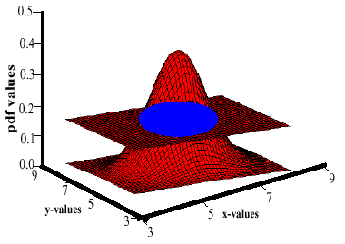
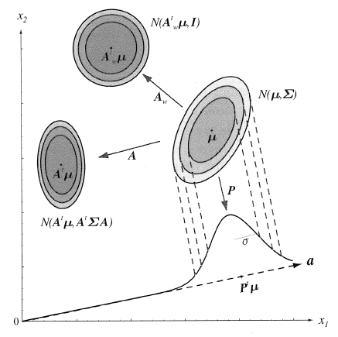
Support Regions
A support region is the obtained by the intersection of a Gaussian distribution with a plane.
For a horizontal plane, this generates an ellipse whose points are of equal probability density.
The shape of the support region is defined by the covariance matrix.

Slide 11
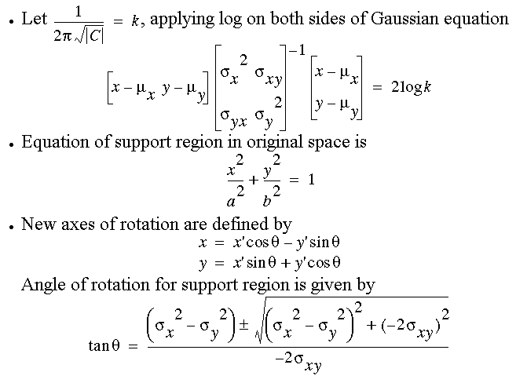
Derivation

Slide 12
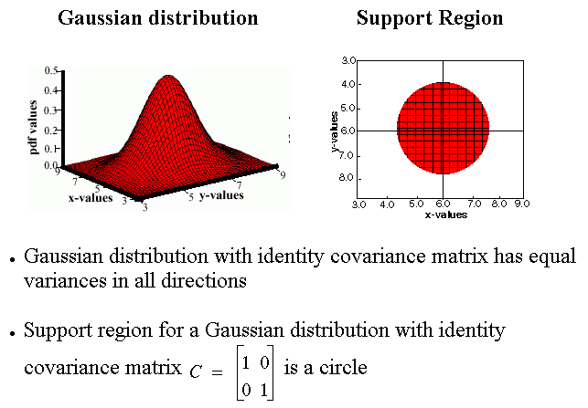
Identity Covariance

Slide 13
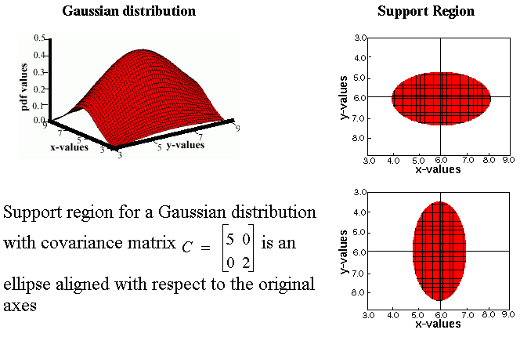
Unequal Variances

Slide 14
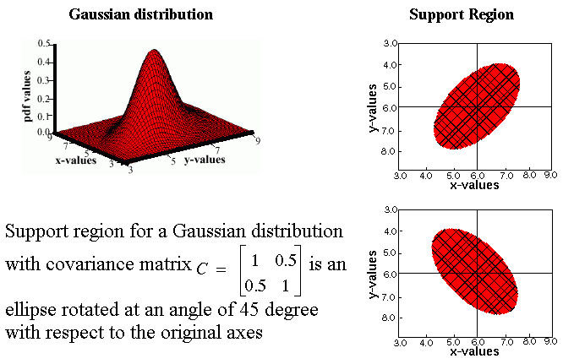
Nonzero Off-Diagonal Elements

Slide 15
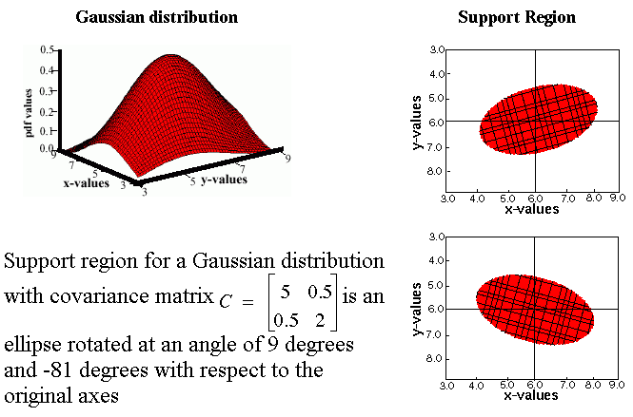
Unconstrained or “Full” Covariance

Slide 16
Log Probabilities
Some monotonically increasing functions can simplify calculations considerably:
$$g_{i}\left(x\right)=P\left(ω_{i} | x\right)=\frac{p\left(x | ω_{i}\right)P\left(ω_{i}\right)}{\sum_{j=1}^{c}{p\left(x | ω_{j}\right)P\left(ω_{j}\right)}}$$
$g_{i}\left(x\right)=$ $p\left(x | ω_{i}\right)P\left(ω_{i}\right)$
$$f\left(g_{i}\left(x\right)\right)=ln\left(g_{i}\left(x\right)\right)=ln\left(p\left(x | ω_{i}\right)\right)+ln\left(P\left(ω_{i}\right)\right)$$
What are some of the reasons (3) is particularly useful?
Computational complexity (e.g., Gaussian)
Numerical accuracy (e.g., probabilities tend to zero)
Decomposition (e.g., likelihood and prior are separated and can be weighted differently)
Normalization (e.g., likelihoods are channel dependent).

Slide 17
Summary
Discriminant Functions: used to classify data.
Decision Surfaces: Geometric interpretation of a Bayesian classifier. The shape of the decision surface is influenced by the number of categories and the statistics of the data.
Gaussian Distributions: how is the shape of the distribution influenced by the mean and covariance?
Log Probabilities: solves some important computational problems.

