Slide 1
Lecture 04: Alternate Decision Criteria
Objectives:
Likelihood Ratios ROC Curves Minimum Risk Minimax Criterion Multicategory Decision Surfaces
Resources:
DHS: Chapter 2 (Part 3)

Slide 2
Two-Category Classification
Let $α1$ correspond to $ω1$, $α2$ to $ω2$, and $λij= λ(αi|ωj)$.
The conditional risk is given by:
$$R(α1|x) = λ11P(ω1|x) + λ12P(ω2|x)$$
$$R(α2|x) = λ21P(ω1|x) + λ22P(ω2|x)$$
Our decision rule is:
$choose:$ $ω1 if: R(α1|x) < R(α2|x)$; $otherwise:$ $decide$ $ω2$
This results in the equivalent rule:
$choose:$ $ω1 if: (λ21− λ11) P(x|ω1) > (λ12− λ22) P(x|ω2)$;
$otherwise:$ $decide$ $ω2$
If the loss incurred for making an error is greater than that incurred for being correct, the factors $(λ21− λ11)$ and $(λ12− λ22)$ are positive, and the ratio of these factors simply scales the posteriors.

Slide 3
Likelihood
By employing Bayes formula, we can replace the posteriors:
$$(λ21− λ11) P(x|ω1) > (λ12− λ22) P(x|ω2)$$
by the prior probabilities and conditional densities:
$choose:$ $ω1 if:(λ21− λ11) p(x|ω1) P(ω1) > (λ12− λ22) p(x|ω2) P(ω2);$ $otherwise:$ $decide$ $ω2$
If $λ21− λ11$is positive, our rule becomes:
$$choose ω1 if:\frac{p(x|ω1)}{p(x|ω2)}>\frac{λ12− λ22}{λ21− λ11}\frac{P(ω2)}{P(ω1)}$$
If the loss factors are identical, and the prior probabilities are equal, this reduces to a standard likelihood ratio:
$$choose ω1 if: \frac{p(x|ω1)}{p(x|ω2)}>1$$

Slide 4
Minimum Error Rate
Consider a symmetrical or zero-one loss function:
$$λ\left(α_{i} | ω_{j}\right)= \left\{\begin{matrix}0, i=j \\ 1, i≠j\end{matrix} i,j=1, 2, 3, …, c\right.$$
The conditional risk is:
$$\begin{matrix}R\left(αi | x\right)=\sum_{j=1}^{c}{R(αi|ωj)P\left(ωj | x\right)} \\ =\sum_{j≠i}^{c}{P\left(ωj | x\right)} \\ =1−P\left(ωi | x\right)\end{matrix}$$
The conditional risk is the average probability of error.
To minimize error, maximize $P(ωi|x)$ — also known as maximum a posteriori decoding (MAP).

Slide 5
Likelihood Ratio
Minimum error rate classification:
$$choose ωi if: P(ωi| x) > P(ωj| x) for all j≠i$$

Slide 6
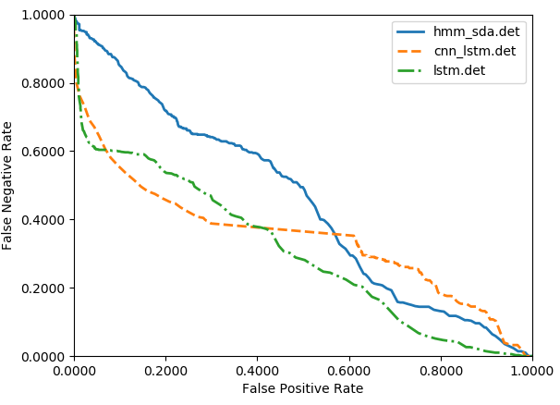
Example: Which System is Better?

Slide 7
Bayes Risk
An expected loss is called a risk.
$R(ωi|x)$ is called the conditional risk.
A general decision rule is a function $α(x)$ that tells us which action to take for every possible observation.
The overall risk is given by:
$$R=\int{R\left(α\left(x\right) | x\right)p\left(x\right)dx}$$
If we choose $α(x)$ so that $R(αi(x))$is as small as possible for every $x$, the overall risk will be minimized.
Compute the conditional risk for every $ω$ and select the action that minimizes $R(ωi|x)$. This is denoted $R^{∗}$, and is referred to as the Bayes risk.
The Bayes risk is the best performance that can be achieved (for the given data set or problem definition).

Slide 8
Minimax Criterion
Design our classifier to minimize the worst overall risk (avoid catastrophic failures)
Factor overall risk into contributions for each region:
Using a simplified notation (Van Trees, 1968):

Slide 9
Minimax Criterion
We can rewrite the risk:
Note that I₁₁=1-I₂₁ and I₂₂=1-I₁₂:
We make this substitution because we want the risk in terms of error probabilities and priors.
Multiply out, add and subtract P₁λ₂₁, and rearrange:

Slide 10
Expansion of the Risk Function
Note P₁ =1- P₂:

Slide 11
Explanation of the Risk Function
Note that the risk is linear in P_{2:}
If we can find a boundary such that the second term is zero, then the minimax risk becomes:
For each value of the prior, there is an associated Bayes error rate.
Minimax: find the maximum Bayes error for the prior P₁, and then use the corresponding decision region.

Slide 12
Neyman-Pearson Criterion
Guarantee the total risk is less than some fixed constant (or cost).
Minimize the risk subject to the constraint:
(e.g., must not misclassify more than 1% of salmon as sea bass)
Typically must adjust boundaries numerically.
For some distributions (e.g., Gaussian), analytical solutions do exist.

Slide 13
Multicategory Decision Surfaces
Define a set of discriminant functions: g_{i}(x), i = 1,…, c
Define a decision rule:
choose ω_{i} if: g_{i}(x) > g_{j}(x) ∨j ≠ i
For a Bayes classifier, let g_{i}(x) = -R(ω_{i}|x) because the maximum discriminant function will correspond to the minimum conditional risk.
For the minimum error rate case, let g_{i}(x) = P(ω_{i}|x), so that the maximum discriminant function corresponds to the maximum posterior probability.
Choice of discriminant function is not unique:
multiply or add by same positive constant
Replace g_{i}(x) with a monotonically increasing function, f(g_{i}(x)).

Slide 14
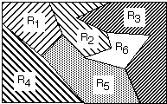
Decision Surfaces
We can visualize our decision rule several ways:
choose ω_{i} if: g_{i}(x) > g_{j}(x) ∨j ≠ i

Slide 15
Summary
Likelihood Ratios: Convenient for two-class problems.
Decision Criteria: Several viable choices for decision rules.
Decision Surfaces: The shape of the decision surface is influenced by the number of categories and the statistics of the data.
Gaussian Distributions: how is the shape of the distribution influenced by the mean and covariance?

