Slide 1
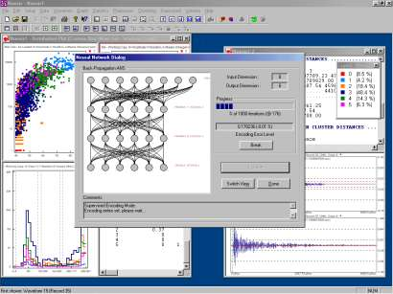
Lecture 01: Course Overview
Objectives:
Terminology
Generalization and Risk
Machine Understanding
Feature Confusability
The Design Cycle
Feature Selection
The Bayesian Approach
First Principles
Resources:
Syllabus
DHS: Chapter 1
DJM: Information Theory

Slide 2
Terminology
Pattern Recognition: “the act of taking raw data and taking an action based on the category of the pattern.”
Common Applications: speech recognition, fingerprint identification (biometrics), DNA sequence identification
Related Terminology:
  Machine Learning: “It gives computers the ability to learn without being explicitly programmed.” (Arthur Samuel, 1959)
  The ability of a machine to improve its performance based on previous results.
  Machine Understanding: acting on the intentions of the user
  generating the data.
  Big Data: “Big data is like teenage sex: everyone talks about it, nobody really knows how to do it, everyone thinks everyone else is doing it, so everyone claims they are doing it.” (Dan Ariely, 2013)
Related Fields: artificial intelligence, signal processing and discipline-specific research (e.g., target recognition, speech recognition, natural language processing).

Slide 3
Generalization And Risk
How much can we trust isolated data points?
Optimal decision surface is a line
Optimal decision surface still a line
Optimal decision surface changes abruptly. Why? Is this a good thing?
In this course, we will study techniques that can easily drive the error rate to zero on the training data – referred to as overtraining.
However, is this the best classifier for previously unseen data?
We will see that the formulation of the problem, including collection of data that accurately characterizes the problem, is critical.
“There is no data like more data”
Some applications, particularly bioengineering, only have limited data.
Can we integrate prior knowledge about data, confidence, or willingness to take risk to make better decisions using limited amounts of data?

Slide 4



Recognition or Understanding?
Which of these images are most scenic?
Half of the battle in building a machine learning system is understanding the requirements and developing data (e.g., annotated data) to support those requirements. We often iterate several times to get things ‘right’.
How can we develop a system to automatically determine scenic beauty? (Hint: feature combination)
Solutions to such problems require good feature extraction, good decision theory and good user interface engineering (e.g., Alexa).

Slide 5
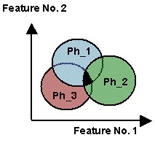
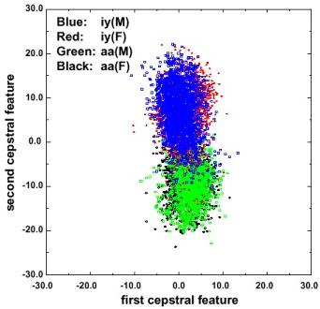
Features Are Confusable
Regions of overlap represent the classification error
Error rates can be computed with knowledge of the joint probability distributions (see OCW-MIT-6-450Fall-2006).
Context is used to reduce overlap.
In real problems, features are confusable and represent actual variation in the data.
The traditional role of the signal processing engineer has been to develop better features (e.g., “invariants”).

Slide 6
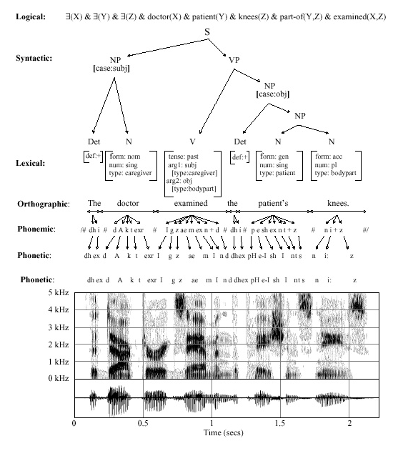
Decomposition
Decision
Post-Processing
Classification
Feature Extraction
Segmentation
Sensing
Input

Slide 7
The Design Cycle
Start
Collect Data
Key issues:
  “There is no data like more data.”
  Perceptually-meaningful features?
  How do we find the best model?
  How do we estimate parameters?
  How do we evaluate performance?
Goal of the course:
  Introduce you to mathematically rigorous ways to train and evaluate models.
Choose Features
Choose Model
Train Classifier
Evaluate Classifier
End

Slide 8
Common Mistakes
I got 100% accuracy on...
  Almost any algorithm works some of the time, but few real-world problems have ever been completely solved.
  Training on the evaluation data is forbidden.
  Once you use evaluation data, you should discard it.
My algorithm is better because...
  Statistical significance and experimental design play a big role in determining the validity of a result.
  There is always some probability a random choice of an algorithm will produce a better result.
Hence, in this course, we will also learn how to evaluate algorithms.

Slide 9

Image Processing Example: Sorting Fish
Sorting Fish: incoming fish are sorted according to species using optical sensing (sea bass or salmon?)
Problem Analysis:
  Set up a camera and take some sample images to extract features
  Consider features such as length, lightness, width, number and shape of fins, position of mouth, etc.
Sensing
Segmentation
Feature Extraction

Slide 10
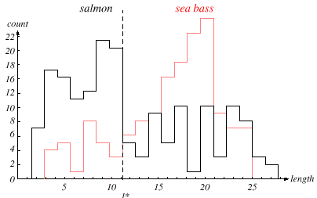
Length As A Discriminator
Conclusion: Length is a poor discriminator

Slide 11
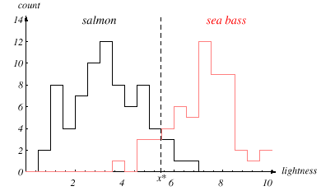
Add Another Feature
Lightness is a better feature than length because it reduces the misclassification error.
Can we combine features in such a way that we improve performance?
(Hint: correlation)

Slide 12
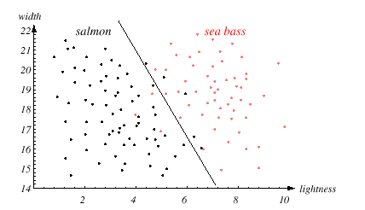
Width And Lightness
Treat features as a N-tuple (two-dimensional vector)
Create a scatter plot
Draw a line (regression) separating the two classes

Slide 13
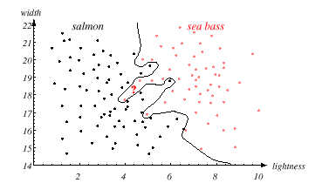
Decision Theory
Can we do better than a linear classifier?
What is wrong with this decision surface? (Hint: generalization)

Slide 14
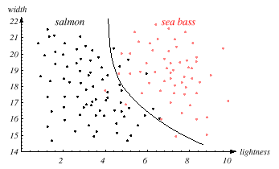
Generalization and Risk Revisited
Why might a smoother decision surface be a better choice?
(Hint: Occam’s Razor).
This course investigates how to find such “optimal” decision surfaces and how to provide system designers with the tools to make intelligent
trade-offs.

Slide 15
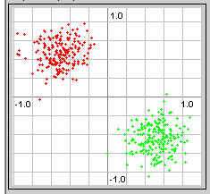
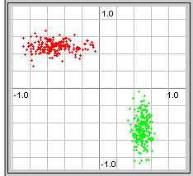
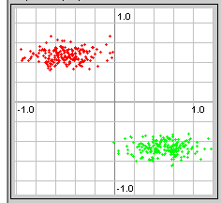
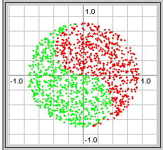
Feature Correlation
Degrees of difficulty:
Real data is often much harder:

Slide 16
Bayesian Formulations
Message
Source
Linguistic
Channel
Articulatory
Channel
Acoustic
Channel
Message
Words
Phones
Features
Bayesian formulation for speech recognition:
Objective: minimize the word error rate by maximizing
Approach: maximize (training)
  acoustic model (hidden Markov models, Gaussian mixtures, etc.
  language model (finite state machines, N-grams)
  acoustics (ignored during maximization)
  Bayes Rule allows us to convert the problem of estimating an unknown posterior probability to a process in which we can postulate a model, collect data under controlled conditions, and estimate the parameters of the model.

Slide 17
Summary
Pattern recognition vs. machine learning vs. machine understanding
We will focus more on decision theory and less on feature extraction.
This course emphasizes statistical and data-driven methods for optimizing system design and parameter values.
First most important principle discussed today?
Second most important principle?
Was there a third?

Slide 18
Review
An Overview of Feature Extraction (the 1970’s is calling!)
Normal (Gaussian) Distributions
Multivariate Normal (Gaussian) Distributions
Support Regions: a convenient visualization tool

Slide 19
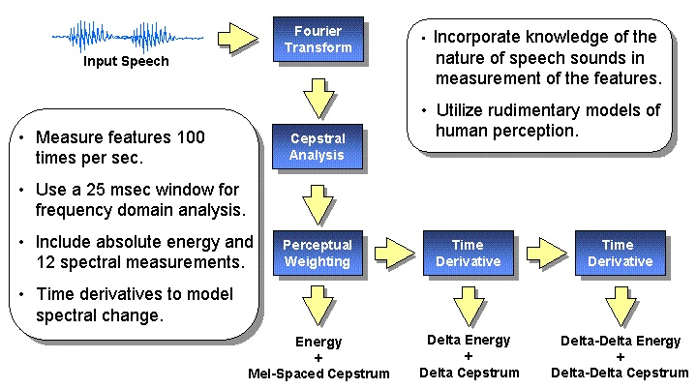
Feature Extraction

Slide 20
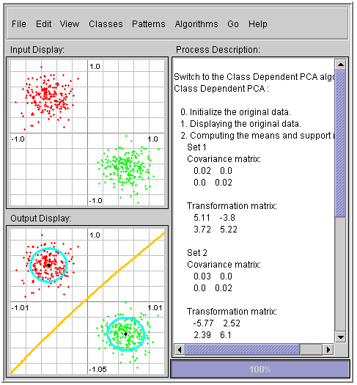
Java Pattern Recognition Applet
There are many excellent resources on the Internet that demonstrate pattern recognition concepts.
There are many MATLAB toolboxes that implement state of the art algorithms.
One such resource is a Java Applet that lets you quickly explore how a variety of algorithms process the same data.
An important first principle is:
  There are no magic equations or algorithms.
  You must understand the properties of your data and what a priori knowledge you can bring to bear on the problem.
….

Slide 21
Normal Distributions
Recall the definition of a normal distribution (Gaussian):
Why is this distribution so important in engineering?
Mean:
Covariance:
Statistical independence?
Higher-order moments? Occam’s Razor?
Entropy?
Linear combinations of normal random variables?
Central Limit Theorem?

Slide 22
Univariate Normal Distribution
A normal or Gaussian density is a powerful model for modeling continuous-valued feature vectors corrupted by noise due to its analytical tractability.
Univariate normal distribution:
where the mean and covariance are defined by:
The entropy of a univariate normal distribution is given by:

Slide 23
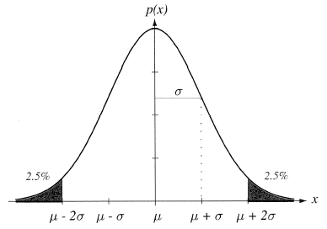
Mean and Variance
A normal distribution is completely specified by its mean and variance:
The peak is at:
66% of the area is within one σ; 95% is within two σ; 99% is within three σ.
A normal distribution achieves the maximum entropy of all distributions having a given mean and variance.
Central Limit Theorem: The sum of a large number of small, independent random variables will lead to a Gaussian distribution.

Slide 24
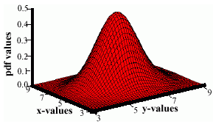
Multivariate Normal Distributions
A multivariate distribution is defined as:
where μ represents the mean (vector) and Σ represents the covariance (matrix).
Note the exponent term is really a dot product or
weighted Euclidean distance.
The covariance is always symmetric and positive semidefinite.
How does the shape vary as a function of the covariance?

Slide 25
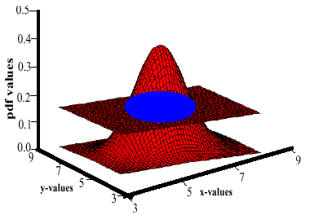
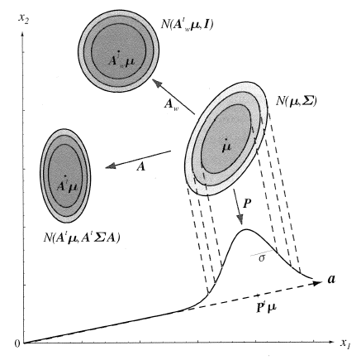
Support Regions
A support region is the obtained by the intersection of a Gaussian distribution with a plane.
For a horizontal plane, this generates an ellipse whose points are of equal probability density.
The shape of the support region is defined by the covariance matrix.

Slide 26
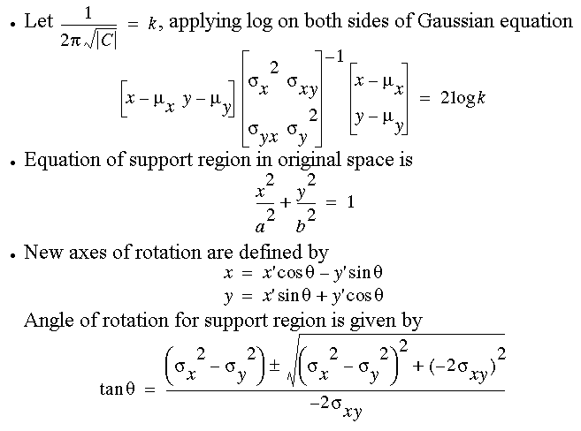
Derivation

Slide 27
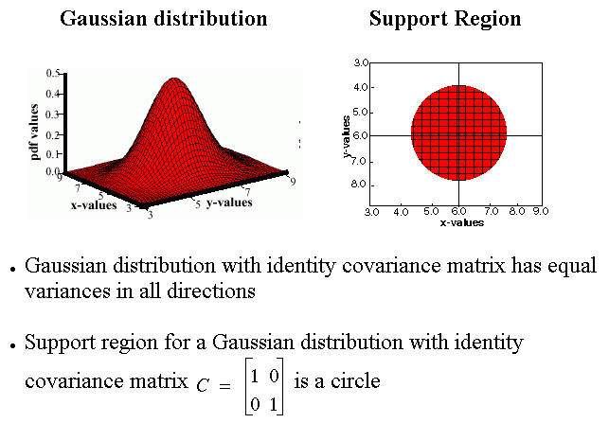
Identity Covariance

Slide 28
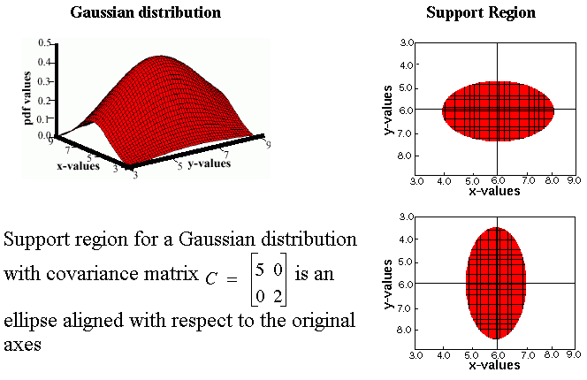
Unequal Variances

Slide 29
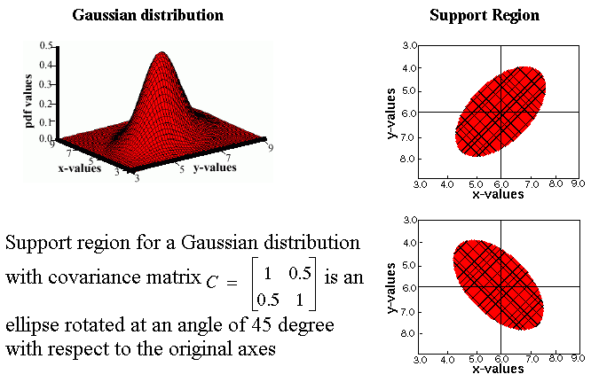
Nonzero Off-Diagonal Elements

Slide 30
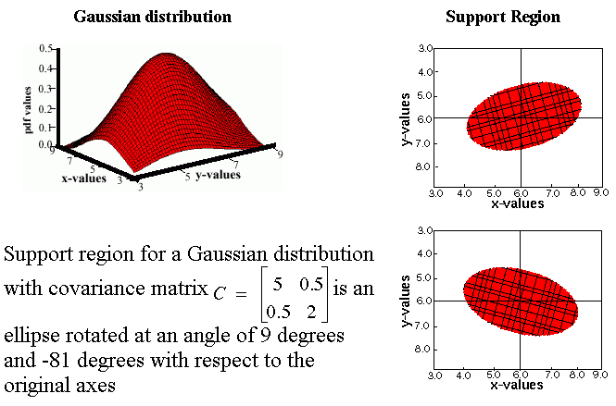
Unconstrained or “Full” Covariance

