Slide 1
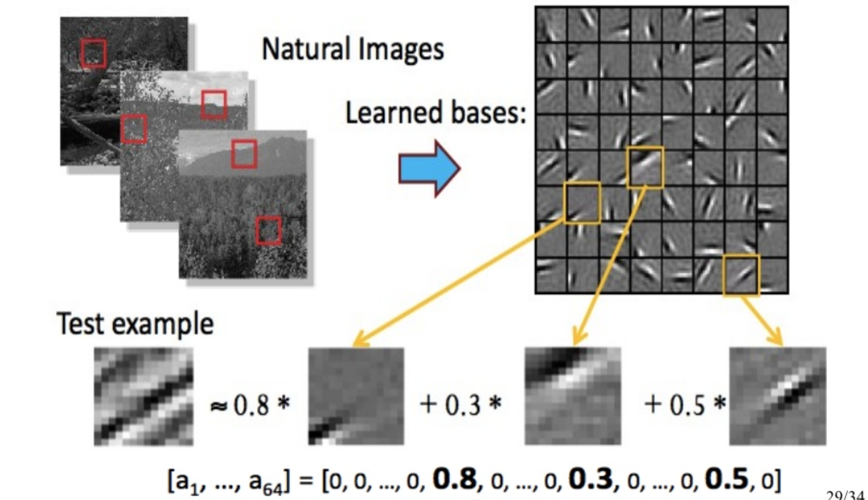
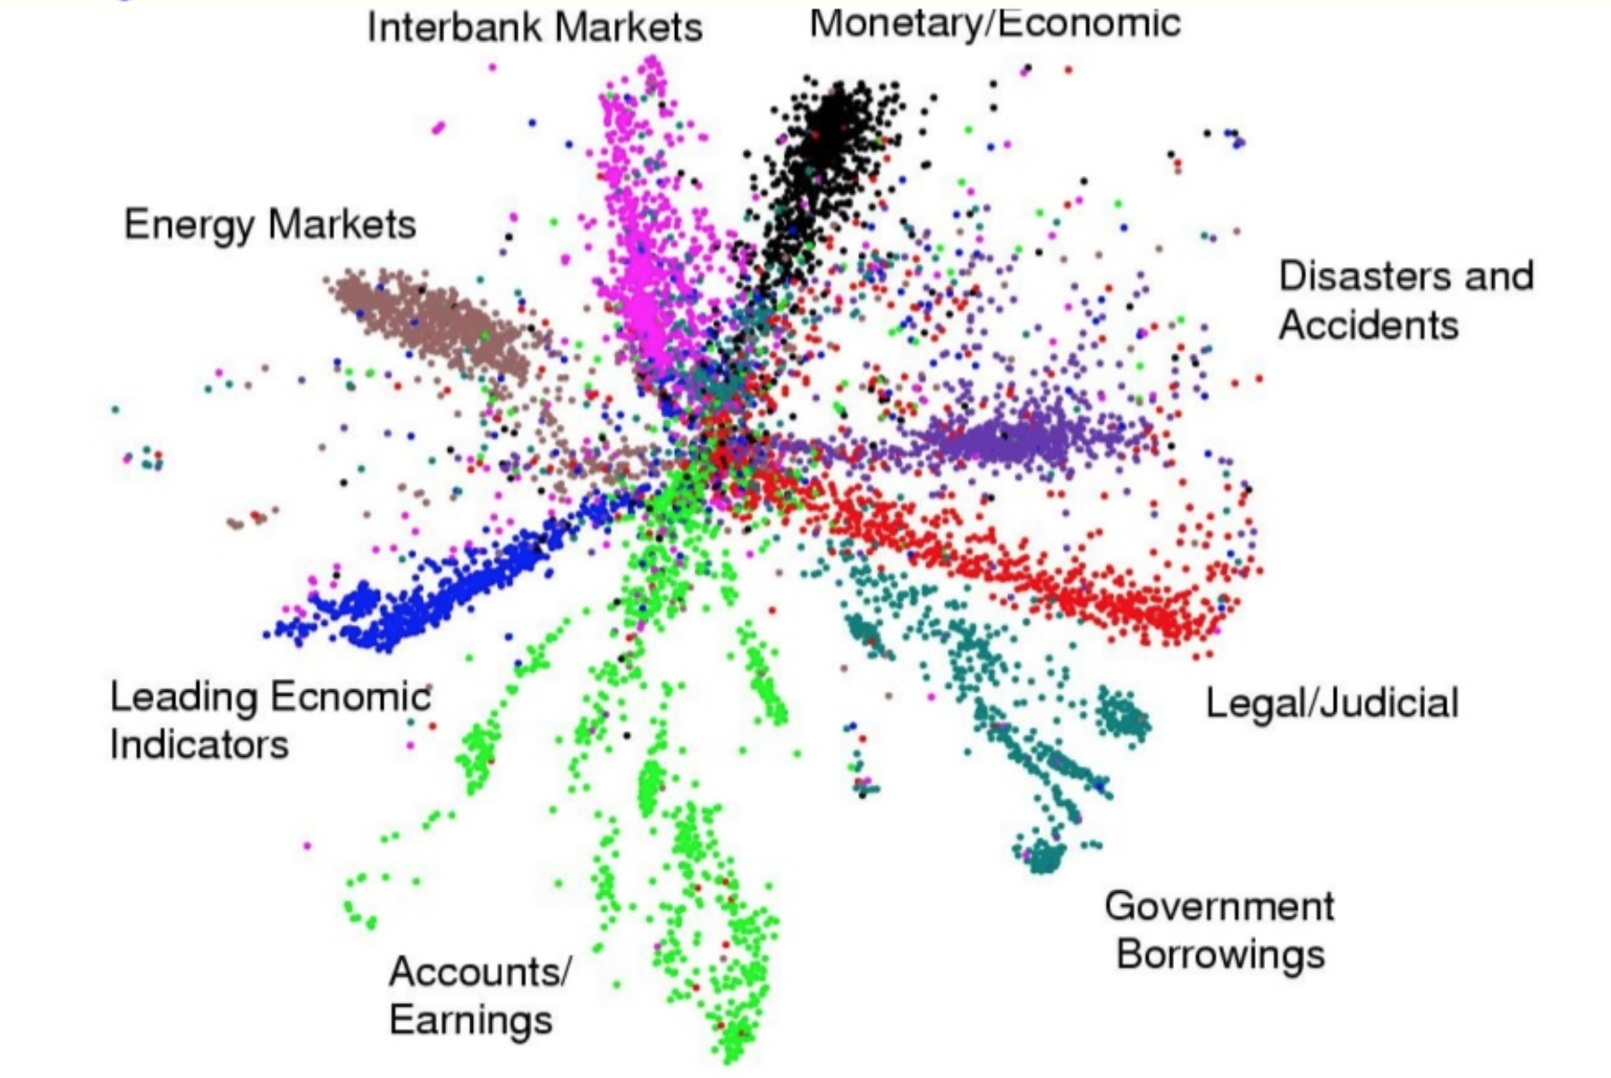
LECTURE 38: Alternative OPTIMIZERS
Objectives: Stochastic Gradient Descent Adaptive Moment Estimation Generative Adversarial Networks The Neural Network Zoo Autoencoders
Stacked Autoencoders Denoising Autoencoders
Resources: Learning Architectures for AI Contrastive Divergence RBMs

Slide 2
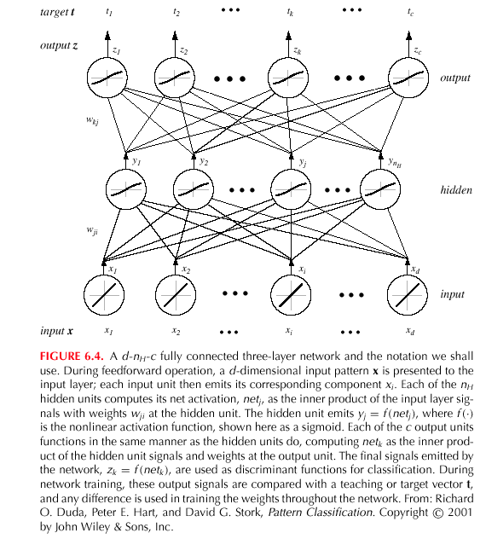
Multilayer Perceptron (MLP)
Notes:
XOR: x_1, x_2, and we want to transform to x_1^2, x_2^2, x_1 x_2
It can also be viewed as feature extraction from the feature vector x, but now we extract more feature than the number of features in x.

Slide 3
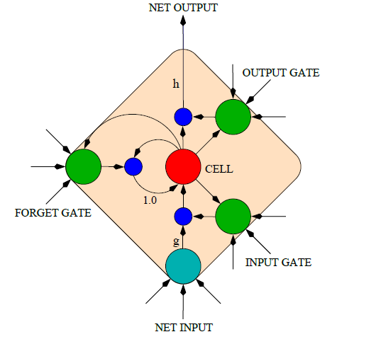
Long Short-Term Memory (LSTM)
An LSTM is a special kind of RNN architecture, capable of learning long-term dependencies.
An LSTM can learn to bridge time intervals in excess of 1000 steps.
LSTM networks outperform RNNs and Hidden Markov Models (HMMs):
Speech Recognition: 17.7% phoneme error rate on TIMIT acoustic phonetic corpus.
Winner of the ICDAR handwriting competition for the best known results in handwriting recognition.
This is achieved by multiplicative gate units that learn to open and close access to the constant error flow.
LSTM Memory Cell
Notes:
Long Short Term Memory networks are a special kind …

Slide 4
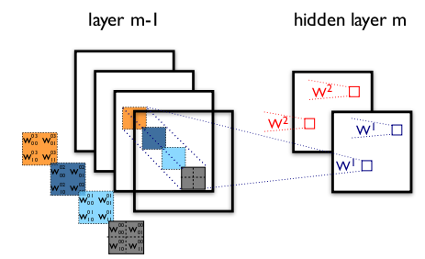
Convolutional Neural Networks (CNN)
The figure contains two different CNN layers. Layer $m−1$ contains four feature maps, while layer $m$ contains 2 ($h^{0}$ and $h^{1}$).
The blue and red squares in $m$ are computed from pixels of layer $m−1$ that fall within their 2x2 receptive field (squares in $m−1$).
$W_{ij}^{kl}$ then denotes the weight connecting each pixel of the $k^{th}$feature map at layer $m$ with the pixel at coordinates $(i,j)$ of the $l^{th}$ feature map at layer $m−1$.
It is important to know that the frame length of the filter for image recognition, called stride, is usually set to 1 or 2.
To control the spatial size of the output, zero-padding around the borders is commonly performed

Slide 5
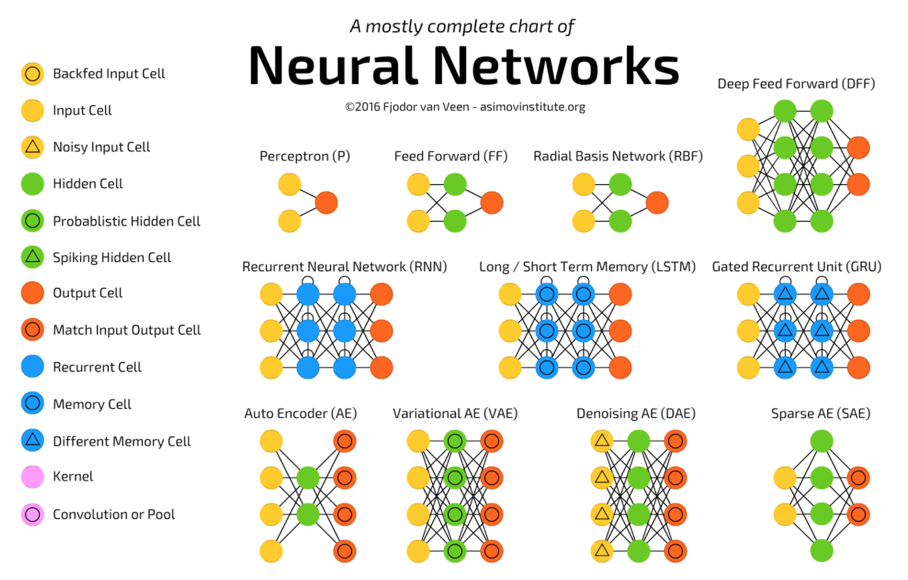
A Taxonomy of Architectures
Notes:
http://www.iro.umontreal.ca/~bengioy/papers/ftml.pdf

Slide 6
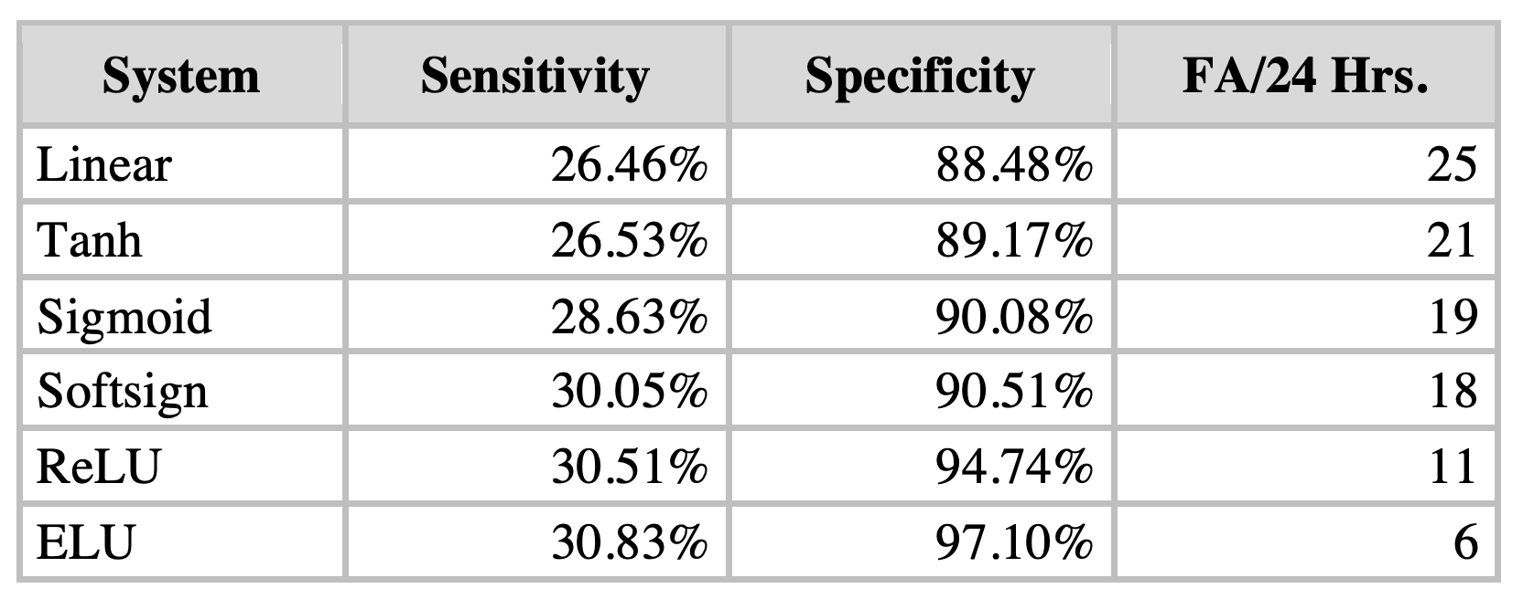
Comparison of Activation Functions
Notes:
http://www.iro.umontreal.ca/~bengioy/papers/ftml.pdf

Slide 7
Gradient Descent Algorithms For Optimization
Notes:
http://www.iro.umontreal.ca/~bengioy/papers/ftml.pdf

Slide 8
Gradient Descent Algorithms For Optimization
SGD: Stochastic Gradient Descent http://ufldl.stanford.edu/tutorial/supervised/OptimizationStochasticGradientDescent/
RMSprop: Root Mean Square Propagation http://www.cs.toronto.edu/~tijmen/csc321/slides/lecture_slides_lec6.pdf)
Adagrad: Adaptive Gradient Algorithm http://jmlr.org/papers/v12/duchi11a.html
Adadelta: an extension of Adagrad that seeks to reduce its aggressive, monotonically decreasing learning rate https://arxiv.org/abs/1212.5701
Adam: Adaptive Moment Estimation – keeps separate learning rates for each weight as well as an exponentially decaying average of previous gradients. http://arxiv.org/abs/1412.6980v8
Adamax: A variant of Adam that scales the gradient inversely proportionally to the ℓ₂ norm of the past gradients https://arxiv.org/abs/1412.6980v8
Nadam: Nesterov-accelerated Adaptive Moment Estimation http://cs229.stanford.edu/proj2015/054_report.pdf
Notes:
http://www.iro.umontreal.ca/~bengioy/papers/ftml.pdf

Slide 9
Why different optimization algorithms?
The main difference is actually how they treat the learning rate.
Stochastic Gradient Descent:
Theta (weights) is getting changed according to the gradient of the loss with respect to theta.
alpha is the learning rate.
If alpha is very small, convergence will be very slow. On the other hand, large alpha will lead to divergence.
Notes:
http://www.iro.umontreal.ca/~bengioy/papers/ftml.pdf

Slide 10
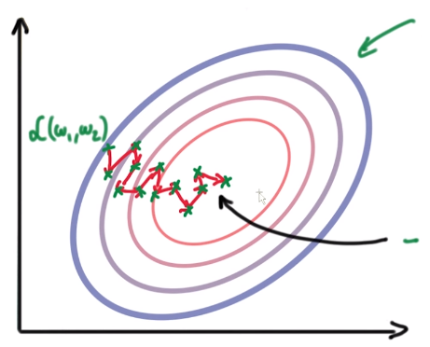
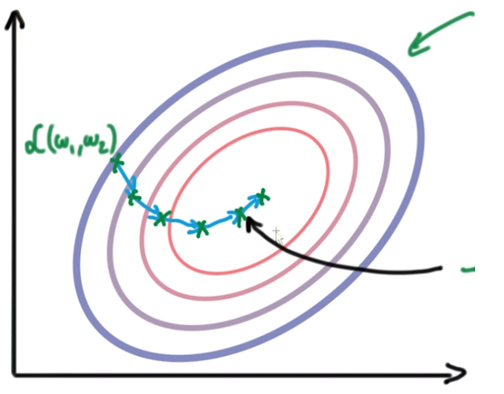
Why different optimization algorithms?
Due to the diversity of each training example, the gradient of the loss (L) changes quickly after each iteration. We are taking small steps but they are quite zig-zag (even though we slowly reach to a loss minima).
To overcome this, we introduce momentum. Basically taking knowledge from previous steps about where we should be heading. We are introducing a new hyperparameter:
Notes:
http://www.iro.umontreal.ca/~bengioy/papers/ftml.pdf

Slide 11
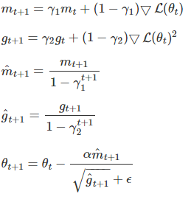
Adaptive Moment Estimation (Adam)
Adam is another method that computes adaptive learning rates for each parameter.
Like Adadelta and RMSprop, but in addition to storing an exponentially decaying average of past squared gradients $g_{t}$, Adam also keeps an exponentially decaying average of past gradients $m_{t}$, similar to momentum:
Notes:
http://www.iro.umontreal.ca/~bengioy/papers/ftml.pdf

Slide 12
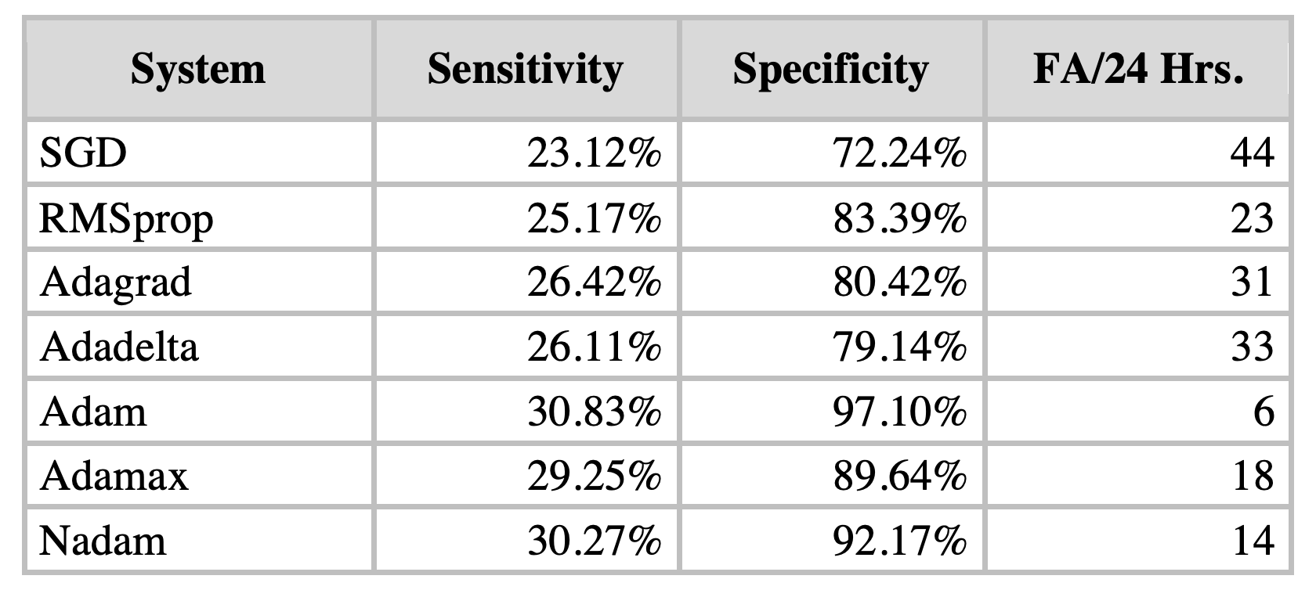
Comparison of Optimization Algorithms
Notes:
http://www.iro.umontreal.ca/~bengioy/papers/ftml.pdf

Slide 13
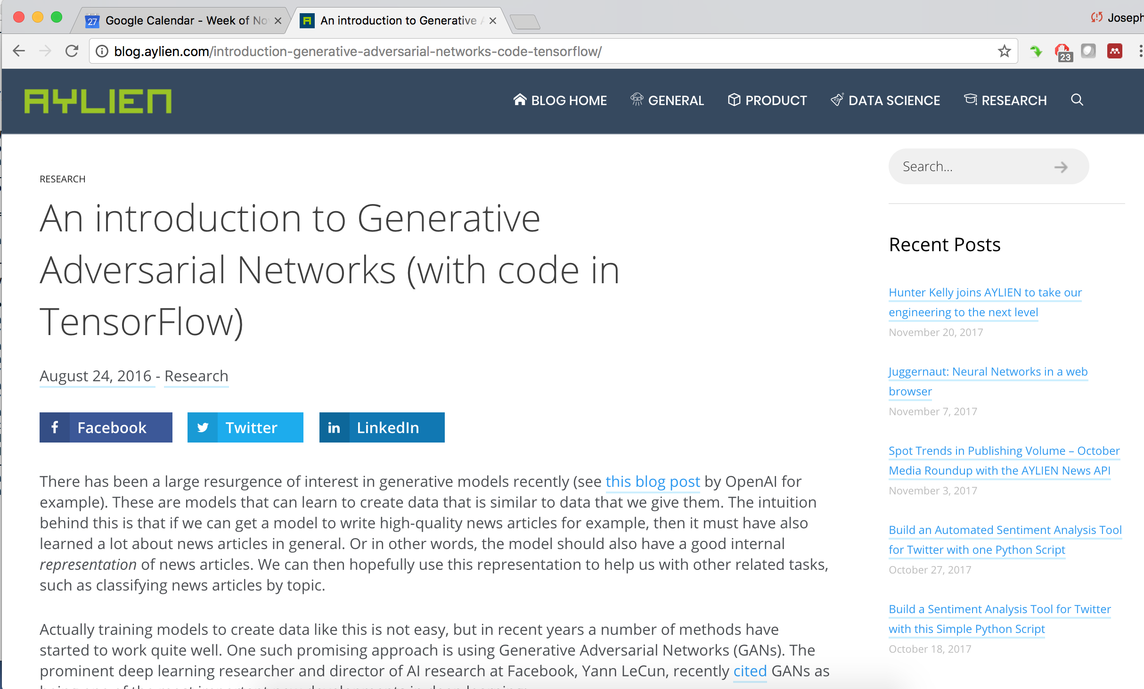
Generative Adversarial Networks
Notes:
http://www.iro.umontreal.ca/~bengioy/papers/ftml.pdf

Slide 14
Summary
Convolutional Neural Networks (CNN) attempt to exploit local correlations (e.g., spatial and temporal context).
Many deep learning systems that process physical signals use CNNs for the first layer.
Optimization algorithms play an important role in allowing deep learning systems to converge.
Stochastic gradient descent and specifically Adam are popular approaches that are widely used.
Alternate training methodologies are emerging that combine generative and discriminative training (what used to be called analysis by synthesis methods).
Generative Adversarial Networks (GAN) are emerging as one such powerful approach.
Notes:
http://www.iro.umontreal.ca/~bengioy/papers/ftml.pdf

