Slide 1
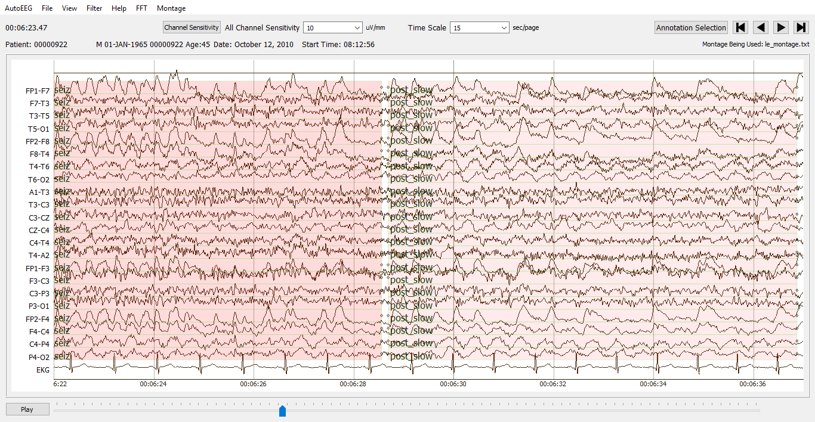
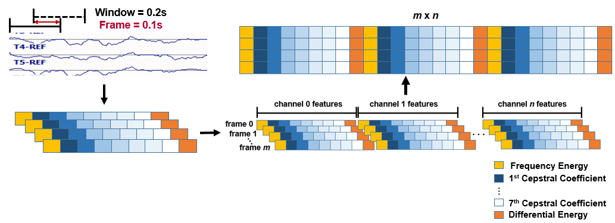
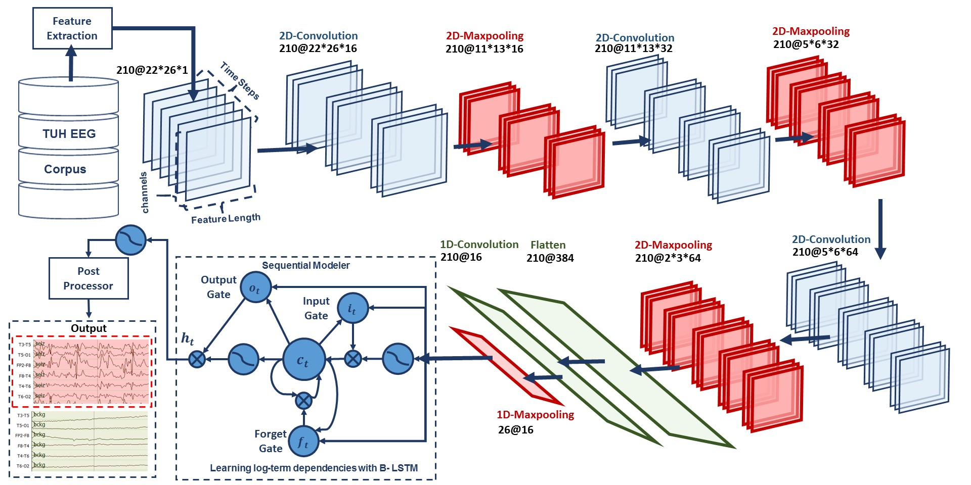
LECTURE 41: AUTOMATIC INTERPRETATION OF EEGS
Objectives: Sequential Data Processing Feature Extraction Event Spotting Postprocessing Integrated Deep Learning
Resources: AH: Feature Extraction SL: Montages MG: Gated Networks Cadence: Traffic Signs

Slide 2
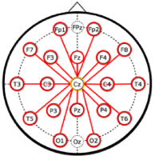
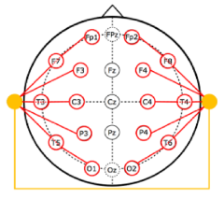
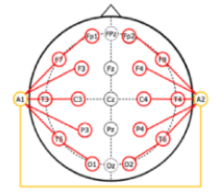
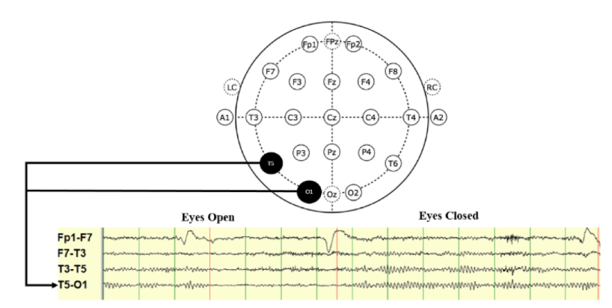
The EEG Signal
Common Vertex Reference
Average Reference
Linked Ear Reference
Notes:
I start from scratch with Recurrent Neural Networks. Then I’ll explain Long Short-Term Memory Networks. After that I will continue with Deep Recurrent Neural Networks. Then I will introduce you to Deep Bidirectional Long Short-Term Memory Networks. And finally I’ll wrap up the discussion with an overview on EEG classification using deep learning.

Slide 3
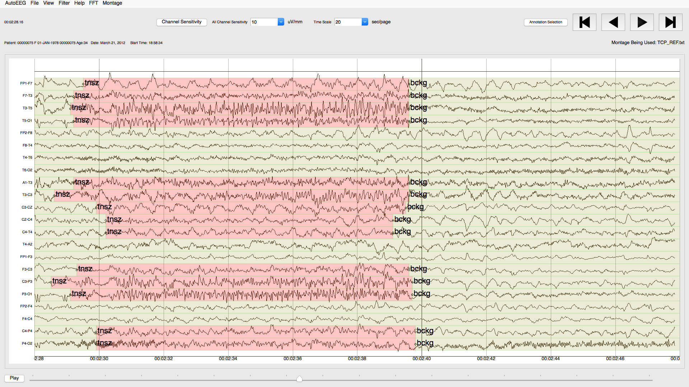
The EEG Signal
Notes:
I start from scratch with Recurrent Neural Networks. Then I’ll explain Long Short-Term Memory Networks. After that I will continue with Deep Recurrent Neural Networks. Then I will introduce you to Deep Bidirectional Long Short-Term Memory Networks. And finally I’ll wrap up the discussion with an overview on EEG classification using deep learning.

Slide 4
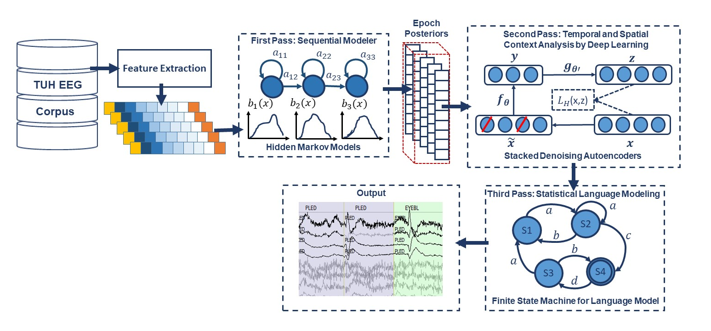
A Generic Architecture
Notes:
I start from scratch with Recurrent Neural Networks. Then I’ll explain Long Short-Term Memory Networks. After that I will continue with Deep Recurrent Neural Networks. Then I will introduce you to Deep Bidirectional Long Short-Term Memory Networks. And finally I’ll wrap up the discussion with an overview on EEG classification using deep learning.

Slide 5
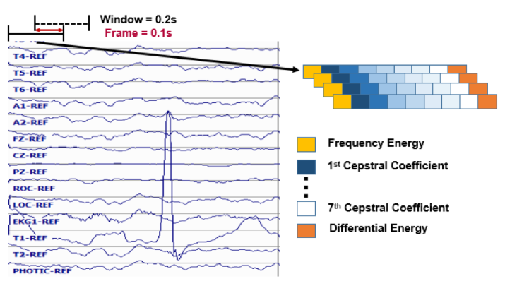
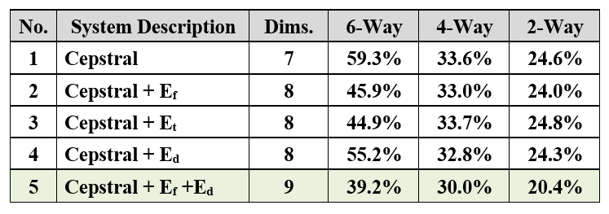
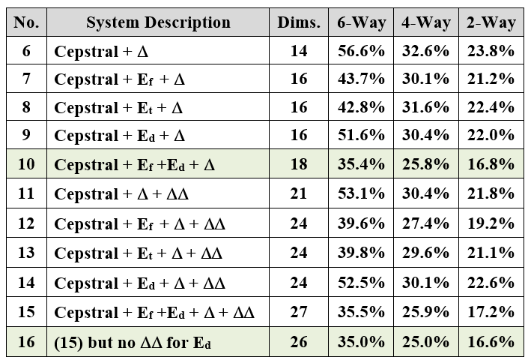
Feature Extraction
Notes:
I start from scratch with Recurrent Neural Networks. Then I’ll explain Long Short-Term Memory Networks. After that I will continue with Deep Recurrent Neural Networks. Then I will introduce you to Deep Bidirectional Long Short-Term Memory Networks. And finally I’ll wrap up the discussion with an overview on EEG classification using deep learning.

Slide 6
Feature Extraction
A 22-channel EEG is transformed into 22 independent feature streams using standard Linear Frequency Cepstral Coefficients (LFCCs).
We analyze the signal in 1-sec epochs, and further divide this interval into 10 frames of 0.1 secs each so that features are computed every 0.1 seconds using 0.2-second analysis windows.
The output of our feature extraction process is a feature vector of dimension 26 for each of 22 channels, with a frame duration of 0.1 secs.

Slide 7
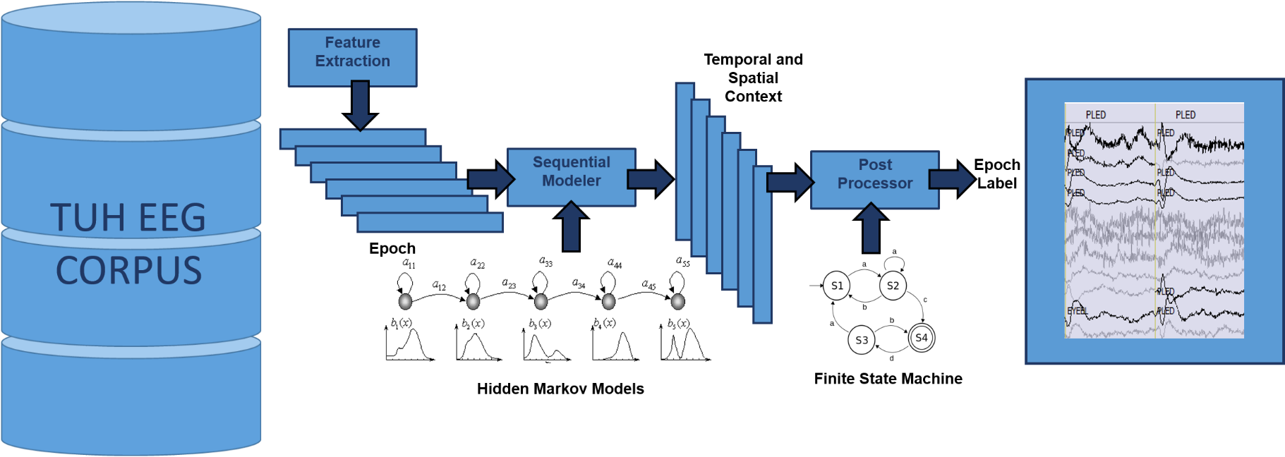
EEG classification using SdAs
AutoEEG is a hybrid system that uses three levels of processing to achieve high performance event detection on clinical data:
P1: hidden Markov models
P2: SdA
P3: Language Model

Slide 8
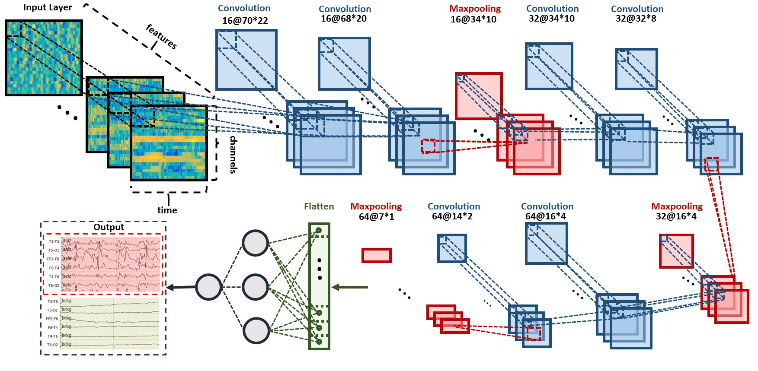
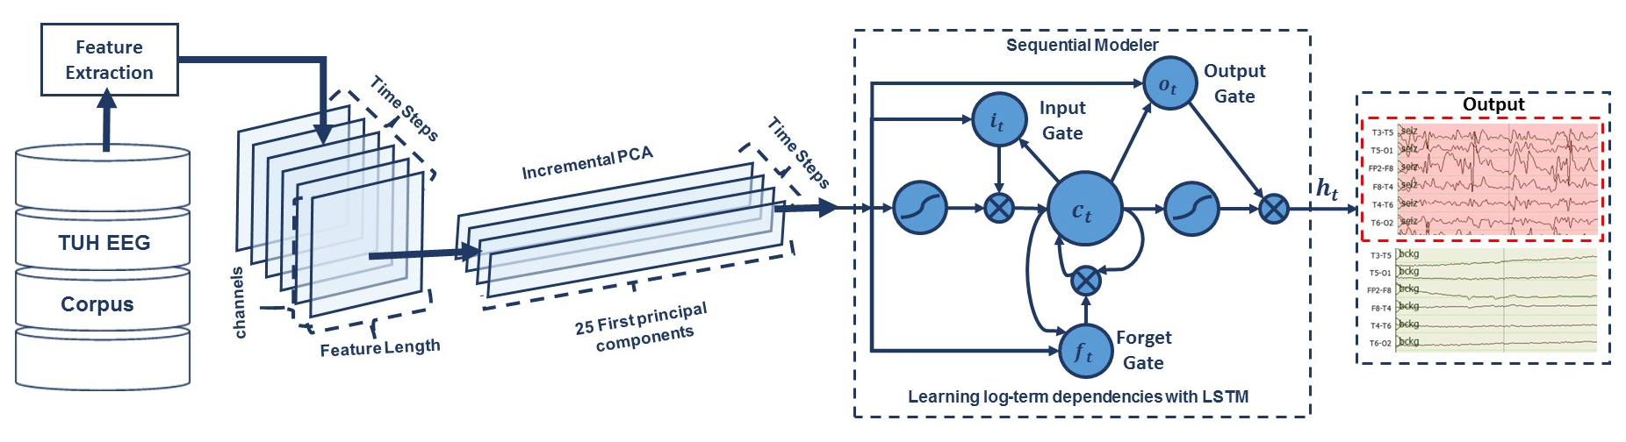
CNN/MLP and IPCA/LSTM Architectures

Slide 9
CNN/RNN Architecture
A hybrid architecture that integrates Convolutional Neural Networks (CNNs) used for temporal and spatial context analysis, with RNNs used for learning long-term dependencies.
Integrates 2D CNNs, 2D max-poolings, 1D CNNs, 1D max-poolings and RNNs.

Slide 10
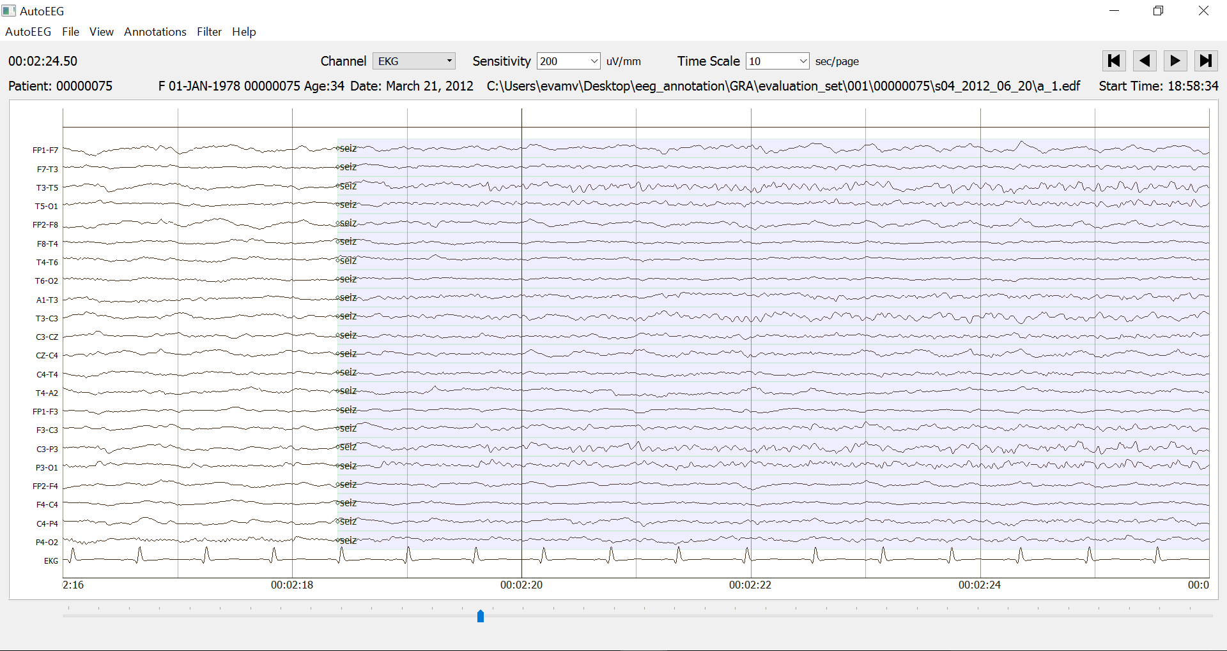
Data Preparation For CNNs
In our optimized system, the window duration is 21 seconds.
10 feature frames per second
with feature length of 26.
22 Channels
21 seconds
Input data to the first layer of CNNs is composed of frames:
W = 26: length of a feature vector
H = 22: number of EEG channels
N = 1: number of color channels
T = 210: the window length x the number of frames per/second

Slide 11
Two-Dimensional Convolutional Neural Networks
CNNs are comprised of convolutional layers along with subsampling layers which are followed by one or more fully connected layers or RNNs.
In the case of 2D CNNs that are common in image and speech recognition, the input to a convolutional layer is W × H × N data (e.g. an image) where W and H are the width and height of the input data, and N is the number of channels (e.g. in an RGB image, N = 3).
First 2D convolutional layer filters 210 frames (T = 21 × 10) of EEGs distributed in time with a size of 26 × 22 × 1 (W=26, H=22, N=1) using 16 kernels of size 3 × 3 and with a stride of 1.
The first 2D max pooling layer takes as input a vector which is 210 frames distributed in time with a size of 26 × 22 × 16 and applies a pooling size of 2 × 2.
This process is repeated two times with two 2D convolutional layers with 32 and 64 kernels of size 3 × 3 respectively and two 2D max pooling layers with a pooling size of 2 × 2.

Slide 12
One-Dimensional Convolutional Neural Networks
1D convolution layer (e.g. temporal convolution) creates a convolution kernel that is convolved with the layer input over a single spatial (or temporal) dimension to produce a tensor of outputs.
The output of the third max pooling layer is flattened to 210 frames with a size of 384 × 1.
A 1D convolutional layer filters the output of the flattening layer using 16 kernels of size 3 which decreases the dimensionality in space to 210 × 16.
Apply a 1D maxpooling layer with a size of 8 to decrease the dimensionality to 26 × 16.
This output becomes the input to a deep bidirectional LSTM network.
Periodically inserting a pooling layer in between successive convolutional layers reduces the spatial and temporal size.
Reduces the number of parameters and amount of computation.
Controls overfitting.

Slide 13
Deep Bidirectional LSTM Networks
The input dimension to the deep bidirectional LSTM network is 26 × 16.
The dimensionality of the output space for the first and second LSTM is 128 and 256 respectively.
The output of the last bidirectional LSTM layer is fed to a 2-way sigmoid function which produces a final classification of an epoch.
Epochs are typically 1 sec in duration.
Regularizations are used in first two layers of CNNs.
To increase nonlinearity, Exponential Linear Units (ELU) are used.
Adam is used in the optimization process along with a mean squared error loss function.
A stateless LSTM configuration is used where the internal state is reset after each training batch.
Applying stateful LSTM was not successful, since we cannot leverage shuffling data.

Slide 14
TUH EEG Seizure Subset
Contains over 30,000 sessions collected from 16,000+ patients over period of 14 years at Temple University Hospital.
Deidentified medical reports are available that include a brief patient history and a neurologist’s findings.
EEG data is stored in EDF files and contains anywhere from 19 to 128 channels. In this study we use a standard 10/20 channel configuration.
A subset of this data focused on seizure detection was released that includes a 50-patient evaluation set and a 64-patient training set (publicly available at: https://www.isip.piconepress.com/projects/tuh_eeg/).
Description | TUHS
 | Train | Eval
Patients | 64 | 50
Sessions | 281 | 229
Files | 1,028 | 985
Seizure (secs) | 17,686 | 45,649
Non-Seizure (secs) | 596,696 | 556,033
Total (secs) | 614,382 | 601,682

Slide 15
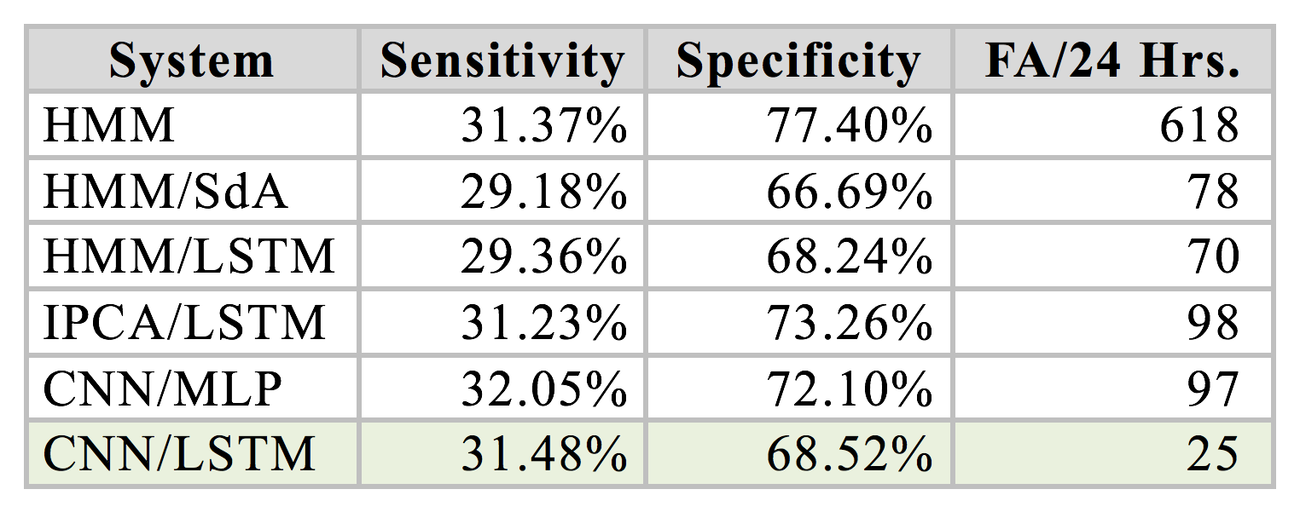
Performance Analysis

Slide 16
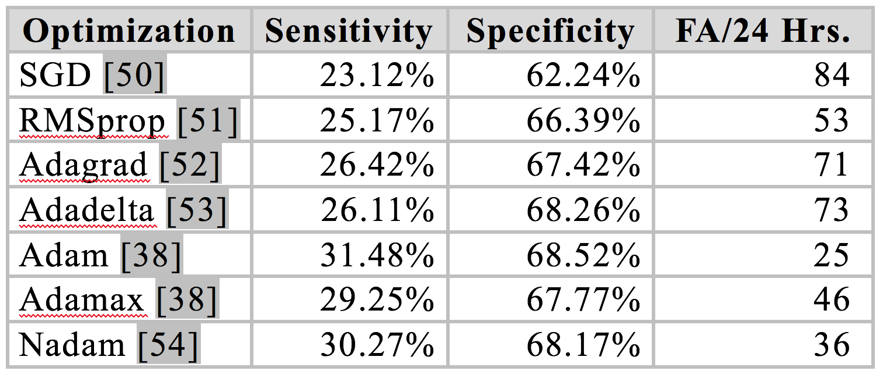
Performance Analysis

Slide 17
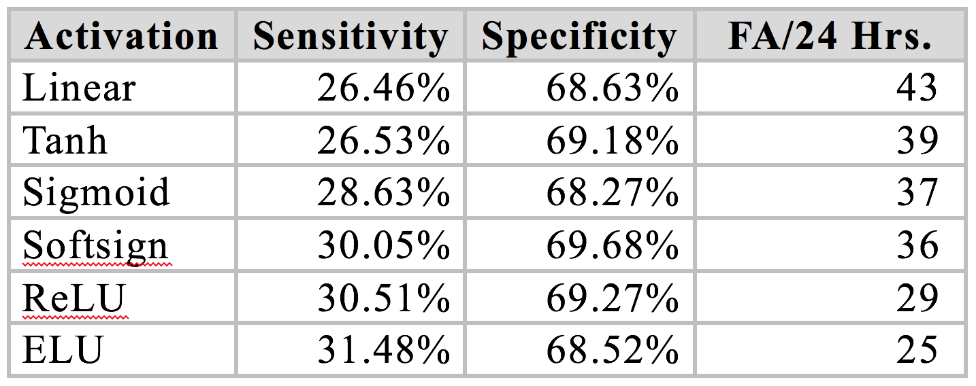
Performance Analysis

Slide 18
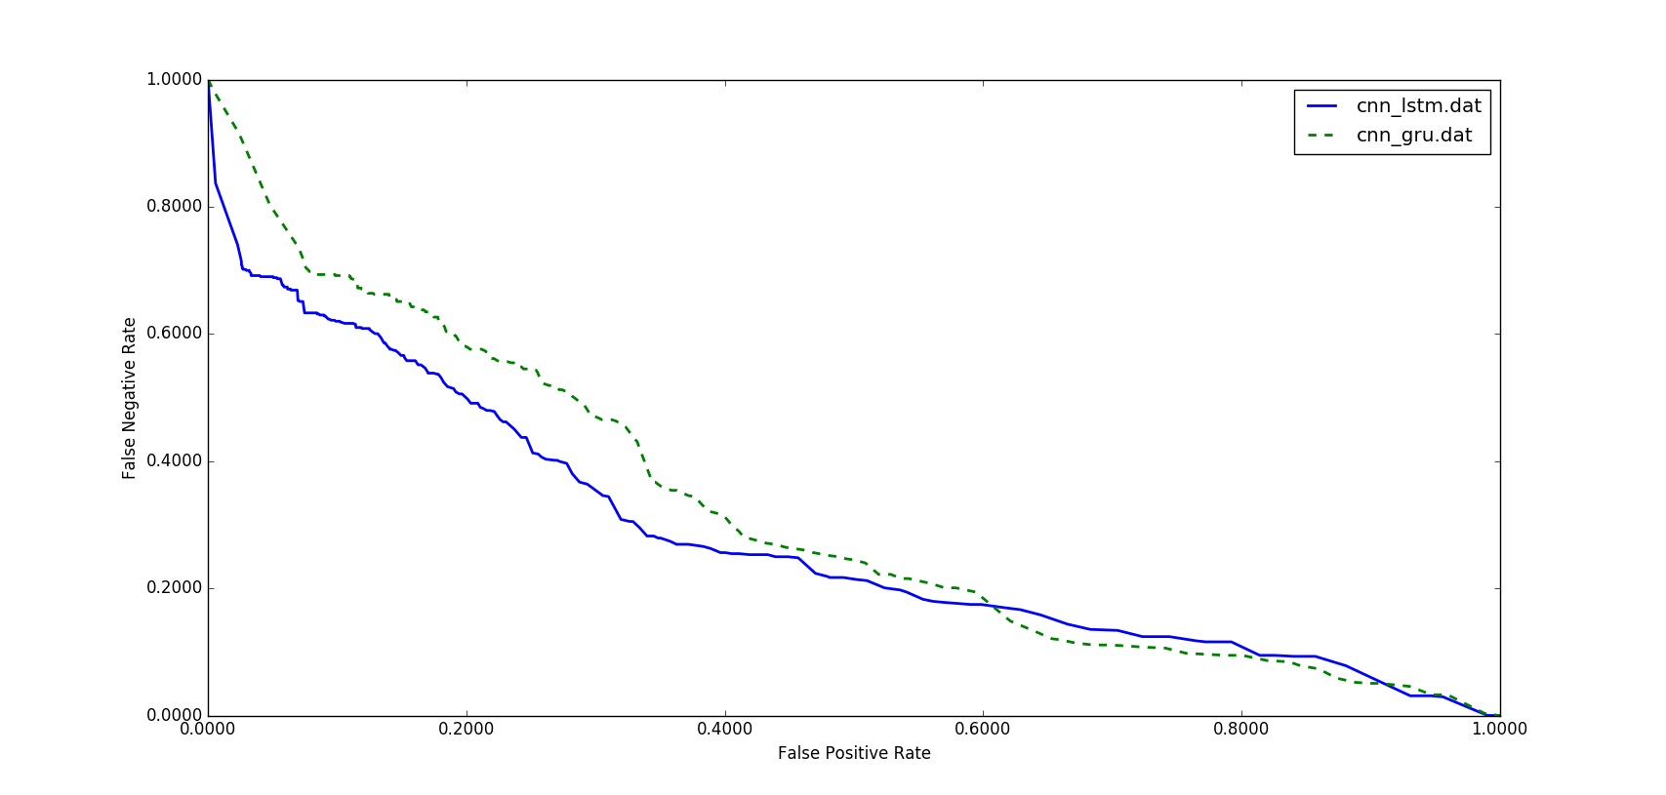
Performance of Convolutional Recurrent Neural Networks
These systems were evaluated using a method of scoring popular in the EEG research community known as the overlap method.
In lower false positive rates, CNN/LSTM has significantly better performance than CNN/GRU.
In the DET curve, we see CNN/LSTM performs better in a region where false alarms are low, which is our region of interest.
While a GRU unit controls the flow of information like an LSTM unit, it does not have a memory unit.
LSTMs can remember longer sequences better than GRUs and outperform it in this task, since seizure detection requires modeling long distance relationships.
System | Sens. | Spec. | FAs per 24 Hrs.
CNN/GRU | 30.8% | 91.5% | 21
CNN/LSTM | 30.8% | 97.1% | 6

Slide 19
Results For Different Initialization Methods
A variety of initialization methods were investigated.
The proper initialization of weights in a convolutional recurrent neural network is critical to convergence.
Initialization with zeros or ones completely stalled the convergence.
FAs for a sensitivity of 30% can change from 7 to 40.
Some initializations can result in the deeper layers receiving inputs with small variances, which in turn slows down back propagation, and retards the overall convergence process.
The best performance is obtained by orthogonal initialization which solves the exploding and vanishing gradient problems by preserving the norm of a vector ‎during matrix multiplications.
Initialization | Sens. | Spec. | FAs
Orthogonal | 30.8% | 96.9% | 7
Lecun Uniform | 30.3% | 96.5% | 8
Glorot Uniform | 31.0% | 94.2% | 13
Glorot Normal | 29.5% | 92.4% | 18
Variance Scaling | 31.8% | 92.1% | 19
Lecun Normal | 31.8% | 92.1% | 19
He Normal | 31.3% | 91.1% | 22
Random Uniform | 30.2% | 90.0% | 25
Truncated Normal | 31.6% | 87.8% | 31
He Uniform | 29.2% | 85.1% | 40

Slide 20
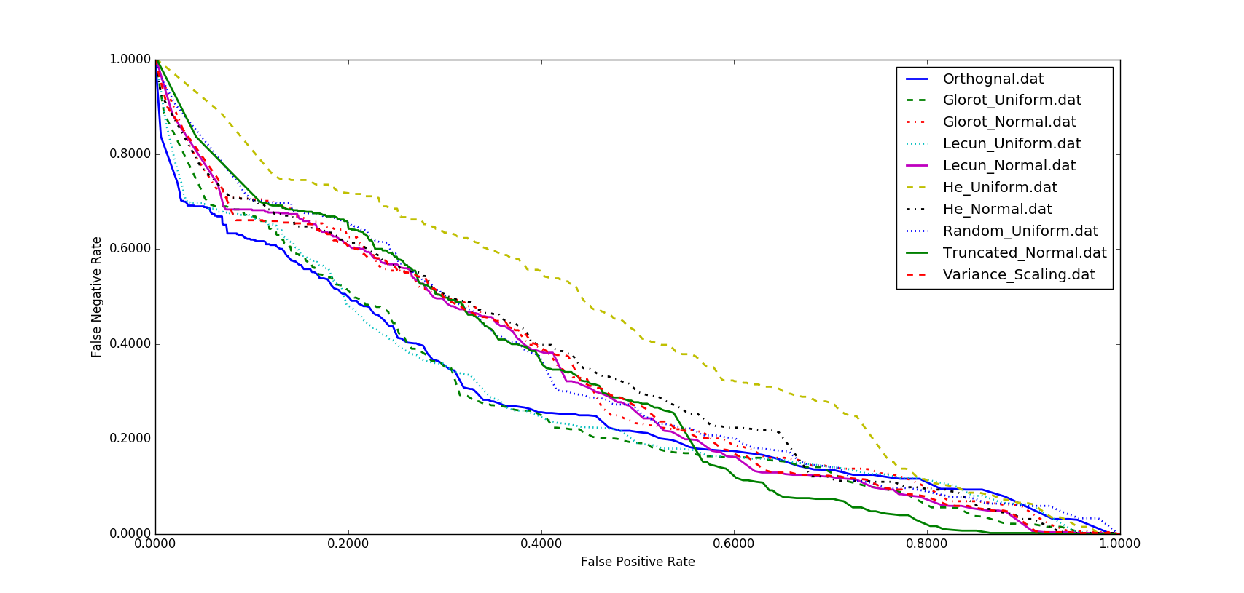
Results For Different Initialization Methods
Most interested in the region where false alarms are low.
He uniform initialization is significantly worse across the board.
Lecun Uniform initialization delivers a performance close to orthogonal initialization.
Orthogonal matrices preserve the norm of a vector ‎and their eigenvalues have absolute value of one. This means that, no matter how many times we perform repeated matrix multiplication, the resulting matrix doesn't explode or vanish.
Also in orthogonal matrices, columns and rows are all orthonormal to one another, which helps the weights to learn different input features.

Slide 21
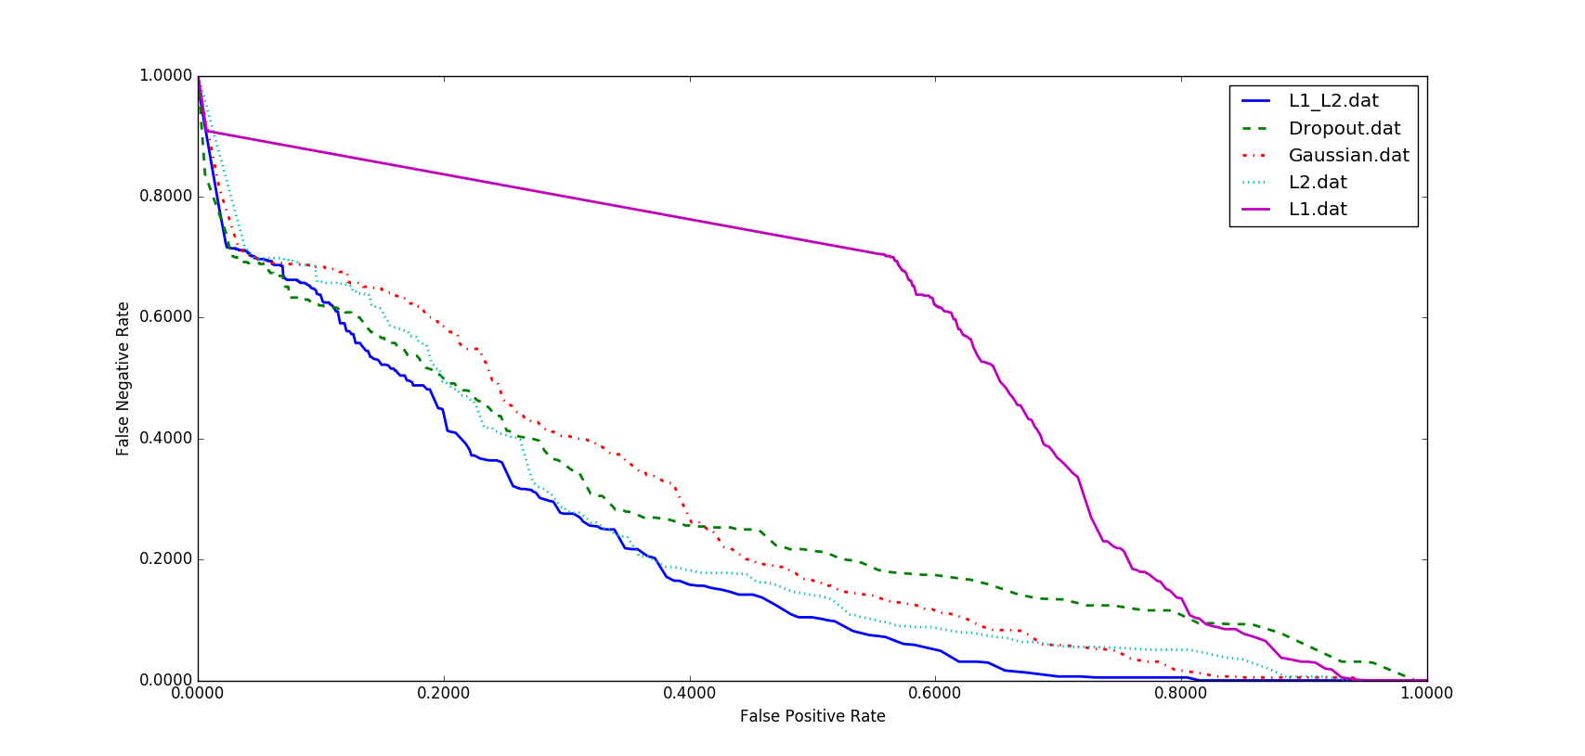
Results For Different Regularizations
Overfitting is a serious problem in deep neural nets.
Five popular regularization methods were investigated to address overfitting.
L1, L2 and L1/L2 techniques apply penalties on layer parameters. These penalties are incorporated in the loss function that the network optimizes.
Zero-centered Gaussian noise were studied as one type of regularization.
Dropout prevents units from co-adapting too much by randomly dropping units and their connections from the neural network during training.
While generally L1/L2 has the best performance, as we move towards a low FA rate, dropout delivers a lower FA rate.
Initialization | Sens. | Spec. | FAs
L1/L2 | 30.8% | 97.1% | 6
Dropout | 30.8% | 96.9% | 7
Gaussian | 30.8% | 95.8% | 9
L2 | 30.2% | 95.6% | 10
L1 | 30.0% | 43.7% | 276

Slide 22
Error Analysis
Primary Error Modalities:
False alarms generated during brief delta range slowing patterns such as intermittent rhythmic delta activity.
Example of a seizure followed by a post-ictal slowing:
Our closed-loop experiments showed us that all the regularizing methods explored in this study are playing an important role in increasing the false alarms of slowing patterns.
Even though dropout is effective in CNNs, when dropout is placed over kernels it leads to diminished results.
Seizure
Slowing

Slide 23
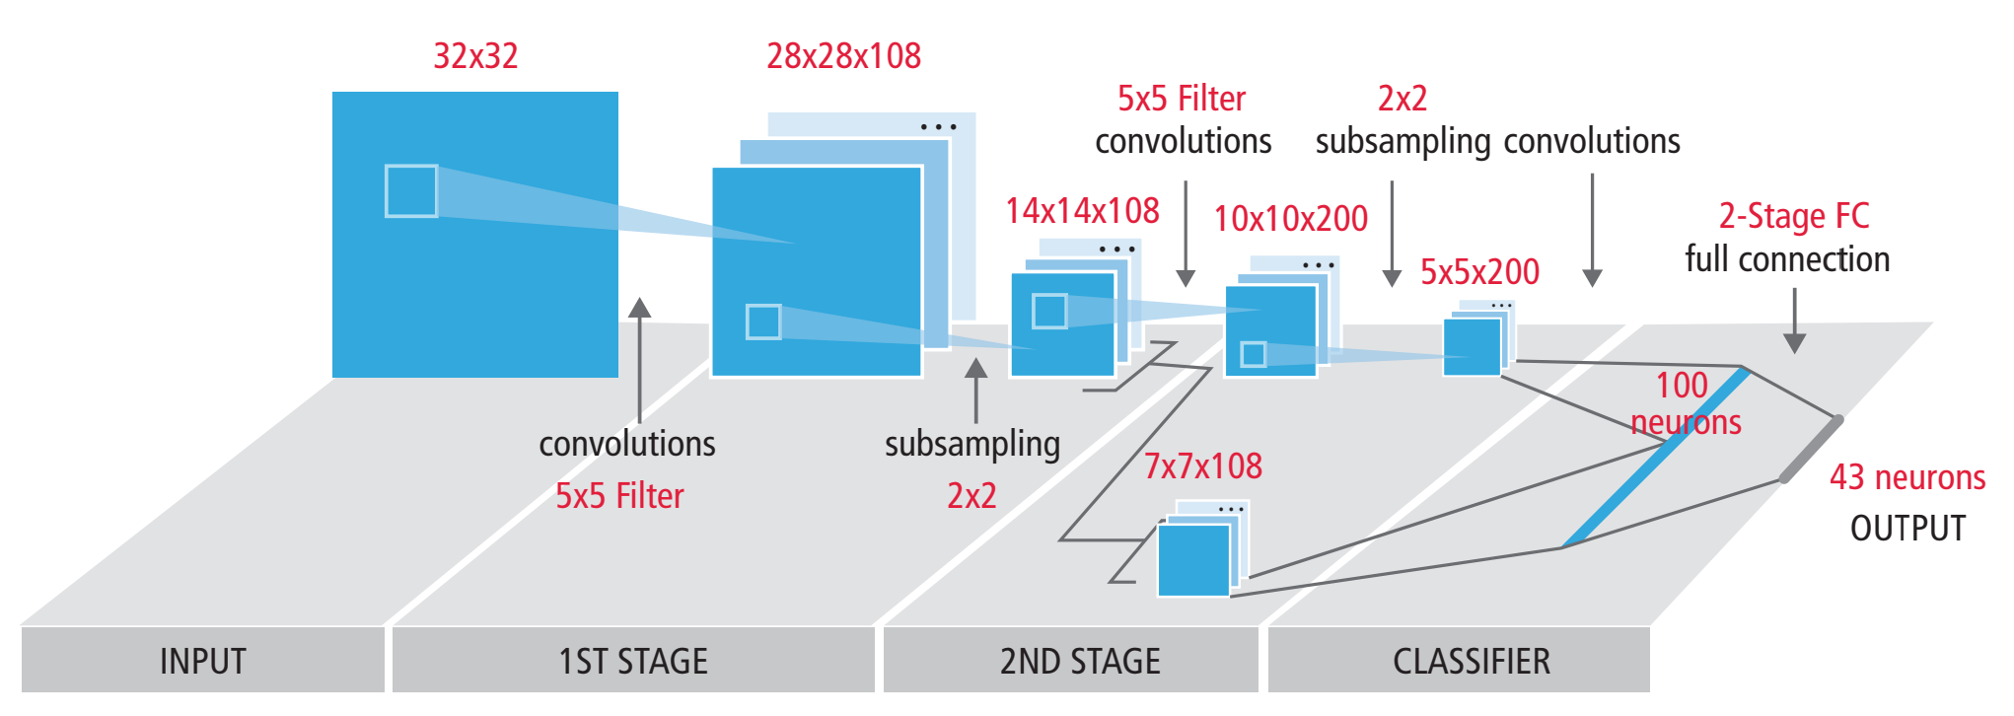
Image Processing Architectures

Slide 24
Summary and Future Directions
Summary:
Convolutional Neural Networks are popular front ends to encode temporal and spatial correlations.
CNN/LSTM is a popular combination for many signal processing applications because LSTM has a separate memory cell and remembers longer sequences better than many architectures.
Orthogonal initialization provided the best performance because it handles the exploding and vanishing gradient problems.
Future Directions:
Robust training procedures are needed to make this technology relevant to a wide range of healthcare applications.

