Slide 1
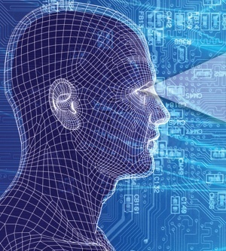
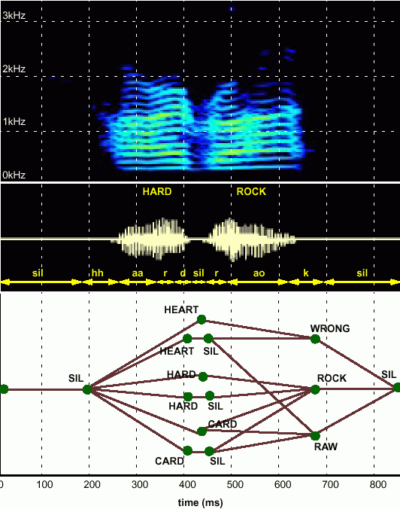
HUMAN LANGUAGE TECHNOLOGY:
From Bits to Blogs
Joseph Picone, PhD
Professor and Chair
Department of Electrical and Computer Engineering
Temple University
URL:

Slide 2
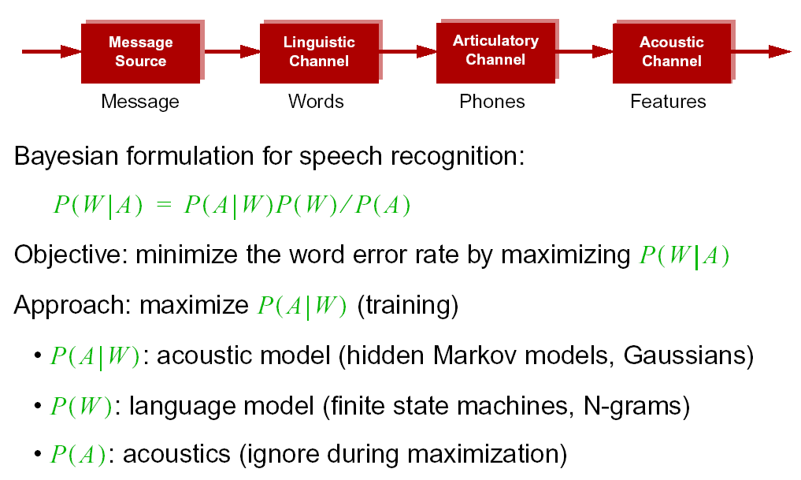
Statistical Approach: Noisy Communication Channel Model

Slide 3
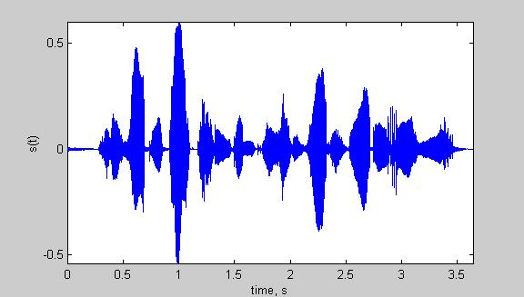
Speech Recognition Overview
Based on a noisy communication channel
model in which the intended message is
corrupted by a sequence of noisy models
Bayesian approach is most common:
Objective: minimize word error rate by
maximizing P(W|A)
P(A|W): Acoustic Model
P(W): Language Model
P(A): Evidence (ignored)
Acoustic models use hidden Markov
models with Gaussian mixtures.
P(W) is estimated using probabilistic
N-gram models.
Parameters can be trained using generative (ML)
or discriminative (e.g., MMIE, MCE, or MPE) approaches.
Input
Speech
Feature
Extraction
Acoustic
Front-end
Acoustic Models
P(A/W)
Language Model
P(W)
Search
Recognized Utterance

Slide 4
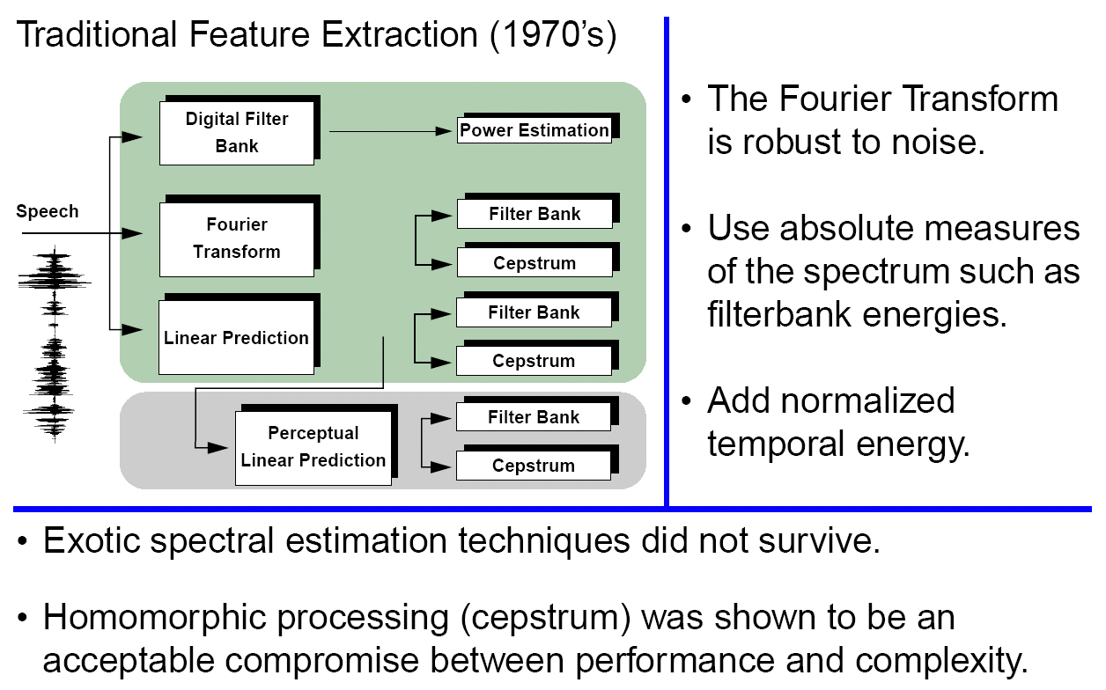
Signal Processing in Speech Recognition

Slide 5
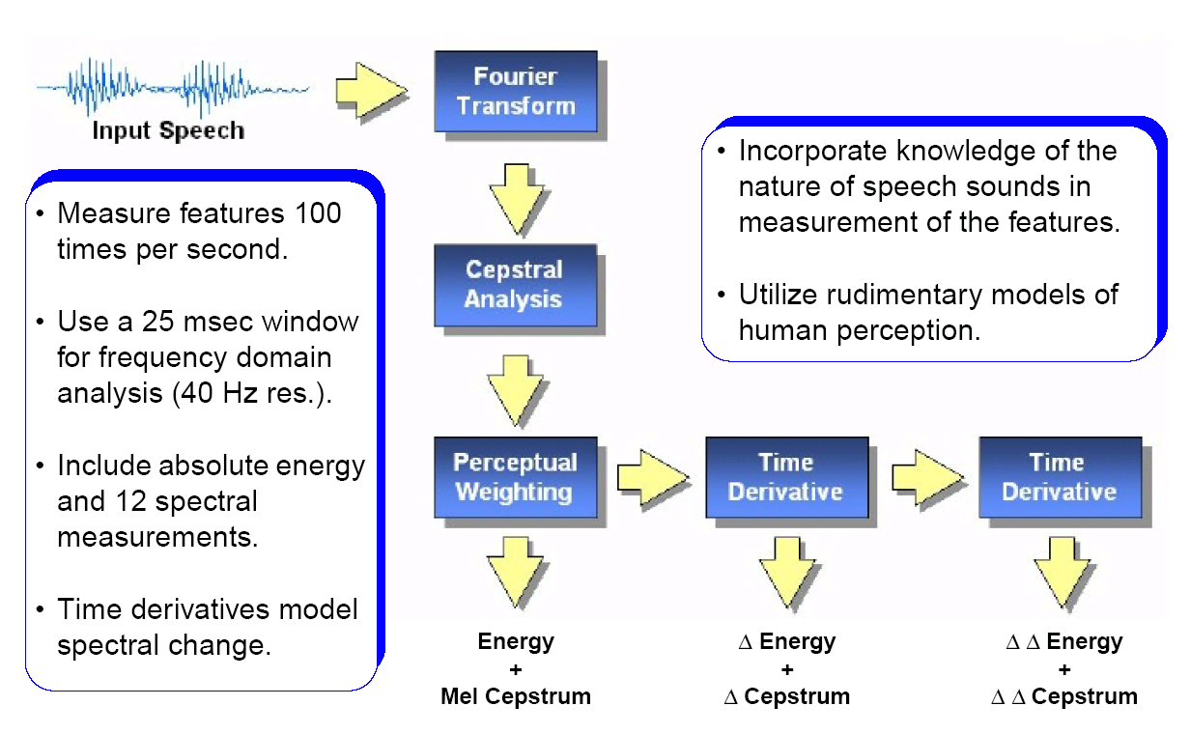
Features: Convert a Signal to a Sequence of Vectors

Slide 6
iVectors: Towards Invariant Features
The i-vector representation is a data-driven approach for feature extraction that provides a general framework for separating systematic variations in the data, such as channel, speaker and language.
The feature vector is modeled as a sum of three (or more) components:
M = m + Tw + ε
where M is the supervector, m is a universal background model, ε is a noise term, and w is the target low-dimensional feature vector.
M is formed as a concatenation of consecutive feature vectors.
This high-dimensional feature vector is then mapped into a low-dimensional space using factor analysis techniques such as Linear Discriminant Analysis (LDA).
The dimension of T can be extremely large (~20,000 x 100), but the dimension of the resulting feature vector, w, is on the order of a traditional feature vector (~50).
The i-Vector representation has been shown to give significant reductions (20% relative) in EER on speaker/language identification tasks.

Slide 7
Speech Recognition Overview
Based on a noisy communication channel
model in which the intended message is
corrupted by a sequence of noisy models
Bayesian approach is most common:
Objective: minimize word error rate by
maximizing P(W|A)
P(A|W): Acoustic Model
P(W): Language Model
P(A): Evidence (ignored)
Acoustic models use hidden Markov
models with Gaussian mixtures.
P(W) is estimated using probabilistic
N-gram models.
Parameters can be trained using generative (ML)
or discriminative (e.g., MMIE, MCE, or MPE) approaches.
Input
Speech
Acoustic
Front-end
Research Focus
Acoustic Models
P(A/W)
Language Model
P(W)
Search
Recognized Utterance

Slide 8
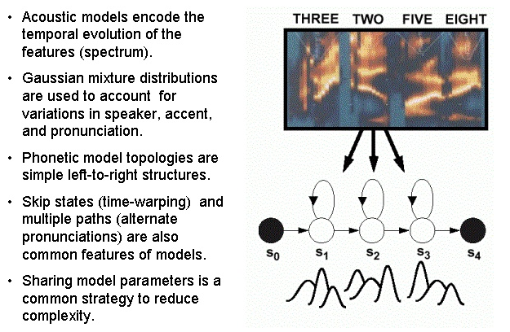
Acoustic Models: Capture the Time-Frequency Evolution

Slide 9
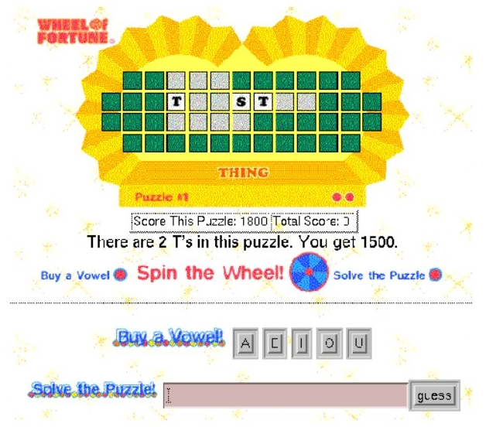
Language Modeling: Word Prediction

Slide 10
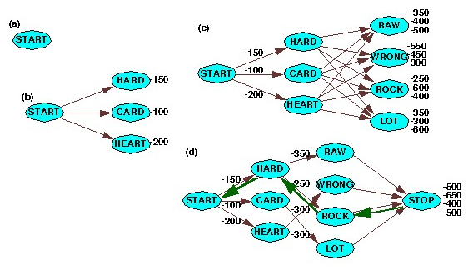
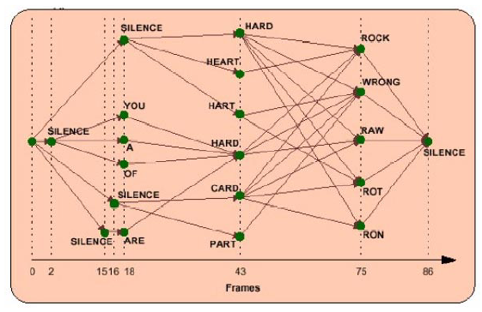
Search: Finding the Best Path
breadth-first
time synchronous
beam pruning
supervision
word prediction
natural language

Slide 11


Information Retrieval From Voice Enables Analytics
Speech Activity Detection
“What is the number one complaint of my customers?”
Gender Identification
Language Identification
Speaker Identification
Keyword Search
Speech to Text
Relationship
Analysis
Entity
Extraction
Relational Database

Slide 12
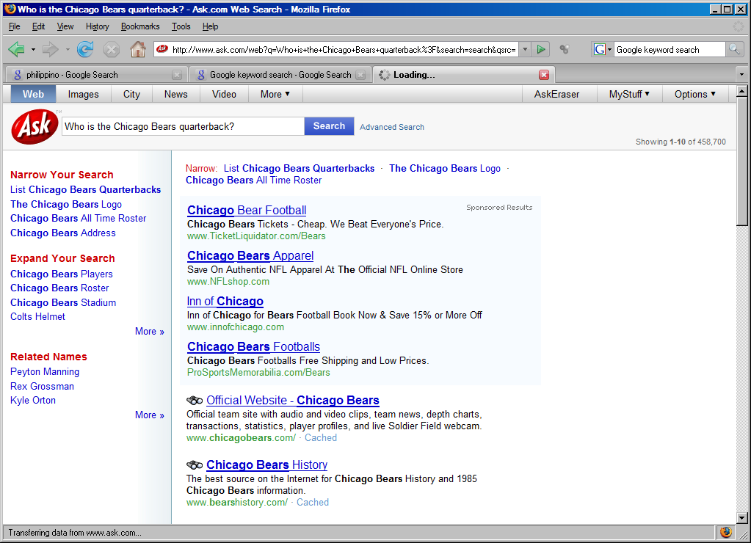

Content-Based Searching
Once the underlying data is analyzed and “marked up” with metadata that reveals content such as language and topic, search engines can match based on meaning.
Such sites make use several human language technologies and allow you to search multiple types of media (e.g., audio tracks of broadcast news).
This is an emerging area for the next generation Internet.

Slide 13
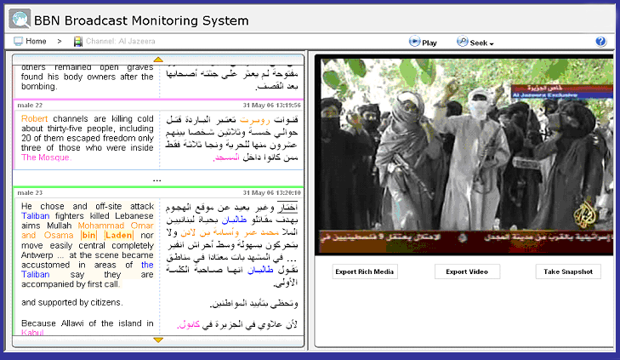
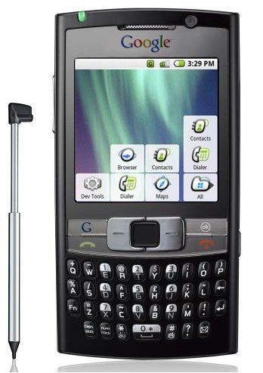
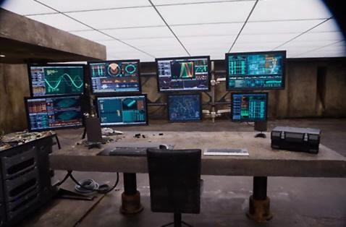
Applications Continually Find New Uses for the Technology
Real-time translation of news broadcasts in multiple languages (DARPA GALE)
Google search using voice queries
Keyword search of audio and video
Real-time speech translation in 54 languages
Monitoring of communications networks for military and homeland security applications

Slide 14
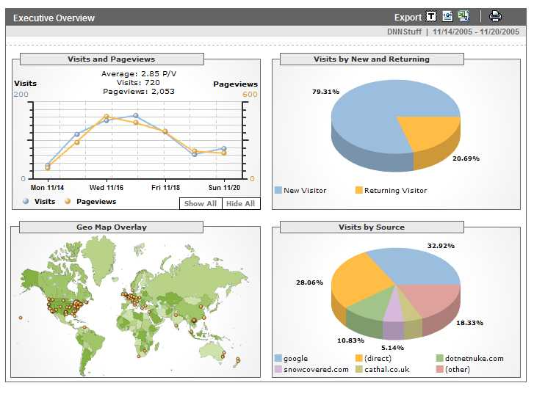
Analytics
Definition: A tool or process that allows an entity (i.e., business) arrive at an optimal or realistic decision based on existing data. (Wiki).
Google is building a highly
profitable business around
analytics derived from people
using its search engine.
Any time you access a web page,
you are leaving a footprint of
yourself, particularly with respect
to what you like to look at.
This has allows advertisers to tailor
their ads to your personal interests
by adapting web pages to your
habits.
Web sites such as amazon.com, netflix.com and pandora.com have taken this concept of personalization to the next level.
As people do more browsing from their telephones, which are now GPS enabled, an entirely new class of applications is emerging that can track your location, your interests and your network of “friends.”

Slide 15
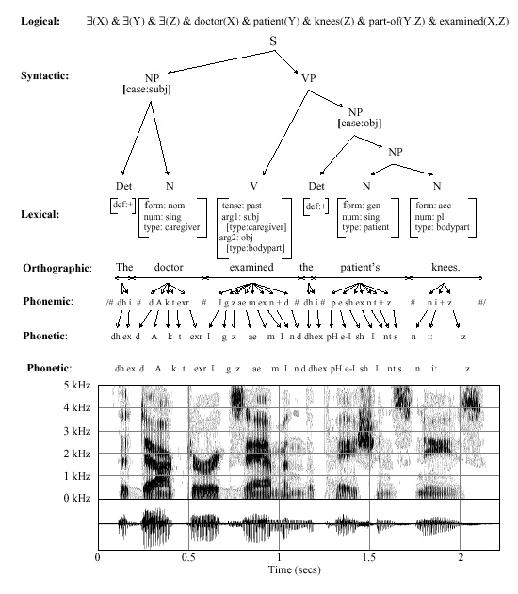
Speech Recognition is Information Extraction
Traditional Output:
  best word sequence
  time alignment of information
Other Outputs:
  word graphs
  N-best sentences
  confidence measures
  metadata such as speaker identity, accent, and prosody
Applications:
  Information localization
  data mining
  emotional state
  stress, fatigue, deception

Slide 16
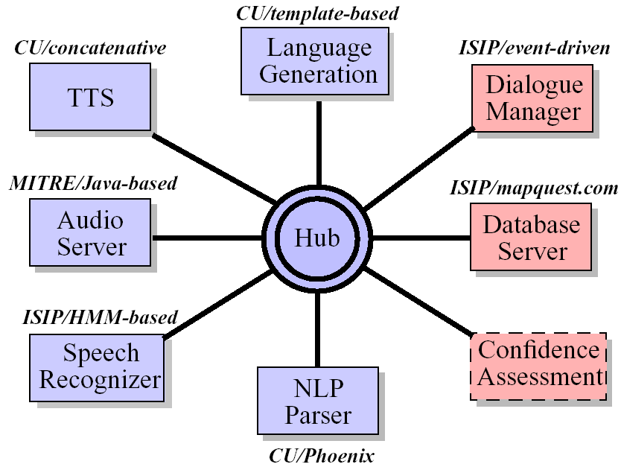
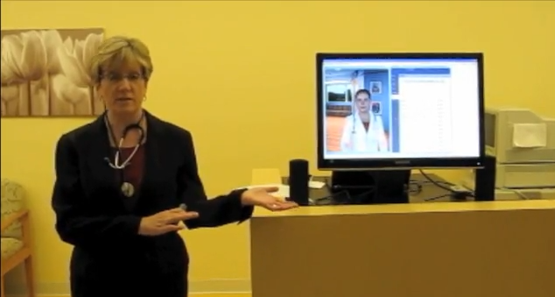
Dialog Systems
DARPA Communicator architecture
Extendable distributed processing architecture
Frame-based dialog manager
Open-source speech recognition
Goal: combine the best of all research systems to assess
state of the art
Dialog systems for involve speech recognition, speech synthesis, avatars, and even gesture and emotion recognition
Avatars increasingly lifelike
But… systems tend to be application-specific

Slide 17
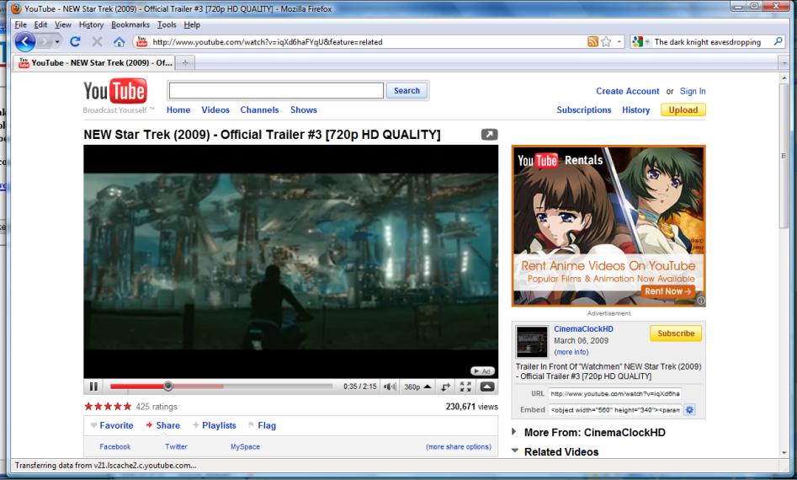

Future Directions
How do we get better?
Supervised transcription is slow, expensive and limited. Unsupervised learning on large amounts of data is viable.
More data, more data, more data…
YouTube is opening new possibilities
Courtroom and governmental
proceedings are providing significant
amounts of parallel text
Google???
But this type of data is imperfect…
… and learning algorithms are still very primitive
And neuroscience has yet to inform our learning algorithms!

Slide 18
Brief Bibliography of Related Research
S. Pinker, The Language Instinct: How the Mind Creates Language, William Morrow and Company, New York, New York, USA, 1994.
F. Juang and L.R. Rabiner, “Automatic Speech Recognition - A Brief History of the Technology,” Elsevier Encyclopedia of Language and Linguistics, 2nd Edition, 2005.
M. Benzeghiba, et al., “Automatic Speech Recognition and Speech Variability, A Review,” Speech Communication, vol. 49, no. 10-11, pp. 763–786, October 2007.
B.J. Kroger, et al., “Towards a Neurocomputational Model of Speech Production and Perception,” Speech Communication, vol. 51, no. 9, pp. 793-809, September 2009.
B. Lee, “The Biological Foundations of Language”, available at http://www.duke.edu/~pk10/language/neuro.htm (a review paper).
M. Gladwell, Blink: The Power of Thinking Without Thinking, Little, Brown and Company, New York, New York, USA, 2005.

