Slide 1


Tutorials on Deploying Neural Network Architectures using Keras and Tensorflow
Vinit Shah, Joseph Picone and Iyad Obeid
Neural Engineering Data Consortium
Temple University

Slide 2
Outline
Brief introduction to Tensorflow and Keras
Comparison between Numpy and TF
Examples of NN architectures
LR tricks
Regularizers
Model analysis

Slide 3

Introduction to Tensorflow
Tensorflow provides primitives for defining functions on tensors and automatically computing their derivatives.
But wait, what is a Tensor ?
  Tensors are multilinear maps from vector spaces to real numbers
Tensorflow is funded by google and constantly evolving to optimize performance for any hardware specifications. (i.e. multigpu training, memory allocation, cpu support, etc.)
Gives us ability to develop systems from ground up. TF core layers allows us to edit the properties of the fundamental neurons.
TFLearn and Keras are the higher-level APIs which use Tensorflow as its backend. This gives researchers a convenient way to develop models in a few lines of code.

Slide 4
Introduction to Tensorflow
Tensorflow uses a dataflow graph to represent the model computation in terms of the dependencies between individual operators.
Primary elements of TF:
  Graph
  Session
  Ops
  Variable scopes
Placeholders, constants, variables and operations are added to the graphs by default. It is a good practice to define a Graph object explicitly which allows us to create multiple graphs/models in the same script.
  ## initiate a new model
  New_graph = tf.Graph()
  with new_graph.as_default():
  ## assign a constant to the graph
  new_g_const = tf.constant([1.0, 2.0])
  Sessions encapsulate the environment where operations are executed.

Slide 5
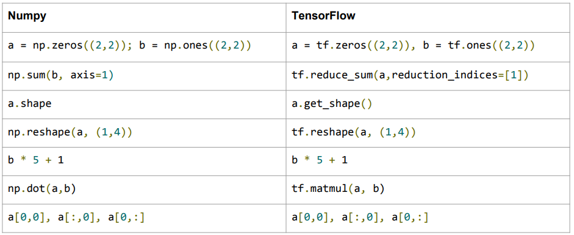
Comparison between Numpy and TF
Scopes are used for breaking down the complexity of the models into individual pieces.
Numpy Vs. TF commands:

Slide 6
Keras
Keras allows you to quickly build and test a neural network architectures with minimal effort. Beginners should start deploying models using Keras first.
This same model will take 50+ lines of code in Tensorflow which is hard to understand and prune to errors as well.
# Keras model template
model = Sequential()
model.add(Dense(300, activation='relu', input_dim=100))
model.add(Dense(30, activation='relu'))
model.add(Dense(30, activation='relu'))
model.add(Dense(4, activation=‘softmax'))
model.compile(optimizer='rmsprop',
loss=‘categorical_crossentropy',
metrics=['accuracy'])
# Train the model, iterating on the data in batches of 32 samples
model.fit(data, labels, epochs=10, batch_size=32)

Slide 7
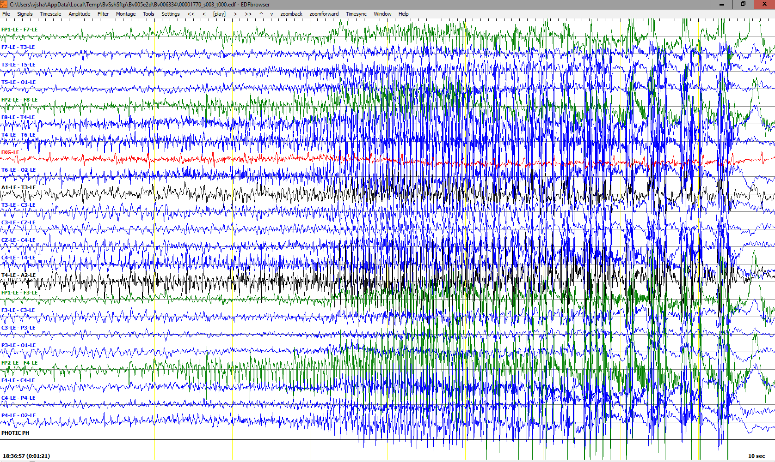
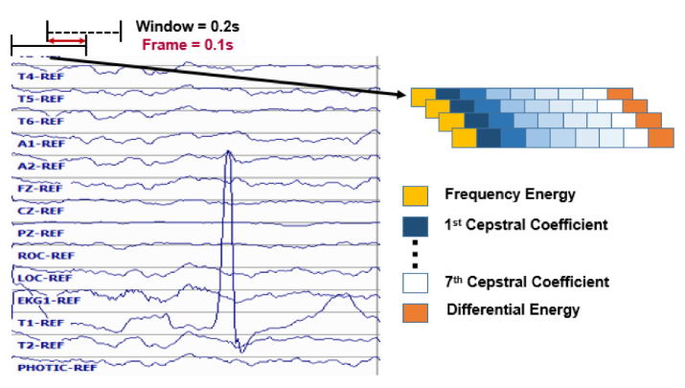
Example of Time-series Data
Temporal and spatial information is observed during EEG event classification.
Events observed on adjacent channels are correlated within its locality.
Raw signals is too much information (with
much higher entropy) for ML
algorithms to learn.
Spatial domain (electrode positioning)
Temporal domain (seconds)
Frequency domain features:
  10 frames per second
  0.2 second analysis window
  9 base features including energy, differential energy, and 7 cepstral coefficients.
  1st and 2nd derivatives are used for most features.
  Total dimension: 26.

Slide 8
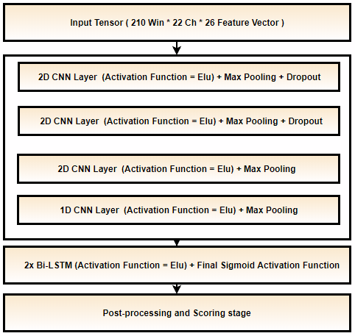
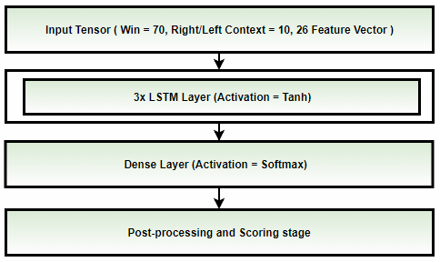
NN Architectures
  CNN-LSTM model: EEG data is represented as an image with a 26-dimensional feature vector.
  CNN layers can learn spatial correlation between the channels.
  LSTM layers learn long term dependencies of the signal.
  Postprocessing includes setting a threshold for hypothesis events and filtering out short sequences.
  Context information is concatenated with each feature vector.
  The model learns 1 second of data per sample and 7 second long sequence using RNNs (LSTM).

Slide 9
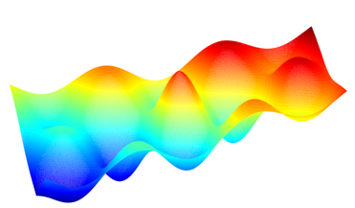
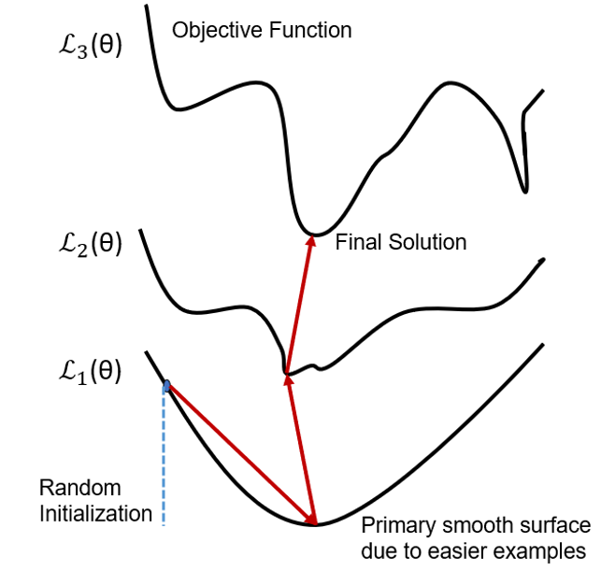
LR Tricks
  Learning rate tricks used in NN architectures are:
  Constant LR
  Annealing LR
  Snapshot Ensembling
  Preconditioned LRs
Random Initialization
  Error surface generated by training data is non-convex and includes multiple minimas.
  The best solution is to choose features and models which can virtually create as smoother surface as possible.
  Normalization of features in deep learning plays a very crucial role in terms of convergence and speed.

Slide 10
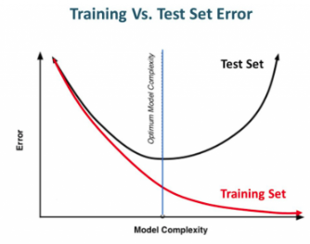

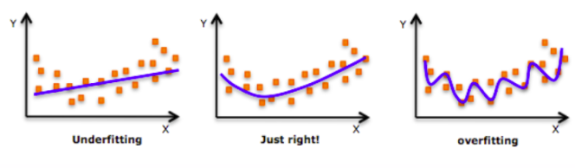
Regularizers
Dropout layers: Forces neural network layer to generalize better instead of relying on a few specific sets of neurons during training.
Kernel initializers: Initializing weight and bias variables using specific distribution (i.e. Normal)
Early stopping: Avoid overfitting by stopping training earlier.
Data augmentation: Introduction to noise in data can help develop robust models.
L1 & L2 regularization: Penalizing the cost function by Ridge and/or Lasso regression techniques to avoid under/over fitting.
Steep Error surface

Slide 11
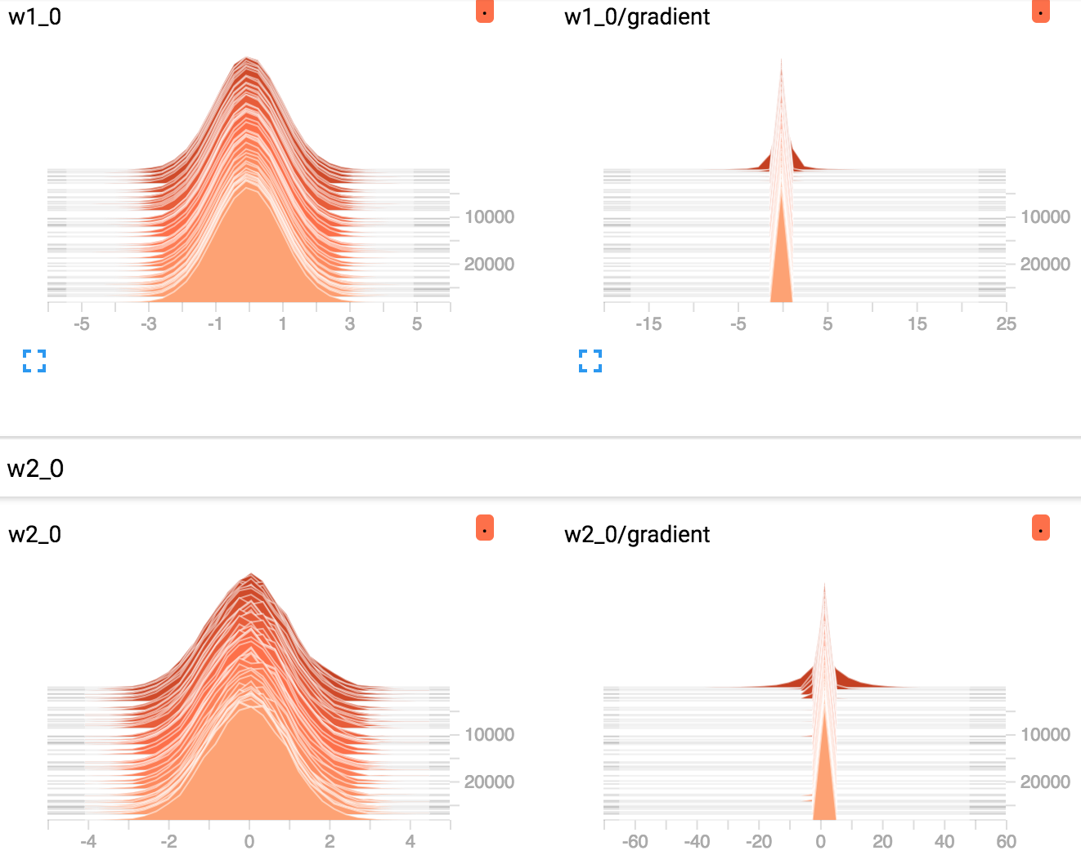
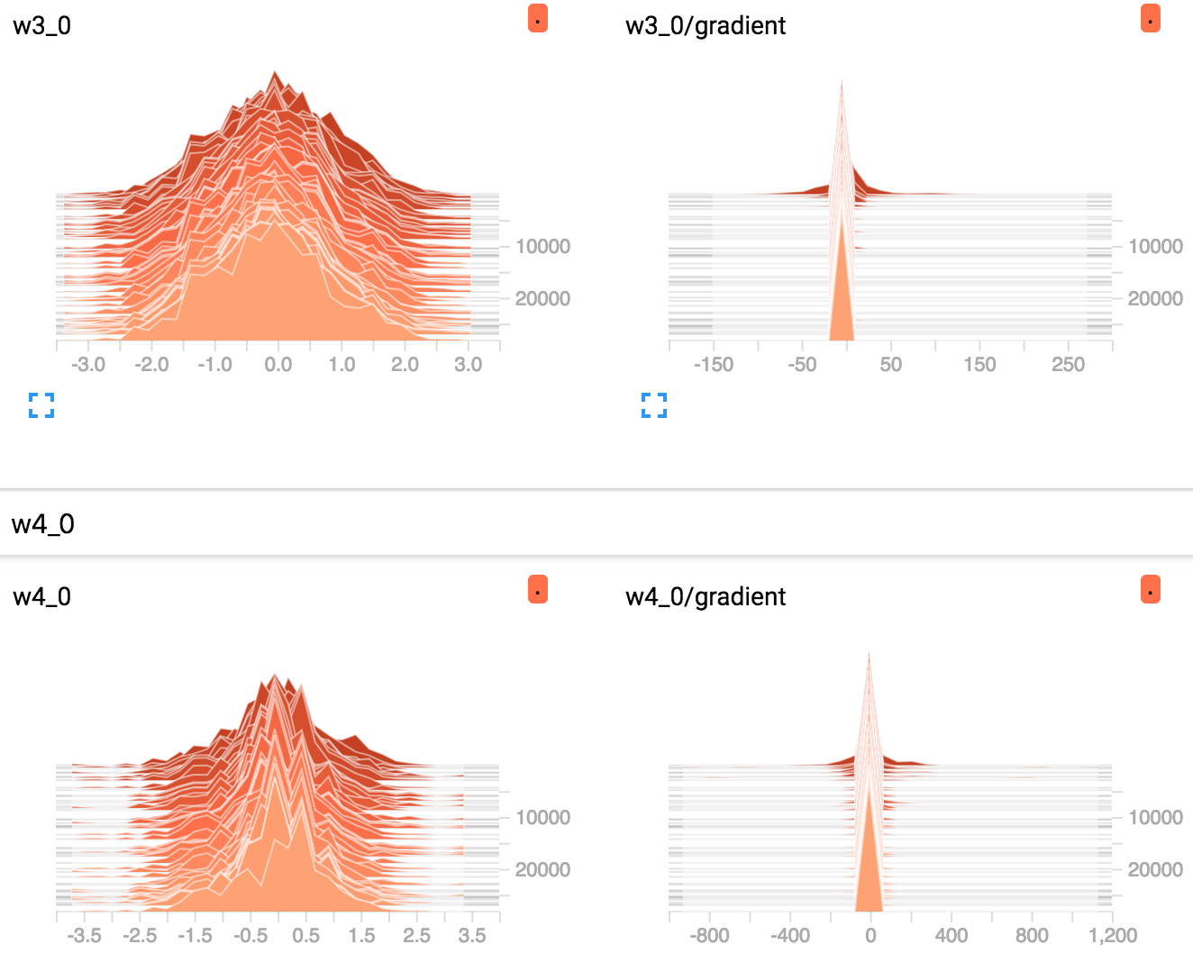
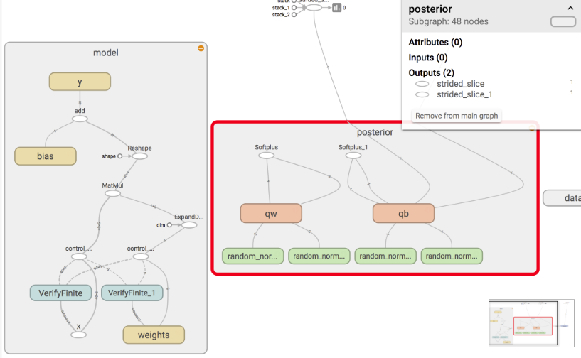
Tensorboard Analysis
  Tensorboard utility helps us in analysis of the network by collecting statistics related to the graph, layers, gradients, etc..
  It provides projection methods such as t-SNE to visualize higher dimensional data.

