Slide 1
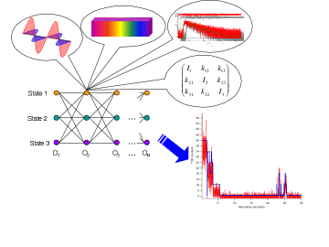
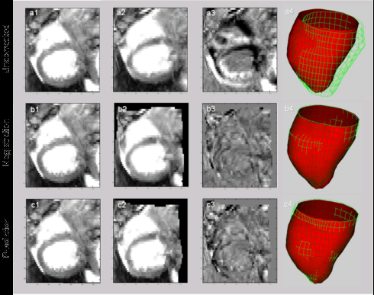
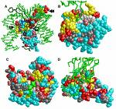
LECTURE 26: REVIEW OF NONPARAMETRIC METHODS
Objectives: Hidden Markov Models Support Vector Machines Decision Trees Foundations of Machine Learning Combining Classifiers K-Means Clustering Hierarchical Clustering Agglomerative Clustering Basic Information Theory Discriminative Training Statistical Significance
Resources: D.H.S.: Chapter 3 (Part 3) F.J.: Statistical Methods MS: No Free Lunch

