Slide 1
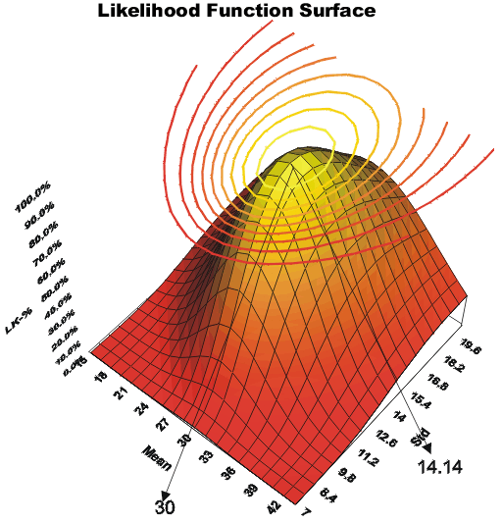
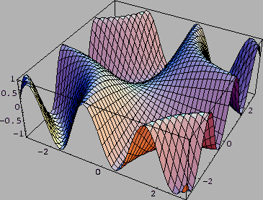
LECTURE 11: Exam No. 1 Review
• Objectives: Gaussian Distributions Bayes Rule Classification (ML and MAP) Parameter Estimation (ML and Bayes) Multi-category Decision Surfaces Discriminant Analysis Examples Resources: D.H.S: Chapter 2 (Part 3) D.H.S.: Chapter 3 (Part 2) K.F.: Intro to PR

Slide 2
Bayes Risk
An expected loss is called a risk.
R(ω_{i}|x) is called the conditional risk.
A general decision rule is a function α(x) that tells us which action to take for every possible observation.
The overall risk is given by:
If we choose α(x) so that R(ω_{i}(x)) is as small as possible for every x, the overall risk will be minimized.
Compute the conditional risk for every ω and select the action that minimizes R(ω_{i}|x). This is denoted R*, and is referred to as the Bayes risk.
The Bayes risk is the best performance that can be achieved (for the given data set or problem definition).

Slide 3
Two-Category Classification
Let α₁ correspond to ω₁, α₂ to ω₂, and λ_{ij} = λ(α_{i}|ω_{j})
The conditional risk is given by:
R(α₁|x) = λ₁₁P(ω₁|x) + λ₁₂P(ω₂|x)
R(α₂|x) = λ₂₁P(ω₁|x) + λ₂₂P(ω₂|x)
Our decision rule is:
choose ω₁ if: R(α₁|x) < R(α₂|x); otherwise decide ω₂
This results in the equivalent rule:
choose ω₁ if: (λ₂₁- λ₁₁) P(ω₁|x) ) > (λ₁₂- λ₂₂) P(ω₂|x);
otherwise decide ω₂
If the loss incurred for making an error is greater than that incurred for being correct, the factors (λ₂₁- λ₁₁) and (λ₁₂- λ₂₂) are positive, and the ratio of these factors simply scales the posteriors.

Slide 4
Likelihood
By employing Bayes formula, we can replace the posteriors by the prior probabilities and conditional densities:
choose ω₁ if:
(λ₂₁- λ₁₁) p(x|ω₁) P(ω₁) > (λ₁₂- λ₂₂) p(x|ω₂) P(ω₂);
otherwise decide ω₂
If λ₂₁- λ₁₁ is positive, our rule becomes:
If the loss factors are identical, and the prior probabilities are equal, this reduces to a standard likelihood ratio:

Slide 5
Minimum Error Rate
Consider a symmetrical or zero-one loss function:
The conditional risk is:
The conditional risk is the average probability of error.
To minimize error, maximize P(ω_{i}|x) — also known as maximum a posteriori decoding (MAP).

Slide 6
Likelihood Ratio
Minimum error rate classification: choose ω_{i} if: P(ω_{i}| x) > P(ω_{j}| x) for all j≠i

Slide 7
Minimax Criterion
Design our classifier to minimize the worst overall risk (avoid catastrophic failures)
Factor overall risk into contributions for each region:
Using a simplified notation (Van Trees, 1968):

Slide 8
Minimax Criterion
We can rewrite the risk:
Note that I₁₁=1-I₂₁ and I₂₂=1-I₁₂:
We make this substitution because we want the risk in terms of error probabilities and priors.
Multiply out, add and subtract P₁λ₂₁, and rearrange:

Slide 9
Expansion of the Risk Function
Note P₁ =1- P₂:

Slide 10
Explanation of the Risk Function
Note that the risk is linear in P_{2:}
If we can find a boundary such that the second term is zero, then the minimax risk becomes:
For each value of the prior, there is an associated Bayes error rate.
Minimax: find the maximum Bayes error for the prior P₁, and then use the corresponding decision region.

Slide 11
Neyman-Pearson Criterion
Guarantee the total risk is less than some fixed constant (or cost).
Minimize the risk subject to the constraint:
(e.g., must not misclassify more than 1% of salmon as sea bass)
Typically must adjust boundaries numerically.
For some distributions (e.g., Gaussian), analytical solutions do exist.

Slide 12
Multicategory Decision Surfaces
Define a set of discriminant functions: g_{i}(x), i = 1,…, c
Define a decision rule:
choose ω_{i} if: g_{i}(x) > g_{j}(x) ∨j ≠ i
For a Bayes classifier, let g_{i}(x) = -R(ω_{i}|x) because the maximum discriminant function will correspond to the minimum conditional risk.
For the minimum error rate case, let g_{i}(x) = P(ω_{i}|x), so that the maximum discriminant function corresponds to the maximum posterior probability.
Choice of discriminant function is not unique:
multiply or add by same positive constant
Replace g_{i}(x) with a monotonically increasing function, f(g_{i}(x)).

Slide 13
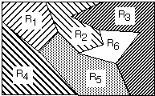
Decision Surfaces
We can visualize our decision rule several ways:
choose ω_{i} if: g_{i}(x) > g_{j}(x) ∨j ≠ i

Slide 14
Network Representation of a Classifier
A classifier can be visualized as a connected graph with arcs and weights:
What are the advantages of this type of visualization?

Slide 15
Normal Distributions
Recall the definition of a normal distribution (Gaussian):
Why is this distribution so important in engineering?
Mean:
Covariance:
Statistical independence?
Higher-order moments? Occam’s Razor?
Entropy?
Linear combinations of normal random variables?
Central Limit Theorem?

Slide 16
Univariate Normal Distribution
A normal or Gaussian density is a powerful model for modeling continuous-valued feature vectors corrupted by noise due to its analytical tractability.
Univariate normal distribution:
where the mean and covariance are defined by:
The entropy of a univariate normal distribution is given by:

Slide 17
Multivariate Normal Distributions
A multivariate distribution is defined as:
where μ represents the mean (vector) and Σ represents the covariance (matrix).
Note the exponent term is really a dot product or weighted Euclidean distance.
The covariance is always symmetric and positive semidefinite.
How does the shape vary as a function of the covariance?

Slide 18
Support Regions
A support region is the obtained by the intersection of a Gaussian distribution with a plane.
For a horizontal plane, this generates an ellipse whose points are of equal probability density.
The shape of the support region is defined by the covariance matrix.

Slide 19
Log Probabilities
Some monotonically increasing functions can simplify calculations considerably:
What are some of the reasons (3) is particularly useful?
Computational complexity (e.g., Gaussian)
Numerical accuracy (e.g., probabilities tend to zero)
Decomposition (e.g., likelihood and prior are separated and can be weighted differently)
Normalization (e.g., likelihoods are channel dependent).

Slide 20
Summary
Likelihood Ratios: Convenient for two-class problems.
Decision Criteria: Several viable choices for decision rules.
Decision Surfaces: The shape of the decision surface is influenced by the number of categories and the statistics of the data.
Gaussian Distributions: how is the shape of the distribution influenced by the mean and covariance?
Log Probabilities: solves some important computational problems.

Slide 21
Error Bounds
Bayes decision rule guarantees lowest average error rate
Closed-form solution for two-class Gaussian distributions
Full calculation for high dimensional space difficult
Bounds provide a way to get insight into a problem and engineer better solutions.
Need the following inequality:
Assume a > b without loss of generality: min[a,b] = b.
Also, a^{β}b^{(1- β)} = (a/b)^{β}b and (a/b)^{β} > 1.
Therefore, b < (a/b)^{β}b, which implies min[a,b] < a^{β}b^{(1- β)} .
Apply to our standard expression for P(error).

Slide 22
Chernoff Bound
Recall:
Note that this integral is over the entire feature space, not the decision regions (which makes it simpler).
If the conditional probabilities are normal, this expression can be simplified.

Slide 23
Chernoff Bound for Normal Densities
If the conditional probabilities are normal, our bound can be evaluated analytically:
where:
Procedure: find the value of β that minimizes exp(-k(β ), and then compute P(error) using the bound.
Benefit: one-dimensional optimization using β

Slide 24
Bhattacharyya Bound
The Chernoff bound is loose for extreme values
The Bhattacharyya bound can be derived by β = 0.5:
where:
These bounds can still be used if the distributions are not Gaussian (why? hint: Occam’s Razor). However, they might not be adequately tight.

