Slide 1
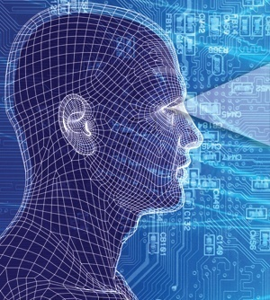
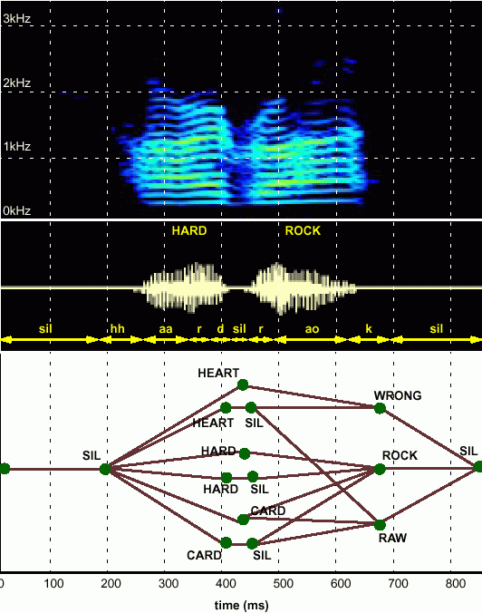
HUMAN LANGUAGE TECHNOLOGY:
From Bits to Blogs
Joseph Picone, PhD
Professor and Chair
Department of Electrical and Computer Engineering
Temple University
URL:

Slide 2
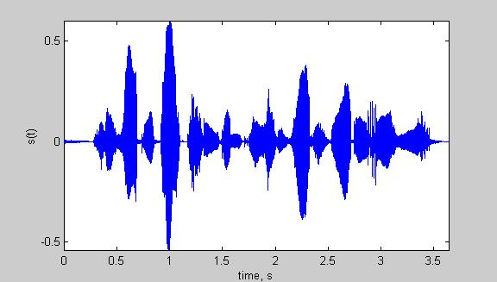
Speech Recognition Architectures
Core components of modern speech recognition systems:
Transduction: conversion of an electrical or acoustic signal to a digital signal;
Feature Extraction: conversion of samples to vectors containing the salient information;
Acoustic Model: statistical representation of basic sound patterns (e.g., hidden Markov models);
Language Model: statistical model of common words or phrases (e.g., N-grams);
Search: finding the best hypothesis for the data using an optimization procedure.
Input
Speech
Acoustic
Front-end
Acoustic Models
P(A/W)
Language Model
P(W)
Search
Recognized Utterance

Slide 3
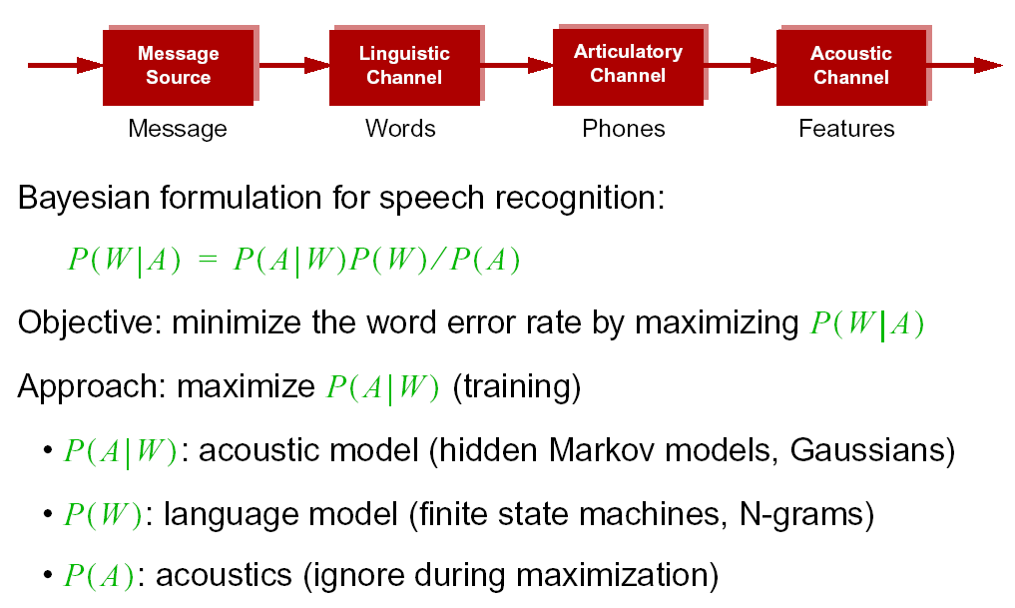
Statistical Approach: Noisy Communication Channel Model

Slide 4
Speech Recognition Overview
Based on a noisy communication channel
model in which the intended message is
corrupted by a sequence of noisy models
Bayesian approach is most common:
Objective: minimize word error rate by
maximizing P(W|A)
P(A|W): Acoustic Model
P(W): Language Model
P(A): Evidence (ignored)
Acoustic models use hidden Markov
models with Gaussian mixtures.
P(W) is estimated using probabilistic
N-gram models.
Parameters can be trained using generative (ML)
or discriminative (e.g., MMIE, MCE, or MPE) approaches.
Input
Speech
Feature
Extraction
Acoustic
Front-end
Acoustic Models
P(A/W)
Language Model
P(W)
Search
Recognized Utterance

Slide 5
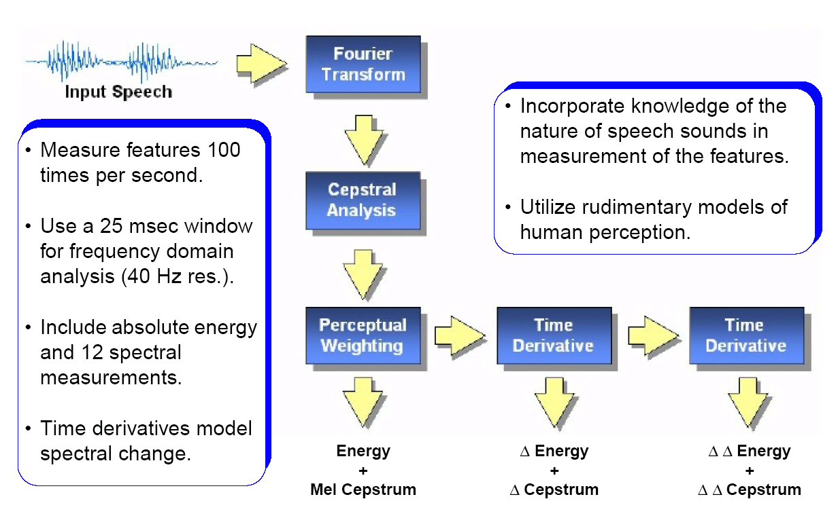
Features: Convert a Signal to a Sequence of Vectors

Slide 6
Speech Recognition Overview
Based on a noisy communication channel
model in which the intended message is
corrupted by a sequence of noisy models
Bayesian approach is most common:
Objective: minimize word error rate by
maximizing P(W|A)
P(A|W): Acoustic Model
P(W): Language Model
P(A): Evidence (ignored)
Acoustic models use hidden Markov
models with Gaussian mixtures.
P(W) is estimated using probabilistic
N-gram models.
Parameters can be trained using generative (ML)
or discriminative (e.g., MMIE, MCE, or MPE) approaches.
Input
Speech
Acoustic
Front-end
Research Focus
Acoustic Models
P(A/W)
Language Model
P(W)
Search
Recognized Utterance

Slide 7
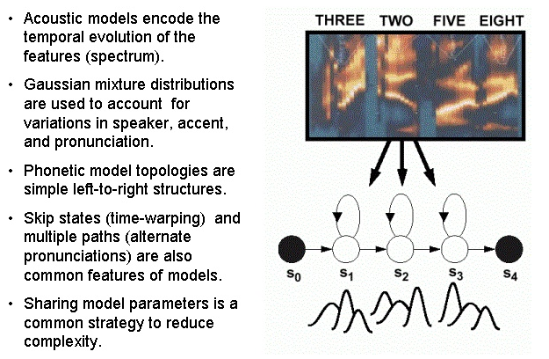
Acoustic Models: Capture the Time-Frequency Evolution

Slide 8
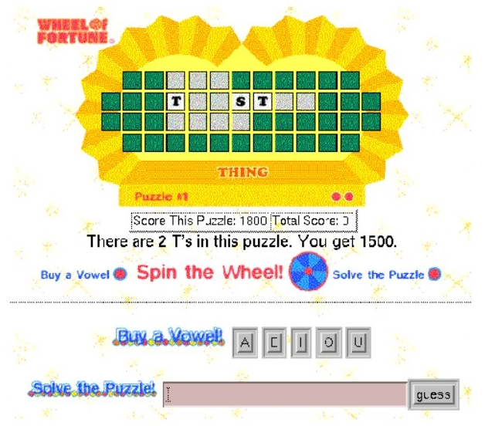
Language Modeling: Word Prediction

Slide 9
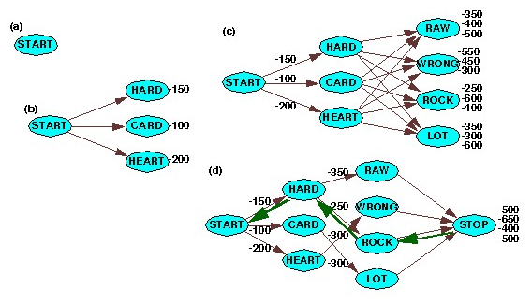
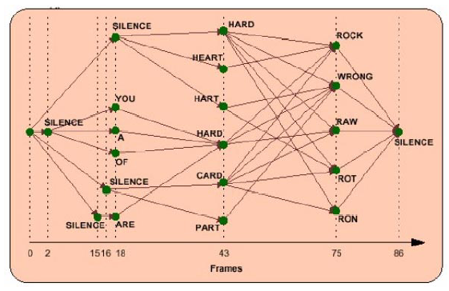
Search: Finding the Best Path
breadth-first
time synchronous
beam pruning
supervision
word prediction
natural language

Slide 10
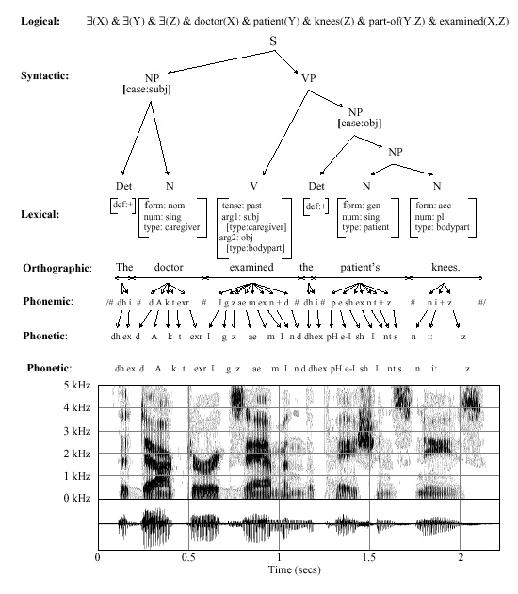
Speech Recognition is Information Extraction
Traditional Output:
  best word sequence
  time alignment of information
Other Outputs:
  word graphs
  N-best sentences
  confidence measures
  metadata such as speaker identity, accent, and prosody
Applications:
  Information localization
  data mining
  emotional state
  stress, fatigue, deception

Slide 11
Brief Bibliography of Related Research
S. Pinker, The Language Instinct: How the Mind Creates Language, William Morrow and Company, New York, New York, USA, 1994.
F. Juang and L.R. Rabiner, “Automatic Speech Recognition - A Brief History of the Technology,” Elsevier Encyclopedia of Language and Linguistics, 2nd Edition, 2005.
M. Benzeghiba, et al., “Automatic Speech Recognition and Speech Variability, A Review,” Speech Communication, vol. 49, no. 10-11, pp. 763–786, October 2007.
B.J. Kroger, et al., “Towards a Neurocomputational Model of Speech Production and Perception,” Speech Communication, vol. 51, no. 9, pp. 793-809, September 2009.
B. Lee, “The Biological Foundations of Language”, available at http://www.duke.edu/~pk10/language/neuro.htm (a review paper).
M. Gladwell, Blink: The Power of Thinking Without Thinking, Little, Brown and Company, New York, New York, USA, 2005.

