Slide 1
Representation Learning: A Review and New Perspectives
Yoshua Bengio, Aaron Courville, and Pascal Vincent
Aviv Zaharoni
Roee Levy

Slide 2
Outline
Representation Learning:
Intro
What makes a good representation?
Unsupervised learning
Representation learning models:
Probabilistic model – RBM
Autoencoder
Manifold Learning

Slide 3
Representation Learning

Slide 4
Representation Learning - Motivation
The success of machine learning heavily depends on data representation (feature).
Different data representation can hide or entangle variation factors behind the data.
Machine learning algorithms have inability to extract and organize the discriminative information from the input.
Notes:
להדגיש שעד עכשיו הציגו הרבה תוצאות של רשתות עמוקות והצלחתן בכל מיני תחומים, ע"י הצגה של למידת פיצ'רים אנחנו באים להדגיש על המוטיבציה למעבר בין אלגוריתמים קלאסיים של למידה ללמידה עמוקה. לא הסבירו מה המוטיבציה שבחרו בהכרח בלמידה עמוקה , בשיעור הראשון הסבירו שלומדים פיצ'רים תוך כדי המעבר בשכבות הרשת. אנחנו נסביר למה נעשה המעבר בין האלגוריתמים הישנים (SIFT) ואלגוריתמי למידה קלאסיים לרשתות עמוקות.
באלגוריתמים שהם לא רשתות נוירונים, יש צורך לקבוע את הייצוג של המידע או ע"י הפעלת אלגוריתמים ידועים כמו SIFT או SURF לתמונות למשל, או ע"י ממש חיפוש המידע המעניין, כלומר אתה כמי שיש לו את כל המידע צריך לבחור בעצמך מה אמור להיות מעניין מתוכו לצורך הלמידה.
אם למשל יש קלטים של תמונות אז יכול להיות שיש קשר כשלהו ביניהם שלא ניתן לגלות אותו באמצעות ייצוג פשוט של מטריצת פיקסלים, המרה לפיצ'רים יכולה לגלות שונות משותפת בין התמונות.
יש המון עבודה על ייצוג הקלט שלאו דווקא מתאימה בצורה טובה לאלגוריתם, למשל ייצוג של מילים
Feature engineering - a way to take advantage of human ingenuity and prior knowledge to compensate the algorithms weakness in terms of data representation.
The success of machine learning (in performance terms) generally is heavily depends on data representation (feature). Different data representation can hide or entangle variation factors behind the data. Learning generic priors of the data can help to design the representation.
Machine learning algorithms have inability to extract and organize the discriminative information from the input. We would want the learning algorithms to be less dependent on feature engineering in order to ease the applicability of machine learning.

Slide 5
Representation Learning - Motivation
We would want the learning algorithms to be less dependent on feature engineering in order to ease the applicability of machine learning.
Representation learning help to improve performance of classifiers by extracting features from high dimensional data, such as image or audio.
Notes:
-
אם למשל יש קלטים של תמונות אז יכול להיות שיש קשר כשלהו ביניהם שלא ניתן לגלות אותו באמצעות ייצוג פשוט של מטריצת פיקסלים, המרה לפיצ'רים יכולה לגלות שונות משותפת בין התמונות.
יש המון עבודה על ייצוג הקלט שלאו דווקא מתאימה בצורה טובה לאלגוריתם, למשל ייצוג של מילים
Feature engineering - a way to take advantage of human ingenuity and prior knowledge to compensate the algorithms weakness in terms of data representation.
The success of machine learning (in performance terms) generally is heavily depends on data representation (feature). Different data representation can hide or entangle variation factors behind the data. Learning generic priors of the data can help to design the representation.
Machine learning algorithms have inability to extract and organize the discriminative information from the input. We would want the learning algorithms to be less dependent on feature engineering in order to ease the applicability of machine learning.

Slide 6
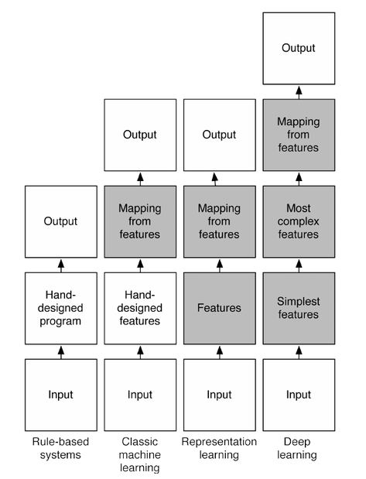
Representation Learning - Definition
A set of techniques that learn a feature: a transformation of raw data input to a representation that can be effectively exploited in machine learning tasks.
Representation learning means learning the representations of the data that makes it easier to extract useful information when building classifiers (or other predictors).
Notes:
אפשר לבצע באמצעות למידה פיצ'רים שימוש של כמה אפליקציות באותו מידע לאחר שעבר עליו העיבוד.
לומדים על המידע באמצעות המידע.

Slide 7
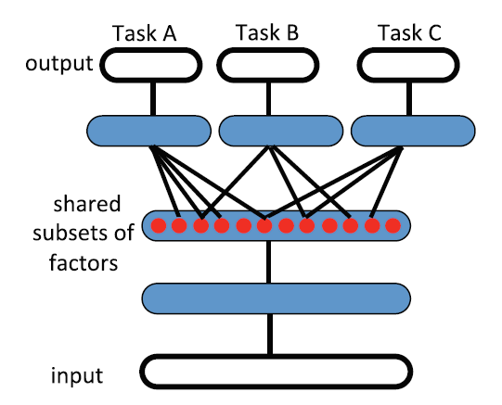
Representation Learning – Definition
Representation learning has an advantage for learning tasks (which have commonalities) because it intends to capture underlying explanatory factors, a subset which may be relevant for each particular task.
Notes:
למידת פיצרים היא לא למשימה מסויימת (task specific) אלא יותר על המסד נתונים .
לתת כדוגמא לימוד של מספר פיצ'רים מאותה תמונה – זיהוי פנים , זיהוי אובייקטים וכו'

Slide 8
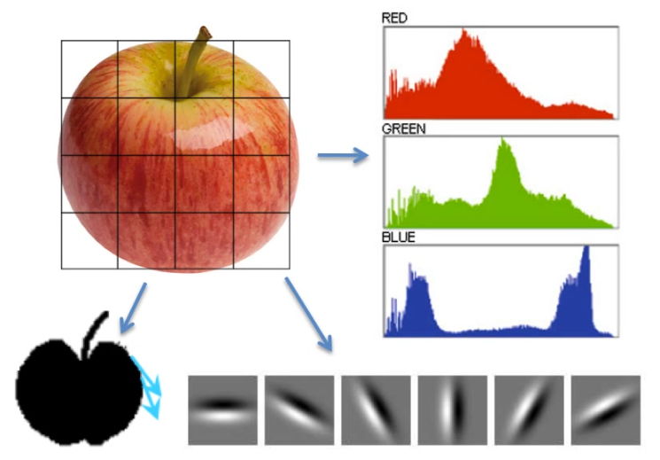
What makes representation good?
Representation can conveniently express many general priors about the world around us (priors which are not task specific but would likely be useful for a learning machine to solve AI tasks)
We will discuss about several such priors (representation properties)
Notes:
ייצוג טוב הוא ייצוג שעוזר לנו לשמור מידע כללי על הקלט, לאו דווקא מידע הקשור למשימה ספציפית

Slide 9
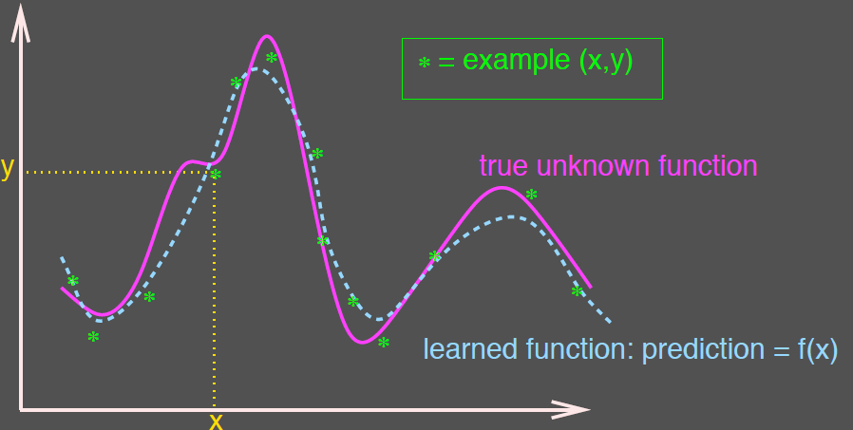
What makes representation good?
1. Smoothness
By “smoothness” we mean that close inputs are mapped to close outputs (representations).
Smoothness-based learners and linear models can be useful on top of learned representations.
Notes:
חלקות – אם יש שני קלטים דומים אז גם הייצוג שלהם יהיה דומה
הנחת החלקות (מציאת פונק' חלקה) אומר שבאיזורים שהם לא ראינו דוגמאות נוכל לבצע אינטרפולציה לערכים שלא ראינו ולמצוא את הפונק' בקירוב טוב.

Slide 10
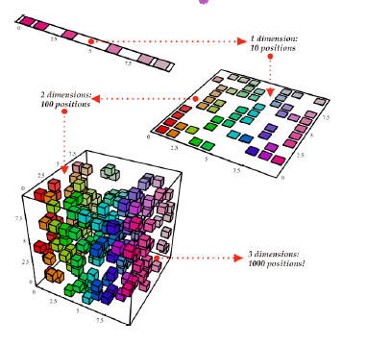
What makes representation good?
2. The Curse of Dimensionality
Sometimes we would like to have a representation with a lower dimension than the input dimension, to avoid complicated calculations or having too many configurations.
That is, the quality of the learned representation increases as its dimension is smaller, but note that we mustn’t loose too much important data.
Notes:
מימד גבוה משמע סיבוכיות חישובית גבוהה יותר, נרצה להוריד מימד במינ' אובדן מידע.
לתת דוגמא של חיזוי מזג אוויר עם טמפ' לחות ומהירות רוח
דוגמא אחרת אביב יציג באנקודר

Slide 11
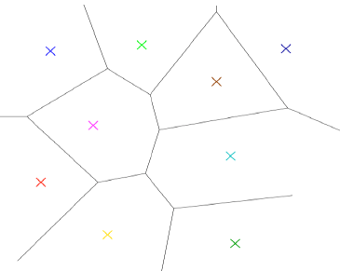
What makes representation good?
3. Distributed Representations
Learners of 1-hot representation (non-distributed) require $O(N)$ parameters to distinguish $O(N)$ input regions (clusters).
Classical algorithms like nearest-neighbors, SVM, decision trees and non-parametric algorithms generalize locally by clustering (breaking the input space into regions).
Notes:
לתת דוגמא עם דגם מכונית גודל וצבע כך שעבור איקס מכוניות יש איקס איזורים
כאשר נצבע קלסיפיקציה בעצם נחפש את את האיזור בו היא נפלה ולשם נתאים אותה

Slide 12
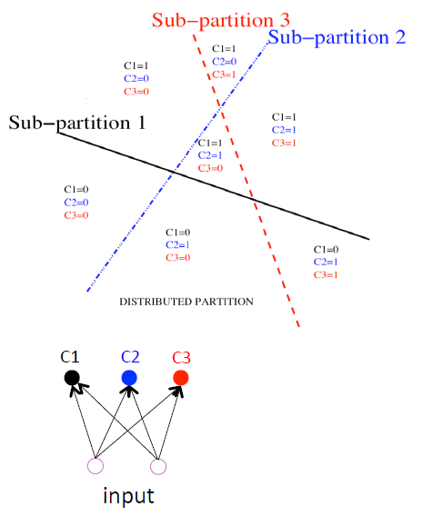
What makes representation good?
3. Distributed Representations
With a distributed representation, an exponentially large number of possible subsets of features or hidden units can be activated in response to a given input.
Distributed representation means
to have the ability to create a new region without seeing any data belongs to it. Algorithms like PCA, RBMs and neural networks try to divide the space into
regions which are not mutually exclusive.
Notes:
ייצוג טוב נותן חלוקה מבוזרת של המרחב
בייצוג מבוזר מחלקים את המרחב ע"י שילוב של פרמטרים שונים (בינאריים) ובכך ניתן ליצור איזורי מיפוי גם אם לא ראינו בהכרח דוגמא המתאימה לכך

Slide 13
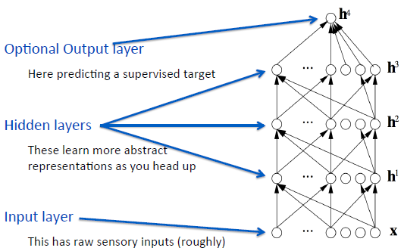
What makes representation good?
4. Depth and abstraction
A good representation expresses high level and abstract features.
In order to achieve such representations we can use deep architectures that allow reuse of low level features to potentially get more abstract features at higher layers.
Notes:
ייצוג טוב נותן לנו אבסטרקציה גבוהה יותר, ופיצ'רים מורכבים יותר – משיגים זאת ע"י רשת עמוקה.

Slide 14
What makes representation good?
5 Disentangling Factors of Variation
This is the goal of building features which are insensitive to variations in the data that are uninformative to the task at hand.
The hypothesis is that the local directions of a variation that is least represented in the training data should be first to be pruned out.
Notes:
נרצה להתעלם מהגורמים שלא מעניינים ולא משפיעים על מה שרוצים למצוא
ישנם גורמים במידע שיכול ליצור תלויות וקשרים בין פיצ'רים שונים במידע. נרצה להתיר את קשרים אלה.
למשל – זיהוי אובייקטים בתמונה, אם ישנם צללים למשל שנופלים אחד על השני ויכולים להשפיע על זיהוי שונה של אובייקטים אז נרצה לזרוק את השפעתם על הפיצ'רים שנוציא מהתמונה.
למשל בזיהוי דיבור נרצה להתעלם מגורמים כמו זהות הדובר/ סוג המיקרופון/ עוצמת הקול.
בזיהוי דובר נרצה להתעלם מתוכן הדיבור.
בצורה זו מורידים את המימד

Slide 15
Unsupervised Learning
Unsupervised learning is a type of machine learning algorithm used to draw inferences from datasets consisting of input data without label.
In unsupervised learning we are trying to learn the important aspects of an unknown distribution $P(X)$ where X is the input space.
The most common unsupervised learning method is cluster analysis which is used for exploratory data analysis to find hidden patterns or grouping in data.
Notes:
להדגיש שלמידת פיצ'רים מבוססת אך ורק על למידה ללא לייבלים.

Slide 16
Unsupervised VS Supervised Learning
Notes:
לתת דוגמא של פירות – בננות ותפוחים
עם לייבל – יודעים את המחלקות שמחפשים אליהם
בקלסטרים לא יודעים מה החלוקה והאלגוריתם ימצא תבניות שהקלט מתאים אליהם.

Slide 17
Representation Learning Models
There are two broad parallel lines of representation learning approaches:
Probabilistic graphical model – The hidden units are considered latent random variables, for example: RBM.
Neural networks – The hidden units in the model are considered as computational graph, for example: autoencoders.
Manifold learning - Another approach for representation learning, based on the associated geometry and the manifold assumption.
Notes:
מודלים סטטיסטיים הסתברותיים שמשתמשים בשיטות הסתברותיות שמנסים למצוא את התלויות השונות בין המשתנים האקראיים שמייצגים את הקלט.

Slide 18
Probabilistic Graphical Models – Restricted Boltzman Machine

Slide 19
Probabilistic Graphical Models
Probabilistic model is a graph in which every node represents a conditional distribution over its own value, given the value of its parents.
There are 2 kinds of probabilistic models:
Directed models (Bayesian network)
Undirected graphical models (Markov random fields - MRF)
Notes:
מודל הסתברותי הוא דרך להצגת הסתברות שלמה של מספר משתנים אקראיים בעלי תלות אחד בשני.
איקס הוא ההסתברות השלמה של כל המשתנים האקראיים

Slide 20
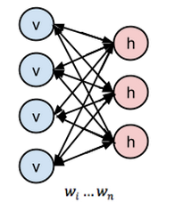
Restricted Boltzman Machines
Restricted Boltzman machine is an undirected probabilistic graphical model with the restriction of connections only between the visible layer and hidden layer (bipartite graph).
RBM is used for unsupervised feature learning.
The basic model consists of 2 layers:
Visible layer – The input layer.
Hidden layer - The representation output.
Notes:
בולצמן מגדירה שכבת visible ושכבת hidden שמפורשת בתור משתנים אקראיים המייצגים תלויות בין מרכיבי הקלט. הייצוג הנלמד הוא שכבת ה-hidden שמתקבלת מלמידה של התפלגות הקלט.
מתייחס למרחב הקלט בתור שני חלקים (מידע גלוי ומידע סמוי), השכבה של המשתנים הסמויים מאפיינים את החלק הסמוי של הקלט. המטרה למדל את מרחב הסתברות הקלט.
Z גורם נרמול. C לקלט. H מימד של W (כמה יחידות יש בשכבה הסמויה)
ההבדל בין בולצמן לרשת נוירונים הוא לא גדול, ההבדל הוא בעיקר תפיסתי – בולצמן משתמש בנקודת מבט הסתברותית כדי למצוא את ההסתברות של קלט מתוך מרחב הקלט ומאפיין את כל הקלט כאוסף של תלויות. רשת נוירונים קלאסית היא בגישה שונה, בה הגרף מתאר מסלול חישוב.

Slide 21
Restricted Boltzman Machines
RBMs are trained to learn $c,b$ (biases) and $W$ (weight matrix) in order to maximize $p(x)$ for every input x:
$$p\left(x\right)=\frac{1}{Z}exp\left\{c^{T}x+\sum_{j=1}^{H}{log⁡(1+e^{b_{j}+W_{j}x})}\right\}$$
RBMs are usually trained with backpropagation with a technique called Contrastive Divergence.
After successful learning, the hidden layer of the RBM provides a closed-form representation of the distribution underlying the training data.
Notes:
בולצמן מגדירה שכבת visible ושכבת hidden שמפורשת בתור משתנים אקראיים המייצגים תלויות בין מרכיבי הקלט. הייצוג הנלמד הוא שכבת ה-hidden שמתקבלת מלמידה של התפלגות הקלט.
מתייחס למרחב הקלט בתור שני חלקים (מידע גלוי ומידע סמוי), השכבה של המשתנים הסמויים מאפיינים את החלק הסמוי של הקלט. המטרה למדל את מרחב הסתברות הקלט.
Z גורם נרמול. C לקלט. H מימד של W (כמה יחידות יש בשכבה הסמויה)
ההבדל בין בולצמן לרשת נוירונים הוא לא גדול, ההבדל הוא בעיקר תפיסתי – בולצמן משתמש בנקודת מבט הסתברותית כדי למצוא את ההסתברות של קלט מתוך מרחב הקלט ומאפיין את כל הקלט כאוסף של תלויות. רשת נוירונים קלאסית היא בגישה שונה, בה הגרף מתאר מסלול חישוב.

Slide 22
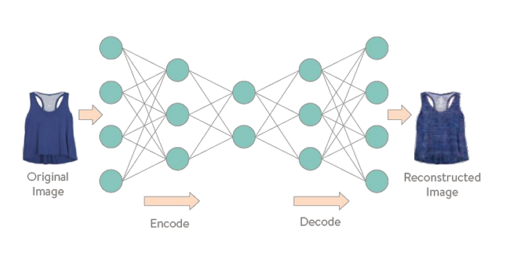
Autoencoders

Slide 23
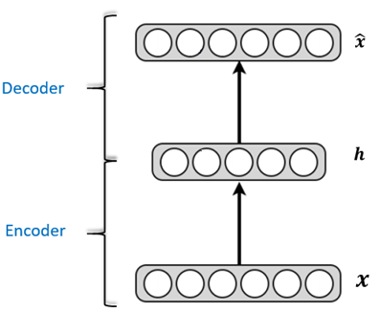
Autoencoders
An Autoencoder is a feed-forward, fully-connected neural network that is trained to reproduce its input.
The output of the hidden layer is the code, which is used to represent the input.
The code should maintain all the information about the input
The output of the network is of the same size as the input.
Autoencoders were first introduced at the late 80’s (Rumelhart et al., 1986; Baldi and Hornik, 1989).
Notes:
1 – להדגיש שמדובר ב-unsupervised learning
2 – להדגיש שבהמשך נדבר על AE עם כמה שכבות

Slide 24
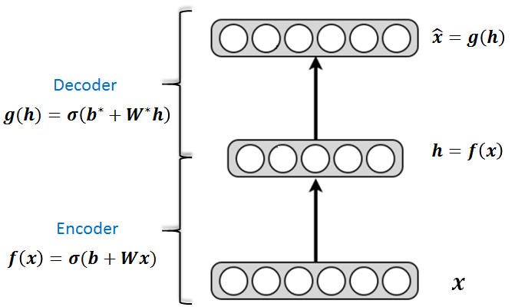
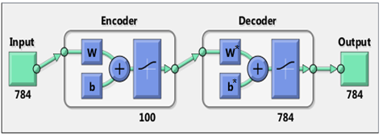
Autoencoders
Formally, we learn two functions:
f(•) is the encoder
g(•) is the decoder
With respect to the reconstruction loss:
$$\frac{1}{2}\sum_{k}{{\left(x_{k}−{\hat{x}}_{k}\right)}^{2}}$$
Notes:
1 – להדגיש שהלמידה נעשית בטכניקות מוכרות – backpropagation עם gradient descent
2 – להסביר שהולכים לראות טכניקות שמונעות מ-AE ללמוד את פונקציית הזהות, שמשיגה loss של 0. אפשר ללמוד אותה במקרה של overcomplete AE ונראה רגולריזציות.
3 – להדגיש שבאופן כללי יכולות להיות activation functions לא לינאריות שונות ל-encoder ול-decoder
4 – להסביר ש-AE לינארי הוא כמו PCA ?

Slide 25
Undercomplete Autoencoder
An Autoencoder is undercomplete if the dimension of the hidden layer is smaller than the dimension of the input layer.
The hidden layer “compresses” the input.
Hinton and Salakhutdinov,
“Reducing the Dimensionality of Data with Neural Networks”, 2006
Notes:
1 – להדגיש שרוצים להשיג כיווץ טוב רק על וקטורים שדומים לאלה שב-training set שלנו. בפרט לא נצליח לשחזר וקטור אקראי כלשהו.
2 – בתמונה: ביצעו אימון של stacked AE 784-100-500-250-30 על MNIST ולמדו ייצוגים בני 30 features. השורה העליונה מכילה תמונות מקוריות והשנייה את הפלט של ה-AE. אם נסתכל על ה-'8', נראה של-AE אין מספיק capacity ללמוד את ה-defect בקצה ולכן השחזור אולי טוב יותר מהמקור.
3 – להסביר שגם במקרה הזה אפשר ללמוד את ה-identity: אם ה-capacity חזקה מספיק (האקטיבציה הלא-לינארית חזקה מספיק), ה-AE ימפה את x_i לקוד i ואז כיווצנו למימד אחד

Slide 26
Overcomplete Autoencoder
An Autoencoder is overcomplete if the dimension of the hidden layer is larger than (or equal to) the dimension of the input layer.
In this case, we might have a duplication of the input in the features with perfect reconstruction (identity function), without learning meaningful features.
We use different forms of regularization to avoid this.

Slide 27
Regularized Autoencoder
The objective of the regularization applied to autoencoder is making the representation as insensitive as possible to changes in the input.
Regularized autoencoders use a loss function that encourages the model to have other properties besides the ability to copy its input to its output.
We will see 2 different ways to regularize an autoencoder in order to avoid learning “uninteresting” encodings:
Denoising Autoencoder (DAE)
Contractive Autoencoder (CAE)
Notes:
More precisely, it suffices that g ◦ f be the identity to obtain zero reconstruction error. For d = d ′ if we had a linear encoder and decoder this would be achieved for any invertible matrix W by setting W′ = W−1 . Now there is a sigmoid nonlinearity in the encoder, but it is possible to stay in the linear part of the sigmoid with small enough W
----
The above techniques can come together with a weight decay regularization or with weights tying.
Weight decay – add to the loss $λ\sum_{ij}{W_{ij}^{2}}$

Slide 28
Denoising Autoencoder (DAE)
The idea is to learn a representation that is robust to introduction of noise to the input.
Instead of feeding the autoencoder with the original input $x$, we feed it with an artificially corrupted noisy version of it, $\tilde{x}$, which can be achieved for example by:
Randomly assign some of the features of $x$ to 0, with probability $p$.
Add Gaussian additive noise to each of the features of $x$.
Notes:
Rather than constrain the representation, we change the reconstruction criterion for a both more challenging and more interesting objective: cleaning partially corrupted input. In doing so we modify the implicit definition of a good representation into the following: “a good representation is one that can be obtained robustly from a corrupted input and that will be useful for recovering the corresponding clean input”
• First it is expected that a higher level representation should be rather stable and robust under corruptions of the input. • Second, it is expected that performing the denoising task well requires extracting features that capture useful structure in the input distribution.
1 – כמו dropout רק בשכבת ה-input

Slide 29
Denoising Autoencoder (DAE)
The loss function compares the reconstruction $\hat{x}$ to the noiseless input $x!$
The objective optimized by DAE is: $𝒥_{DAE}=\sum_{t}{𝔼_{q\left(\tilde{x} | x^{\left(t\right)}\right)}\left[L\left(x^{\left(t\right)},g\left(f\left(\tilde{x}\right)\right)\right)\right]}$ Where $𝔼_{q\left(\tilde{x} | x^{\left(t\right)}\right)}[∙]$ averages over corrupted examples drawn from corruption process $q.$
Learning the identity is no longer enough because we want to learn to reconstruct the clean input from a corrupted version.
Notes:
Rather than constrain the representation, we change the reconstruction criterion for a both more challenging and more interesting objective: cleaning partially corrupted input. In doing so we modify the implicit definition of a good representation into the following: “a good representation is one that can be obtained robustly from a corrupted input and that will be useful for recovering the corresponding clean input”
• First it is expected that a higher level representation should be rather stable and robust under corruptions of the input. • Second, it is expected that performing the denoising task well requires extracting features that capture useful structure in the input distribution.
1 – כמו dropout רק בשכבת ה-input

Slide 30
Denoising Autoencoder (DAE)
Notes:
חייבים ללמוד את המבנה של התפלגות הקלט כדי לבטל את האפקט של הרעש בצורה אופטימלית.
DAE לומד פונקציית שחזור שמתאימה לשדה וקטורי המצביע לכיוון האזורים הצפופים (מבחינה הסתברותית), כלומר היריעה עליה הדוגמאות מתרכזות.

Slide 31
Denoising Autoencoder
Vincent, Larochelle, Lajoie, Bengio and Manzagol,
“Stacked Denoising Autoencoders: Learning Useful Representations in a Deep Network with a Local Denoising Criterion”, ICML 2008
Notes:
Filters learnt by denoising autoencoder on 28 × 28 gray-scale images of handwritten digits from MNIST, using zero-masking noise. The pictures show some of the filters learnt by denoising autoencoders trained with various corruption levels ν. For this experiment, we used a 120 hidden layer denoising autoencoders with tied weights, cross-entropy reconstruction error, and zero-masking noise. The goal was to better understand the qualitative effect of the noise level. So we trained several denoising autoencoders, all starting from the same initial random point in weight space, but with different noise levels.
With 0% corruption, the majority of the filters appear totally random, with only a few that specialize as little ink blob detectors. With increased noise levels, a much larger proportion of interesting (visibly non random and with a clear structure) feature detectors are learnt. These include local oriented stroke detectors and detectors of digit parts such as loops. It was to be expected that denoising a more corrupted input requires detecting bigger, less local structures: the denoising auto-encoder must rely on longer range statistical dependencies and pool evidence from a larger subset of pixels. Interestingly, filters that start from the same initial random weight vector often look like they “grow” from random, to local blob detector, to slightly bigger structure detectors such as a stroke detector, as we use increased noise levels.

Slide 32
Contractive Autoencoder (CAE)
Explicitly avoid uninteresting solutions by adding a term to the loss that penalizes such solutions.
Reduce the number of effective degrees of freedom of the representation by making the encoder contractive (making the derivative of the encoder small, thus making the hidden units saturate).
Notes:
the sum of squares of all partial derivatives of the extracted features with respect to input dimensions

Slide 33
Contractive Autoencoder (CAE)
The new loss function:
$$𝒥_{CAE}=\sum_{x∈D}{\left(L(x,g\left(f\left(x\right)\right)\right)}+λ{\left\|J_{f}(x)\right\|}_{F}^{2}$$
$λ$ – An hyper parameter controlling the strength of the regularization.
$J_{f}(x)$ – The Jacobian of the encoder.
${\left\|⋅\right\|}_{F}$ – The Frobenius Norm, namely:
$${\left\|J_{f}(x)\right\|}_{F}^{2}=\sum_{ij}{{\left(\frac{∂{\left(f\left(x\right)\right)}_{j}}{∂x_{i}}\right)}^{2}}$$
Notes:
the sum of squares of all partial derivatives of the extracted features with respect to input dimensions

Slide 34
Contractive Autoencoder (CAE)
$${\left\|J_{f}(x)\right\|}_{F}^{2}=\sum_{ij}{{\left(\frac{∂{\left(f\left(x\right)\right)}_{j}}{∂x_{i}}\right)}^{2}}$$
If the encoder is linear, this term is equal to the weight decay term.
In case of a sigmoid nonlinearity, we obtain
$${\left\|J_{f}(x)\right\|}_{F}^{2}=\sum_{i=1}^{d_{h}}{{\left(h_{i}\left(1−h_{i}\right)\right)}^{2}}\sum_{j=1}^{d_{x}}{W_{ij}^{2}}$$
The overall computations complexity is $O\left(d_{x}×d_{h}\right)$.
Notes:
(As shown by Rifai et al., “Contractive Auto-Encoders: Explicit Invariance During Feature Extraction”, 2011)
---
Computing this penalty (or its gradient), is similar to and has about the same cost as computing the reconstruction error (or, respectively, its gradient). The overall computational complexity is O(dx × dh).

Slide 35
Contractive Autoencoder (CAE)
The new loss function:
$$𝒥_{CAE}=\sum_{x∈D}{\left(L(x,g\left(f\left(x\right)\right)\right)}+λ{\left\|J_{f}(x)\right\|}_{F}^{2}$$
The red term forces the encoder to keep all the good information that is necessary for the reconstruction.
The blue term forces the encoder to “throw away” all of the information.
Because minimizing the square of the partial derivative means to have a partial derivative that is 0, so changing the input won’t affect the hidden unit. Namely, the hidden unit doesn’t contain information about that input value.
Note also that the flatness induced by having low valued first derivatives will imply robustness of the representation for small variations of the input.
Notes:
1 – הקומבינציה של שני ה-term-ים אומרת שרוצים encoder ששומר רק "מידע טוב"
2 –
To clarify, the CAE is contractive only locally—all perturbations of a training point x are mapped near to f(x). Globally, two diﬀerent points x and x’ may be mapped to points that are farther apart than the original points
3 –
If the data generating distribution concentrates near a low-dimensional manifold, this yields representations that implicitly capture a local coordinate system for this manifold: only the variations tangent to the manifold around x need to correspond to changes in h = f(x). Hence the encoder learns a mapping from the input space x to a representation space, a mapping that
is only sensitive to changes along the manifold directions, but that is insensitive to changes orthogonal to the manifold. The goal of the CAE is to learn the manifold structure of the data. Directions x with large Jx rapidly change h, so these are likely to be directions which approximate the tangent planes of the manifold.
The representation learned by the CAE tends to be saturated rather than sparse – most hidden units are near the extremes of their range (e.g. 0 or 1) and their derivative is near 0. The non-saturated units are few and sensitive to the inputs, with their weight vectors forming a basis explaining the local changes around x.

Slide 36
CAE vs DAE
DAEs encourages robustness of reconstruction. DAEs’ robustness is obtained stochastically by having explicitly corrupted versions of training points aim for a perfect reconstruction.
CAEs explicitly encourage robustness of representation. CAEs’ robustness to tiny perturbations is obtained analytically by penalizing the magnitude of first derivatives at training points only.
The implementation of the DAE is considered simpler than the implementation of CAE.
Notes:
1 – להדגיש גם ש-DAE פשוט יותר למימוש (רק להוסיף רעש לדגימות ולא צריך לחשב את הנגזרות של ה-hidden layer)
2 – מצד שני ב-CAE אין איפוס קלטים (בגלל הרעש) ולכן הגראדיינט דרטמיניסטי
3 –
Proposition 1 shows that the DAE with small corruption of variance σ^2 is similar to a contractive auto-encoder with penalty coefficient λ = σ^2 but where the contraction is imposed explicitly on the whole reconstruction function r(·) = g(f(·)) rather than on f(·) alone

Slide 37
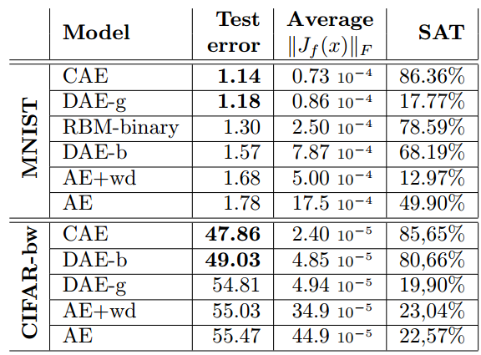
CAE vs DAE
Empirical results:
Rifai et al., “Contractive Auto-Encoders: Explicit Invariance During Feature Extraction”, 2011)
Notes:
Our first series of experiments focuses on the MNIST and CIFAR-bw datasets. We compare the classification performance obtained by a neural network with one hidden layer of 1000 units, initialized with each of the unsupervised algorithms under consideration. For each case, we selected the value of hyperparameters (such as the strength of regularization) that yielded, after supervised fine-tuning, the best classification performance on the validation set. Final classification error rate was then computed on the test set. With the parameters obtained after unsupervised pre-training (before fine-tuning), we also computed in each case the average value of the encoder’s contraction kJf (x)kF on the validation set, as well as a measure of the average fraction of saturated units per example.
We used sigmoid+cross-entropy for binary classification, and log of softmax for multi-class problems. The models were trained by optimizing their (regularized) objective function on the training set by stochastic gradient descent. These algorithms were applied on the training set without using the labels (unsupervised) to extract a first layer of features. Optionally the procedure was repeated to stack additional feature-extraction layers on top of the first one. Once thus trained, the learnt parameter values of the resulting feature-extractors (weight and bias of the encoder) were used as initialization of a multilayer perceptron (MLP) with an extra random-initialised output layer. The whole network was then fine-tuned by a gradient descent on a supervised objective appropriate for classification, using the labels in the training set.

Slide 38
Deep Autoencoder
Deep autoencoders were also introduced in the ‘80s, but turned out to be hard to train using backpropagation.
Several old papers used small initial weights, what caused vanishing gradient issues. Others showed that with large or random initial weights the autoencoder only finds a poor local minimum of the reconstruction loss.
In 2006, Salakhutdinov & Hinton introduced the “layer-by-layer pre-training”.

Slide 39
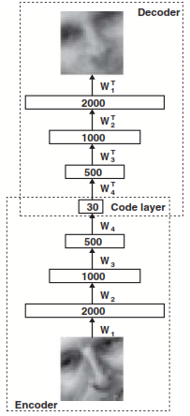
Deep Autoencoder
Layer-wise pre-training of stacked autoencoders consists of the following steps:
Train the bottommost autoencoder.
After training, remove the decoder layer, construct a new autoencoder by taking the latent representation of the previous autoencoder as input.
Train the new autoencoder. Note the weights and bias of the encoder from the previously trained autoencoders are fixed when training the newly constructed autoencoder.
Repeat step 2 and 3 until enough layers are pre-trained.
Note - After pre-training , we can do a supervised fine-tuning.
Notes:
greedy layer-wise unsupervised pretraining, it is a greedy algorithm meaning that it optimizes each piece of the solution independently, one piece at a time, rather than jointly optimizing all pieces. However it is also called pretraining, because it is supposed to be only a ﬁrst step before a joint training algorithm is applied to ﬁne-tune all the layers together.

Slide 40
Unsupervised pre-training not always useful…
Deep learning techniques based on supervised learning, regularized with dropout or batch normalization, alongside the ReLU non-linearity, are able to achieve human-level performance on very many tasks, but only with large labeled datasets.
These techniques out-perform unsupervised pre-training on datasets such as CIFAR-10 and MNIST, which have roughly 5,000 labeled examples per class
Notes:
From the point of view of unsupervised pretraining as a regularizer, we can expect unsupervised pretraining to be most helpful when the number of labeled examples is very small.
(semi-supervised)

Slide 41
Unsupervised pre-training not always useful…
Today, unsupervised pre-training has been largely abandoned, except in the ﬁeld of natural language processing, where the natural representation of words as one-hot vectors conveys no similarity information and where very large unlabeled sets are available.
In that case, the advantage of pre-training is that one can pre-train once on a huge unlabeled set (for example with a corpus containing billions of words), learn a good representation (typically of words, but also of sentences), and then use this representation or ﬁne-tune it for a supervised task for which the training set contains substantially fewer examples.
This approach was pioneered by by Collobert and Weston (2008b), Turian et al. (2010), and Collobert et al.(2011a) and remains in common use today.
Notes:
From the point of view of unsupervised pretraining as learning a representation, we can expect unsupervised pretraining to be more eﬀective when the initial representation is poor. One key example of this is the use of word embeddings. Words represented by one-hot vectors are not very informative because every two distinct one-hot vectors are the same distance from each other (squared L2 distance of 2). Learned word embeddings naturally encode similarity between words by their distance from each other. Because of this, unsupervised pretraining is especially
useful when processing words. It is less useful when processing images, perhaps because images already lie in a rich vector space where distances provide a low quality similarity metric.

Slide 42
Manifold Learning

Slide 43
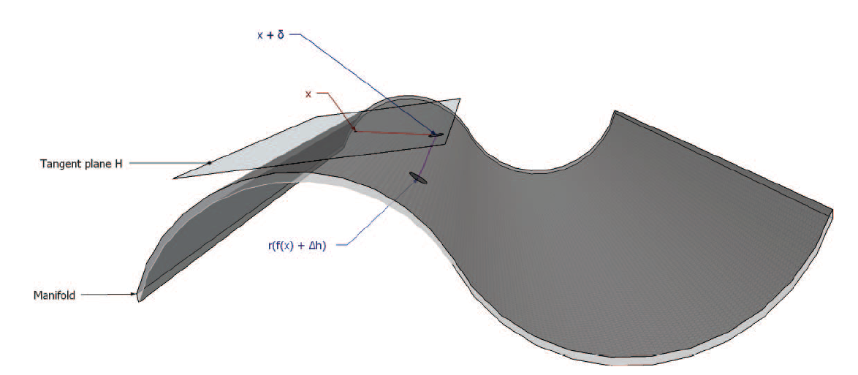
Manifold Hypothesis
Real-world data presented in high-dimensional spaces are expected to concentrate in the vicinity of a manifold $ℳ$ of much lower dimensionality $d_{ℳ}$, embedded in high-dimensional input space $ℝ^{d_{x}}$.
Notes:
At a point x on a d-dimensional manifold, the tangent plane is given by d-basis vectors that span the local directions of variation allowed on the manifold.

Slide 44
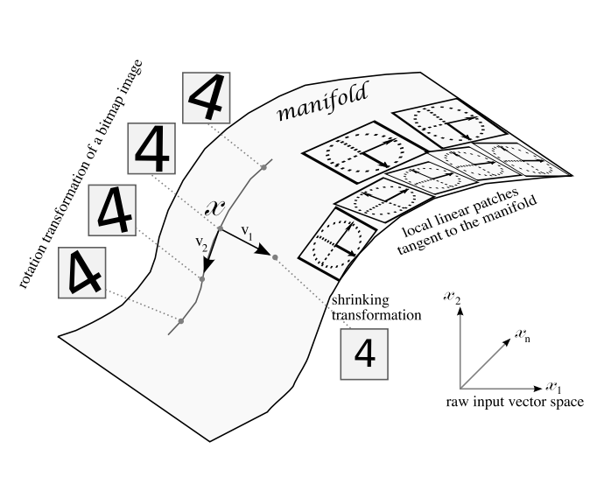
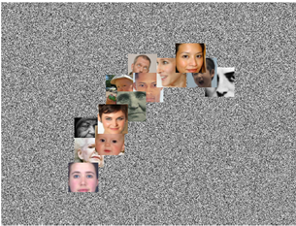
Manifold Learning
Notes:
Prior: examples concentrate near lower dimensional manifold for example:
1) Images of faces are very rare in the space of images. The task is to find the surface where the distribution of face images concentrates.
2) If the data contains geometric transformations like rotation or scaling, the number of different changes we can make is basically the dimensionality of the manifold. The actual variations we care about are of low dimension, even though the data lives in a high dimensional space.
If the data generating distribution concentrates near a low-dimensional manifold, this yields representations that implicitly capture a local coordinate system for this manifold: only the variations tangent to the manifold around x need to correspond to changes in h=f(x). Hence the encoder learns a mapping from the input space x to a representation space, a mapping that is only sensitive to changes along the manifold directions, but that is insensitive to changes orthogonal to the manifold.

Slide 45
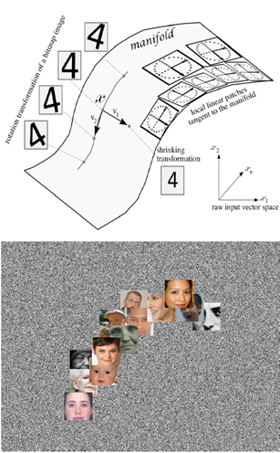
Manifold Learning
By the manifold structure, some directions are well preserved (the tangent directions of the manifold), while others are not (directions orthogonal to the manifolds).
With this perspective, the primary unsupervised learning task is then seen as modeling the structure of the manifold.
The associated representation being learned can be associated with an intrinsic coordinate system on the embedded manifold.

Slide 46
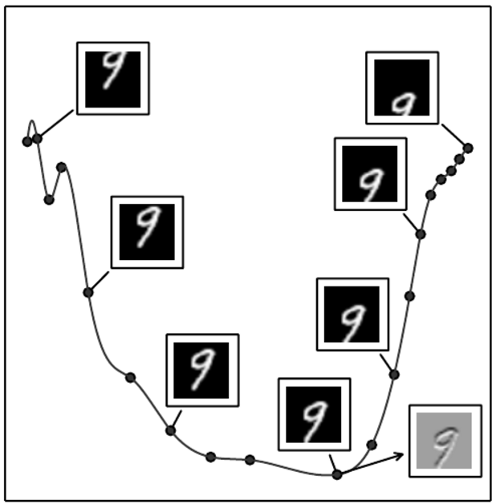
Manifold Hypothesis
Notes:
An illustration of the concept of a tangent hyperplane. Here we create a one-dimensional manifold in 784-dimensional space. We take an MNIST image with 784 pixels and transform it by translating it vertically. The amount of vertical translation deﬁnes a coordinate along a one-dimensional manifold that traces out a curved path through image space. This plot shows a few points along this manifold. For visualization, we have projected the manifold into two dimensional space using PCA. An n-dimensional manifold has an n-dimensional tangent plane at every point. This tangent plane touches the manifold exactly at that point and is oriented parallel to the surface at that point. It deﬁnes the space of directions in which it is possible to move while remaining on the manifold. This one-dimensional manifold has a single tangent line. We indicate an example tangent line at one point, with an image showing how this tangent direction appears in image space. Gray pixels indicate pixels that do not change as we move along the tangent line, white pixels indicate pixels that brighten, and black pixels indicate pixels that darken.

Slide 47
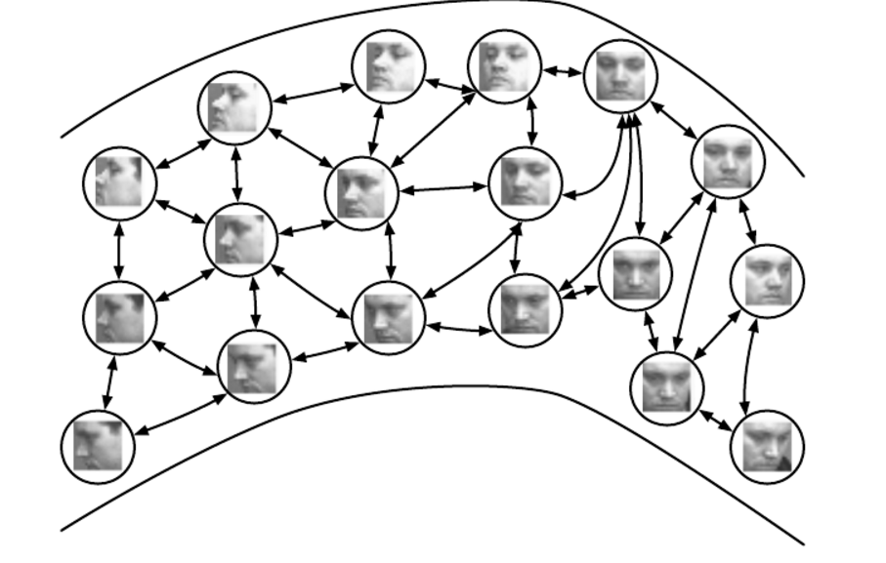
Manifold Learning
Notes:
Non-parametric manifold learning procedures build a nearest neighbor graph whose nodes are training examples and arcs connect nearest neighbors. Various procedures can thus obtain the tangent plane associated with a neighborhood of the graph as well as a coordinate system that associates each training example with a real-valued vector position, or embedding. It is possible to generalize such a representation to new examples by a form of interpolation. So long as the number of examples is large enough to cover the curvature and twists of the manifold, these approaches work well. Images from the QMUL Multiview Face Dataset (Gong et al., 2000).

Slide 48
Manifold Learning
However, there is a fundamental difficulty with such local approaches to manifold learning, raised in Bengio and Monperrus (2005):
if the manifolds are not very smooth (have many peaks and troughs and twists), one may need a very large number of training examples to cover each one of these variations, with no chance to generalize to unseen variations.
Indeed, local approaches can only generalize the shape of the manifold by interpolating between neighboring examples.

Slide 49
Manifold Learning
Unfortunately, the manifolds involved in AI problems can have very complicated structure that can be difficult to capture from only local interpolation.
This motivates the use of distributed representations and deep learning for capturing manifold structure.
Autoencoders!

Slide 50
Discussion
Representations learning and its advantages.
Three approaches for representations learning:
Probabilistic models – directed (sparse coding), undirected (Boltzman machines).
Reconstruction based algorithms – Autoencoders:
Undercomplete / Overcomplete.
Regularized autoencoders (CAE, DAE).
Deep autoencoders – unsupervised pre-training.
Geometrically motivated manifold learning.

Slide 51
Thank you for your attention!
Questions?

