Slide 1
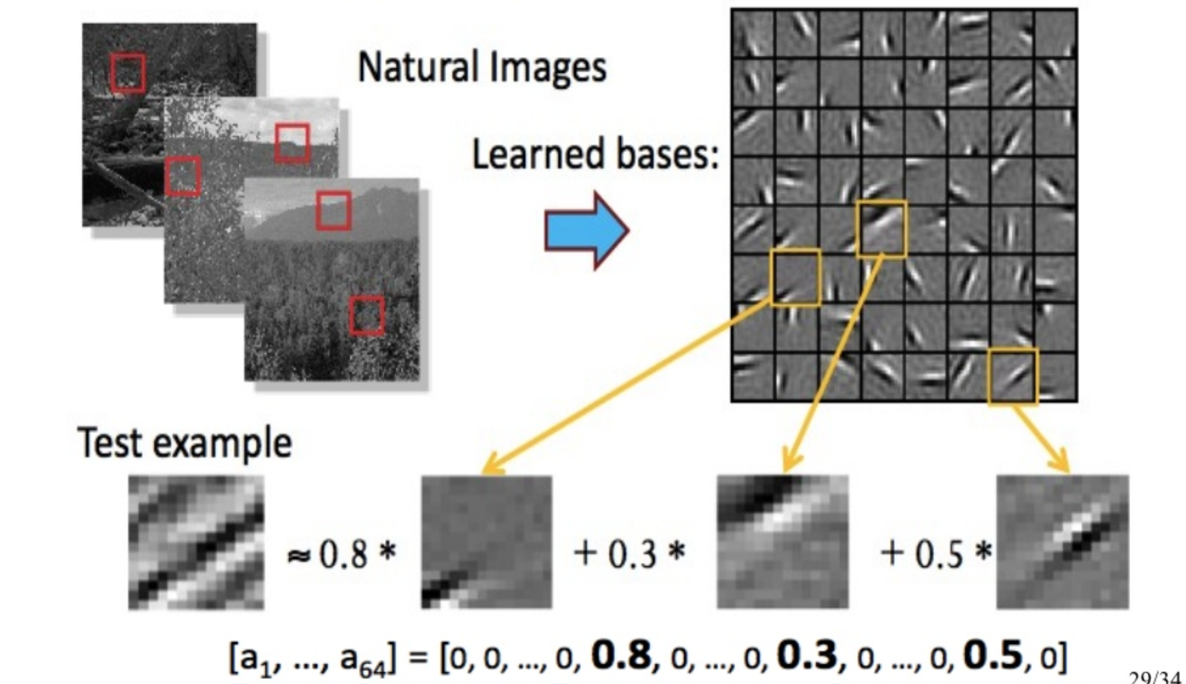
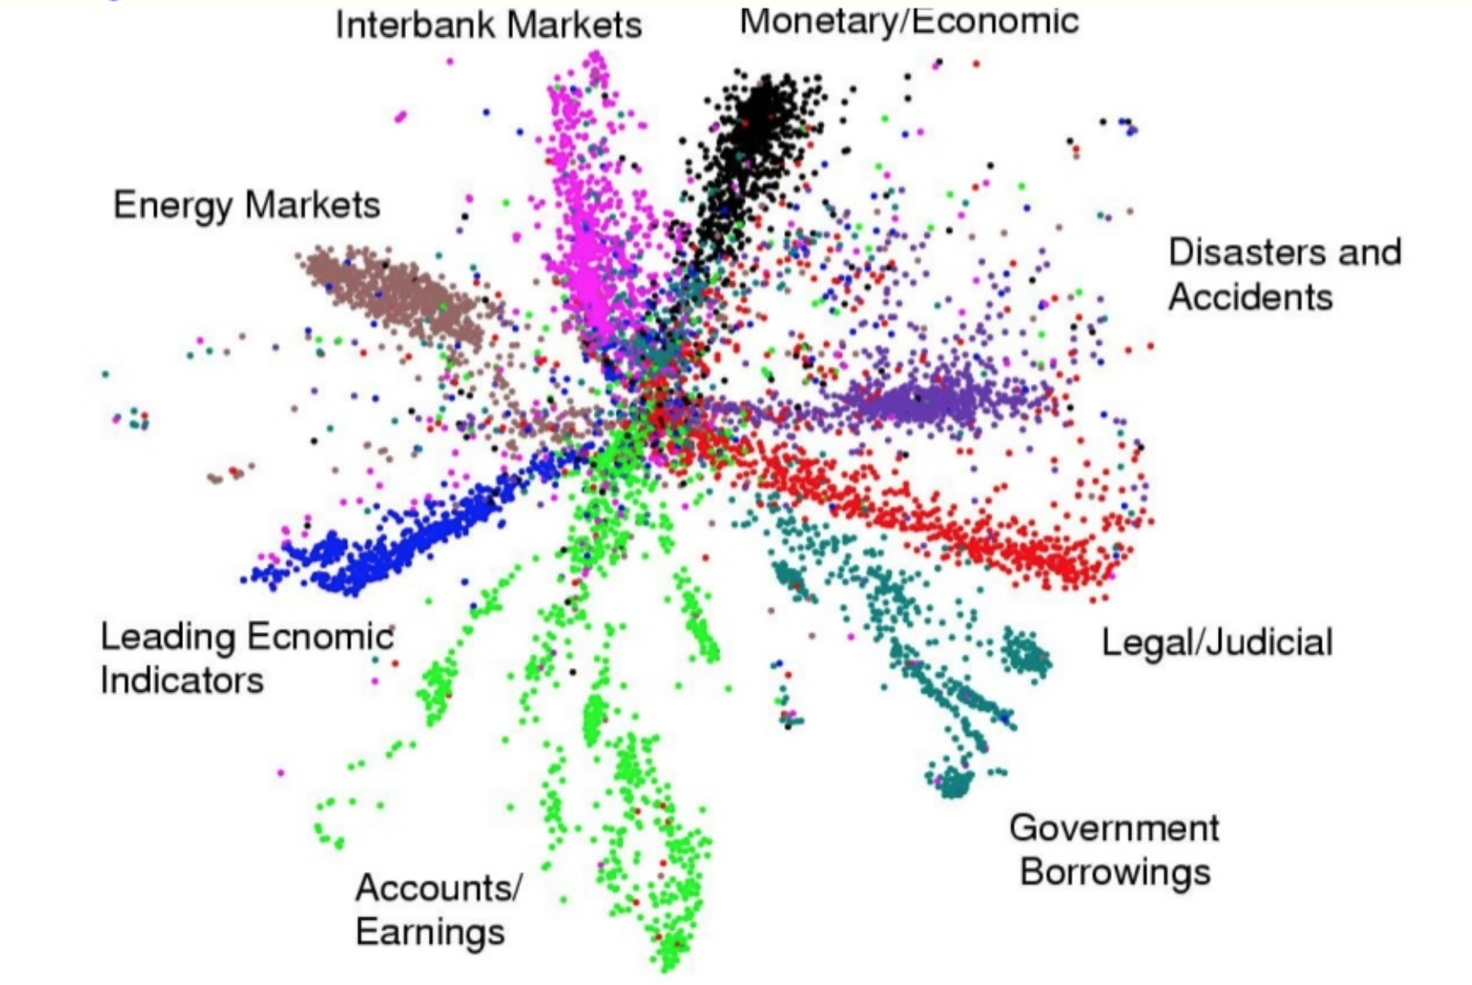
LECTURE 34: Autoencoders
Objectives:
Autoencoders
Stacked Autoencoders Denoising Autoencoders
Resources:
JB: Learning
SU: Unsupervised Learning
LP: Autoencoders
LJ: Autoencoders
PM: Autoencoders
Keras: Building Autoencoders

Slide 2
Summary
The autoencoding approach combined with a hierarchical network structure revolutionized deep learning systems.
Stacked denoising autoencoders are very popular techniques for doing feature extraction, feature selection or dimensionality reduction.
The denoising process can make training much more robust and avoid overfitting.
Notes:
http://www.iro.umontreal.ca/~bengioy/papers/ftml.pdf

