Slide 1
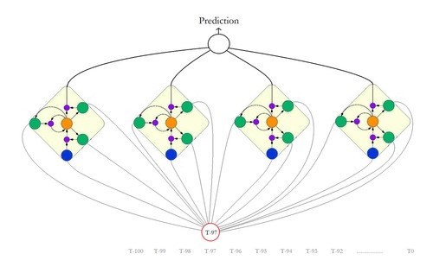
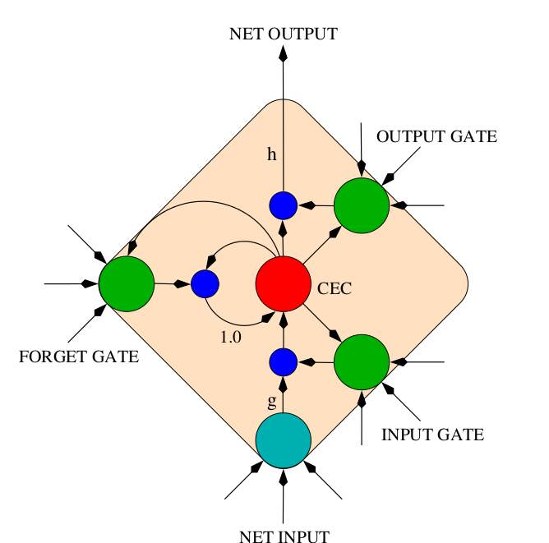
A Tutorial on implementation of LSTM networks using Theano
Meysam Golmohammadi
meysam@temple.edu
Neural Engineering Data Consortium
College of Engineering
Temple University
December 2016

Slide 2
Introduction
Theano Basics
Recurrent Neural Networks
Long Short-Term Memory Networks
Deep Recurrent Neural Networks and Deep Bidirectional Long Short-Term Memory Networks
An overview of gradient descent optimization algorithms
LSTM Networks For Sentiment Analysis
Notes:
I start from scratch with Recurrent Neural Networks. Then I’ll explain Long Short-Term Memory Networks. After that I will continue with Deep Recurrent Neural Networks. Then I will introduce you to Deep Bidirectional Long Short-Term Memory Networks. And finally I’ll wrap up the discussion with an overview on EEG classification using deep learning.

Slide 3
What is Theano? What is not Theano?
Theano has been developed and used since 2008, by LISA lab at the University of Montreal (leaded by Yoshua Bengio)
Theano is many things:
Programming Language
Linear Algebra Compiler
Python library
Define, optimize, and evaluate mathematical expressions involving multi-dimensional arrays.
Theano is not a machine learning toolkit, but a mathematical toolkit that makes building downstream machine learning models easier.

Slide 4
Theano features
Tight integration with NumPy
Transparent use of a GPU
Efficient symbolic differentiation
Speed and stability optimizations
Dynamic C code generation:
Symbolically define mathematical functions
Automatically derive gradient expressions
Compile expressions into executable functions
theano.function([input params], output)
Execute expression

Slide 5
How To Use Theano?
Building Symbolic Expressions Using:
Tensor
Scalars
Vectors
Matrices
Tensors
Tensors are multi-dimensional arrays:
Order of tensor: dimensionality
0th-order tensor = scalar
1th-order tensor = vector
2th-order tensor = matrix
…

Slide 6
Scalar math
from theano import tensor as T
# Note that theano is fully typed
x = T.scalar()
y = T.scalar()
z = x + y
w = z * x
a = T.sqrt(w)
b = T.exp(a)
c = a ** b
d = T.log(c)

Slide 7
Vector Math
from theano import tensor as T
x = T.vector()
y = T.vector()
# Scalar math applied elementwise
a = x * y
# vector dot product
b = T.dot(x, y)

Slide 8
Matrix Math
from theano import tensor as T
x = T.matrix()
y = T.matrix()
a = T.vector()
# Matrix-matrix product
b = T.dot(x, y)
# Matrix-vector product
c = T.dot(x, a)

Slide 9
Theano function
>>> from theano import tensor as T
>>> x = T.scalar()
>>> y = T.scalar()
>>> from theano import function
>>> # first arg is list of SYMBOLIC inputs
>>> # second arg is SYMBOLIC output
>>> f = function([x, y], x + y)
>>> # Call it with NUMERICAL values
>>> # Get a NUMERICAL output
>>> f(1., 2.)
array(3.0)

Slide 10
Shared variables
A “shared variable” is a buffer that stores a numerical value for a theano variable (think as a global variable)
Modify outside function with get_value and set_value. For example:
>>> from theano import shared
>>> x = shared(0.)
>>> from theano.compat.python2x import OrderedDict
>>> updates[x] = x + 1
>>> f = T.function([], updates=updates)
>>> f() # updates
>>> x.get_value()
>>> x.set_value(100.)
>>> f() # updates
>>> x.get_value()

Slide 11
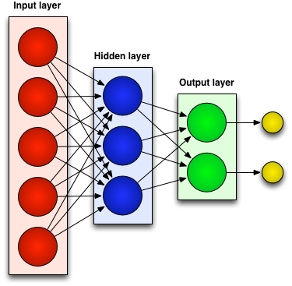
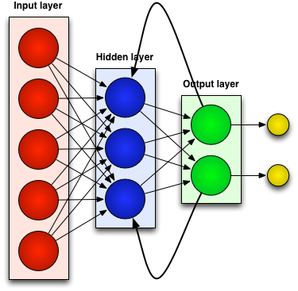
Neural Networks
Generally there are two kinds of neural networks:
Feedforward Neural Networks:
connections between the units do not form a cycle
Recurrent Neural Network:
connections between units form cyclic paths
Notes:
In recent years, neural networks composed of multiple layers, which are often termed as Deep Learning, have emerged as a powerful machine learning approach.
A feedforward neural network is an artificial neural network where connections between the units do not form a cycle. In other word in feedforward networks processing of information is piped through the network from input layers to output layers.
In contrast, a recurrent neural network (RNN) is an artificial neural network where connections between units form cyclic paths.

Slide 12
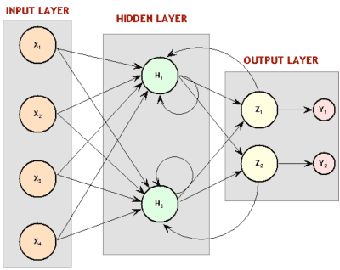
Recurrent Neural Network (RNN)
Recurrent since they receive inputs, update the hidden states depending on the previous computations, and make predictions for every element of a sequence.
RNNs are a neural network with memory.
RNNs are very powerful dynamic system for sequential tasks such as speech recognition or handwritten recognition since they maintain a state vector that implicitly contains information about the history of all the past elements of a sequence.
Notes:
RNNs are called recurrent …
We can consider RNNs as …
RNNs are very …

Slide 13
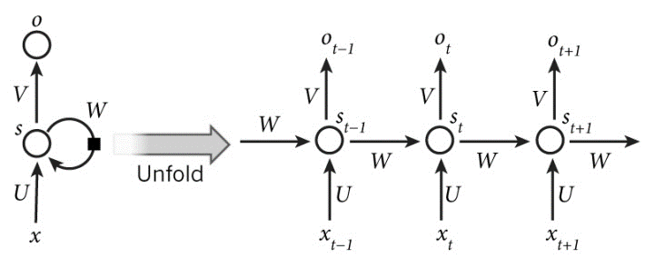
Unrolling an RNN for Sequential Modeling
An unrolled RNN (in time) can be considered as a deep neural network (DNN) with indefinitely many layers:
$x_{t}$: input at time $t$
$s_{t}$: hidden state at time $t$ (memory of the network).
$f$: is an activation function (e.g, $tanh()$ and ReLUs).
U, V, W: network parameters (unlike a feedforward neural network, an RNN shares the same parameters across all time steps).
g: activation function for the output layer (typically a softmax function).
y: the output of the network at time $t$
$$s_{t}=f\left(Ux_{t}+Ws_{t−1}\right)$$
$$\left.y=g(Vs_{t}\right)$$
Notes:
In these equations $x_{t}$is the input at time step t. $S_{t}$ is the hidden state at time step t which is in fact the memory of the network and it is calculated based on the input at the current step and the previous hidden state. $f$ is a activation function which transforms the inputs of the layer into its outputs and allows us to fit nonlinear hypotheses. Common choices for $f$ are tanh and ReLUs. $S_{−1}$ which is required to initialize the first hidden state is typically set to all zeroes. The output of the network is $y$ which is calculated by a nonlinear function of matrix multiplication of V and $S_{t}$. In fact this nonlinear function, g, is the activation function for the output layer and usually it is the softmax function. It is simply a way to convert raw scores to probabilities. Unlike feed forward neural networks, which have different parameters at each layer, a RNN shares the same parameters (U, V, W in Eq. 2.1 and Eq. 2.2) across all steps.
rectified linear unit (ReLU)

Slide 14
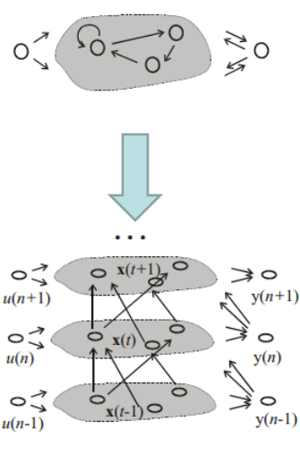
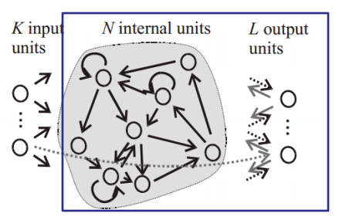
RNN Training
There are different approaches for training of RNNs:
Back-Propagation Through Time (BPTT): Unfolding an RNN in time and using the extended version of backpropagation.
Extended Kalman Filtering (EKF): a set of mathematical equations that provides an efficient computational means to estimate the state of a process, in a way that minimizes the mean of the squared error on linear system.
BPTT
Real-Time Recurrent Learning (RTRL): Computing the error gradient and update weights for each time step.
RTRL
Notes:
The feedforward neural networks can be trained by backpropagation algorithm. In RNNs, a slightly modified version of this algorithm called Backpropagation through Time (BPTT) is used to train the network.

Slide 15
Backpropagation Through Time
The backpropagation algorithm can be extended to BPTT by unfolding RNN in time and stacking identical copies of the RNN.
As the parameters that are supposed to be learned (U, V and W) are shared by all time steps in the network, the gradient at each output depends, not only on the calculations of the current time step, but also the previous time steps.
In RNNs, a common choice for the loss function is the cross-entropy loss which is given by:
$L\left(y_{l},y\right)=−\frac{1}{N}\sum_{n∈N}{y_{ln}\log{y_{n}}}$
$N:$the number of training examples
$y:$ the prediction of the network
$y_{l}$: the true label
Let’s look at a real script
Notes:
The backpropagation algorithm can be extended to BPTT by unfolding RNN in time and stacking identical copies of the RNN.
As the parameters that are supposed to be learnt (U, V and W) are shared by all time steps in the network, the gradient at each output depends not only on the calculations of the current time step, but also the previous time steps.

Slide 16
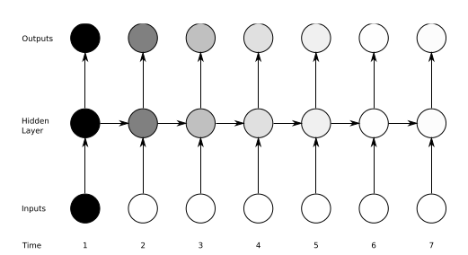
The Vanishing Gradient Problem
Definition: The influence of a given input on the hidden layer, and therefore on the network output, either decays or grows exponentially as it propagates through an RNN.
In practice, the range of contextual information that standard RNNs can access are limited to approximately 10 time steps between the relevant input and target events.
Solution: LSTM networks.
Notes:
While RNNs are powerful structures, they are hard to train.
One of the main reason is “vanishing gradient problem” which explored in depth by Bengio and it refers to
They found that in theory RNNs can make use of information in arbitrarily long sequences, but in practice they are limited to looking back only a few steps.
This means in practice …
The most successful solution is to use Long Short-Term Memory (LSTM) which will be introduced in next chapter.

Slide 17
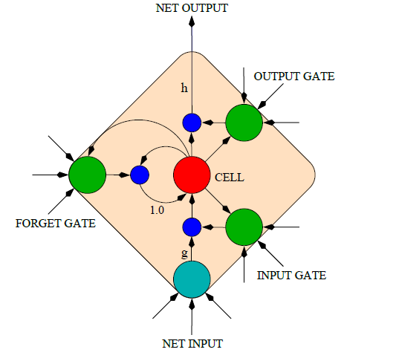
LONG SHORT-TERM MEMORY (LSTM)
An LSTM is a special kind of RNN architecture, capable of learning long-term dependencies.
An LSTM can learn to bridge time intervals in excess of 1000 steps.
LSTM networks outperform RNNs and Hidden Markov Models (HMMs):
Speech Recognition: 17.7% phoneme error rate on TIMIT acoustic phonetic corpus.
Winner of the ICDAR handwriting competition for the best known results in handwriting recognition.
This is achieved by multiplicative gate units that learn to open and close access to the constant error flow.
LSTM Memory Cell
Notes:
Long Short Term Memory networks are a special kind …

Slide 18
Memory Cell in LSTM
LSTM networks introduce a new structure called a memory cell.
Each memory cell contains four main elements:
Input gate
Forget gate
Output gate
Neuron with a self-recurrent
These gates allow the cells to keep and access information over long periods of time.
LSTM Memory Cell

Slide 19
LSTM Equations
$i:$input gate, how much of the new information will be let through the memory cell.
$f$: forget gate, responsible for information should be thrown away from memory cell.
$o:$output gate, how much of the information will be passed to expose to the next time step.
$g:$self-recurrent which is equal to standard RNN
$c_{t}$: internal memory of the memory cell
$s_{t}$: hidden state
$y$: final output
$i= σ\left(x_{t}U^{i}+s_{t−1}W^{i}\right)$
$f= σ\left(x_{t}U^{f}+s_{t−1}W^{f}\right)$
$o= σ\left(x_{t}U^{o}+s_{t−1}W^{o}\right)$
$g= \tanh\left(x_{t}U^{g}+s_{t−1}W^{g}\right)$
$c_{t}=c_{t−1}∘f+g ∘i$
$s_{t}= \tanh\left(c_{t}\right)∘o$
$y= softmax\left(Vs_{t}\right)$
LSTM Memory Cell

Slide 20
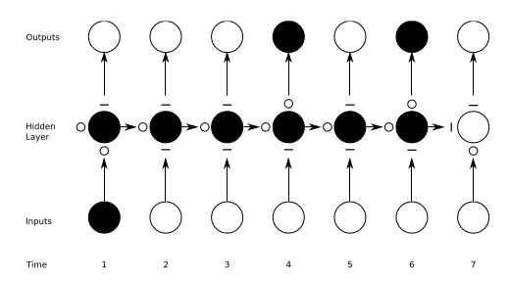
Preserving the information in LSTM
A demonstration of how an unrolled LSTM preserves sequential information.
The input, forget, and output gate activations are displayed to the left and above the memory block (respectively). The gates are either entirely open (‘O’) or entirely closed (‘—’).
Traditional RNNs are a special case of LSTMs: Set the input gate to all ones (passing all new information), the forget gate to all zeros (forgetting all of the previous memory) and the output gate to all ones (exposing the entire memory).

Slide 21
Deep Bidirectionsal LSTMs (DBLSTM)
By stacking multiple LSTM layers on top of each other, DBLSTMs could also benefit from depth in space.
Bidirectional LSTM: process information in both directions with two separate hidden layers, which are then fed forwards to the same output layer, providing it with access to the past and future context of every point in the sequence.
BLSTM outperform unidirectional LSTMs and standard RNNs and it is also much faster and more accurate.
DBLSTMs equations: repeat the equations of LSTM for every layer, and replace each hidden state, $c_{t}^{l}$, in every layer with the forward and backward states, ${\vec{c}}_{t}^{l}$and ${\overset{⃖}{c}}_{t}^{l} ,$in a way that every hidden layer receives input from both the forward and backward layers at the level below.
Notes:
One of the greatest disadvantageous of RNN and LSTM structures that were introduced in part 1 and 2, is that they are processing information just based on the previous context.
In a lot of application including speech recognition, we prefer another structure called bidirectional LSTM (BLSTM) which can …
BLSTMs contain two separate hidden layers, one of them processes the input sequence forwards, while the other processes it backwards. Both hidden layers are connected to the same output layer, providing it with access to the past and future context of every point in the sequence.

Slide 22
DEEP RECURRENT NEURAL NETWORKS (DRNN)
Standard RNN: the information only passes through one layer of processing before going to the output.
In sequence tasks we usually process information at several time scales.
DRNN: a combination of the concepts of deep neural networks (DNN) with RNNs.
By stacking RNNs, every layer is an RNN in the hierarchy that receives the hidden state of the previous layer as input.
Processing of different time scales at different levels, and therefore a temporal hierarchy will be created.
Notes:
One potential disadvantage of traditional RNN which explained in the first part of the presentation is that,
In this part a structure called deep recurrent neural network(DRNN) will be explained which is basically
In DRNN by stacking RNNs,
In this way processing

Slide 23
DRNN-1O vs. DRNN-AO
Two variants of DRNN structures:
DRNN-1O: the output will be computed just based on the hidden state of the last layer.
DRNN-AO: the output will be the combination of the hidden states of the all layers.
DRNN-AO has two great advantages:
Using BPTT for DRNN-AO, the error will propagate from the top layer down the hierarchy without attenuation of the magnitude. As a result, training will be more effective.
It gives us the ability to evaluate the impact of each layer in solving the task by leaving out an individual layer’s contribution.
Notes:
Different variations of the structures of DRNNs are depicted in this slide.
In this picture connection matrices are shown by arrows.
Also input frames, hidden states, and output frames are represented by white,black and grey circles respectively.
In both of these structures the looped arrows represent the recurrent weights.

Slide 24
DRNN Equations
DRNN with L layers, N neurons per layer, a time series x(t) as input and dimensionality of N_{­in} and y(t) as the output: of DRNN:
$s_{t}^{l}=tanh\left(U^{l}x_{t}+W^{l}s_{t−1}^{l}\right) if l=1$
$s_{t}^{l}=tanh\left(U^{l}s_{t}^{l−1}+W^{l}s_{t−1}^{l}\right) if l>1$
The output for DRNN-1O:
$y_{t}=softmax\left(Vs_{t}^{L}\right)$
The output for DRNN-AO:
$y_{t}= softmax\left(\sum_{l=1}^{L}{{V^{L}s}_{t}^{l}}\right)$

Slide 25
DRNN Training
Use stochastic gradient decent for optimization:
$θ\left(j+1\right)=θ\left(j\right)−η_{0}\left(1−\frac{j}{T}\right)\frac{∇_{θ}\left(j\right)}{\left\|∇_{θ}\left(j\right)\right\|}$
$θ\left(j\right):$the set of all trainable parameters after j updates
$∇_{θ}\left(j\right)$: the gradient of a cost function with respect to this parameter set, as computed on a randomly sampled part of the training set.
T: the number of batches
$η_{0}$: the learning rate is set at an initial value which decreases linearly with each subsequent parameter update.
Incremental layer-wise method: train the full network with BPTT and linearly reduce the learning rate to zero before a new layer is added. After adding a new layer the previous output weights will be discarded, and new output weights are initialized connecting from the new top layer.
For DRNN-AO, we test the influence of each layer by setting it to zero, assuring that model is efficiently trained.
Notes:
In order to train a DRNN, …

Slide 26
An overview of gradient descent optimization algorithms
1) SGD Reference:http://ufldl.stanford.edu/tutorial/supervised/OptimizationStochasticGradientDescent/
2) RMSprop Reference:http://www.cs.toronto.edu/~tijmen/csc321/slides/lecture_slides_lec6.pdf)
3) Adagrad Reference: http://jmlr.org/papers/v12/duchi11a.html
4) Adadelta Reference: https://arxiv.org/abs/1212.5701
5) Adam Reference: http://arxiv.org/abs/1412.6980v8
6) Adamax Reference: https://arxiv.org/abs/1412.6980v8
7) Nadam Reference: http://cs229.stanford.edu/proj2015/054_report.pdf
Notes:
.

Slide 27
Why different optimization algorithm
The main difference is actually how they treat the learning rate.
Stochastic Gradient Descent:
Theta (weights) is getting changed according to the gradient of the loss with respect to theta.
alpha is the learning rate.
If alpha is very small, convergence will be very slow. On the other hand, large alpha will lead to divergence.
Notes:
The data was collected by Stanford researchers and was used in a 2011 paper where a split of 50-50 of the data was used for training and test. An accuracy of 88.89% was achieved. This is my result on IMDB dataset using LSTM network:
.

Slide 28
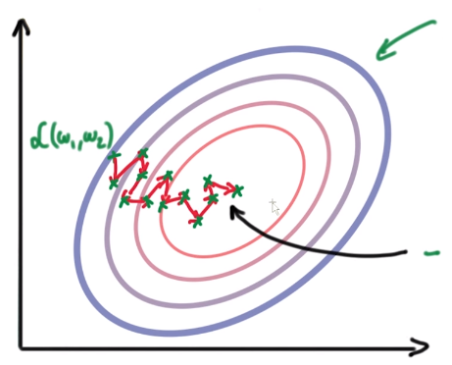
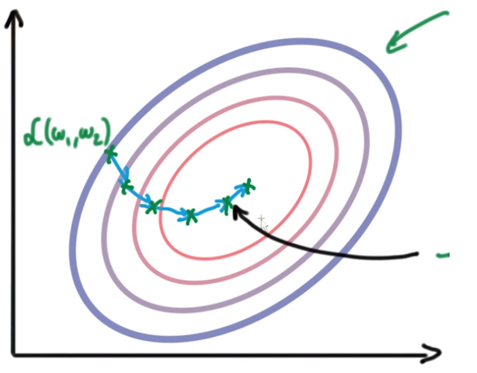
Why different optimization algorithm
Due to the diversity of each training example, the gradient of the loss (L) changes quickly after each iteration. We are taking small steps but they are quite zig-zag (even though we slowly reach to a loss minima).
To overcome this, we introduce momentum. Basically taking knowledge from previous steps about where we should be heading. We are introducing a new hyperparameter:
Notes:
.

Slide 29
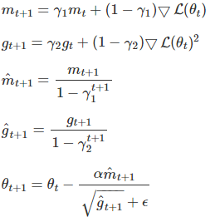
Adaptive Moment Estimation (Adam)
Adam is another method that computes adaptive learning rates for each parameter.
Like Adadelta and RMSprop, but in addition to storing an exponentially decaying average of past squared gradients $g_{t}$, Adam also keeps an exponentially decaying average of past gradients $m_{t}$, similar to momentum:
Notes:
.

Slide 30
LSTM NETWORKS FOR SENTIMENT ANALYSIS
In this tutorial, we provide an example of how a Recurrent Neural Network (RNN) using the Long Short Term Memory (LSTM) architecture can be implemented using Theano.
This model is used to perform sentiment analysis on movie reviews from the Large Movie Review Dataset, known as the IMDB dataset.
In this task, given a movie review, the model attempts to determine whether a given movie review has a positive or negative sentiment. This is a binary classification task.
Each movie review is a variable sequence of words and contains 25,000 highly-polar movie reviews (good or bad) for training and the same amount again for testing.
Notes:
The data was collected by Stanford researchers and was used in a 2011 paper where a split of 50-50 of the data was used for training and test. An accuracy of 88.89% was achieved. This is my result on IMDB dataset using LSTM network:
.

Slide 31
Brief Bibliography
[1] M. Hermans and B. Schrauwen, “Training and Analyzing Deep Recurrent Neural Networks,” Adv. Neural Inf. Process. Syst., pp. 190–198, 2013.
[2] A. Graves, A. Mohamed, and G. Hinton, “Speech Recognition With Deep Recurrent Neural Networks,” IEEE Int. Conf. Acoust. Speech, Signal Process., no. 3, pp. 6645–6649, 2013.
[3] J. T. Turner, A. Page, T. Mohsenin, and T. Oates, “Deep Belief Networks used on High Resolution Multichannel Electroencephalography Data for Seizure Detection,” AAAI Spring Symp. Ser., no. 1, pp. 75–81, 2014.
[4] Y. LeCun, Y. Bengio, and G. Hinton, “Deep learning,” Nature, vol. 521, no. 7553, pp. 436–444, 2015.
[5] Y. Bengio, P. Simard, and P. Frasconi, “Learning Long-Term Dependencies with Gradient Descent is Difficult,” IEEE Trans. Neural Networks, vol. 5, no. 2, pp. 157–166, 1994.
[6] R. Pascanu, T. Mikolov, and Y. Bengio, “On the difficulty of training recurrent neural networks,” in International Conference on Machine Learning, 2013, no. 2, pp. 1310–1318.
[7] S. Hochreiter, Y. Bengio, P. Frasconi, and J. Schmidhuber, “Gradient flow in recurrent nets: the difficulty of learning long-term dependencies,” A F. Guid. to Dyn. Recurr. Networks, pp. 237–243, 2001.
[8] S. Hochreiter, S. Hochreiter, J. Schmidhuber, and J. Schmidhuber, “Long short-term memory.,” Neural Comput., vol. 9, no. 8, pp. 1735–80, 1997.
[9] K. Greff, R. K. Srivastava, J. Koutník, B. R. Steunebrink, and J. Schmidhuber, “LSTM: A Search Space Odyssey,” arXiv, p. 10, 2015.
[10] A. Graves and J. Schmidhuber, “Framewise phoneme classification with bidirectional LSTM networks,” in Proceedings of the International Joint Conference on Neural Networks, 2005, vol. 4, pp. 2047–2052.
[11] A. Graves, S. Fernandez, F. Gomez, and J. Schmidhuber, “Connectionist Temporal Classification : Labelling Unsegmented Sequence Data with Recurrent Neural Networks,” Proc. 23rd Int. Conf. Mach. Learn., pp. 369–376, 2006.
[12] A. Graves, “Sequence transduction with recurrent neural networks,” in ICML Representation Learning Workshop, 2012
[13] G. E. Hinton and R. R. Salakhutdinov, “Reducing the Dimensionality of Data with Neural Networks,” Science (80-. )., vol. 313, no. 5786, pp. 504–507, 2006.
[14] Y. Bengio, P. Lamblin, D. Popovici, and H. Larochelle, “Greedy Layer-Wise Training of Deep Networks,” Adv. Neural Inf. Process. Syst., vol. 19, no. 1, p. 153, 2007.

