Slide 1
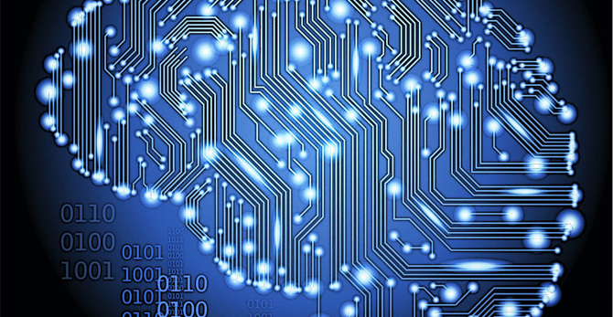
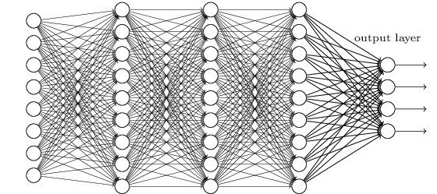
LECTURE ??: DEEP LEARNING
Objectives:
Deep Learning
Restricted Boltzmann Machines
Deep Belief Networks
Resources:
Learning Architectures for AI
Contrastive Divergence RBMs

Slide 2
Deep Learning
Deep learning is a branch of machine learning that has gained great popularity in the latest years
The first deep network descriptions emerged in the late 60s and early 70s. Ivankhnenko (1971) published a paper that described a deep network with 8 layers trained by the Group Method of Data Handling algorithm
In 1989 LeCun was able to apply the standard backpropagation algorithm to train a deep network to recognize handwritten Zip codes. This process was not very practical, since it took three days for training
In 1998, a team led by Larry Heck achieved the first success for deep learning on speaker recognition.
Nowadays, several speech recognition problems have been approached with a deep learning method called a Long Short Term Memory (LSTM), a recurrent neural network proposed by Schmidhuber in 1997
New training methodologies (greedy-layer-wise learning algorithm) and advances in hardware (GPUs) have contributed to the renewed interest on this topic.

Slide 3
Vanishing Gradient and Backpropagation
One of the reasons that made the training of deep neural networks a difficult task is related to the vanishing gradient, which results from gradient based training techniques and the backpropagation algorithm
Considering a very simple deep network, with only one neuron per layer, a cost C and a sigmoid activation function:
A small change in $b_{1}$ sets off a series of cascading changes in the network
$∆a_{1}≈\frac{dσ\left(ω_{1}a_{0}+b_{1}\right)}{db_{1}}∆b_{1}$ or ${∆a_{1}=σ}^{′}\left(z_{1}\right)∆b_{1}$ The chance in $a_{1}$, then causes a change in the weighted input $z_{2}$, which would be given by $∆z_{2}≈σ^{′}\left(z_{1}\right)ω_{2}∆b_{1}$. Basically, a term $σ′(z_{j})$ and $ω_{j}$ is picked up in every neuron
The resulting change in cost (divided by $∆b_{1}$), produced by the change $∆b_{1}$ is given by:
$$\frac{ⅆC}{db_{1}}=σ^{′}\left(z_{1}\right)×ω_{2}×σ^{′}\left(z_{2}\right)×ω_{3}×σ^{′}\left(z_{3}\right)×ω_{4}×σ^{′}\left(z_{4}\right)×\frac{ⅆC}{da_{4}}$$
For a sigmoid, $σ^{′}\left(0\right)=\frac{1}{4}$, in this sense, the terms $\left|ω_{j}σ^{′}\left(z_{j}\right)\right|<\frac{1}{4}$, contributing to a vanishing gradient
Notes:
If the weights tend to increase during training and the terms get large enough, the gradient would grow exponentially and the problem would be an exploding gradient instead.

Slide 4
Boltzmann Machines (BM)
The vanishing gradient results in very slow training for the front layers of the network
One of the solutions to this issue was proposed by Hinton (2006). He proposed to use a Restricted Boltzmann Machine (RBM) to model each new layer of higher level features
RBMs are energy based models, they associate a scalar energy to each configuration of the variables of interest
Energy based probabilistic models define a probability distribution as:
$p\left(x\right)=\frac{e^{−E\left(x\right)}}{Z}$ where $Z=\sum_{x}{e^{−E\left(x\right)}}$
An energy-based model can be learnt by performing (stochastic) gradient descent on the empirical negative log-likelihood of the training data, where the log-likelihood and the loss function are:
$$V_{1}$$
RBM
$$h_{1}$$
$$V_{2}$$
$$h_{2}$$
$$V_{3}$$
$$h_{2}$$
$$V_{4}$$
$L\left(θ, D\right)=\frac{1}{N}\sum_{x^{i}εD}{log p(x^{i})}$ and $l\left(θ,D\right)=−L(θ, D)$

Slide 5
Boltzmann Machines (BM)
RBMs consist of a visible layer v and a hidden layer h, so
$P\left(x\right)=\sum_{h}{P\left(x,h\right)=\sum_{h}{\frac{e^{−E\left(x,h\right)}}{Z}}}$
Introducing the notation of free energy: $F\left(x\right)=−log\sum_{h}{e^{−E(x,h)}}$ we can write:
$P\left(x\right)=\frac{e^{−F\left(x\right)}}{Z}$ with $Z=\sum_{x}{e^{−F\left(x\right)}}$
Then the data negative log-likelihood gradient has the following form:
$$−\frac{dlogp\left(x\right)}{dθ}=\frac{dF\left(x\right)}{dθ}−\sum_{\tilde{x}}{p\left(\tilde{x}\right)}\frac{dF\left(\tilde{x}\right)}{dθ}$$
Usually, samples belonging to N are used to estimate the gradient. The elements $\tilde{x}$ of N are sampled according to P:
$$−\frac{dlogp\left(x\right)}{dθ}=\frac{dF\left(x\right)}{dθ}−\frac{1}{|N|}\sum_{\tilde{x}εN}{p\left(\tilde{x}\right)}\frac{dF\left(\tilde{x}\right)}{dθ}$$
Positive Phase: increase probability of training data
Negative Phase:
Decrease probability of samples generated by model

Slide 6
Restricted Boltzmann Machines (RBM)
RBMs have energy functions that are linear in their free parameters. Some of the variables are never observed (hidden) and restrict BMs to those without interconnections in the same layer
The energy function for an RBM with weights W is
$E\left(v,h\right)=−b^{′}v−c^{′}h−h^{′}Wv$ or $F\left(v\right)=−b^{′}v−\sum_{i}{log\sum_{h_{i}}{e^{h_{i}\left(c_{i}+W_{i}v\right)}}}$
Where b and c are offsets of the visible and hidden layers
Given that visible and hidden units are conditionally independent given one another:
$p\left(h | v\right)=\prod_{i}{p\left(h_{i} | v\right)}$ and $p\left(v | h\right)=\prod_{j}{p(v_{j}|h)}$
If using binary units, the free energy and the probabilistic version of the activation function are given by:
$$F\left(v\right)=−b^{′}v−\sum_{i}{log(1+e^{c_{i}+W_{i}v})}$$
$$P\left(h_{i}=1 | v\right)=σ\left(c_{i}+W_{i}v\right)$$
$$P\left(v_{j}=1 | h\right)=σ(b_{j}+{W′}_{j}h)$$

Slide 7
Restricted Boltzmann Machines (RBM)
Considering the previous information, the update equations are theoretically given by:
$$−\frac{dlog\left(p\left(v\right)\right)}{dW_{ij}}=E_{v}\left[p\left(h_{i} | v\right)∙v_{j}\right]−v_{j}^{\left(i\right)}∙σ\left(W_{i}∙v^{\left(i\right)}+c_{i}\right)$$
$−\frac{dlog\left(p\left(v\right)\right)}{dc_{i}}=E_{v}\left[p\left(h_{i} | v\right)\right]−σ\left(W_{i}∙v^{\left(i\right)}\right)$
$$−\frac{dlog\left(p\left(v\right)\right)}{db_{j}}=E_{v}\left[p\left(v_{j} | h\right)\right]−v_{j}^{(i)}$$
In practice, the log-likelihood gradients are commonly approximated by algorithms such as Contrastive Divergence (CD-k), which does the following:
Since we want $p\left(v\right)≈p_{train}\left(v\right)$ a Markov Chain is initialized with a training example that is close to p (so chain is close to convergence)
CD selects samples after only k steps of Gibbs sampling (does not wait for convergence)
Notes:
http://www.iro.umontreal.ca/~bengioy/papers/ftml.pdf

Slide 8
RBM Training Summary
1. Forward Pass: Inputs are combined with an individual weights and a bias. Some hidden nodes are activated.
2. Backward Pass: Activations are combined with an individual weight and a bias. Results are passed to the visible layer.
3. Divergence calculation: Input $x$ and samples $\tilde{x}$ are compared in visible layer. Parameters are updated and steps are repeated
$$w_{1}$$
$$c$$
$$V_{1}$$
$$w_{2}$$
$$−\frac{dlogp\left(x\right)}{dθ}$$
$$h_{2}$$
$$V_{2}$$
$$w_{1}$$
$$h_{1}$$
$$b$$
$$h_{3}$$
$$w_{3}$$
$$h_{1}$$
$$h_{2}$$
$$V_{1}$$
$$V_{2}$$
$$w_{4}$$
Input being passed to first hidden node
$$h_{2}$$
$$h_{1}$$
$$h_{3}$$
$$V_{2}$$
$$V_{1}$$
$$h_{3}$$
$$h_{2}$$
Activations are passed to visible layer for reconstruction
$$V_{2}$$
$$h_{3}$$
$$Update W, b, c$$
$h_{1}$ activates in this example
Notes:
http://www.iro.umontreal.ca/~bengioy/papers/ftml.pdf

Slide 9
Deep Belief Networks (DBN)
These networks can be seen as a stack of RBMs. The hidden layer of one RBM is the Visible layer of the one above it
A pre-training step is done by training the layers one RBM at a time. The output for one set is used as the input for the next one
In this sense, each RBM layer learns the entire input. The DBN fine tunes the entire input in succession as the model improves.
This is called unsupervised, layer-wise, greedy pre-training
$$RBM_{1}$$
$$RBM_{2}$$
$$RBM_{3}$$
$$RBM_{4}$$
Notes:
http://www.iro.umontreal.ca/~bengioy/papers/ftml.pdf

Slide 10
Supervised Fine-Tuning of DBNs
After unsupervised pre-training, the network can be further optimized by gradient descent with respect to a supervised training criterion.
As a small set of labeled samples is introduced, the parameters are slightly updated to improve the network’s perception of the patterns
This training process can be accomplished in a reasonable amount of time (depending on the depth and other parameters of the DBN) in a GPU
Given that DBN attempt to sequentially learn the entire input and then reconstruct it in a backward pass, they are commonly used to learn features for the data.
Labels
Notes:
http://www.iro.umontreal.ca/~bengioy/papers/ftml.pdf

Slide 11
Example: Movie Recommendations
In this example, a simple RBM will be constructed and utilized for movie recommendations
In 2007, Hinton proposed the utilization of RBMs in order to produce more accurate movie recommendations with Netflix data
Essentially, the input data is comprised of the movies that users liked. The output is a set of weights that activate (or not) the hidden units that, in this case will represent movie genre.
As it was shown in the RBM training section, the input will be passed to the hidden layer, where the activation energy is calculated and the weights and biases are updated
The input is then attempted to be reconstructed in a similar manner and the hidden units are updated accordingly
In this example the visible units will represent a movie and the input will be 1 if the user liked it, and 0 if the user did not like it
For a new user, the activation (or not activation) of the hidden units, indicates whether or not the use should be recommended to a set of movies
Note that this is a simple example to illustrate one application of RBMs
Notes:
http://www.iro.umontreal.ca/~bengioy/papers/ftml.pdf

Slide 12
Example: Movie Recommendations
The RBM used in this examples is constructed to have 6 visible units and 2 hidden units
$$m_{1}:Harry Potter$$ $m_{2}:Avatar$ $m_{3}:Lord of the Rings 3$
$$m_{4}:Gladiator \\ m_{5}:Titanic \\ m_{6}:Glitter$$
Hidden Layer
Visible Layer
$$m_{1}$$
$$m_{2}$$
$$m_{4}$$
$$m_{5}$$
$$m_{6}$$
Input for Training User#: $\left[m_{1} m_{2} m_{3} m_{4} m_{5} m_{6}\right]$ User1: [1 1 1 0 0 0] User2: [1 0 1 0 0 0] User3: [1 1 1 0 0 0] User4: [0 0 1 1 1 0] User5: [0 0 1 1 0 1] User6: [0 0 1 1 1 0]
1: User liked the movie 0: User did not like the movie
$$m_{3}$$
In this case, the hidden units will learn two latent variables underlying the movie preferences.
For example: It could learn to identify the Sci-Fi/Fantasy movies from the Oscar winning movies
Notes:
http://www.iro.umontreal.ca/~bengioy/papers/ftml.pdf

Slide 13
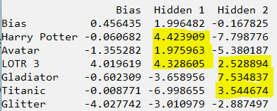
Example: Movie Recommendations
Running the code for the specified RBM and the provided examples produces the following weights:
The probability of activation is the sigmoid of the activation energy, negative values will correspond to low probability of activation.
It can be seen that the first hidden layer activates for Sci-Fi/Fantasy movies, while the second hidden layer corresponds to Oscar Winners.
When entering the information of a new user that likes Titanic and Gladiator, we get this result:
In this sense, the system is more likely to recommend Oscar Winning Movies to the new user.
Notes:
http://www.iro.umontreal.ca/~bengioy/papers/ftml.pdf

Slide 14
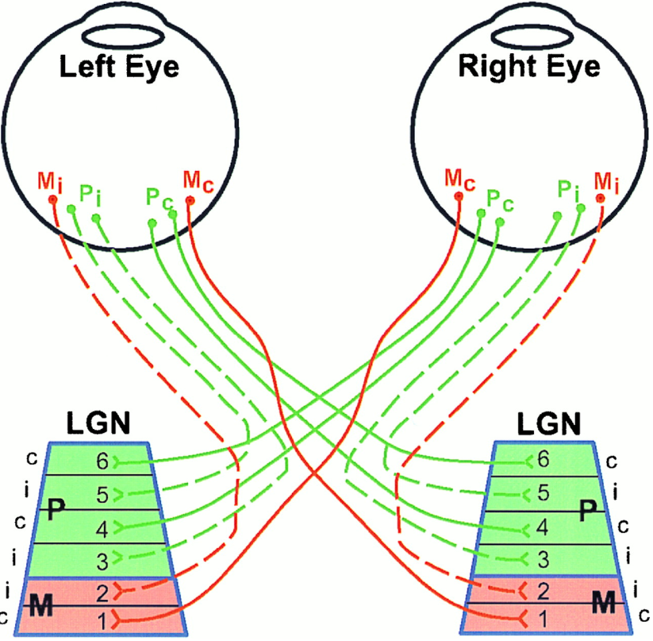
The Visual System: Inspiration for CNNs
The visual system contains a complex arrangement of cells
Each cell is responsible for only a sub-region of the visual field, or receptive field
The arrangement of these sub-regions is such, that the entire visual field is covered
Convolutional Neural Networks (CNNs) were proposed to emulate the animal visual cortex, which exploits the spatially local correlations present in natural images.
Before reaching the primary visual cortex, fibers on the optic nerve make a synapse in the lateral geniculate nucleus (LGN), cells from the fovea (in eye) project to layers composed parvocellular layers. These take care of the fine details that necessary to determine what an object is. Ganglion cells from the peripheral retina project to the Magnocellular (M) layers, which help determine where an object is.

Slide 15
CNNs Connectivity
To exploit the spatially local correlations, the neurons in a layer receive inputs only from a subset of units in the previous layer (spatially contiguous visual field).
The units (neurons) are unresponsive to changes outside of their receptive fields
Higher layers, become more global
Receptive Field = 3
These units have a receptive field of 3, therefore, they are only connected to 3 contiguous units in the previous layer

Slide 16
CNNs Convolutional Layer
The convolutional layer is comprised of several “filters” that search for different patterns in the entire input
A feature map can be generated with the information from the learned filters as follows:
$$h_{ij}^{k}=tahn{\left({(W}^{k}⋆x\right)}_{ij}+b_{k})$$
Where $h^{k}$ represents the $k^{th}$ feature map in a hidden layer.
Note that the weight and bias parameters are shared within the same filter
Gradient descent is commonly used for the training of CNNs, but the gradient of the shared weights is given by the sum of the shared parameters
Parameter sharing allows the search of the same pattern in the entire visual field
Each hidden layer is formed of several feature maps
Filter 2

Slide 17
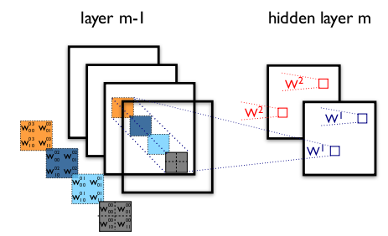
CNNs Convolutional Layer
The figure contains two different CNN layers. Layer $m−1$ contains four feature maps, while layer $m$ contains 2 ($h^{0}$ and $h^{1}$).
The blue and red squares in $m$ are computed from pixels of layer $m−1$ that fall within their 2x2 receptive field (squares in $m−1$).
$W_{ij}^{kl}$ then denotes the weight connecting each pixel of the $k^{th}$feature map at layer $m$ with the pixel at coordinates $(i,j)$ of the $l^{th}$ feature map at layer $m−1$.
It is important to know that the frame length of the filter for image recognition, called stride, is usually set to 1 or 2.
To control the spatial size of the output, zero-padding around the borders is commonly performed

Slide 18
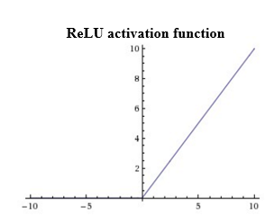
CNNs ReLU Layer
An activation layer is added after one or more convolutional layers.
Typically, for the image recognition tasks, a Rectified Linear Unit activation function (ReLU) is used.
This function is given by
$$f\left(x\right)=max(0,x)$$
Using this activation function increases the non-linear properties of the decision function without affecting the receptive fields of the convolutional layer.
$$x=0$$

Slide 19
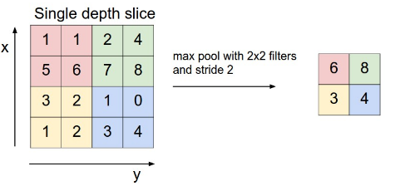
CNNs Pooling Layer
Another typical layer in a CNN is a pooling layer
Pooling layers reduce the resolution through a local maximum, which also reduces the amount of computations and parameters in the network
The pooling layer needs two hyperparameters:
$F:$ Spatial extent (size)
$S:$ Stride (frame length)
Common parameters used in literature are
$$F=2×2$$
$$S=2$$
The most common pooling operation is maxPooling, which partitions the input into a set of non-overlapping section and, for each sub-region outputs the max value.
Pooling helps to make the representation become approximately invariant to small translations in the input.

Slide 20
CNNs Fully Connected Layer
If classification is being performed, a fully-connected layer is added
This layer corresponds to a traditional Multilinear Perceptron (MLP)
As the name indicates it, the neurons in the fully connected layer have full connections to all activations in the previous layers
Adding this layer allows the classification of the input described by the feature maps extracted by the previous layers
This layer works in the same way as an MLP and activation functions used commonly include the sigmoid function and the tahn function

Slide 21
CNN: All Together
Summarizing the layers shown so far, a CNN is depicted:
ReLu Layer
Convolutional Layer
Pooling Layer
Fully Connected Layer

Slide 22
Summary
Deep learning has gained popularity in the latest years due to hardware advances (GPUs, etc.) and new training methodologies, which helped overcome the issue of the vanishing gradient
RBMs are shallow 2 layer networks (visible and hidden) that can find patterns in data by reconstructing the input in an unsupervised manner.
RBM training can be accomplished through algorithms such as Contrastive Divergence (CD)
Hinton (2006) proposed Deep Belief Networks (DBN), which are trained like stacked RBMs (unsupervised, layer-wise, greedy training) and can be tuned with respect to a supervised training criterion by introducing labeled data
DBNs can be trained in reasonable amounts of time with GPUs, and their training method overcomes the vanishing gradient issue
Notes:
http://www.iro.umontreal.ca/~bengioy/papers/ftml.pdf

