Slide 1
So, 1. what exactly is deep learning ?
And, 2. why is it generally better than other methods on image, speech and certain other types of data?

Slide 2
So, 1. what exactly is deep learning ?
And, 2. why is it generally better than other methods on image, speech and certain other types of data?
The short answers
1. ‘Deep Learning’ means using a neural network
with several layers of nodes between input and output
2. the series of layers between input & output do
feature identification and processing in a series of stages,
just as our brains seem to.

Slide 3
hmmm… OK, but:
3. multilayer neural networks have been around for
25 years. What’s actually new?

Slide 4
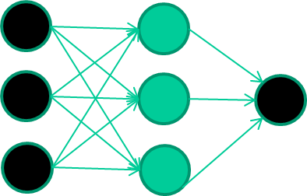
hmmm… OK, but:
3. multilayer neural networks have been around for
25 years. What’s actually new?
we have always had good algorithms for learning the
weights in networks with 1 hidden layer
but these algorithms are not good at learning the weights for
networks with more hidden layers
what’s new is: algorithms for training many-later networks

Slide 5
longer answers
reminder/quick-explanation of how neural network weights are learned;
the idea of unsupervised feature learning (why ‘intermediate features’ are important for difficult classification tasks, and how NNs seem to naturally learn them)
The ‘breakthrough’ – the simple trick for training Deep neural networks

Slide 6
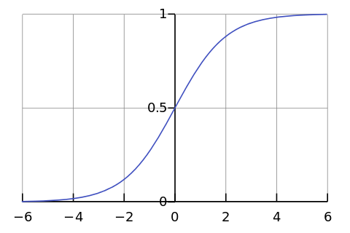
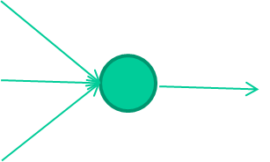
-0.06
W1
W2
f(x)
-2.5
W3
1.4

Slide 7
-0.06
2.7
-8.6
f(x)
-2.5
0.002
x = -0.06×2.7 + 2.5×8.6 + 1.4×0.002 = 21.34
1.4

Slide 8
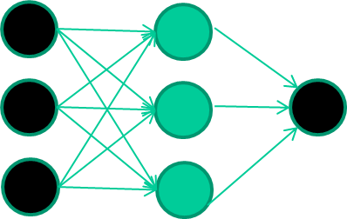
A dataset
Fields class
1.4 2.7 1.9 0
3.8 3.4 3.2 0
6.4 2.8 1.7 1
4.1 0.1 0.2 0
etc …

Slide 9
Training the neural network
Fields class
1.4 2.7 1.9 0
3.8 3.4 3.2 0
6.4 2.8 1.7 1
4.1 0.1 0.2 0
etc …

Slide 10
Training data
Fields class
1.4 2.7 1.9 0
3.8 3.4 3.2 0
6.4 2.8 1.7 1
4.1 0.1 0.2 0
etc …
Initialise with random weights

Slide 11
Training data
Fields class
1.4 2.7 1.9 0
3.8 3.4 3.2 0
6.4 2.8 1.7 1
4.1 0.1 0.2 0
etc …
Present a training pattern
1.4
2.7
1.9

Slide 12
Training data
Fields class
1.4 2.7 1.9 0
3.8 3.4 3.2 0
6.4 2.8 1.7 1
4.1 0.1 0.2 0
etc …
Feed it through to get output
1.4
2.7 0.8
1.9

Slide 13
Training data
Fields class
1.4 2.7 1.9 0
3.8 3.4 3.2 0
6.4 2.8 1.7 1
4.1 0.1 0.2 0
etc …
Compare with target output
1.4
2.7 0.8
0
1.9 error 0.8

Slide 14
Training data
Fields class
1.4 2.7 1.9 0
3.8 3.4 3.2 0
6.4 2.8 1.7 1
4.1 0.1 0.2 0
etc …
Adjust weights based on error
1.4
2.7 0.8
0
1.9 error 0.8

Slide 15
Training data
Fields class
1.4 2.7 1.9 0
3.8 3.4 3.2 0
6.4 2.8 1.7 1
4.1 0.1 0.2 0
etc …
Present a training pattern
6.4
2.8
1.7

Slide 16
Training data
Fields class
1.4 2.7 1.9 0
3.8 3.4 3.2 0
6.4 2.8 1.7 1
4.1 0.1 0.2 0
etc …
Feed it through to get output
6.4
2.8 0.9
1.7

Slide 17
Training data
Fields class
1.4 2.7 1.9 0
3.8 3.4 3.2 0
6.4 2.8 1.7 1
4.1 0.1 0.2 0
etc …
Compare with target output
6.4
2.8 0.9
1
1.7 error -0.1

Slide 18
Training data
Fields class
1.4 2.7 1.9 0
3.8 3.4 3.2 0
6.4 2.8 1.7 1
4.1 0.1 0.2 0
etc …
Adjust weights based on error
6.4
2.8 0.9
1
1.7 error -0.1

Slide 19
Training data
Fields class
1.4 2.7 1.9 0
3.8 3.4 3.2 0
6.4 2.8 1.7 1
4.1 0.1 0.2 0
etc …
And so on ….
6.4
2.8 0.9
1
1.7 error -0.1
Repeat this thousands, maybe millions of times – each time
taking a random training instance, and making slight
weight adjustments
Algorithms for weight adjustment are designed to make
changes that will reduce the error

Slide 20
The decision boundary perspective…
Initial random weights

Slide 21
The decision boundary perspective…
Present a training instance / adjust the weights

Slide 22
The decision boundary perspective…
Present a training instance / adjust the weights

Slide 23
The decision boundary perspective…
Present a training instance / adjust the weights

Slide 24
The decision boundary perspective…
Present a training instance / adjust the weights

Slide 25
The decision boundary perspective…
Eventually ….

Slide 26
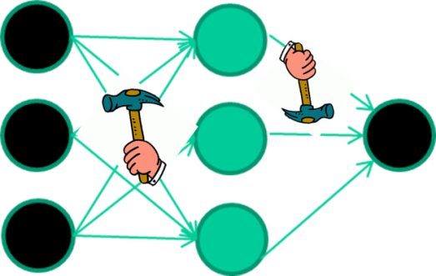
The point I am trying to make
weight-learning algorithms for NNs are dumb
they work by making thousands and thousands of tiny adjustments, each making the network do better at the most recent pattern, but perhaps a little worse on many others
but, by dumb luck, eventually this tends to be good enough to
learn effective classifiers for many real applications

Slide 27
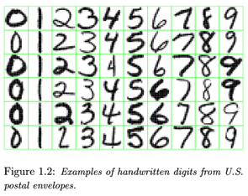
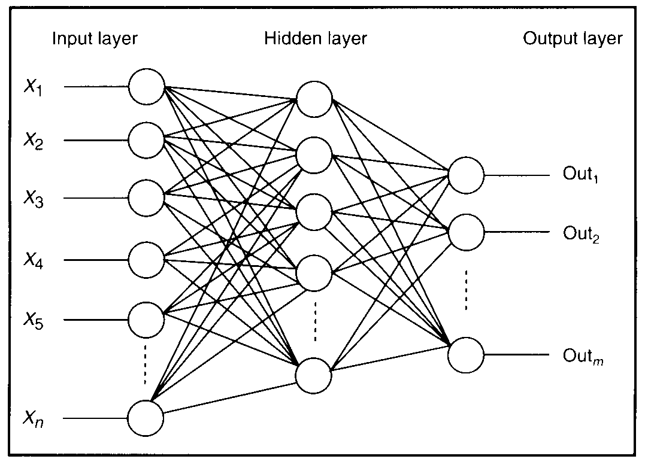
Feature detectors

Slide 28
what is this unit doing?

Slide 29
Hidden layer units become self-organised feature detectors
1 5 10 15 20 25 …
…
1
strong +ve weight
low/zero weight
63

Slide 30
What does this unit detect?
1 5 10 15 20 25 …
…
1
strong +ve weight
low/zero weight
63

Slide 31
What does this unit detect?
1 5 10 15 20 25 …
…
1
strong +ve weight
low/zero weight
it will send strong signal for a horizontal
line in the top row, ignoring everywhere else
63

Slide 32
What does this unit detect?
1 5 10 15 20 25 …
…
1
strong +ve weight
low/zero weight
63

Slide 33
What does this unit detect?
1 5 10 15 20 25 …
…
1
strong +ve weight
low/zero weight
Strong signal for a dark area in the top left
corner
63

Slide 34
What features might you expect a good NN
to learn, when trained with data like this?

Slide 35
vertical lines
1
63

Slide 36
Horizontal lines
1
63

Slide 37
Small circles
1
63

Slide 38
Small circles
1
But what about position invariance ???
our example unit detectors were tied to
specific parts of the image
63

Slide 39
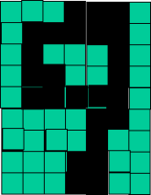
successive layers can learn higher-level features …
detect lines in
Specific positions
etc …
Higher level detetors
( horizontal line,
“RHS vertical lune”
“upper loop”, etc…
etc …
v

Slide 40
successive layers can learn higher-level features …
detect lines in
Specific positions
etc …
Higher level detetors
( horizontal line,
“RHS vertical lune”
“upper loop”, etc…
etc …
v
What does this unit detect?

Slide 41
So: multiple layers make sense

Slide 42
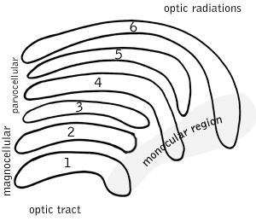
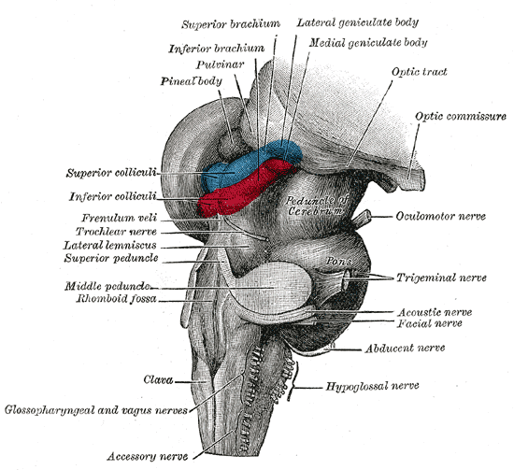
So: multiple layers make sense
Your brain works that way

Slide 43
So: multiple layers make sense
Many-layer neural network architectures should be capable of learning the true underlying features and ‘feature logic’, and therefore generalise very well …

Slide 44
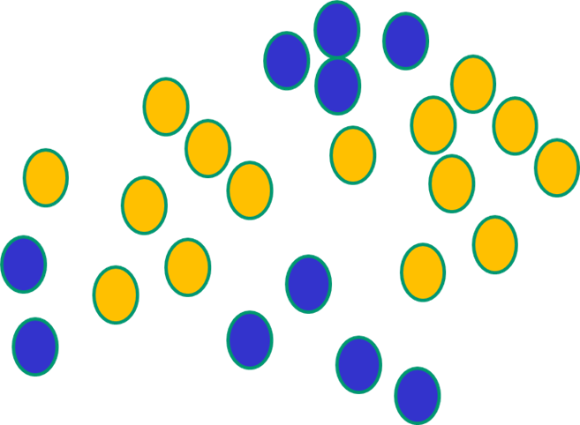
But, until very recently, our weight-learning algorithms simply did not work on multi-layer architectures

Slide 45
Along came deep learning …

Slide 46
The new way to train multi-layer NNs…

Slide 47
The new way to train multi-layer NNs…
Train this layer first

Slide 48
The new way to train multi-layer NNs…
Train this layer first
then this layer

Slide 49
The new way to train multi-layer NNs…
Train this layer first
then this layer
then this layer

Slide 50
The new way to train multi-layer NNs…
Train this layer first
then this layer
then this layer
then this layer

Slide 51
The new way to train multi-layer NNs…
Train this layer first
then this layer
then this layer
then this layer
finally this layer

Slide 52
The new way to train multi-layer NNs…
EACH of the (non-output) layers is trained to be an auto-encoder
Basically, it is forced to learn good features that describe what comes from the previous layer

Slide 53
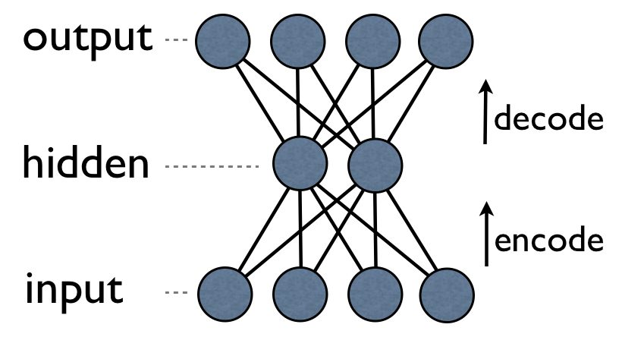
an auto-encoder is trained, with an absolutely standard weight-adjustment algorithm to reproduce the input

Slide 54
an auto-encoder is trained, with an absolutely standard weight-adjustment algorithm to reproduce the input
By making this happen with (many) fewer units than the inputs, this forces the ‘hidden layer’ units to become good feature detectors

Slide 55
intermediate layers are each trained to be auto encoders (or similar)

Slide 56
Final layer trained to predict class based on outputs from previous layers

Slide 57
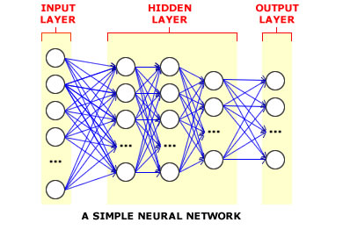
And that’s that
That’s the basic idea
There are many many types of deep learning,
different kinds of autoencoder, variations on architectures and training algorithms, etc…
Very fast growing area …

