Slide 1
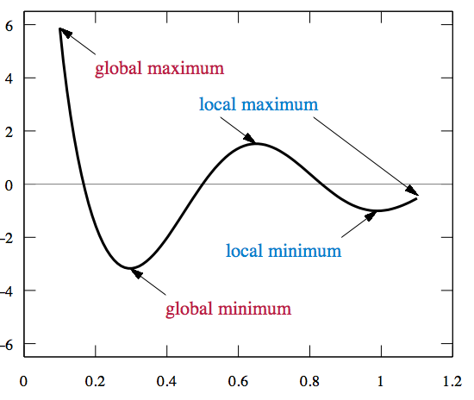
LECTURE 21: LINEAR DISCRIMINANT FUNCTIONS
Objectives: Linear Discriminant Functions Gradient Descent Nonseparable Data
Resources: SM: Gradient Descent JD: Optimization Wiki: Stochastic Gradient Descent MJ: Linear Programming

Slide 2
Discriminant Functions
Recall our discriminant function for minimum error rate classification:
For a multivariate normal distribution:
Consider the case: Σ_{i} = σ²I
(statistical independence, equal variance, class-independent variance)

Slide 3
Gaussian Classifiers
The discriminant function can be reduced to:
Since these terms are constant w.r.t. the maximization:
We can expand this:
The term x^{t}x is a constant w.r.t. i, and μ_{i}^{t}μ_{i} is a constant that can be precomputed.

Slide 4
Linear Machines
We can use an equivalent linear discriminant function:
w_{i0} is called the threshold or bias for the i^{th} category.
A classifier that uses linear discriminant functions is called a linear machine.
The decision surfaces defined by the equation:

Slide 5
Linear Discriminant Functions
A discriminant function that is a linear combination of the components of x can be written as:
In the general case, c discriminant functions for c classes.
For the two class case:

Slide 6
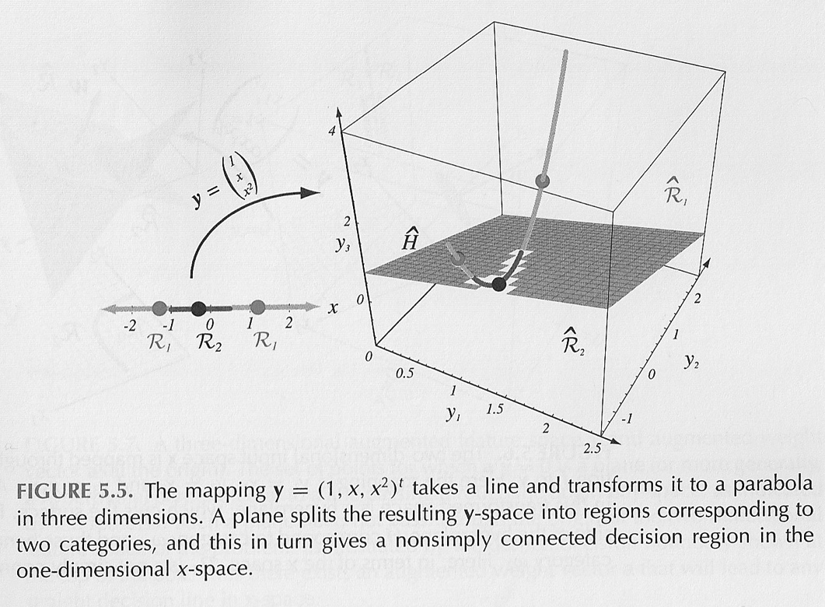
Generalized Linear Discriminant Functions
Rewrite g(x) as:
Add quadratic terms:
Generalize to a functional form:
For example:

Slide 7
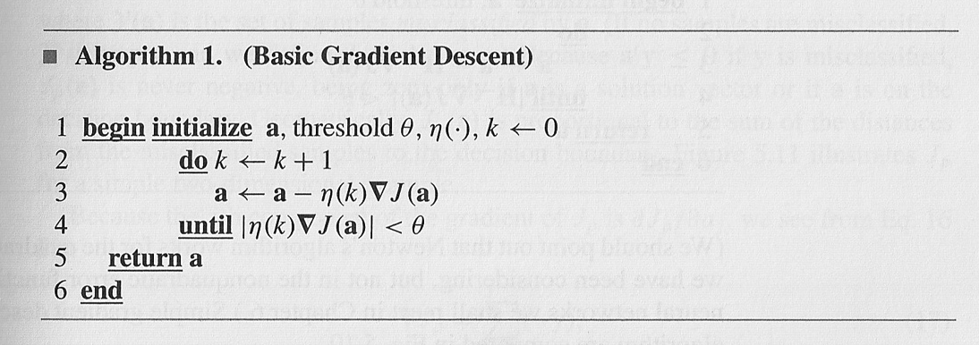
A Gradient Descent Solution
Define a cost function, J(a), and minimize:
Gradient descent:
Approximate J(a) with a Taylor’s series:
The optimal learning rate is:

Slide 8
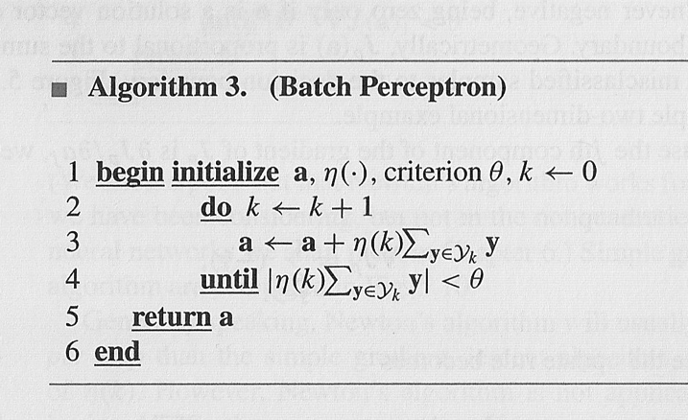
Additional Gradient Descent Approaches
Newton Descent:
Perceptron Criterion:
Relaxation Procedure:

Slide 9
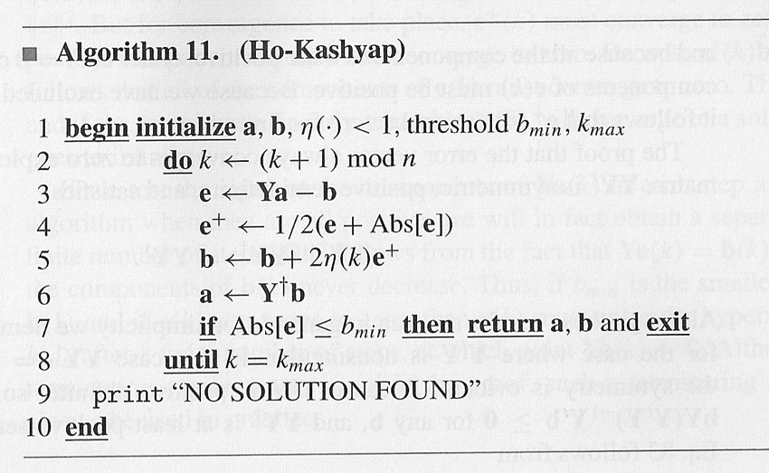
The Ho-Kashyap Procedure
Previous algorithms do not converge if the data is nonseparable.
If linearly separable, we can define a cost function:
If a and b are allowed to vary (with b > 0), the minimum value of J_{s} is zero for separable data.
Computing gradients with respect to a and b:
Solving for a and b yields the Ho-Kashyap update rule:

Slide 10
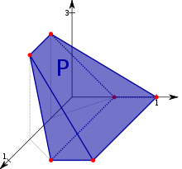
Linear Programming
A classical linear programming problem can be stated as:
Find a vector u = (u₁, u₂, …, u_{m}) that minimizes the linear objective function:
u is arbitrarily constrained such that u_{i} > 0.
The solution to such an optimization problem is not unique. A range of solutions lie in a convex polytope (an n-dimensional polyhedron).
Solutions can be found in polynomial time: O(n^{k}).
Useful for problems involving scheduling, asset allocation, or routing.
Example:
An airline has to assign crews to its flights
Make sure each flight is covered.
Meet regulations such as the number of hours flown each day.
Minimize costs such as fuel, lodging, etc.
Notes:
XOR: x_1, x_2, and we want to transform to x_1^2, x_2^2, x_1 x_2
It can also be viewed as feature extraction from the feature vector x, but now we extract more feature than the number of features in x.

Slide 11
Summary
Machine learning in its most elementary form is a constrained optimization problem in which we find a weighting vector.
The solution is only as good as the cost function.
There are many gradient descent type algorithms that operate using first or second derivatives of a cost function.
Convergence of these algorithms can be slow and hence selecting a suitable convergence factor is critical.
Nonseparable data poses additional challenges and makes the use of margin-based classifiers critical.

