Slide 1
Deep Belief Network Training
Same greedy layer-wise approach
First train lowest RBM (h⁰ – h¹) using RBM update algorithm (note h⁰ is x)
Freeze weights and train subsequent RBM layers
Then connect final outputs to a supervised model and train that model
Finally, unfreeze all weights, and train full DBN with supervised model to fine-tune weights
During execution typically iterate multiple times at the top RBM layer
Notes:
Picture above is for generative model (so ignore solid vs dotted lines at this point

Slide 2
Can use DBN as a Generative model to create sample x vectors
Initialize top layer to an arbitrary vector
Gibbs sample (relaxation) between the top two layers m times
If we initialize top layer with values obtained from a training example, then need less Gibbs samples
Pass the vector down through the network, sampling with the calculated probabilities at each layer
Last sample at bottom is the generated x value (can be real valued if we use the probability vector rather than sample)
Alternatively, can start with an x at the bottom, relax to a top value, then start from that vector when generating a new x, which is the dotted lines version. More like standard Boltzmann machine processing.
Notes:
Alternatively, Can start with an x at bottom, relax to a top value, then start from that vector when generating a new x, which is the dotted lines added version

Slide 3
Notes:
Initial x can be real valued
Note that nodes have two sets of biases. Only one is used at a time depending on if node is visible or hidden for that layer
While loop does RBM weight training until convergence for the kth layer
second for loop samples from x up to k-1 so that we can then do RBM update at the kth layer
Mean_field_computation just a flag on whether we sample or use the real values – Lots of wiggle room here, could do it different for different layers or even randomly, etc.

Slide 4
DBN Learning Notes
Each layer updates weights so as to make training sample patterns more likely (lower energy) in the free state (and non-training sample patterns less likely).
This unsupervised approach learns broad features (in the hidden/subsequent layers of RBMs) which can aid in the process of making the types of patterns found in the training set more likely. This discovers features which can be associated across training patterns, and thus potentially helpful for other goals with the training set (classification, compression, etc.)
Note still pairwise weights in RBMs, but because we can pick the number of hidden units and layers, we can represent any arbitrary distribution

Slide 5
DBN Notes
Can use lateral connections in RBM (no longer RBM) but sampling becomes more difficult – ala standard Boltzmann requiring longer sampling chains.
Lateral connections can capture pairwise dependencies allowing the hidden nodes to focus on higher order issues. Can get better results.
Deep Boltzmann machine – Allow continual relaxation across the full network
Receive input from above and below rather than sequence through RBM layers
Typically for successful training, first initialize weights using the standard greedy DBN training with RBM layers
Requires longer sampling chains ala Boltzmann
Conditional and Temporal RBMs – allow node probabilities to be conditioned by some other inputs – context, recurrence (time series changes in input and internal state), etc.

Slide 6
Discrimination with Deep Networks
Discrimination approaches with DBNs (Deep Belief Net)
Use outputs of DBNs as inputs to supervised model (i.e. just an unsupervised preprocessor for feature extraction)
Basic approach we have been discussing
Train a DBN for each class. For each clamp the unknown x and iterate m times. The DBN that ends with the lowest normalized free energy (softmax variation) is the winner.
Train just one DBN for all classes, but with an additional visible unit for each class. For each output class:
Clamp the unknown x, initiate the visible node for that class high, relax, and then see which final state has lowest free energy – no need to normalize since all energies come from the same network.
Or could just clamp x, relax, and see which class node ends up with the highest probability
See http://deeplearning.net/demos/
Notes:
The Demo shows generated instance first with just one iteration from the top RBN. In practice would not do bottom generation until after m iterations. (i.e. after top has settled into a lower energy state)
Should improve in the discrimination variation also after m steps, though seems to get good results sooner
Using Hinton's generating digits demo

Slide 7
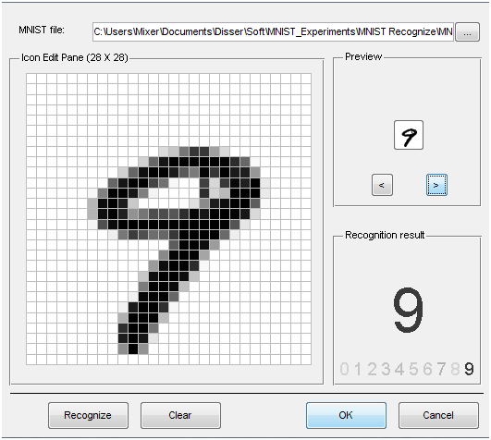
MNIST
Notes:
Go to project page
Mnist 28x28 (784) grey scale (0-255) values.
Could do some smarter preprocessing of features!
Just use straight data as our baseline.

Slide 8
DBN Project Notes
To be consistent just use 28×28 (764) data set of gray scale values (0-255)
Normalize to 0-1
Could try better preprocessing if want, but start with this
Small random initial weights
Last year only slight improvements over baseline MLP (which gets high 90's)
Best results when using real net values vs. sampling
Fine tuning helps
Parameters
Hinton Paper, others – do a little searching and e-mail me a reference for extra credit points
Still figuring out

Slide 9
Conclusion
Much recent excitement, still much to be discovered
Biological Plausibility
Potential for significant improvements
Good in structured/Markovian spaces
Important research question: To what extent can we use Deep Learning in more arbitrary feature spaces?
Recent deep training of MLPs with BP shows potential in this area

