Slide 1
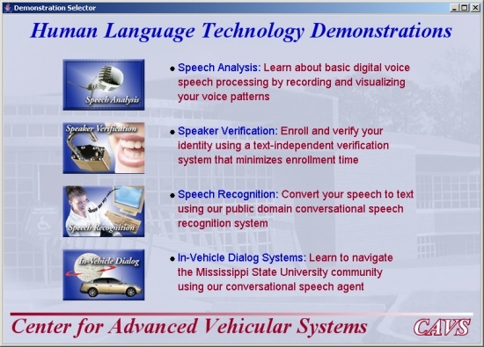
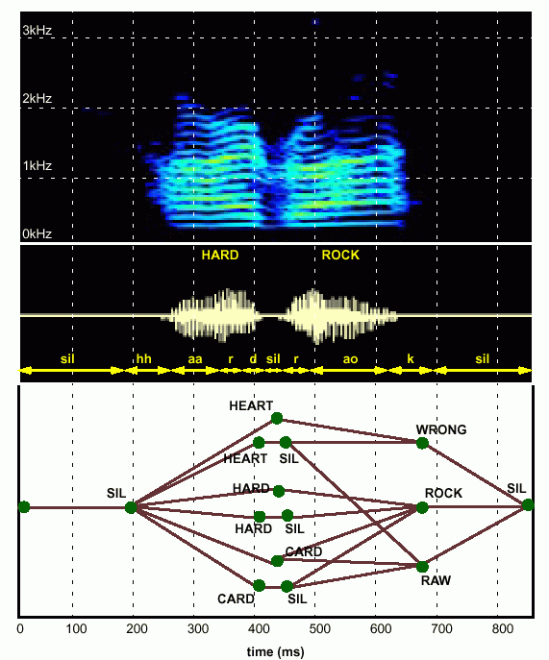
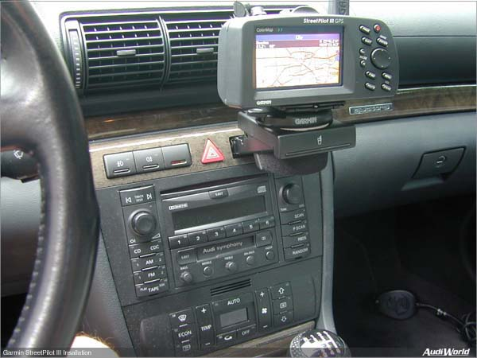

LECTURE 29: EXAMPLES OF PATTERN RECOGNITION IN SPEECH RECOGNITION
Objectives:
Acoustic Modeling
Language Modeling
Feature Extraction
Search
Pronunciation Modeling
Resources:
J.P.: Speech Recognition - Part I
T.H.: Speech Recognition - Part II
ISIP: ASR Tutorial
ISIP: ASR Resources
IEEE: SP Magazine
URL:
Audio:
Notes:
MS Equation 3.0 was used with settings of: 18, 12, 8, 18, 12.

Slide 2
Introduction
Speech technology has quietly become a pervasive influence in our daily lives despite widespread concerns about research progress over the past 20 years.
The ability of a hidden Markov models to explain (and predict) variations in the acoustic signal have been the cornerstone of this progress.
Other statistical modeling techniques (e.g., SVMs, finite state machines, entropy-based language modeling) have had significant impact.
Generative models have given way to discriminative models that attempt to directly optimize objective measures such as word error rate.
Why research human language technology?
“Language is the preeminent trait of the human species.”
“I never met someone who wasn’t interested in language.”
“I decided to work on language because it seemed to be the hardest problem to solve.”
Fundamental challenge: diversity of data that often defies mathematical descriptions or physical constraints.
Solution: Integration of multiple knowledge sources.
In this lecture we will focus on use of pattern recognition in high performance speech recognition systems.

Slide 3
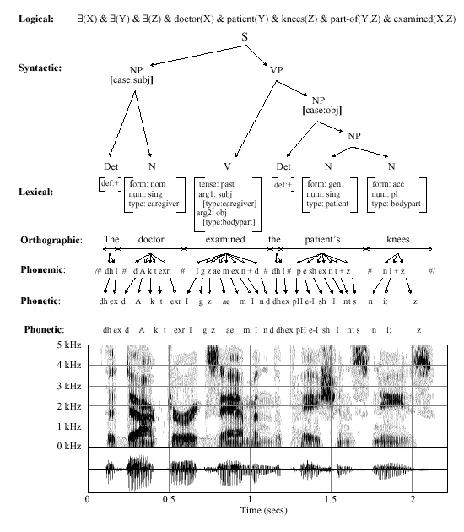
Speech Recognition Is Information Extraction
Traditional Output:
  best word sequence
  time alignment of information
Other Outputs:
  word graphs
  N-best sentences
  confidence measures
  metadata such as speaker identity, accent, and prosody
Applications:
  Information localization
  data mining
  emotional state
  stress, fatigue, deception

Slide 4
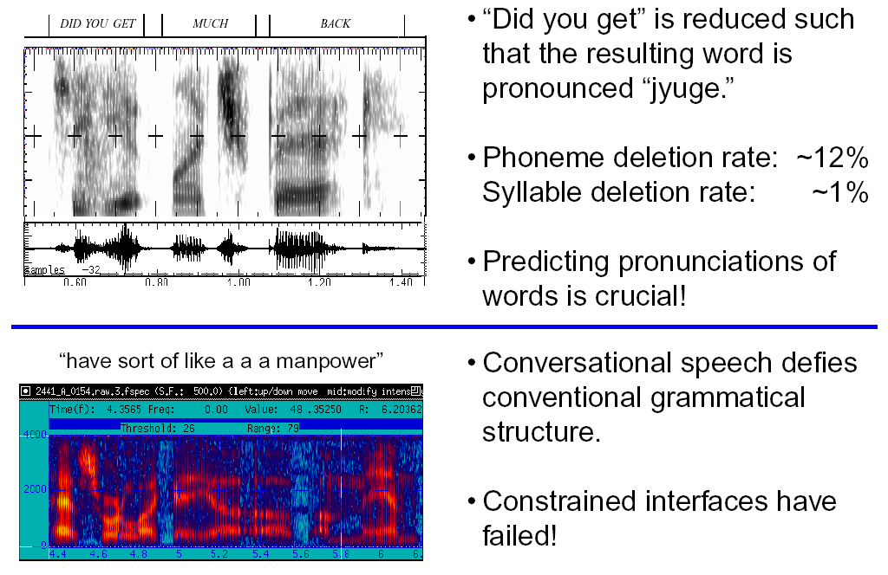
What Makes Acoustic Modeling So Challenging?

Slide 5
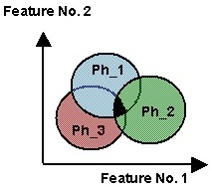
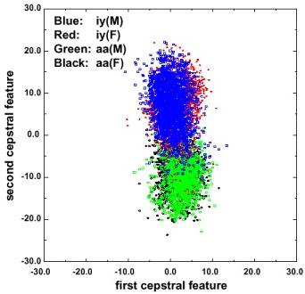
What Makes Acoustic Modeling So Challenging?
Regions of overlap represent classification error
Reduce overlap by introducing acoustic and linguistic context
Comparison of “aa” in “lOck” and “iy” in “bEAt” for conversational speech

Slide 6
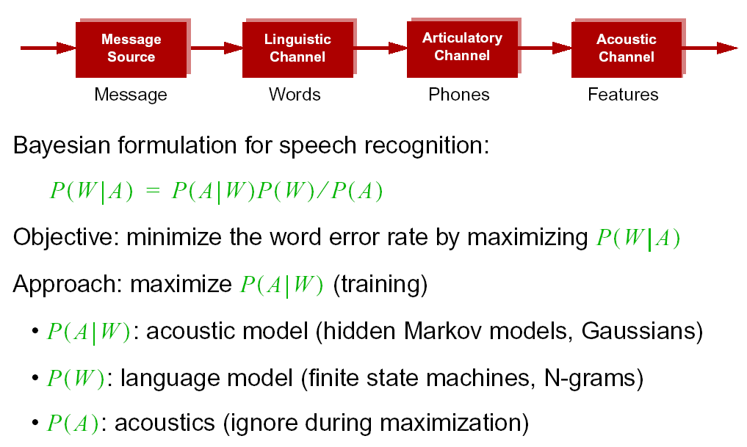
Statistical Approach: Noisy Communication Channel Model

Slide 7
Information Theoretic Basis
Given an observation sequence, O, and a word sequence, W, we want minimal uncertainty about the correct answer
(i.e., minimize the conditional entropy):
To accomplish this, the probability of the word sequence given the observation must increase.
The mutual information, I(W;O), between W and O:
Two choices: minimize H(W) or maximize I(W;O)

Slide 8
Relationship to Maximum Likelihood Methods
Maximizing the mutual information is equivalent to choosing the parameter set λ to maximize:
Maximization implies increasing the numerator term (maximum likelihood estimation – MLE) or decreasing the denominator term (maximum mutual information estimation – MMIE)
The latter is accomplished by reducing the probabilities of incorrect, or competing, hypotheses.

Slide 9
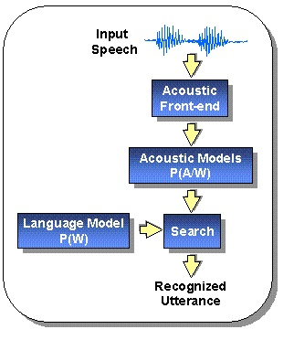
Speech Recognition Architectures
Core components:
transduction
feature extraction
acoustic modeling (hidden Markov models)
language modeling (statistical N-grams)
search (Viterbi beam)
knowledge sources
Our focus will be on the acoustic modeling components of the system.

Slide 10
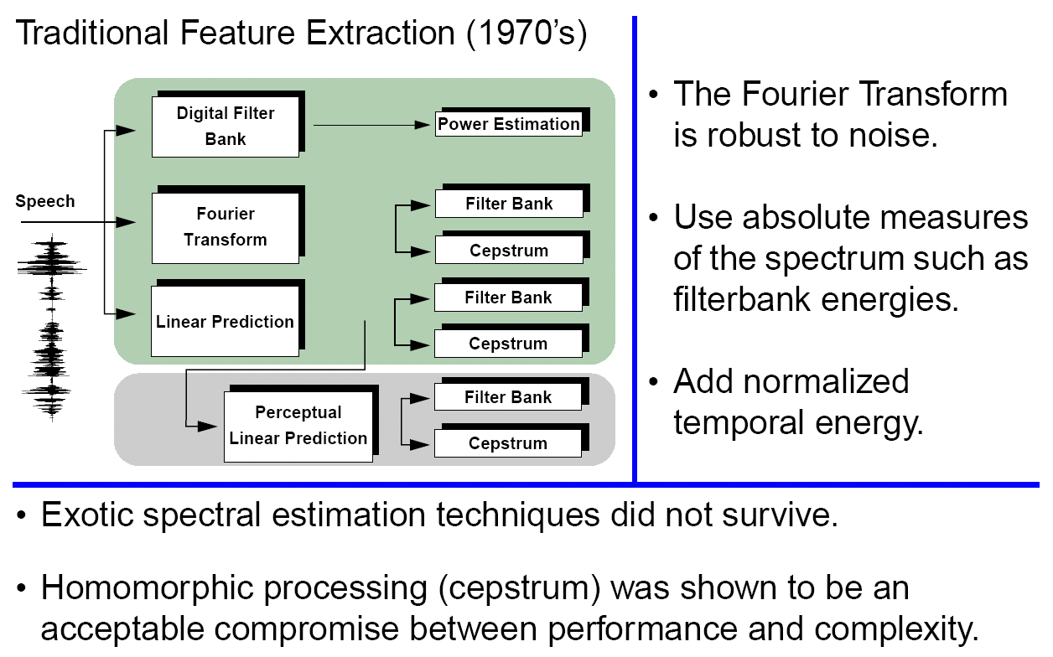
Signal Processing in Speech Recognition

Slide 11
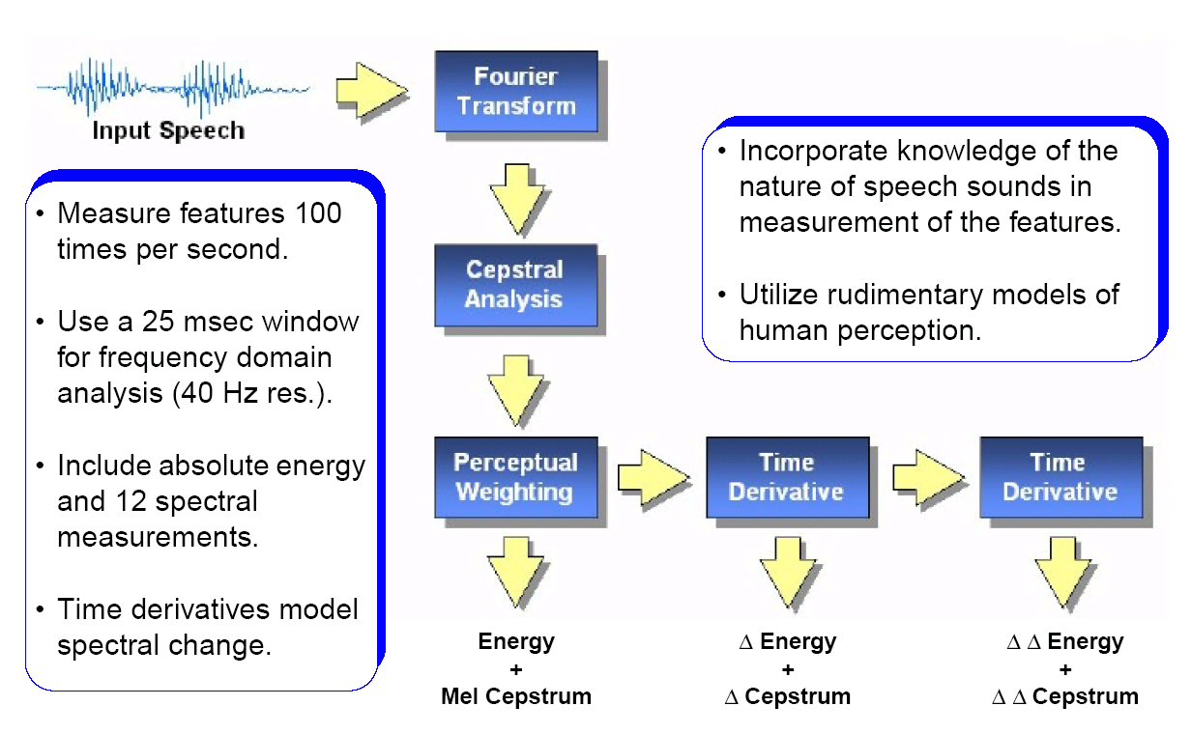
Feature Extraction in Speech Recognition

Slide 12
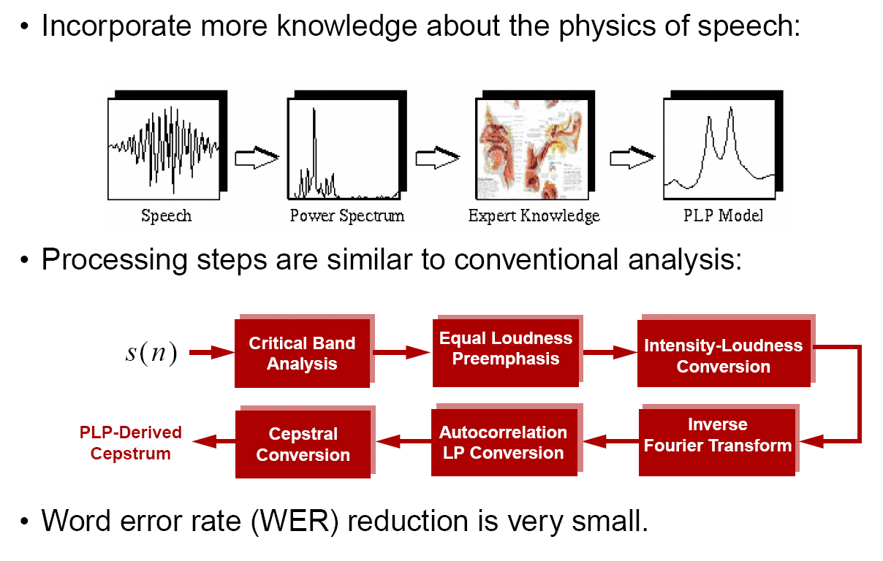
Adding More Knowledge to the Front End

Slide 13
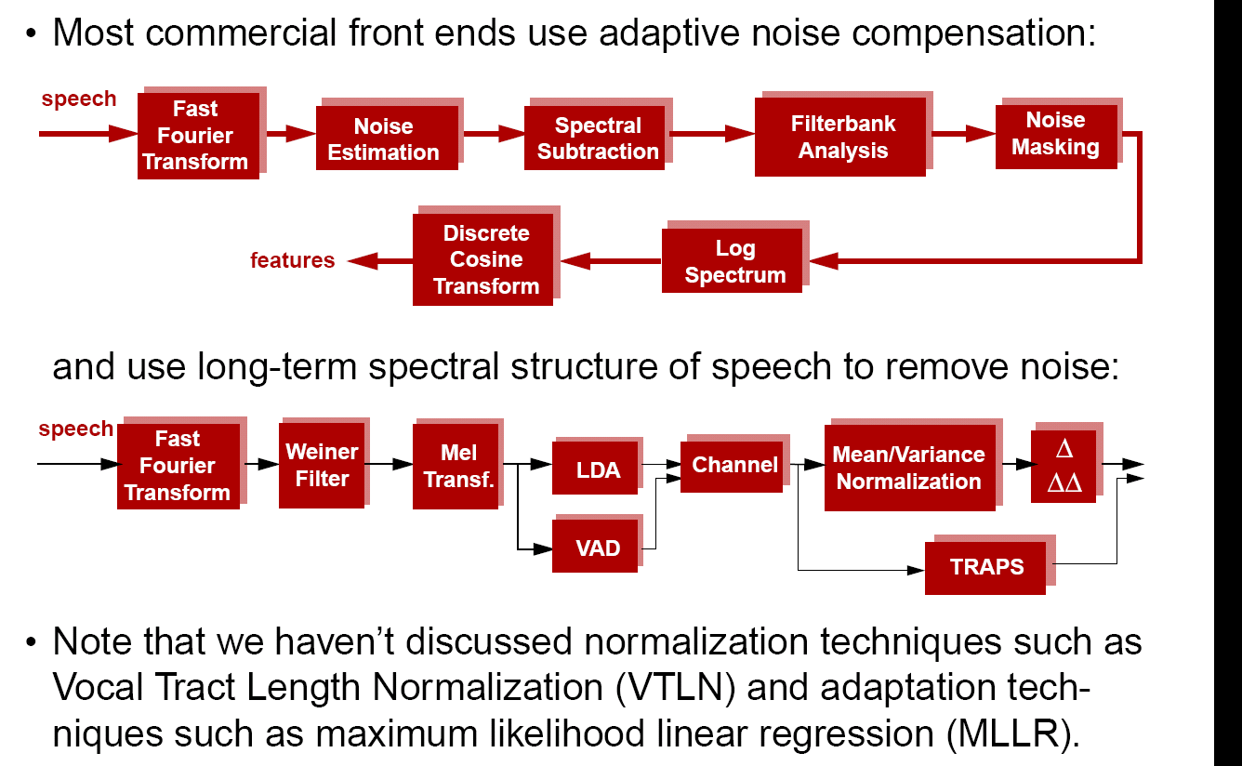
Noise Compensation Techniques

Slide 14
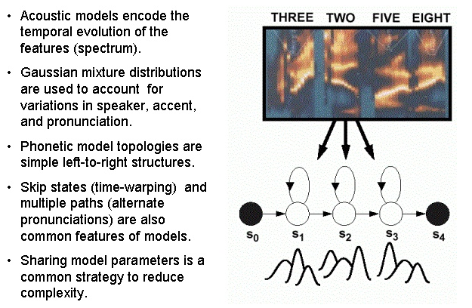
Acoustic Modeling: Hidden Markov Models

Slide 15
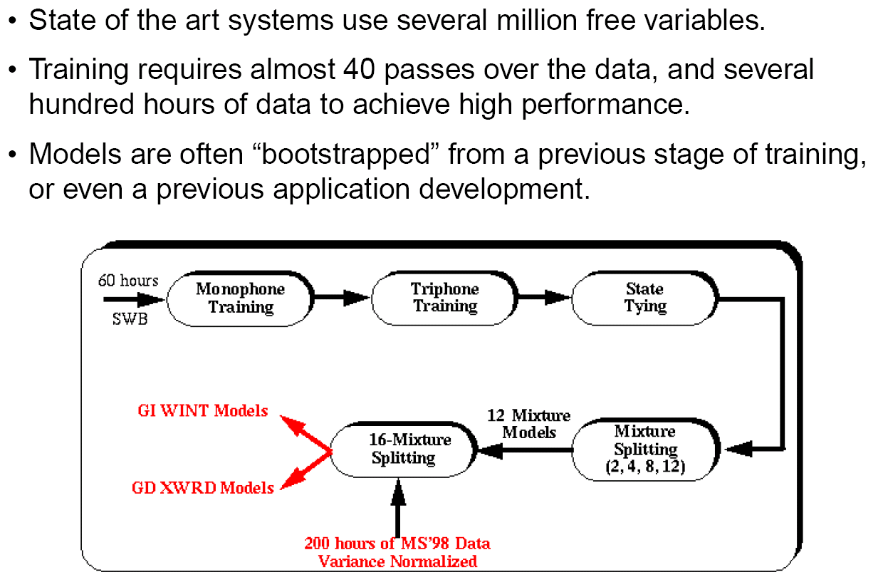
Training Recipes Are Complex And Iterative

Slide 16
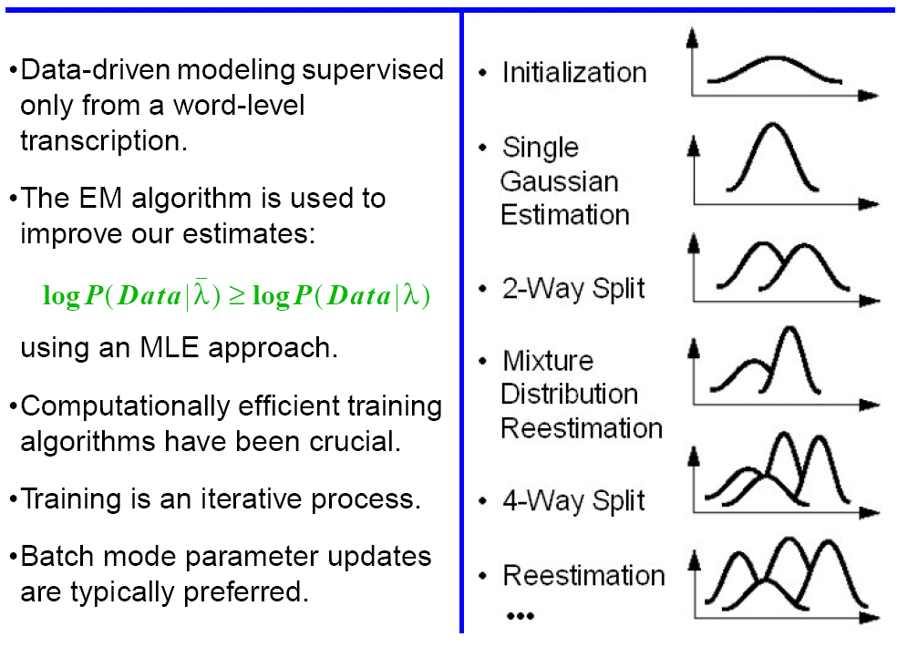
Bootstrapping Is Key In Parameter Reestimation

Slide 17
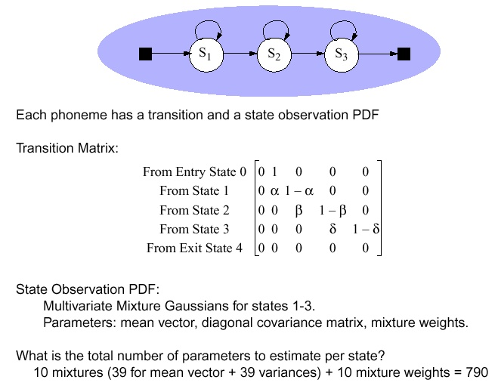
Controlling Model Complexity

Slide 18
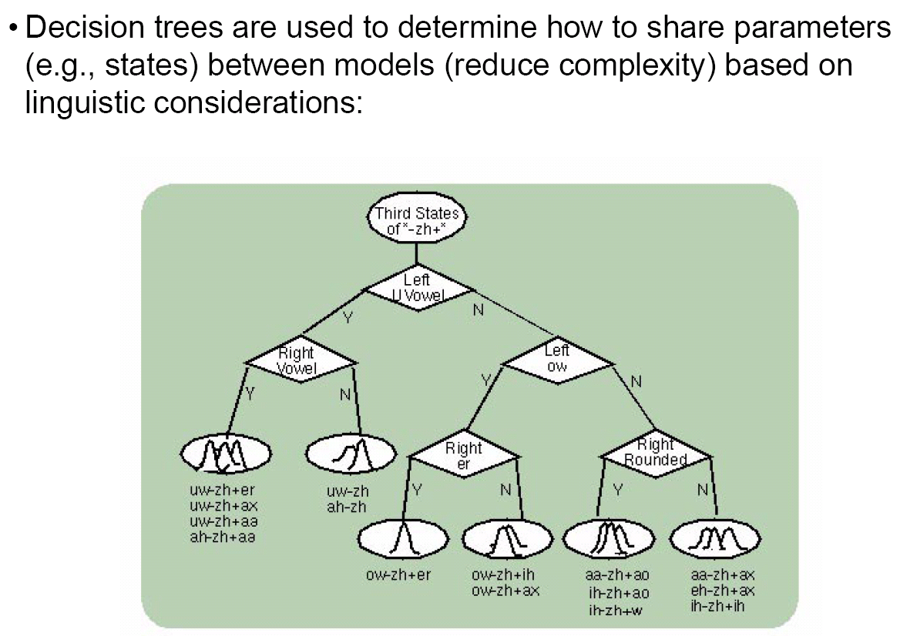
Data-Driven Parameter Sharing Is Crucial

Slide 19
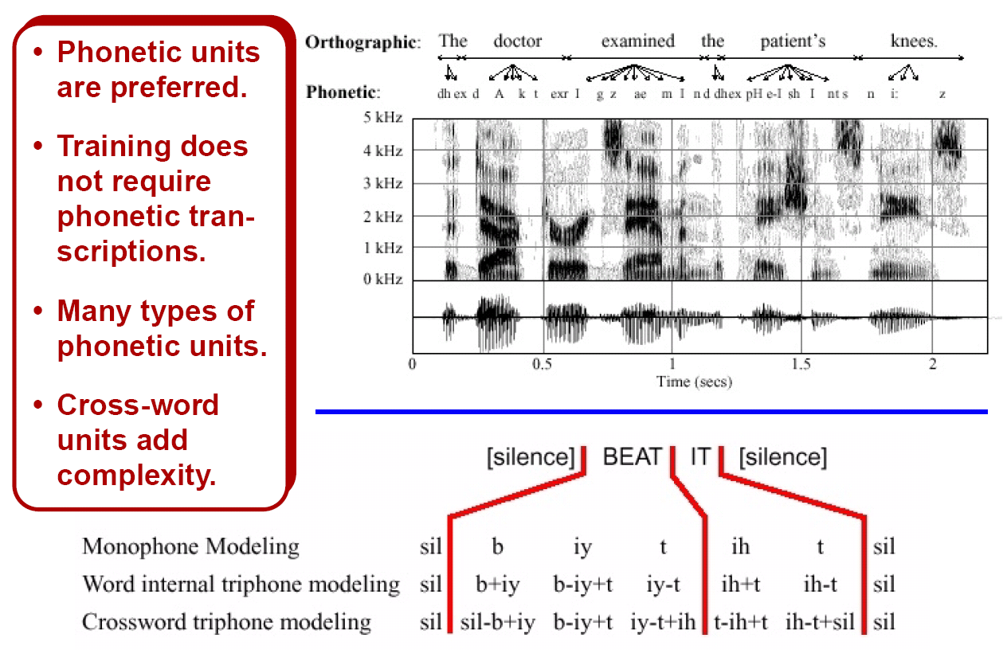
Context-Dependent Acoustic Units

Slide 20
Summary
What we haven’t talked about: duration models, adaptation, normalization, confidence measures, posterior-based scoring, hybrid systems, discriminative training, and much, much more…
Applications of these models to language (Hazen), dialog (Phillips, Seneff), machine translation (Vogel, Papineni), and other HLT applications
Machine learning approaches to human language technology are still in their infancy (Bilmes)
A mathematical framework for integration of knowledge and metadata will be critical in the next 10 years.
Information extraction in a multilingual environment -- a time of great opportunity!

Slide 21
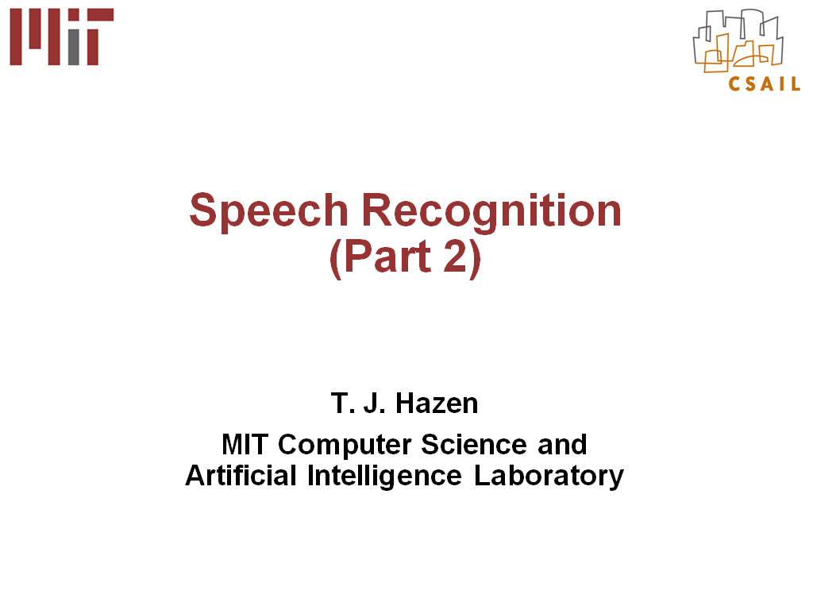
Language Modeling in Speech Recognition

Slide 22
Demonstrations
Audio Demonstrations: Why is speech recognition so difficult?
Phonetic Units: Context is very important in speech recognition
State of the Art: Example of high performance speech recognition systems

Slide 23
Appendix: Relevant Publications
Useful textbooks:
X. Huang, A. Acero, and H.W. Hon, Spoken Language Processing - A Guide to Theory, Algorithm, and System Development, Prentice Hall, ISBN: 0-13-022616-5, 2001.
D. Jurafsky and J.H. Martin, SPEECH and LANGUAGE PROCESSING: An Introduction to Natural Language Processing, Computational Linguistics, and Speech Recognition, Prentice-Hall, ISBN: 0-13-095069-6, 2000.
F. Jelinek, Statistical Methods for Speech Recognition, MIT Press, ISBN: 0-262-10066-5, 1998.
L.R. Rabiner and B.W. Juang, Fundamentals of Speech Recognition, Prentice-Hall, ISBN: 0-13-015157-2, 1993.
J. Deller, et. al., Discrete-Time Processing of Speech Signals, MacMillan Publishing Co., ISBN: 0-7803-5386-2, 2000.
R.O. Duda, P.E. Hart, and D.G. Stork, Pattern Classification, Second Edition, Wiley Interscience, ISBN: 0-471-05669-3, 2000 (supporting material available at http://rii.ricoh.com/~stork/DHS.html).
D. MacKay, Information Theory, Inference, and Learning Algorithms, Cambridge University Press, 2003.
Relevant online resources:
“Intelligent Electronic Systems,” http://www.cavs.msstate.edu/hse/ies, Center for Advanced Vehicular Systems, Mississippi State University, Mississippi State, Mississippi, USA, June 2005.
Internet-Accessible Speech Recognition Technology,” http://www.cavs.msstate.edu/hse/ies/projects/speech, June 2005.
“Speech and Signal Processing Demonstrations,” http://www.cavs.msstate.edu/hse/ies/projects/speech/software/demonstrations, June 2005.
“Fundamentals of Speech Recognition,” http://www.isip.msstate.edu/publications/courses/ece_8463, September 2004.

