Slide 1
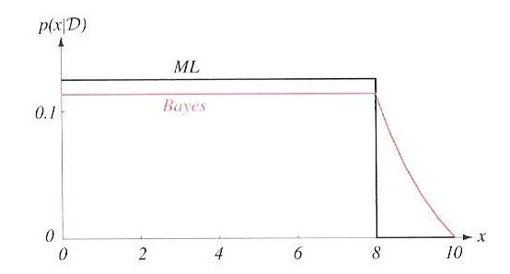
LECTURE 07: MAXIMUM LIKELIHOOD AND BAYESIAN ESTIMATION
• Objectives: Class-Conditional Density The Multivariate Case General Theory Sufficient Statistics Kernel Density
Resources: D.H.S.: Chapter 3 (Part 2) Rice: Sufficient Statistics B.M.: Sufficient Statistics
URL:
Audio:

Slide 2
Introduction to Bayesian Parameter Estimation (Review)
In Chapter 2, we learned how to design an optimal classifier if we knew the prior probabilities, P(ω_{i}), and class-conditional densities, p(x|ω_{i}).
Bayes: treat the parameters as random variables having some known prior distribution. Observations of samples converts this to a posterior.
Bayesian learning: sharpen the a posteriori density causing it to peak near the true value.
Supervised vs. unsupervised: do we know the class assignments of the training data.
Bayesian estimation and ML estimation produce very similar results in many cases.
Reduces statistical inference (prior knowledge or beliefs about the world) to probabilities.

Slide 3
Class-Conditional Densities (Review)
Posterior probabilities, P(ω_{i}|x), are central to Bayesian classification.
Bayes formula allows us to compute P(ω_{i}|x) from the priors, P(ω_{i}), and the likelihood, p(x|ω_{i}).
But what If the priors and class-conditional densities are unknown?
The answer is that we can compute the posterior, P(ω_{i}|x), using all of the information at our disposal (e.g., training data).
For a training set, D, Bayes formula becomes:
We assume priors are known: P(ω_{i}|D) = P(ω_{i}).
Also, assume functional independence: D_{i} have no influence on
This gives:

Slide 4
Univariate Gaussian Case (Review)
p(μ|D) is an exponential of a quadratic function, which makes it a normal distribution. Because this is true for any n, it is referred to as a reproducing density.
p(μ) is referred to as a conjugate prior.
Write p(μ|D) ~ N(μ_{n},σ_{n}²):
and equate coefficients:
Two equations and two unknowns. Solve for μ_{n} and σ_{n}²:

Slide 5
Bayesian Learning (Review)
μ_{n} represents our best guess after n samples.
σ_{n}² represents our uncertainty about this guess.
σ_{n}² approaches σ²/n for large n – each additional observation decreases our uncertainty.
The posterior, p(μ|D), becomes more sharply peaked as n grows large. This is known as Bayesian learning.

Slide 6
Class-Conditional Density
How do we obtain p(x|D) (derivation is tedious):
where:
Note that:
The conditional mean, μ_{n}, is treated as the true mean.
p(x|D) and P(ω_{j}) can be used to design the classifier.

Slide 7
Multivariate Case
Assume:
where are assumed to be known.
Applying Bayes formula:
which has the form:
Once again:
and we have a reproducing density.

Slide 8
Estimation Equations
Equating coefficients between the two Gaussians:
The solution to these equations is:
It also follows that:

Slide 9
General Theory
p(x | D) computation can be applied to any situation in which the unknown density can be parameterized.
The basic assumptions are:
The form of p(x | θ) is assumed known, but the value of θ is not known exactly.
Our knowledge about θ is assumed to be contained in a known prior density p(θ).
The rest of our knowledge θ is contained in a set D of n random variables x₁, x₂, …, x_{n} drawn independently according to the unknown probability density function p(x).

Slide 10
Formal Solution
The posterior is given by:
Using Bayes formula, we can write p(D| θ ) as:
and by the independence assumption:
This constitutes the formal solution to the problem because we have an expression for the probability of the data given the parameters.
This also illuminates the relation to the maximum likelihood estimate:
Suppose p(D| θ ) reaches a sharp peak at .

Slide 11
Comparison to Maximum Likelihood
This also illuminates the relation to the maximum likelihood estimate:
Suppose p(D| θ ) reaches a sharp peak at .
p(θ| D) will also peak at the same place if p(θ) is well-behaved.
p(x|D) will be approximately , which is the ML result.
If the peak of p(D| θ ) is very sharp, then the influence of prior information on the uncertainty of the true value of θ can be ignored.
However, the Bayes solution tells us how to use all of the available information to compute the desired density p(x|D).

Slide 12
Recursive Bayes Incremental Learning
To indicate explicitly the dependence on the number of samples, let:
We can then write our expression for p(D| θ ):
where .
We can write the posterior density using a recursive relation:
where .
This is called the Recursive Bayes Incremental Learning because we have a method for incrementally updating our estimates.

Slide 13
When do ML and Bayesian Estimation Differ?
For infinite amounts of data, the solutions converge. However, limited data is always a problem.
If prior information is reliable, a Bayesian estimate can be superior.
Bayesian estimates for uniform priors are similar to an ML solution.
If p(θ| D) is broad or asymmetric around the true value, the approaches are likely to produce different solutions.
When designing a classifier using these techniques, there are three sources of error:
Bayes Error: the error due to overlapping distributions
Model Error: the error due to an incorrect model or incorrect assumption about the parametric form.
Estimation Error: the error arising from the fact that the parameters are estimated from a finite amount of data.

Slide 14
Noninformative Priors and Invariance
The information about the prior is based on the designer’s knowledge of the problem domain.
We expect the prior distributions to be “translation and scale invariance” – they should not depend on the actual value of the parameter.
A prior that satisfies this property is referred to as a “noninformative prior”:
The Bayesian approach remains applicable even when little or no prior information is available.
Such situations can be handled by choosing a prior density giving equal weight to all possible values of θ.
Priors that seemingly impart no prior preference, the so-called noninformative priors, also arise when the prior is required to be invariant under certain transformations.
Frequently, the desire to treat all possible values of θ equitably leads to priors with infinite mass. Such noninformative priors are called improper priors.

Slide 15
Example of Noninformative Priors
For example, if we assume the prior distribution of a mean of a continuous random variable is independent of the choice of the origin, the only prior that could satisfy this is a uniform distribution (which isn’t possible).
Consider a parameter σ, and a transformation of this variable: new variable, . Suppose we also scale by a positive constant: . A noninformative prior on σ is the inverse distribution p(σ) = 1/ σ, which is also improper.

Slide 16
Sufficient Statistics
Direct computation of p(D|θ) and p(θ|D) for large data sets is challenging (e.g. neural networks)
We need a parametric form for p(x|θ) (e.g., Gaussian)
Gaussian case: computation of the sample mean and covariance, which was straightforward, contained all the information relevant to estimating the unknown population mean and covariance.
This property exists for other distributions.
A sufficient statistic is a function s of the samples D that contains all the information relevant to a parameter, θ.
A statistic, s, is said to be sufficient for θ if p(D|s,θ) is independent of θ:

Slide 17
The Factorization Theorem
Theorem: A statistic, s, is sufficient for θ, if and only if p(D|θ) can be written as: .
There are many ways to formulate sufficient statistics (e.g., define a vector of the samples themselves).
Useful only when the function g() and the sufficient statistic are simple (e.g., sample mean calculation).
The factoring of p(D|θ) is not unique:
Define a kernel density invariant to scaling:
Significance: most practical applications of parameter estimation involve simple sufficient statistics and simple kernel densities.

Slide 18
Gaussian Distributions
This isolates the θ dependence in the first term, and hence, the sample mean is a sufficient statistic using the Factorization Theorem.
The kernel is:

Slide 19
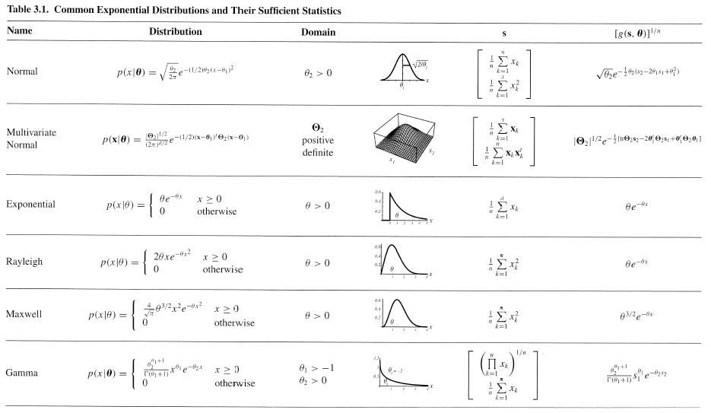
The Exponential Family
This can be generalized:
and:
Examples:

Slide 20
Summary
Bayesian estimates of the mean for the multivariate Gaussian case.
General theory for Bayesian estimation.
Comparison to maximum likelihood estimates.
Recursive Bayesian incremental learning.
Noninformative priors.
Sufficient statistics
Kernel density.

