Slide 1
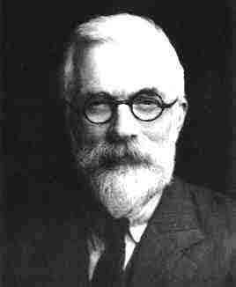
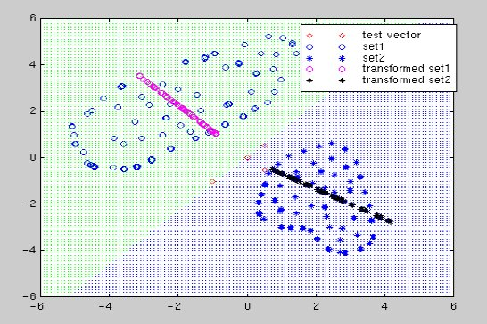
LECTURE 09: LINEAR DISCRIMINANT ANALYSIS
• Objectives: Fisher Linear Discriminant Analysis Multiple Discriminant Analysis Examples
Resources: D.H.S.: Chapter 3 (Part 2) W.P.: Fisher DTREG: LDA S.S.: DFA
• URL: .../publications/courses/ece_8443/lectures/current/lecture_09.ppt

Slide 2
Component Analysis (Review)
Previously introduced as a “whitening transformation”.
Component analysis is a technique that combines features to reduce the dimension of the feature space.
Linear combinations are simple to compute and tractable.
Project a high dimensional space onto a lower dimensional space.
Three classical approaches for finding the optimal transformation:
Principal Components Analysis (PCA): projection that best represents the data in a least-square sense.
Multiple Discriminant Analysis (MDA): projection that best separates the data in a least-squares sense.
Independent Component Analysis (IDA): projection that minimizes the mutual information of the components.

Slide 3
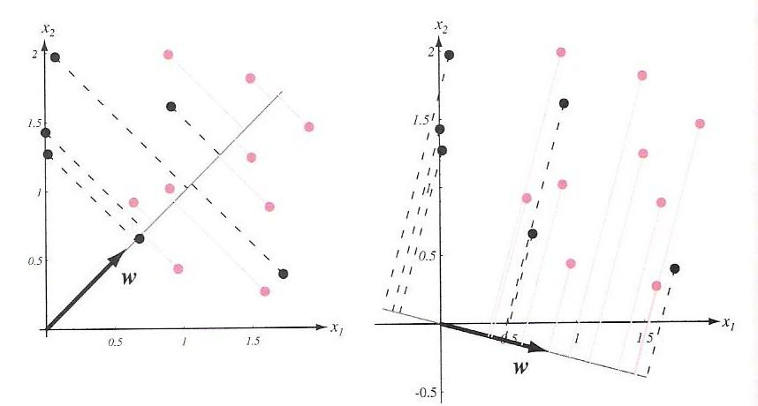
Discriminant Analysis
Discriminant analysis seeks directions that are efficient for discrimination.
Consider the problem of projecting data from d dimensions onto a line with the hope that we can optimize the orientation of the line to minimize error.
Consider a set of n d-dimensional samples x₁,…,x_{n} in the subset D1 labeled ω₁ and n₂ in the subset D₂ labeled ω₂.
Define a linear combination of x:
and a corresponding set of n samples y₁, …, y_{n} divided into Y₁ and Y₂.
Our challenge is to find w that maximizes separation.
This can be done by considering the ratio of the between-class scatter to the within-class scatter.

Slide 4
Separation of the Means and Scatter
Define a sample mean for class i:
The sample mean for the projected points are:
The sample mean for the projected points is just the projection of the mean (which is expected since this is a linear transformation).
It follows that the distance between the projected means is:
Define a scatter for the projected samples:
An estimate of the variance of the pooled data is:
and is called the within-class scatter.

Slide 5
Fisher Linear Discriminant and Scatter
The Fisher linear discriminant maximizes the criteria:
Define a scatter for class I, S_{i} :
The total scatter, S_{w}, is:
We can write the scatter for the projected samples as:
Therefore, the sum of the scatters can be written as:

Slide 6
Separation of the Projected Means
The separation of the projected means obeys:
Where the between class scatter, S_{B}, is given by:
S_{w} is the within-class scatter and is proportional to the covariance of the pooled data.
S_{B} , the between-class scatter, is symmetric and positive definite, but because it is the outer product of two vectors, its rank is at most one.
This implies that for any w, S_{B}w is in the direction of m₁-m₂.
The criterion function, J(w), can be written as:

Slide 7
Linear Discriminant Analysis
This ratio is well-known as the generalized Rayleigh quotient and has the well-known property that the vector, w, that maximizes J(), must satisfy:
The solution is:
This is Fisher’s linear discriminant, also known as the canonical variate.
This solution maps the d-dimensional problem to a one-dimensional problem (in this case).
From Chapter 2, when the conditional densities, p(x|ω_{i}), are multivariate normal with equal covariances, the optimal decision boundary is given by:
where , and w₀ is related to the prior probabilities.
The computational complexity is dominated by the calculation of the within-class scatter and its inverse, an O(d²n) calculation. But this is done offline!
Let’s work some examples (class-independent PCA and LDA).

Slide 8
Multiple Discriminant Analysis
For the c-class problem in a d-dimensional space, the natural generalization involves c-1 discriminant functions.
The within-class scatter is defined as:
Define a total mean vector, m:
and a total scatter matrix, S_{T}, by:
The total scatter is related to the within-class scatter (derivation omitted):
We have c-1 discriminant functions of the form:

Slide 9
Multiple Discriminant Analysis (Cont.)
The criterion function is:
The solution to maximizing J(W) is once again found via an eigenvalue decomposition:
Because S_{B} is the sum of c rank one or less matrices, and because only c-1 of these are independent, S_{B} is of rank c-1 or less.
An excellent presentation on applications of LDA can be found at PCA Fails!

Slide 10
Summary
Introduced Component Analysis.
Defined a criterion that maximizes discrimination.
Derived the solution to the two-class problem.
Generalized this solution to c classes.
Compared LDA and PCA on some interesting data sets.

