Slide 1
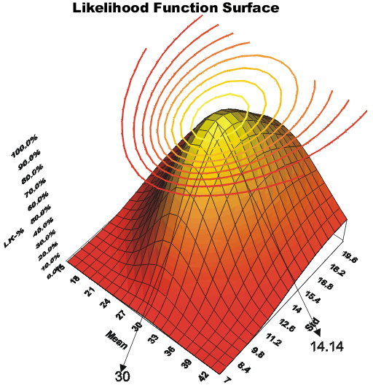
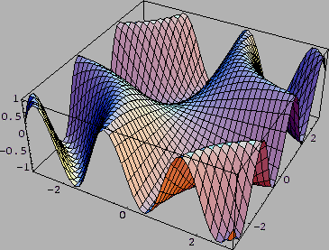
LECTURE 05: MAXIMUM LIKELIHOOD ESTIMATION
• Objectives: Discrete Features Maximum Likelihood
Resources: D.H.S: Chapter 3 (Part 1) D.H.S.: Chapter 3 (Part 2) J.O.S.: Tutorial Nebula: Links BGSU: Example A.W.M.: Tutorial A.W.M.: Links S.P.: Primer CSRN: Unbiased A.W.M.: Bias
• URL: .../publications/courses/ece_8443/lectures/current/lecture_05.ppt

Slide 2
Discrete Features
For problems where features are discrete:
Bayes formula involves probabilities (not densities):
where
Bayes rule remains the same:
The maximum entropy distribution is a uniform distribution:

Slide 3
Discriminant Functions For Discrete Features
Consider independent binary features:
Assuming conditional independence:
The likelihood ratio is:
The discriminant function is:

Slide 4
Introduction to Maximum Likelihood Estimation
In Chapter 2, we learned how to design an optimal classifier if we knew the prior probabilities, P(ω_{i}), and class-conditional densities, p(x|ω_{i}).
What can we do if we do not have this information?
What limitations do we face?
There are two common approaches to parameter estimation: maximum likelihood and Bayesian estimation.
Maximum Likelihood: treat the parameters as quantities whose values are fixed but unknown.
Bayes: treat the parameters as random variables having some known prior distribution. Observations of samples converts this to a posterior.
Bayesian Learning: sharpen the a posteriori density causing it to peak near the true value.

Slide 5
General Principle
I.I.D.: c data sets, D₁,...,D_{c}, where D_{j} drawn independently according to p(x|ω_{j}).
Assume p(x|ω_{j}) has a known parametric form and is completely determined by the parameter vector θ_{j} (e.g., p(x|ω_{j}) ≈ N(μ_{j},∑_{j}), where θ_{j}=[μ₁, ..., μ_{j} , ∑₁₁, ∑₁₂, ...,∑_{dd}]).
p(x|ω_{j}) has an explicit dependence on θ_{j}: p(x|ω_{j},θ_{j})
Use training samples to estimate θ₁, θ₂,..., θ_{c}
Functional independence: assume D_{i} gives no useful information about θ_{j} for i≠j.
Simplifies notation to a set D of training samples (x₁,... x_{n}) drawn independently from p(x|θ) to estimate θ.
Because the samples were drawn independently:

Slide 6
Example of ML Estimation
p(D|θ) is called the likelihood of θ with respect to the data.
The value of θ that maximizes this likelihood, denoted ,
is the maximum likelihood estimate (ML) of θ.
Given several training points
Top: candidate source distributions are shown
Which distribution is the ML estimate?
Middle: an estimate of the likelihood of the data as a function of θ (the mean)
Bottom: log likelihood

Slide 7
General Mathematics
The ML estimate is found by solving this equation:
The solution to this equation can be a global maximum, a local maximum, or even an inflection point.
Under what conditions is it a global maximum?

Slide 8
Maximum A Posteriori Estimation
A class of estimators – maximum a posteriori (MAP) – maximize where describes the prior probability of different parameter values.
An ML estimator is a MAP estimator for uniform priors.
A MAP estimator finds the peak, or mode, of a posterior density.
MAP estimators are not transformation invariant (if we perform a nonlinear transformation of the input data, the estimator is no longer optimum in the new space). This observation will be useful later in the course.

Slide 9
Gaussian Case: Unknown Mean
Consider the case where only the mean, θ = μ, is unknown:
which implies:
because:

Slide 10
Gaussian Case: Unknown Mean
Substituting into the expression for the total likelihood:
Rearranging terms:
Significance???

Slide 11
Gaussian Case: Unknown Mean and Variance
Let θ = [μ,σ²]. The log likelihood of a SINGLE point is:
The full likelihood leads to:

Slide 12
Gaussian Case: Unknown Mean and Variance
This leads to these equations:
In the multivariate case:
The true covariance is the expected value of the matrix , which is a familiar result.

Slide 13
Convergence of the Mean
Does the maximum likelihood estimate of the variance converge to the true value of the variance? Let’s start with a few simple results we will need later.
Expected value of the ML estimate of the mean:

Slide 14
Variance of the ML Estimate of the Mean
The expected value of x_{i}x_{j} will be μ² for j ≠ k since the two random variables are independent.
The expected value of x_{i}² will be μ² + σ².
Hence, in the summation above, we have n²-n terms with expected value μ² and n terms with expected value μ² + σ².
Thus,
which implies:
We see that the variance of the estimate goes to zero as n goes to infinity, and our estimate converges to the true estimate (error goes to zero).

Slide 15
Summary
Discriminant functions for discrete features are completely analogous to the continuous case (end of Chapter 2).
To develop an optimal classifier, we need reliable estimates of the statistics of the features.
In Maximum Likelihood (ML) estimation, we treat the parameters as having unknown but fixed values.
Justified many well-known results for estimating parameters (e.g., computing the mean by summing the observations).
Biased and unbiased estimators.
Convergence of the mean and variance estimates.

