Slide 1
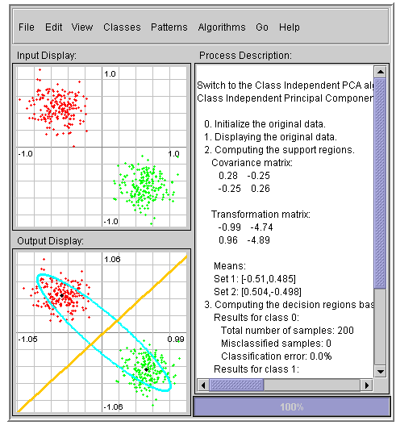
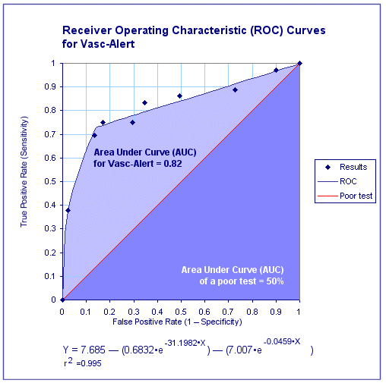

ECE 8443 – Pattern Recognition
LECTURE 04: PERFORMANCE BOUNDS
• Objectives:
Typical Examples
Performance Bounds
ROC Curves
Resources:
D.H.S.: Chapter 2 (Part 3)
V.V.: Chernoff Bound
J.G.: Bhattacharyya
T.T. : ROC Curves
NIST: DET Curves
URL:
Audio:

Slide 2
Two-Category Case (Review)
A classifier that places a pattern in one of two classes is often referred to as a dichotomizer.
We can reshape the decision rule:
If we use log of the posterior probabilities:
A dichotomizer can be viewed as a machine that computes a single discriminant function and classifies x according to the sign (e.g., support vector machines).

Slide 3
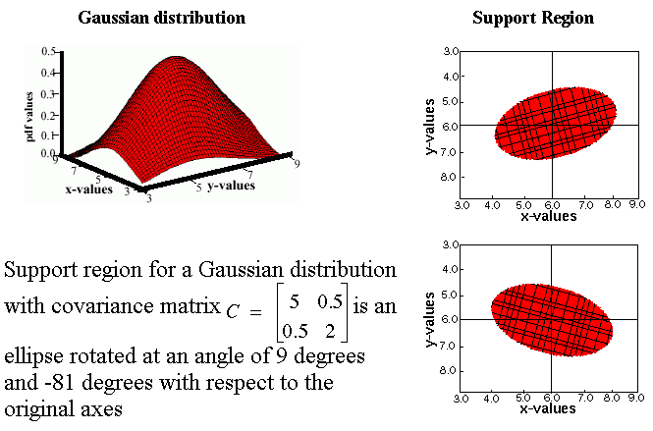
Unconstrained or “Full” Covariance (Review)

Slide 4
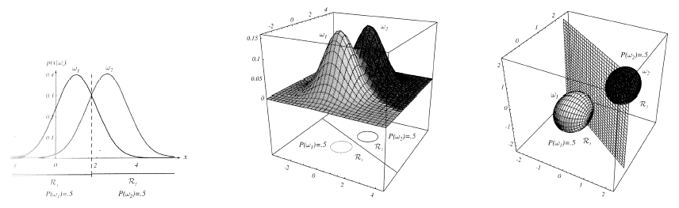
Threshold Decoding (Review)
This has a simple geometric interpretation:
The decision region when the priors are equal and the support regions are spherical is simply halfway between the means (Euclidean distance).

Slide 5
General Case for Gaussian Classifiers

Slide 6
Identity Covariance
Case: ∑_{i} = σ²I
This can be rewritten as:

Slide 7
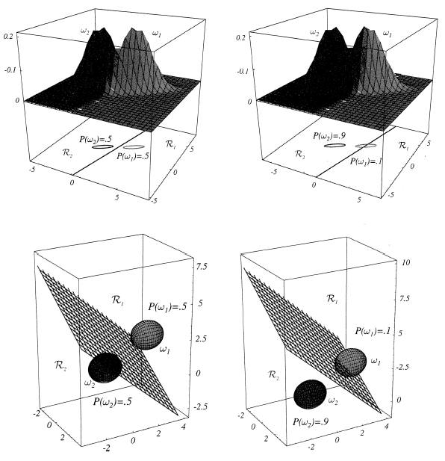
Equal Covariances
Case: ∑_{i} = ∑

Slide 8
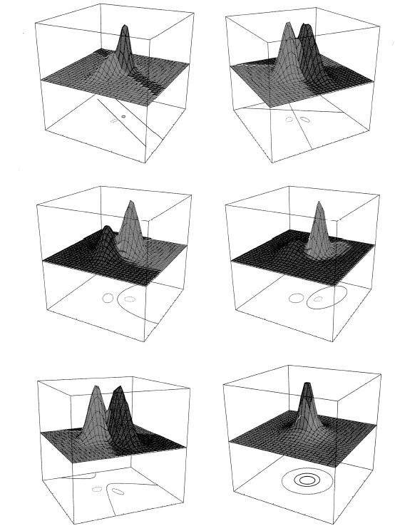
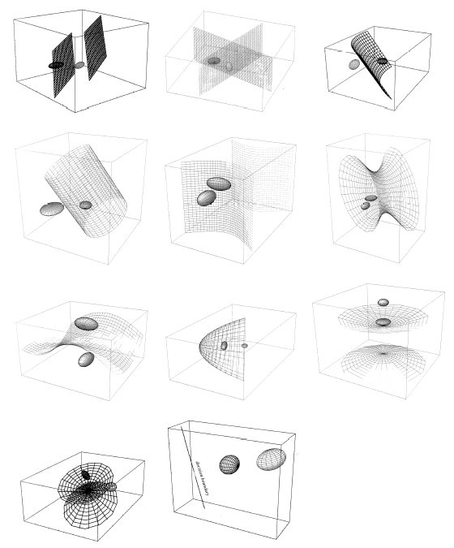
Arbitrary Covariances

Slide 9
Typical Examples of 2D Classifiers

Slide 10
Error Bounds
Bayes decision rule guarantees lowest average error rate
Closed-form solution for two-class Gaussian distributions
Full calculation for high dimensional space difficult
Bounds provide a way to get insight into a problem and
engineer better solutions.
Need the following inequality:
Assume a ≥ b without loss of generality: min[a,b] = b.
Also, a^{β}b^{(1- β)} = (a/b)^{β}b and (a/b)^{β} ≥ 1.
Therefore, b ≤ (a/b)^{β}b, which implies min[a,b] ≤ a^{β}b^{(1- β)} .
Apply to our standard expression for P(error).

Slide 11
Chernoff Bound
Recall:
Note that this integral is over the entire feature space, not the decision regions (which makes it simpler).
If the conditional probabilities are normal, this expression can be simplified.

Slide 12
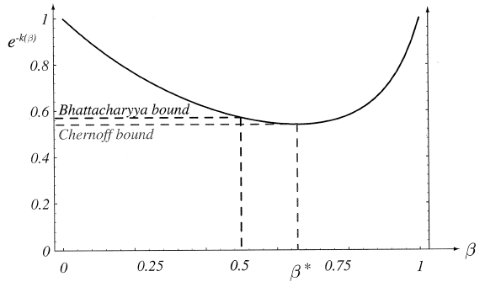
Chernoff Bound for Normal Densities
If the conditional probabilities are normal, our bound can be evaluated analytically:
where:
Procedure: find the value of β that minimizes exp(-k(β ), and then compute P(error) using the bound.
Benefit: one-dimensional optimization using β

Slide 13
Bhattacharyya Bound
The Chernoff bound is loose for extreme values
The Bhattacharyya bound can be derived by β = 0.5:
where:
These bounds can still be used if the distributions are not Gaussian (why? hint: Occam’s Razor). However, they might not be adequately tight.

Slide 14
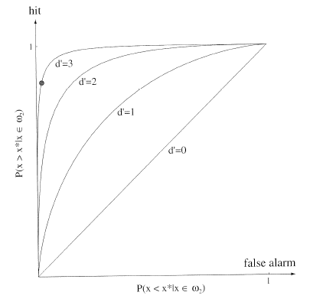
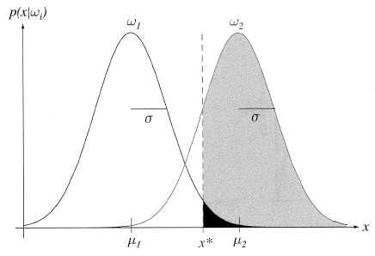
Receiver Operating Characteristic (ROC)
How do we compare two decision rules if they require different thresholds for optimum performance?
Consider four probabilities:

Slide 15
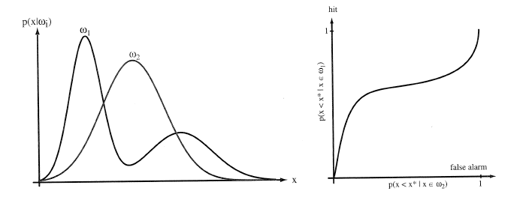
General ROC Curves
An ROC curve is typically monotonic but not symmetric:
One system can be considered superior to another only if its ROC curve lies above the competing system for the operating region of interest.

Slide 16
Summary
Gaussian Distributions: how is the shape of the decision region influenced by the mean and covariance?
Bounds on performance (i.e., Chernoff, Bhattacharyya) are useful abstractions for obtaining closed-form solutions to problems.
A Receiver Operating Characteristic (ROC) curve is a very useful way to analyze performance and select operating points for systems.
Discrete features can be handled in a way completely analogous to continuous features.

