Slide 1

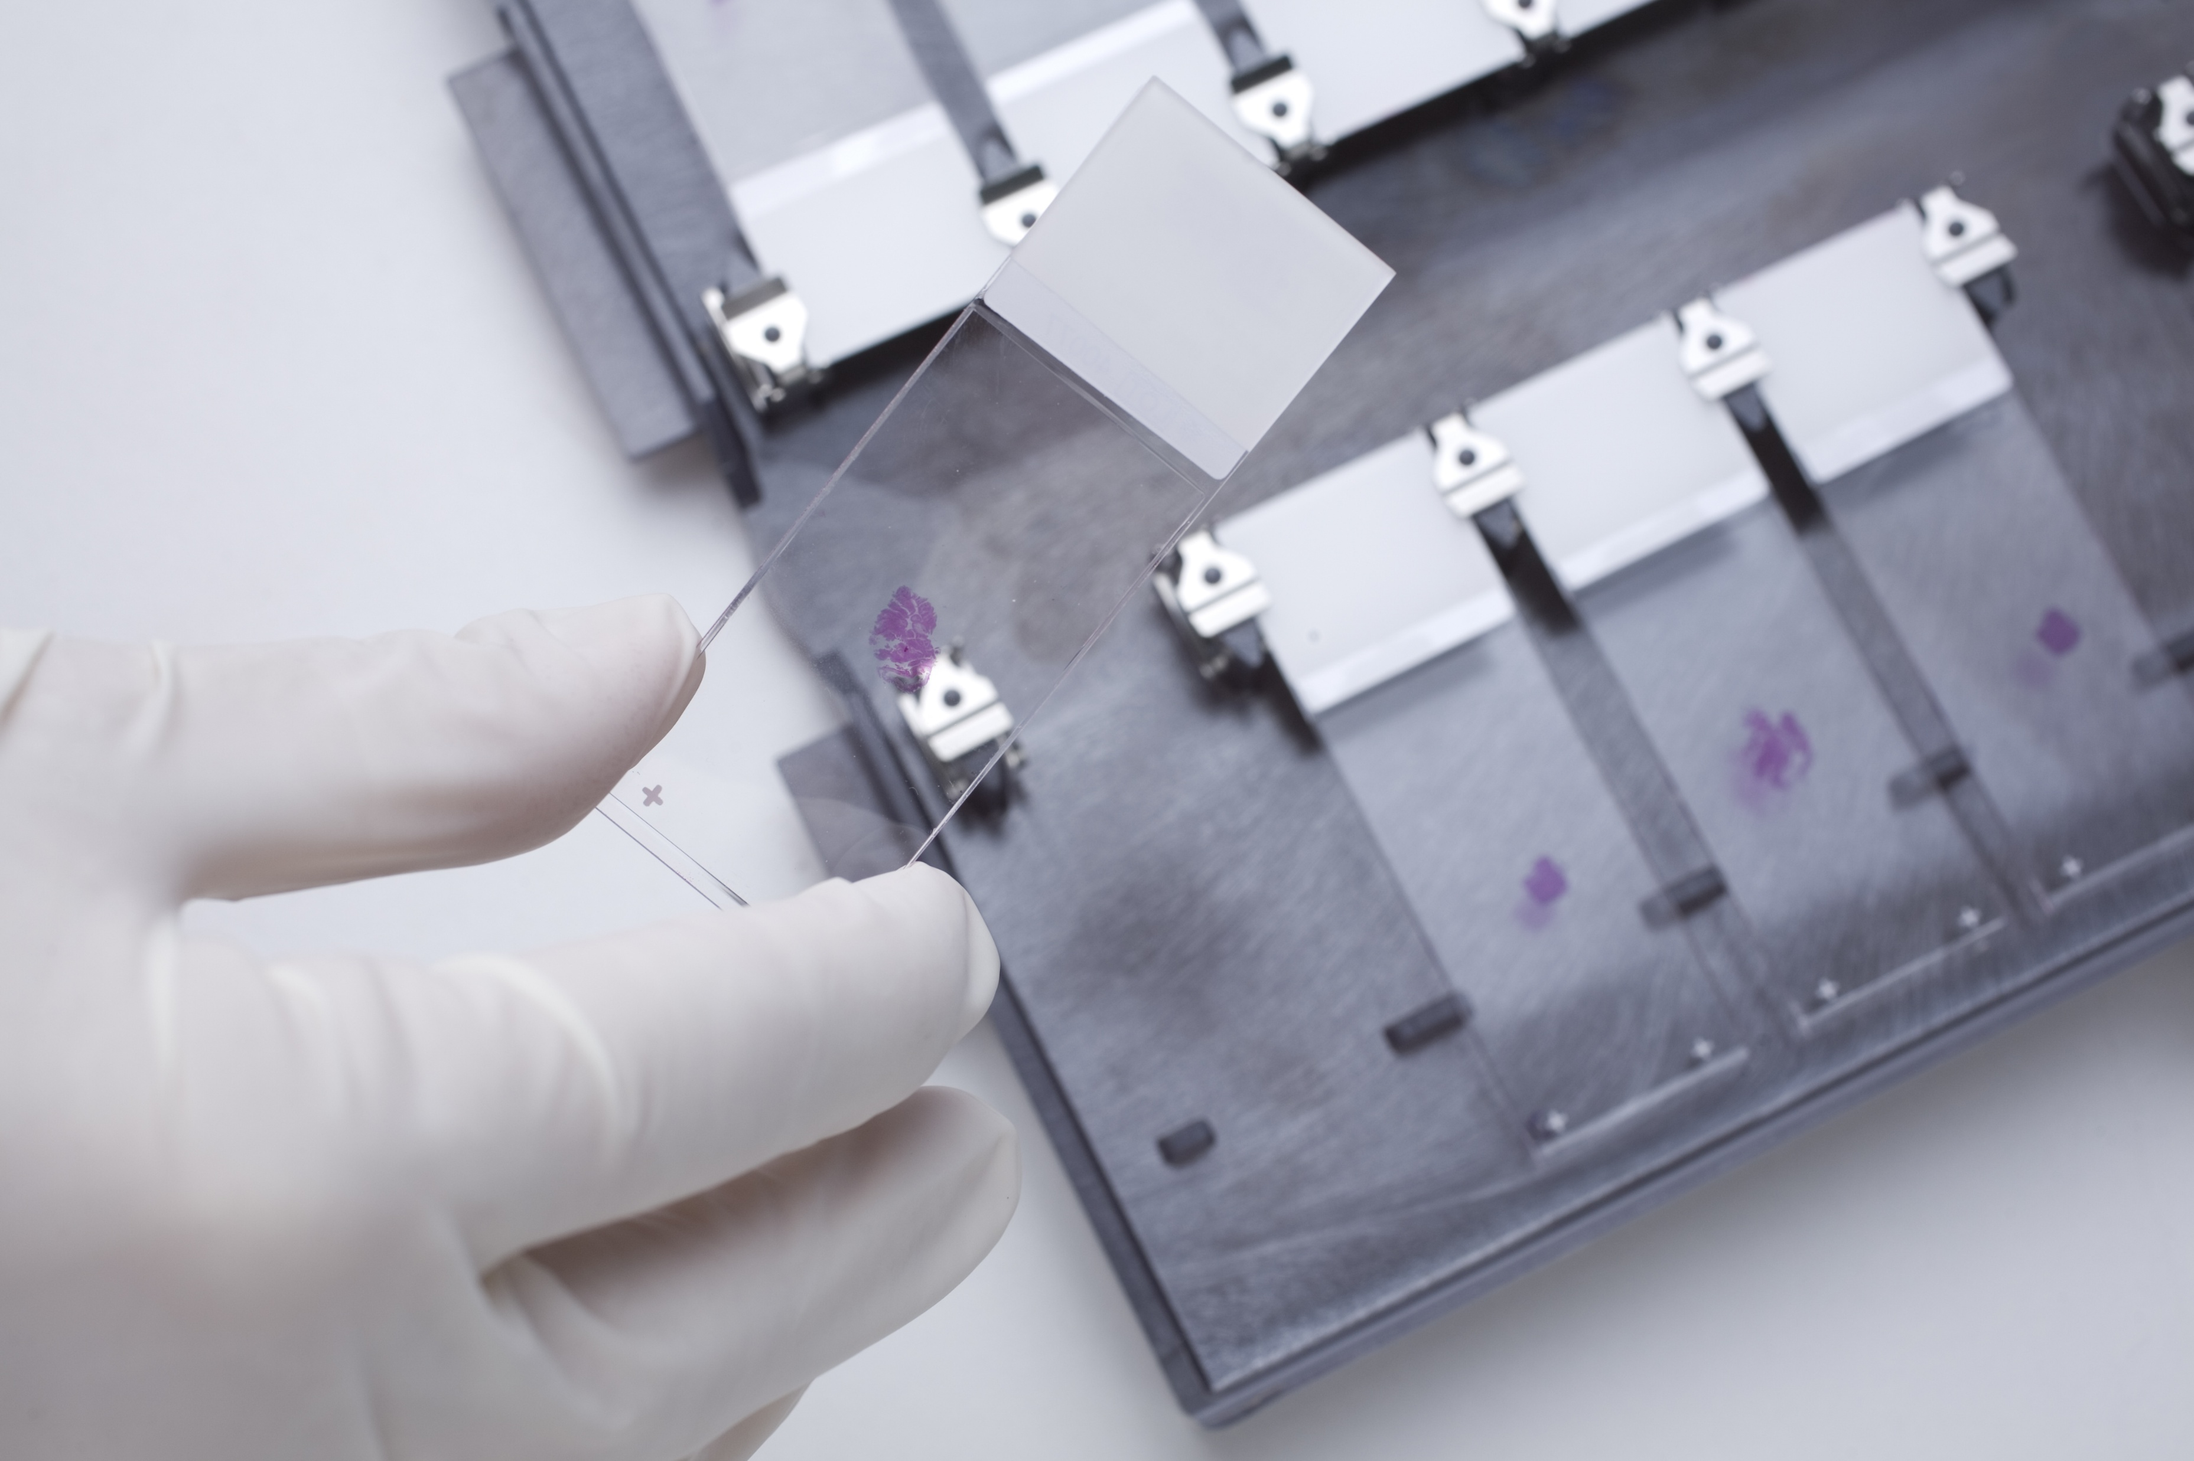

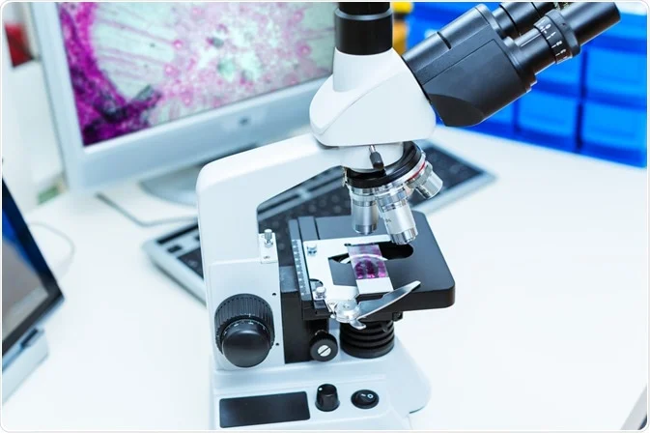
ECE 8527: Project Presentation
Sadia Afrin Purba
Neural Engineering Data Consortium
Temple University

Slide 2
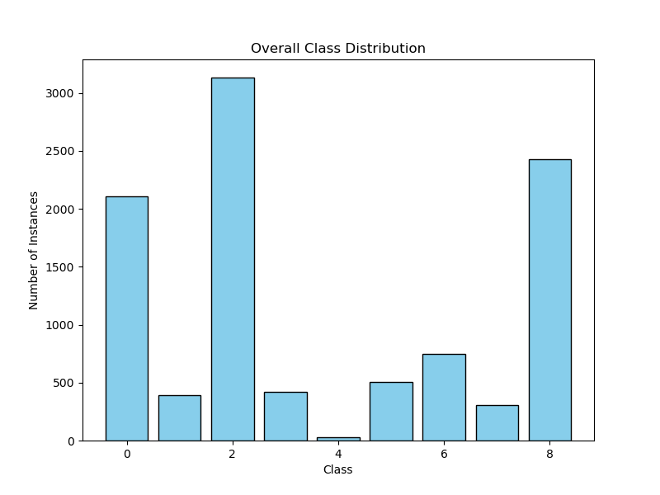
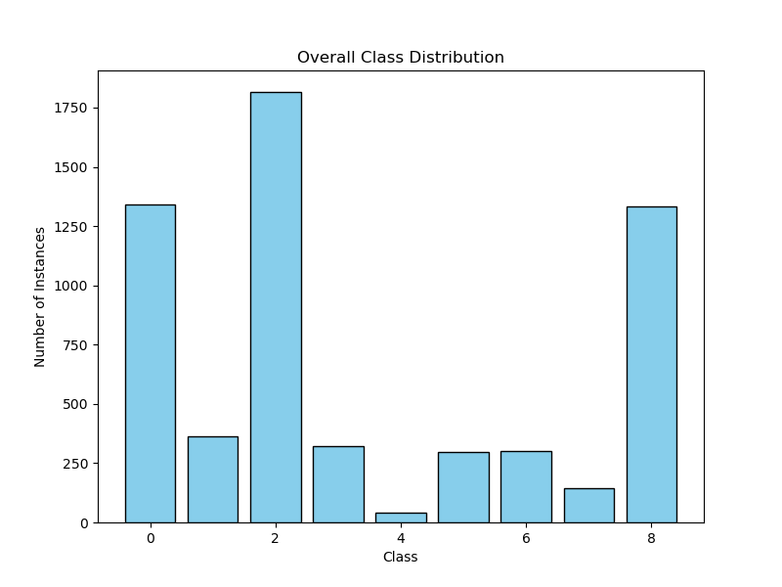
Problem Statement
Given a dataset of Discrete Cosine Transform (DCT) coefficients from digital pathology images, classify them into nine classes.
Dataset Description:
- Column 0 contains the labels (0-8).
- Columns 1-1024 contain the Red channel’s DCT coefficients.
- Columns 1025-2048 contain the Green channel’s DCT coefficients.
- Columns 2049-3072 contain the Blue channel’s DCT coefficients.
Figure 1. Train set
Figure 2. Dev set

Slide 3
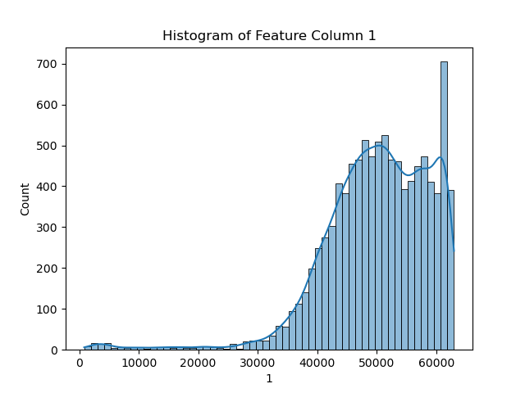
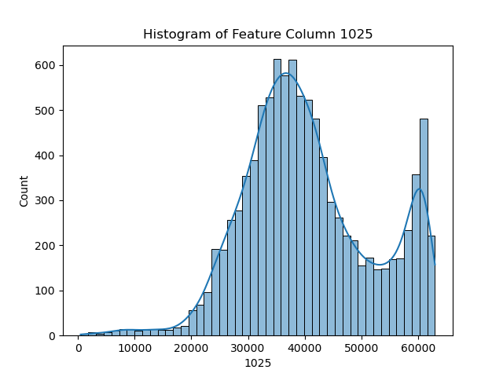
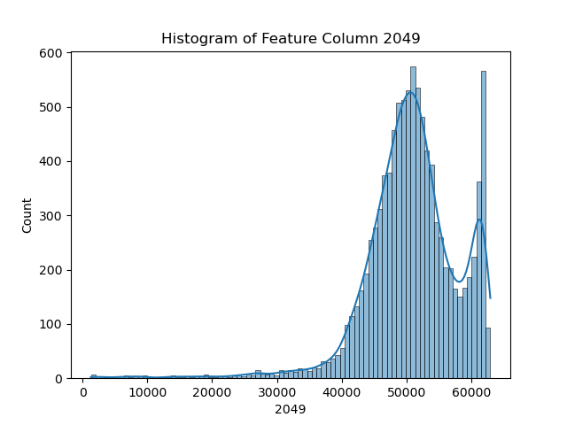
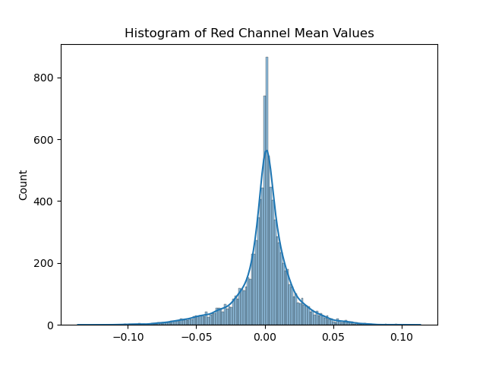
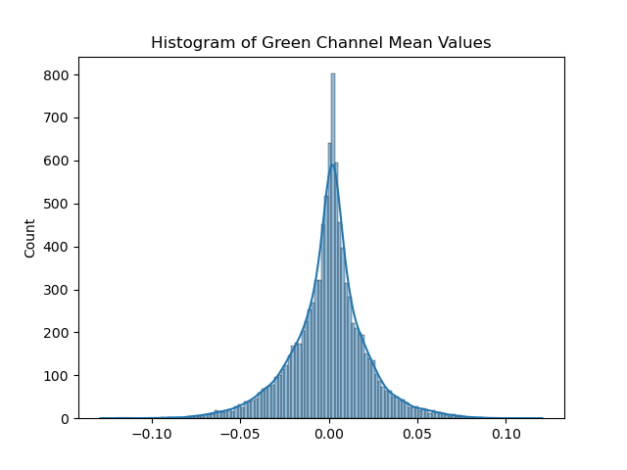
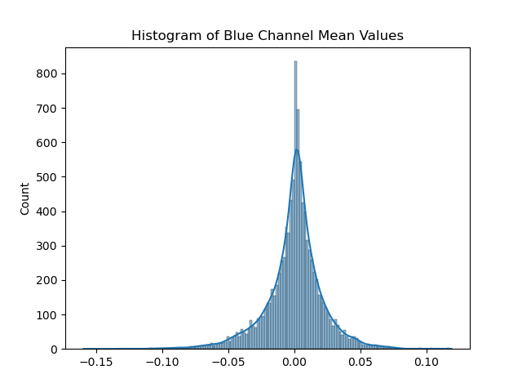
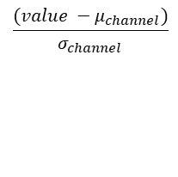
Data Preprocessing
$$\frac{(value −μ_{channel})}{σ_{channel}}$$
Figure 3. Gaussian Normalization

Slide 4
Baseline Algorithms
System | Preprocessing | Training Data | Train (%) |  |  | Dev (%)
 |  |  | avg lbls | avg bckg | score | avg lbls | avg bckg | score
RNF | raw | /train | 81.58 | 10.59 | 74.48 | 83.06 | 18.80 | 76.64
 | gaussian_norm | /train | 81.58 | 10.59 | 74.48 | 83.11 | 18.20 | 76.61
SVM | raw | /train | 0.00 | 0.00 | 0.00 | 80.00 | 100.00 | 82.00
 | gaussian_norm | /train | - | - | 0.55 | - | - | 68.80
NB | raw | /train | 56.03 | 64.39 | 56.87 | 64.33 | 62.10 | 64.11
 | gaussian_norm | /train | 56.03 | 64.39 | 56.87 | 64.85 | 62.32 | 64.60
KNN | raw | /train | 73.06 | 43.90 | 70.14 | 78.92 | 38.50 | 74.88
 | gaussian_norm | /train | 92.99 | 39.04 | 87.60 | 96.39 | 62.47 | 92.99
KMeans | raw | /train | 86.29 | 99.96 | 87.66 | 87.56 | 100.00 | 88.80
 | gaussian_norm | /train | 92.32 | 100.00 | 96.08 | 93.48 | 100.00 | 94.13

Slide 5
Baseline Algorithms
System | Preprocessing | Training Data | Train (%) |  |  | Dev (%)
 |  |  | avg lbls | avg bckg | score | avg lbls | avg bckg | score
MLP | raw | /train | 15.47 | 9.85 | 12.66 | 80.35 | 43.00 | 61.67
 | gaussian_norm | /train | 23.60 | 9.11 | 22.15 | 82.84 | 47.64 | 79.33
Transformer | raw | /train | 17.29 | 1.98 | 9.63 | 81.57 | 29.66 | 55.62
 | gaussian_norm | /train | 44.17 | 14.96 | 41.25 | 83.25 | 46.07 | 79.53
CNN (5 Layers) | raw | /train | 86.52 | 70.57 | 84.92 | 62.86 | 6.52 | 57.23
 | gaussian_norm | /train | 85.81 | 74.73 | 84.70 | 61.73 | 9.51 | 56.51

Slide 6
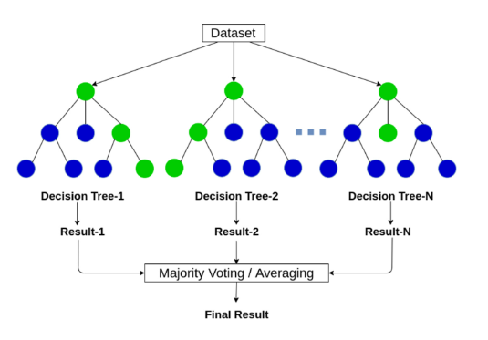
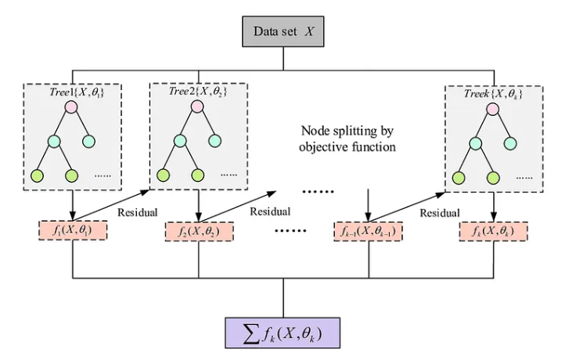
XGBoost
Both RNF and XGB build a model consisting of multiple trees.
The difference is in how the trees are built and combined.
RNF uses a technique called bagging to build full decision trees in parallel from random bootstrap samples of datasets.
The final prediction is an average of all of the decision tree predictions.
XGB is a gradient boosting algorithm meaning it learns from its mistake and improve its predictions iteratively.
It begins with an initial estimation.
It then looks at where the initial guess went wrong, identifying the “residuals” or difference between the guess and true value.
A new decision tree is trained specifically to address those errors.
The final prediction is summation of all of the decision tree predictions.

Slide 7
Result
System | Preprocessing | Training Data | Train (%) |  |  | Dev (%)
 |  |  | avg lbls | avg bckg | score | avg lbls | avg bckg | score
NB | raw | /train | 56.03 | 64.39 | 56.87 | 64.33 | 62.10 | 64.11
 | gaussian_norm | /train | 56.03 | 64.39 | 56.87 | 64.85 | 62.32 | 64.60
CNN (5 Layers) | raw | /train | 86.52 | 70.57 | 84.92 | 62.86 | 6.52 | 57.23
 | gaussian_norm | /train | 85.81 | 74.73 | 84.70 | 61.73 | 9.51 | 56.51
XGB | raw | /train | 1.37 | 0.04 | 1.23 | 68.74 | 11.54 | 63.02
 | gaussian_norm | /train | 2.93 | 1.39 | 2.78 | 70.12 | 10.71 | 64.18
System | Preprocessing | Training Data | Eval (%)
 |  |  | avg lbls | avg bckg | score
XGB | raw | /train | 67.99 | 9.81 | 62.18

Slide 8
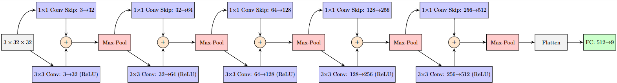
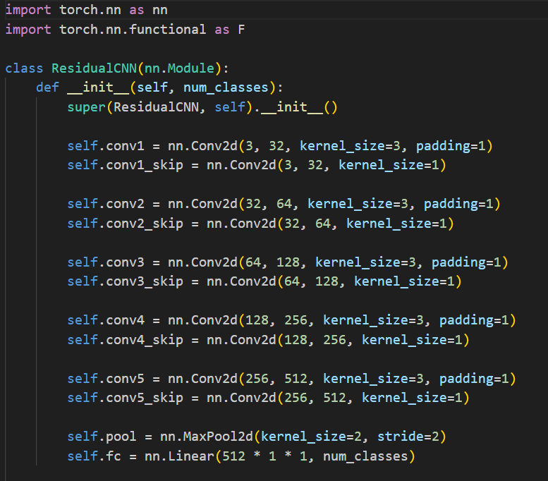
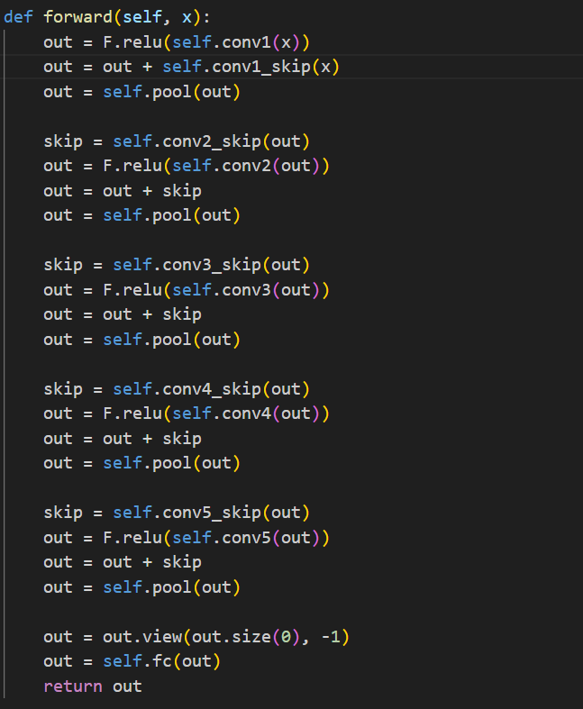
CNN with Skip Connections

Slide 9
Result
System | Preprocessing | Training Data | Train (%) |  |  | Dev (%)
 |  |  | avg lbls | avg bckg | score | avg lbls | avg bckg | score
NB | raw | /train | 56.03 | 64.39 | 56.87 | 64.33 | 62.10 | 64.11
 | gaussian_norm | /train | 56.03 | 64.39 | 56.87 | 64.85 | 62.32 | 64.60
CNN (5 Layers) | raw | /train | 86.52 | 70.57 | 84.92 | 62.86 | 6.52 | 57.23
 | gaussian_norm | /train | 85.81 | 74.73 | 84.70 | 61.73 | 9.51 | 56.51
CNN+Skip | gaussian_norm | /train + /dev | 2.16 | 1.87 | 2.13 | 4.16 | 1.87 | 3.93
System | Preprocessing | Training Data | Eval (%)
 |  |  | avg lbls | avg bckg | score
CNN+Skip | gaussian_norm | /train + /dev | 56.91 | 15.99 | 52.81

Slide 10
Hyperparameter Optimizer
Optuna:
an open-source hyperparameter optimization framework designed to automate the process of tuning parameters in machine learning models. It uses a flexible and efficient sampling algorithm (often based on Bayesian optimization) to find the best combination of hyperparameters for a given objective function.
Best trial dev error: 37.24% Best hyperparameters: lr: 0.0010719476722953968 weight_decay: 5.775669887410536e-06 batch_size: 16 n_blocks: 7 channels_l0: 16 kernel_l0: 3 channels_l1: 128 kernel_l1: 3 channels_l2: 32 kernel_l2: 3 channels_l3: 64 kernel_l3: 3 channels_l4: 64 kernel_l4: 7 channels_l5: 32 kernel_l5: 11 channels_l6: 256 kernel_l6: 3

Slide 11
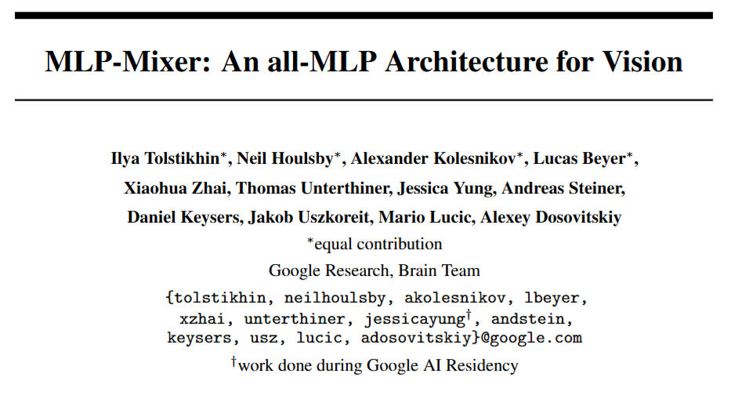
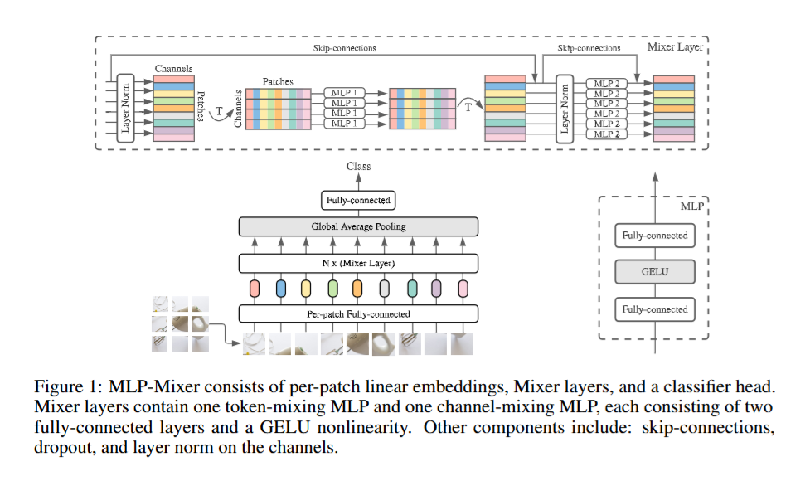
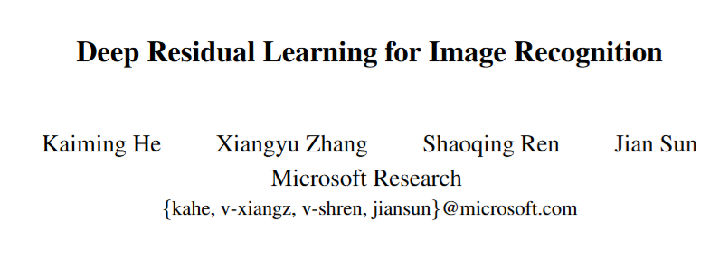
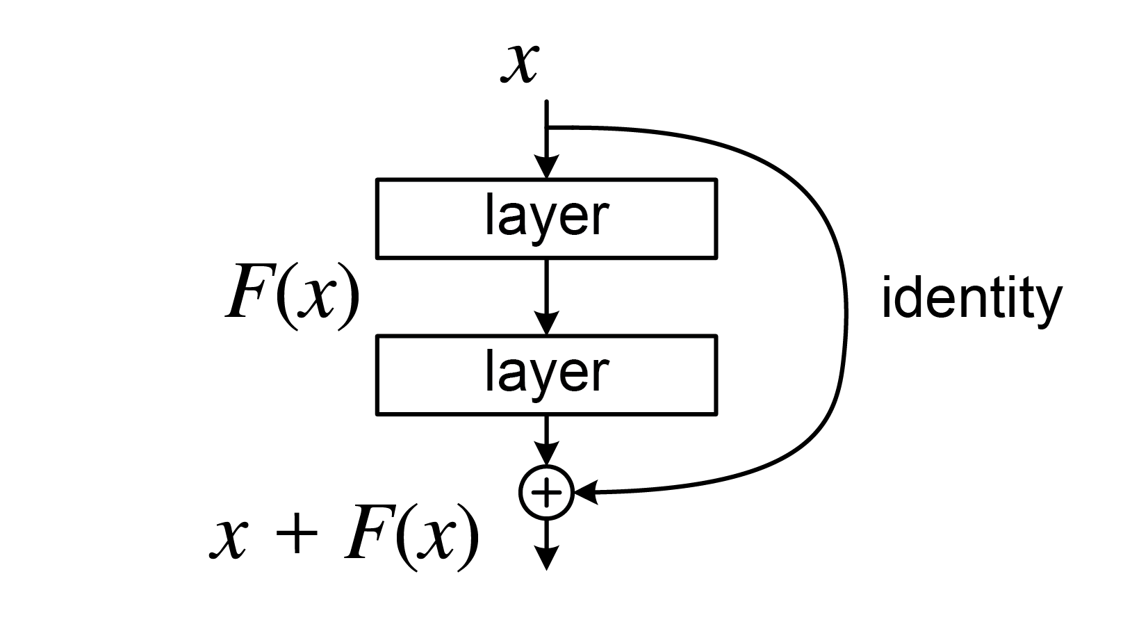
Other Architectures
Tolstikhin, I. O., Houlsby, N., Kolesnikov, A., Beyer, L., Zhai, X., Unterthiner, T., ... & Dosovitskiy, A. (2021). Mlp-mixer: An all-mlp architecture for vision. Advances in neural information processing systems, 34, 24261-24272.
He, K., Zhang, X., Ren, S., & Sun, J. (2016). Deep residual learning for image recognition. In Proceedings of the IEEE conference on computer vision and pattern recognition (pp. 770-778).

Slide 12
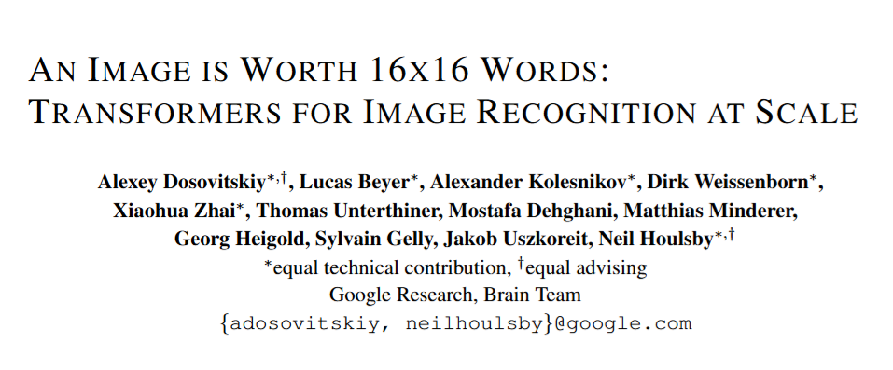
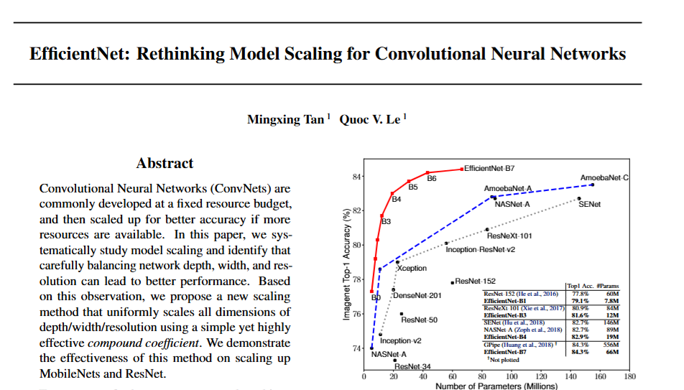
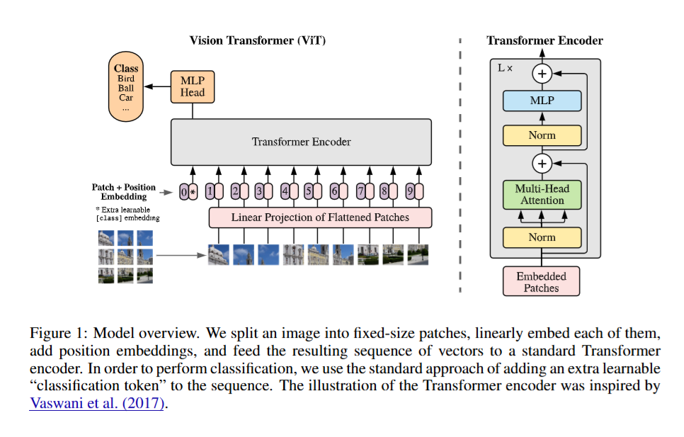
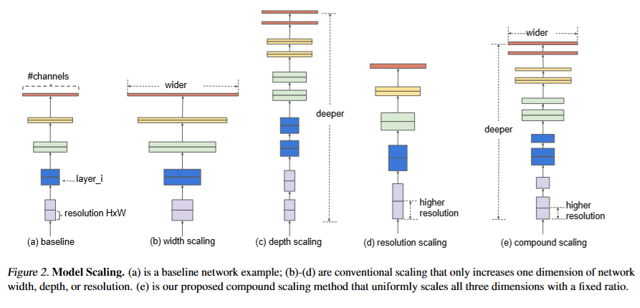
Other Architectures
Dosovitskiy, A., Beyer, L., Kolesnikov, A., Weissenborn, D., Zhai, X., Unterthiner, T., ... & Houlsby, N. (2020). An image is worth 16x16 words: Transformers for image recognition at scale. arXiv preprint arXiv:2010.11929.
Tan, M., & Le, Q. (2019, May). Efficientnet: Rethinking model scaling for convolutional neural networks. In International conference on machine learning (pp. 6105-6114). PMLR.

Slide 13
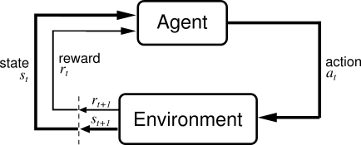
Other Architectures
“When something works, we experiment further.”
RL Component | Description
Environment | A dataset of breast cancer to determine nine classes
State | 32x32x3 patch
Agent | MLP-Mixer Model
Action | Class Label (0-8)
Penalty | Penalty is derived by the error rate from the dev set after each epoch.

Slide 14
Other Architectures
System | Preprocessing | Training Data | Train (%) |  |  | Dev (%)
 |  |  | avg lbls | avg bckg | score | avg lbls | avg bckg | score
MLP-Mixer | raw | /train | 85.97 | 74.94 | 84.87 | 60.19 | 18.58 | 56.03
 | gaussian_norm | /train | 86.27 | 77.54 | 85.39 | 64.82 | 17.08 | 60.05
MLP-Mixer+RL | raw | /train | 84.92 | 74.01 | 83.83 | 61.03 | 18.01 | 56.73
 | gaussian_norm | /train | 85.21 | 75.39 | 84.68 | 64.27 | 11.69 | 59.01
ViT | raw | /train | 88.02 | 15.96 | 76.31 | 85.00 | 16.03 | 78.13
 | gaussian_norm | /train | 85.91 | 11.36 | 78.46 | 75.36 | 10.36 | 68.86
ViT (Pretrain weights) | raw | /train | 86.12 | 17.68 | 79.28 | 77.93 | 18.36 | 71.97
 | gaussian_norm | /train | 84.15 | 13.36 | 77.01 | 73.15 | 19.32 | 67.77
Resnet18 | raw | /train | 87.06 | 68.76 | 85.23 | 58.82 | 6.74 | 53.61
 | gaussian_norm | /train | 86.83 | 71.81 | 85.32 | 59.74 | 9.59 | 54.72
EfficientNet-b0 | raw | /train | 86.13 | 71.85 | 84.70 | 58.75 | 10.56 | 53.93
 | gaussian_norm | /train | 86.49 | 69.95 | 84.84 | 60.18 | 8.24 | 54.99
 | raw | /train + /dev | 35.83 | 3.42 | 32.60 | 36.30 | 4.42 | 33.11
 | gaussian_norm | /train + /dev | 37.02 | 4.49 | 33.77 | 35.57 | 5.32 | 32.55
EfficientNet-b7 | raw | /train | 86.23 | 74.97 | 85.10 | 62.91 | 14.38 | 58.06
 | gaussian_norm | /train | 86.14 | 73.29 | 84.86 | 61.65 | 10.64 | 56.55

Slide 15
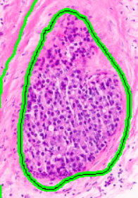
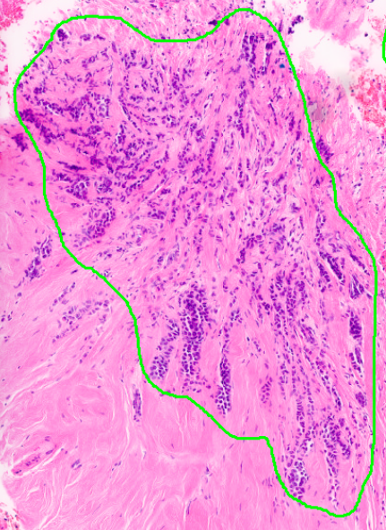
Discussion
Training score and dev score discrepancy across deep learning models.
  Training Score > Dev Score
  Swap the dataset; Train score= 85.19% and Dev Score=52.07%
Label 5 and 6 (dcis and indc) have the highest error rate for almost all deep learning models.
  With only two classes using CNN+SkipConn
    train error = 0.00%, dev error = 32.44%
dcis
indc

Slide 16
Conclusion
System | Preprocessing | Training Data | Eval (%)
 |  |  | avg lbls | avg bckg | score
XGB | raw | /train | 67.99 | 9.81 | 62.18
CNN+Skip | gaussian_norm | /train + /dev | 56.91 | 15.99 | 52.81

