Slide 1
Machine Learning Final
Spring 2025 ECE 4527
Jouri Ghazi
May 02, 2025

Slide 2
Spring 2025 ECE 4527
Machine Learning Final
Jouri Ghazi
May 02, 2025
Professor Picone
INTRODUCTION
Digital Pathology Images
The process of using computer technology to analyze digitized tissue images
Enables faster and accurate diagnoses
We are provided a dataset of DCTs with 9 classes
9 Classes
Create a non-neural and neural method to classify these the sets
Task: classify using a neural method and non-neural method

Slide 3


Discrete Cosine Transform
Converts a sequence of numbers to a sum of cosines different frequencies
$$\left[\begin{matrix}{RGB}_{11} & ⋯ & {RGB}_{1n} \\ ⋮ & ⋱ & ⋮ \\ {RGB}_{m1} & ⋯ & {RGB}_{mn}\end{matrix}\right]$$
$$\left[\begin{matrix}C_{11} & ⋯ & C_{1n} \\ ⋮ & ⋱ & ⋮ \\ C_{m1} & ⋯ & C_{mn}\end{matrix}\right]$$
RGB Values
Cosine coefficients

Slide 4
Visualized DCT
DCT Coefficients
…
…
…
1
1024
2048
3072
1
1
…
4
1
…
4
1
…
4
2
1
1
1
3
Image
…
…
…
4
…
4
4
4
N
RED Channel
Green Channel
Blue Channel

Slide 5
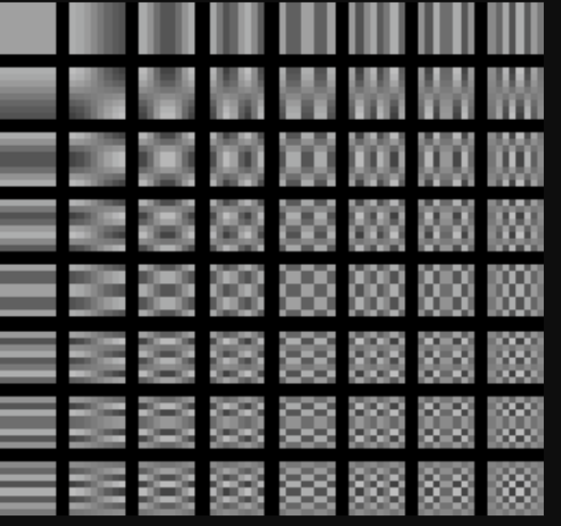
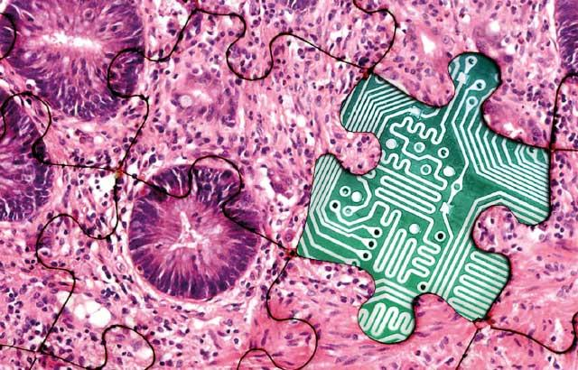
Discrete Cosine Transform
1
32
1
32
1
32
1
…
32 X 32
Matrix of DCT Values for the RED channel
1
…
32 X 32
Matrix of DCT Values for the GREEN channel
1
…
32 X 32
Matrix of DCT Values for the BLUE channel
…
…
…
…
…
…
…
…
…
…
…
…
…
…
…
…
…
…
…
…
…
32
…
32
…
32
…
Brightness
Horizontal Frequencies
Low Freq.
Low Frequency
Quantifies subtle changes
Smooth gradients
Vertical Frequencies
Combined Frequencies
High Frequency
Sudden changes in pixel values
High Freq.
Edges, borders, fine textures
Example 8x8 DCT Matrix
Example of Image

Slide 6
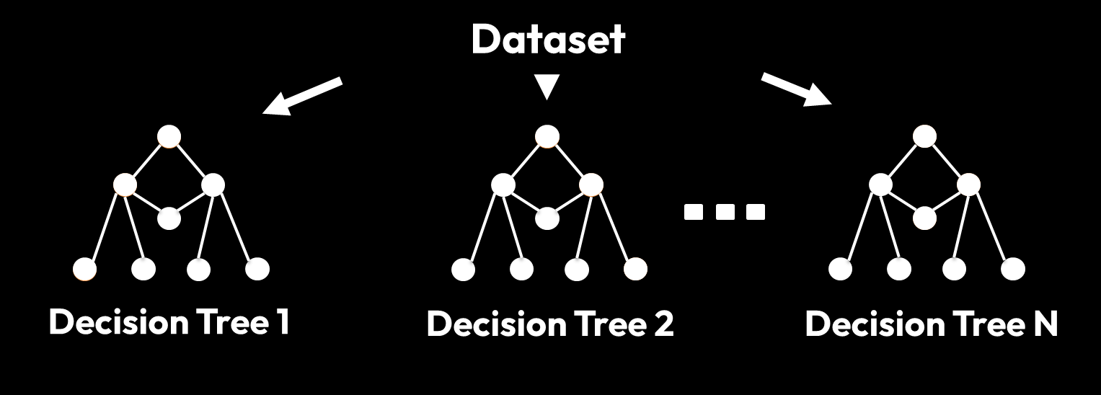
Non-Neural Network
Implementing a Random Forest as our baseline model
Dataset
Decision Tree 1
Decision Tree 2
Decision Tree N
Result 1
Result 2
Result N
Averaging
Final Result
Notes:
Jahtega

Slide 7



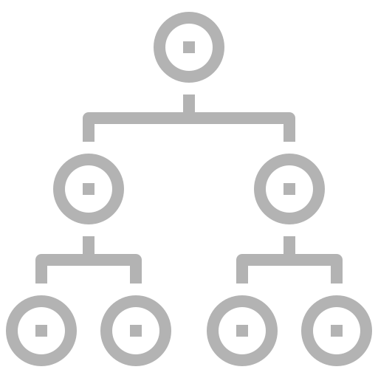


Random Forest Hyperparameters
N Estimators
Max Depth
Min Samples Split
Max Leaf Nodes
Number of trees in the forest
Maximum depth of each tree
When a node in the tree is allowed to split
How many end leaves a tree can have
Max Features
Bootstrap
Features sampled per node split
Samples with replacement
Notes:
Jahtega

Slide 8
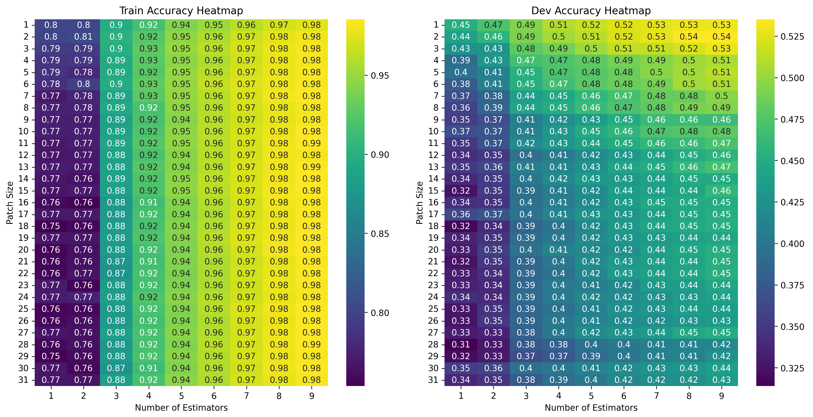
Estimators vs. NxN
Accuracy increases with the # of estimators, Accuracy decreases as N increases
N Estimators
Number of trees in the forest

Slide 9
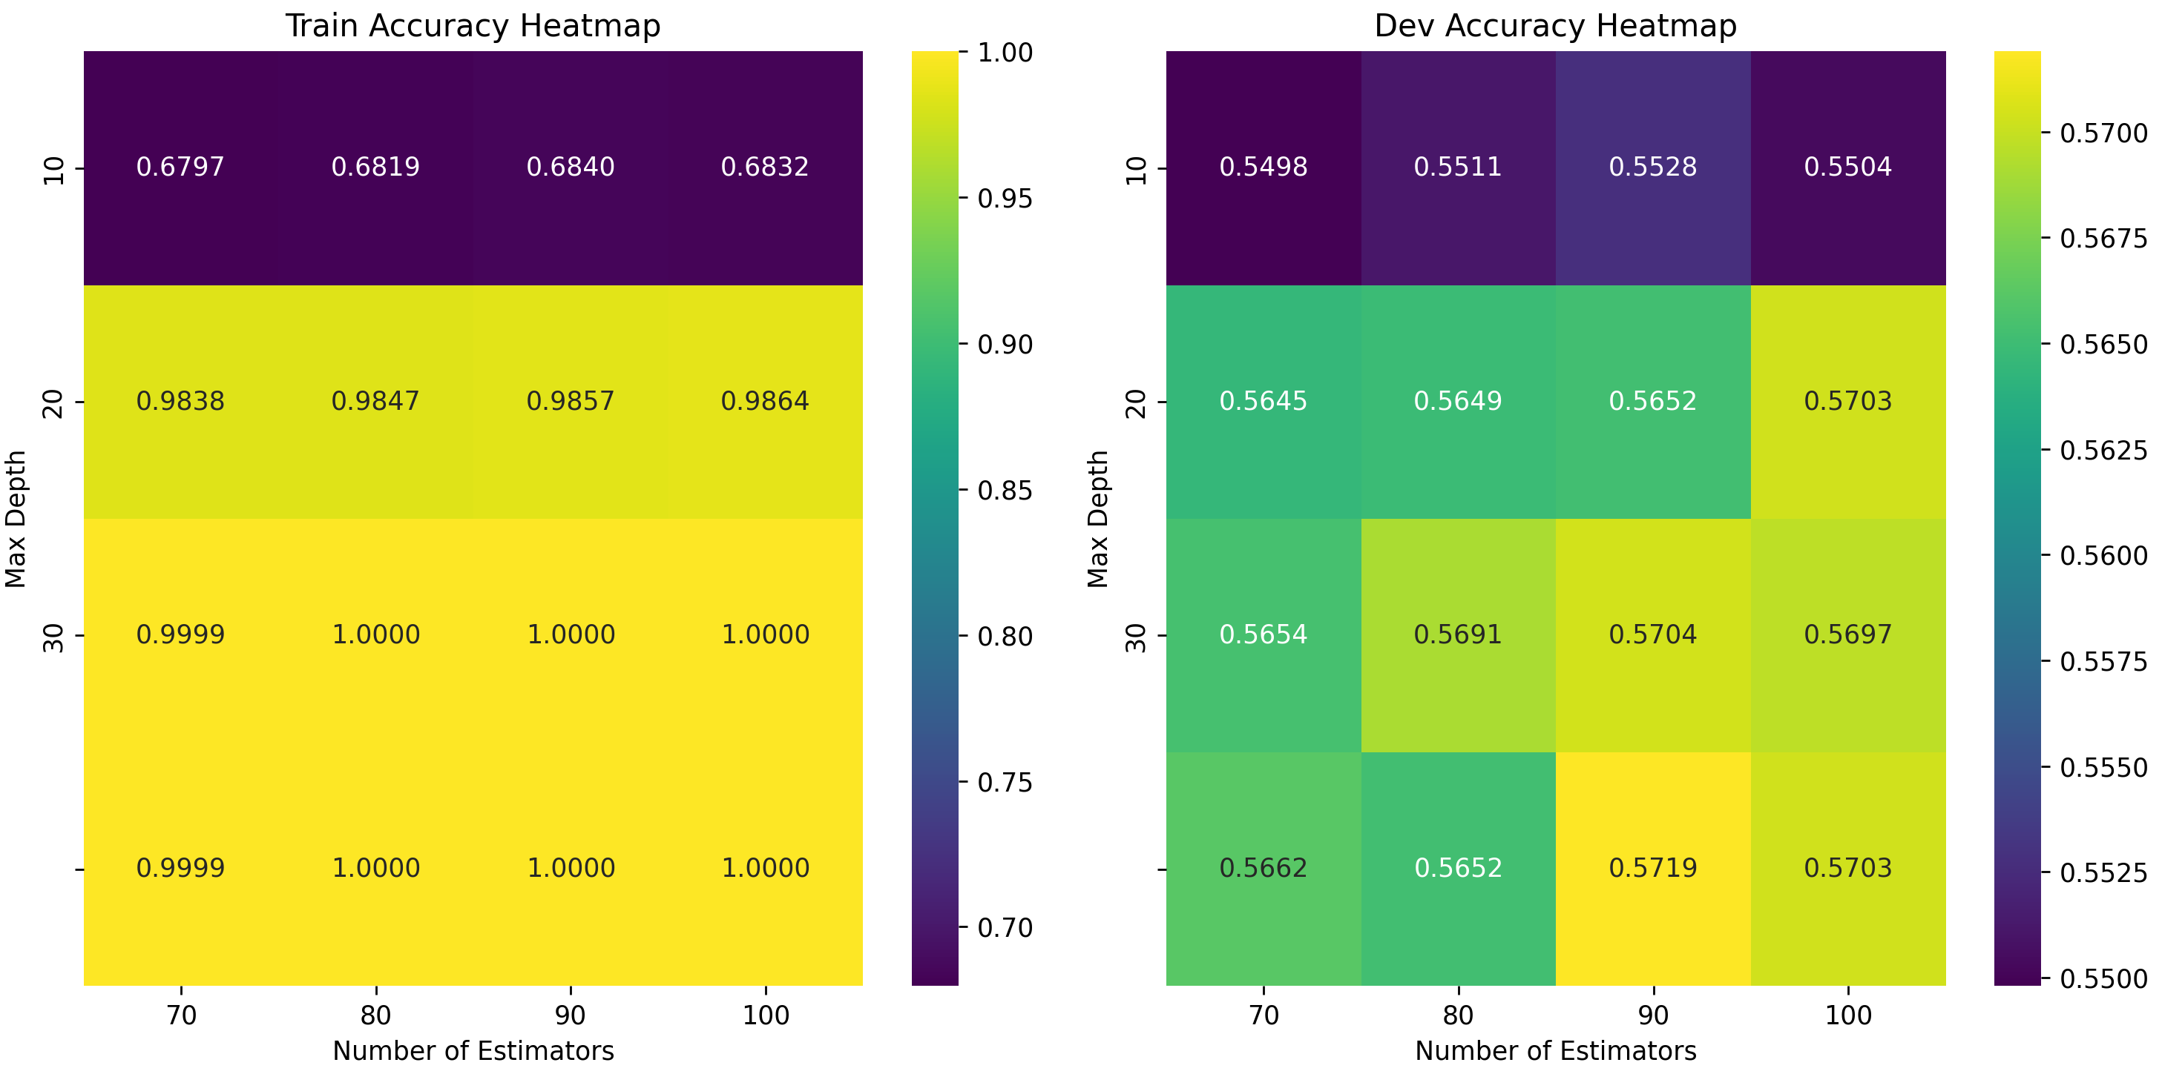
Estimators vs. Max Depth
Accuracy increases with Max Depth, no limit- gives best accuracy
Max Depth
Maximum depth of each tree

Slide 10
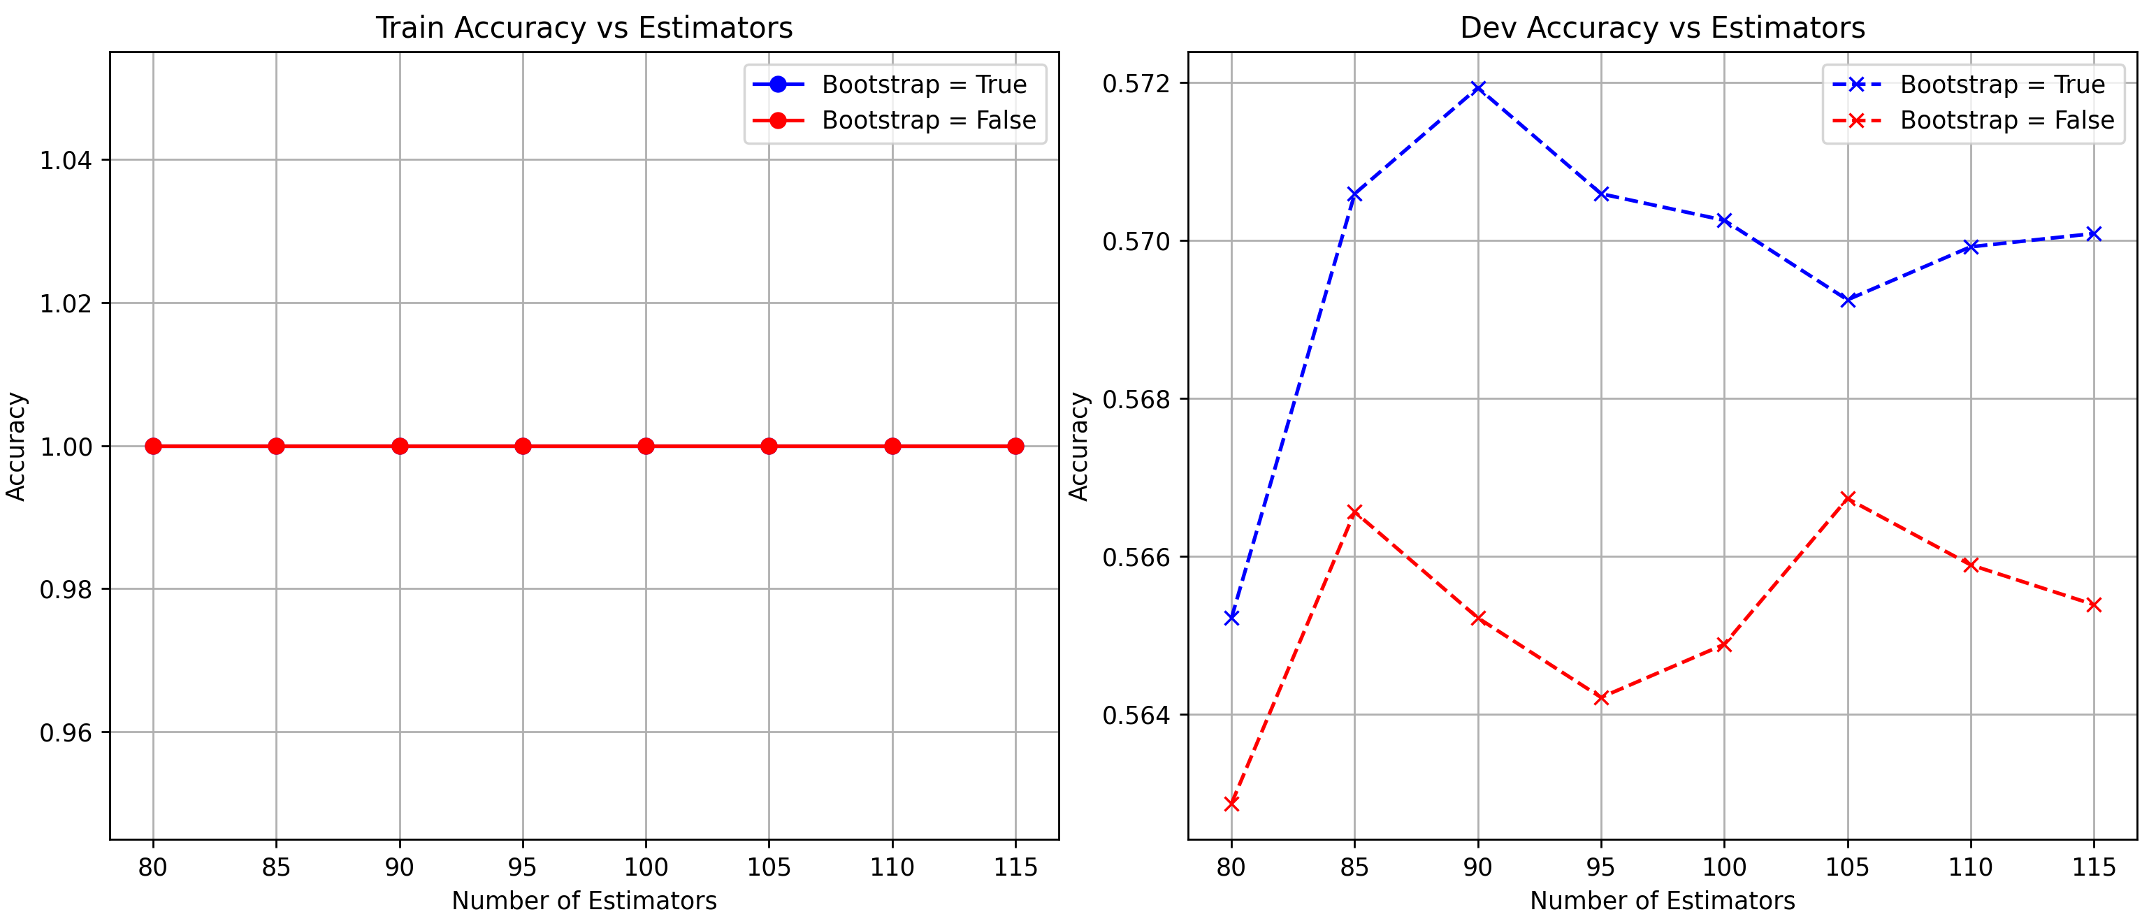
Estimators vs. Bootstrap
Bootstrapping gives higher accuracy
Bootstrap
Samples with replacement

Slide 11
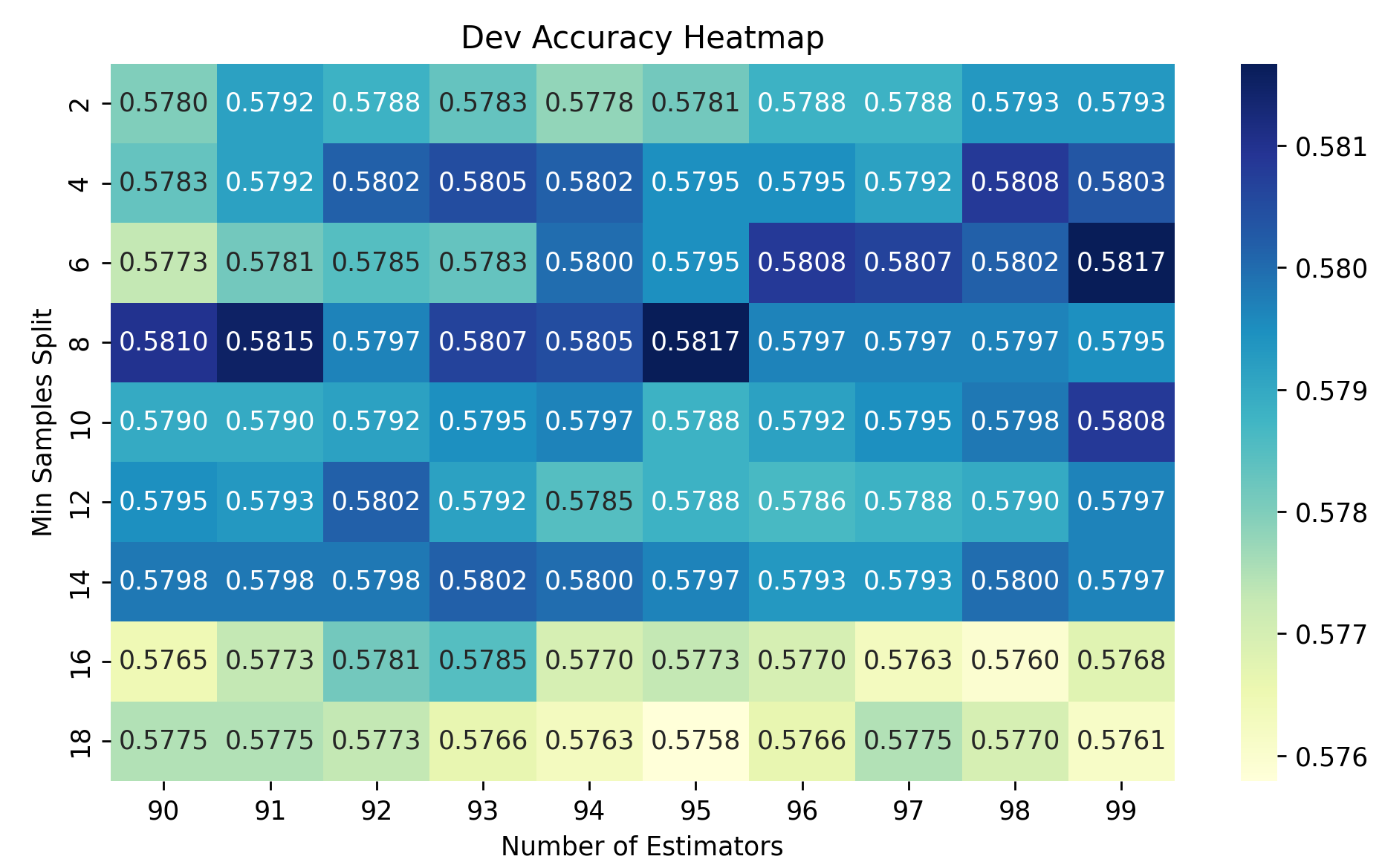
Estimators vs. Min Samples Split
Slightly decreased accuracy as it increases
Min Samples Split
When a node in the tree is allowed to split

Slide 12
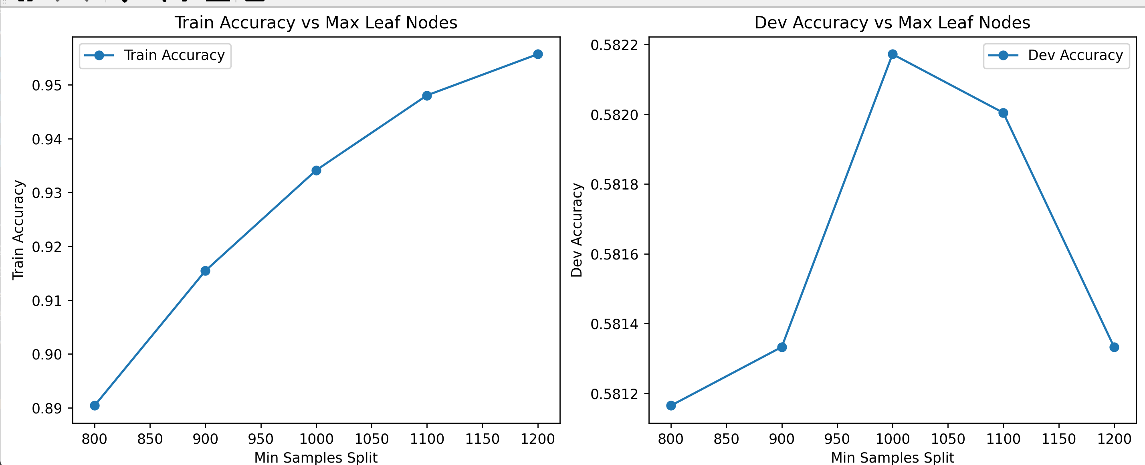
Accuracy vs. Max Leaf Nodes
Fits better to Train, generalizes worse with dev
Max Leaf Nodes
How many end leaves a tree can have

Slide 13
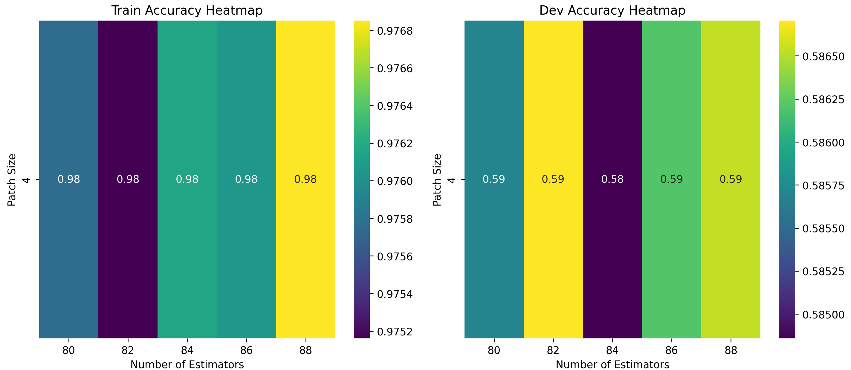
Final Accuracies
Train Accuracy: 97.51%
Dev Accuracy: 58.67%
NxN = 4x4
Notes:
Include the observations

Slide 14
Random Forest Hyperparameters
N Estimators
Max Depth
Min Samples Split
Max Leaf Nodes
Final Value: 82
Final Value: None
Final Value: None
Final Value: 998
Max Features
Bootstrap
Train Accuracy: 97.51%
Dev Accuracy: 58.67%
NxN = 4x4
Max Features
Bootstrap
Features sampled per node split
Samples with replacement
Final Value: None
Final Value: True
Notes:
Include the observations

Slide 15
Neural Network
Using Feed Forward Network to Classify
Why? This model takes in an input of vectors, the DCT is extracted information from the image
Input:
Hidden
Each node represents a feature within the input data
Input
Output
Hidden:
perform transformations from input using activation functions
Output
Provides final classification

Slide 16





FFN Hyperparameters
Number of Layers
Learning Rate
Activation Function
Epochs
Layers between input and output
How much to adjust weight in each update
Brings non-linearity in neuron output
Number training data passed in the network
Optimization Algorithm
Dropout Value
Algorithm used to optimize weight
Disables neurons to prevent overfitting
Notes:
Jahtega

Slide 17
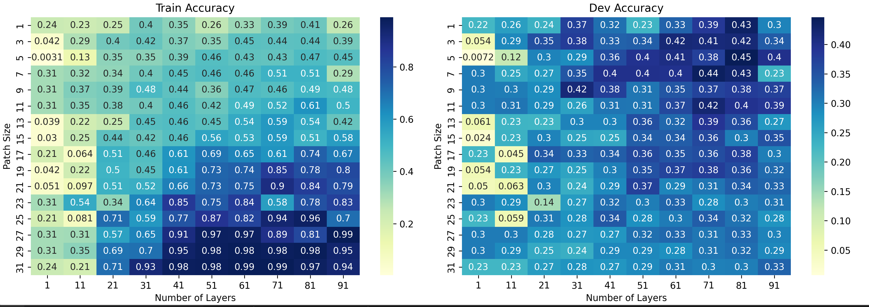
Number of Layers vs. NxN
Fits better to train, generalizes worse on dev
Number of Layers
Layers between input and output

Slide 18
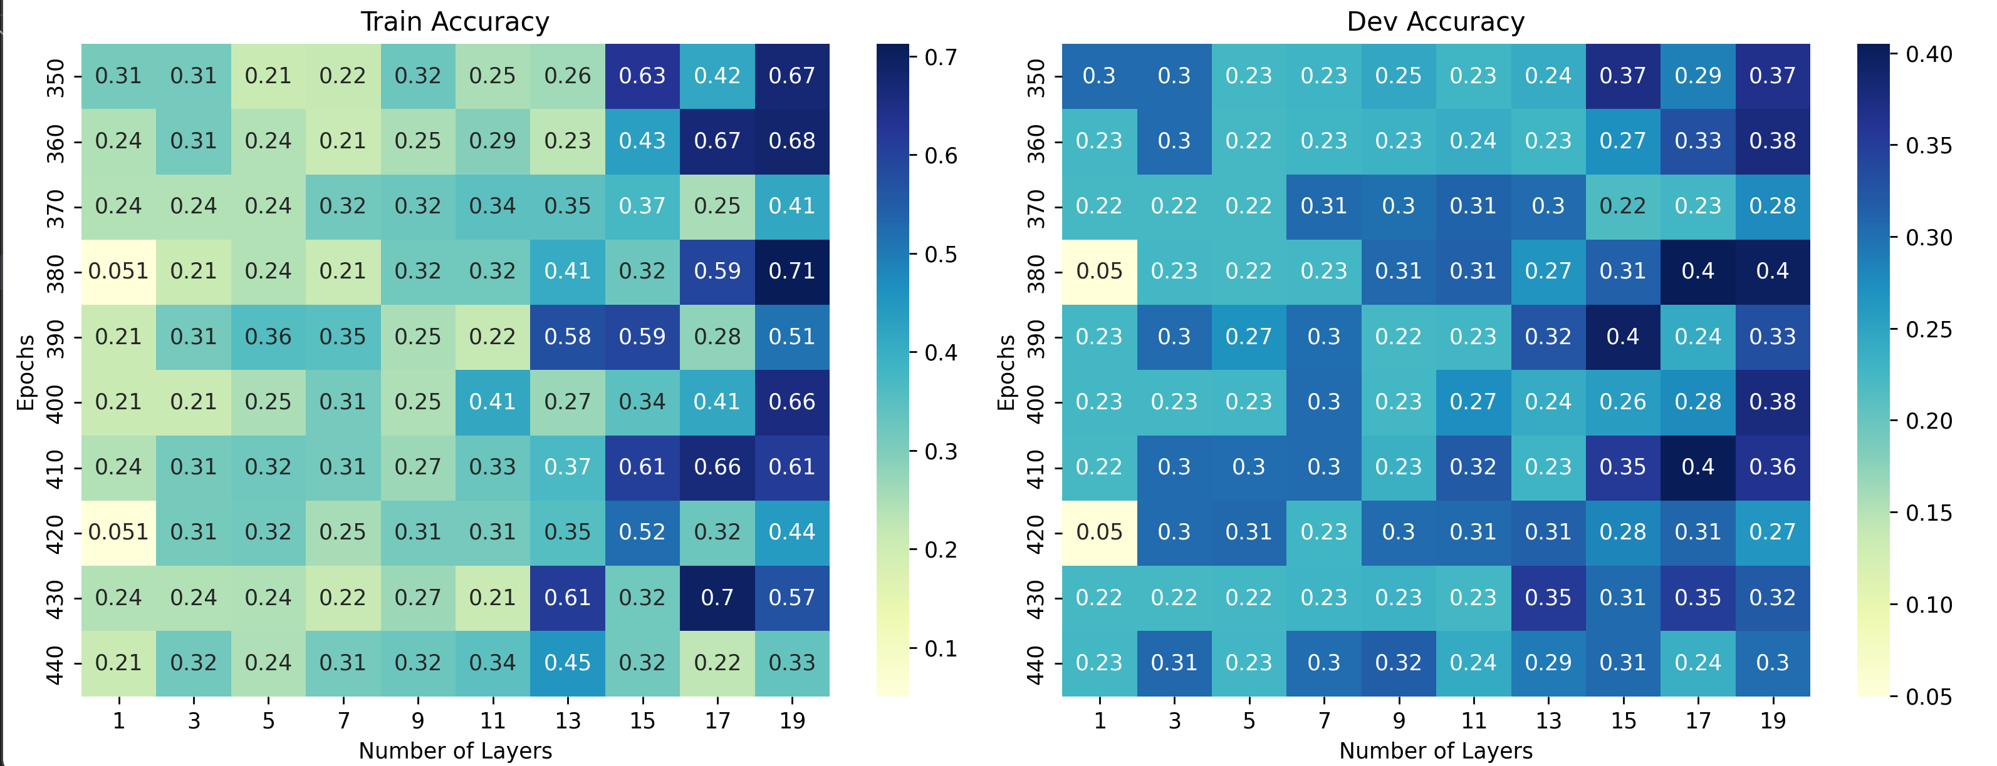
Layers vs. Epochs
More layers allow for better classification
Epochs
Number training data passed in the network
Number of Layers
Layers between input and output

Slide 19
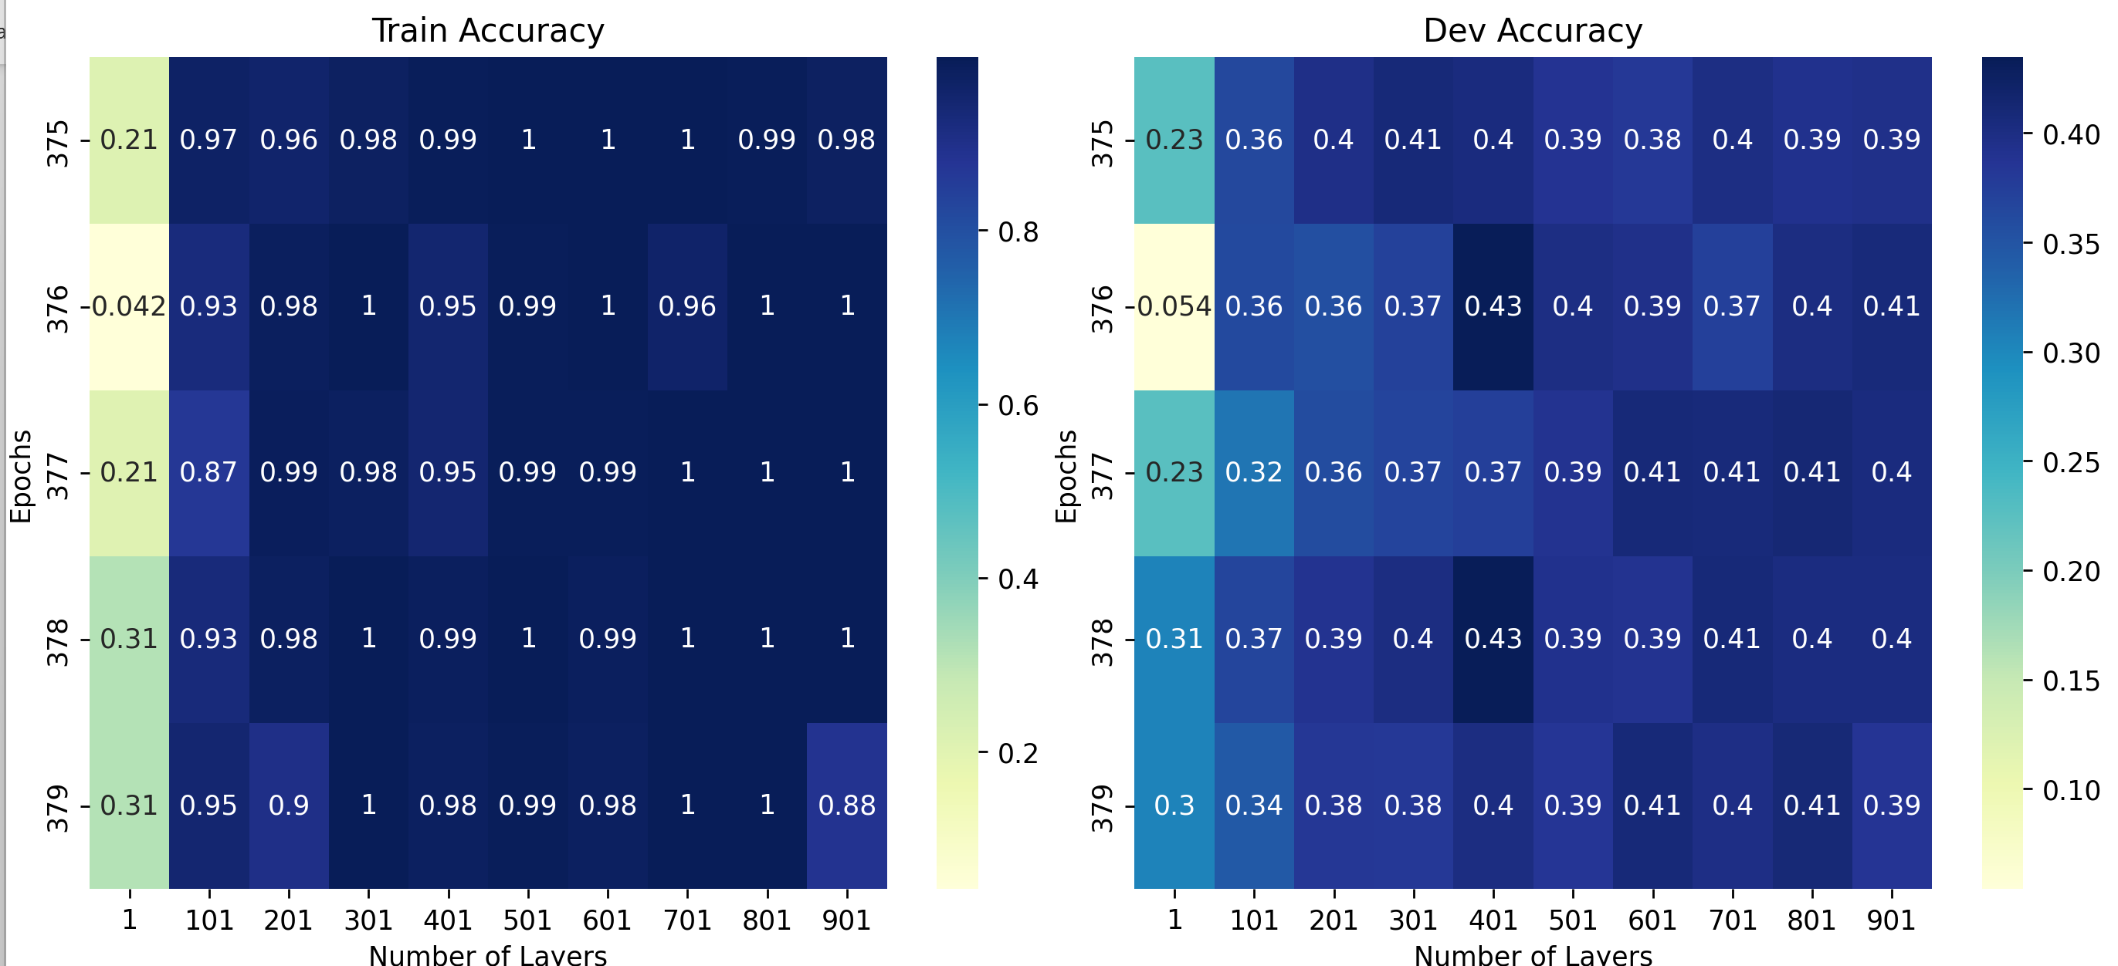
Layers vs. Epochs
Significantly increasing the number of layers- accuracy converges
Epochs
Number training data passed in the network
Number of Layers
Layers between input and output

Slide 20
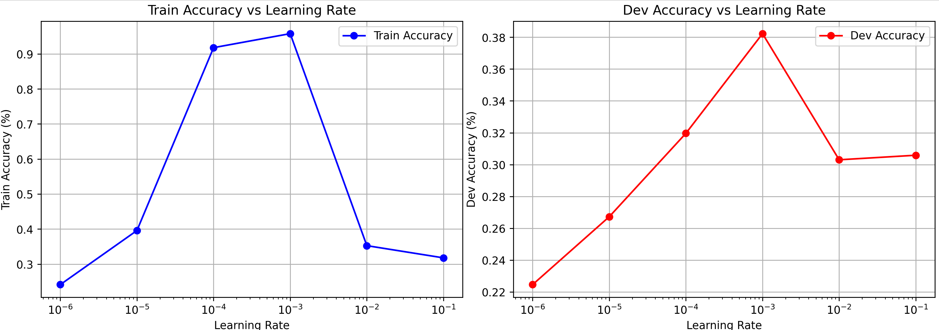
Learning Rate
Accuracy increases around 10^-3
Learning Rate
How much to adjust weight in each update

Slide 21
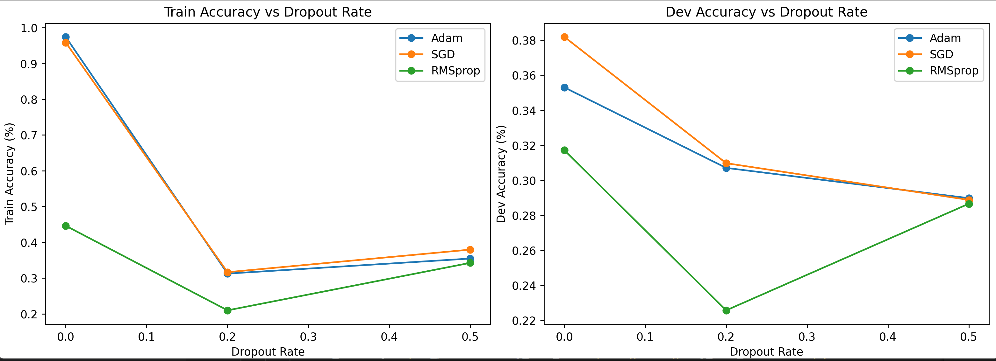
Dropout vs. Accuracy for Optimization
A dropout rate of 0 is best for different optimization functions
Optimization Algorithm
Algorithm used to optimize weight
Dropout Value
Disables neurons to prevent overfitting

Slide 22
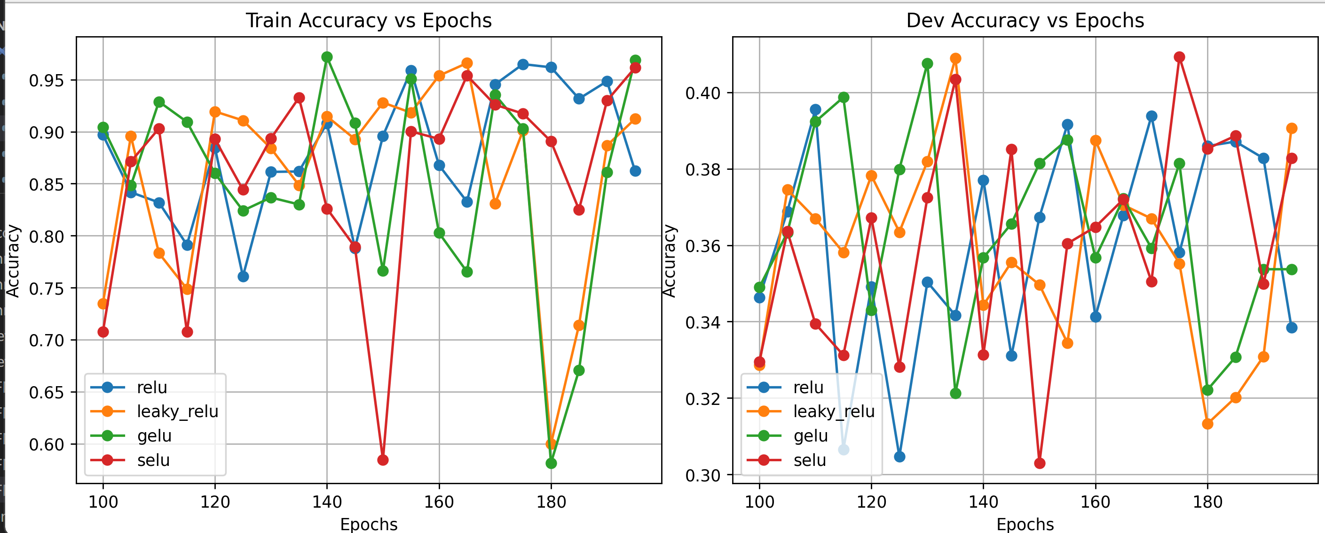
Various Activation Functions across Epochs
Gelu provides the highest accuracy around the same epoch value for both Train and Dev
Activation Function
Brings non-linearity in neuron output

Slide 23
FFN Hyperparameters
Number of Layers
Learning Rate
Activation Function
Epochs
Final Value:100
Final Value:0.001
Final Value: Gelu
Final Value: 115
Optimization Algorithm
Bootstrap
Dropout
Observation:
Activation: GELU
Epochs: 115
Train Accuracy: 90.94%
Dev Accuracy: 39.87%
Max Features
Max Features
Features sampled per node split
Features sampled per node split
Final Value: Adam
Final Value:
Final Value: 0
Notes:
Include the observations

Slide 24
Spring 2025 ECE 4527
Machine Learning Final
Thank You
Notes:
Include the confusion matrix and the number of accuracy

