Slide 1
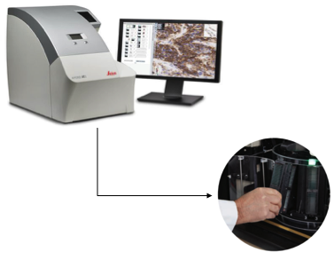
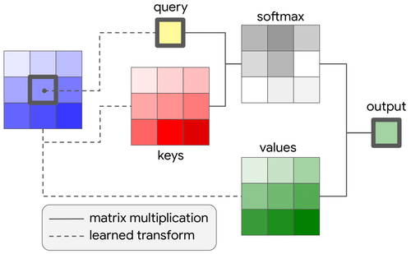
Final Project:
Introduction to
Machine Learning and Pattern Recognition
Digital Pathology
Claudia Dumitrescu

Slide 2
4527: Introduction to ML and PR
Summary
ML Approach:
AutoML
Cross Validation
Tuning
Results
DL Approach:
Implementation
xAI
Conclusions

Slide 3
4527: Introduction to ML and PR
ML Approach: AutoML
AutoML (lazypredict)
  Default Models (settings)
  Not efficient (32 models)
Interpretation:
  LightGBM buckets continuous
  DCT features into histograms,
  drastically reducing both memory
  and training time, while still
  capturing non-linear interactions.
  Unlike depth-wise trees, LightGBM
  grows the leaf with the largest
  error, which often leads to better
  fit on minority classes (internal
  “feature selection” – features that
  don't help classification are rarely
  used in splits).
Model | Balanced Acc | F1 | Time
LGBMClassifier | 0.37 | 0.56 | 661s
XGBClassifier | 0.36 | 0.55 | 922s
BaggingClassifier | 0.33 | 0.50 | 636s
DecisionTree Classifier | 0.31 | 0.44 | 95s
AdaBoost Classifier | 0.26 | 0.44 | 219s
RandomForest Classifier | 0.26 | 0.42 | 102s
ExtraTrees Classifier | 0.26 | 0.40 | 24s
SVC | 0.26 | 0.39 | 569s
GaussianNB | 0.37 | 0.36 | 4s
SGDClassifier | 0.21 | 0.36 | 291s

Slide 4
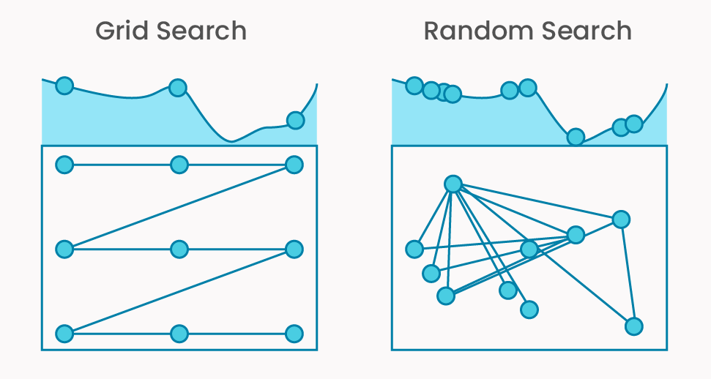
4527: Introduction to ML and PR
ML Approach: Cross Validation
Best parameters: {'clf__class_weight': 'balanced', 'clf__learning_rate': 0.05,
'clf__n_estimators': 200, 'clf__num_leaves': 31, 'reg_alpha': 0.5, 'reg_lambda': 0.0}
Per-fold test F1 scores for best params:
Fold 0: 0.5693
Fold 1: 0.5487
Fold 2: 0.5861
Fold 3: 0.5805
Fold 4: 0.5738
Mean F1: 0.5717 ± 0.0128.
Data is moderately separable but not
trivially easy. (may contain noise).
Upper bounds on performance may be limited unless more discriminative features
or better labels are introduced.
In most of the folds, std deviation ranges from ~0.006 to ~0.012, which implies:
  Consistent generalization across folds (dataset is reasonably balanced and
  stratified across splits).
  The model is not overfitting to particular folds.

Slide 5
4527: Introduction to ML and PR
ML Approach: Tunning
Baseline
  Started with default settings
  Imbalanced data => weighting
  Mutual Information (statistical
  dependency between feature -
  target, not just linear
  correlation)
Counter-intuitive
  PCA preserves directions of
  maximum variance in the
  feature space, without
  considering the class labels.
  Models like LightGBM (well
  regularized), reduce variance
  without preserving
  class-separating information.
Approach | Error Dev | Error Eval | Error Train
LGBMClassifier | 61.65% | 60.59% | 0.01%
LGBMClassifier (tuned) – (class_weight: 'balanced', learning_rate': 0.05, estimators': 200, reg_alpha': 0.5) | 55.99% | 56.15% | 0.00%
PCA (n_components=200) & LGBMClassifier (balanced) | 55.09% | 58.08% | 0.00%
PCA (n_components=200) & LGBMClassifier (tuned) | 54.92% | 57.54% | 0.00%
PCA SelectKBest(mutual_info_classif, k=150) + LGBMClassifier (balanced) | 54.66% | 57.45% | 0.00%
PCA SelectKBest(mutual_info_classif, k=150) + LGBMClassifier (tuned) | 53.92% | 56.62% | 0.00%

Slide 6
4527: Introduction to ML and PR
ML Approach: Results
Comments
  Mutual information has helped
  by stripping away those principal
  components that although they
  captured variance, didn’t actually
  carry much class-discriminative
  signal.
  L₁ regularization (via reg_alpha)
  induces true sparsity in the model’s
  leaf‐weight coefficients
  automatically driving many weak
  PCA components’ contributions
  to zero - whereas L₂ (reg_lambda)
  shrinks weights without ever
  zeroing them out.
  => L₁ acted like an automatic
  feature pruner.
Approach | Error Dev | Error Eval | Error Train
LGBMClassifier | 61.65% | 60.59% | 0.01%
LGBMClassifier (tuned) – (class_weight: 'balanced', learning_rate': 0.05, estimators': 200, reg_alpha': 0.5) | 55.99% | 56.15% | 0.00%
PCA (n_components=200) & LGBMClassifier (balanced) | 55.09% | 58.08% | 0.00%
PCA (n_components=200) & LGBMClassifier (tuned) | 54.92% | 57.54% | 0.00%
PCA SelectKBest(mutual_info_classif, k=150) + LGBMClassifier (balanced) | 54.66% | 57.45% | 0.00%
PCA SelectKBest(mutual_info_classif, k=150) + LGBMClassifier (tuned) | 53.92% | 56.62% | 0.00%

Slide 7
4527: Introduction to ML and PR
DL Approach: Implemntation
Key Components:
  Inverse-DCT (upsampling)
  Transfer-learning model
  (EfficientNetB0)
  Two-stage training: (head → tune)
  Freeze all EfficientNetB0
  convolutional layers
  (base.trainable = False)
  Train only the newly-added
  classifier head (global pooling,
  dropout, Dense) from scratch.
Still Improving:
  Class-weight (ignore certain
  labels)
  masked F1 loss
Approach | Error Dev | Error Eval | Error Train
LGBMClassifier | 61.65% | 60.59% | 0.01%
LGBMClassifier (tuned) – (class_weight: 'balanced', learning_rate': 0.05, estimators': 200, reg_alpha': 0.5) | 55.99% | 56.15% | 0.00%
PCA (n_components=200) & LGBMClassifier (balanced) | 55.09% | 58.08% | 0.00%
PCA (n_components=200) & LGBMClassifier (tuned) | 54.92% | 57.54% | 0.00%
PCA SelectKBest(mutual_info_classif, k=150) + LGBMClassifier (balanced) | 54.66% | 57.45% | 0.00%
PCA SelectKBest(mutual_info_classif, k=150) + LGBMClassifier (tuned) | 53.92% | 56.62% | 0.00%
Efficientnet (sparse_categorical_crossentropy, adjusting LR) | 89.80% | 88.29% | 87.84%
ResNet | 47.61% | 52.52% | 35.53%

Slide 8
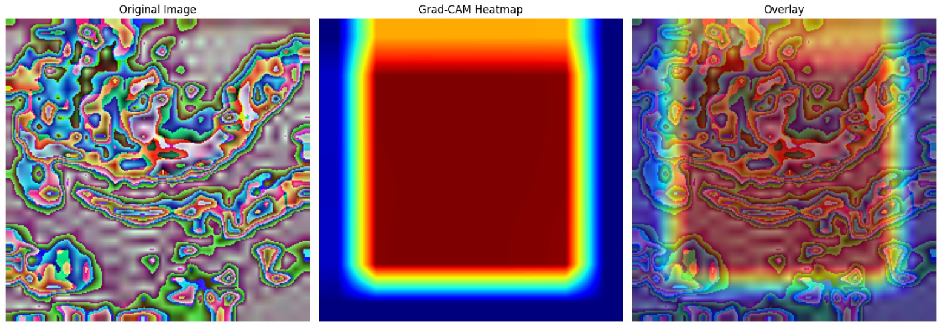
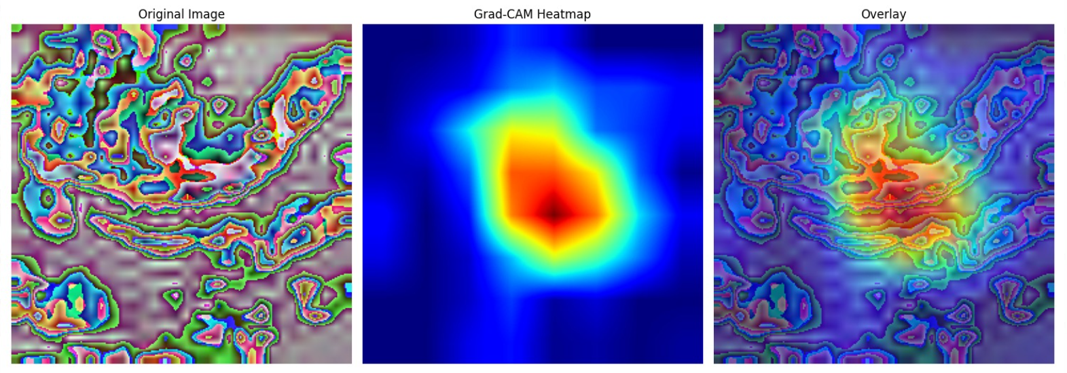
4527: Introduction to ML and PR
DL Approach: xAI
EfficientNet
(256 x 256)
ResNet
(256 x 256)

Slide 9
4527: Introduction to ML and PR
Conclusions
Tree-based pipelines:
LightGBM that overfit the training set (near‐zero train error) but
generalized poorly (∼61.7% Dev error), we progressively introduced
class‐weight balancing, hyperparameter optimization (learning_rate,
n_estimators, reg_alpha), PCA, and mutual-information–based
feature selection.
(from 61.65% down to 53.92%)
End-to-end CNNs on reconstructed DCT images:
Struggled without tunning (especially in the EfficientNet) - head-only
training (with standard cross-entropy and LR schedules) yielded
extremely high error rates (∼89% Dev error), indicating a poor fit –
likely due to domain mismatch, insufficient epochs etc.
ResNet variant fared better but still underfit (train error 47.6%,
Dev error 35.5%), suggesting that direct image-based models require
more extensive fine-tuning.
xAI

Slide 10
4527: Introduction to ML and PR
Thank you!
Questions?

