Slide 1
ECE 8527: Intro to Machine Learning and Pattern Recognition
Final Project

Slide 2
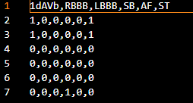
The ask
Given EKG chart data
8 channel Data
6 possible health conditions
Train and Dev labeled data
Classify data using one neural network and one non neural network
Output HYP files with our predictions
Notes:
Given ECG charts
Looks similar to audio data
Decided on convolution for N
Researched how to read in and analyze audio files
CNNs good for this

Slide 3
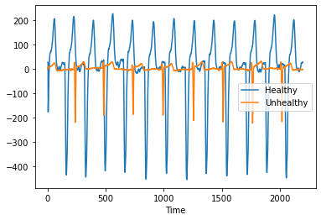
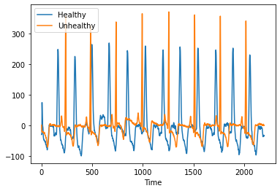
The Data
Given ECG charts
Looks similar to audio data
Decided on convolution
Was provided in .list files of data in bytes
Read in the data using NumPy.Frombuffer
Plotted a small sample to get a feel for the data
Different channels have different shapes – depending on where the ECG lead is placed
Notes:
Given ECG charts
Looks similar to audio data
Decided on convolution for N
Researched how to read in and analyze audio files
CNNs good for this

Slide 4
Random Forest Network
Data Processing
Read in the data
Feature Engineering
Computed convolution with different kernel sizes
Each heartbeat is 0.8 seconds
Each convolution takes the area under the curve of each signal
Took the max and min of each convolution
Notes:
Motivated by CNN
Capture the peeks

Slide 5
Random Forest Network
Model training
RNF from SciKitLearn
First test trained on just unhealthy but for final results trained on the whole training set
Metrics
Ran Dr. Picone’s score script to see results
Notes:
Used standard SciKitLearn pack

Slide 6
CNN
Data Processing
Read in the data
Normalized the data by dividing by 255
Convert to torch tensor and then floats to use PyTorch
Notes:
Given ECG charts
Looks similar to audio data
Decided on convolution for N
Researched how to read in and analyze audio files
CNNs good for this

Slide 7
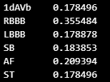
CNN
Model
CNN
3 convolutions, 3 non linear
ReLu
Maxpool
Adjusted the loss function
Starting point torch.nn.bce
Higher penalty for guessing 0 when truth was 1
Tried to balance
Certain health issues were more common than others
Notes:
Binary cross entropy
Adds up results pytorch not built in
Scikitlearn its built in
Tried 2 convs and 2 linear but it wasn’t learning – not complicated enough

Slide 8
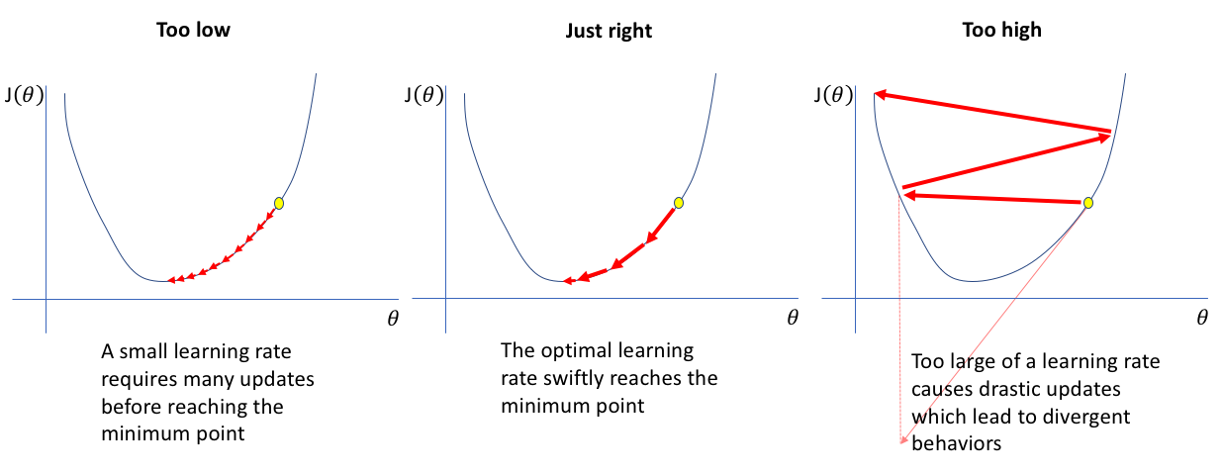
CNN
Standard optimizer but originally had too high of a learning rate
https://www.jeremyjordan.me/nn-learning-rate/

Slide 9
CNN
Training the Model
Originally trained on only sick data
Had ok results
Finally trained on whole training set
Several rounds of epochs from 100 to 50
Loaded saved model

Slide 10
Results

Slide 11
Thank you

