Slide 1
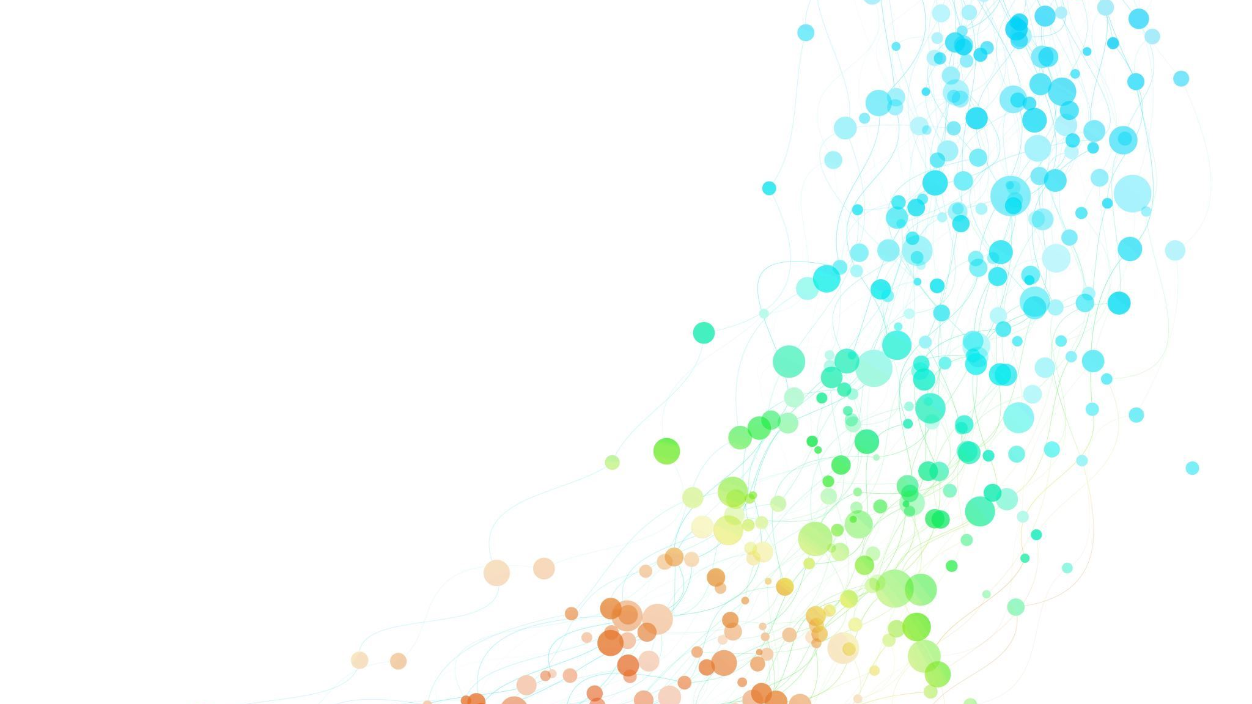
Classification of Digital Pathology Images using Machine Learning
Md Abdullah Al Mamun
MS student, ECE, Temple University

Slide 2
Introduction & Background
Conversion of traditional glass histology slides into high-resolution digital images
Enables remote viewing, annotation, and collaborative review
Key Applications : Clinical diagnosis (e.g., cancer grading), Research (biomarker discovery, drug response studies), Quantitative image analysis (automated feature extraction)
Main Challenges
Extremely large file sizes (gigapixel images)
Complex tissue patterns and staining variability
High computational cost for storage, transmission, and processing

Slide 3
Dataset Overview
Features: 3072 Discrete Cosine Transform (DCT) coefficients per sample.
Target Variable: Located at index 0 of each data instance.
Labels (9 total): { 0: norm, 1: artf, 2: nneo, 3: infl, 4: susp, 5: dcis, 6: indc, 7: null, 8: bckg }
Data Splits:
Training Set: 10,066 samples
Development Set: 5,958 samples
Evaluation Set: 6,260 samples

Slide 4
Custom Evaluation Metric
Metric Type: Weighted Average Error Rate (%).
Goal: Lower score indicates better performance.
Calculation:
Based on a confusion matrix derived from reference and predicted labels.
Excludes: Samples with true labels artf (1), susp (4), or null (7) are ignored.
Calculates individual error rates for key classes (norm, nneo, infl, dcis, indc, bckg).
Computes a final score using a weighted average:
90% weight on the average error of classes 0, 2, 3, 5, 6.
10% weight on the error of the bckg class (8).

Slide 5
XGBoost Model Results
Approach: Non-neural (XGBoost classifier).
Data Preprocessing: Significantly down-sampled unweighted data (retained 2%).
Best Model Selection: Based on development set error (0.46).
Custom Evaluation Scores (%):
Train: 1.69%
Dev: 63.45%
Eval: 61.01% (Note: Lower custom score is better)

Slide 6
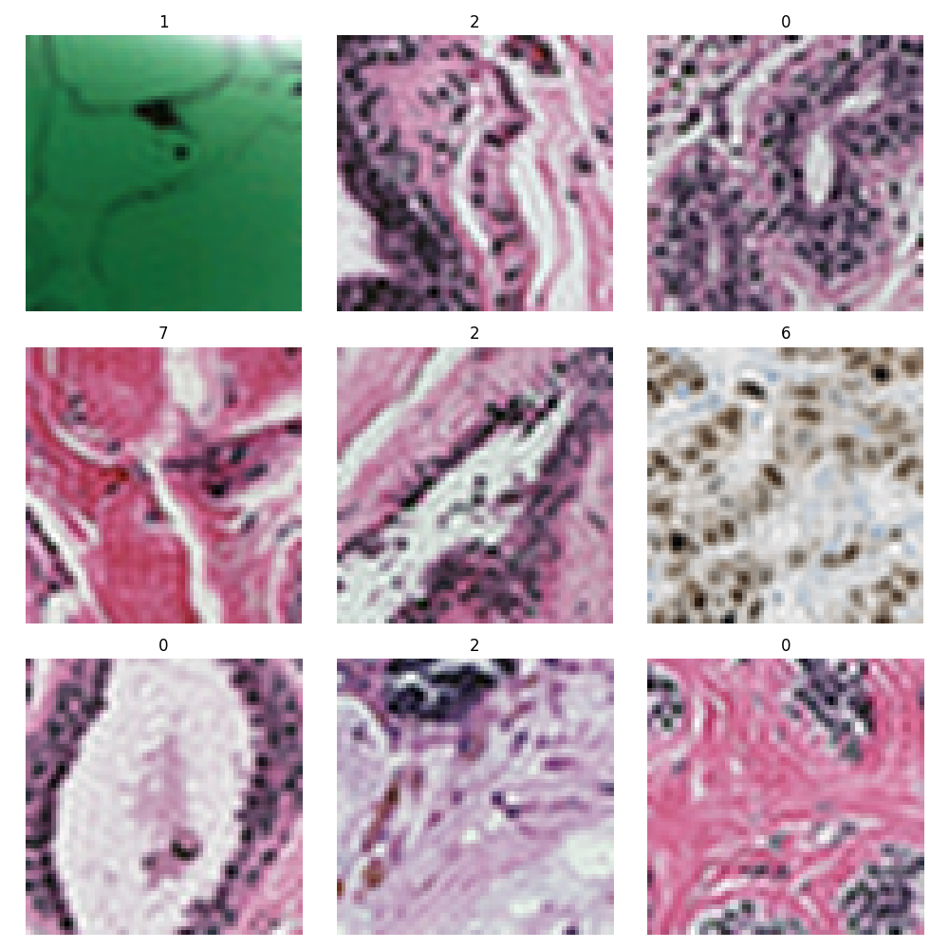
Data preprocessing For neural network
Goal was to convert DCT coefficients back to spatial domain images for NN input.
The Method was to apply Inverse Discrete Cosine Transform (IDCT).
Details(Known):
Original features were 32x32 DCT coefficients (from the top-left quadrant of a 64x64 transform).
IDCT recovered spatial domain image representations.
Achieved good image recovery from coefficients.

Slide 7
Neural Network Models Explored
Convolutional Neural Networks (CNNs):
ResNet (trained from scratch)
ResNet (pretrained)
MobileNet (pretrained)
InceptionNet (pretrained)
VGG16 (pretrained)
DenseNet (pretrained)
EfficientNet (B0-B7, V2S, V2L - pretrained)
Transformers:
Vision Transformer (ViT - base & large, pretrained)

Slide 8
Results (Round 1)
Model | Train Error (%) | Dev Error (%)
ResNet (scratch) | 17.96% | 30.75%
ResNet (pretrained) | 0.06% | 28.90%
MobileNet (pretrained) | 2.27% | 27.64%
InceptionNet (pretrained) | 1.24% | 29.76%
VGG16 (pretrained) | 20.28% | 35.55%
DenseNet (pretrained) | 29.83% | 31.29%
EfficientNet B0 (pretrained) | 7.06% | 26.97%
EfficientNet B7 (pretrained) | 20.60% | 26.85%
ViT-Base (pretrained) | 0.04% | 27.76%
ViT-Large (pretrained) | 14.09% | 28.26%
Base Model Architecture (as listed previously).
Training Strategy: From scratch or Pretrained weights.

Slide 9
Weighting Strategy: Standard vs. Weighted loss
Challenge: Standard loss functions treat all classes equally, but the custom evaluation metric ignores certain classes (artf, susp, null).
Goal: Align the model's training objective with the final evaluation criteria.
Solution: Implemented a Weighted Loss Function.
Mechanism:
Assigned a weight of zero to the loss contribution from samples with true labels artf (1), susp (4), and null (7).
Assigned a weight of one to all other classes relevant to the evaluation score.

Slide 10
Results (Round 2)
Model | Dev Error (%) | Label Error (%) | Background Error (%) | Score (%)
Weighted B0 | 32.78% | 31.79% | 11.99% | 29.81%
Weighted B1 | 31.94% | 32.25% | 8.91% | 29.92%
Weighted V2S | 32.63% | 33.27% | 7.57% | 30.70%
Weighted V2L | 31.45% | 32.72% | 9.21% | 30.37%
Weighted B7 | 32.61% | 32.12% | 8.76% | 29.78%
Weighted ViT-Base | 37.16% | 34.43% | 3.82% | 31.37%

Slide 11
Cross-Validation: Evaluating model robustness and generalization
Method: K-Fold Cross-Validation employed for model evaluation and hyperparameter tuning.
Folds Explored: Both 5-fold and 10-fold cross-validation were tested.
5-Fold: i) train sample: 12819 ii) 3205
10-Fold ii) train sample: 14421 ii) 1603
Final Choice: 5-fold cross-validation was selected.
Rationale:
Provided strong generalization performance on this dataset.
Deemed sufficient given the dataset size (avoiding potential overfitting to specific folds with 10-fold and reducing computation).

Slide 12
Results (Round 3): Unweighted B7
Fold | Val Error (%)
Fold 1 | 24.87%
Fold 2 | 23.96%
Fold 3 | 26.33%
Fold 4 | 23.56%
Fold 5 | 24.13%
Overall Best | 23.56%
Avg. Best | 24.57%
Fold | Val Error (%)
Fold 1 | 22.77%
Fold 2 | 24.14%
Fold 3 | 23.02%
Fold 4 | 21.71%
Fold 5 | 24.16%
Fold 6 | 23.35%
Fold 7 | 22.53%
Fold 8 | 23.60%
Fold 9 | 21.66%
Fold 10 | 23.22%
Overall Best | 21.66%
Avg. Best | 23.02%

Slide 13
Results (Round 3): weighted B7
Fold | Best Score
Fold 1 | 0.2446
Fold 2 | 0.2535
Fold 3 | 0.2173
Fold 4 | 0.2446
Fold 5 | 0.2341
Overall Best | 0.2173
Fold | Best Score
Fold 1 | 0.2401
Fold 2 | 0.2463
Fold 3 | 0.2324
Fold 4 | 0.2380
Fold 5 | 0.2368
Fold 6 | 0.2106
Fold 7 | 0.2175
Fold 8 | 0.2472
Fold 9 | 0.2140
Fold 10 | 0.2452
Overall Best | 0.2106

Slide 14
Final Results
Dataset | Label Error (%) | Background Error (%) | Score (%)
Train | 11.73% | 2.84% | 10.84%
Dev | 12.45% | 6.14% | 11.82%
Eval | 34.54% | 7.28% | 31.81%

