Slide 1

ECE-8527
INTRO TO MACHINE LEARNING AND
PATTERN RECOGNITION
FINAL PROJECT
-VENKATESH THOTA

Slide 2
Introduction to Dataset:
The data is generated from the TUH DPATH Breast Dataset using 256x256 DCT on manually annotated patches of digital pathology images.
The dataset consists of 3072 features per sample: 1024 coefficients each for Red, Green, and Blue channels.
Labels: 0-8, representing different tissue or background types (e.g., norm, nneo, infl, dcis, etc.).
Dataset Structure:
First Column: Class label (0-8).
Next 3072 Columns: DCT coefficients for Red, Green, and Blue channels.
Key Point: The dataset is a collection of features derived from DCT coefficients and their corresponding class labels.

Slide 3
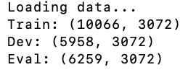
Data Processing:
Data Loading: Read the CSV file, separate the labels and features.
Normalization: Scale DCT coefficients to a standard range using StandardScaler.
Data Splitting: Split the data into training, validation (development), and test (evaluation) datasets.
Class Imbalance Handling: Use techniques like SMOTE or class weighting to mitigate bias towards overrepresented classes.

Slide 4
Label Mapping:
Original Labels: 9 classes, each representing a specific type of tissue or background.
Collapsing Labels: Grouped labels into broader categories like:
  Non-Cancer: norm, nneo.
  Cancer (Interesting): infl, dcis, indc.
  Background (bckg): Used for evaluating model’s ability to differentiate non-relevant tissue.
Scoring Method:
Average error rates for the first five classes and average for bckg.

Slide 5
Model Approach:
Model Selection: Two models were used:
Random Forest (RF): A classical machine learning model based on decision trees.
Convolutional Neural Network (CNN): A deep learning model specialized for image-like data.
Why RF and CNN?
RF: Suitable for high-dimensional data like DCT coefficients and handles mixed-type features.
CNN: Well-suited for spatial data (images) and can learn hierarchical features from raw pixel data or transformed features like DCT coefficients.

Slide 6
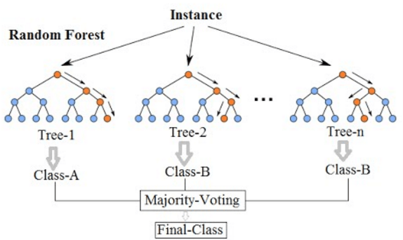
Random Forest(RF):
How It Works:
Random Forest is an ensemble learning method based on decision trees.
It constructs multiple decision trees during training and outputs the mode of the classes (classification) for the individual trees.
Each tree is trained on a random subset of the data, ensuring diversity among the trees.
It uses bagging (Bootstrap Aggregating) to improve model stability and prevent overfitting.
Advantages of RF:
Works well on high-dimensional data (like 3072 features).
Handles imbalanced data better than some other algorithms.
No need for scaling or normalization of input features.
Challenges with RF: Can suffer from overfitting, especially when the model becomes too complex or when the data has many outliers.

Slide 7
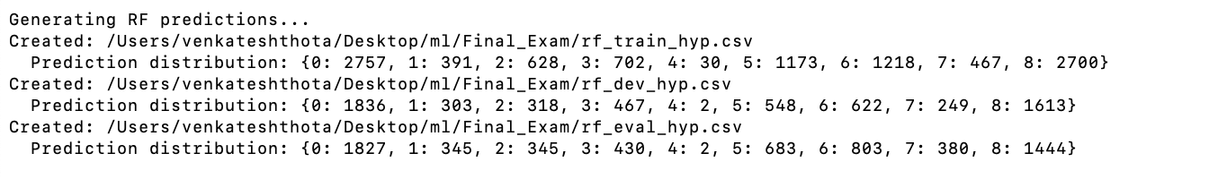
Prediction Files Created:
The first message shows that predictions for the train set have been saved to the file rf_train_hyp.csv.
The second message shows predictions for the dev set have been saved to rf_dev_hyp.csv.
The third message shows predictions for the eval set have been saved to rf_eval_hyp.csv.
Prediction Distribution:
Each prediction distribution shows how many samples of each class (0 to 8) were predicted. For example:
In the train set predictions: {0: 2757, 1: 391, 2: 628, 3: 702, 4: 30, 5: 1173, 6: 1218, 7: 467, 8: 2700} shows that class 0 had 2757 predictions, class 1 had 391, and so on.
In the dev set predictions: {0: 1836, 1: 303, 2: 318, 3: 467, 4: 2, 5: 548, 6: 622, 7: 249, 8: 1613}, showing the distribution for the dev data.
In the eval set predictions: {0: 1827, 1: 345, 2: 345, 3: 430, 4: 2, 5: 683, 6: 803, 7: 380, 8: 1444}, indicating the distribution for the evaluation set.

Slide 8
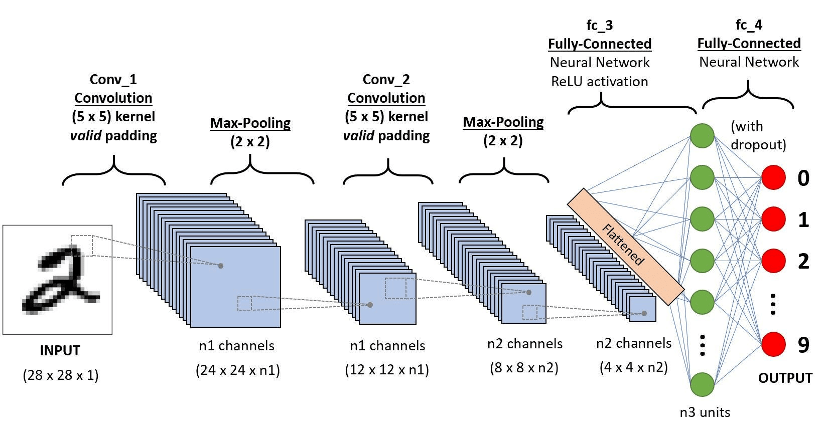
Convolutional Neural Network (CNN):
How It Works:
A CNN is a specialized deep learning model designed for image data.
It works by learning spatial hierarchies using convolutional layers.
CNNs apply filters (kernels) to local patches of an image to learn features like edges, textures, or shapes.
Max pooling layers are used to reduce spatial dimensions and increase computation efficiency.
The fully connected layers at the end of the network perform the classification based on the learned features.
Advantages of CNN:
Feature extraction is learned automatically, reducing the need for manual feature engineering.
Captures complex patterns and hierarchies, making it ideal for image-related tasks.
Challenges with CNN: Requires a large amount of data for training and can be computationally expensive, especially for high-dimensional inputs.

Slide 9
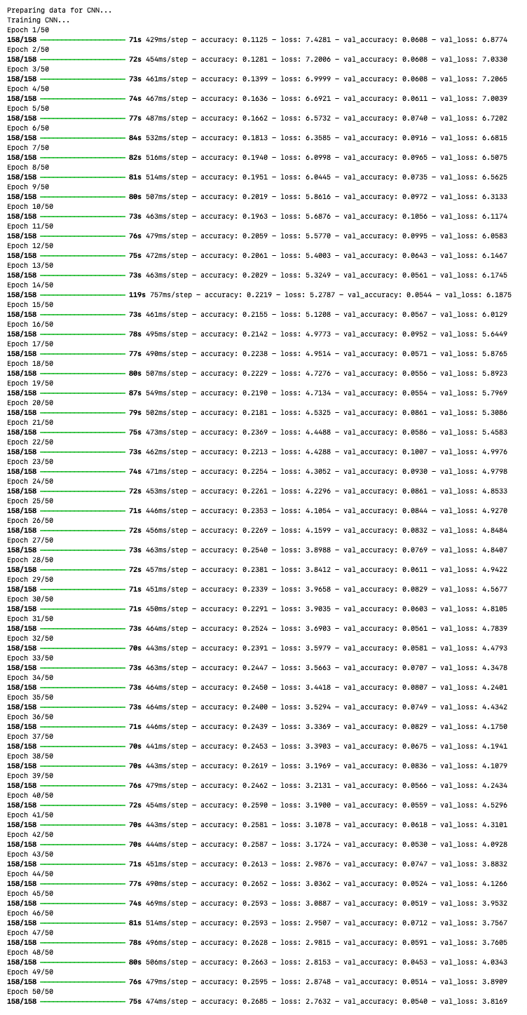
Accuracy: This is the percentage of correct predictions the model is making on the training data. For example, in Epoch 15/58, the training accuracy is 0.8937, meaning 89.37% of the training data was correctly classified at that point.
Loss: This is the error value the model is trying to minimize. The loss function measures the difference between the model's predicted outputs and the actual target values. A lower loss indicates better performance. For instance, in Epoch 15/58, the training loss is 0.3301, which is a good indicator of how well the model is learning.
Validation Accuracy and Loss: These metrics show how well the model is performing on unseen validation data. In the same epoch (15/58), the validation accuracy is 0.8739, which tells us how accurately the model predicts on the validation set. Similarly, the validation loss (0.4231) tells us how far off the predictions are from the actual values on the validation data.
These values help in understanding whether the model is overfitting or underfitting. For example, a high training accuracy with a much lower validation accuracy might indicate overfitting, where the model performs well on the training data but poorly on new, unseen data.

Slide 10
Results:
ALGORITHM | TRAIN | DEV | EVAL
RNF | 67.88% / 96.08% | 52.39% / 96.33% | 29.19% / 97.14%
CNN | 9.81% / 98.29% | 7.14% / 98.77% | 0.03% / 99.83%

Slide 11
Comparison of RF and CNN Models
Sensitivity:
RF shows significantly higher sensitivity on the training data but experiences a sharp decline in sensitivity during development and evaluation.
CNN also demonstrates moderate sensitivity on training and development data but performs poorly on evaluation data .
Both models struggle to generalize to unseen evaluation data, with RF showing better performance on training data and CNN providing more balanced performance in development.
Specificity:
Both models perform well in terms of specificity, particularly RF on training data and CNN on training and development data.
RF maintains relatively high specificity even on development and evaluation data.
Overfitting:
Both models show signs of overfitting, especially RF, which performs significantly better on training data than on development and evaluation data.
CNN, while it shows less overfitting, still struggles with sensitivity on unseen data.

Slide 12
Key Challenges and Insights:
Overfitting:
Both RF and CNN overfitted to the training data. RF performed well on training but struggled on unseen data, while CNN showed better balance but still had low sensitivity on evaluation data.
Class Imbalance:
The dataset’s imbalance impacted both models, with overrepresented classes like nneo leading to higher specificity but lower sensitivity for minority classes. Class weighting or SMOTE could help.
CNN vs. RF:
CNN excelled at capturing image features due to its spatial learning capabilities, while RF was better for general classification but couldn’t capture detailed patterns.

Slide 13
Future work and Improvements
Experiment with pretrained CNN architectures like ResNet or VGG for better feature extraction.
Use ensemble methods like RF + CNN to leverage the strengths of both models.
Investigate data augmentation or transfer learning to improve model generalization and reduce overfitting.

Slide 14
CONCLUSION:
RF performed well with high specificity but struggled with sensitivity on unseen data, indicating overfitting.
CNN showed promise but faced challenges with small sample sizes and overfitting.
Hybrid models or fine-tuning could improve performance and address the current limitations.

Slide 15


