Slide 1
ML Models for DCT Data ECE 8527 Final Project Zephan Joseph

Slide 2
Project Overview
256x256 DCT of a digital pathology image
8 coefficients:
0 = 'norm'
1 = 'artf'
2 = 'nneo'
3 = 'infl'
4 = 'susp'
5 = 'dcis'
6 = 'indc'
7 = 'null'
8 = 'bckg’
Our goal: develop a non-NN and NN based systems to classify data to be non-cancerous or data of interest

Slide 3
1st Model: Random Forest

Slide 4
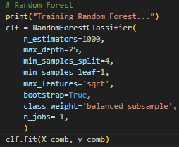
Random Forest
1000 Trees
More trees to improve stability and accuracy, useful for this data
25 levels deep, split control, $\sqrt{features}$ at each split
Prevents overfitting, promote generalization, complex decision boundaries
Introduce more randomness, improve generalization
Bootstrapping
Each tree is trained on bootstrapped sample
Helps to diversify the trees
Class weighting
Adjusts weights to fight against class imbalance (bias)

Slide 5
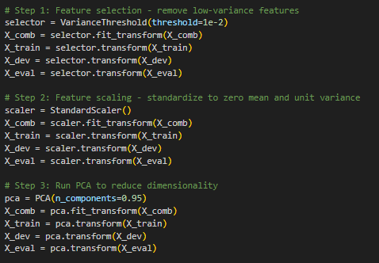
Pre-Processing
Remove low-variance features
Noise, negatively impacts generalization
Standardization
Scales each feature to have 0 mean and similar variance
Necessary for PCA
PCA
Reduces dimensionality, helps with faster training and less overfitting

Slide 6
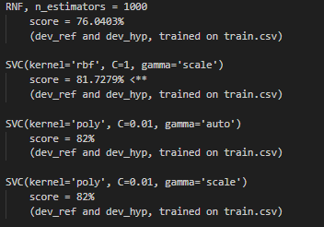
Model Selection
Previous models
RNF over SVC
Better for high-dimensional data
Handles data with multiple classes better
Easily allows for bootstrapping

Slide 7
Results Train: 0.61% Dev: 0.78%

Slide 8
2nd Model: Convolutional Neural Network

Slide 9
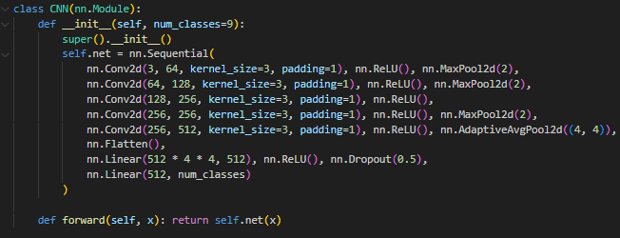
CNN
5 layer Convolutional Neural Network
Increased input and output layers incrementally between each layer
Maxpooling
Prevent overfitting, keep strongest activation within each region, noise reduction
Implemented average pooling in deepest layer to keep a consistent output size
Use ReLU for non-linear decision boundaries
Dropout to prevent overfitting

Slide 10
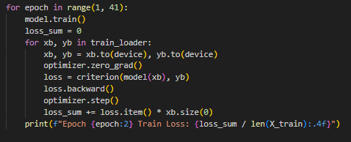
Training Loop
Trained over 40 epochs
xb and yb
Smaller batches of features and labels
Compute cross-entropy loss in each iteration, comparing predictions to true labels
Perform backpropagation to compute loss
Use adamW (optimizer.step())
Computes total loss and prints average loss for the epoch

Slide 11
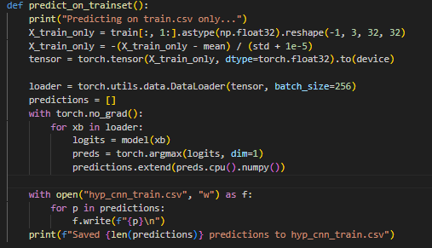
Predictions
Load and reshape training features into tensors
Applies normalization like the training loop
Argmax takes the predicted class label for each sample from logits

Slide 12
Results Train: score = 12.2269% Dev: score = 12.2074%

