Slide 1
ECE8527 Final PROJEct
Spring 2024
lucas raab

Slide 2
KNN Implemenation hOW DO WE DEFINE OUR FEATURES?
Statistical measures:
Mean, Standard Deviation, Variance
Mean sign change rate, Range
Frequency domain measures
5 most dominant frequencies
Other measures
Wavelet energy
11 features for each channel = 88 features total.

Slide 3
KNN RESULTS & SOURCES OF ERROR
All the current features were extremely relevant, and removing any one tanked my accuracy rate by at least 10%.
To increase our metrics, we needed to find more useful features.
 | /train | /dev | /eval
Macro Accuracy | 0.9099 | 0.9009 | 0.9013
Macro Precision | .0.7456 | 0.3948 | 0.4351
Macro Recall | 0.2282 | 0.1890 | 0.1907
Macro F1 | 0.2862 | 0.2243 | 0.2276

Slide 4
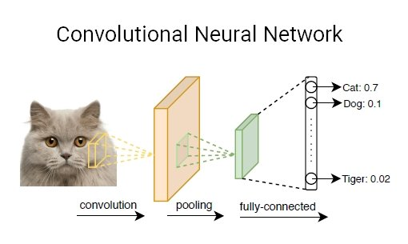
Why choose a CNN?
Our data set involved multi-dimensional time-series data. CNNs excel at discerning intricate spatial patterns within data.
CNN layers are good at learning complex data representations in a structured way, allowing them to extract important features from the data at different levels of detail
CNNs benefit from shared weights and local connections, making them more robust to changes in input and decreasing the number of parameters, which is particularly advantageous for our time-series data.
Saw a lot instances of 1D CNNs being applied to similar digital signal tasks while researching.

Slide 5
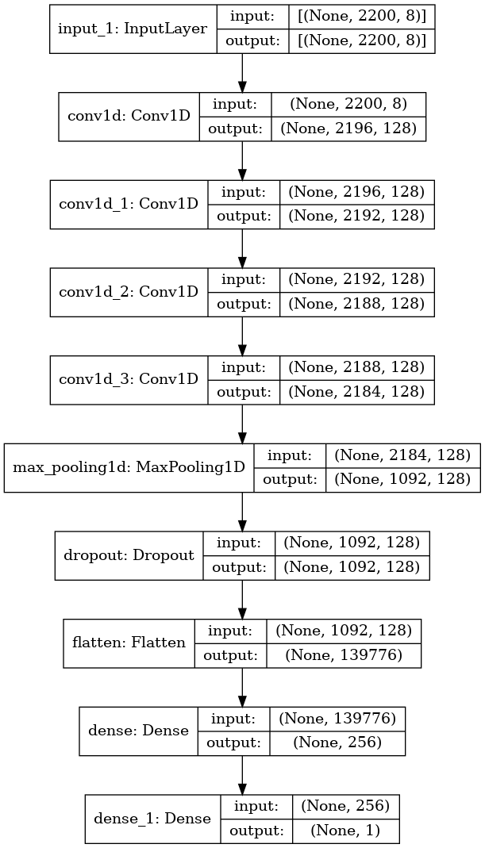
Training Setup
Optimizer: Adam with learning rate 0.0001
Loss function: Binary Cross entropy
Batch Size: 32
Epochs: 20, with early stopping at a patience of 3 epochs, stopping when accuracy plateaus.
6 separate binary classifiers, one for each label.

Slide 6
Model Architecture
Sequential model with Convolutional Neural Network layers for feature extraction and Fully Connected layers for classification.
CNN Layers:
Four 1D Convolutional layers with 128 filters, kernel size 5, and ReLU activation function.
Pooling Layer:
MaxPooling1D layer with pool size 2 for down-sampling.
Dropout Layer:
Applied with a rate of 0.2 to prevent over-fitting.
Flatten Layer:
Flattens the output of the dropout layer for input to the fully connected layers.
Fully Connected Layers:
One dense layer with 256 units and ReLU activation, with L2 regularization of 0.001.
Output Layer:
Dense layer with 1 neuron and sigmoid activation for binary classification.
Overall, about 16 million parameters each model.

Slide 7
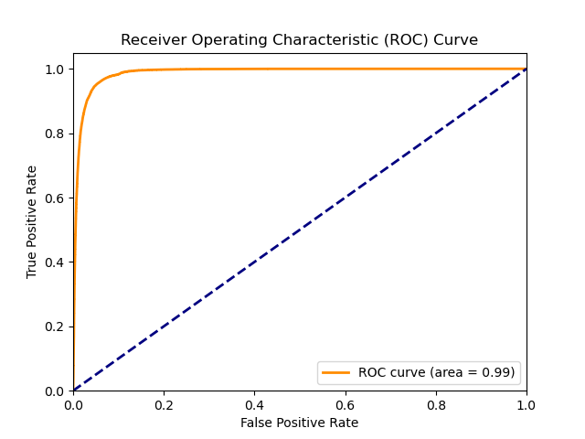
Threshold Determination
We Compute ROC curve to visualize the trade-off between true positive rate (sensitivity) and false positive rate (1 - specificity).
Calculate the AUC to quantify model performance.
Determine the threshold that maximizes the difference between true positive rate and false positive rate on the ROC curve.
Convert predicted probabilities to binary predictions using the optimal threshold
For some classes, it improved our F1 score, on others it had little affect.
1DAVB | RBBB | LBBB | SB | AF | ST
50.20% | 49.13% | 75.63% | 52.48% | 58.65% | 50.10%

Slide 8
CNN RESULTS
 | /train | /dev | /eval
Macro Accuracy | 0.9012 | 0.8518 | 0.9044
Macro Precision | .6117 | 0.8834 | 0.7048
Macro Recall | .7516 | 0.5564 | 0.5700
Macro F1 | .6450 | 0.6491 | 0.6066

Slide 9
sOURCES OF error
Overall, my models preformed well, performance on ‘1dAVb’ and ‘ST’ killed my overall metrics.
‘ST’ and ‘AF’ were both the lowest occurring classes, but ‘1dAVb’ had much more data available than these two but had the worse performance rate by all metrics
Its possible ‘1dAVB’ needed more computation, more layers to get better results.
 | 1dAVb | ST | AF
Macro Accuracy | 0.5510 | 0.7185 | 0.9354
Macro Precision | 0.6608 | 0.8225 | 0.9291
Macro Recall | 0.1220 | 0.2142 | 0.6291
Macro F1 | 0.2060 | 0.3399 | 0.7502

Slide 10
CONCLUSIONS
My CNN model preformed much better than my KNN model.
To improve metrics on my KNN model, I would need to learn more about our cardiology data to derive more statistical features for my model to use. Possible, but would require a lot of research.
To improve metrics on my CNN Model, I would need to improve performance on the ‘1dAVb’ and ‘ST’ classes. This would likely require more computation, and under sampling of the healthy classes.
Performance on my KNN model was much greater than my CNN. KNN was able to run on a single cpu core in 10 minutes, while my CNN model took about 2 hours to train with 4 A40’s or 4 hours with RTX2080’s.

