Slide 1
ECE 8527 Final Project
Luke Dewees

Slide 2
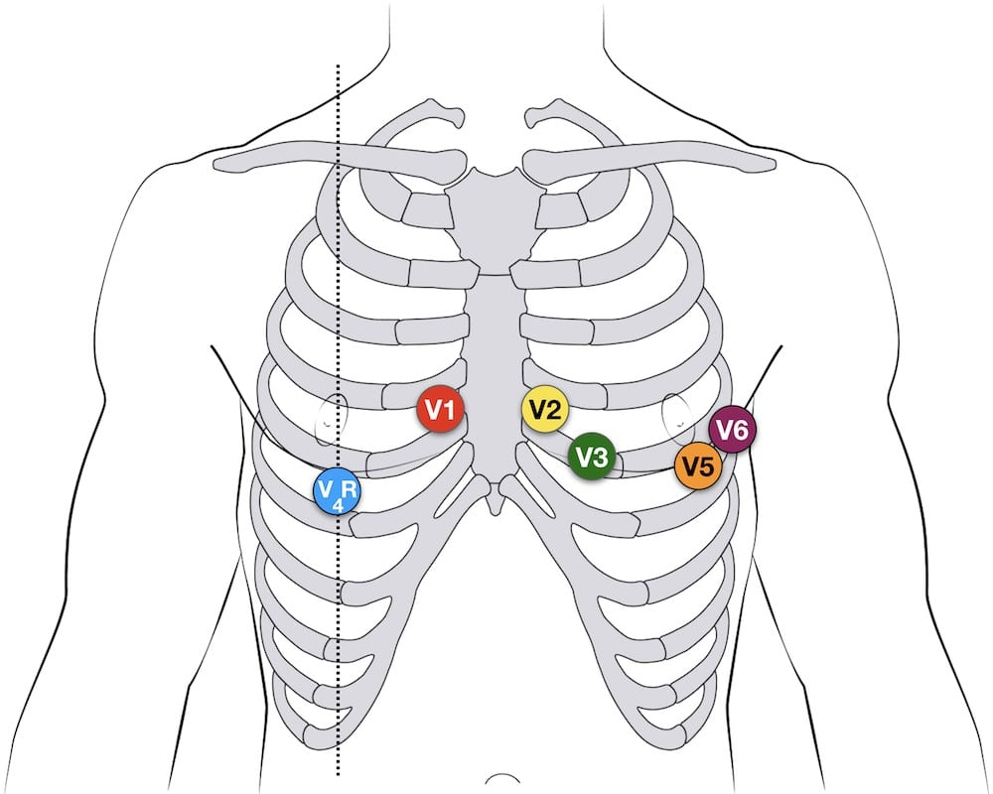
Dataset
Comprised of 8-lead ECG exams
Stored as raw voltage values
Train
199487 exams
Dev
20000 exams
Eval
20000 exams

Slide 3
Training Dataset Composition
Disease Type | Number of Occurrences
1dAVB | 17758
RBBB | 35366
LBBB | 17796
SB | 18291
AF | 20832
ST | 17758

Slide 4
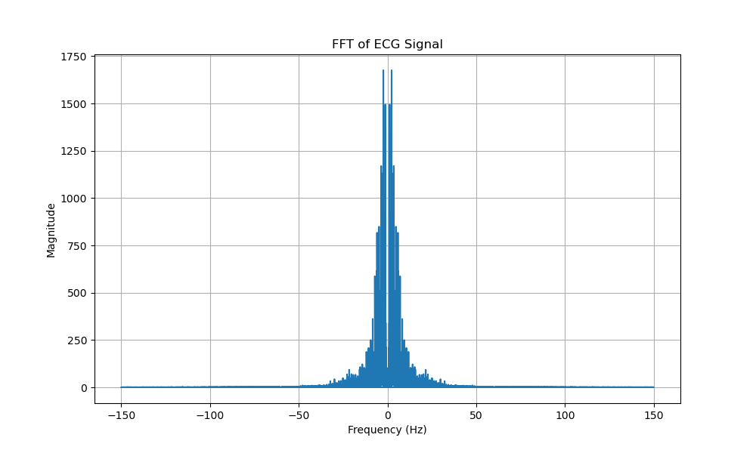
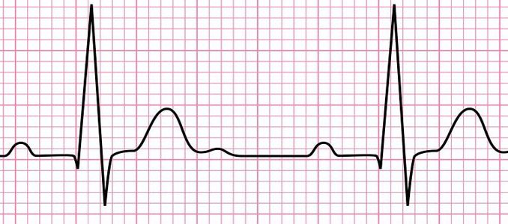
Model 1- Random Forest
RNF
1dAVB
RNF
RBBB
RNF
LBBB
RNF
SB
RNF
AF
RNF
ST

Slide 5
Issues- Random Forest
Training Time
Training RNF with 100 estimators on full training dataset took >48 hours
Crashed with memory error
Data processing was likely inefficient, and took very long as a result
Solution- train with unhealthy portion of training data exclusively
Cut down on time significantly
RNF finished training on unhealthy data in ~10 hours
Possible benefits to prediction accuracy
Most frequent disease, RBBB, has 35366 occurrences in the training set

Slide 6
Results- Random Forest
 | Train | Dev | Eval
Micro F1 | 0.878 | 0.540 | TBD
Macro F1 | 0.890 | 0.488 | TBD

Slide 7
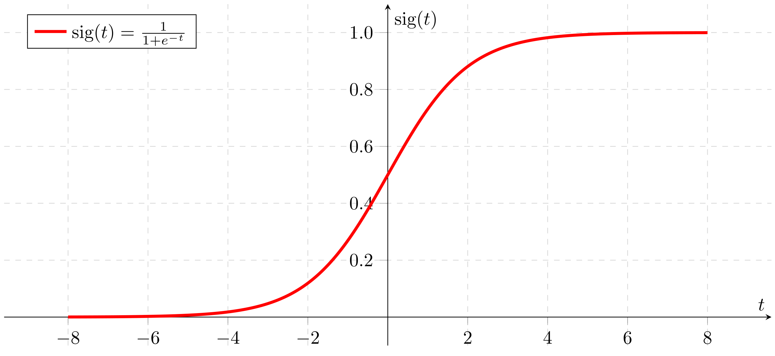
Model 2- RNN
2 Layers- LSTM and Dense layer with Sigmoid activation
LSTM

Slide 8
Issues- RNN
Predictions either all negative, or all positive
Too few epochs
Takes ~1 hour to train
Future work
Train with 50 epochs
Train model with unhealthy data
Train model with complete training dataset

