Slide 1
ECE 8527 Homework Final: Common Evaluations
By Andrew Powell

Slide 2
Outline
Introduction
Objectives
Tools
Obstacles
Algorithms (Training / Classification / Performance)
Hidden Markov Models (HMM)
K-Nearest Neighbors (KNN)
Neural Network (NN)
Conclusion
Final Thoughts
References

Slide 3
Outline
Introduction
Objectives
Tools
Obstacles
Algorithms (Training / Classification / Performance)
Hidden Markov Models (HMM)
K-Nearest Neighbors (KNN)
Neural Network (NN)
Conclusion
Final Thoughts
References

Slide 4
Introduction: Objectives
Select three nontrivial, machine-learning algorithms supported in MATLAB©. The selected algorithms are the following.
Hidden Markov Models (HMM) ***
K-Nearest Neighbors (KNN)
Neural Networks (NN)
Determine the performance of the selected algorithms as a function of their “key” parameters through a series of simulations.
Recognition Error Rate
Discriminant Values
Timing Analysis
Present the information.

Slide 5
Introduction: Tools
MATLAB
Used for all the programming and simulation
Important to note since performing the same simulations in different languages/environments will most likely produce different results
Kevin Murphy’s Hidden Markov Model Toolbox
Used for training HMMs that emit Gaussian-mixtures and classification
HMM training supported in MATLAB’s Statistics Toolbox is relatively more difficult to use since there is no built-in support for continuous observations.
Statistics Toolbox
Used for classification with KNN
Neural Network Toolbox
Used for training regular feed-forward NN and classification

Slide 6
Introduction: Obstacles
Timing
Although determining the time it takes to train the models and classify the data vectors is relatively simple, comparing the timing results of each algorithm with each other’s timing results is problematic since a number of factors impact how well an algorithm can perform.
The focus will be on how the timing results change when parameters are altered
Discriminant Values
Part of the project requires to show that the recognition error rates correlate with the discriminant values generated for the purpose of classifying the data vectors. Due to the nature of how MATLAB’s proprietary toolboxes are implemented (e.g. Statistics Toolbox), it is difficult to obtain these values with the functions that perform the classification.

Slide 7
Outline
Introduction
Objectives
Tools
Obstacles
Algorithms (Training / Classification / Performance)
Hidden Markov Models (HMM)
K-Nearest Neighbors (KNN)
Neural Network (NN)
Conclusion
Final Thoughts
References

Slide 8
Algorithms: Hidden Markov Models
Introduction
A HMM model is created for each class. Each model consists of transitional probabilities from one hidden state to another and the Gaussian mixtures emitted from each hidden state.
Training of each model is of course done with the Baum-Welch (i.e. Expectation Maximization) algorithm.
Prior to training, the models are randomized but stochastic matrices are ensured.
The sequential data vectors of each class are considered to result from sequential time steps, and a class’s entire set of data vectors is interpreted as a single set of data
Classification of a data vector is simply choosing the class whose model produces the largest log-likelihood.
Parameters
Iterations of Training domain: 1 to 4, inclusively
Number of Mixtures domain: 1 to 4, inclusively
Number of Hidden States domain: 1 to 10, inclusively
Performance Metrics
Recognition Error Rate
Average Difference between Largest and Second-Largest Log-Posterior
Training Time
Classification Time

Slide 9
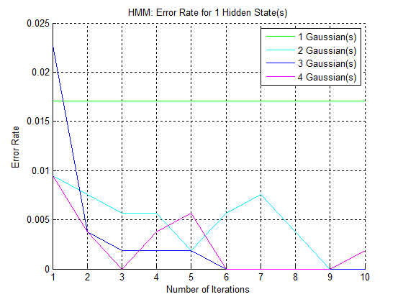
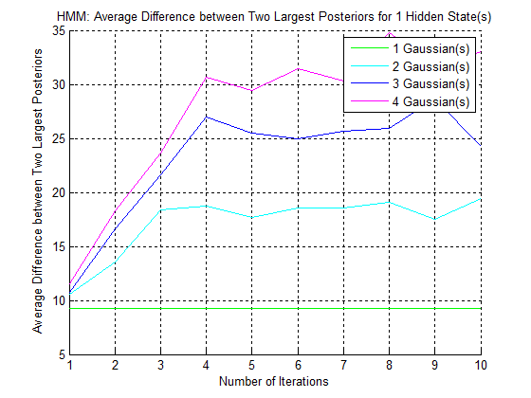
Algorithms: Hidden Markov Models

Slide 10
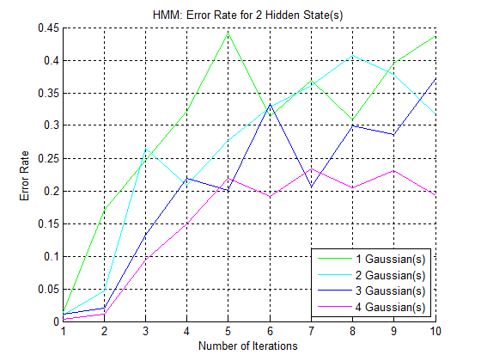
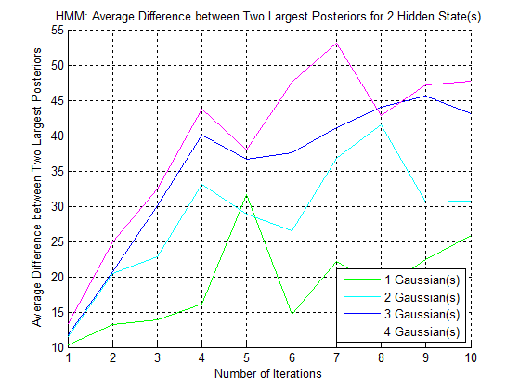
Algorithms: Hidden Markov Models

Slide 11
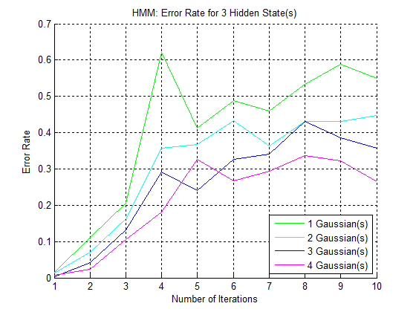
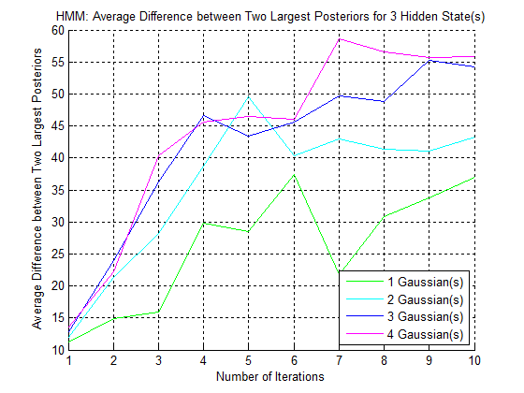
Algorithms: Hidden Markov Models

Slide 12
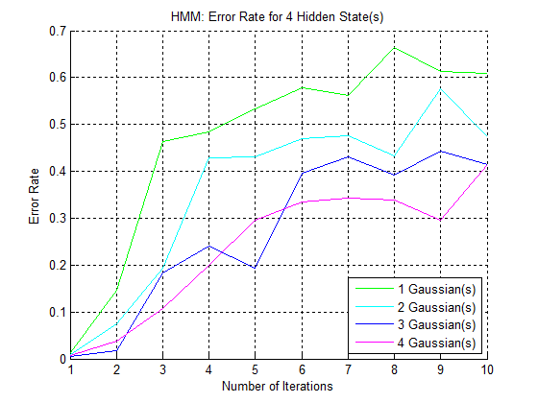
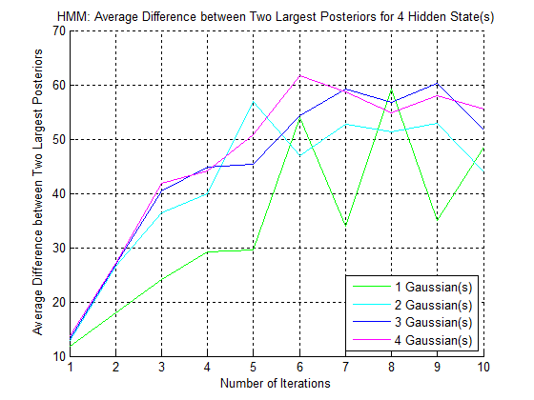
Algorithms: Hidden Markov Models

Slide 13
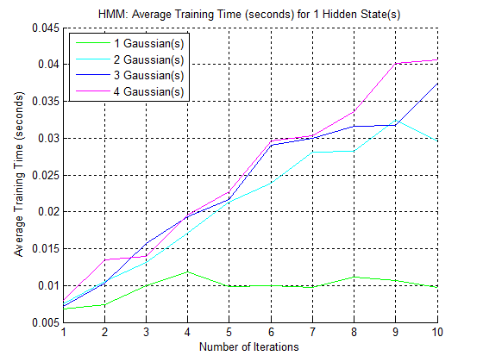
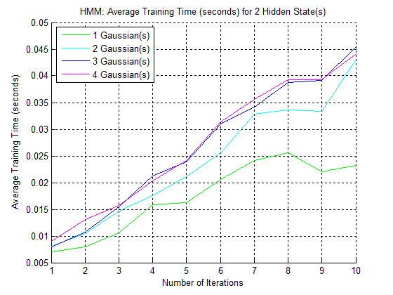
Algorithms: Hidden Markov Models

Slide 14
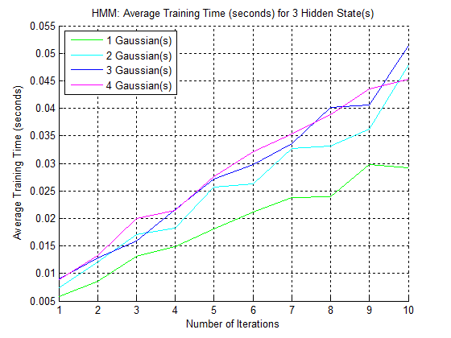
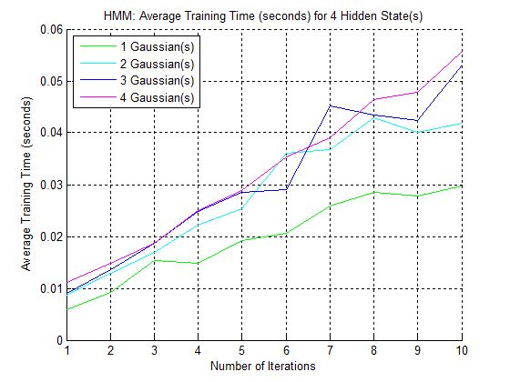
Algorithms: Hidden Markov Models

Slide 15
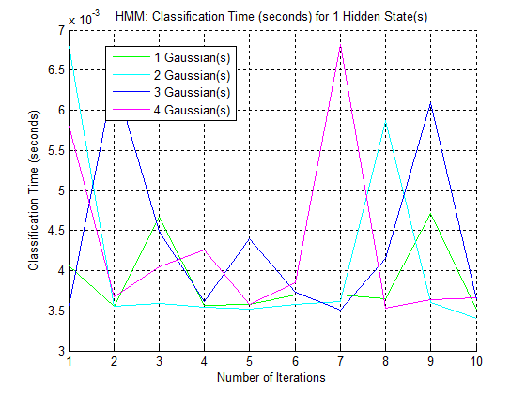
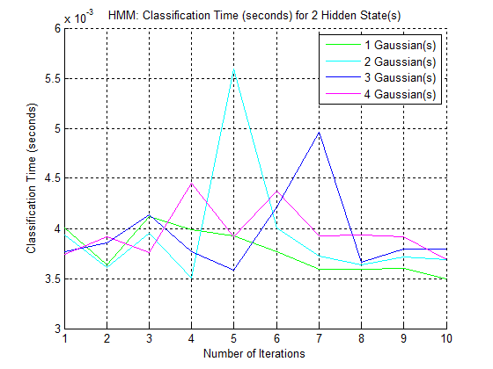
Algorithms: Hidden Markov Models

Slide 16
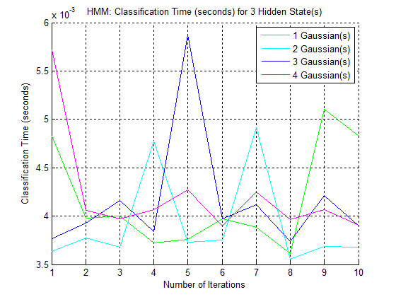
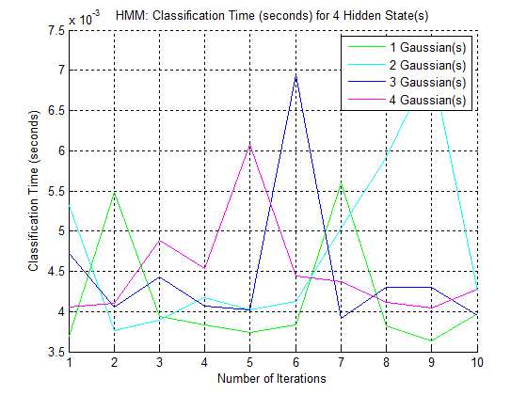
Algorithms: Hidden Markov Models

Slide 17
Algorithms: Hidden Markov Models
Key Observations
Recognition error rate is relatively low for fewer iterations
The average difference between the two largest discriminant values for each assignment correlates with the recognition error rate, excluding when the number of hidden states is equal to 1.
The more iterations appears to cause to the recognition error rate to increase.

Slide 18
Algorithms: K-Nearest Neighbors
Introduction
Computation is all done during classification
Classification of a data vector is simply determining closest neighboring data vectors and then selecting the class that has the most data vectors within the set of closest neighboring data vectors.
Parameters
Number of Neighbors domain: odd numbers between 1 to 201, inclusively
Performance Metrics
Recognition Error Rate
Classification Time

Slide 19
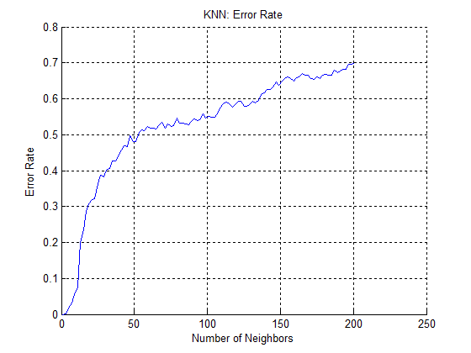
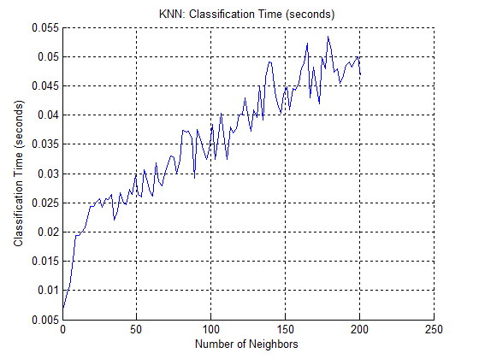
Algorithms: K-Nearest Neighbors

Slide 20
Algorithms: K-Nearest Neighbors
Key Observations
The recognition error rate actually grows with larger number of neighbors (i.e. k)

Slide 21
Algorithms: Neural Networks
Introduction
The single output of the forward-feed NN is converted from a continuous value to one of the possible discrete values (i.e. the possible classes) with Nearest Neighbors (i.e. KNN, where K=1).
The training algorithm for the weights and biases is simply MATLAB’s default algorithm: Levenberg-Marquardt
Recommended by MATLAB for its speed, though requires more memory
The Neural Network Training toolbox allows for the manipulation of many parameters (such as allowing parallelization over GPUs and cross-validation); however, to keep the simulations relatively simple, only two parameters are modified
Parameters
Number of Layers domain: 1, 5, 10, and 15
Number of Neutrons Per Layer domain: 1, 5, 10, and 15
Performance Metrics
Recognition Error Rate
Average Distance from Selected Class
Training Time
Classification Time

Slide 22
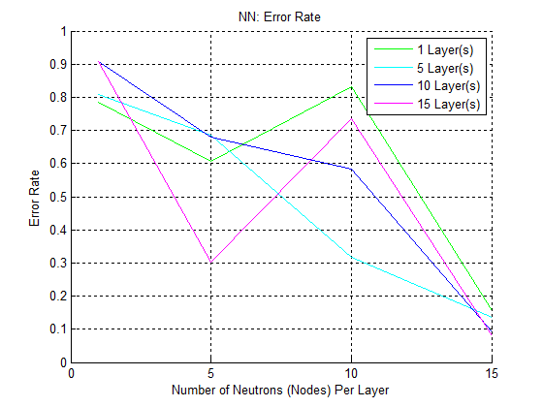
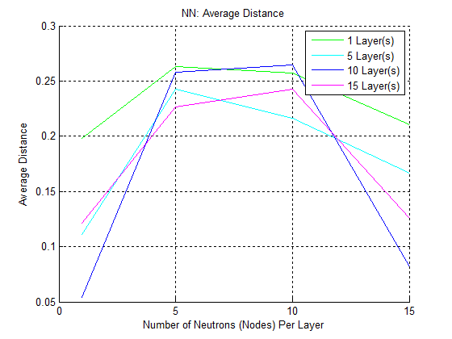
Algorithms: Neural Networks

Slide 23
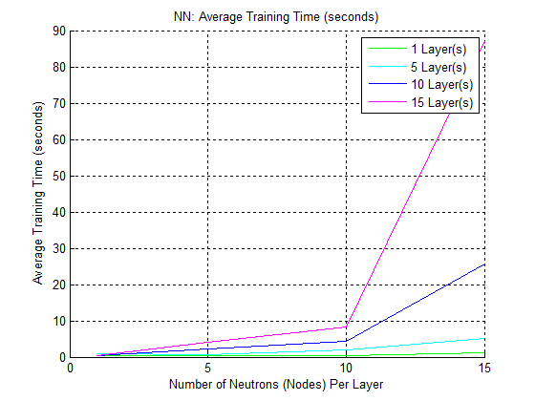
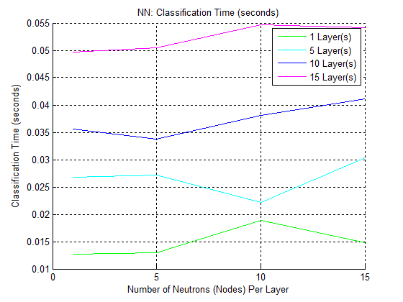
Algorithms: Neural Networks

Slide 24
Algorithms: Neural Networks
Key Observations
In regards to classification, extra neutrons per layer do not appear to have much of an affect on the classification time. Extra layers appear to increase the classification time linearly.
In regards to training, extra layers and neutrons per layer greatly increase training time.

Slide 25
Outline
Introduction
Objectives
Tools
Obstacles
Algorithms (Training / Classification / Performance)
Hidden Markov Models (HMM)
K-Nearest Neighbors (KNN)
Neural Network (NN)
Conclusion
Final Thoughts
References

Slide 26
Conclusion: Final Thoughts
Simulations for the algorithms HMM, KNN, and NN were implemented.
The algorithms were tested for their performance
Recognition Error Rate
Discriminant Values
Timing Analysis

Slide 27
Conclusion: References
Keven Murphy’s HMM Implementation:
http://www.cs.ubc.ca/~murphyk/Software/HMM/hmm.html
Neural Network Toolbox and Statistics Toolbox MATLAB documentation

